Slide 1
Active Network Management Schemes to Facilitate the Integration of Renewables and New Loads into Distribution Networks
Prof. Damien ERNST

Slide 2
Active network management
Distribution networks (DNs) are traditionally operated according to the fit and forget doctrine.
Fit and forget: Network planning is carried with respect to a set of critical scenarios to ensure that sufficient operational margins are always guaranteed (i.e., no over/under voltage problems, overloads) without any control over the loads or the generation sources.
Shortcomings: With rapid growth of distributed generation resources and of new loads (mostly heat pumps and electric vehicles), maintaining such conservative margins comes at continuously increasing network reinforcement costs.

Slide 3
Active network management (ANM): Smart modulation of generation sources, loads and storage devices so as to safely operate the electrical network without having to rely on significant investments in infrastructure.
There are very few real-life applications of ANM schemes: Implementing real-life ANM schemes may be tricky– even if very beneficial - for several reasons (i) poor observability of distribution networks (ii) computational complexity of the schemes (iii) data management issues at the distribution level (iv) regulatory issues.

Slide 4
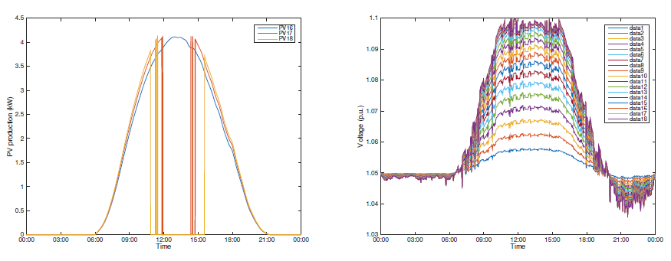
The most well-know ANM scheme: Grid-tied PV inverters that disconnect from the grid when voltages reach critical values!
Distributed scheme; inefficient.

Slide 5
A real-life application of an ANM scheme for integrating more wind energy into a DN
Regulatory context: Wind farms connected to the grid under non-firm access contracts. Contracts allow DN operators to specify dynamic access limits according to a given regulatory policy (e.g., “last-in, first-out”). Access limits must be communicated to the wind farm in advance. These limits upper bound the power that can be injected by the wind farm into the DN.
Challenge: To compute the least constraining dynamic access limits to maximize the energy that can be injected by the wind farms into the distribution network while satisfying the regulatory policy and, with a high probability, the constraints of the network.

Slide 6
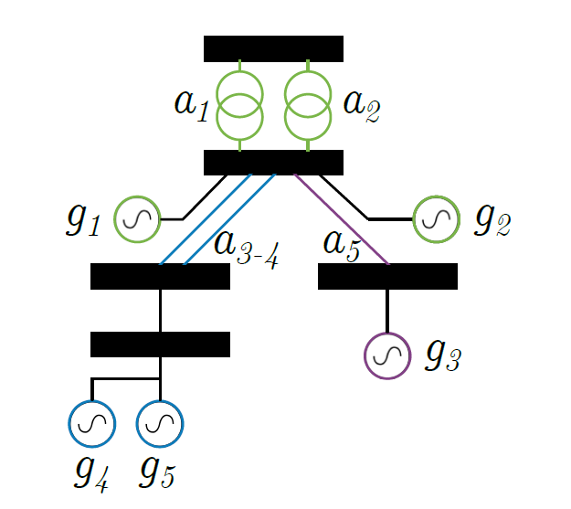
Schematic representation of a typical distribution network with constrained assets indexed by a and generators by g. Picture taken from Mathieu (2020).

Slide 7
Methodology developed: At regular time interval, compute the probabilistic forecast of specific future flows into the constrained assets of the networks.
If the probability of observing congestion is higher than a specific threshold, compute new access limits and communicate them to the generators.
Difficulties: (i) Having the right probabilistic forecasts (ii) Intelligently processing those forecasts to quickly calculate the right access limits (iii) Putting in place all the right software infrastructure to make this possible.

Slide 8
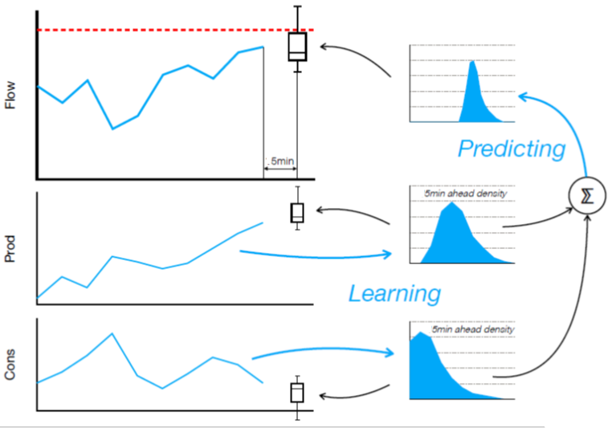

Slide 9
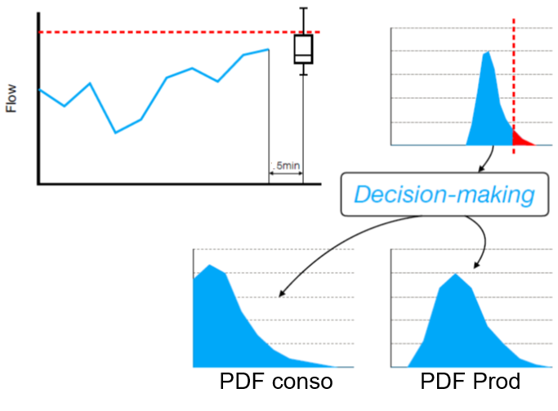
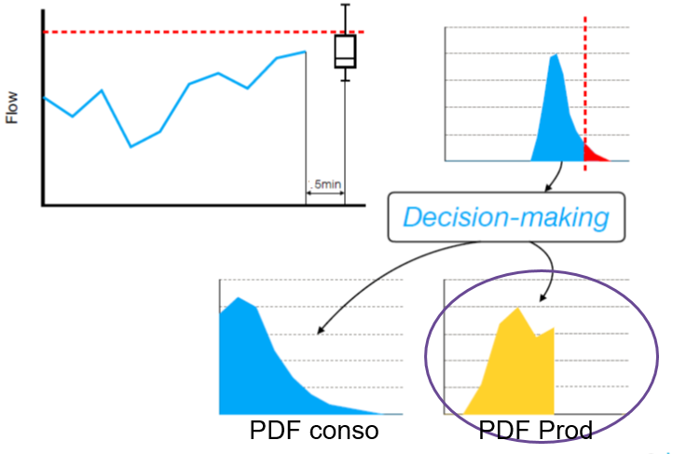
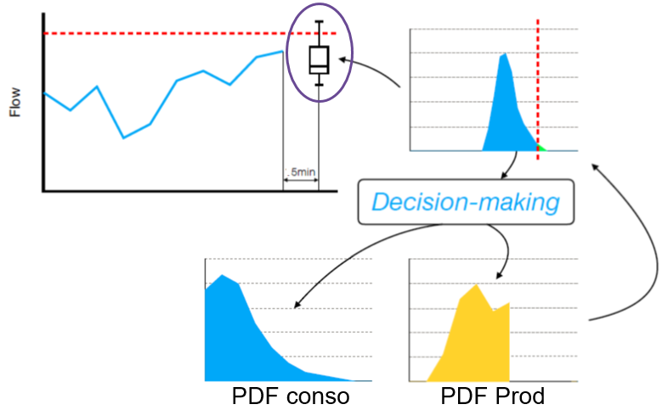
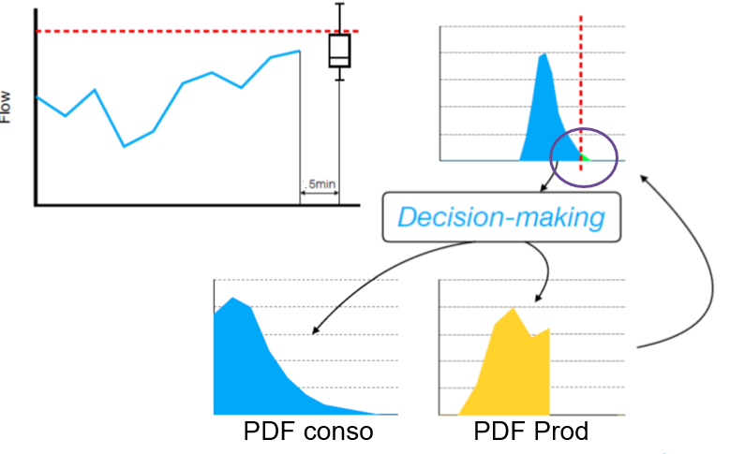

Slide 10
On the difficulty for transitioning from academic work to real-life implementation of ANM
Algorithmic developed through academia are great, but they do not take into account the many particular cases related to real-life of distribution networks (topology is changing, loss of communication channels, etc.).
Implementing such schemes needs to be done by professional software engineers, not researchers. However, researchers are still needed for developing them!
The real-life implementation of these schemes has been made possible by creating a company dedicated to this task which is now part of Haulogy (the IT energy company with the electric ray as its symbol)

Slide 11
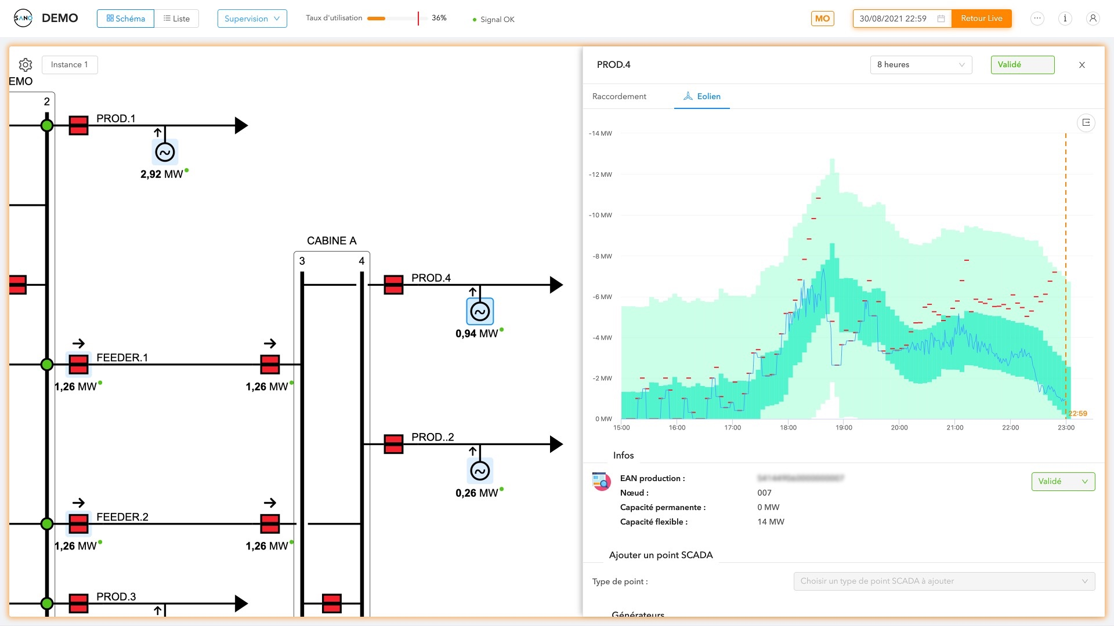
A few snapshots of the SANO tool developed by Haulogy for active network management

Slide 12
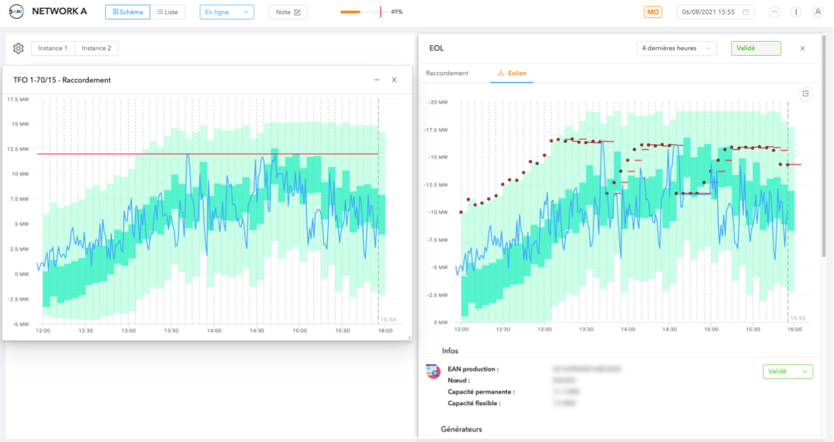

Slide 13
This video is illustrating the Active Network Management scheme implemented by Haulogy and ORES on a distribution network operated by ORES. Click here if the video does not appear above. Sorry to those of you who do not speak French.

Slide 14
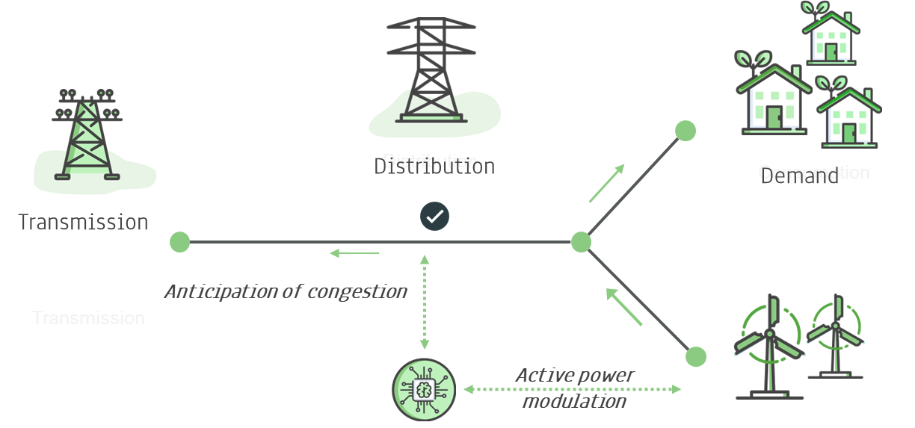
A higher-level view of the SANO tool, as it is now

Slide 15
Beyond active power modulation as actions: next development steps for SANO
Topological reconfigurations: Powerful mean for handling congestion problems in many distribution networks.
Reactive power control: Necessary since voltage problems become more and more pressing in distribution networks. This is due to several factors such as long cables with low loading, photovoltaic panels, etc.
Dynamic distribution tariffs: Rather than directly modulating generation/consumption, the DNOs could send well-designed dynamic distribution tariffs that could have similar effects.

Slide 16
References
Mathieu, S., Ernst, D., & Gemine, Q. (2020). Short-term active distribution network operation under uncertainty. In Proceeedings of the16th International Conference on Probabilistic Methods Applied to Power Systems (PMAPS 2020) (pp. 6).
Olivier, F., Aristidou, P., Ernst, D., & Van Cutsem, T. (March 2016). Active Management of Low-Voltage Networks for Mitigating Overvoltages due to Photovoltaic Units. IEEE Transactions on Smart Grid, 2 (7), 926-936. doi:10.1109/TSG.2015.2410171
Gemine, Q., Ernst, D., & Cornélusse, B. (October 2016). Active network management for electrical distribution systems: problem formulation, benchmark, and approximate solution. Optimization and Engineering, 18 (3), 587-629. doi:10.1007/s11081-016-9339-9

