Slide 1
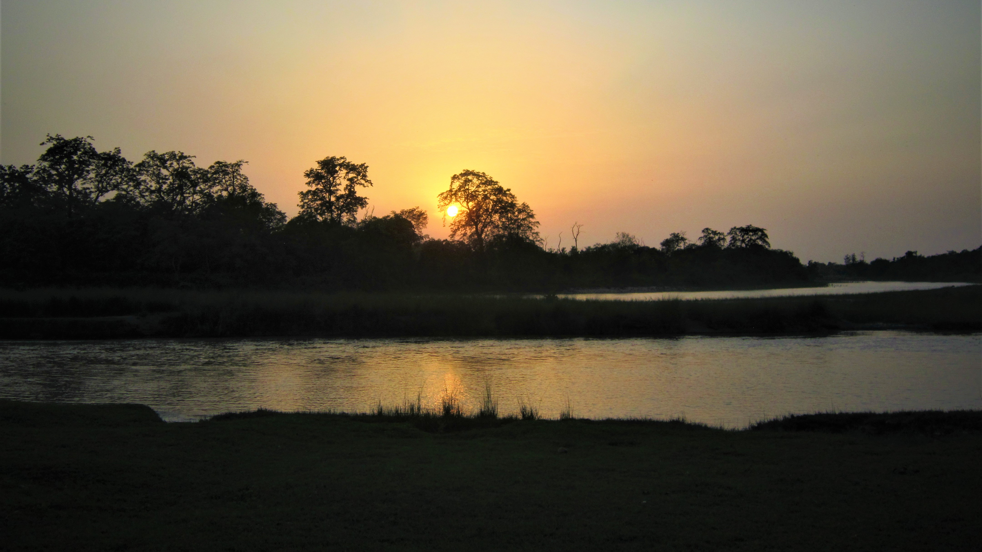


Slide 2
Supporting a thesis in a multi-sensory, multi-species and interdisciplinary environment
Nolwen Vouiller
Psychomot therapist
(Medecine Sorbonne University)
Anthropologist
(UCLouvain Belgium)
PhD student in anthropology (EHESS, France x Uliège, Belgium)

Slide 3
‘‘At the frontiers of human and non-human worlds: ethnography of multi-species relations around the Khauraha River, Nepal’’
Sound and photographic recordings: Nolwen Vouiller

Slide 4
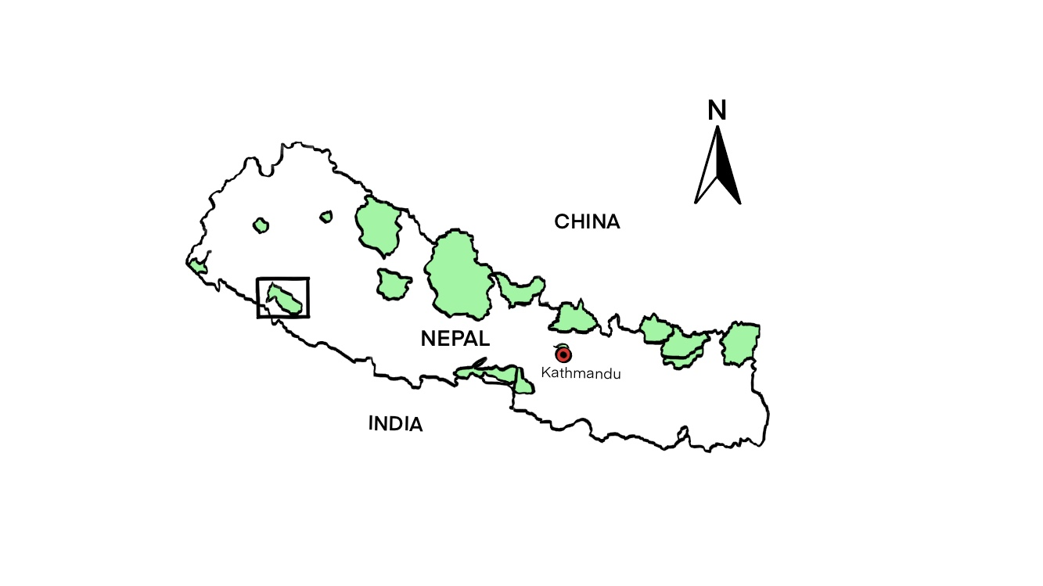
Bardiya National Park Since 1988 968 sq.km
Subtropical
Source : WWF NEPAL

Slide 5
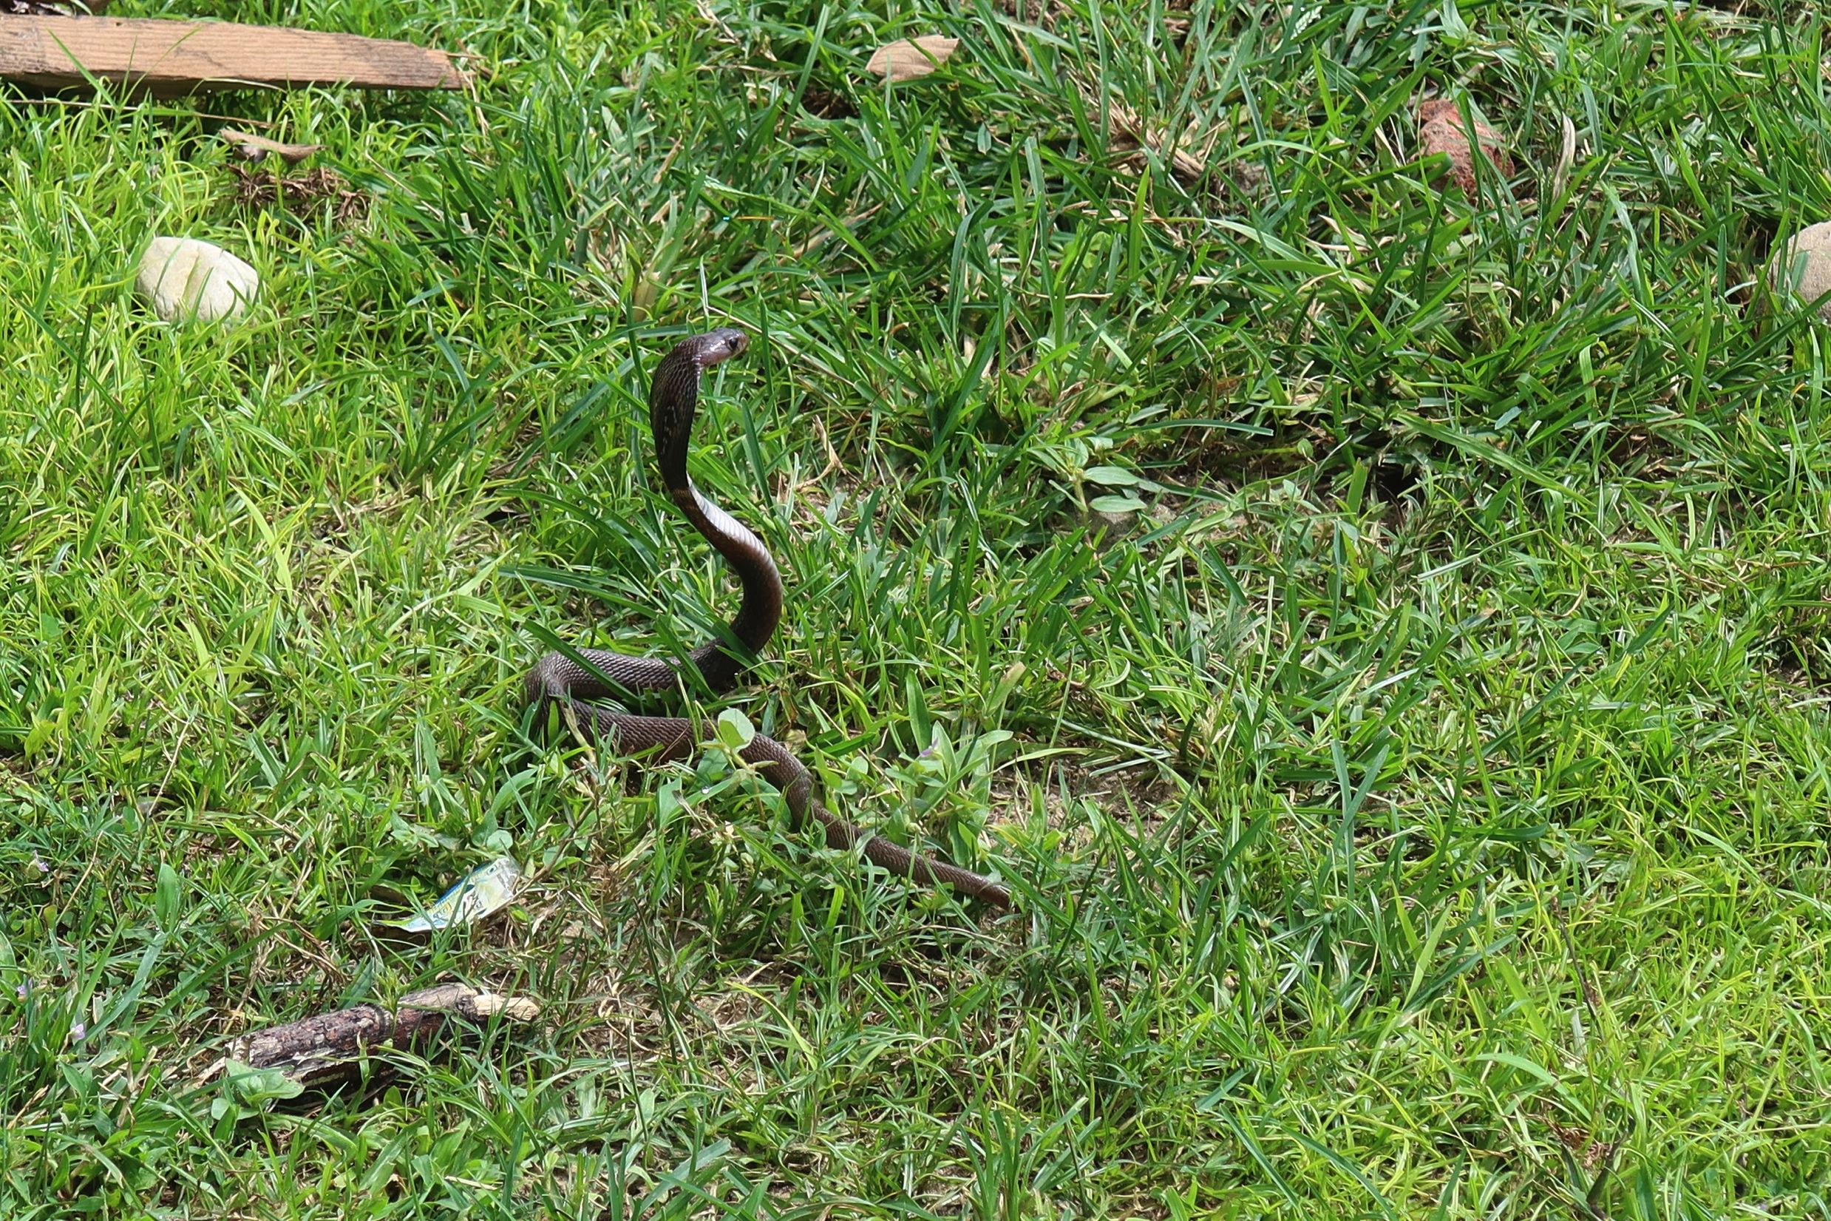

Slide 6
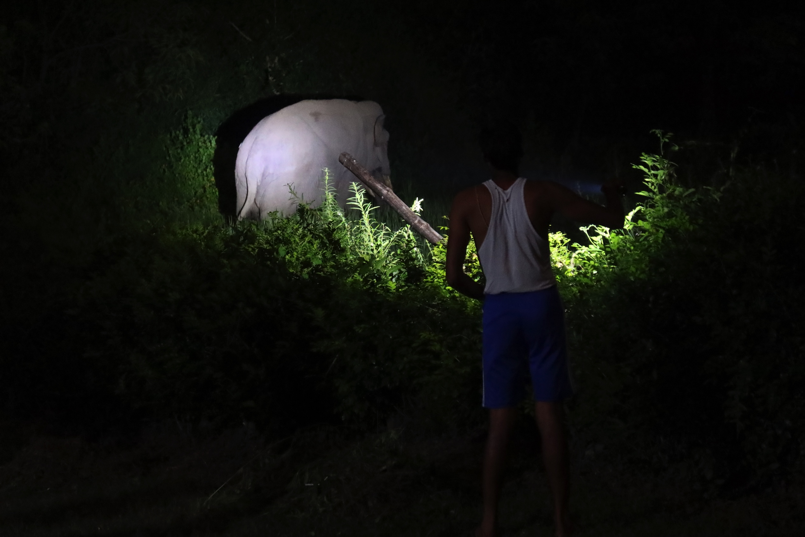

Slide 7
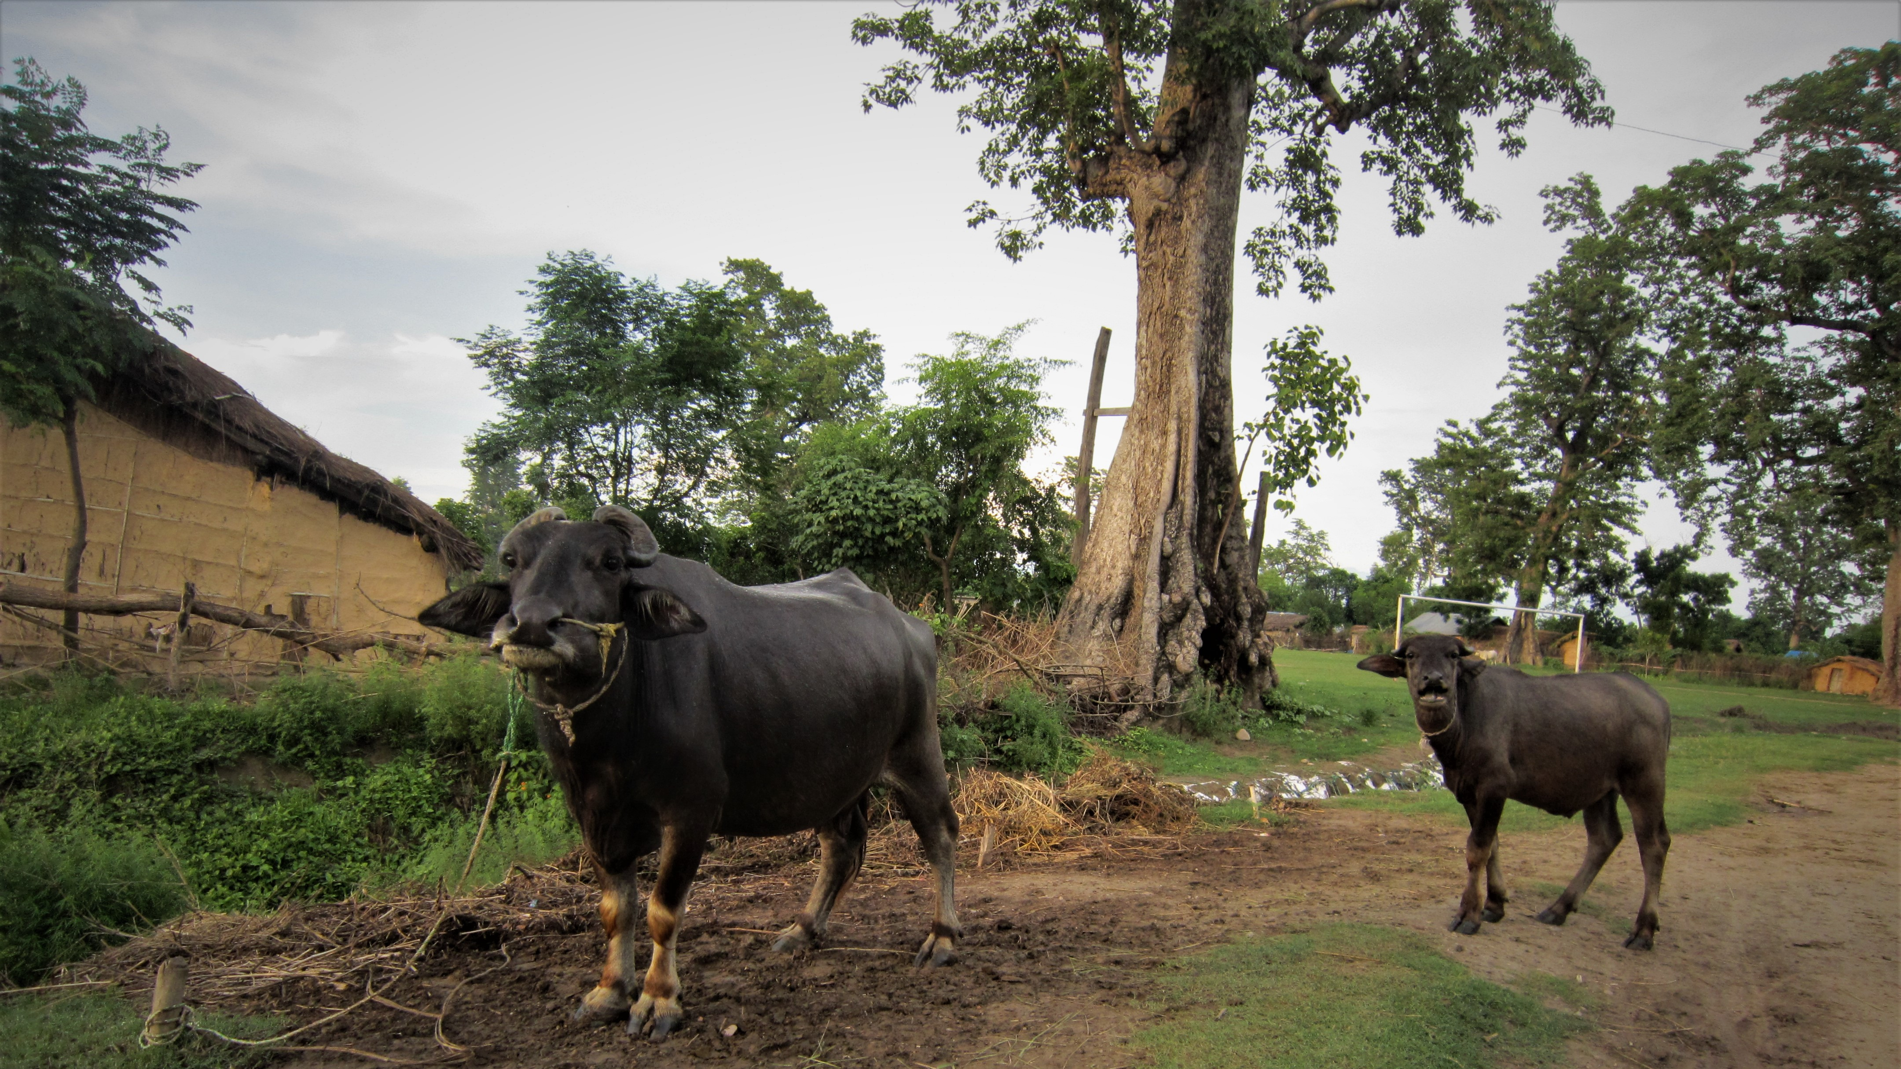

Slide 8
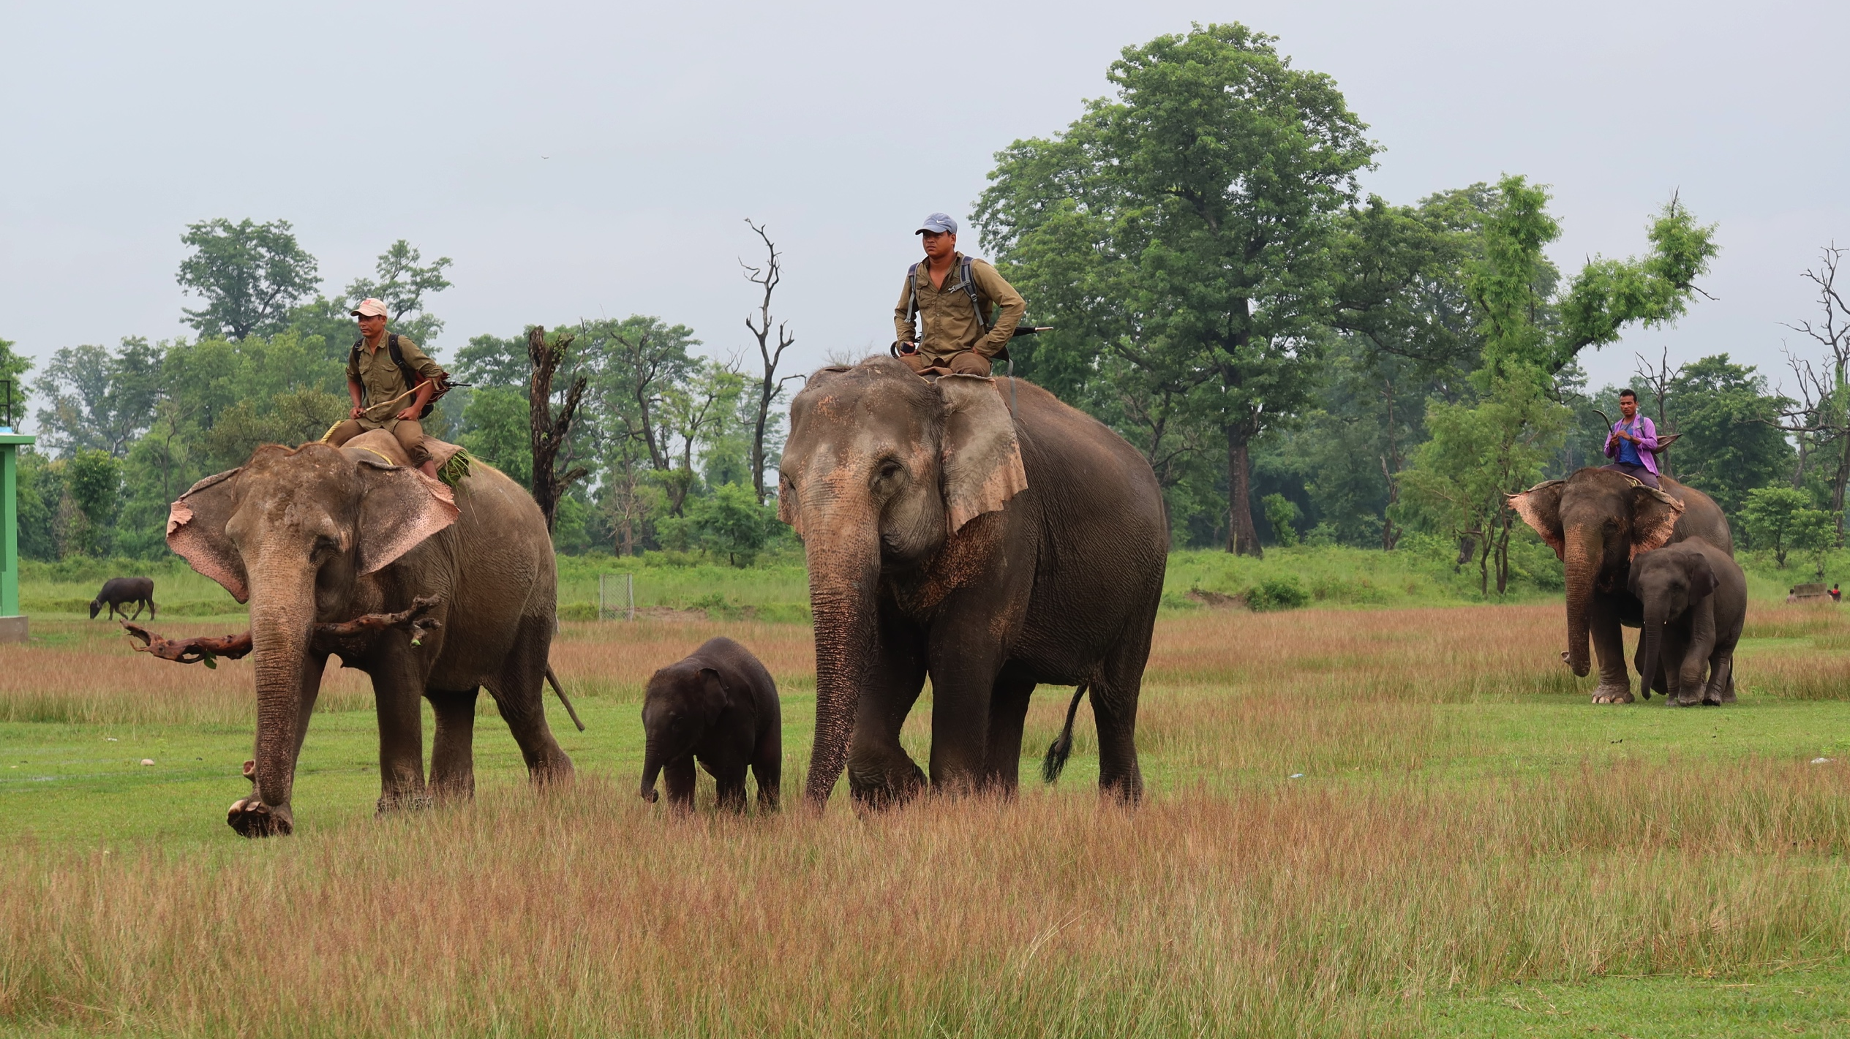

Slide 9
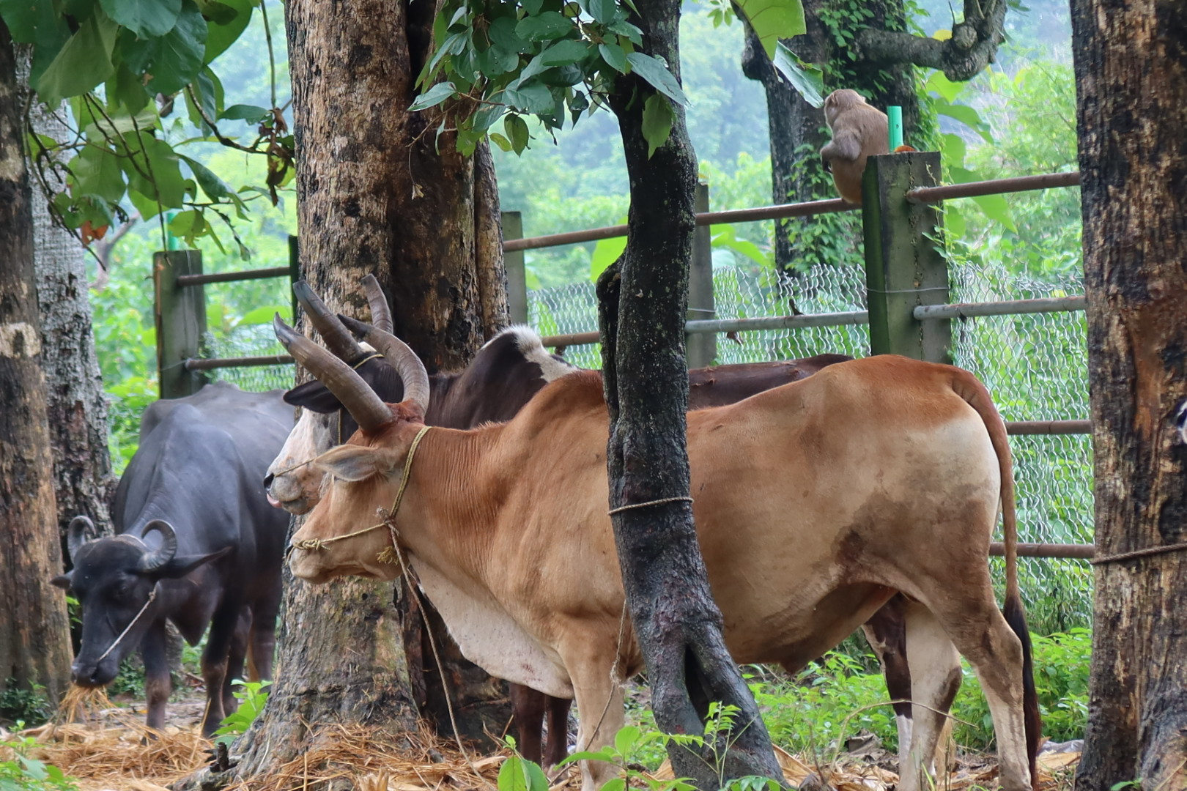

Slide 10
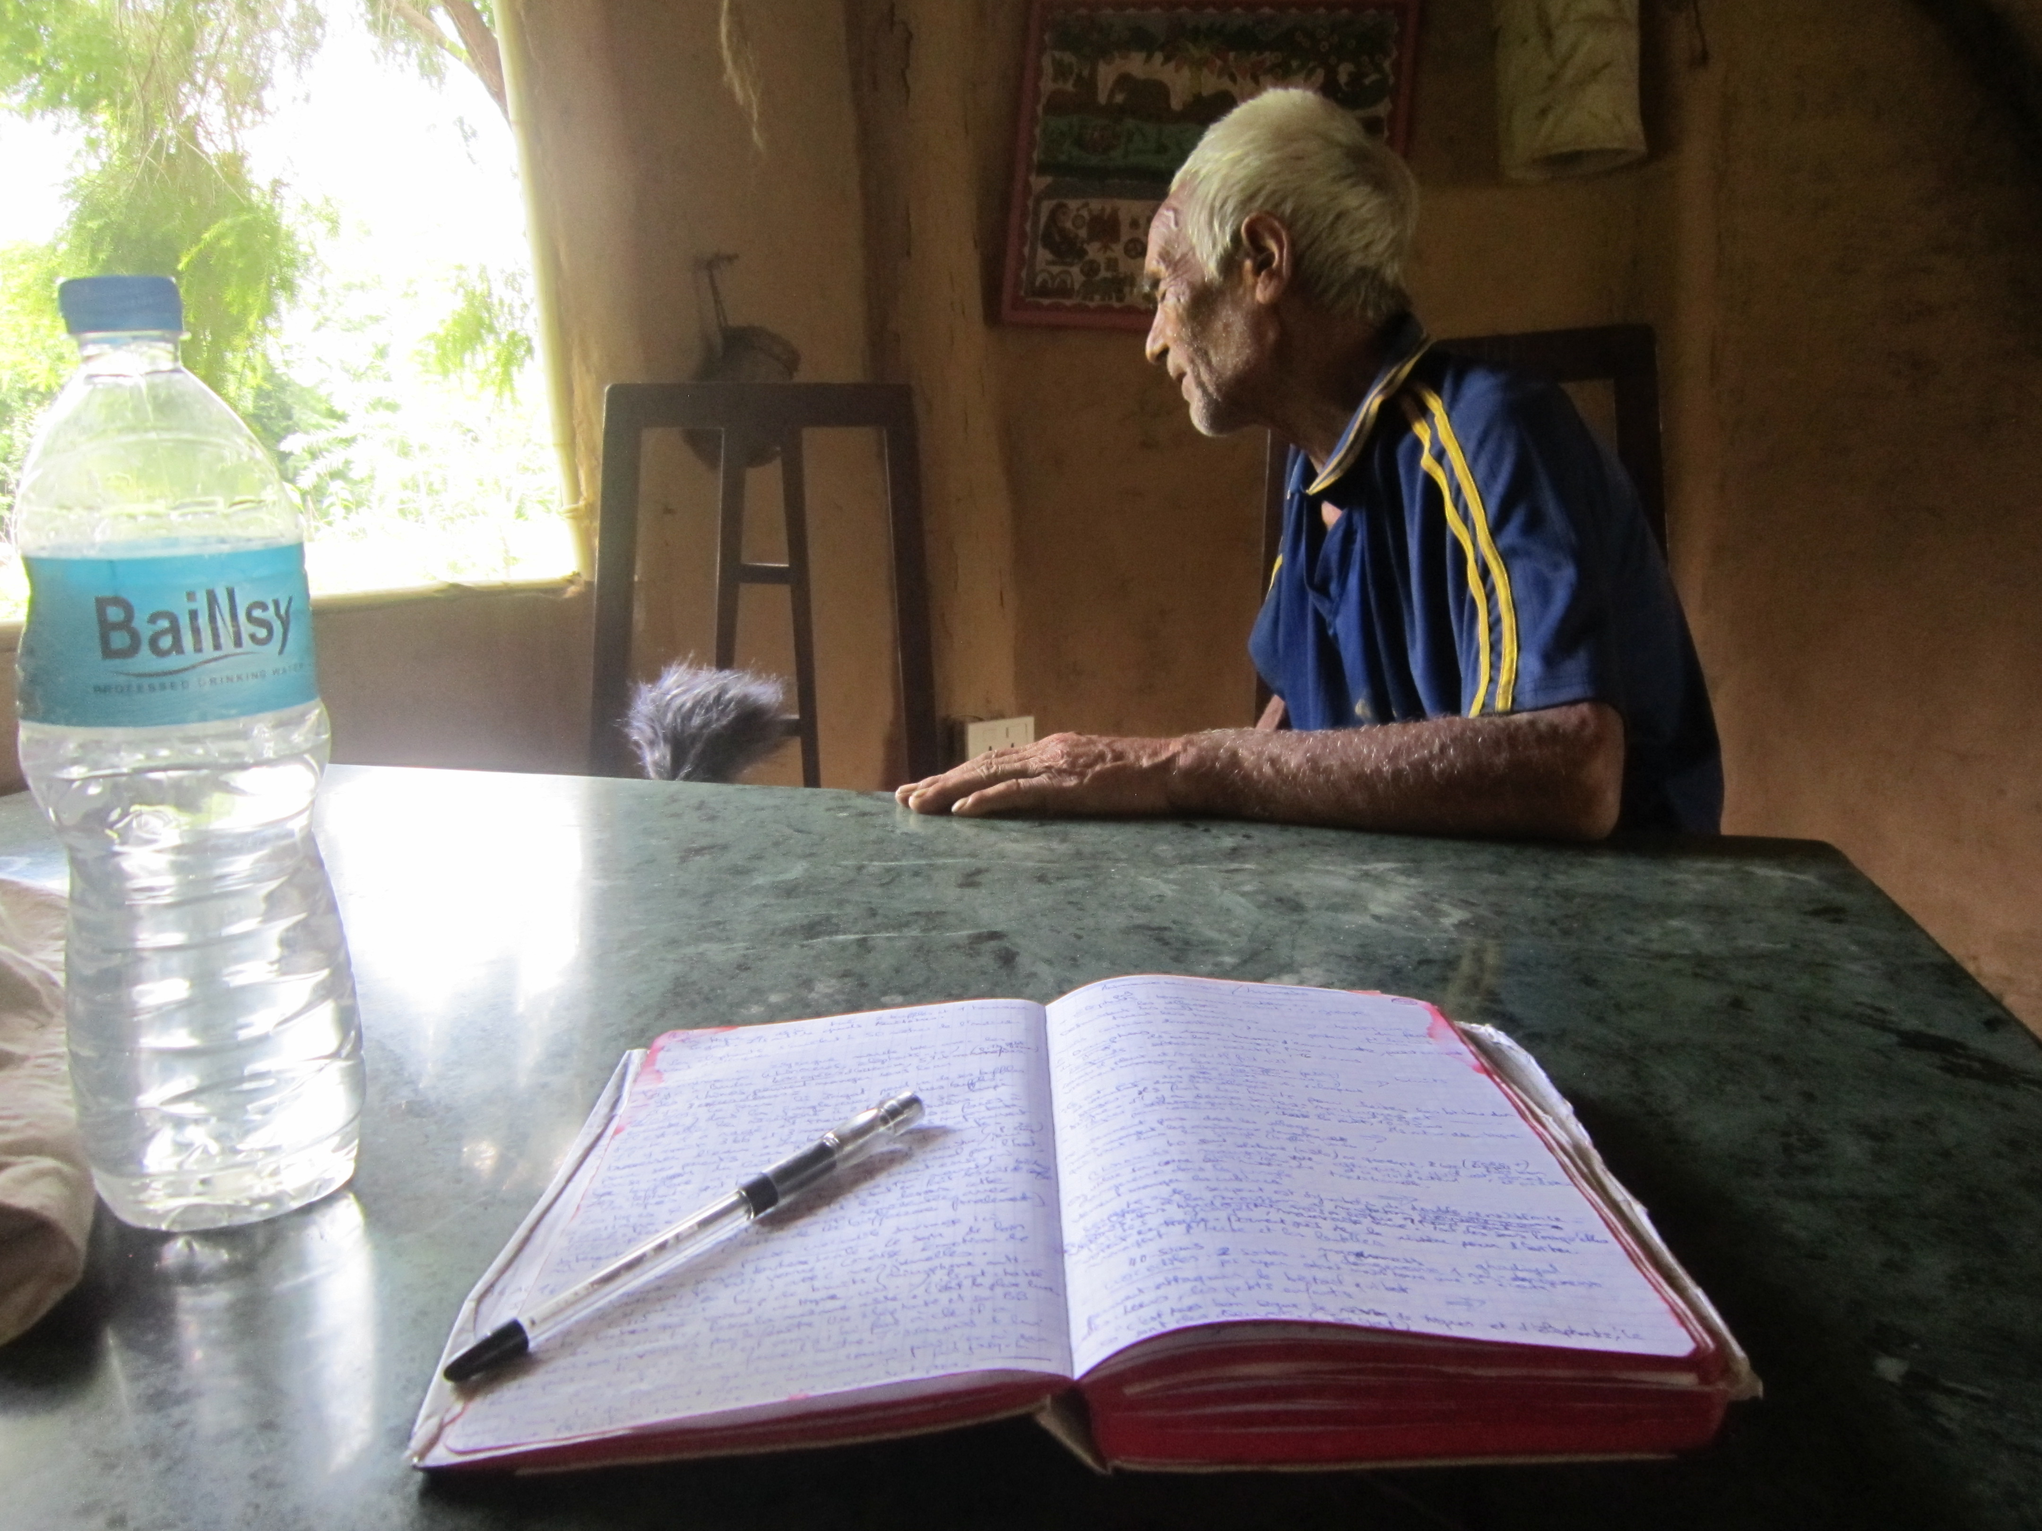

Slide 11
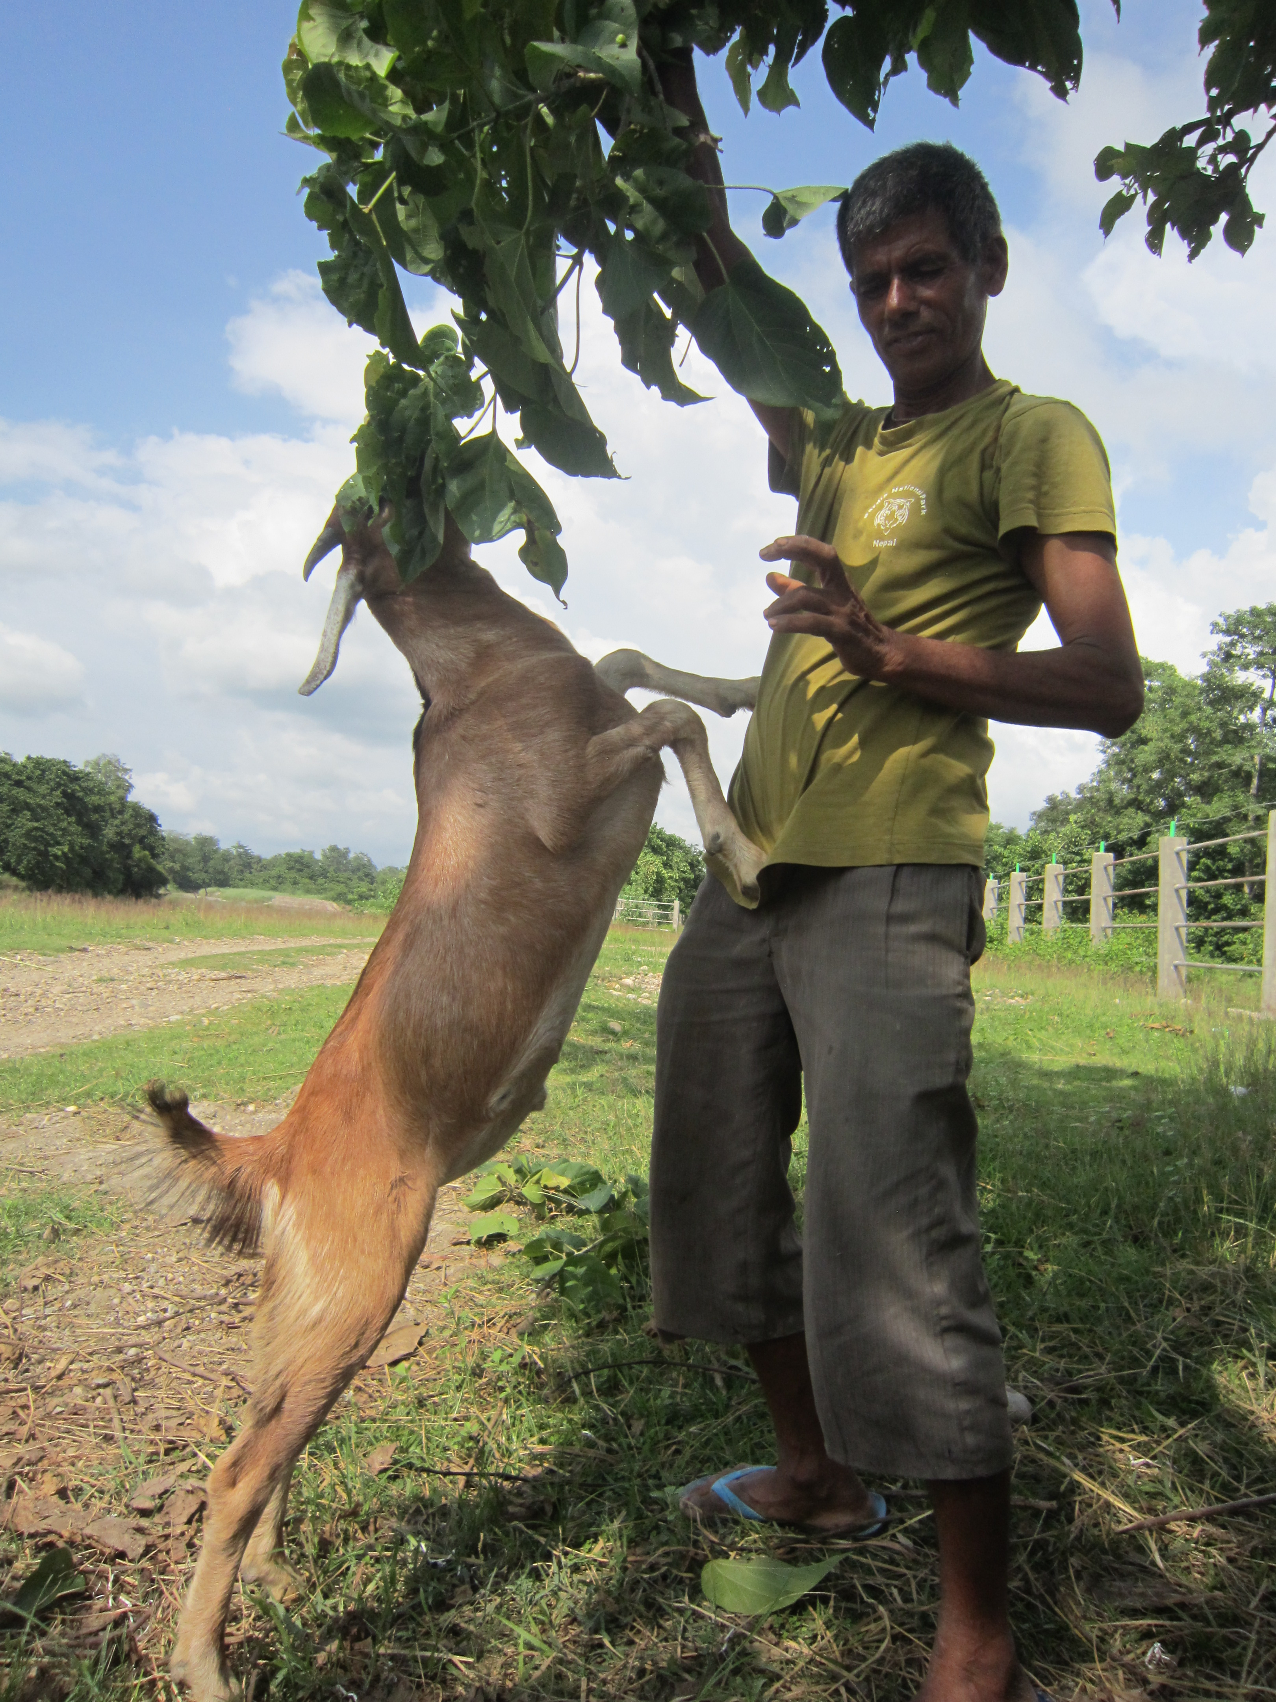
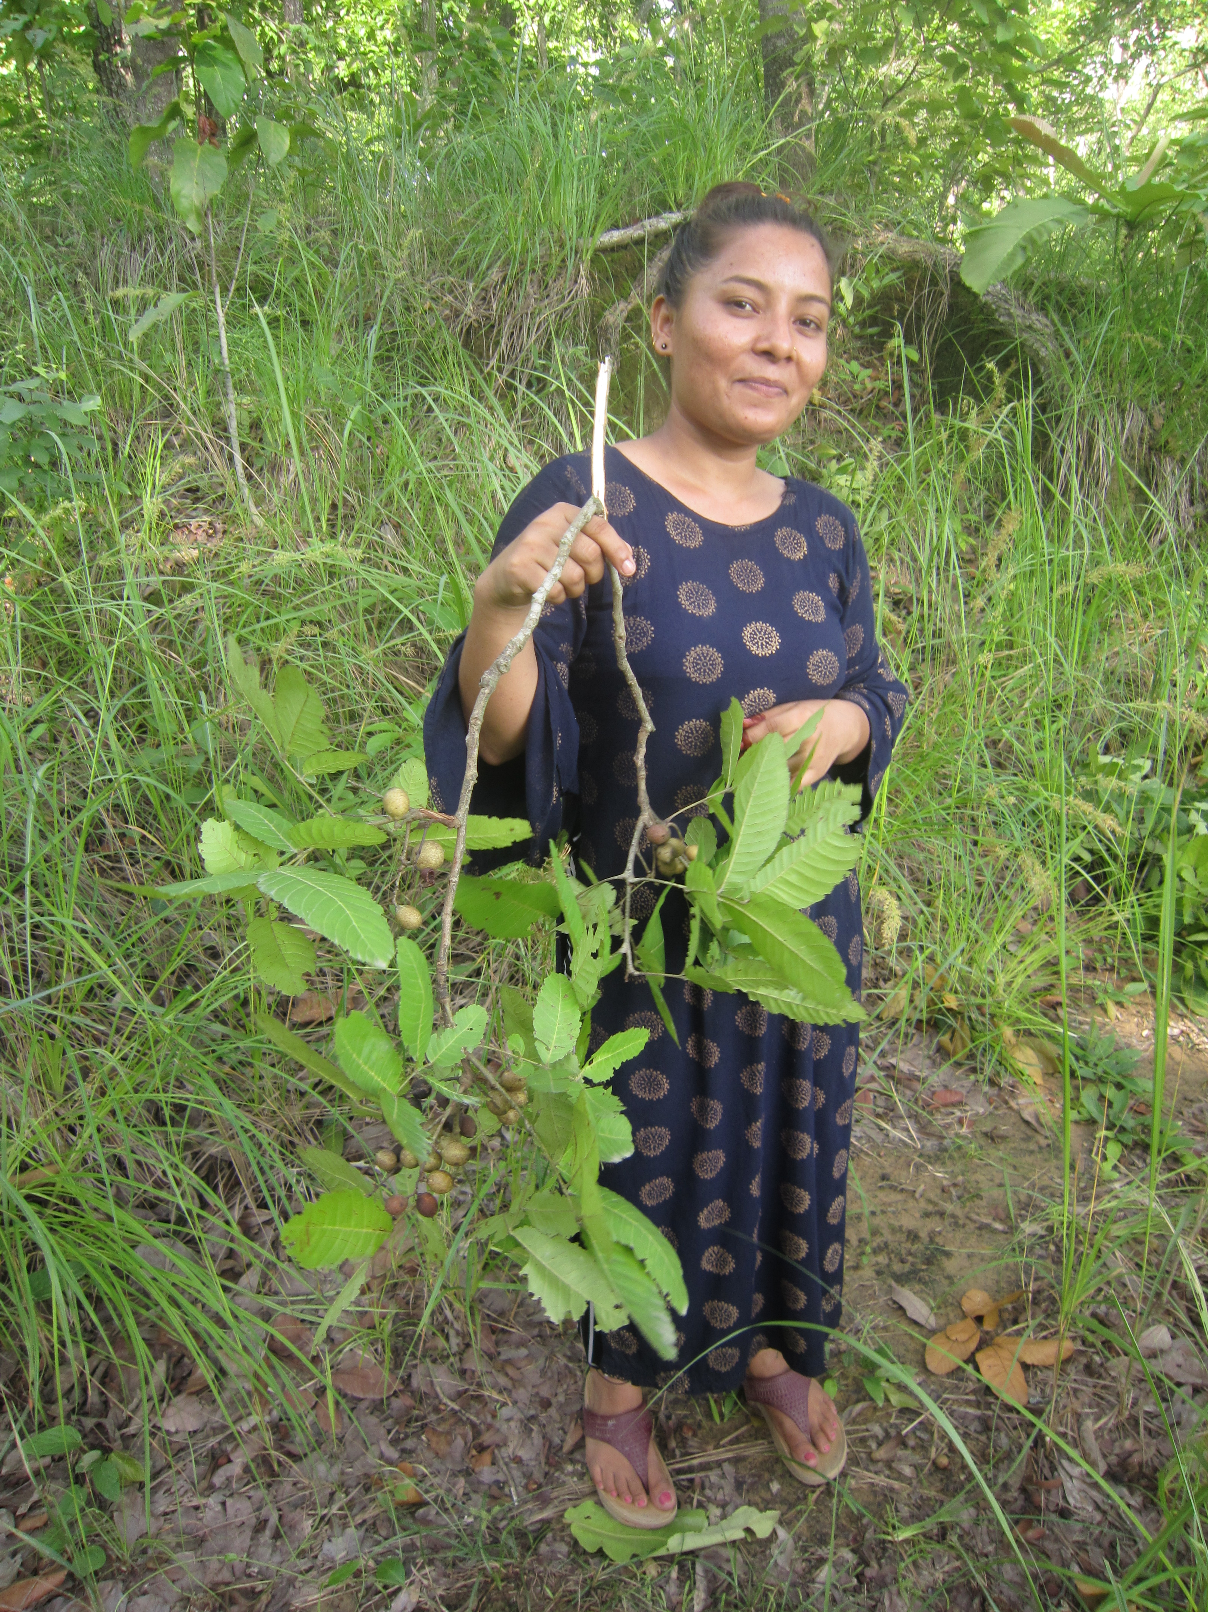

Slide 12
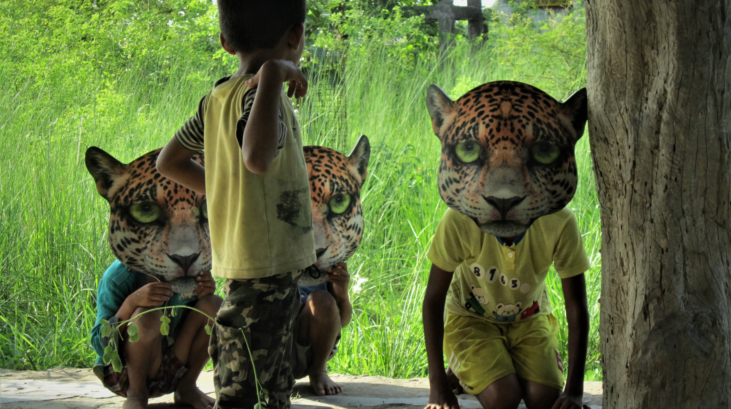

Slide 13
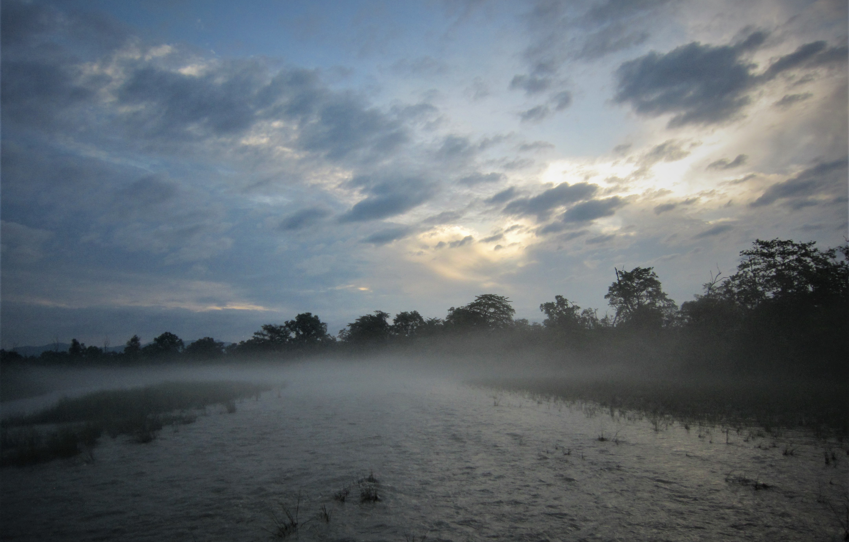

Slide 14
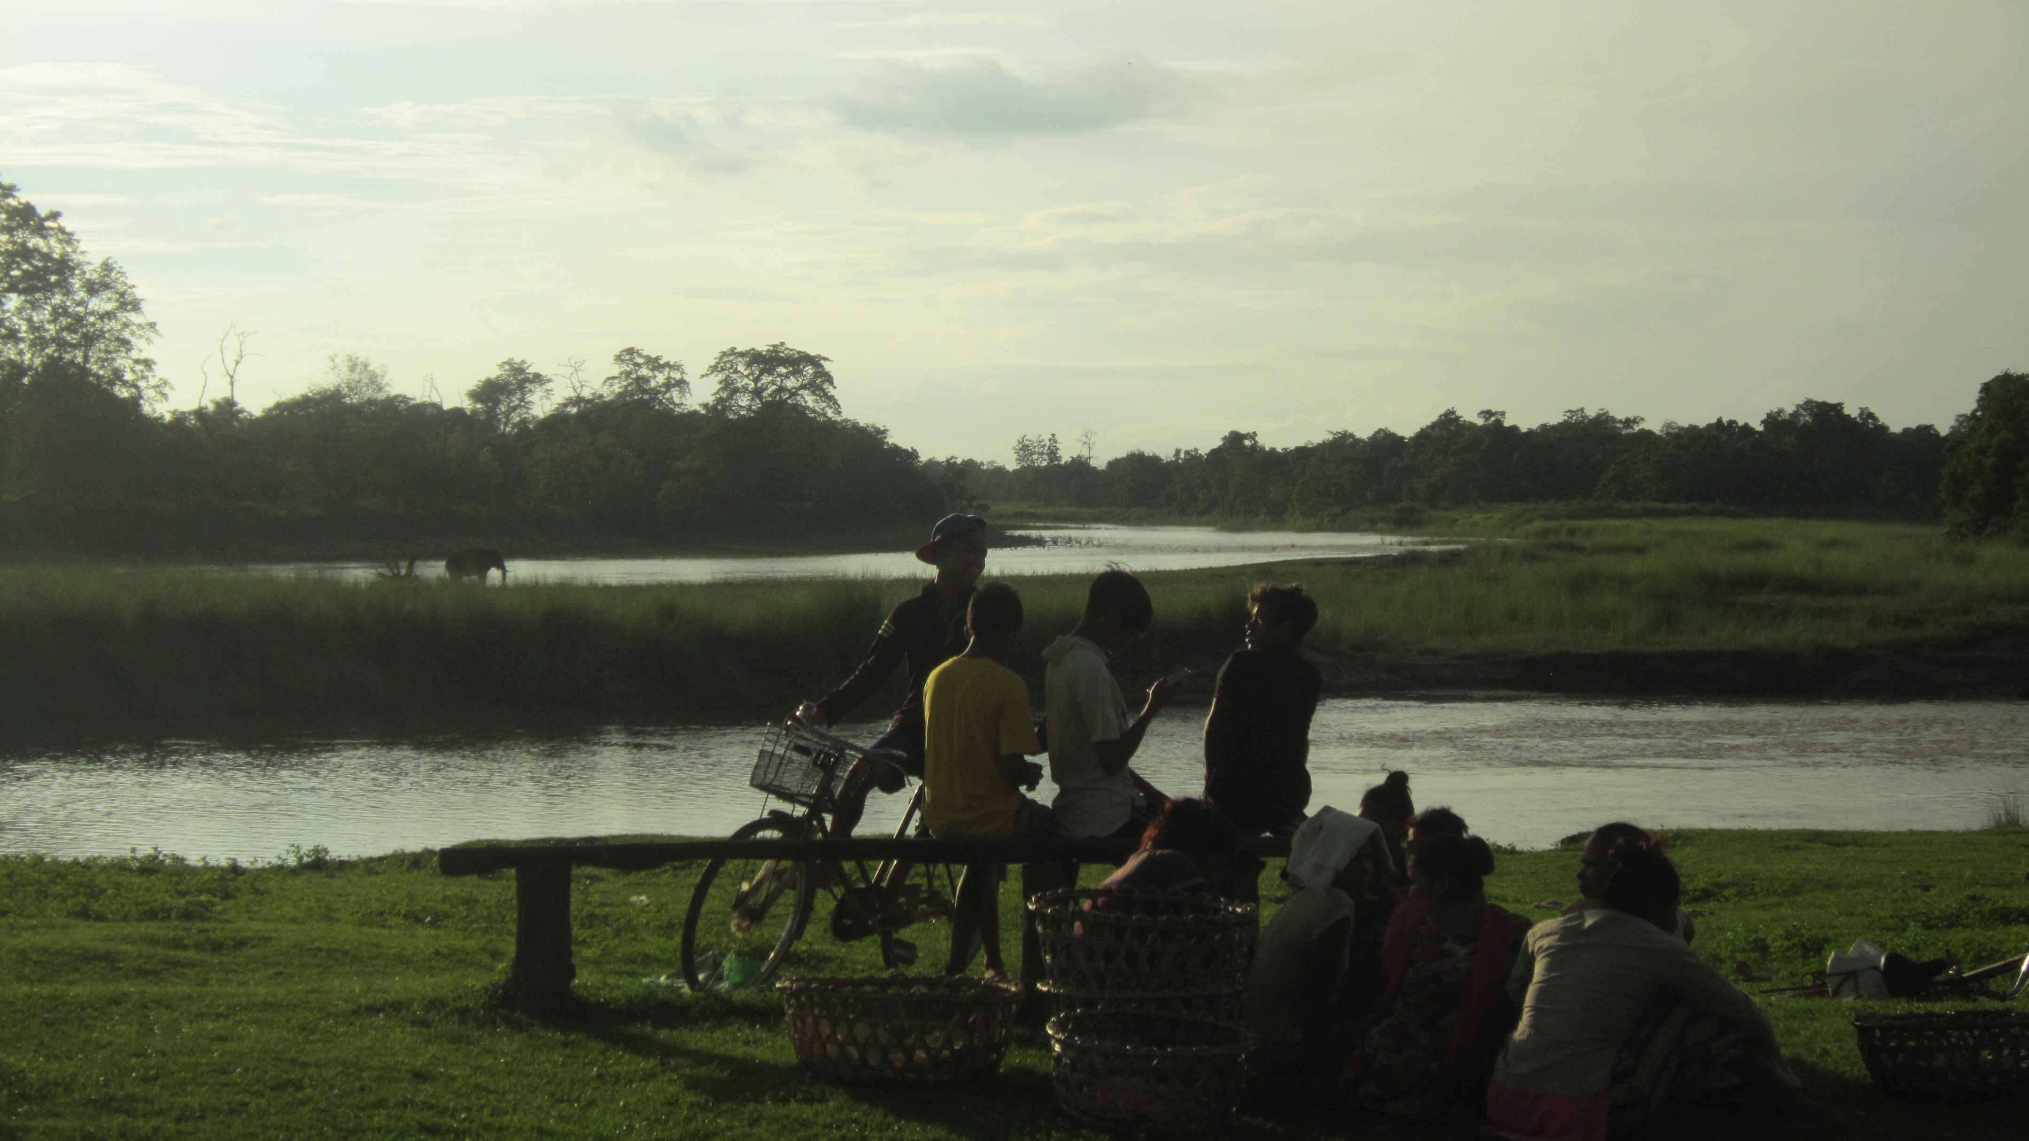

Slide 15
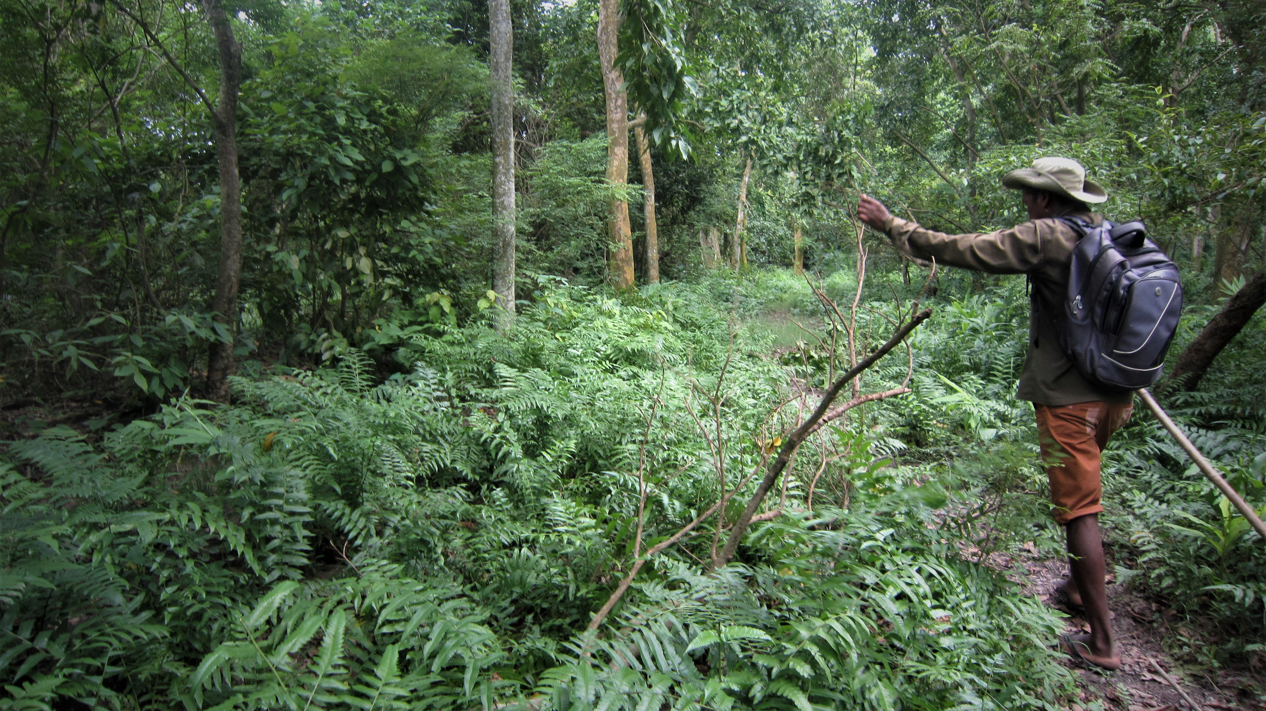

Slide 16
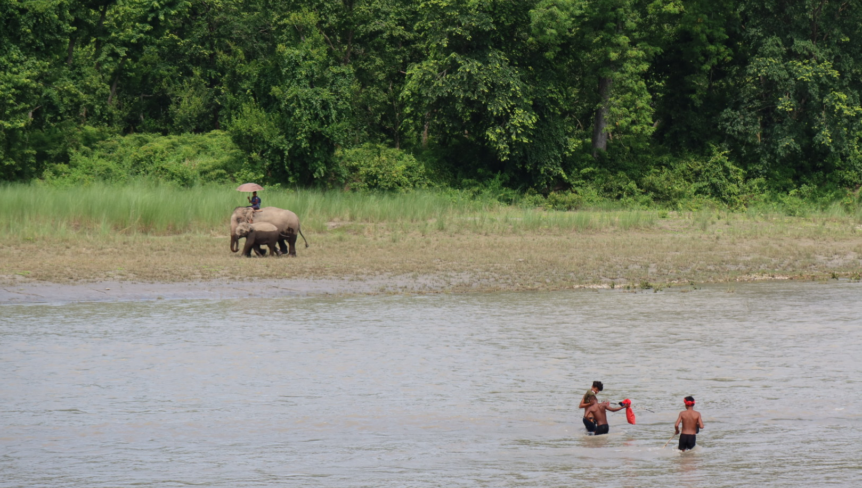

Slide 17
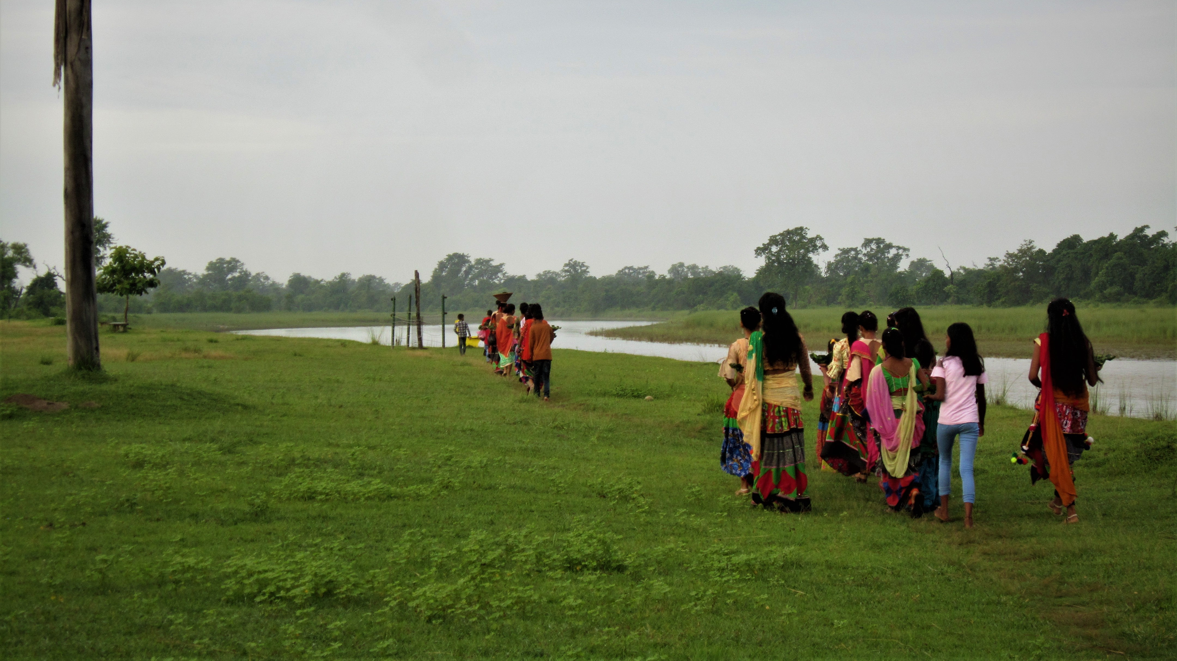

Slide 18
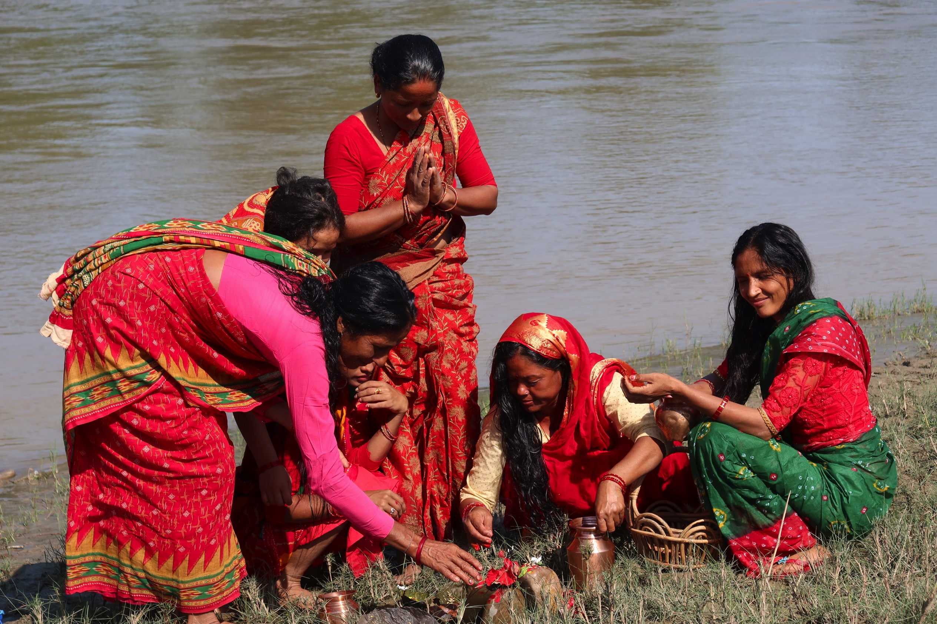

Slide 19
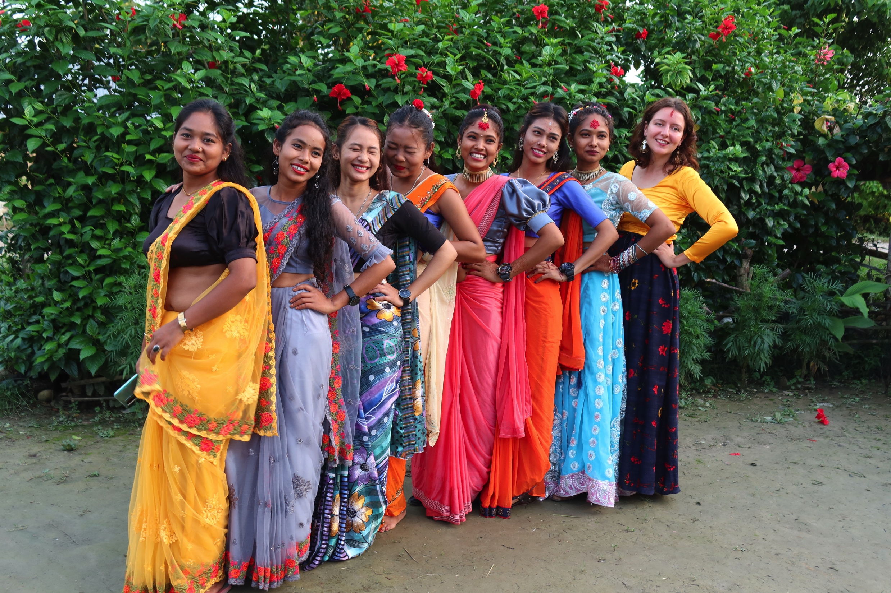

Slide 20
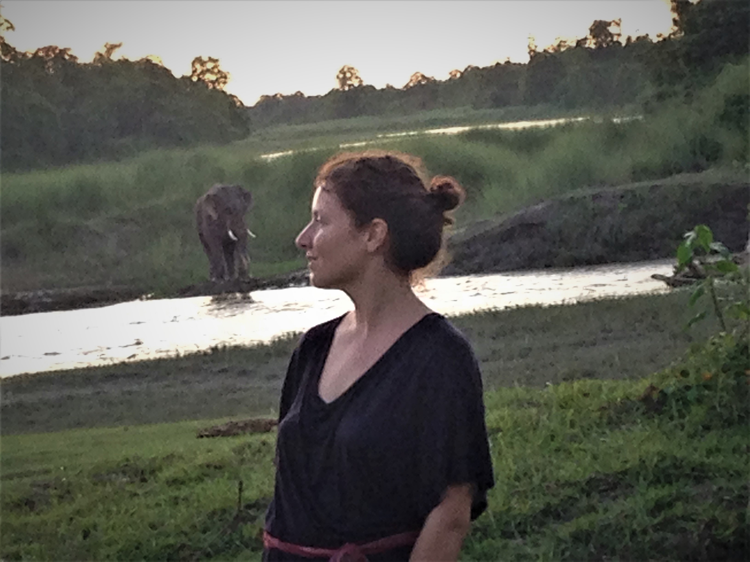
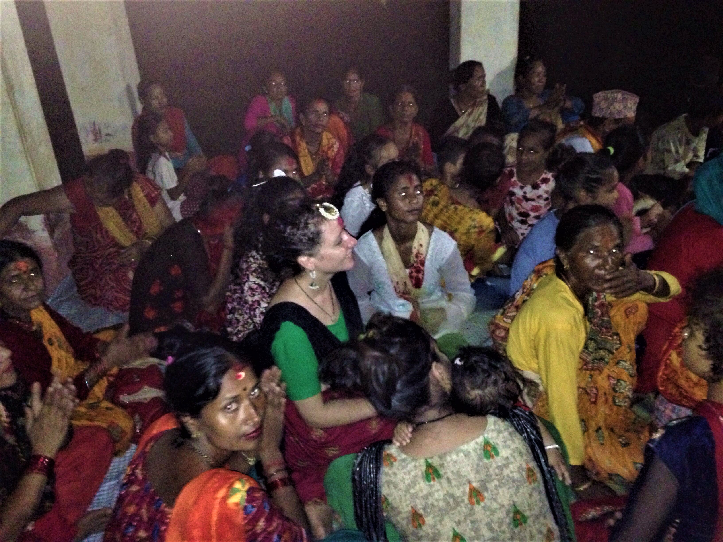

Slide 21
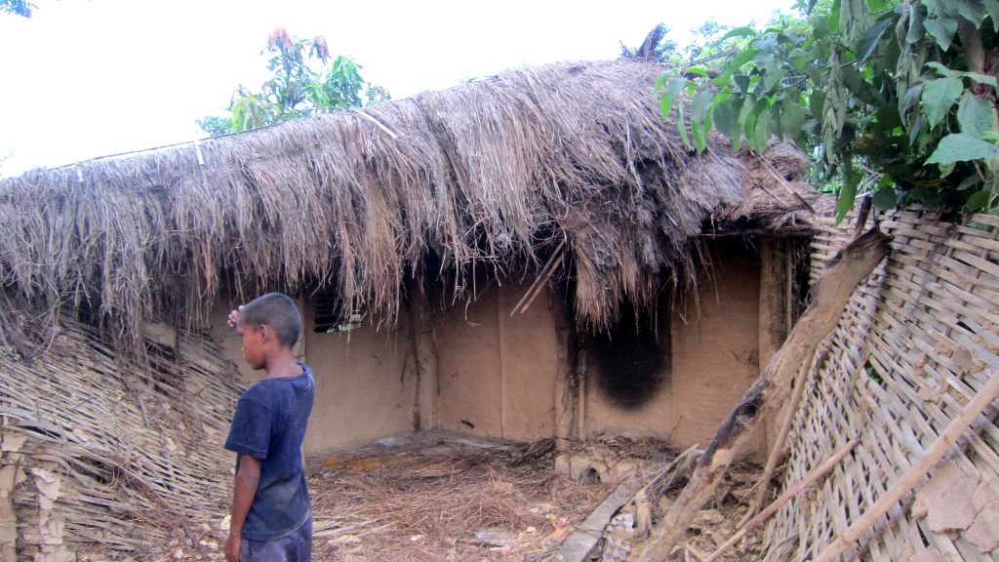

Slide 22
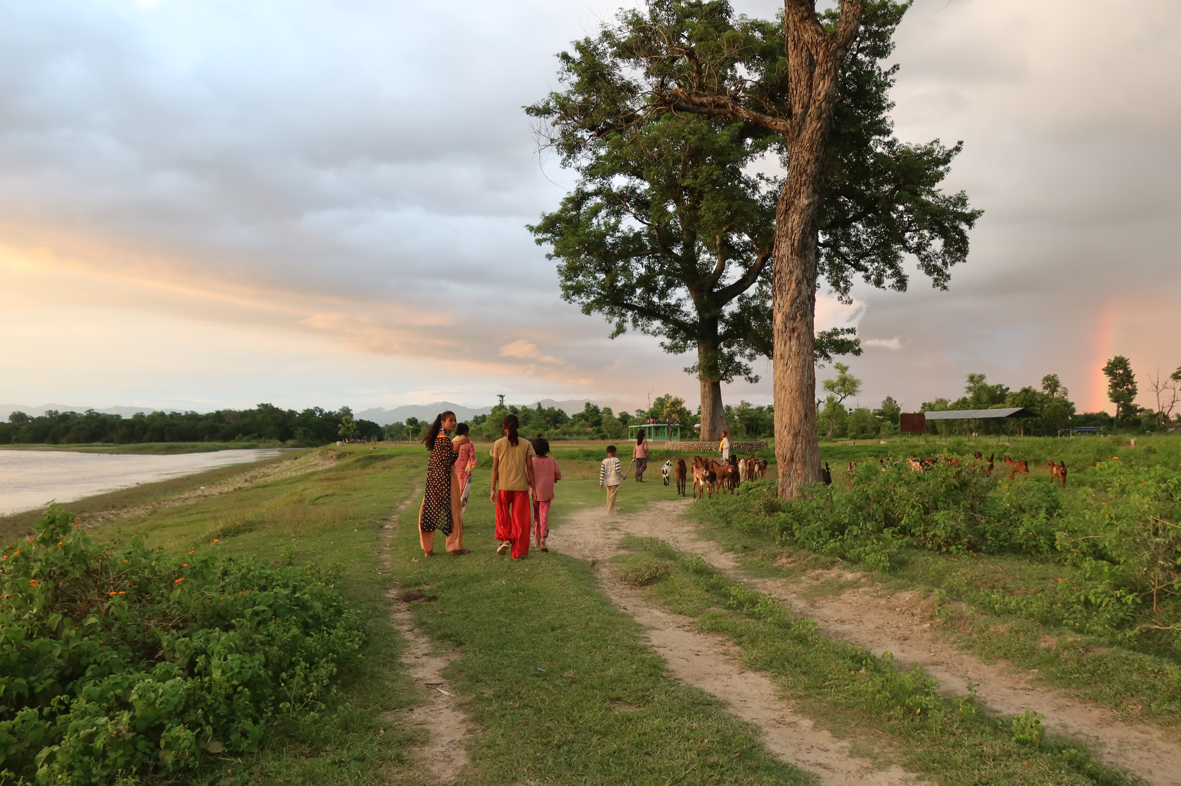

Slide 23
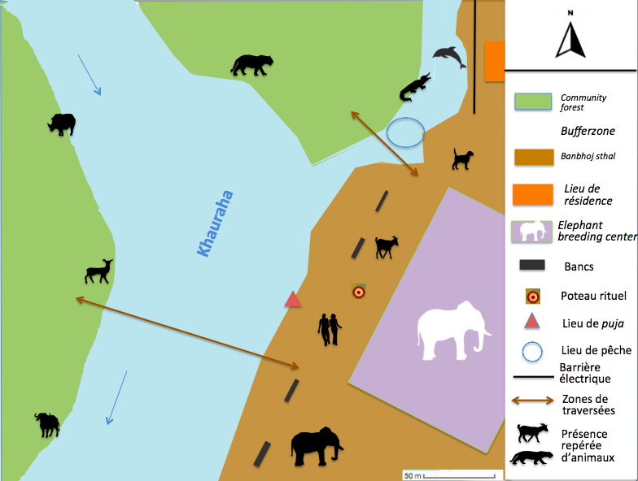

Slide 24
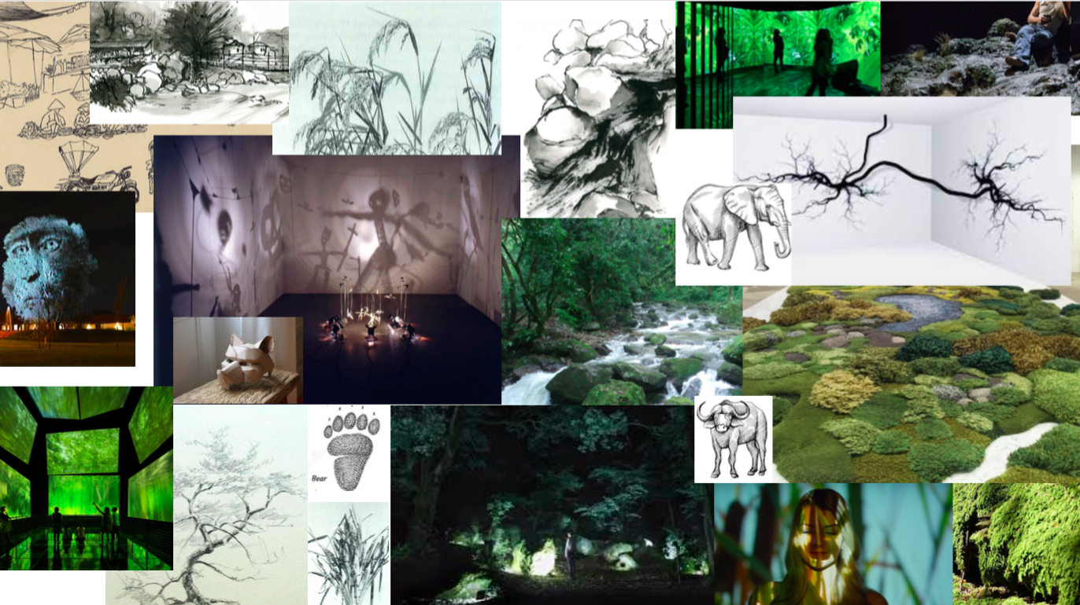
MOODBOARD © Laura Erba

Slide 25
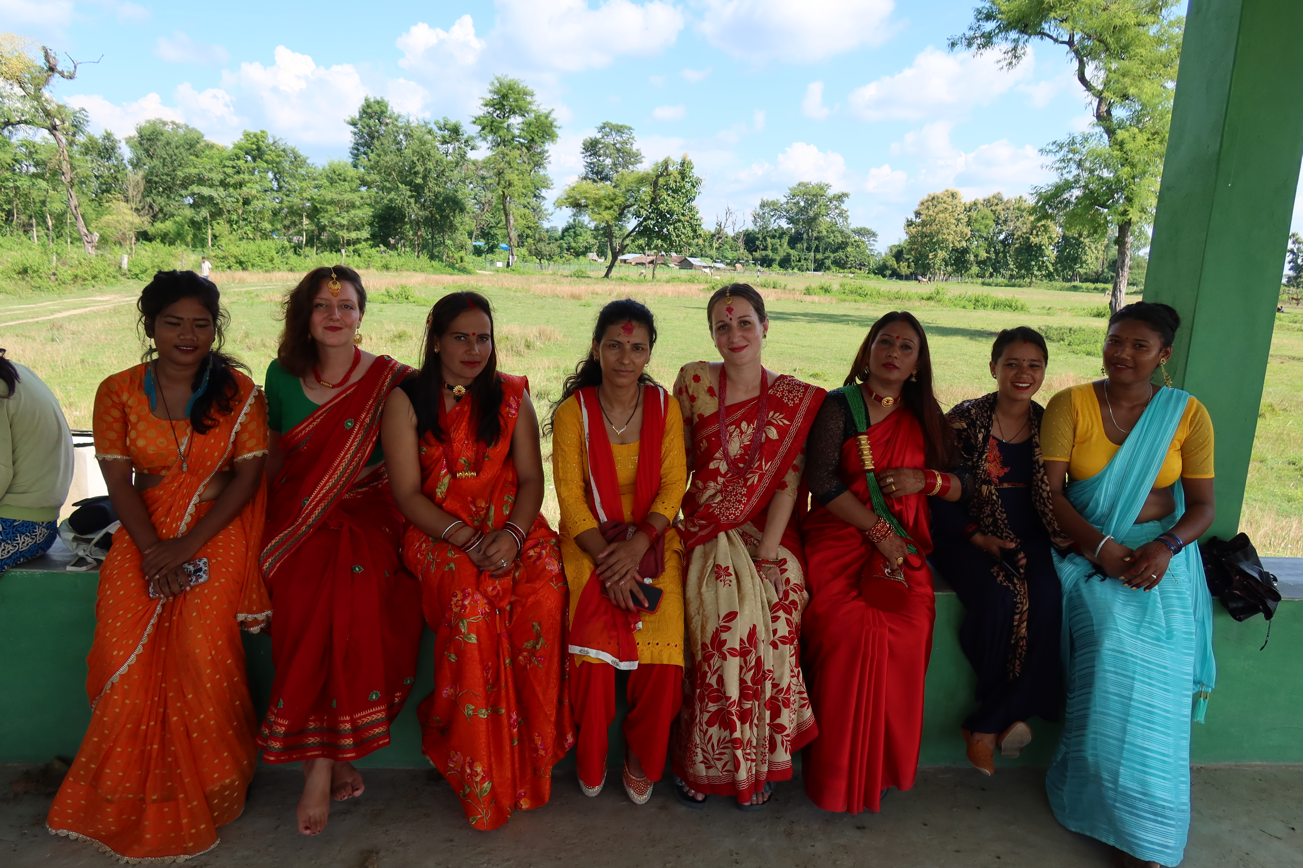

Slide 26
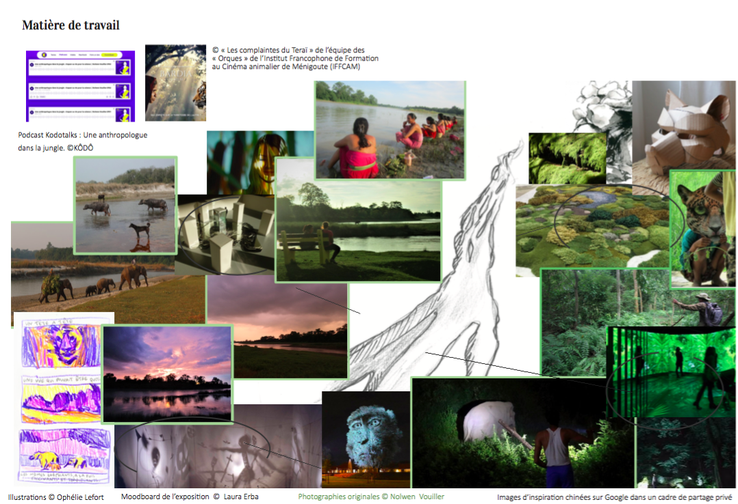
© Laura Erba

Slide 27
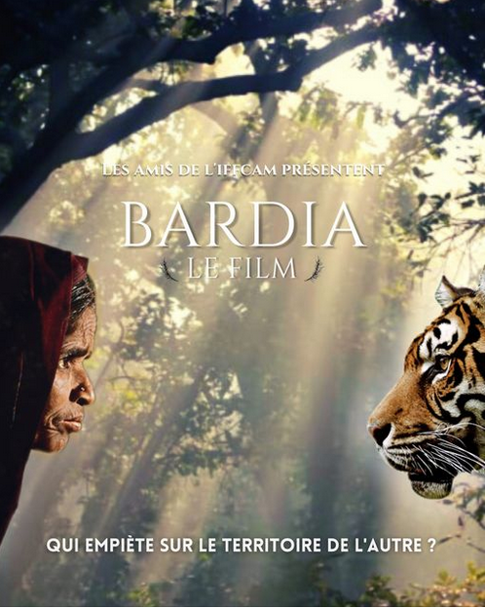
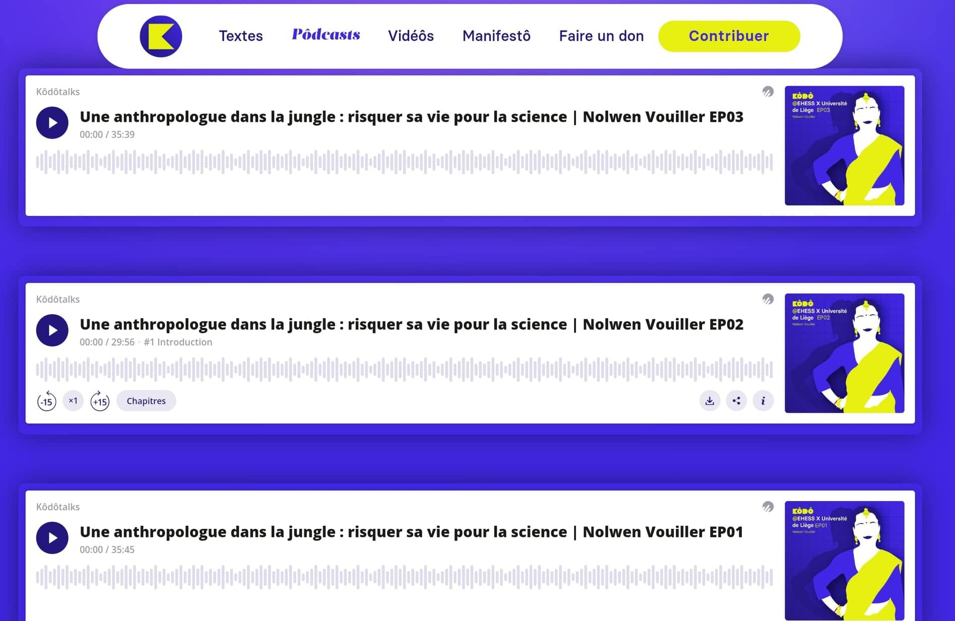
Podcasts, KÔDÔ
Bardia le film, IFFCAM

Slide 28
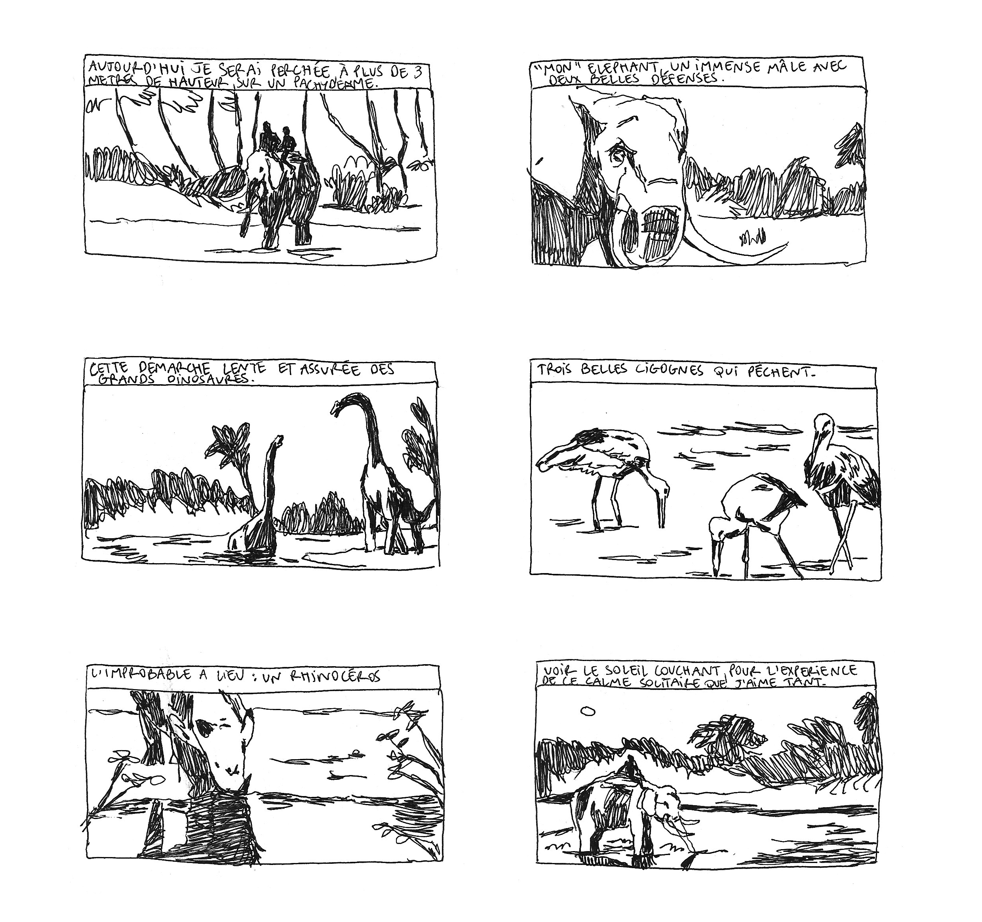
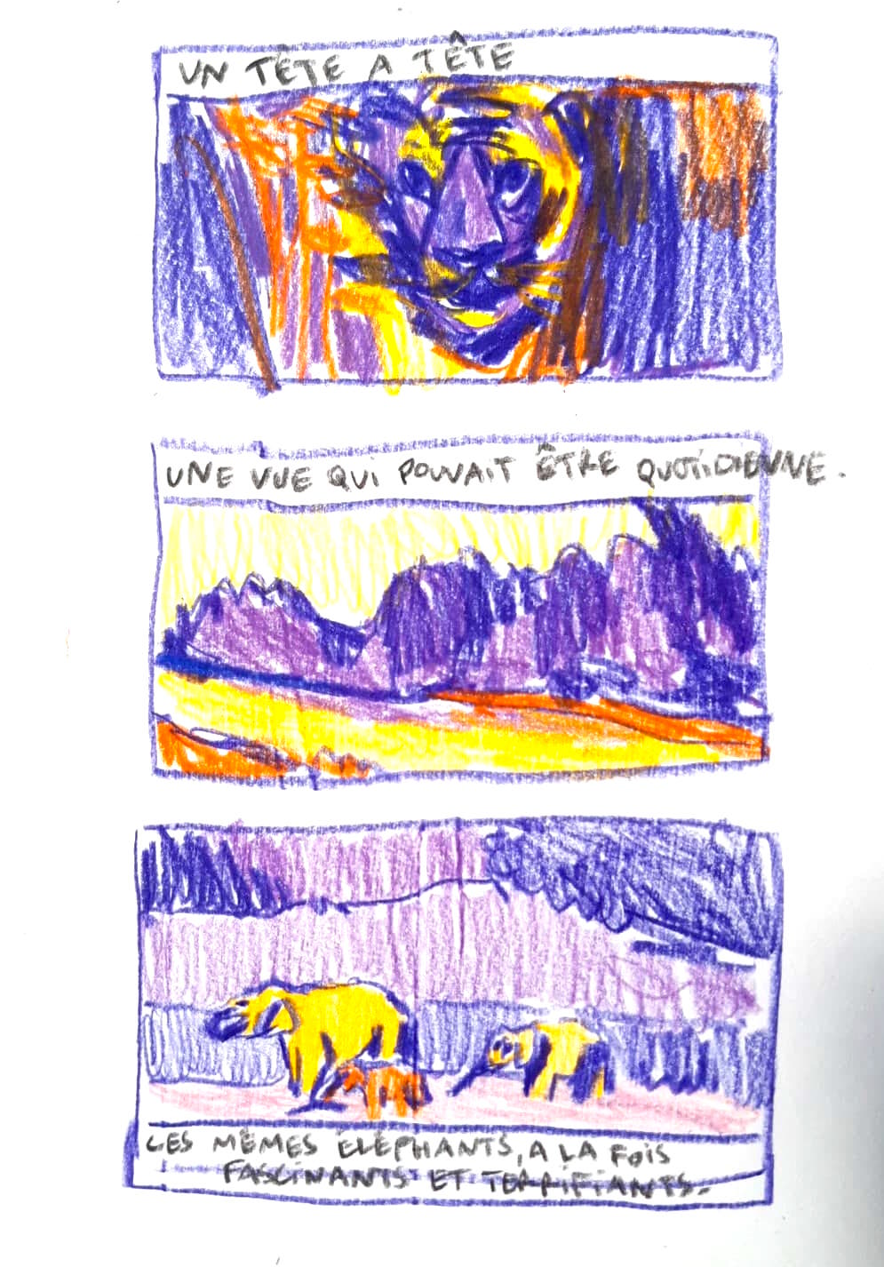
Drawings © Ophélie Lefort

Slide 29
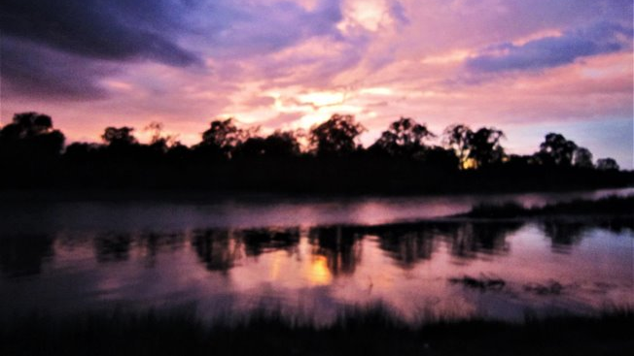
Merci​
धन्यवाद​
Thank you

