Slide 1

E-MRS
Environmental and economic assessment of advanced coatings over their whole life cycle: a case study on HiPIMS and TiAlN
Antoine Merlo
01/06/2022

Slide 2
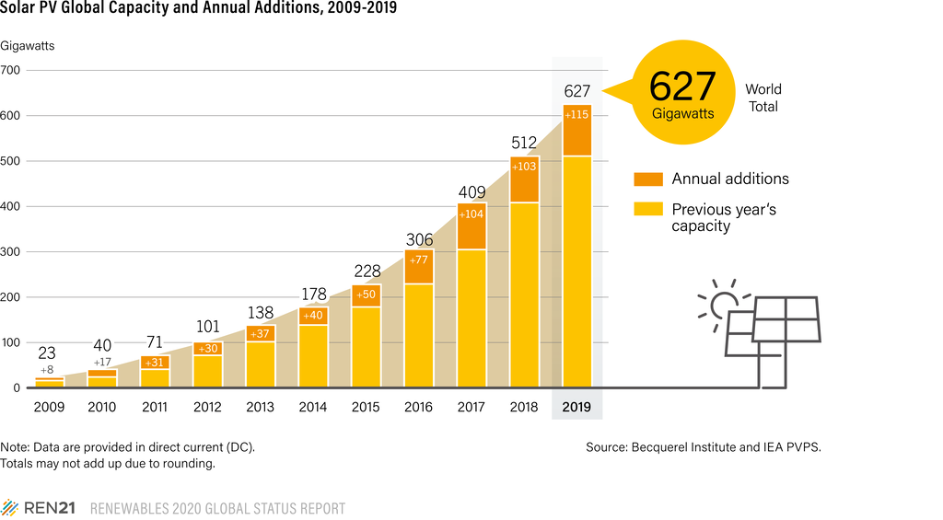

Introduction
1
Thin films are becoming more prevalent than ever
… and there is a need for environmental accountability!
Applying assessment techniques to deposition processes
Joint economic and environmental assessment

Slide 3
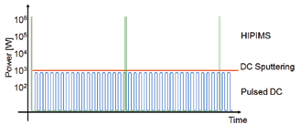
PULSATEC project
INTERREG Great-Region project (Liège, NE France, West Germany, Luxembourg)
Project based around HiPIMS
High Powered Impulse Magnetron Sputtering!

Slide 4
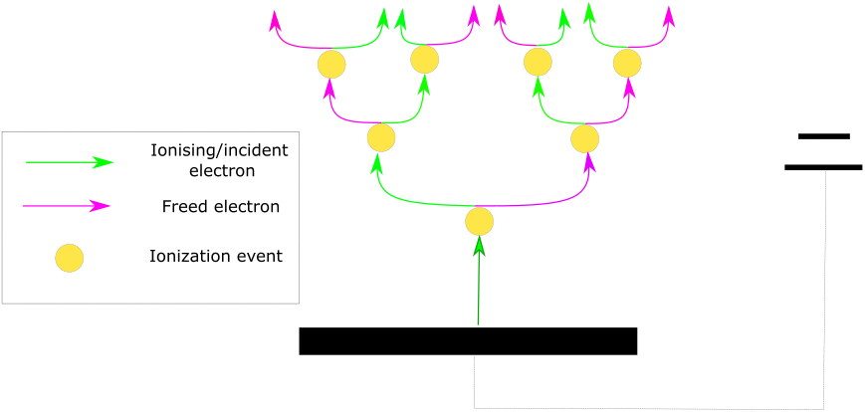
HiPIMS
Magnetron Sputtering: coating technology
Vaccuum chamber
Voltage to sputter target
HiPIMS: High V pulses to increase ionization rate!

Slide 5
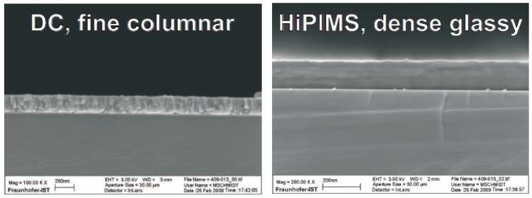
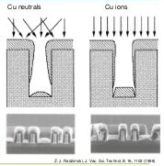
Characteristics of HiPIMS coatings
High energy ➔ High density
More ions ➔ Better coverage
Better adhesion
BUT lower deposition rate!

Slide 6
Goal
HiPIMS: costlier, but better performing coatings than MS-DC
Evaluate costs and impacts for both:
Coating phase
Cutting phase
Higher tool life ➔ Lower downtimes ➔ Higher productivity and lower passive electricity consumption
Joint evaluation of costs and environmental impacts

Slide 7
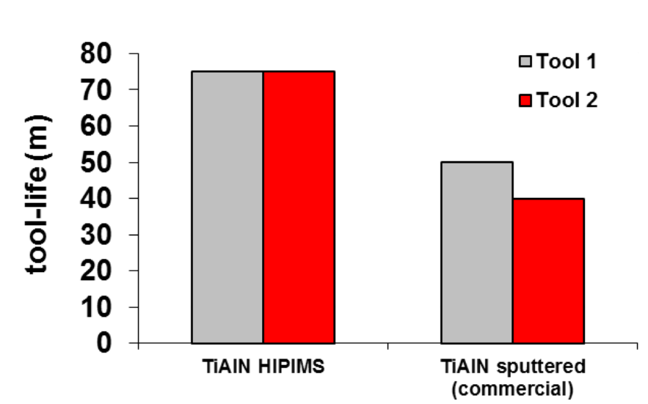
TiAlN and HiPIMS
Higher performances of HiPIMS coatings➔ Improved tool life
Good enough to compensate higher HiPIMS costs?
Weichart, J. (2012). ‘Titanium aluminum nitride sputtered by HIPIMS’, IOP Conference Series Materials Science and Engineering

Slide 8
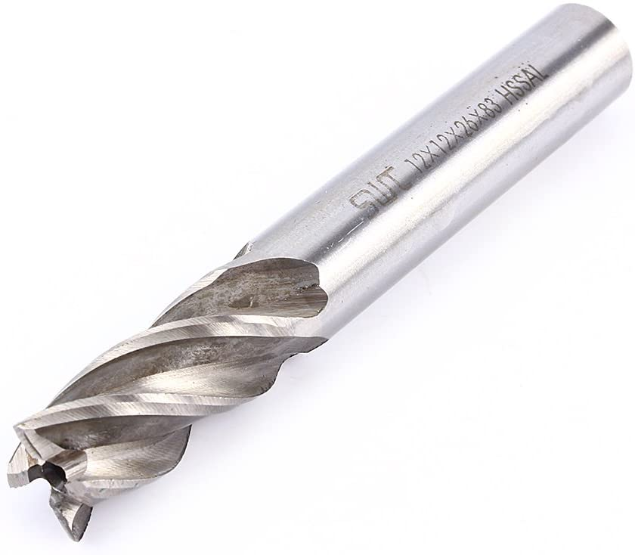
Tools considered
HSS milling tools: 8mm diameter, 8 cm length
4µm TiAlN
Tool life of 75 min for HiPIMS and 50 min for MS-DC
1.8µm/h for HiPIMS 3.6µm/h for DC-MS

Slide 9
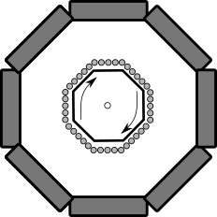
Installations
200 tools per batch
Rotating and heating substrates
HiPIMS :1 300 000 € DC-MS :1 200 000 €
Same consumptions for both processes but longer deposition time for HiPIMS (133 min vs 67 min)

Slide 10
Cost evaluation of 1 coating
Two 8h shifts per day (40€ per operator)
1464 vs 1094 batches a year (MS-DC vs HiPIMS)
0.08€/kWh
5 year payback

Slide 11
Environmental impact of 1 coating
CO2 emissions: 320.7 gCO2 for HiPIMS, 191.2 gCO2
Electricity production is the main factor (Belgian EF: 174 gCO2/kWh

Slide 12
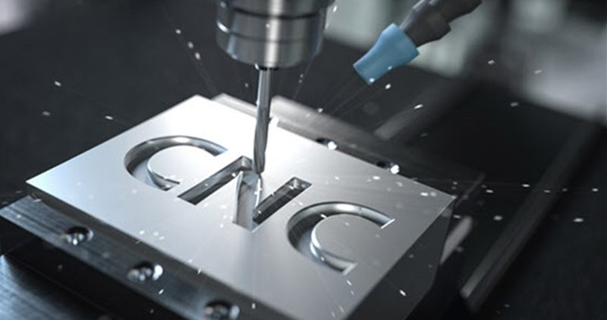
Cutting phase
Inclusion of costs and impacts of cutting phase:
Substrate
Coatings
Cutting fluid
Electricity consumed
Tool life has an impact on those factors!

Slide 13
Cutting phase costs
Longer tool life leads to lower down times ➔ Lower costs and higher productivity

Slide 14
Cutting phase impacts
Higher CO2 emissions for HiPIMS coatings, but:
Less substrates used
Less cutting fluid
Less passive electricity usage

Slide 15
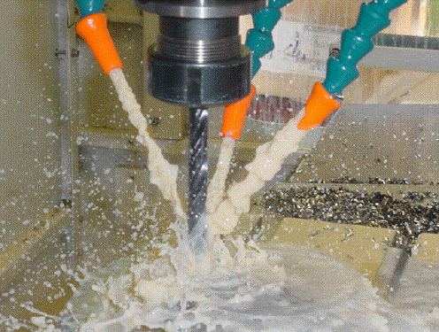

Cutting phase evaluation conclusions
Use of HiPIMS reduces the total cost by around 10% and CO2 emissions by 15%
High potential for HiPIMS technology
Different operating parameters ?
Lubrification conditions
Cutting speed
Costa, Eder & Bacci Da Silva, Marcio & Machado, Alisson. (2009). Burr Produced on the Drilling Process as a Function of Tool Wear and Lubricant-Coolant Conditions. Journal of The Brazilian Society of Mechanical Sciences and Engineering - J BRAZ SOC MECH SCI ENG. 31. 10.1590/S1678-58782009000100009.

Slide 16
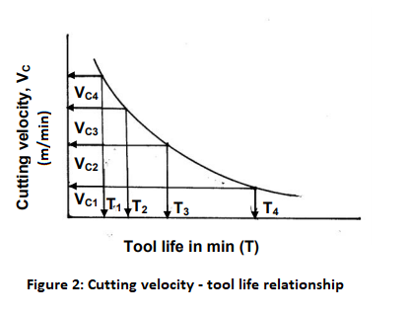

Parametrisation: Taylor’s equation
Parametrisation of cost and CO2 (2 objectives)
$VTn = C$ ➔ Use cutting speed as a parameter

Slide 17

Parametrisation: Taylor’s equation
Until experimental data, assumed that tool lives and powers evolve with speed as in *
$\frac{T(2V)}{T(V)}= \frac{T′(2V^{′})}{T′(V′)}$
*Li, C. (2015). ‘A quantitative approach to analyze carbon emissions of CNC-based machining systems’, Journal of Intelligent Manufacturing 26, pp. 911-922

Slide 18
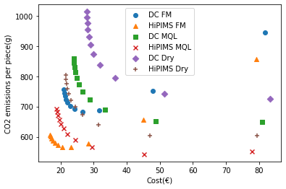
Parametrisation
Plot of CO2 emissions vs costs
Several lubrication scenarios
Cutting speed varies between 5 and 100 m/min

Slide 19
Parametrisation
Plot of CO2 emissions vs costs
Several lubrication scenarios
Cutting speed varies between 5 and 100 m/min
HiPIMS lowers both costs and CO2 impacts !

Slide 20
Parametrisation
Plot of CO2 emissions vs costs
Several lubrication scenarios
Cutting speed varies between 5 and 100 m/min
Cutting speeds reduce costs, but increase CO2 emissions
HiPIMS lowers both costs and CO2 impacts !

Slide 21
Parametrisation conclusions
HiPIMS in flood machining conditions seems to bring the best outcomes for both costs and CO2 emissions
Trade-offs between CO2 emissions and costs
How to choose the best cutting speed?
➔ Aggregation of CO2 emissions via a carbon tax

Slide 22
Carbon tax: 120€/tCO2

Slide 23
Carbon tax: 250€/tCO2

Slide 24
Carbon tax: 5000€/tCO2

Slide 25
TiAlN Conclusions
CO2 emissions differences are negligible, even with aberrant carbon taxes
HiPIMS in FM at high machining speeds seem to be the best option
Need of experimental data to validate assumptions

Slide 26
Thank you for your attention!

Slide 27
Références
[1] IndustryArc (2021). ‘Cutting Tools Market - Forecast(2021 - 2026)’
[2] Bobzin, K. (2016). ‘High-performance coatings for cutting tools’, CIRP Journal of Manufacturing Science and Technology
[3] Jindal, P.C. et al. (1999). ‘Performance of PVD TiN, TiCN, and TiAlN coated cemented carbide tools in turning’, International Journal of Refractory Metals & Hard Materials, 17, pp. 163-170.
[4] Kottfer, D. et al. (2013). ‘Investigation of Ti and Cr based PVD coatings deposited onto HSS Co 5 twist drills’, Applied Surface Science, 282, pp. 770-776.
[5] Münz, V.-D. (1986), ‘Titanium aluminum nitride films: A new alternative to TiN coatings’, Journal of Vacuum Science & Technology A, 4(6)
[6] Weichart, J. (2012). ‘Titanium aluminum nitride sputtered by HIPIMS’, IOP Conference Series Materials Science and Engineering
[7] Anders, A. (2010). ‘Deposition rates of high power impulse magnetron sputtering: Physics and economics’, Journal of Vacuum Science & Technology A 28, p. 783
[8] Li, C. (2015). ‘A quantitative approach to analyze carbon emissions of CNC-based machining systems’, Journal of Intelligent Manufacturing 26, pp. 911-922

