Slide 1
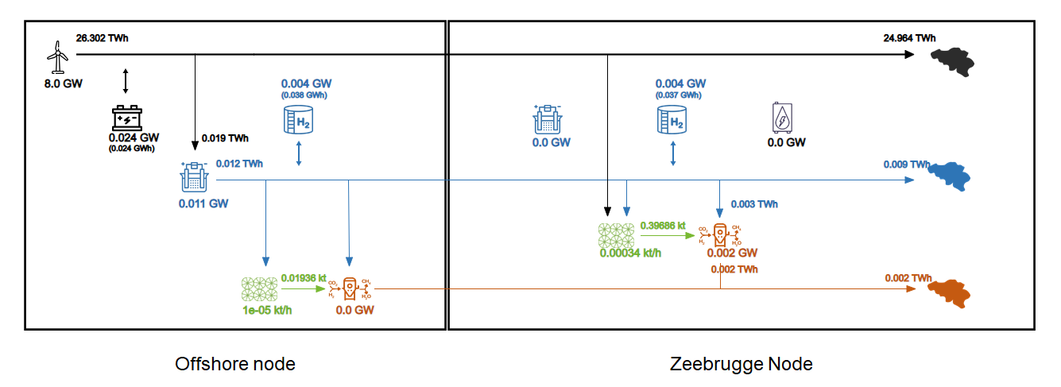
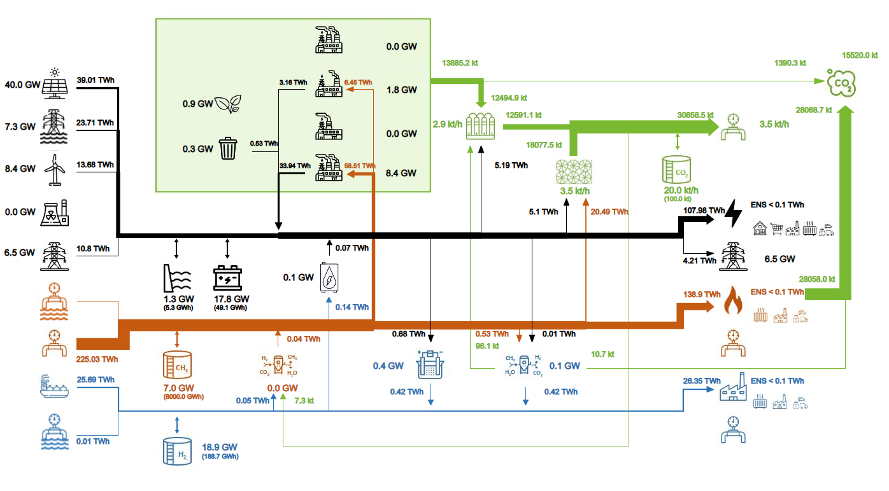
Title : Study and optimization of multi-energy systems for the Belgian energy transition
Jocelyn MBENOUN
Scientific contribution (methodology)
Block scheme of my works:
Difficulties (I need help)
Data collection
Split final energy demands into sectors (transport, heating, industry, etc) for each energy carrier
Define the scientific questions that may be answered with such a problem
Inputs:
Belgium’s objectives relative to the energy transition (co2 emission quota, etc)
What I do : Building an optimisation-based framework using GBOML taking into account different energy carriers and the demand related to each of them
My result:
Sizes of each technology with the total cost of the model
Applications / results
My current objectives are:
Understanding the impact of the different techno-economic parameters (costs, efficiency, ramping curves, maximum capacity installed, etc..), demand profiles and production profiles of renewable resources on the results
Extending the model with new technologies and neighbouring countries
Current model
My dreamed objective is:
Modeling the entire Belgian energy system with all energy carriers
Email : jmbenoun@uliege.be Phone : +32 (0)485976786 Language: French/English

