Slide 1
Session 305 – (Im)migrant Workers May 19th 2022
Recruiting and retaining foreign workforce:
The moral economy of labor intermediation in the Belgian construction sector
Ludovic Bakebek & Simon Wuidar (University of Liège, Belgium)

Slide 2
Project context
A first study conducted on labor intermediation in Cameroon
Political context
Variety (and emergence) of intermediaries
Various intermediation practises
Focus on contextual effects
On intermediary bodies
On intermediation practices

Slide 3
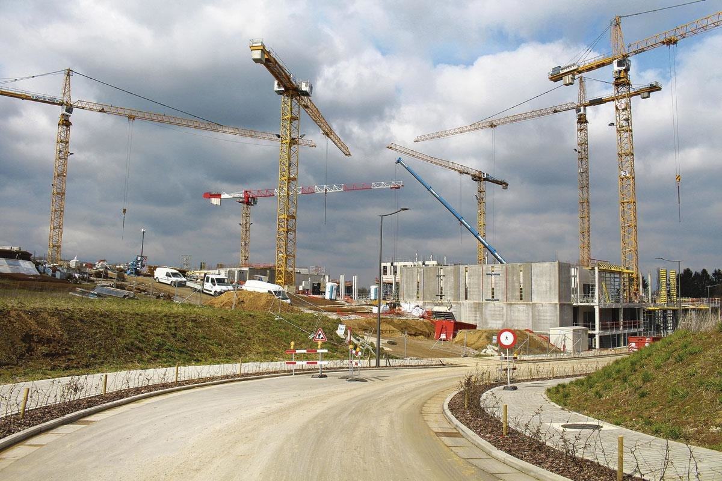
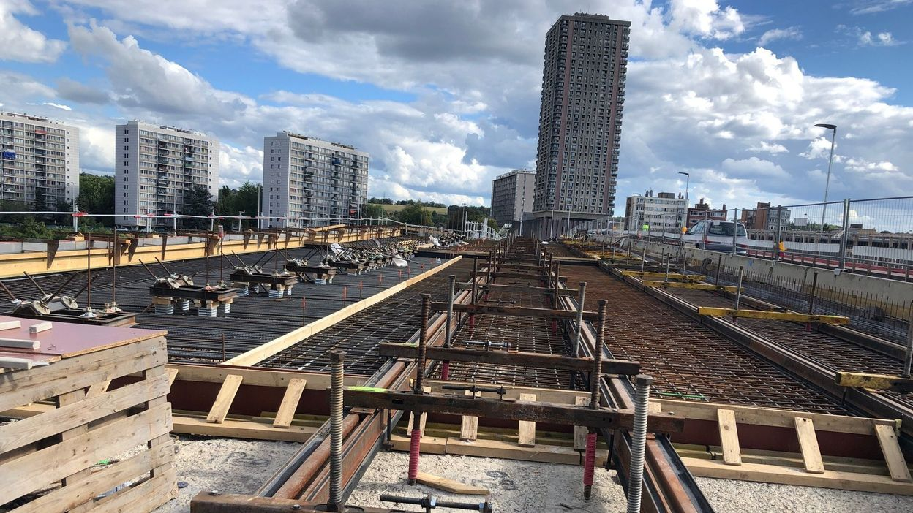
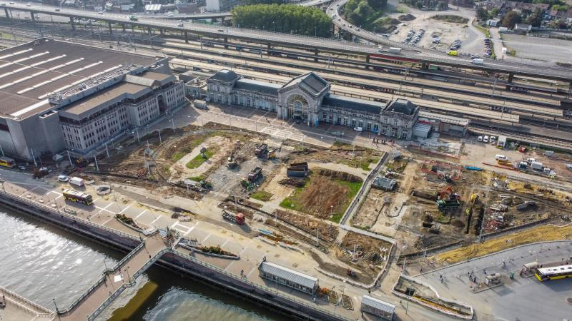
Context – The construction sector in Belgium
Notes:
Investissements publics (240 millions en Wallonie)
Prolongement du tram à Liège (105 millions)
Métro de Charleroi (60 millions)
Volonté d’isoler de nombreux bâtiments
Reconstruction suite aux inondations
➔ Multiplication des projets

Slide 4
Context – Workforce in the sector
Great need for manpower (18,000 annual entries needed) …
… but important shortage (68% of blue-collar jobs considered in shortage)
Sub-contracting practices and importance of recruitment agencies (direct recruitment, temporary work, payroll)
The sector turns more and more to foreign profiles (motivated, skilled and experienced but also unskilled, candidates in “legal situation”)
Empowerment of workers and volatility in the market
➔ How do intermediaries recruit and retain workers in Belgium?

Slide 5
Methodology
Ethnographic approach of labor market intermediaries
Taking LMIs as composite bodies
From the agency policy to a focus on the the day-to-day interactions between consultants and candidates
How to recruit and how to retain foreign candidates ?

Slide 6
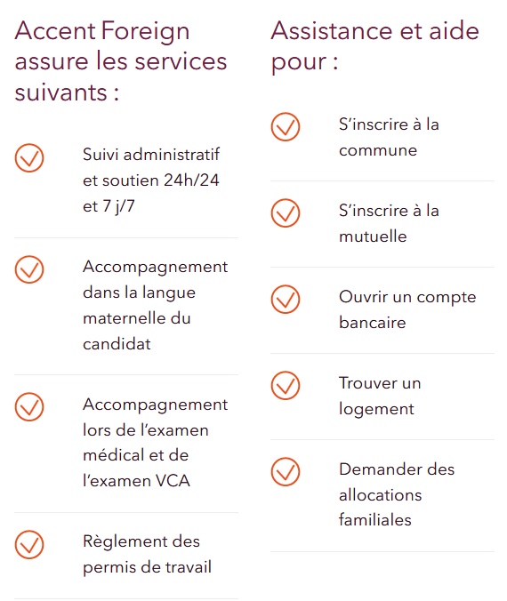
Agencies’ policies towards foreign workers
Expansion of recruitment methods
Establishment of foreign offices (east EU)
Partnerships with freelances
Online communication
New services for foreign candidates
Emergence of the “foreign consultant”
Bilingual
Multi-task
Permanent contact with « Support teams »

Slide 7
Consultants’s strategies
Recruitment strategies
Social networks: Facebook & WhatsApp groups, personalization of publications, etc.
Create trust with candidates to generate referrals
Connecting with refugees centers (internal contacts, displaying information, etc.)
Insertion in ethnic communities (stores, churches, restaurants, etc.)
Closer ties with foreign companies active in Belgium
Retention strategies
Highlighting the (financial) benefits of the construction sector
Personal investment in the relationship (WhatsApp, driving candidates, etc.)
Social support for candidates (regularization procedures)

Slide 8
Evolution of intermediation practices
Classic model | Current model
Candidates considered as a resource | Candidates considered as clients
Disconnection between consultants and candidates | Willingness to get closer to the candidate
Limited assistance to contractual procedures | Social support for candidates
Service that stops once the contract is started | Continuous service throughout the duration of the contract (and even afterwards)
Loyalty to the agency | Loyalty to the consultant

Slide 9
« On est amené à gérer des choses liées à leur vie sociale de manière informelle. J'ai des collègues qui disent: ‘je ne suis pas ici pour faire du social’. Moi je suis très axé sur le social et je suis convaincu que c’est la solution pour fidéliser et pour luter contre la pénurie ».
« Durant ma carrière, j'ai aidé des personnes à se régulariser. Le problème c'est que si on fait ça pour une personne, on risque de devoir le faire pour tout le monde... On risque alors d'avoir la direction qui va venir nous dire : ‘je vous ai engagé comme consultant et pas comme assistant social’ ».

Slide 10
Discussion
Evolution of intermediation practices under the effects of the context (of shortage, but also of fierce competition between agencies).
“Good consultants” are gaining power in the market
Transformation of the intermediation practices produces a moral economy (introduction of affect into the relationship).
Integration into the labor market.
Integration into the local social life.
Neoliberal model in the sector (reinforced by subcontracting practices) BUT which reproduces itself thanks to a moral economy.
Notes:
"On dit souvent dans le secteur de l'intérim que si on perd un consultant, on perd une part de marché de 20%"

Slide 11
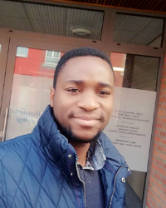
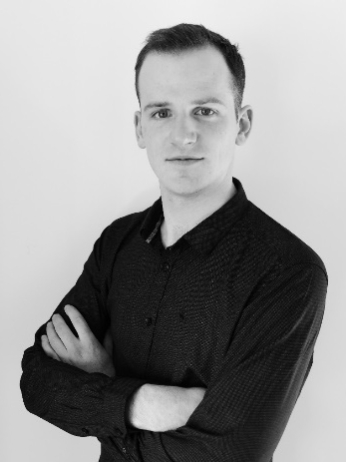
Contacts:
simon.wuidar@uliege.be
ludovic.bakebek@uliege.be
Simon Wuidar
Ludovic Bakebek
+32 4 97 88 50 70
+237 6 93 87 15 12

