Slide 1
Post-mortem mesenchymal stem cells: cryopreservation strategies
Farah Day 2021
19th november, 2021 –
Department of Morphology and Pathology
Histology
Marine Levoz

Slide 2
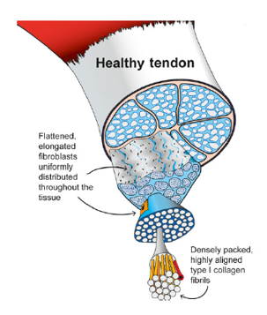
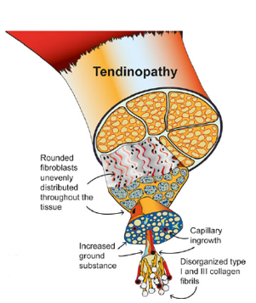
Tendon & tendinopathy
Introduction
Elongated, organized and parallel fibres Uniform repartition of tenocytes Type I collagen +++ Poor vascularization | Disorganized fibres Rounded tenoblasts unevenly distributed Type III collagen +++ Hypoxia → VEGF → neovascularization → MMPs
(Mead et al., 2018)

Slide 3
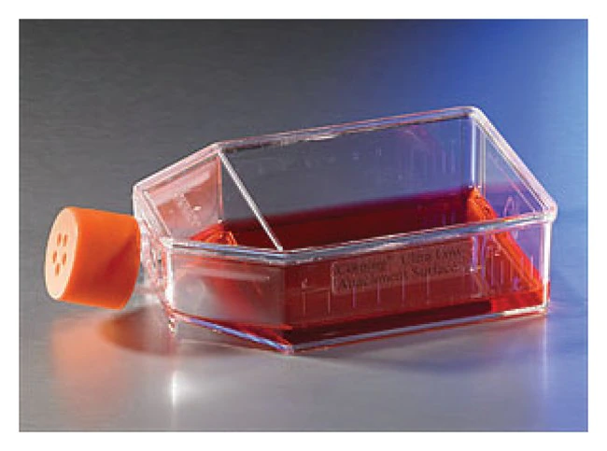
Tendon-derived mesenchymal stem cells
Introduction
Mesenchymal stem cells
(ISCT criteria)
Plastic adhesion
Expression of specific membrane markers
Differentiation capacity
CD90, CD105, CD29, CD44, …
CD45, MHC-II, …

Slide 4
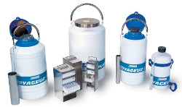
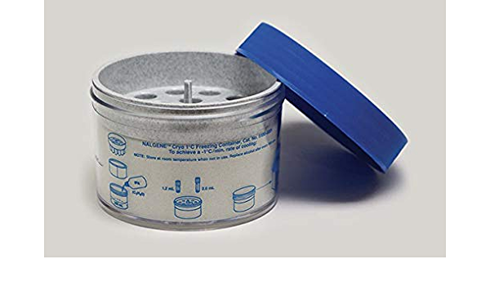
TDSCs cryopreservation strategy
Introduction
Challenges :
Long-term storage
Post-thaw viability
Accessibility of frozen cells
The necessity for cryoprotective agents :
Decrease the risk of osmotic shocks
Reduce the damaging effects of intracellular solutes
Prevent the formation of intracellular ice crystals

Slide 5
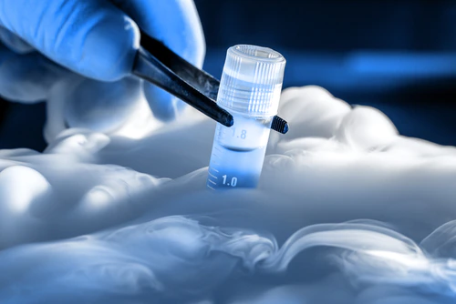
Issues & Solutions
Introduction
STORAGE
TRANSPORT
INJECTION
DRY ICE
DMSO
LIQUID NITROGEN
FBS
GLYCEROL
KNOCK-OUT SERUM REPLACEMENT
TREHALOSE

Slide 6
Aims
Aims
Storage solutions for TDSCs compatible with clinical use
Verification of the TDSCs stemness after freezing

Slide 7
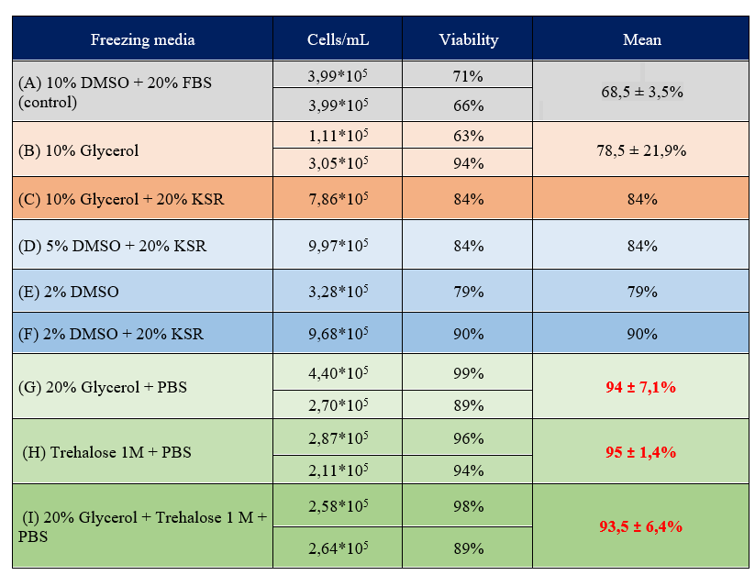
Cells viability
Storage solutions for TDSCs compatible with clinical use
Findings

Slide 8
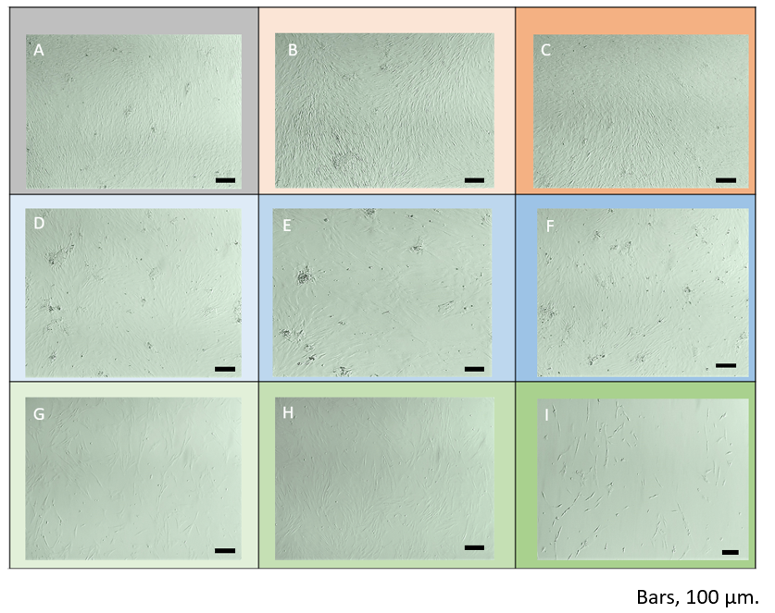
Cells morphology
Storage solutions for TDSCs compatible with clinical use
Findings

Slide 9
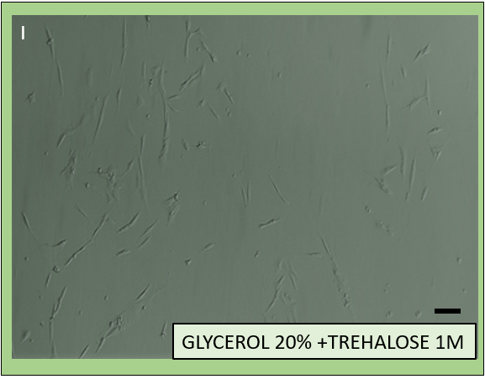
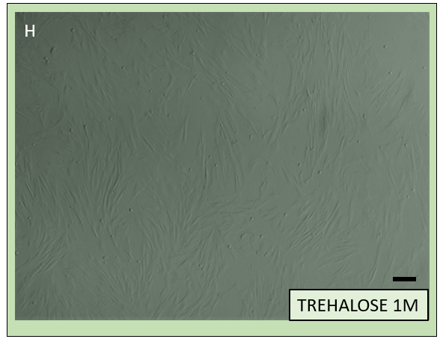
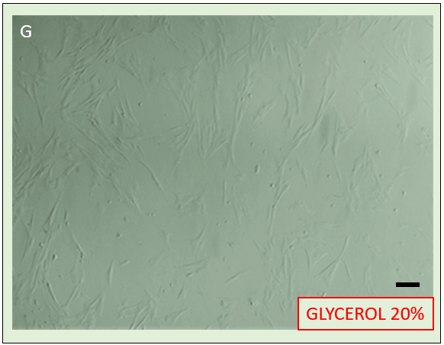
Cells morphology
Storage solutions for TDSCs compatible with clinical use
Findings
Bars, 100 μm.

Slide 10
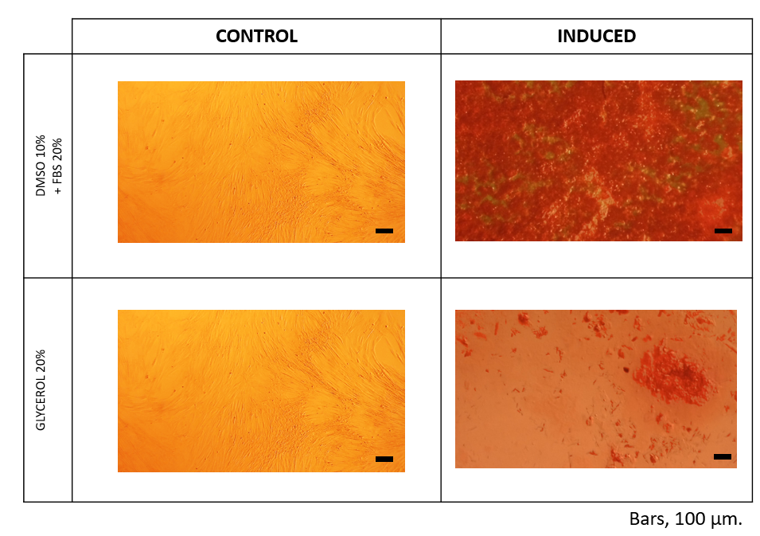
Osteogenic differentiation
Verification of the TDSCs stemness after freezing
Findings

Slide 11
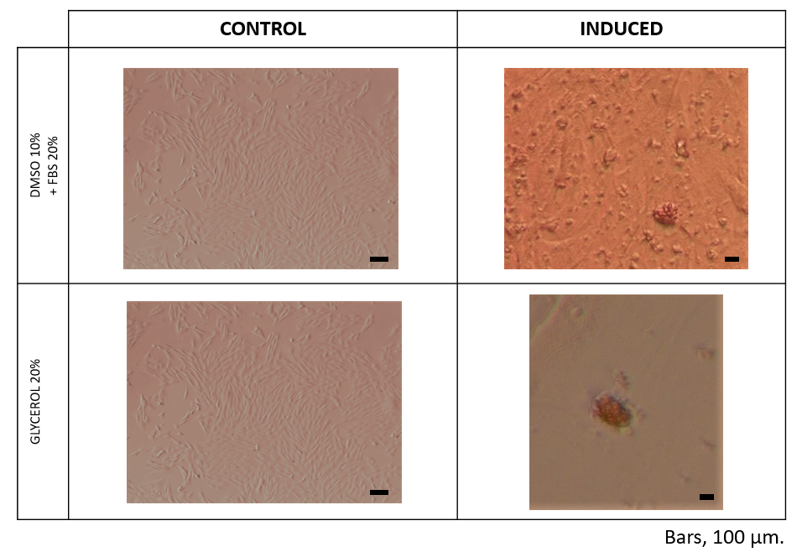
Verification of the TDSCs stemness after freezing
Findings
Adipogenic differentiation

Slide 12
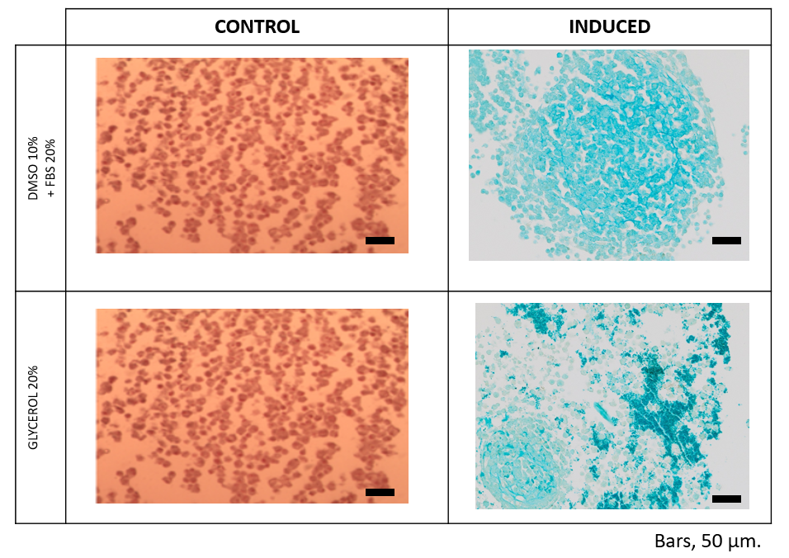
Chondrogenic differentiation
Verification of the TDSCs stemness after freezing
Findings

Slide 13
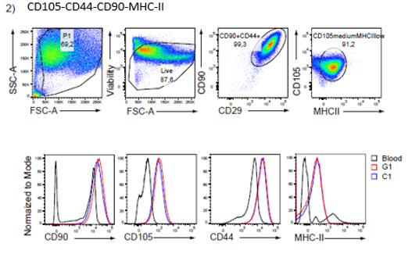
Flow cytometry
Verification of the TDSCs stemness after freezing
Findings
CD105-CD90-CD29-CD44-MHC-II
CD29 = 100%
98,7%
43,1%
99%
0,19%
G1 = TDSCs cryopreserved in glycerol 20%
C1 = TDSCs cryopreserved in DMSO 10% + FBS 20%

Slide 14
Thanks for your attention ! Questions ?

