Slide 1
EU internal market law: an introduction
Pieter Van Cleynenbreugel
Professor and Director EU Legal Studies Institute, Uliège
Assessor, Belgian Competition Authority
Brussels, 4 July 2022
Notes:
Bundle N° 2

Slide 2
Structure
1. The EU internal market: a brief history
2. The law of the EU internal market
EU primary law: four freedoms
EU secondary legislation: harmonisation
3. The future of the (law of the) EU internal market

Slide 3
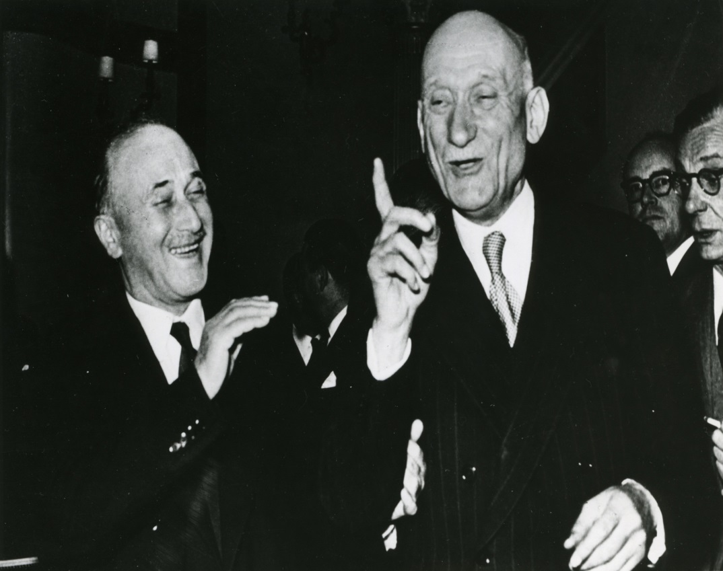
A brief history

Slide 4
A brief history
Internal market as one (feasible) step in a (much) bigger project
European Coal and Steel Community
European Political Community
European Defense Community
European Atomic Energy Community
European Free Trade Association (EFTA)
…

Slide 5
A brief history
No reference to ‘internal market’ in Treaty establishing the European Economic Community (Rome Treaty, 1957) – only reference to ‘common market’
No definition of common market
Legal notion and definition of internal market only with Single European Act in 1986

Slide 6
A brief history
Trade between instead of war against States
Monnet’s visit to the USA
Opening up markets necessary
Customs duties
Limits on employment for foreigners
Limits on capital to be imported

Slide 7
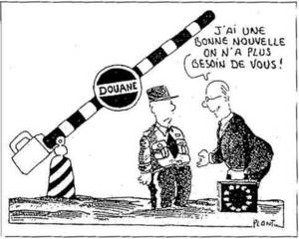
A brief history

Slide 8
Structure
1. The EU internal market: a brief history
2. The law of the EU internal market
EU primary law: four freedoms
EU secondary legislation: harmonisation
3. The future of the (law of the) EU internal market

Slide 9
The law of the EU internal market
Primary law: four freedoms
Secondary legislation: harmonisation

Slide 10
Primary law
In existence since Rome Treaty – pillars of the common/internal market
Article 26(2) TFEU
Free movement of persons (art. 45 + 20-21 TFEU)
Free movement of goods (art. 28-30 + 34-37 TFEU)
Free movement of services (art. 49-52 + 56-62 TFEU)
Free movement of capital (art. 63-66 TFEU)
States have to abolish rules limiting ‘free movement’

Slide 11
Primary law
Rome Treaty, action plan for setting up a common market
By means of approximation/harmonisation of Member States laws – ‘legislative action within the Council’
12 to 15 years before realisation of the common market
Unanimity (among 6 Member States) required
Treaties itself indicated objectives to be attained
Abolition of customs duties
Abolition of quantitative restrictions
Abolition of nationality discrimination of workers
…

Slide 12
Primary law
Rome Treaty: in practice, however, blocking of legislative process (empty chair crisis 1966)
Limited approximation of national laws possible
Absent action by the Member States, could individuals themselves rely on Treaty provisions to force Member States to remove restrictions on free movement?

Slide 13
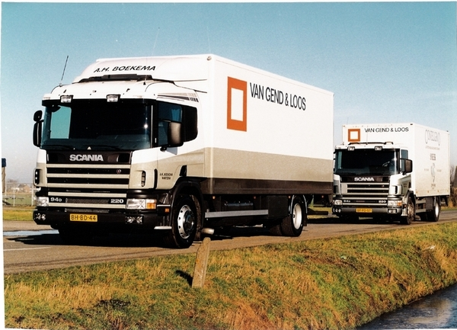
Primary law

Slide 14
Primary law
In the wake of Van Gend & Loos and Costa/ENEL, the Court started to accept the direct effect of Treaty provisions relating to the common market
All benefit from ‘vertical direct effect’
Individuals and businesses can invoke them against Member State public authorities
Court starts determining the speed with which Member States have to remove restrictions on free movement!!

Slide 15
Primary law
Free movement of goods
Tariff restrictions – art. 30 TFEU
Customs duties
Cf. today: products coming from China, UK…
Non-tariff restrictions – art. 34-35 TFEU
Limiting quantities of products to be sold in a given Member State

Slide 16
Primary law
Free movement of goods – art. 30 TFEU
Abolition of customs duties (taxes charged at the border when importing or exporting goods)
Abolition of charges equivalent to customs duties, even within one and the same Member State
Absolute prohibition on maintaining those taxes

Slide 17
Primary law
Free movement of goods
Non tariff restrictions – rules or practices limiting the quantities of goods to be sold
Art. 34 and 35 TFEU prohibit quantitative import and export restrictions and measures having equivalent effect of those restrictions
Art. 36 allows Member States to derogate from this prohibition

Slide 18
Primary law
Free movement of goods
Quantitative restrictions?
MEEQR?
Two interpretations possible:
MEEQR = any rule discriminating against products from a different origin/to a different destination (nationality discrimination)
MEEQR = any rule making the access of a foreign product to another market more difficult or impossible (market access test)

Slide 19
Primary law
Free movement of goods
Case 8/74, Dassonville
Case 120/78, Cassis de Dijon
Case C-15/15, New Valmar
Almost any rule constitutes a MEEQR
Example: « Towing trailers »
More justifications: ‘imperative requirements’, only when measures is not directly discriminatory on the basis of origin/nationality

Slide 20
Primary law
Free movement of persons
At the start: persons = workers (art. 45 TFEU)
Abolition of discrimination on the basis of nationality
Access to labour market
Fiscal and social advantages, including family members
‘Discrimination’ interpreted as covering any restriction making work for other EU nationals more difficult or impossible
Justifications: mandatory requirements

Slide 21
Primary law
Free movement of persons
In the 1980s, the Court of Justice starts to stretch the protection accorded to workers to other persons as well
Job seekers – Case 316/85, Lebon
Future employees – Case 293/83, Gravier
Former employees – Case C-85/96, Martinez Sala

Slide 22
Primary law
Free movement of persons
Maastricht Treaty: EU citizenship
Art. 21 TFEU: right to movement within the EU
Directive 2004/38: harmonisation of residence and movement conditions

Slide 23
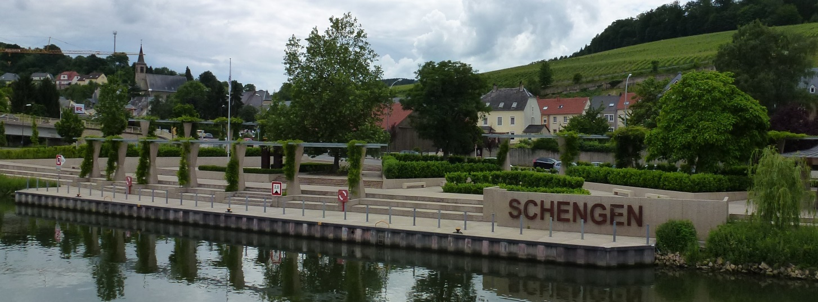
Primary law
Free movement of persons

Slide 24
Primary law
Free movement of services

Slide 25
Primary law
Free movement of services
Art. 49 TFEU – freedom of establishment
Art. 56 TFEU – freedom to provide services on a temporary basis
Directive 2006/123: services directive

Slide 26
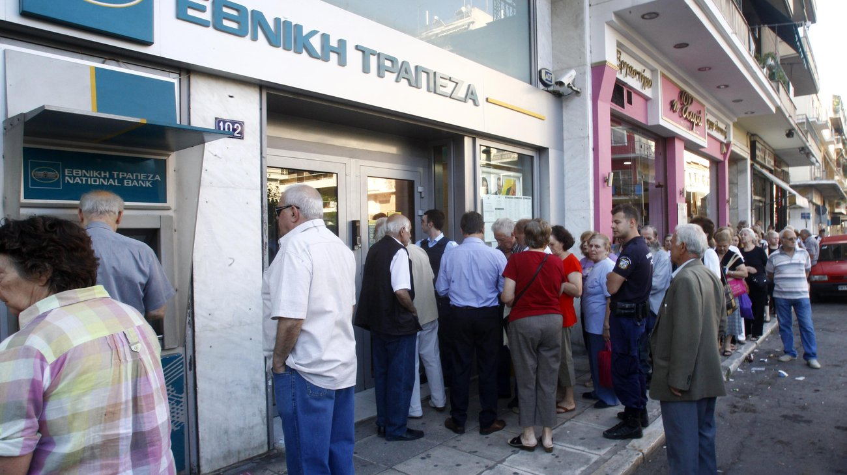
Primary law
Free movement of capital

Slide 27
Primary law
EU primary law – the Court of Justice as the motor of market integration?
In all four freedoms, the Court proposed an extensive definition of what constitutes a restriction
In essence, any rule, measure or administrative practice that makes it more difficult for a product/person/service from another Member State
As a result, Member States are put in a « defensive » mode – if they want to maintain a rule, they have to justify it

Slide 28
Primary law
EU primary law – the Court of Justice as the motor of market integration?
Importance of justifications
Derogations in the Treaty (public order, public health and public security) could justify rules that make an explicit distinction on the basis of nationality
Imperative/mandatory requirements recognised by the Court can justify maintaining rules that do not make such an explicit distinction
Proportionality analysis is key

Slide 29
The law of the EU internal market
Primary law: four freedoms
Secondary legislation: harmonisation

Slide 30
Harmonisation
From
common market (Court-centred)
to internal market (project 1992 – legislator-centred)
Completing the internal market
Alternative to Court’s case-by-case interpretations
Legal uncertainty – risks of ‘deregulation’
Harmonisation of rules in specific sectors
Ex ante and generally binding legal instruments necessary

Slide 31
Harmonisation

Slide 32
Harmonisation
Key provision – Article 114 TFEU
The European Parliament and the Council shall, acting in accordance with the ordinary legislative procedure and after consulting the Economic and Social Committee, adopt the measures for the approximation of the provisions laid down by law, regulation or administrative action in Member States which have as their object the establishment and functioning of the internal market.
This shall not apply to fiscal provisions, to those relating to the free movement of persons nor to those relating to the rights and interests of employed person
Art. 46 TFEU

Slide 33
Harmonisation
Key provision – Article 114 TFEU
The Commission, in its proposals envisaged in paragraph 1 concerning health, safety, environmental protection and consumer protection, will take as a base a high level of protection, taking account in particular of any new development based on scientific facts. Within their respective powers, the European Parliament and the Council will also seek to achieve this objective.

Slide 34
Harmonisation
In practice,
virtually no limits on what can be harmonised, as long as a link with the establishment and functioning of the internal market can be established
in addition, enforcement structures can be set up on that basis
Case C-270/12, United Kingdom v Parliament and Council

Slide 35
Structure
1. The EU internal market: a brief history
2. The law of the EU internal market
EU primary law: four freedoms
EU secondary legislation: harmonisation
3. The future of the (law of the) EU internal market

Slide 36
Future
The role of the internal market and its law in the current EU institutional setup
Rome Treaty, Article 2:
The Community shall shave as its task, by establishing a common market and an economic and monetary union and by implementing the common policies or activities referred to in Articles 3 and 3a, to promote throughout the Community a harmonious and balanced development of economic activities, sustainable and non-inflationary growth respecting the environment, a high degree of convergence of economic performance, a high level of employment and of social protection, the raising of the standard of living and quality of life, and economic and social cohesion and solidarity among Member States.

Slide 37
Future
The role of the internal market and its law in the current EU institutional setup
Art. 3 TEU:
1. The Union's aim is to promote peace, its values and the well-being of its peoples.
2. The Union shall offer its citizens an area of freedom, security and justice without internal frontiers, in which the free movement of persons is ensured in conjunction with appropriate measures with respect to external border controls, asylum, immigration and the prevention and combating of crime.
3. The Union shall establish an internal market. It shall work for the sustainable development of Europe based on balanced economic growth and price stability, a highly competitive social market economy, aiming at full employment and social progress, and a high level of protection and improvement of the quality of the environment. It shall promote scientific and technological advance.
It shall combat social exclusion and discrimination, and shall promote social justice and protection, equality between women and men, solidarity between generations and protection of the rights of the child.
It shall promote economic, social and territorial cohesion, and solidarity among Member States.

Slide 38
Future
Remaining importance of EU internal market law
Type of reasoning (restrictions + justification + proportionality) re-appears in other fields of EU law as well
EU internal market seems to be less controversial than other fields of EU integration
Is and remains the heart of the EU integration project

Slide 39
Thank you for your attention!
pieter.vancleynenbreugel@uliege.be

