Slide 1
Independence of medicine in Belgium
What definition(s) of influence in medical training and R&D?
4S Annual Meeting 2021
Lucas Bechoux, University of Liège, SPIRAL research center

Slide 2
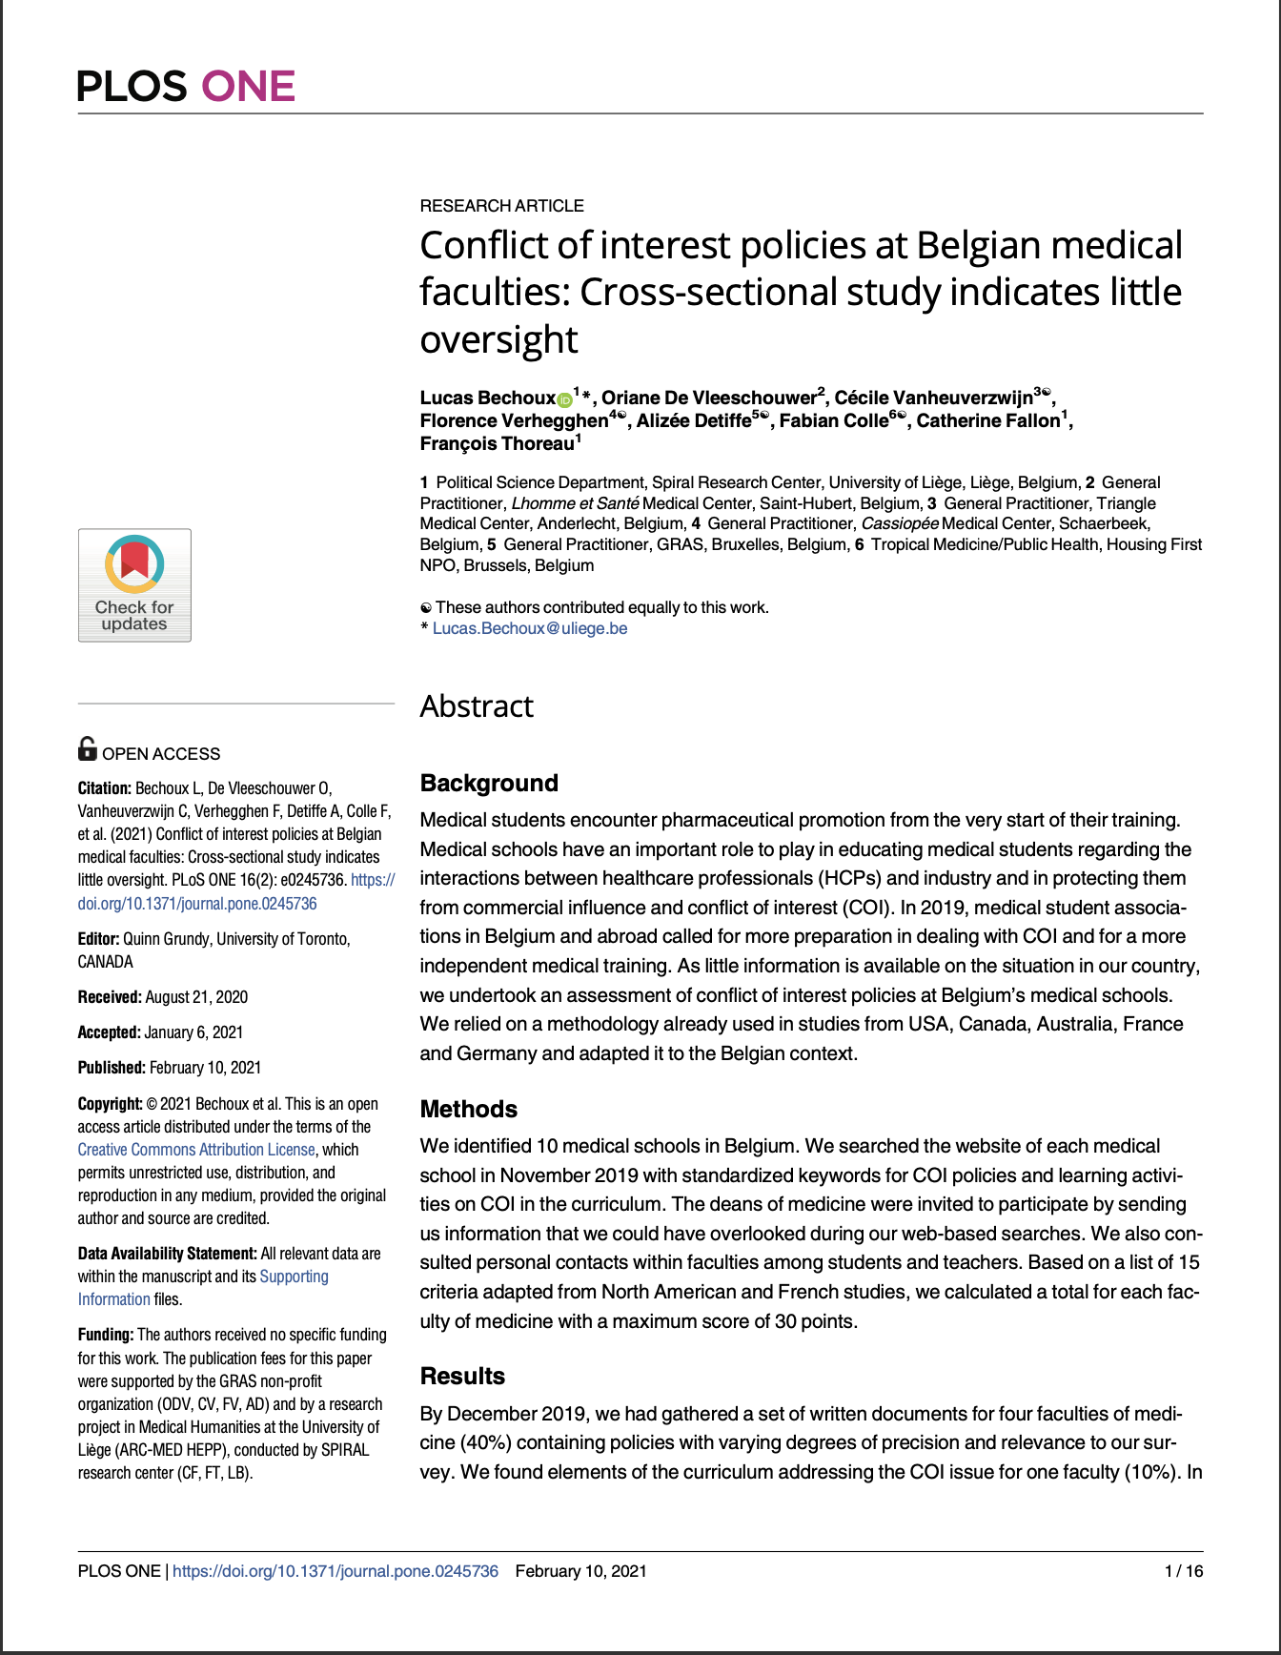
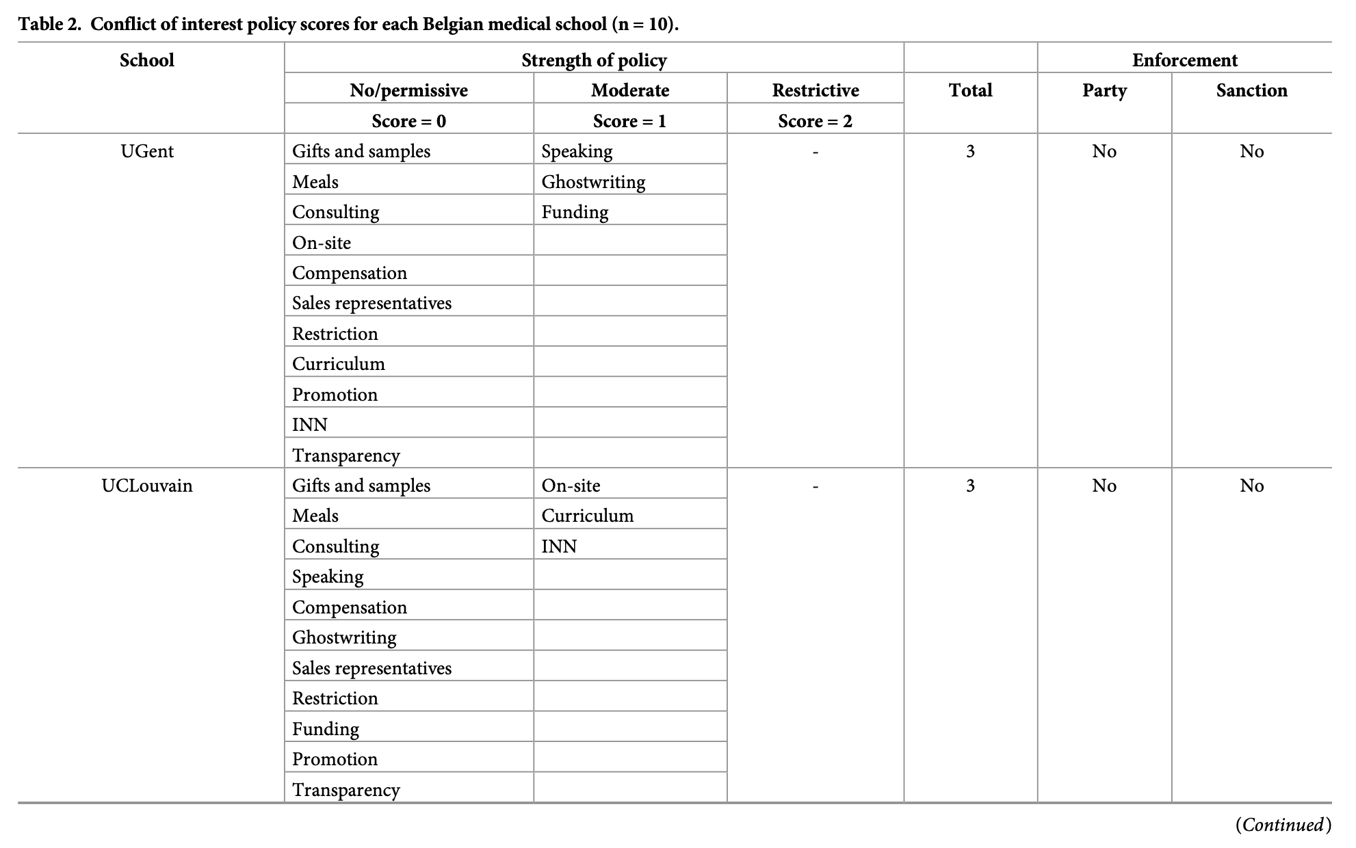
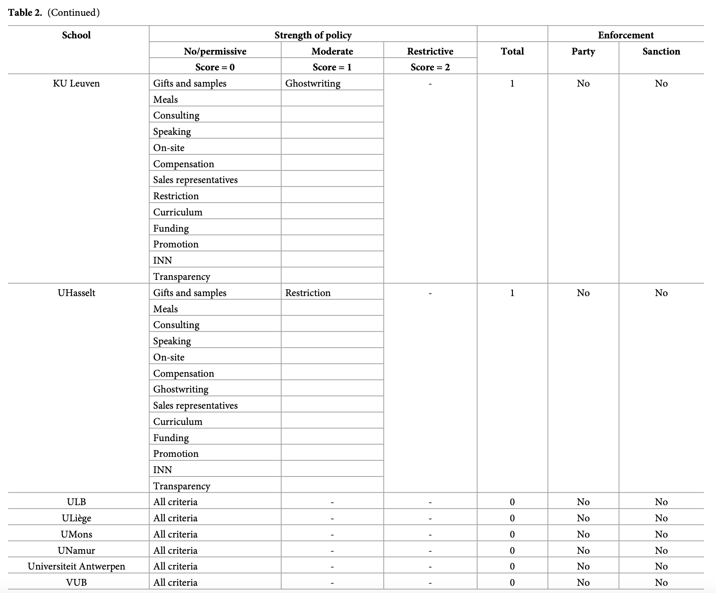

Slide 3
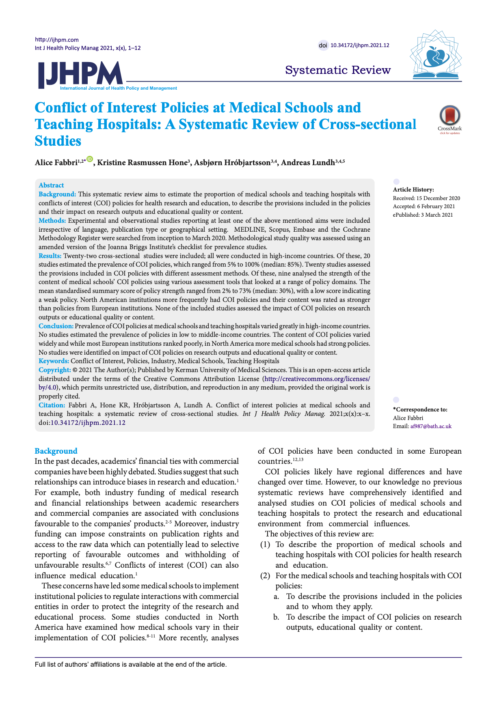
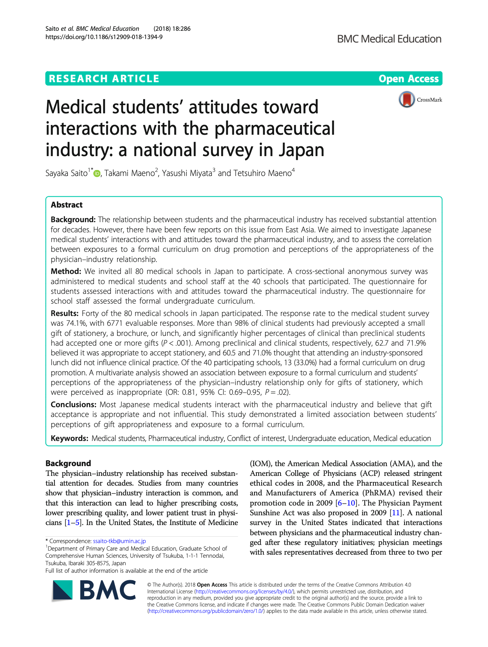
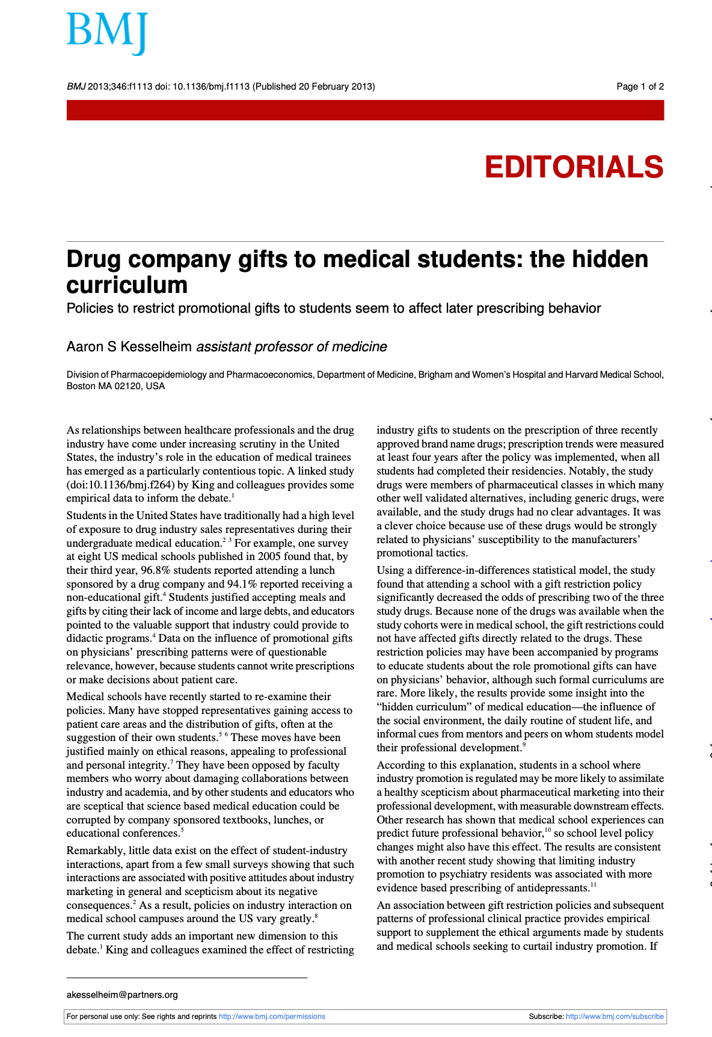
-> Exposure to pharmaceutical promotion is associated with changes in the quality, quantity, frequency and cost of prescribing practices.

Slide 4
Conflict of interest : a reductive approach to influence
Used since the 80’s
Put the blame on individuals
Too broad
Does not reflect the structural dimension of influence
Implementation of ineffective transparency mechanisms

Slide 5
Epistemic corruption (Sismondo)
Design of clinical trials
Ghostwriting
Key Opinion Leaders (KOLs): influence peers
Pharmaceutical promotion (marketing)
Patient associations (disease mongering)
Etc.

Slide 6
Thanks for your attention
Do you have any questions, comments or suggestions?

