Slide 1
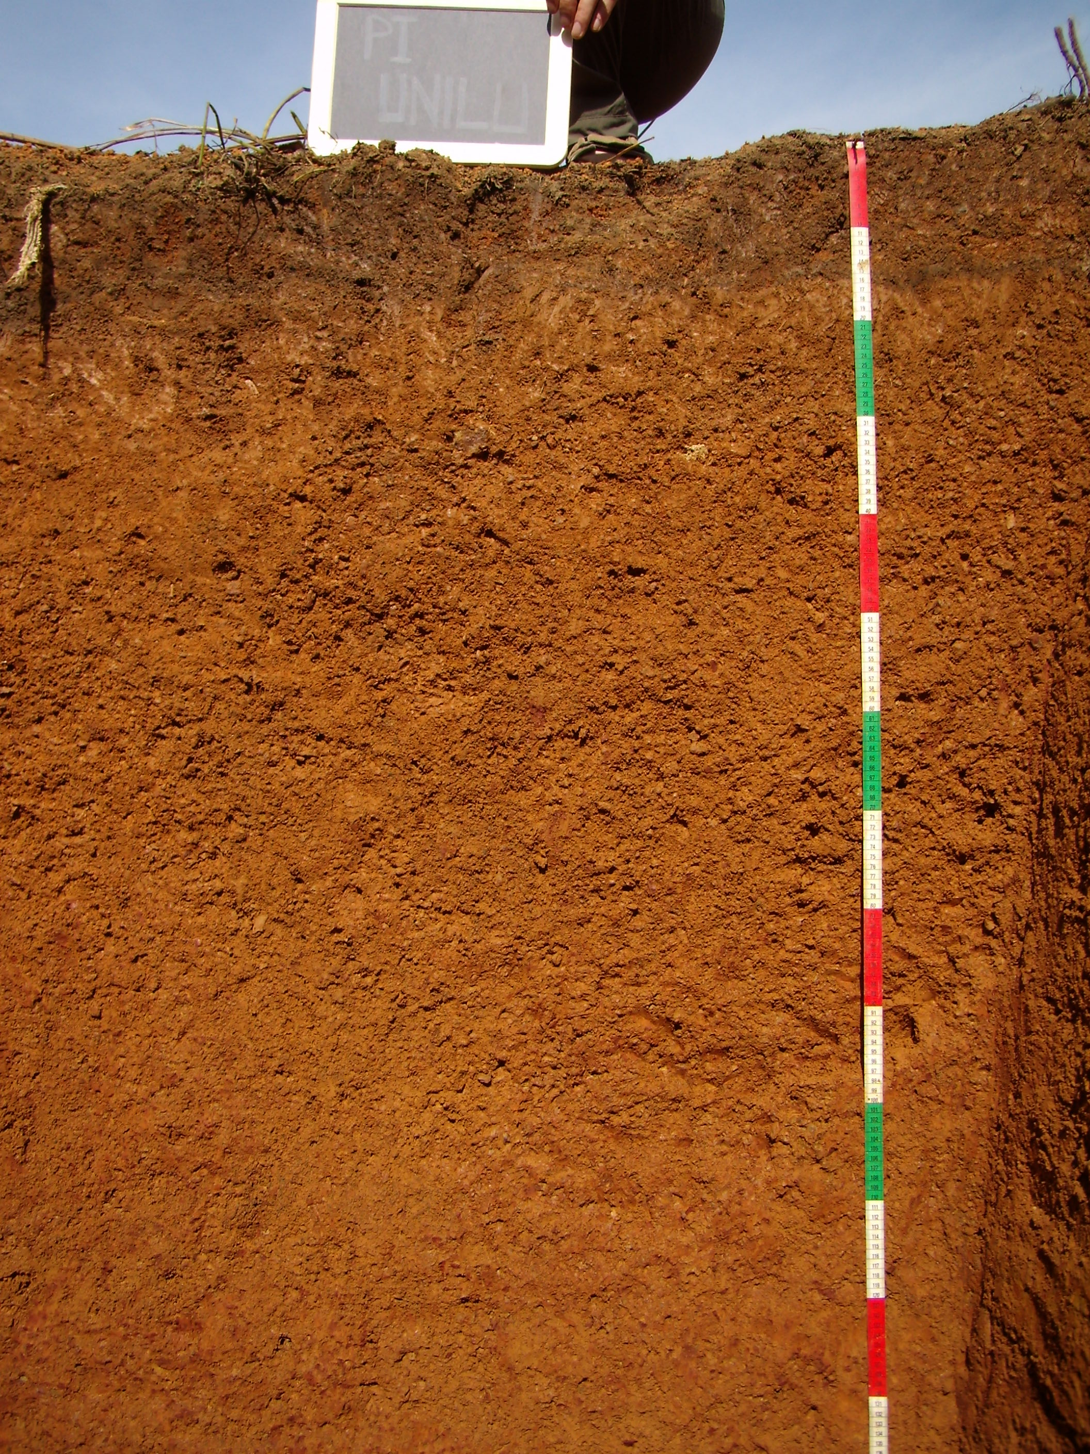
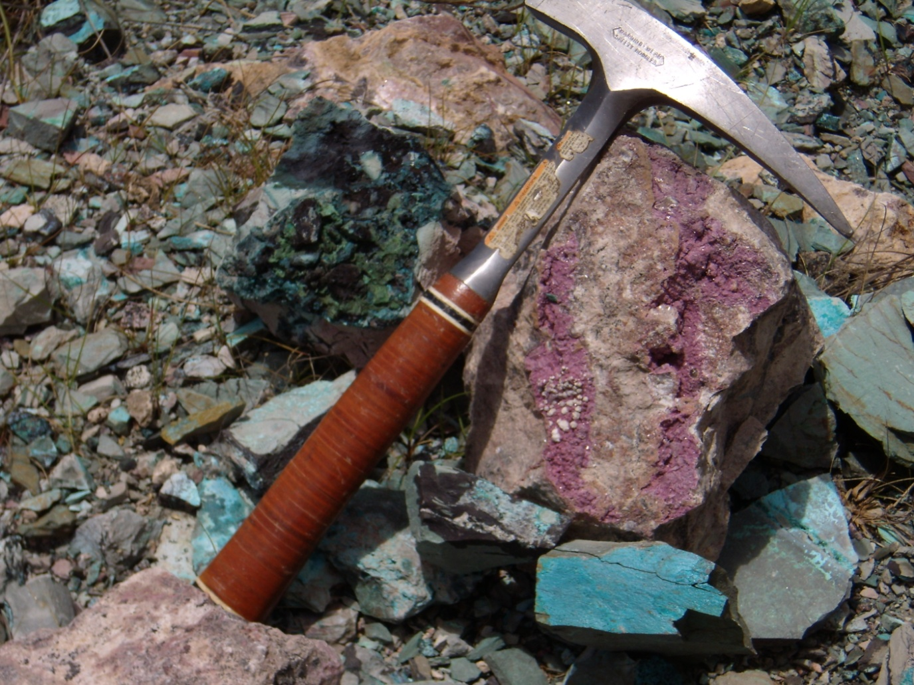
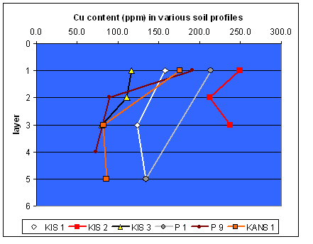
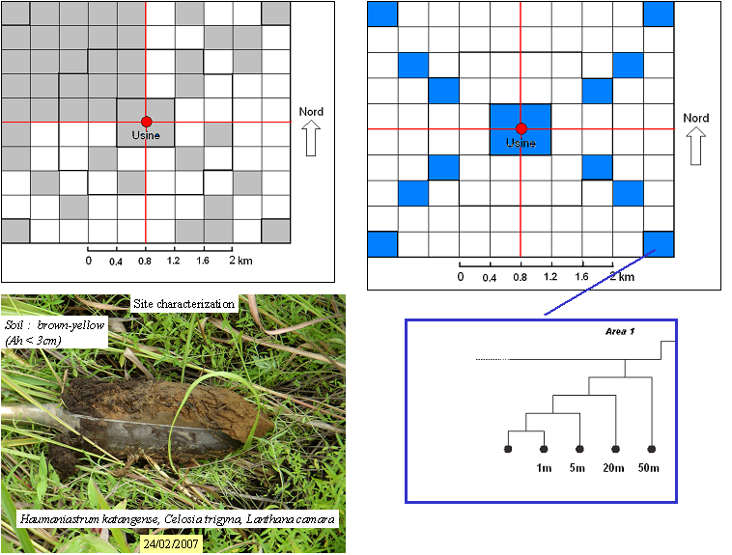
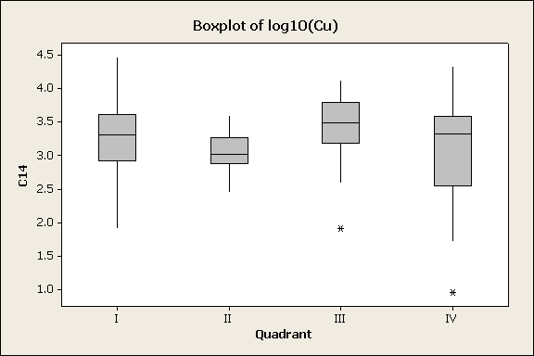
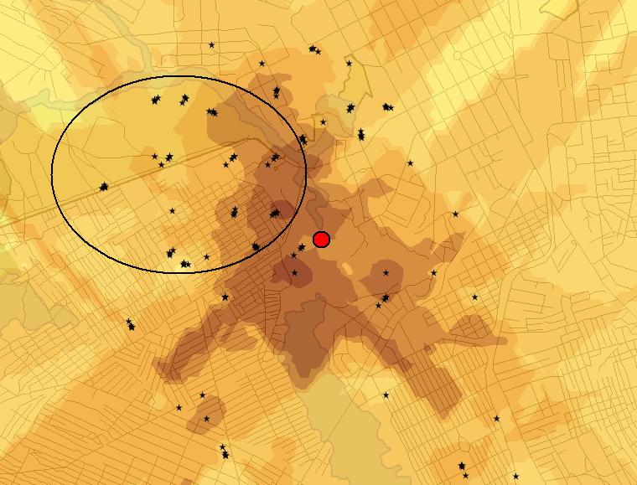
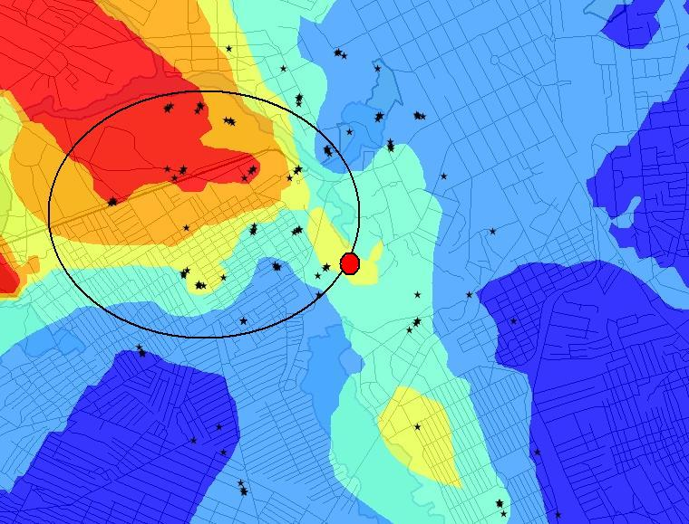
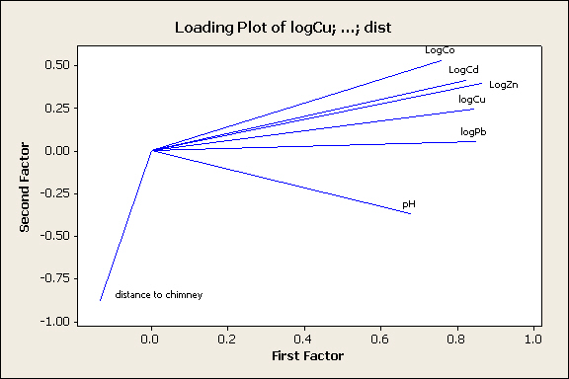
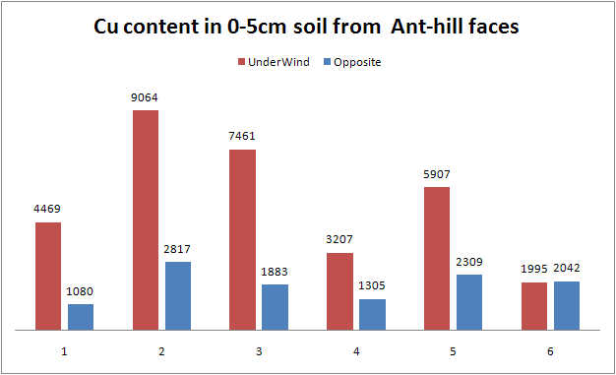
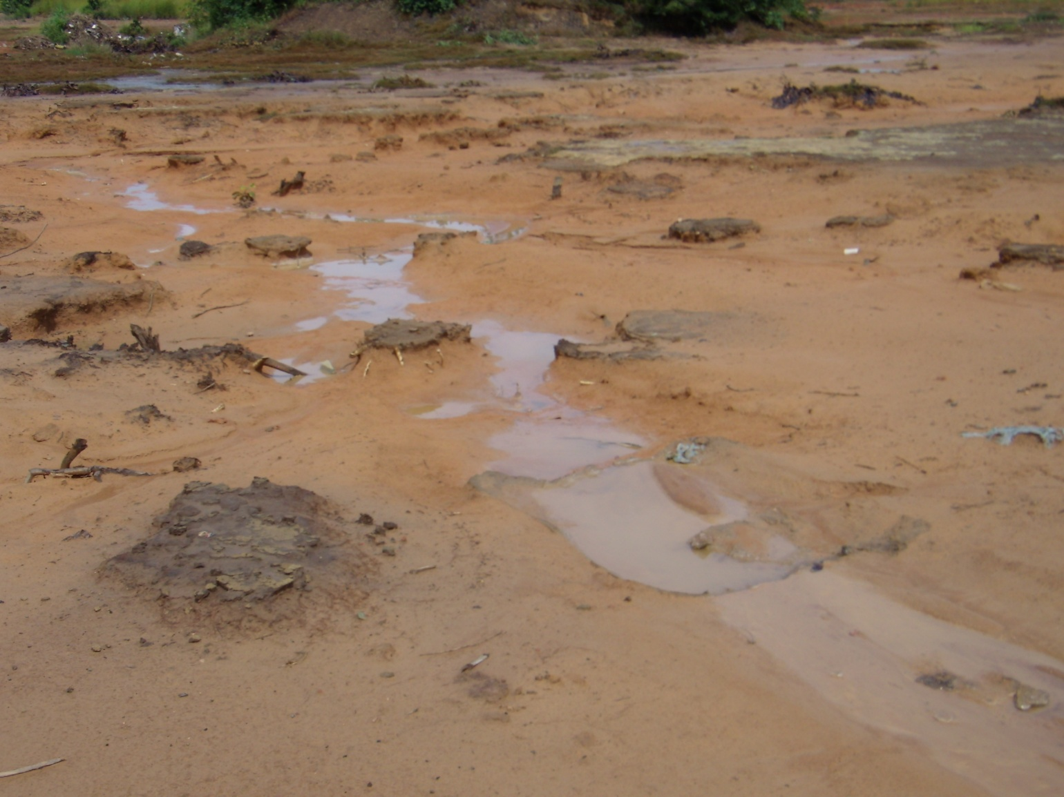
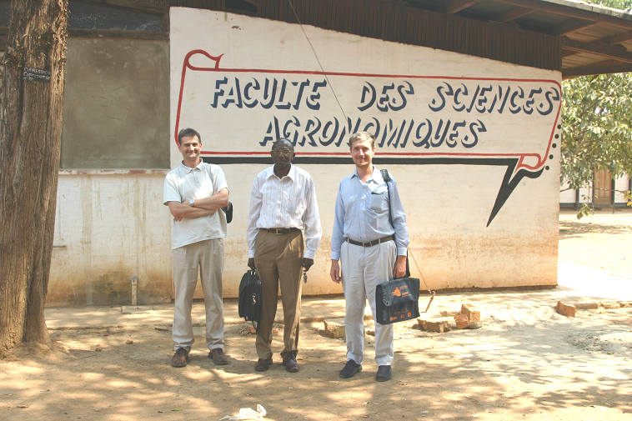
Mapping of soil-sediment systems contaminations around a metal-ore smelter.
The example of Cu in Lubumbashi (R.D.Congo).
Mpundu M.M.^{1,2}, Mukobo R.P.¹, Kaya D.¹, Faucon M.P.³, Andres L.², Ngongo M.¹, Meerts P.J.³, Colinet G.²
¹ Faculté d’agronomie. Université de Lubumbashi. R.D. Congo
² Gembloux Agricultural University, Geopedology Dpt., Passage des deportes 2, B-5030 Gembloux, Belgium (geopedologie@fsagx.ac.be)
³ Laboratoire de génétique et d’écologie végétale. Université libre de Bruxelles. Belgium.
Gembloux
Agricultural
University
 | Introduction The Katanga is famous for its high richness in metal ores, mainly Cu- and Co-minerals (figure 1). The ore-treatments activities lead to metal spreading in the environment which do endanger the viability of ecosystems and human health. The contaminations of soil and sediments around the Gecamines smelter (figure 2) in Lubumbashi have been evaluated through a multi-scale approach. The Gecamines district is located under the dominant wind from the plant chimney and presents evidences of soil degradation (figure 3).
1. Reference values about natural contents 5 major soil types can be found in the Gecamines district (Figure 4). A reference system about the natural contents in these soils has been implemented. The four soil units were studied in natural or weakly contamined areas (figure 5) and in the Gecamines district (Figure 6). Soils were characterized through field observations and laboratory determinations : acido-basic and organic status, particle size distribution, cationic exchange capacity, total contents in Al, Fe, Mn, Cu, Co, Cd, Pb, and Zn. Although being relatively high compared to other references around the world, values found in these sites (figure 7) can be considered as natural background values. Notice surface accumulation. | Figure 4 | Figure 5 | Figure 6
Figure 7 | 2. Exploratory mapping of contaminations Soil samples (0_15cm) were taken according to a stratified random scheme. A square area (4x4km) centered on the Gecamines chimney has been divided in 100 cells (25 in each quadrant). 44 cells were semi-randomly selected and a site randomly chosen within the cell. In 16 cells, 4 additional samples were taken at distances of 1, 5, 20, and 50m of the initial point in random directions (Figure 8). NH4-Oac-EDTA extractable Cu, Co, Cd, Pb and Zn were measured as well as pH. First results indicate very high levels of contaminations compared to background values. However the Gecamines district (quadrant I in figure 9) does’nt appear more contaminated than other districts. | Figure 8 | Figure 9
Figure 10 | Figure 11 | Maps could be produced by kriging for all studied parameters. Cu (the darker the more Cu, see orders of magnitude in figure 9) and pHwater (red : very acidic to blue : neutral soil reaction) are given as examples in figures 10 and 11. However, the spatial differen-ciation (C:C+C0 ratio) was found rather poor. No clear effect of the dominant wind could be identified, except for soil acidity (figure 11). However, ant-hill faces located under the wind were more contaminated than opposite ones (figure 13). A PCA-analysis was performed on the data. The results clearly show that the 5 trace elements are closely linked to each other, which indicates that they are all present in the contaminants, but the effect of distance to the chimney appears rather independant (figure 12). | Figure 12
Figure 13 | 3. Detailed soil study in the Gecamines district To understand the origin of the small-range variability, a study of the organization and properties of soil surface horizons was conducted in the Gecamines district. Three great types of soil surfaces were identified for each soil type (Figure 14). Beside an original profile which collected eolian contaminants from the plant activities, both buried and eroded profiles can be found. The first one present a surface horizon composed of eolian sediments or pile material ( (C) in figure 15). This horizon is less contaminated than A horizon but much more than B horizon. The eroded profile is characterized by the presence of the B horizon at the surface. | Figure 14 | Figure 15
Figure 16 | The surface redistribution processes appear thus as the main explanation for the high variability at short distance (even less than 1m, figure 16). As a result, the contamination affects the sediments deposited in the valleys. Figure 17 (up) shows the augmentation of contamination occuring from up- to down-stream. | Conclusions Our results point out the difficulty to identify the sources of contaminations in an urban environment and stress the need to have approaches with complementary levels of details. As the spatial variability is high at small distances, precise mapping of contaminations appears unrealistic and the delimitation of operationally-defined areas regardings remediation techniques should integer this point. This work was conducted under the REMEDLU research project supported by the Belgian « University Cooperation for Development ». Project coordinators are Pr P.J. Meerts and M. Ngongo (figure 18). | Figure 18

