Slide 1

Numerical and Analytical Study of the Phase Resonances of a Duffing Oscillator
Martin Volvert
Gaëtan Kerschen
Space Structures and Systems Lab.
Aerospace and Mechanical Eng. Dept.
University of Liège
February 2022
Submission 12644

Slide 2
Linear and nonlinear resonances
Amplitude
Amplitude
Phase
Phase
Frequency
Frequency
Analytical amplitude and phase resonances
Analytical expressions ?
Secondary resonances ?

Slide 3
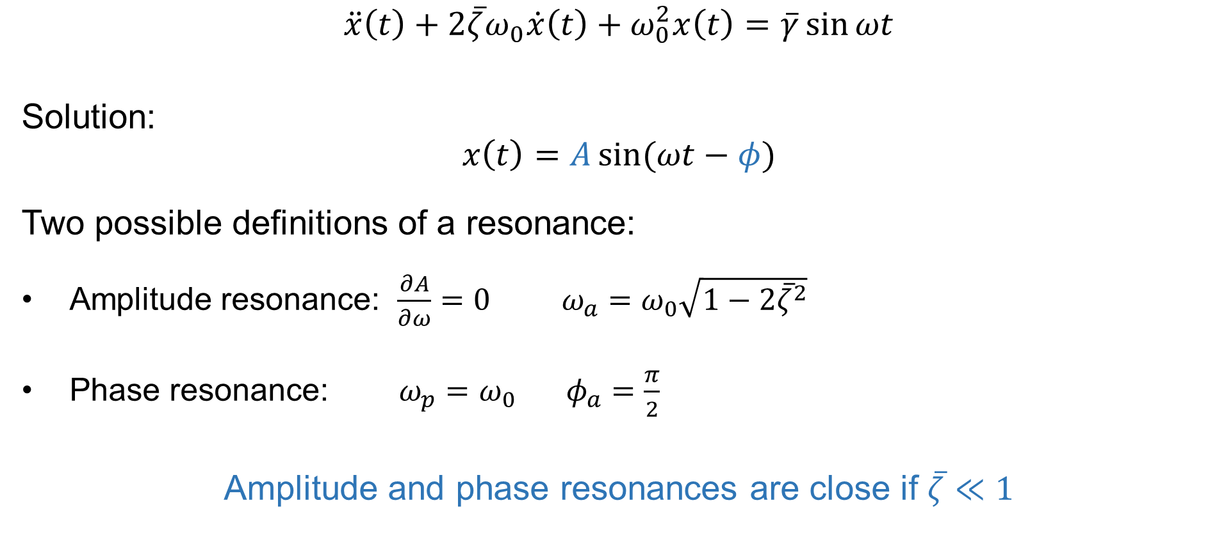

Resonances of a linear system
$$\ddot{x}\left(t\right)+2\overline{ζ}ω_{0}\dot{x}\left(t\right)+ω_{0}^{2}x\left(t\right)=\overline{γ}\sin{ωt}$$
Solution:
$$x\left(t\right)=A\sin{(ωt−φ)}$$
Two possible definitions of a resonance:
Amplitude resonance: $\frac{∂A}{∂ω}=0 ω_{a}=ω_{0}\sqrt{1−2{\overline{ζ}}^{2}}$
Phase resonance: $ω_{p}=ω_{0} φ_{a}=\frac{π}{2}$
Amplitude and phase resonances are close if $\overline{ζ}≪1$
$$ω_{a}≈ω_{p}$$
Amplitude and phase resonances are close if $\overline{ζ}≪1$

Slide 4
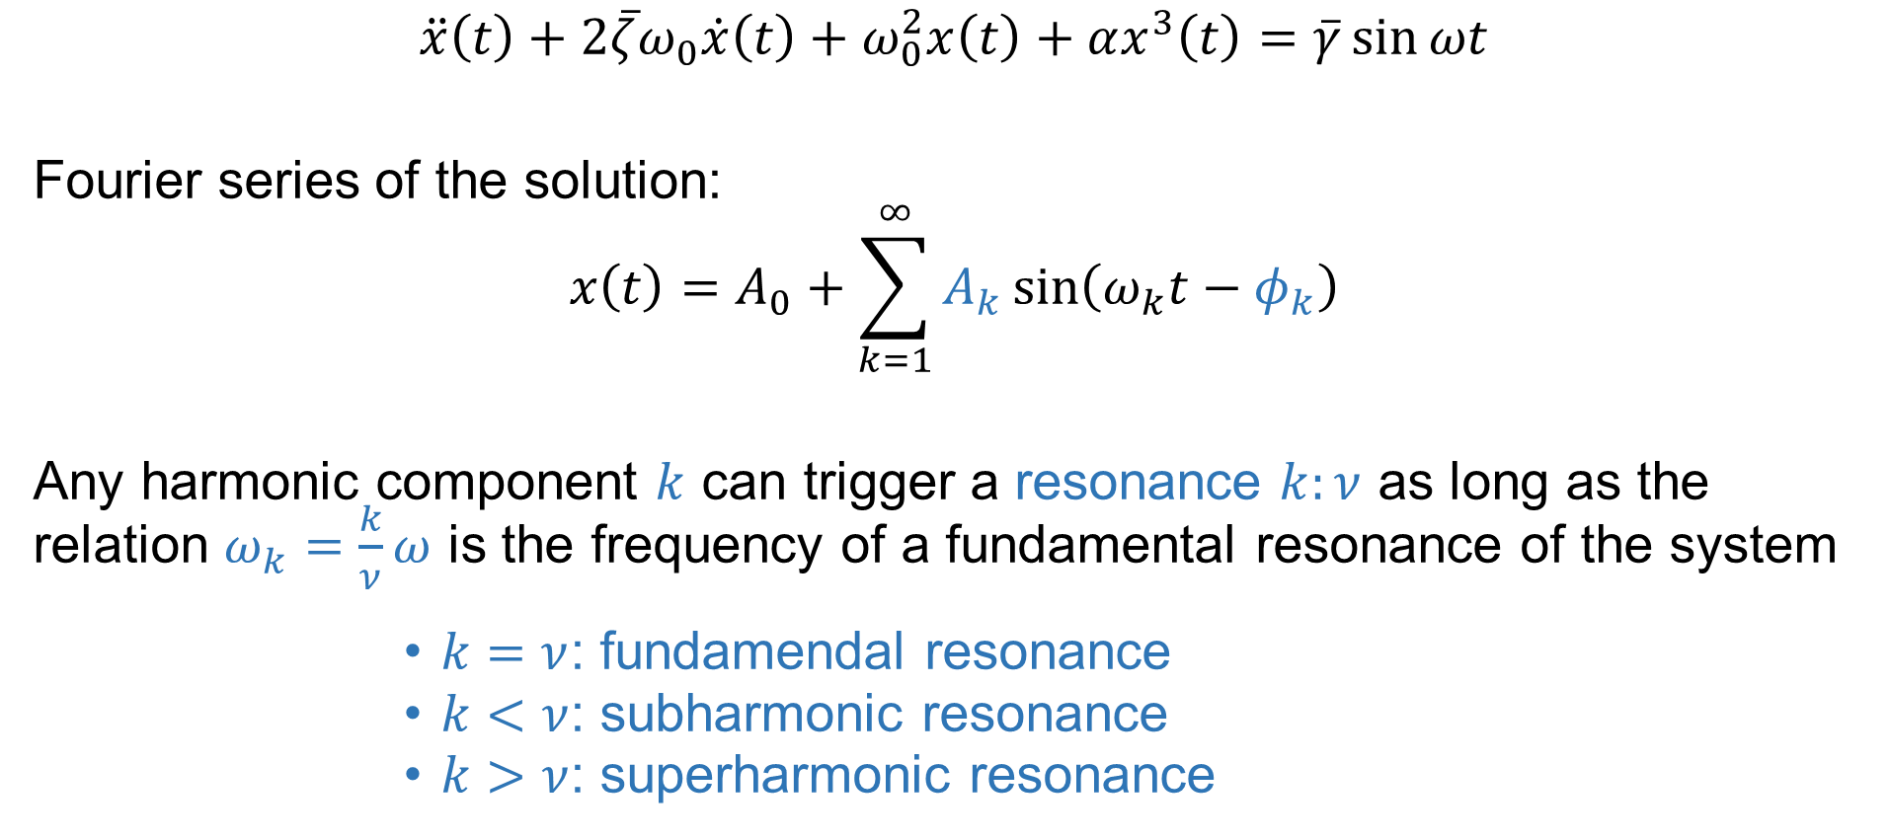
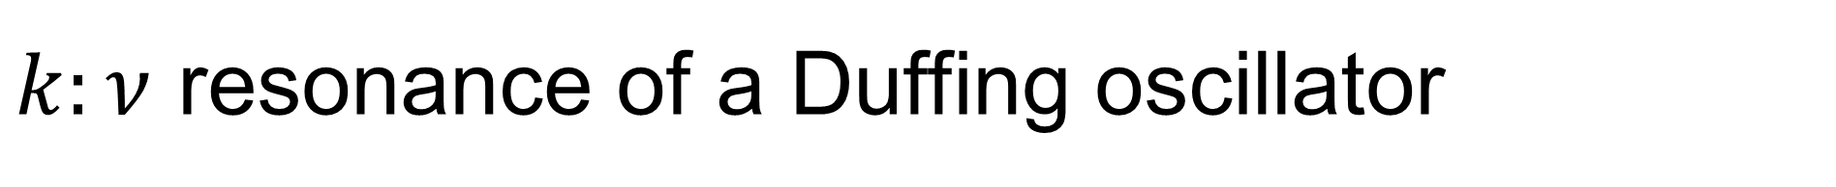
$k:ν$ resonance of a Duffing oscillator
$$\ddot{x}\left(t\right)+2\overline{ζ}ω_{0}\dot{x}\left(t\right)+ω_{0}^{2}x\left(t\right)+αx^{3}\left(t\right)=\overline{γ}\sin{ωt}$$
Fourier series of the solution:
$$x\left(t\right)=A_{0}+\sum_{k=1}^{∞}{A_{k}}\sin\left(ω_{k}t−φ_{k}\right)$$
Any harmonic component $k$ can trigger a resonance $k:ν$ as long as the relation $ω_{k}=\frac{k}{ν}ω$ is the frequency of a fundamental resonance of the system
$k=ν$: fundamendal resonance
$k<ν$: subharmonic resonance
$k>ν$: superharmonic resonance

Slide 5


Resonances of the Duffing oscillator
$$\ddot{x}\left(t\right)+0.01\dot{x}\left(t\right)+x\left(t\right)+x^{3}\left(t\right)=f\sin{ωt}$$
$$f=0.01N$$
$$f=0.25N$$
1:1
1:3
3:1

Slide 6

Resonances of the Duffing oscillator (II)
$$\ddot{x}\left(t\right)+0.01\dot{x}\left(t\right)+x\left(t\right)+x^{3}\left(t\right)=f\sin{ωt}$$
$$f=1N$$
3:1
2:1
5:1
1:3
4:1
7:1
1:2

Slide 7

Resonances of the Duffing oscillator (III)
$$\ddot{x}\left(t\right)+0.01\dot{x}\left(t\right)+x\left(t\right)+x^{3}\left(t\right)=f\sin{ωt}$$
3:2
3:1
2:1
7:3
$$f=3N$$
5:1
4:1
6:2
7:1
7:2
8:1
3:4
5:7
2:3
3:5
1:2
1:3

Slide 8
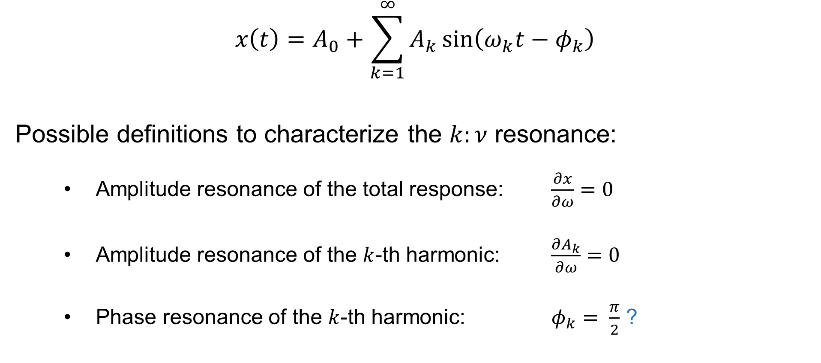
Resonances of a nonlinear system
$$x\left(t\right)=A_{0}+\sum_{k=1}^{∞}{A_{k}}\sin\left(ω_{k}t−φ_{k}\right)$$
Possible definitions to characterize the $k:ν$ resonance:
Amplitude resonance of the total response: $\frac{∂x}{∂ω}=0$
Amplitude resonance of the $k$-th harmonic: $\frac{∂A_{k}}{∂ω}=0$
Phase resonance of the $k$-th harmonic: $φ_{k}= \frac{π}{2}$ ?
Motivation of the study

Slide 9
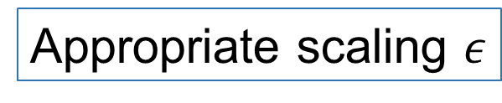













Averaging around the $k:ν$ resonance
Find analytical expressions around the $k:ν$ resonances by assuming a weakly nonlinear system:
$$\ddot{x}\left(t\right)+2\overline{ζ}ω_{0}\dot{x}\left(t\right)+ω_{0}^{2}x\left(t\right)+αx^{3}\left(t\right)=\overline{γ}\sin{ωt}$$
$$\overline{γ}$$
$$\overline{ζ}$$
$$A_{k}$$
$$ω_{k}^{2}−ω_{0}^{2}$$
Appropriate scaling $ε$
$$\ddot{x}\left(t\right)+ω_{0}^{2}x\left(t\right)=ε\left[f\left(x\left(t\right),\dot{x}\left(t\right)\right)+ω_{k}Ωx\left(t\right)\right]$$
$$γ$$
$$ζ$$
$$r$$
$$Ω$$
Suitable for an averaging technique
$0$ for primary resonance
$$\overline{Γ}$$
$$x\left(t\right)=A_{k}\sin\left(ω_{k}t−φ_{k}\right)+\overline{Γ}\sin{ωt}$$
$\frac{\overline{γ}}{ω_{0}^{2}−ω^{2}}$ for secondary resonances

Slide 10

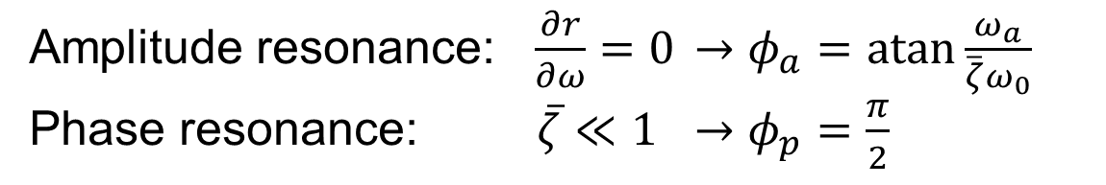

Averaging around the primary resonance
Governing equations at steady-state:
$\left\{\begin{aligned}ζω_{0}ωr=\frac{γ}{2}\sin{φ} \\ \frac{α}{8}\left(3r^{2}−\frac{4Ω}{α}\right)=\frac{γ}{2}\cos{φ}\end{aligned}\right.$
Amplitude resonance: $\frac{∂r}{∂ω}=0$ $→φ_{a}=\operatorname{atan}{\frac{ω_{a}}{\overline{ζ}ω_{0}}}$
Phase resonance: $\overline{ζ}≪1$ $→φ_{p}=\frac{π}{2}$
Phase resonance curve
Amplitude $A_{1}$ [m]
Phase lag [rad]
Frequency [rad/s]
Frequency [rad/s]

Slide 11

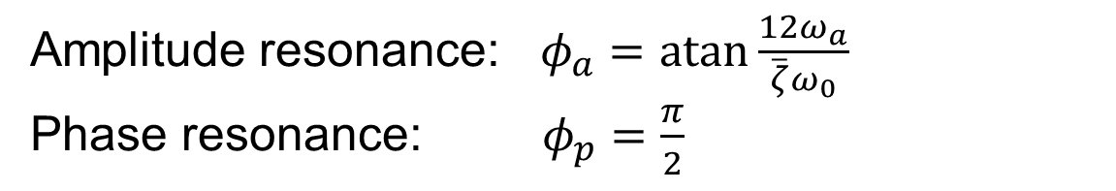

Averaging around the 3:1 resonance
Amplitude resonance: $φ_{a}=\operatorname{atan}{\frac{12ω_{a}}{\overline{ζ}ω_{0}}}$
Phase resonance: $φ_{p}=\frac{π}{2}$
$\left\{\begin{aligned}\frac{24ζω_{0}ω}{α}r=Γ^{3}\sin{φ} \\ \left(3r^{2}+6Γ^{2}−\frac{4Ω}{α}\right)r=Γ^{3}\cos{φ}\end{aligned}\right.$
Phase resonance curve
Amplitude $A_{3}$ [m]
Phase lag [rad]
Frequency [rad/s]
Frequency [rad/s]

Slide 12
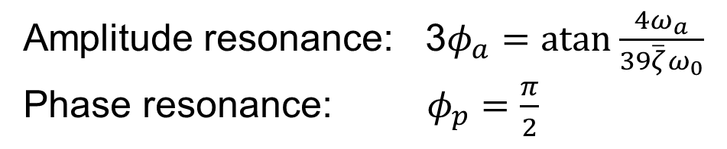

Averaging around the 1:3 resonance
$\left\{\begin{aligned}ζω_{0}=\frac{9αΓ}{8ω}r\sin{3φ} \\ \frac{3α}{8ω}\left(3r^{2}+6Γ^{2}−\frac{4Ω}{α}\right)=\frac{9αΓ}{8ω}r\cos{3φ}\end{aligned}\right.$
Amplitude resonance: 3$φ_{a}=\operatorname{atan}{\frac{4ω_{a}}{39\overline{ζ}ω_{0}}}$
Phase resonance: $φ_{p}=\frac{π}{2}$
Phase resonance curve
Amplitude $A_{1}$ [m]
Phase lag [rad]
Frequency [rad/s]
Frequency [rad/s]

Slide 13


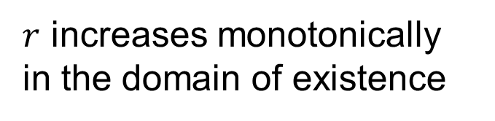
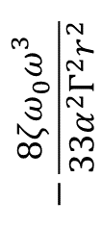
Averaging around the 1:2 resonance
$\left\{\begin{aligned}2ζω_{0}=−\frac{33α^{2}Γ^{2}}{4ω^{3}}r^{2}\sin{4φ} \\ 3r^{2}+6Γ^{2}−\frac{4Ω}{α}=𝒪(ε)\end{aligned}\right.$
$\left\{\begin{aligned}−1≤−\frac{8ζω_{0}ω^{3}}{33α^{2}Γ^{2}r^{2}}≤1 \\ r≈\sqrt{\frac{4Ω}{3α}−2Γ^{2}}\end{aligned}\right.$
Domain of existence of the 1:2 resonance
$$−\frac{8ζω_{0}ω^{3}}{33α^{2}Γ^{2}r^{2}}$$
$$φ=\frac{3π}{8}$$
$r$ increases monotonically
in the domain of existence
Frequency [rad/s]

Slide 14

Averaging around the 1:2 resonance (II)
Phase resonance curve
Amplitude $A_{1}$ [m]
Phase lag [rad]
Frequency [rad/s]
Frequency [rad/s]
Phase and amplitude resonances coincide and correspond to a phase lag $φ=\frac{3π}{8}$

Slide 15



Other $k:ν$ resonances
Performing higher-order averaging for other types of resonances give similar results:
$5:1⇒φ_{p}=π/2$
$1:5⇒φ_{p}=π/2$
$3:2⇒φ_{p}=3π/8$
$2:3⇒φ_{p}=π/4$
…
If $k$ and $ν$ are odd
$φ=\frac{π}{2}$
If $k$ or $ν$ is even
$φ=\frac{3π}{4ν}$

Slide 16







Phase resonance nonlinear modes
$$f=1N$$
$$1:1$$
$$5:1$$
$$3:1$$
$$1:3$$
$$1:2$$
$$2:1$$

Slide 17
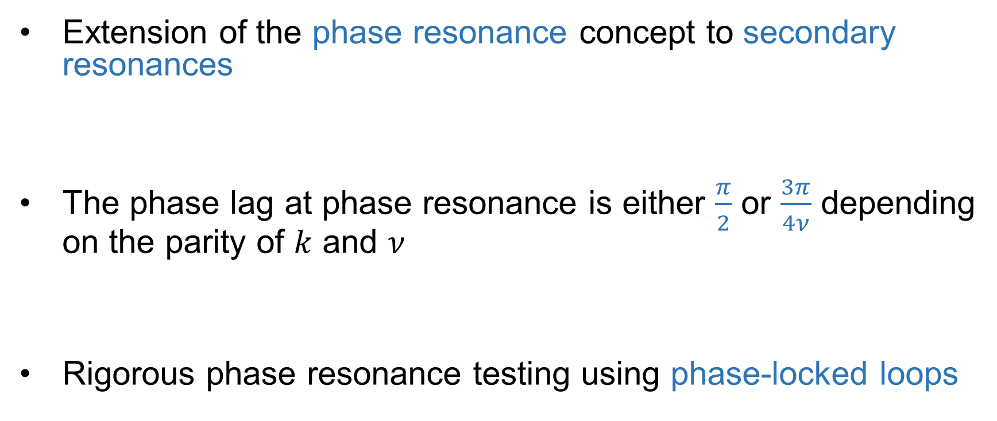
Conclusion
Extension of the phase resonance concept to secondary resonances
The phase lag at phase resonance is either $\frac{π}{2}$ or $\frac{3π}{4ν}$ depending on the parity of $k$ and $ν$
Rigorous phase resonance testing using phase-locked loops

Slide 18


Experimental validation
$$3:1$$
$$1:1$$
For more information, see Gaetan Abeloos’ presentation this afternoon at 6pm!
Amplitude
Frequency

Slide 19
Thank you!
Martin Volvert
Gaëtan Kerschen
Space Structures and Systems Lab
Aerospace and Mechanical Eng. Dept.
University of Liège
February 2022
Submission 12644

