Slide 1


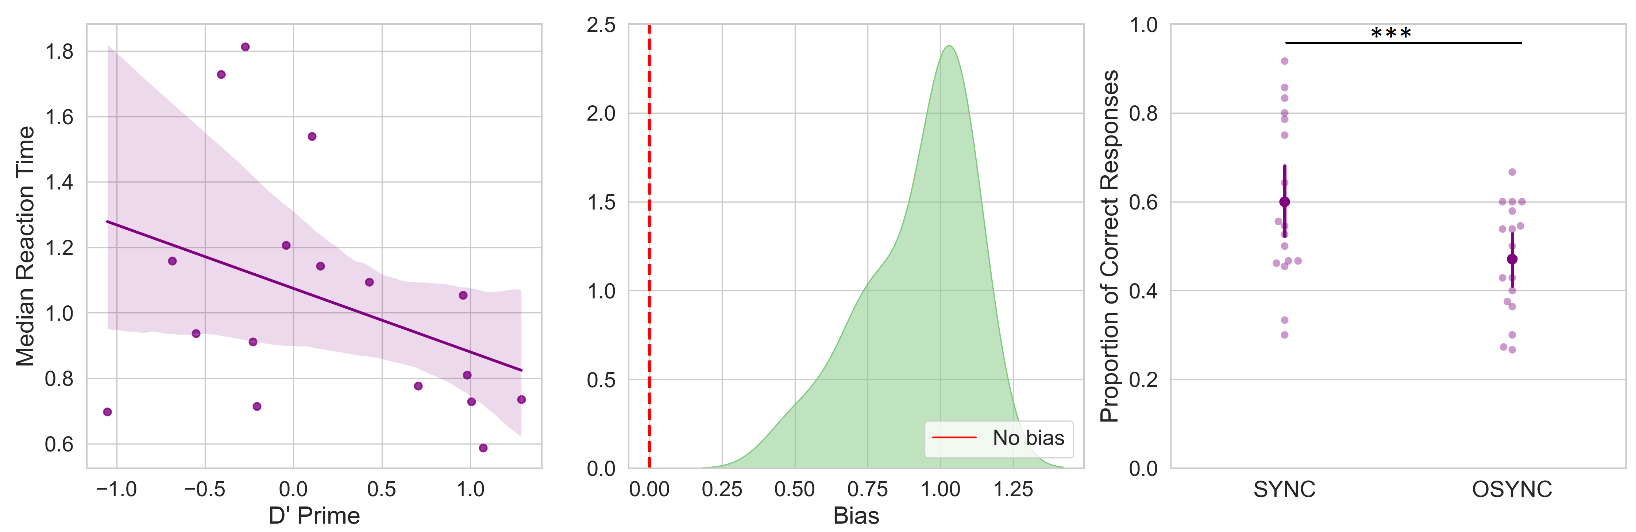
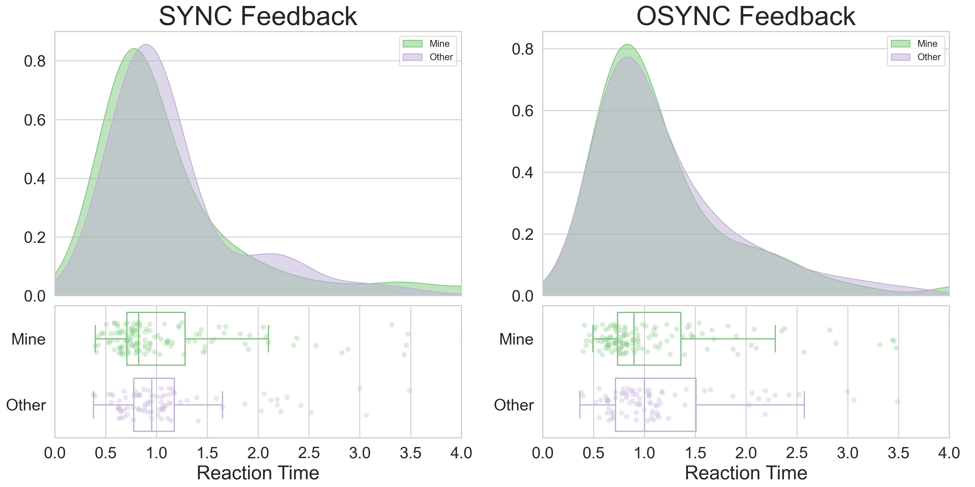
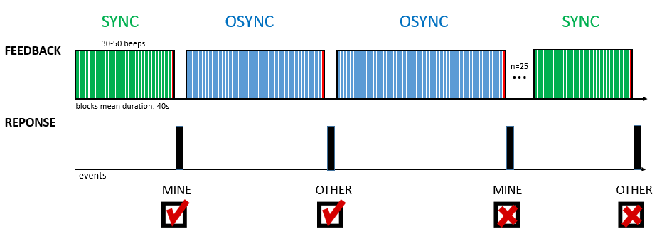
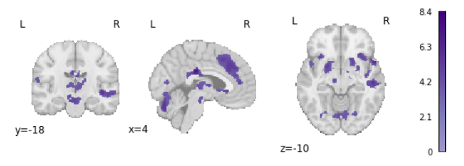
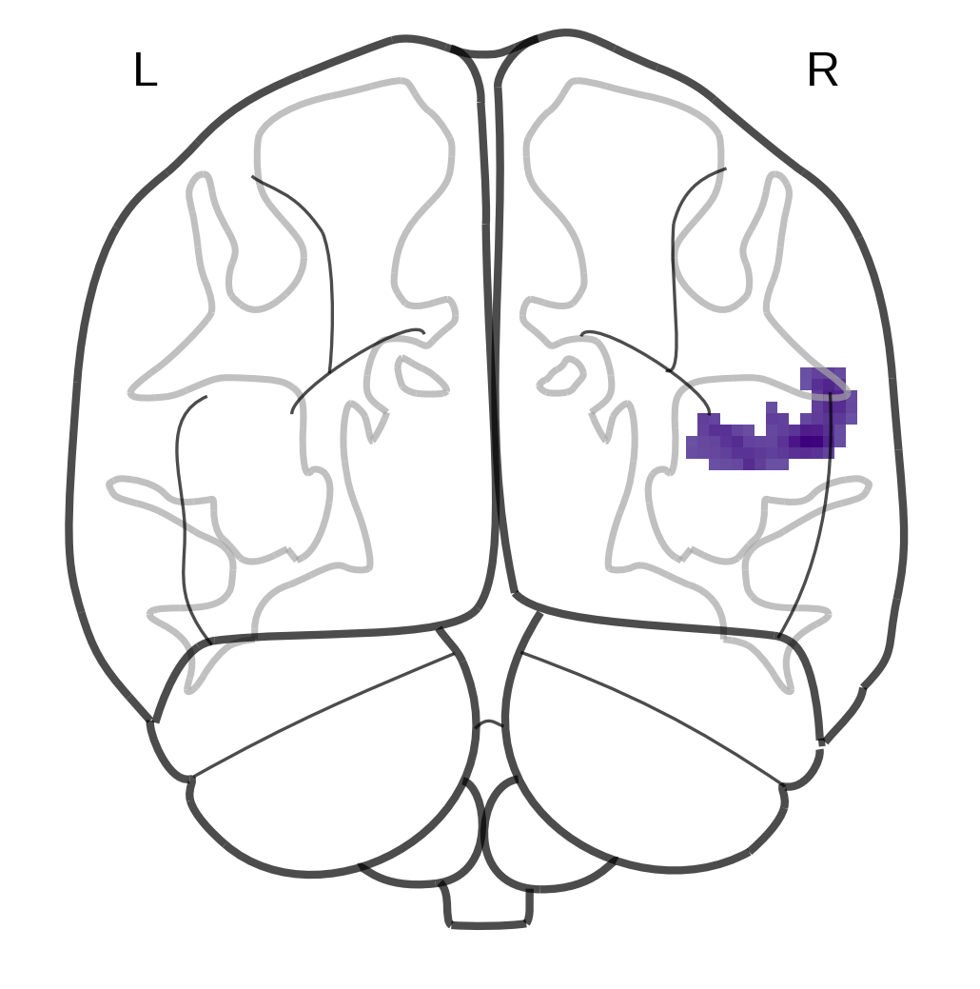
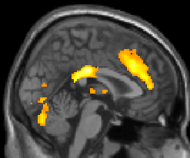
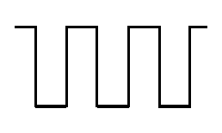
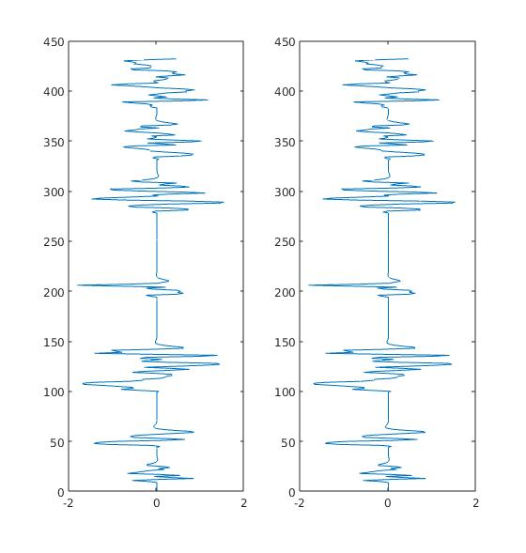
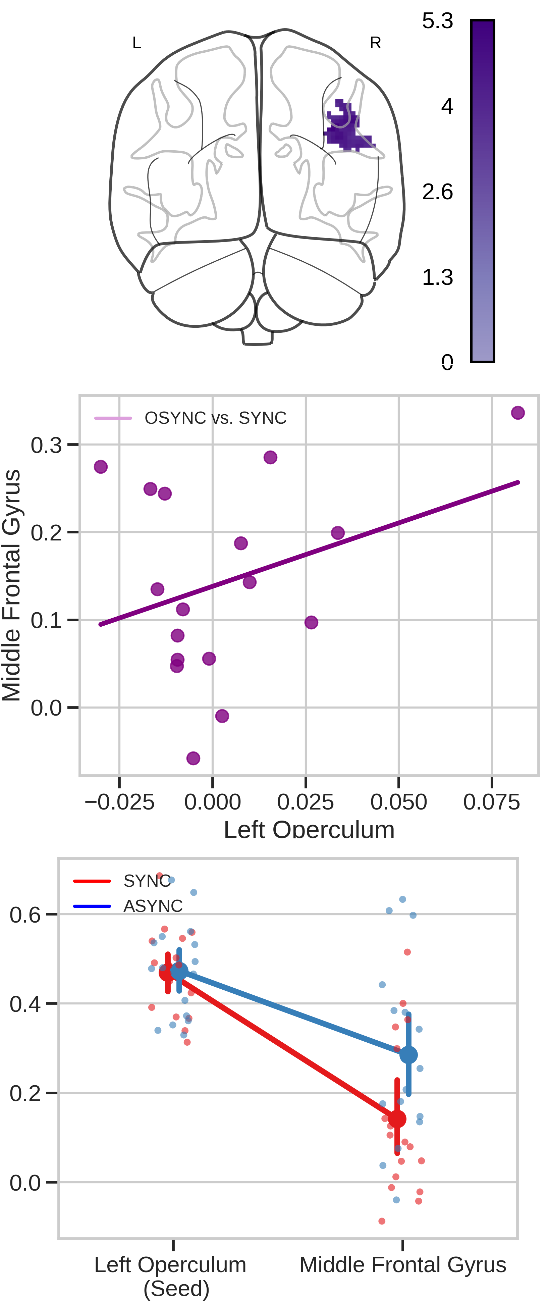
Synchronous cardiac feedback improves interoceptive accuracy despite bias against feedback signals
Paradeisios Alexandros Boulakis¹, Federico Raimondo^{2,3}, Sepehr Mortaheb¹, Lionel Naccache^{4,5}, Athena Demertzi^{1,6,7}
¹Physiology of Cognition Lab, GIGA-Consciousness Research Unit, GIGA Institute, University of Liège, Belgium; ²Institute of Neuroscience and Medicine, Brain & Behaviour (INM-7), Research Centre Jülich, Germany; ³Institute of Systems Neuroscience, Medical Faculty, Heinrich Heine University Düsseldorf, Düsseldorf, Germany; ⁴PICNIC Lab, Institut du Cerveau et de la Moelle épinière, Hôpital Pitié-Salpêtrière, Paris, France; ⁵INSERM, U1127, Paris, France; ⁶Fund for Scientific Research FNRS, Brussels, Belgium; ⁷Psychology and Neuroscience of Cognition Research Unit, University of Liège, Belgium
Introduction
Results
Synchronous presentation of interoceptive signals to internal or external stimuli can improve interoceptive accuracy¹, induce self-identification illusions² or attenuate external signal detection³.
What it is less clear is how people misattribute artificial signals as their own.
Goal: To investigate the neural correlates of (correct and incorrect) interoceptive attributions.
Same rate of “Mine and “Other” across conditions (goodness-of-fit χ²=8.3, p=.93)
RT~ feedback (Sync/ Async) : Non Significant (F=1.42, p=.23)
RT~ response (Mine/ Other) : Non Significant (F=.01, p=.98)
Accuracy was a not significant predictor of RT (p=.09).
Sync condition elicited higher rates of correct responses (p<.001)
Subjects showed high bias (M=0.92).
Methods
Experimental Design
    17 healthy participants (10 females, M=24.17;19-38y)
    25 blocks of sounds (30-50 sounds per block)
    Conditions:
      SYNC: Auditory feedback of heartbeats in synchrony to own
      OSYNC: Auditory feedback of heartbeats in asynchrony (out of phase) to own
At the end of the block, participants responded whether they listened to their own heart or someone else’s.
People seem to have a very high criterion, as they tend to respond ‘Other’ more often. However, synchronicity does improve performance compared to asynchronicity. Even if people are conservative in attributing sources as their own, synchronicity still increases correct bodily attributions.
Contrast: “Mine” ∩ “Other” (p_{FDR} < .05). Colorbars indicates T-values.
Behavioral Analysis
Distribution of Feeback * Response
(chi square goodness of fit)
Reaction Time ~ Feedback * Response
(mixed effects gamma model)
D’Prime / Bias Criterion
Proportion of Correct Response ~ Feedback
(linear model)
Activation Analysis
Proprocessing
(realign, coregister, normalize, smooth)
First Level GLM
MINE & OTHER as events as regressors
SYNC & OSYNC as block as regressors
Group Level GLM
Conjunction Analysis of MINE & OTHER
Seed: Right Anterior Insula
Psychophysiological Interactions Analysis
Seed: Left Operculum
x
=
The ROI from the “Mine” ∩ “Other” contrast are used as seed regions.
Timeseries are extracted from each seed.
The time series are convolved with the SYNC and ASYNC task boxcar regressor.
Task, physiological timeseries and interactions build the GLM model.
Discussion
Although subjects tend to have a bias towards attributing signals to others, functional connectivity increases during asynchronous trials, showing that the brain can track different feedback conditions.
Ιmplicitly, synchronicity boosts performance in interoceptive tasks
Explicitly, subjects do not seem to track synchronicity. They are heavily biased towards attributing sources as external to themselves.
Neuronally, functional connectivity increases between the insula and the operculum track asynchronicity of feedback. The brain can discriminate between different feedbacks.
The findings align with a predictive processing account of interoception. Incongruencies with prior knowledge about signals, as in the OSYNC condition, are propagated in the cortical hierarchy for further processing⁵.
Overall, it seems that synchronicity of feedback engages regions of the salient network to make differences between internal and external signals more salient.
References
Ring C, Brener J, Knapp K, Mailloux J. Biological Psychology. 2015 Jan 1;104:193–8.
Adler D, Herbelin B, Similowski T, Blanke O. Respir Physiol Neurobiol. 2014 Nov 1;203:68–7
Salomon R, Ronchi R, Dönz J, Bello-Ruiz J, Herbelin B, Martet R, et al.. J Neurosci. 2016 May 4;36(18):5115
Iodice P, Porciello G, Bufalari I, Barca L, Pezzulo G. PNAS. 2019 Jul 9;116(28):13897–902.
Apps MAJ, Tsakiris M. Neurosci Biobehav Rev. 2014 Apr;41:85–97.
paradeisios.boulakis@uliege.be

