Slide 1


Proxies to conscious activity in the absence of reportability
Athena Demertzi, PhD
FNRS Research Associate
Director, Physiology of Cognition
Gonda Multidisciplinary Brain Research Center
Bar-Ilan University
Israel
March 21 2022

Slide 2
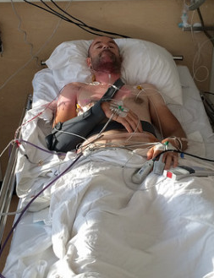
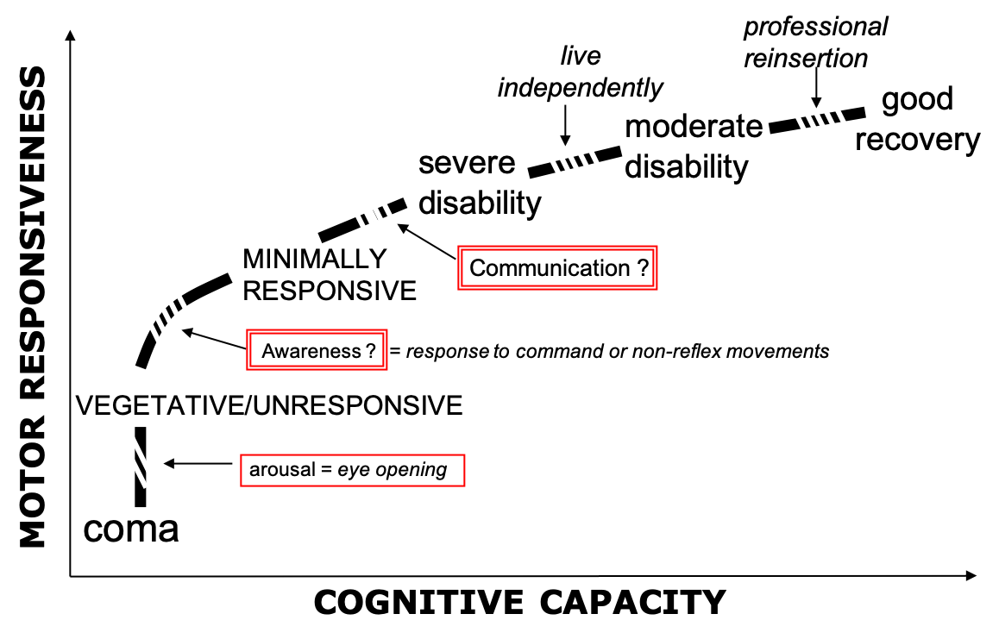
Cognition is referred from behavior
Ethical significance | Brain Proxies | Physiology | Conclusions
Anticorrelations | Inter-network connectivity | Inter-state dynamics
Source: Google pictures (Credit: CC-BY-SA; M Appelman)

Slide 3
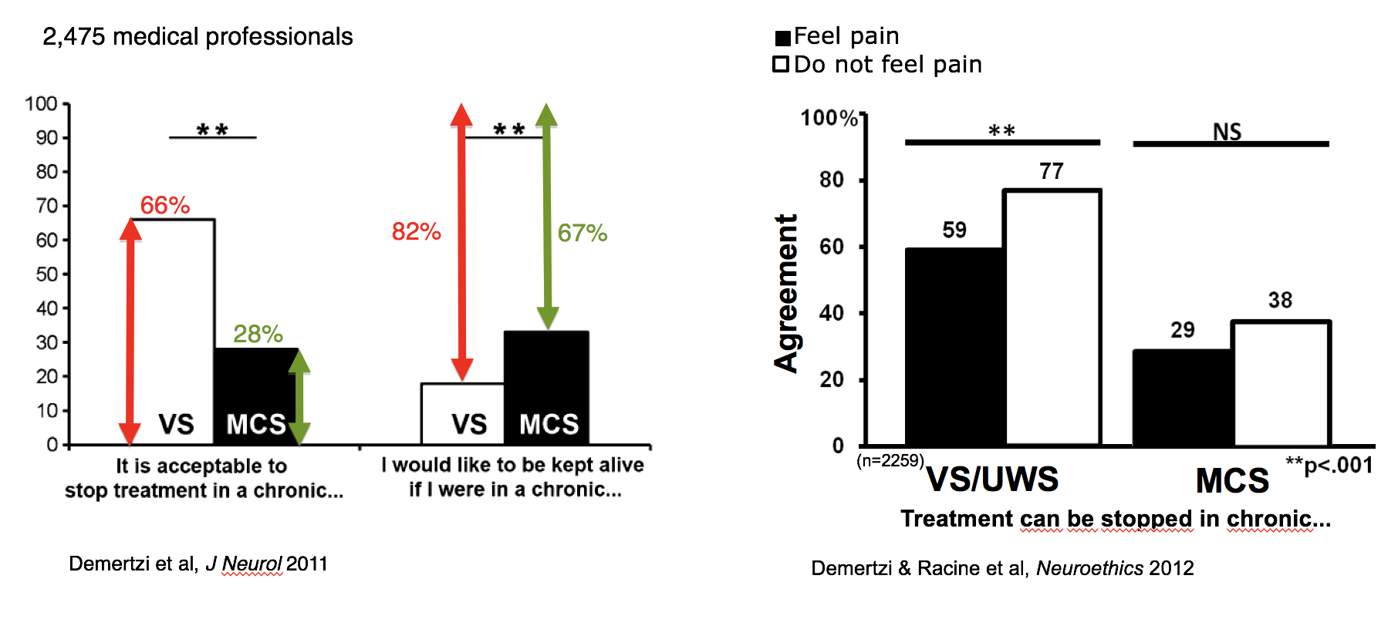
Consciousness as an ethical imperative
Ethical significance | Brain Proxies | Physiology | Conclusions
Anticorrelations | Inter-network connectivity | Inter-state dynamics
Demertzi et al, Prog Brain Res 2009
Demertzi & Racine et al, Neuroethics 2012
Demertzi et al, J Neurol 2011

Slide 4
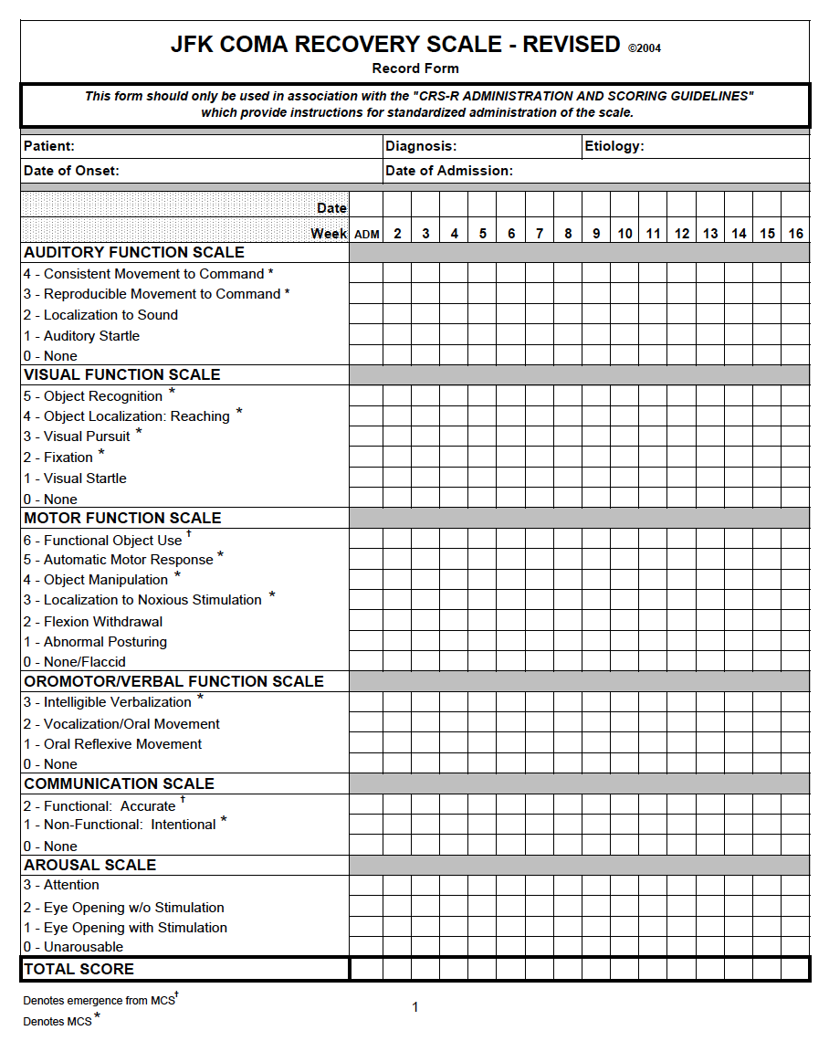
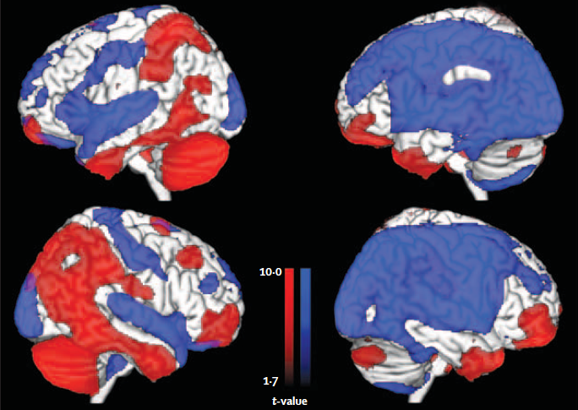
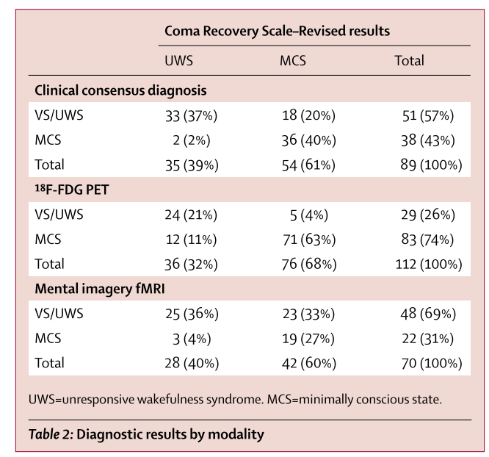
We cannot always trust behavior
Ethical significance | Brain Proxies | Physiology | Conclusions
Anticorrelations | Inter-network connectivity | Inter-state dynamics
Standardized assessment
n=103 post-comatose patients
45 Clinical diagnosis of VS
18 Coma Recovery Scale MCS
40% misdiagnosis
Schnakers et al, Ann Neurol 2006; BMC Neurol 2009
Standardized assessment & Neuroimaging
Giacino et al, Neurology 2002
Stender & Gosseries et al, Lancet 2014

Slide 5
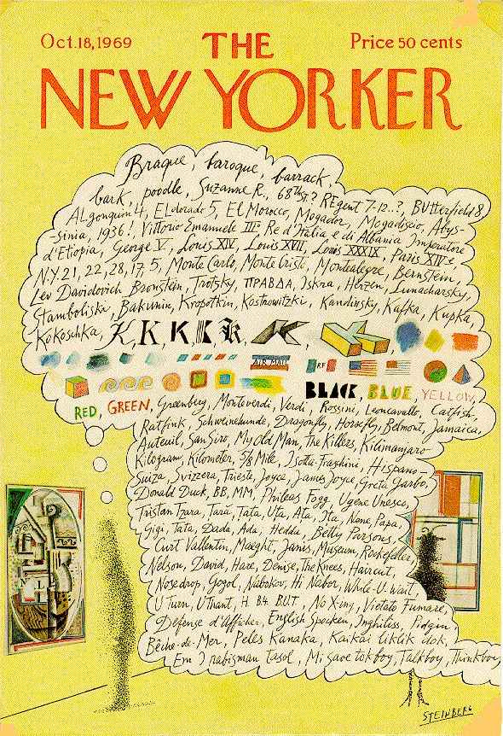

Resting state
Ethical significance | Brain Proxies | Physiology | Conclusions
Anticorrelations | Inter-network connectivity | Inter-state dynamics
The stream of thought (Chapter IX)
The Principles of Psychology 1890
Brain ~2% body’s weight
Evoked changes <5%
80% for neuronal signaling
"While conscious awareness is […] energetically inexpensive, it is dependent upon a very complex, dynamically organize state of the brain that is achieved at great expense"
William James (1842-1910)
Raichle & Snyder, 2009 In: Laureys S, Tononi G The Neurology of Consciousness. Oxford: Elsevier Academic Press
Notes:
Saul Steinberg's marvelous New Yorker cover from October 8, 1969 (see Figure 1), provides the best picture of human consciousness I have encountered. Not just words, but colors and shapessucceed each other in delicious association. Even the genius of Steinberg can't quite render aromas, tickles and sounds on the cover of a magazine, but at least he suggests the likelihood oftheir inclusion. And the whole rendering is made possible by his exploitation of a familiar cartoonists' convention, the thought balloon or thought bubble. Calling this a conventionunderplays its naturalness; I doubt that children ever need to have the convention explained to them--it's quite wonderfully obvious what it depicts, metaphorically: the stream of consciouscontents in the mind of the man looking at the painting in the museum. This powerful and natural metaphor provides a nice setting of the problem of consciousness: If this picture gives us themetaphorical truth, what is the literal truth? How can an account of what happens in the man's brain ever do justice to the familiar--indeed intimate--facts we recognize in this metaphoricalrendering?
W. James (1980): five characters in thought
Every thought tends to be part of a personal consciousness
Within each personal consciousness, thought is always changing
Within each personal consciousness, thought is sensibly continuous
It always appears to deal with objects independent of itself
It is interested in some parts of these objects to the exclusion of others, and welcomes or rejects or chooses from among them, all the while it thinks

Slide 6
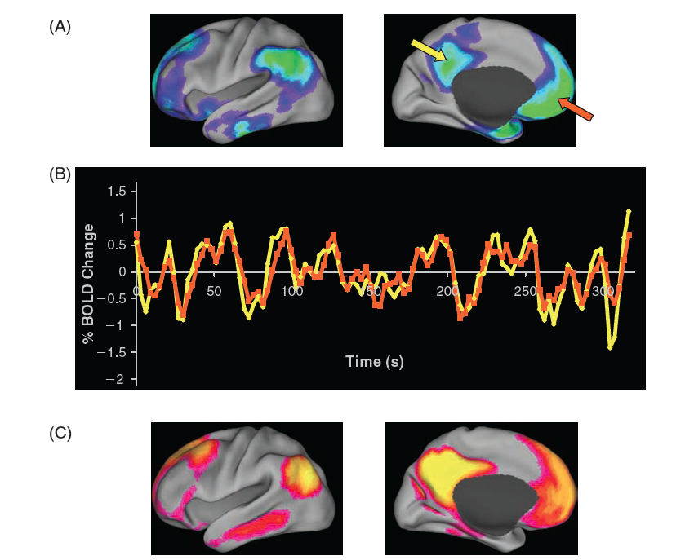
Default mode of brain function
Ethical significance | Brain Proxies | Physiology | Conclusions
Anticorrelations | Inter-network connectivity | Inter-state dynamics
Task deactivations
Task performance - Rest (fixation/eyes closed)
Demertzi & Whitfield-Gabrieli, in: Neurology of Consciousness 2nd ed. 2015
Demertzi, Soddu, Laureys, Curr Opin Neurobiology 2013
Demertzi et al, Front Hum Neurosci 2013 Raichle et al, PNAS 2001
Notes:
Brain areas consistently exhibiting activity decreases during task performance also exhibit coherent spontaneous activity in
the resting state. Performance of a wide variety of tasks has called attention to a group of brain areas (A) that decrease their activity during task performance (data adapted from [4] ). This particular group of brain areas has come to be known as the ‘ default network ’ and serves as an exemplar of all areas of the cerebral cortex which exhibit a systems level organization in the resting (default) state [7] .
If one records the spontaneous fMRI BOLD signal activity in these areas (arrows, A) in the resting state what emerges is a remarkable correlation in the spontaneous fluctuations of the fMRI BOLD signals obtained from the two areas (B). Using these fluctuations to analyse the network as a whole [7] reveals a level of functional organization (C) that parallels that seen in the task-related activity decreases (A).
These data provide a dramatic demonstration of the intrinsic organization of the human brain which likely provides a critical context for all human behaviours including conscious awareness. These data were adapted from our earlier published work [4–6, 24] .

Slide 7
Functional correlations & anticorrelations
Ethical significance | Brain Proxies | Physiology | Conclusions
Anticorrelations | Inter-network connectivity | Inter-state dynamics
Fox et al, PNAS 2005

Slide 8
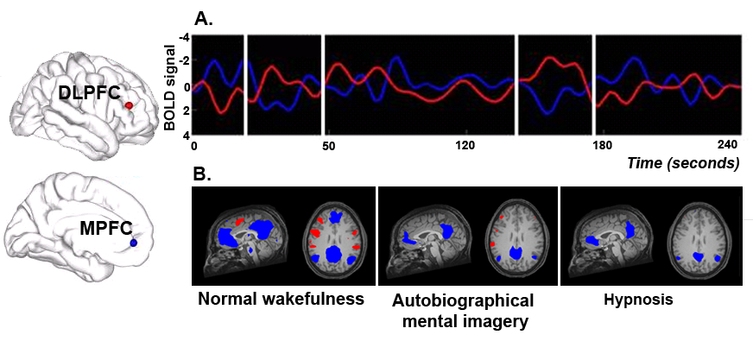
Anticorrelations inform cognitive function?
Ethical significance | Brain Proxies | Physiology | Conclusions
Anticorrelations | Inter-network connectivity | Inter-state dynamics
External awareness
or anticorrelated network
Switch 0.01-0.1Hz
Internal awareness
or Default mode network
Vanhaudenhuyse*, Demertzi* et al, J Cogn Neurosci 2011
Demertzi, Soddu, Laureys, Curr Opin Neurobiology 2013
Demertzi & Whitfield-Gabrieli, in: Neurology of Consciousness 2nd ed. 2015
Demertzi et al, Front Hum Neurosci 2013
Demertzi, Kucyi, Ponces-Alvarez, Keliris, Whitfield-Gabrieli, Deco. Netw Neurosci in press

Slide 9
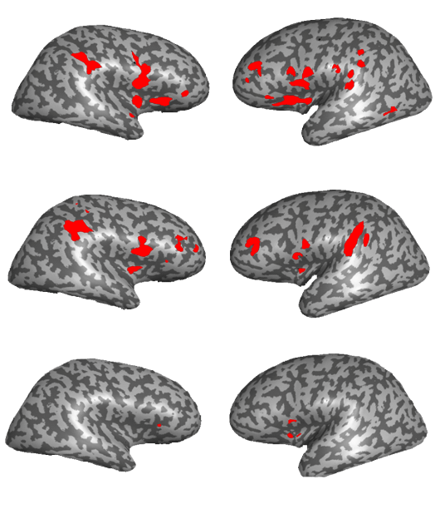
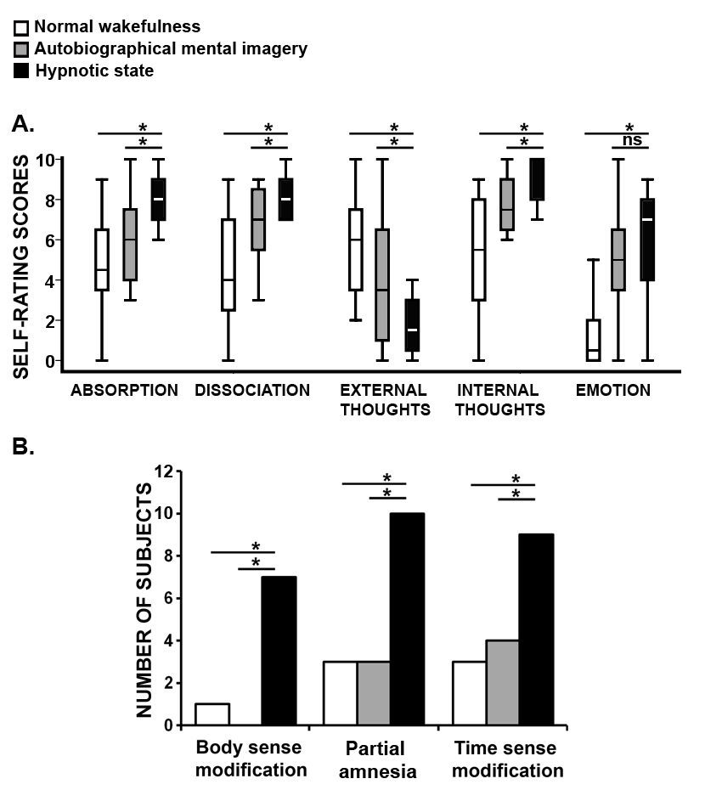
Modified awareness reduces anticorrelations
Ethical significance | Brain Proxies | Physiology | Conclusions
Anticorrelations | Inter-network connectivity | Inter-state dynamics
Normal wakefulness
Normal wakefulness
Autobiographical mental imagery
Hypnosis
Autobiographical mental imagery
Hypnosis
*p<.05
p<0.05 corrected for multiple comparisons
Demertzi, Soddu, Faymonville et al, Prog Brain Res 2011
Demertzi, Vanhaudenhuyse, Noirhomme, Faymonville, Laureys, J Physiol Paris 2015

Slide 10
Modified arousal reduces anticorrelations
Ethical significance | Brain Proxies | Physiology | Conclusions
Anticorrelations | Inter-network connectivity | Inter-state dynamics
Propofol-induced
n=20
Boveroux et al, Anesthesiology 2010

Slide 11
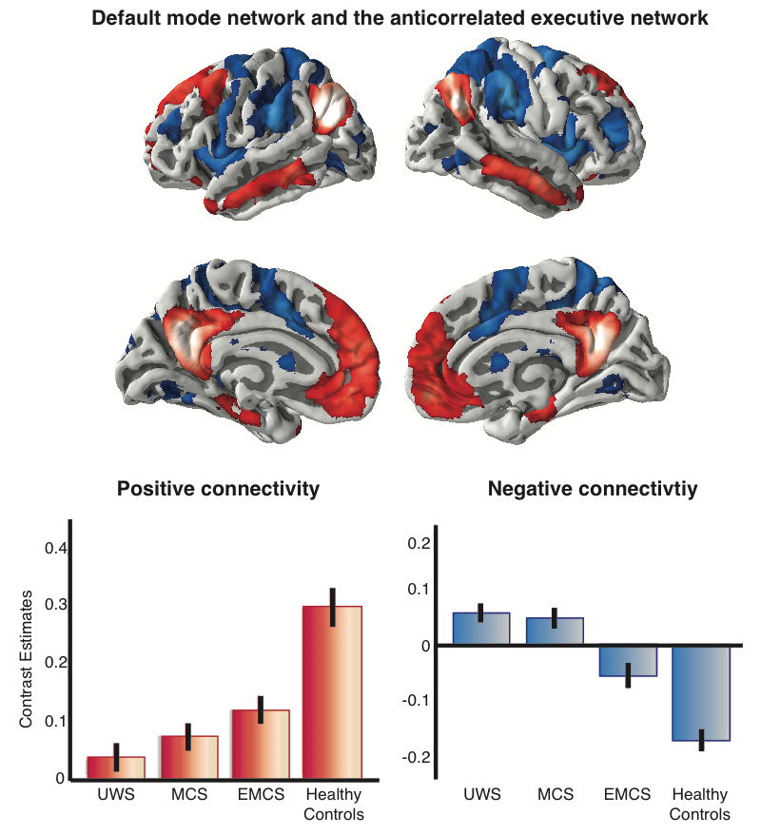
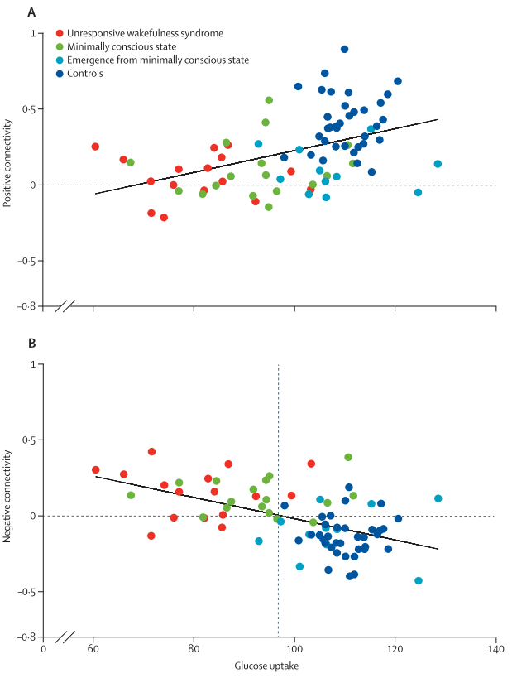
No anticorrelations in DOC
Ethical significance | Brain Proxies | Physiology | Conclusions
Anticorrelations | Inter-network connectivity | Inter-state dynamics
DMN CORRELATIONS
DMN ANTICORRELATIONS
FMRI connectivity
FMRI connectivity
UWS
MCS
EMCS
CTR
fMRI positive connectivity
fMRI negative connectivity
PET glucose uptake
Di Perri, …, Demertzi*, Laureys*, Soddu*, Lancet Neurol 2016

Slide 12
Ethical significance | Brain Proxies | Physiology | Conclusions
Anticorrelations | Inter-network connectivity | Inter-state dynamics
Anticorrelations ≈ Consciousness
Neural inhibition facilitates functional segregation
Demertzi, Kucyi, Ponce-Alvarez, Keliris, Whitfield-Gabrieli, Deco. Network Neurosci in press
Notes:
We suggest that neural inhibition mediates the rise of the anticorrelations indirectly, by breaking the local neural balance which affects network metastability and which eventually permits anticorrelations to appear.
More particularly,
distant brain regions establish connections between their corresponding excitatory neural populations (Fig 1, E-E blue solid-line connectivity).
The resulting local increase of excitation produces an increase of inhibition through the local E-I loop (feedback inhibition).
Apart from the inter-areal excitatory activity, one brain region (A) can also effectively inhibit the activity of a distal brain region (B), by A targeting B’s inhibitory inter-neurons (Fig 1, E-I blue dashed-line connectivity), which in turn, locally connect to the pyramidal cells (Fig 1, I-E red connector; i.e., feedforward inhibition, Isaacson & Scanziani, 2011). However, little attention has been paid to this indirect long-range inhibition in modeling studies and how specifically feedforward inhibition interacts with the local excitation-inhibition (E/I) ratio. Although previous theoretical work has separately examined the effect of regulating the E/I ratio through feedback inhibition or feedforward inhibition in whole-brain models (Deco, Ponce-Alvarez, et al., 2014), a model that takes both effects into account has not been studied yet. Local heterogenous feedback inhibition, in particular, signifies that the excitability of local population activity is achieved by variantly determining each region’s gain response function. Recent studies using heterogeneous and homogeneous whole-brain modelling have mechanistically shown that, besides increasing the level of fitting of the empirical data, an increase in ignition was observed (Deco et al., 2021). Based on this evidence, one could speculate that ignition is related to the presence of regional heterogeneity. Although the type of heterogeneity which is the most relevant for ignition remains open, one can nevertheless say that thanks to heterogeneity in general, ignition-like dynamics may happen (Deco et al., 2021), which are thought to support conscious experience (see next section).
Lisa Roux and György Buzsáki https://www.ncbi.nlm.nih.gov/pmc/articles/PMC4254329/ Types of neural inhibition

Slide 13
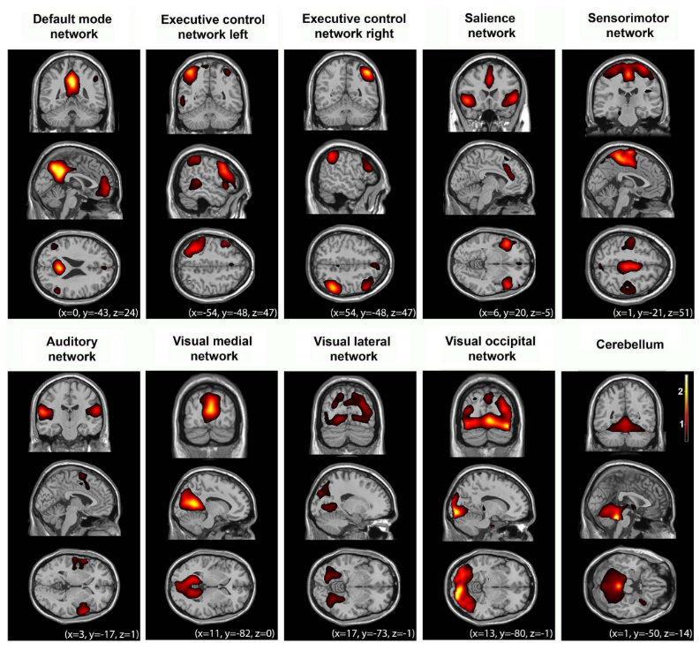
More networks during rest
Ethical significance | Brain Proxies | Physiology | Conclusions
Anticorrelations | Inter-network connectivity | Inter-state dynamics
Biswal et al., Magn Reson. Med 1995
Smith et al, PNAS 2009
Heine et al, Front Psych 2012

Slide 14
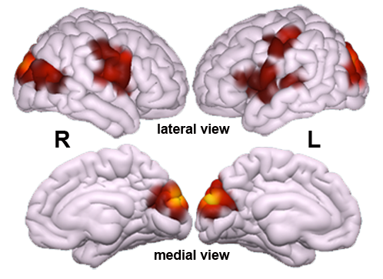
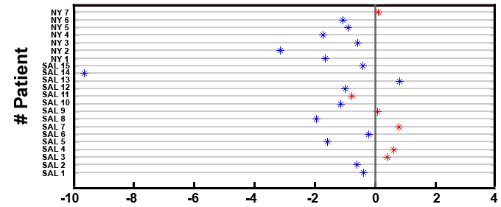
Lower cross-modal interaction in UWS
Ethical significance | Brain Proxies | Physiology | Conclusions
Anticorrelations | Inter-network connectivity | Inter-state dynamics
Training set: 45 DOC (26 MCS, 19 VS/UWS)
14 trauma, 28 non-trauma, 3 mixed
34 patients assessed >1m post-insult
Test set:
16 MCS, 6 VS/UWS (15 non-trauma; all chronic)
2 different centers
Classification MCS Classification VS/UWS
Demertzi & Antonopoulos et al, Brain 2015
Distance from decision plane
Demertzi & Antonopoulos et al, Brain 2015
Notes:
The patient who was misclassified as being in MCS had a CRS-R total score of 5 on the day of scanning (indicating the VS/UWS; Patient 11 of centre two, Supplementary material) and she evolved to MCS 38 days later (Auditory Function: 1, Visual Function: 3, Motor Function: 2, Oromotor/Verbal Function: 2, Communication: 0, Arousal: 2).
The patient who was misclassified as being in VS/UWS had a CRS-R total score of 9 on the day of scanning (indicating the MCS; Patient 13 of centre two, Supplementary material) based on the presence of localization to noxious stimulation but this behaviour could not be elicited in neither previous (AF: 1, VF: 0, MF: 0, O/VF: 1, COM: 0, AR: 2) or subsequent evaluations (AF: 2, VF: 1, MF: 2, O/VF: 1, COM: 0, AR: 2).

Slide 15
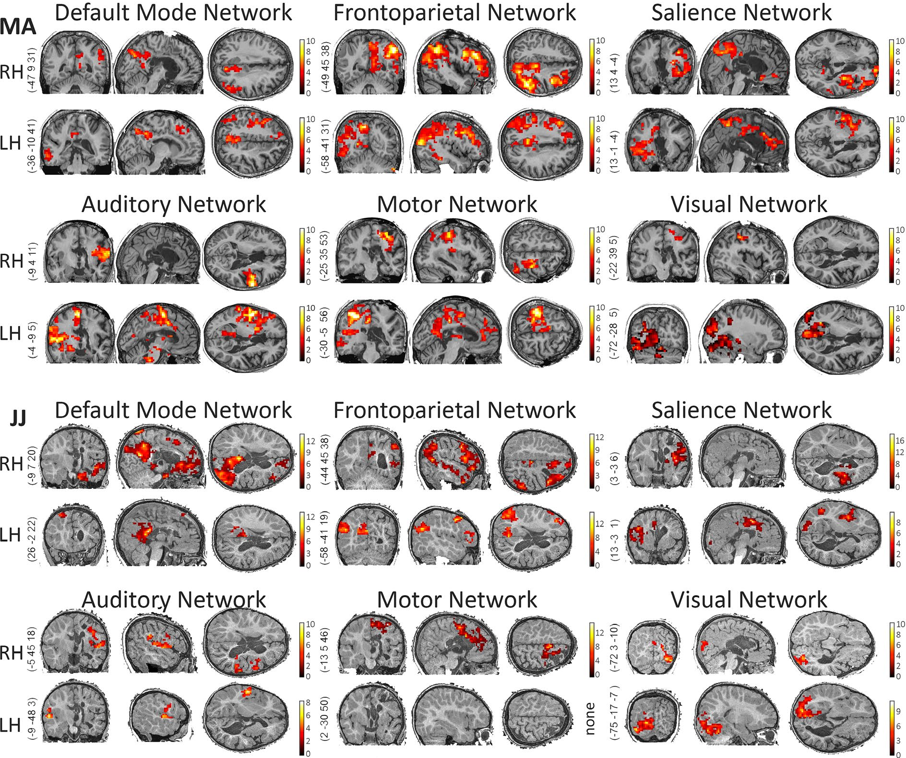
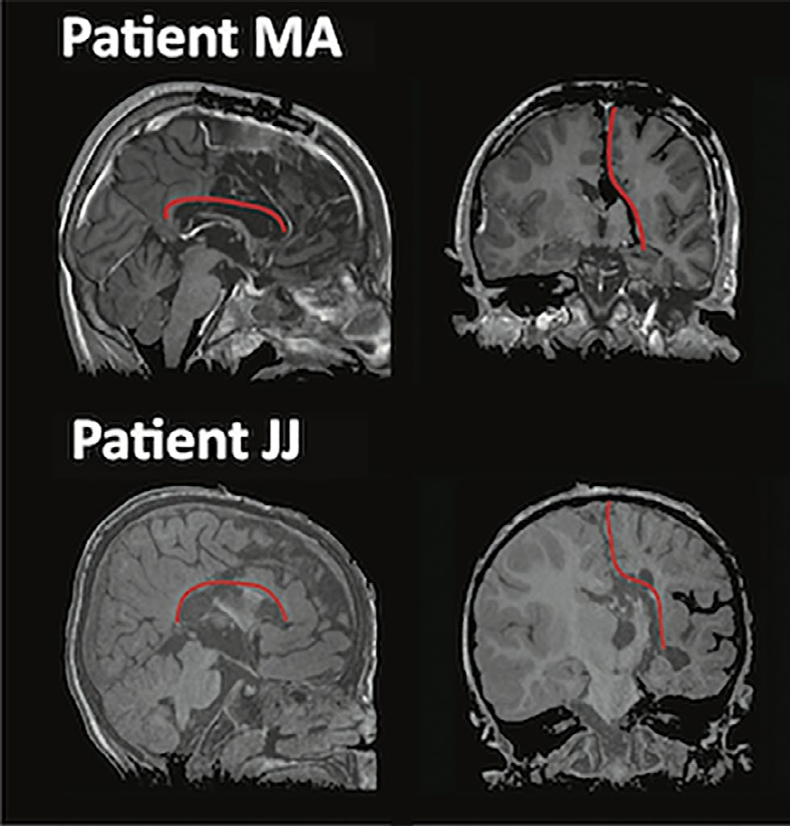
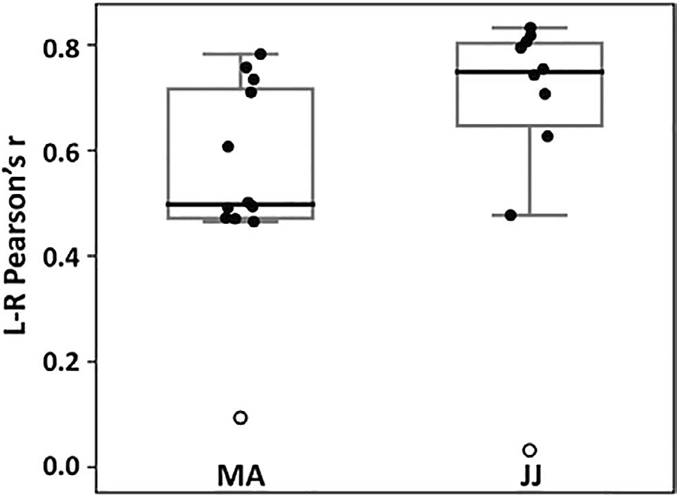

Lower cross-modal interaction in the isolated brain
Ethical significance | Brain Proxies | Physiology | Conclusions
Anticorrelations | Inter-network connectivity | Inter-state dynamics
Complete hemispherotomy
Inter-hemispheric connectivity
Blauwblomme & Demertzi et al, Epilepsia Open 2020
Notes:
The question as to why intrinsic network functional connectivity is preserved in isolated tissue which does not contribute to behavioral output, remains to be answered. A working hypothesis is that brain activity is driven by the underlying anatomy as we have recently found for noncommunicating states.32 At the same time, it may be that preserved network-level connectivity is critical for the development of synaptic connections and maintenance of synaptic homeostasis at large58 which is reduced, yet preserved, in covert or unconscious conditions.32,5

Slide 16
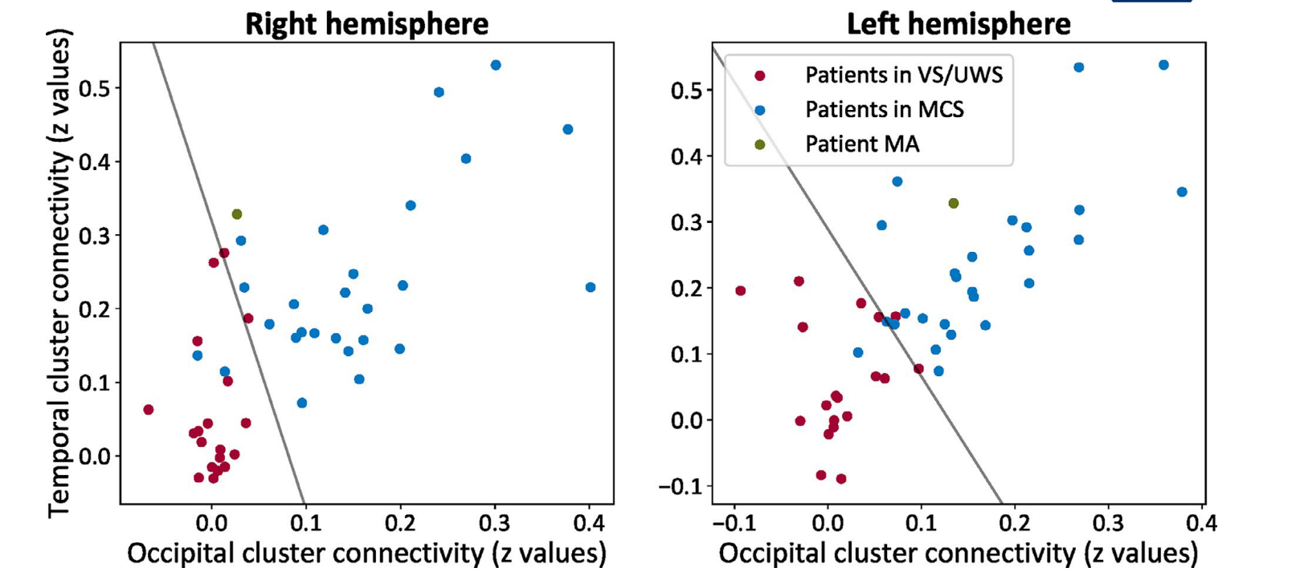
Lower cross-modal interaction in the isolated brain
Ethical significance | Brain Proxies | Physiology | Conclusions
Anticorrelations | Inter-network connectivity | Inter-state dynamics
Blauwblomme & Demertzi et al, Epilepsia Open 2020
Notes:
The question as to why intrinsic network functional connectivity is preserved in isolated tissue which does not contribute to behavioral output, remains to be answered. A working hypothesis is that brain activity is driven by the underlying anatomy as we have recently found for noncommunicating states.32 At the same time, it may be that preserved network-level connectivity is critical for the development of synaptic connections and maintenance of synaptic homeostasis at large58 which is reduced, yet preserved, in covert or unconscious conditions.32,5

Slide 17
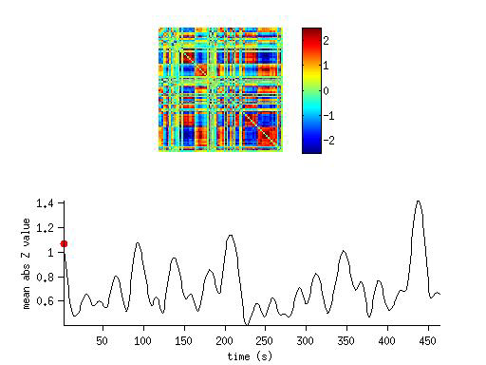
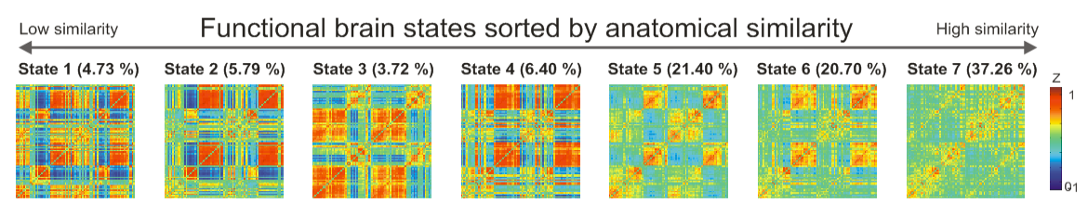
Brain dynamics and cognition
Ethical significance | Brain Proxies | Physiology | Conclusions
Anticorrelations | Inter-network connectivity | Inter-state dynamics
Typical wakefulness
Performance, emotion and cognition
Alavash et al, Neuroimage, 2016
Shine et al Neuron, 2016
Friston Neuroimage, 1997
Thompson et al, Hum Brain Mapp, 2013
Unconsciousness
Rigid spatiotemporal organization, less metastable dynamics
sleep (Tagliazucchi et al, PNAS 2013; Wang et al, PNAS 2016; Wilson et al., Neuroimage 2015; Chow et al, PNAS 2013)
anesthesia
in humans (Tagliazucchi et al, J. R. Soc. Interface 2016; Kafashan et al, Front Neural Circuits, 2016; Amico et al, PLoS One 2014)
in animals (Barttfeld et al, PNAS 2014; Grandjean et al, Neuroimage 2017; Liang et al, Neuroimage 2015)
Barttfeld*, Ulhrig*, Sitt*, et al, PNAS 2015
The brain cannot map the complexity of the internal and external world
(Dehaene et al, Trends Cog Sci, 2006; Tononi et al, Nat Rev Neurosci. 2016)
Notes:
Metastability in the brain is a phenomenon studied in computational neuroscience to elucidate how the human brain recognizes patterns. Here, the term metastability is used rather loosely. There is no lower-energy state, but there are semi-transient signals in the brain that persist for a while and are different than the usual equilibrium state.

Slide 18
Complex patterns in higher conscious states
Ethical significance | Brain Proxies | Physiology | Conclusions
Anticorrelations | Inter-network connectivity | Inter-state dynamics
Demertzi & Tagliazucchi, Dehaene, Deco, Barttfeld, Raimondo, Martial, Fernández-Espejo, Rohaut, Voss, Schiff, Owen, Laureys, Naccache, Sitt. Science Advances 2019

Slide 19
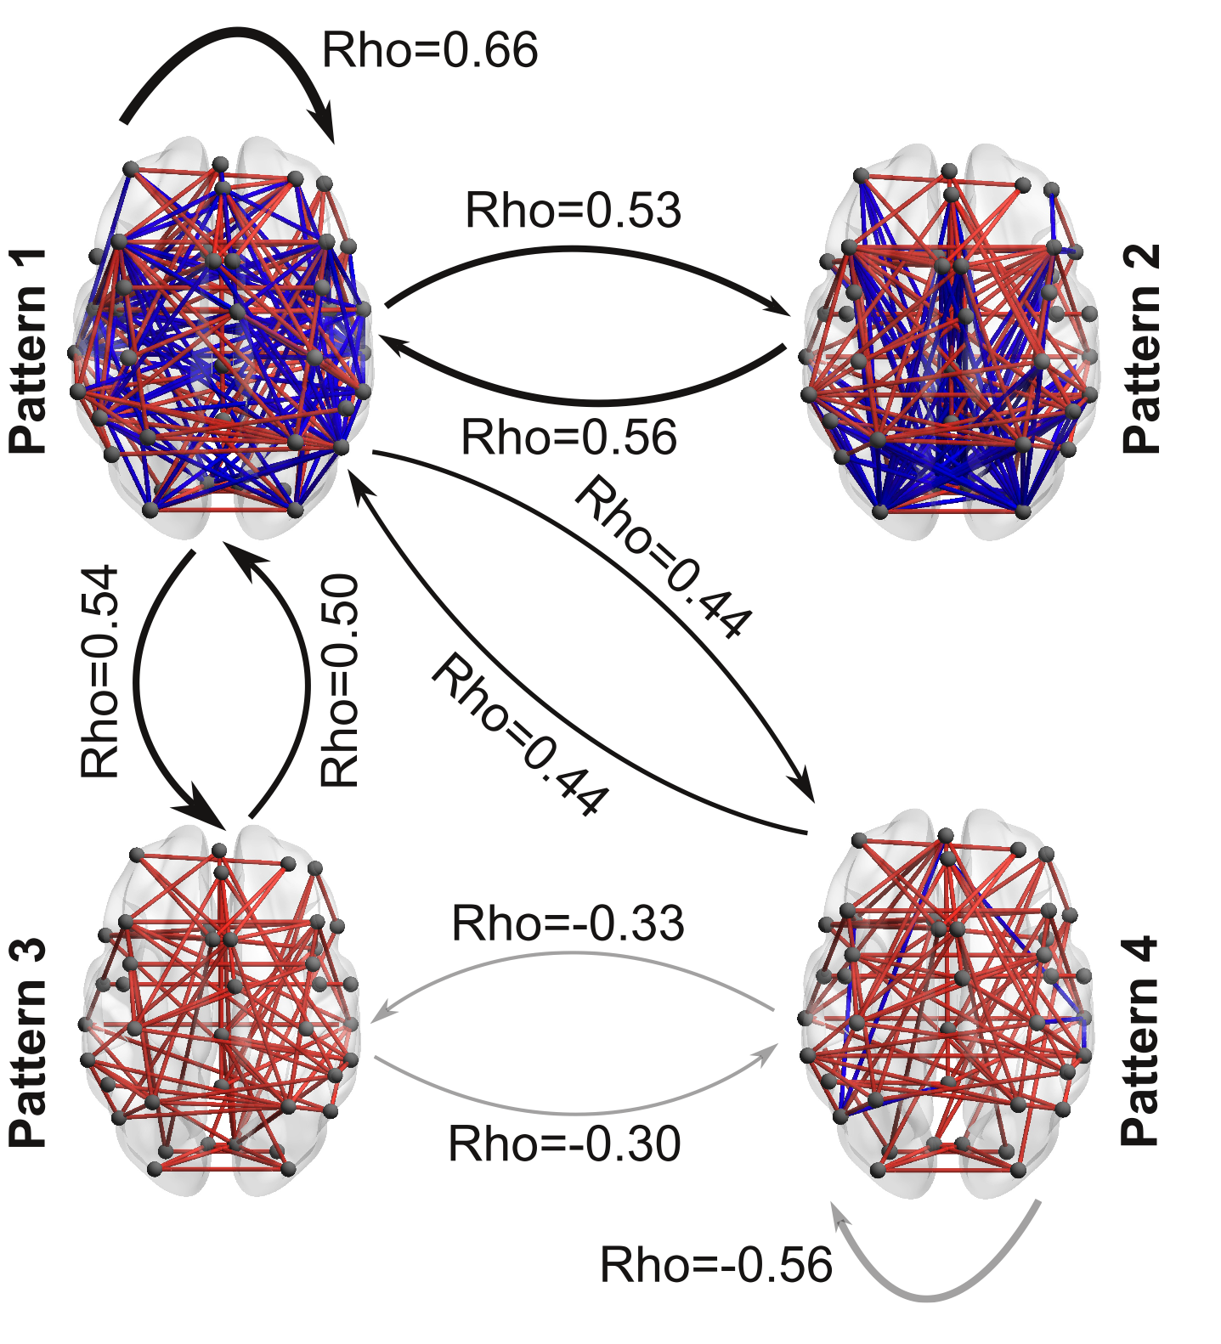
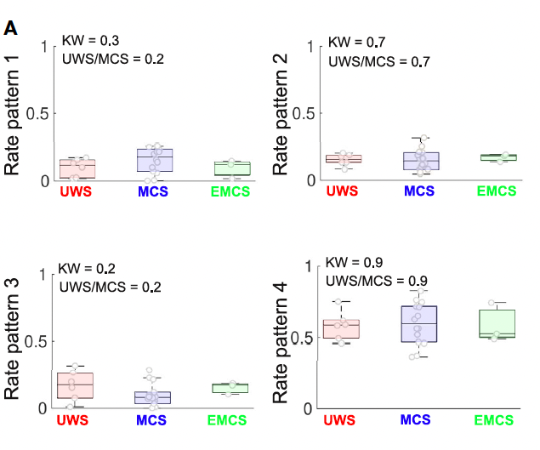
More chances to transition when conscious
Ethical significance | Brain Proxies | Physiology | Conclusions
Anticorrelations | Inter-network connectivity | Inter-state dynamics
Propofol anesthesia
Pattern 1 Pattern 2
rate
Pattern 3 Pattern 4
rate
Demertzi & Tagliazucchi, Dehaene, Deco, Barttfeld, Raimondo, Martial, Fernández-Espejo, Rohaut, Voss, Schiff, Owen, Laureys, Naccache, Sitt. Science Advances 2019
Notes:
﻿Black arrows indicate a higher probability to transit between the coordination patterns in healthy controls (HC) as opposed to patients in MCS and patients in UWS (HC > MCS > UWS). Gray arrows indicate the opposite trend (HC < MCS < UWS)
﻿To further describe the dynamic nature of the pattern exploration, we obtained, for each participant, a matrix containing information about the probabilities that any given pattern to transition into another. This matrix contains, in its ith row, the normalized (i.e., sum equal to one) frequency distribution of observing a volume labeled as the ith pattern transitioning into the pattern corresponding to the jth column. The average contiguous amount of time spent in each pattern for each clinical group was corrected for random durations by subtracting the average duration of surrogate shuffled pattern series.
The sequence predictability for each individual was quantified using the entropy rate (Markov entropy) for the corresponding probabilities and the transition probability matrices. The entropy rate for the sequence of brain patterns of each participant was computed as follows:
Astochastic or random process is a mathematical object usually defined as a family of random variables. Many stochastic processes can be represented by time series. However, a stochastic process is by nature continuous while a time series is a set of observations indexed by integers.

Slide 20
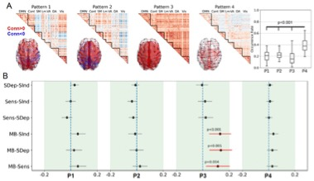
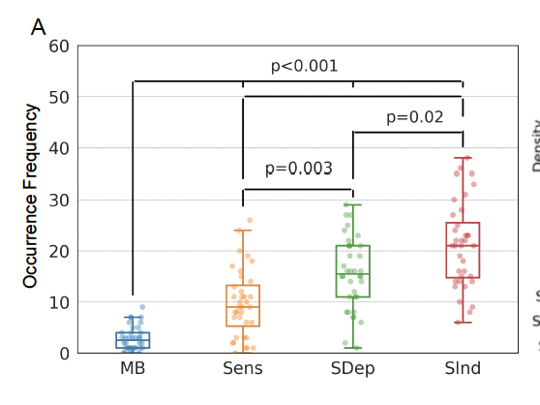
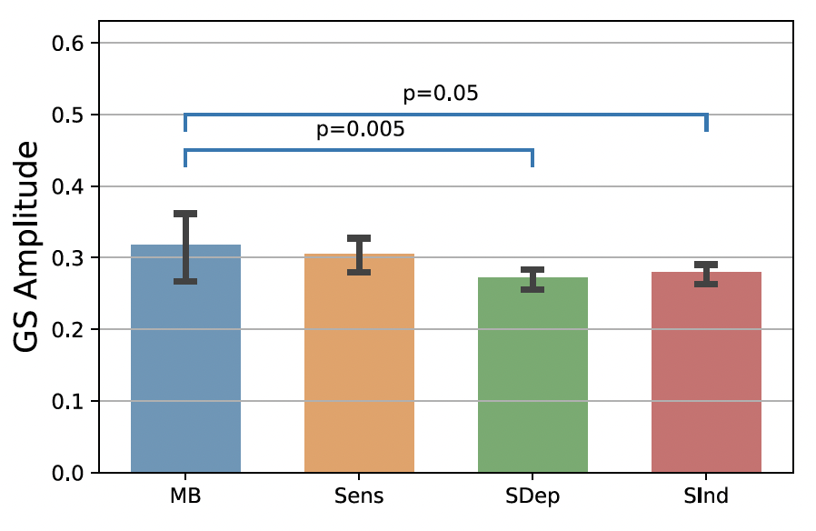
Wakeful and unconscious? The case of Mind Blanking
Ethical significance | Brain Proxies | Physiology | Conclusions
Anticorrelations | Inter-network connectivity | Inter-state dynamics
Mortaheb, Van Calster, Raimondo, Klados, Boulakis, Georgoulaa, Majerus, Van De Ville*, Demertzi*. Under review

Slide 21

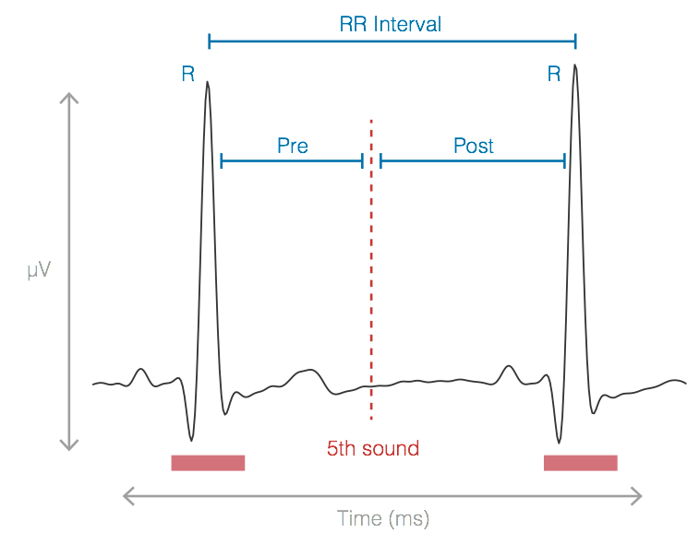
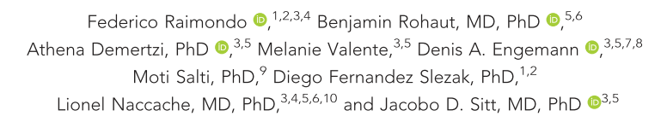

Ethical significance | Brain Proxies | Physiology | Conclusions
Anticorrelations | Inter-network connectivity | Inter-state dynamics
Cardiac reactions to oddballs in MCS
Auditory oddball paradigm
Electrocardiographic markers carry
independent information from EEG
Cardiac cycle-phase acceleration
only in MCS
Post interval
Bekinschtein et al., PNAS, 2009
Bekinschtein et al., PNAS, 2009
Notes:
After the deviant, the foillowing heartbeat is faster in the MCS

Slide 22
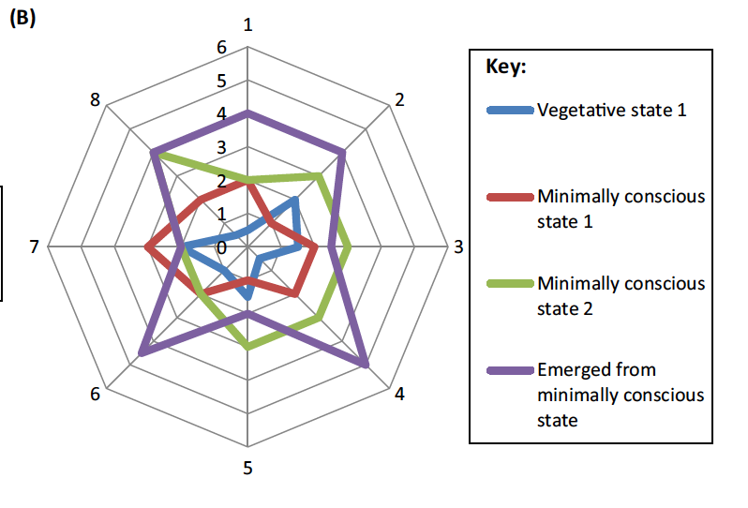
Consciousness is multidimensional
Ethical significance | Brain Proxies | Physiology | Conclusions
Anticorrelations | Inter-network connectivity | Inter-state dynamics
Anticorrelations
(neural inhibition)
Inter-state dynamism
(metastability)
Cross-modal interactions
(multi-sensory integration)
Embodied responsiveness
(active inference)
Bayne, Hohwy, Owen Trends Cogn Sci 2016
Notes:
Metastability refers to the human brain’s ability to integrate several functional parts and to produce neural oscillations in a cooperative and coordinated manner. phase synchronization forms the basis of metastable behavior in neural networks.

Slide 23




Consciousness is a construct
of collective consensus and concerns us all
Physiology of Cognition
GIGA Institute (B34)
Avenue de l’Hôpital, 11
4000 Sart Tilman
University of Liège
BELGIUM
@Ademertzi
@PhysioCognGIGA
a.demertzi@uliege.be
www.gigaphysiologycognition.uliege.be

Slide 24
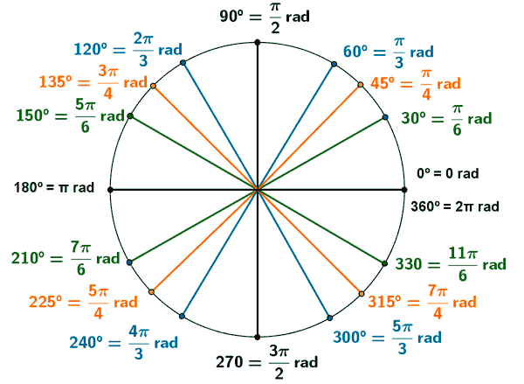
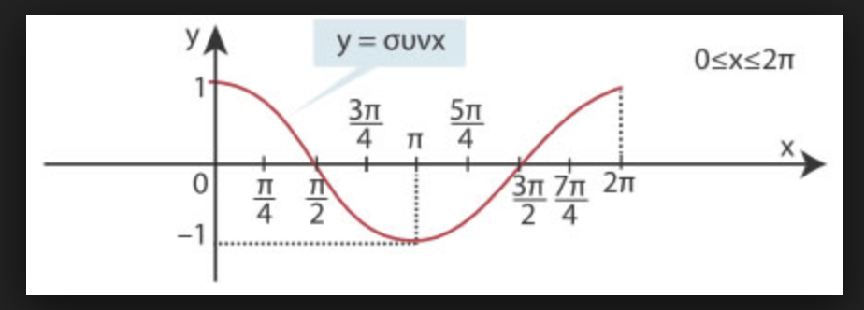

Slide 25
Ethical significance | Brain Proxies | Physiology | Conclusions
Anticorrelations | Inter-network connectivity | Inter-state dynamics
Anticorrelations and Consciousness
Anticorrelations reduce in intensity or are undetectable in :
unresponsive brain-damaged patients (Di Perri et al., 2016; Threlkeld et al., 2018)
hypnosis (Demertzi et al., 2011)
in deep anesthesia (Boveroux et al., 2010)
after sleep deprivation (De Havas et al., 2012; Yeo et al., 2015)
slow wave sleep and REM (Chow et al., 2013)
deep sedation (Luppi et al., 2019)
Anticorrelations recover:
at post-anesthetic period (Nir et al., 2020)
after emergence from a disorder of consciousness (Di Perri et al., 2016; Threlkeld et al., 2018).
Anticorrelations contribute to:
cognitive function (Keller et al., 2015; Vanhaudenhuyse et al., 2011),
greater intensity lead to better within-subject performance (Kucyi et al., 2017)
between-subject performance (Spreng et al., 2010).
life span
start weak in children, strengthen during adolescence, end up fully anticorrelated in young adulthood (Chai et al., 2014)
get selectively decreased during healthy aging (Keller et al., 2015)

