Slide 1
A vision-based correction of inertial measurement of human motion for robot programming by demonstration
Robin Pellois & Olivier Brüls
Aerospace & Mechanical Engineering Department,
Faculty of applied science
University of Liège, Belgium
ICARA, Online, February 18-20, 2022
Notes:
Good afternoon every one, i’ll present our work we made at university of Liege.

Slide 2
Plan
Context & problem
Method
Identifying POIs
Pairing POIs
Correcting trajectory
Experimental implementation
Setup
Tasks
Results
Conclusion & perspectives
Notes:
First i’ll explain the context and the problematique
Secondly i’ll present the method that is composed of 3 main parts
And then the experimental implementation of the method

Slide 3
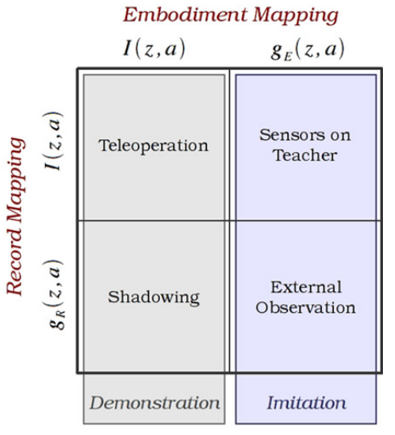
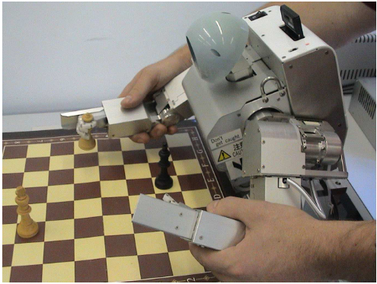
Context & problem
Programing by Demonstration (PbD) aims at transmitting a task to a robot from demonstrations.
Acquiring a demonstration
Easy to use
not limiting human motion
Objective : Develop a method to acquire human demonstrations that is not limiting and easy to implement.
S. Calinon, F. Guenter, A. Billard. On learning, representing, and generalizing a task in a humanoid robot, EEE Transactions on Systems, Man, and Cybernetics, Part B: Cybernetics, 37, 286-298, 2007, 10.1109/TSMCB.2006.886952
B. D. Argall, S. Chernova, M. Veloso, B. Browning, A survey of robot learning from demonstration, Robotics and Autonomous Systems, 57 (5) (2009) 469–483. doi:10.1016/j.robot.2008.10.024.
Notes:
Programming by demonstration (or imitation learning , learning by imitation or learning from demonstration …) is a robotics research field that aims at transmitting a task to a robot from demonstration made by a human.
One of the first challenge is then to be able to acquire a human demonstration. However, PbD aims to facilitate robot programming. The acquiring method should then be easy to use. And furthermore it should not limit human motion in order to be able to transmit any kind of tasks.
One of the most spread method is kinesthesy. In kinesthesy, the human move the robot to make it execute the task. The task is then recorded through robot encoders. It is easy to use since no mapping is necessary between recorded data and data used by robot to reproduce the task. However, it could limit human motion, for instance, in a painting task when dexterity is required.
The demonstrations where the human can move freely are usually gathered under the category of external observation. But in that case mappings are necessary and can be difficult to identify.
The objective is to have a method to acquire human demonstrations that is not limiting and is easy to implement

Slide 4
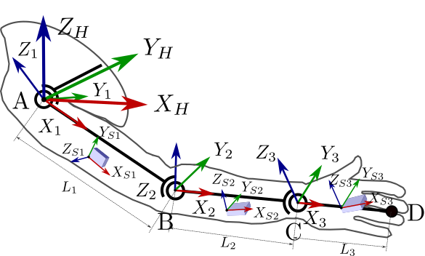
Context & problem
Inertial human measurement :
Human arm model :
3 spherical joints
segment length measured on human
Unkwon sensor positioning
Inertial-to-segment procedure before demonstration
Mean error between 28,5 mm and 61,8 mm
Too high for PbD
Error from measure sensor error and human behavior
Notes:
We started with inertial sensors for their easiness of use, lightness , low cost … and so on. They can even be inserted into clothes.
We developed a method to measure human hand trajectory from these senors. This is not the purpose of the presentation here.
However, the level of accuracy reached is too high for PbD due to the sensors and more importantly the human behaviour and biomecanics complexity.

Slide 5
Context & problem
Complementarity of inertial and vision measurement :
Objective : merging complementary inertial human measurement with vision-base environment measurement for human demonstration applications in a PbD context.
Inertial human measurement | Vision environment measurement
Undisturbed flow of data | Disturbed flow of data (concealment)
Low accuracy | High accuracy
High acquisition frequency | Low acquisition frequency (high frequency has heavy computational cost)
Notes:
Since it is quite complicated to measure human motion, and to keep advantages from inertial sensors, we came up with the idea of merging vision measurement of the environment with inertial measurement of human hand trajectory.
These two measurement are quite complementary.
The problem adressed in this work is how to merge inertial human trajectory with environment measurement by vision.

Slide 6
Method
Position Of Interest : POI:
Identifying POIs
Pairing POIs
Correcting trajectory
Method explained in a context of pick and place:
Inertial = hand
Vision = object
Notes:
We proposed a method that is based on Position of Interest (POIs).
A POI is a spatial position P that last from s to e.
The idea of the method is that the same level of accuracy is not necessary all allong the trajectory.
The inertial estimation of the human hand trajectory can be corrected by vision data only at some precise moment.
The method has 3 steps :
First, POIs are identified in both inertial and vision data
Secondly, POIs that correspond to the same action during the task are associated.
Third, according to the paires, the inertial trajectory is corrected.
The method is explained in a context of Pick and Place. The vision measurement of environment consists on tracking the objects.

Slide 7
Method – Identifying POIs - Vision
Clustering :
Scaling data
DBSCAN algorithm :
POIs creation :
Merging redundant POIs
Or
=>
Notes:
The data being different, the method for POIs identification is slighly different for vision or inertial data.
The DBSCAN algorithm is applied on scaled vision data to identify clusters. To each cluster a POIs is created.
Then some POIs are merged if they correspond to the same action.

Slide 8
Method – Identifying POIs – Inertial
Clustering :
Scaling data
DBSCAN algorithm :
DBSCAN algorithm :
POIs creation :
Notes:
For inertial data the method is a bit more complexe because the data are more noisy.
First a set of POIs is created using DBSCAN algorithm with different value of the parameter epsilon.
Secondly the DBSCAN algorithm is applied again but on the set of POIs. POIs belonging to the same cluster are merged.
This lead to a more robust detection of POIs.

Slide 9
Method – Identifying POIs – Inertial
Merging / separation:
If
if
Merging:
if
if
Separation:
if
Separation:
Notes:
Afterwards, a post treatment is applied on hand POIs.
It consists on merging or separating POIs

Slide 10
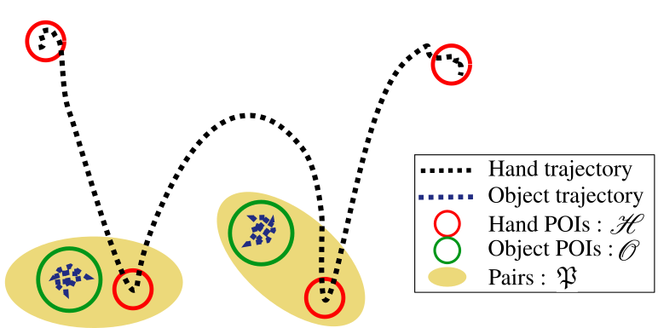
Method - Pairing
Sets of POIs :
Pairing = identifying
2 steps :
Iterative process to eliminate POIs not to be involved in pairs
Pairing remaining POIs
Notes:
The second step of the method consists on associating POIs from vision data to POIs from inertial data.
It is composed of 2 steps :
- Eliminating POIs that should not be involved in Pairs
- and then Pairing the remaining sets of Pairs.

Slide 11
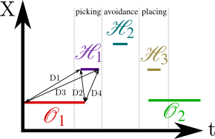
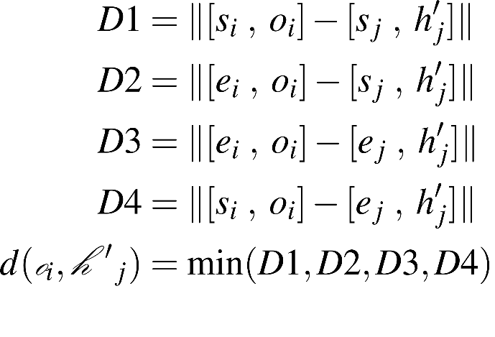
Method - Pairing
Iterative process to eliminate POIs:
Scaling as
Distance computation (for hand POIs here):
Elimination of POIS from based on
Until
Notes:
The iterative process of eliminating unwanted POIs requires a specific distance functions in order to compare object and Hand POIs.
POIs that should be associated should be spatially close and temporally close only by one boundary (s or e)

Slide 12
Method - Pairing
Assignement solved by Hungarian method :
Cost matrix :
Time distance :
Notes:
Once the two sets of POIs that should be involved in pairs are identified, the pairing boils down to an assignment problem.
It is solved thanks to the hungarian method with a cost matrix based on temporal distance

Slide 13
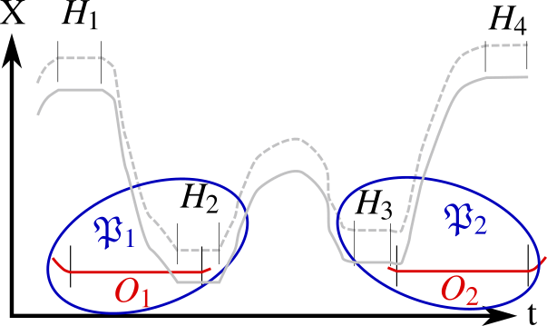
Method – Correcting
Global correction
Notes:
Finally, the inertial based trajectory is corrected.
The first step is a global correction. It consists on applying a transformation estimated from Pairs

Slide 14
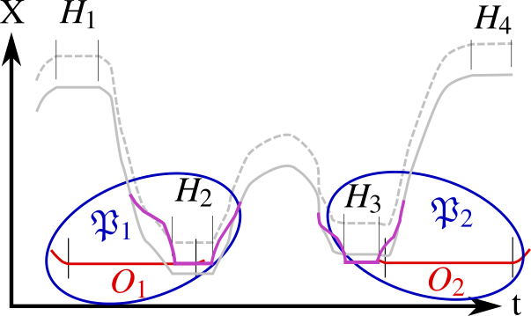
Method – Correcting
Local correction
Notes:
Then the inertial estimation of the hand trajectory is locally corrected in order to make it fit the exact object position measured from vision.

Slide 15
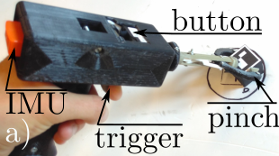
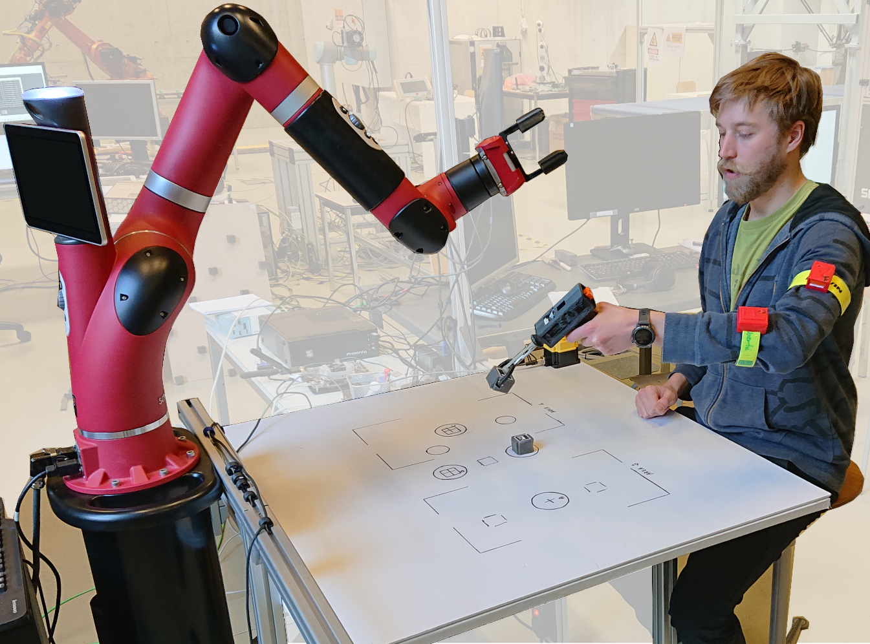
Experimental implementation
Setup:
Notes:
This method has been applied on a sawyer robot. The IMU used are the Xsens Awinda.
The manipulated object are 30 mm side cubes with ARUCO marker to easily track them since object detection is not the purpose here.
A gun shaped tool is used to limit finger disturbing motion in inertial estimation of hand trajectory.

Slide 16
Experimental implementation
Pick and place tasks:
Initial state
Final state
Notes:
We applied our method on 10 different pick and place tasks sometimes with picking and placing at same position, sometimes with a high amount of object or displacement or sometimes with object manipulated 2 times…
The success of an execution of the task by the rebot is measured by the positionning of the object in their final state.
The position of the object on the table are marked only to be able to replace object back to their initial stat for execution of the task by the robot.

Slide 17
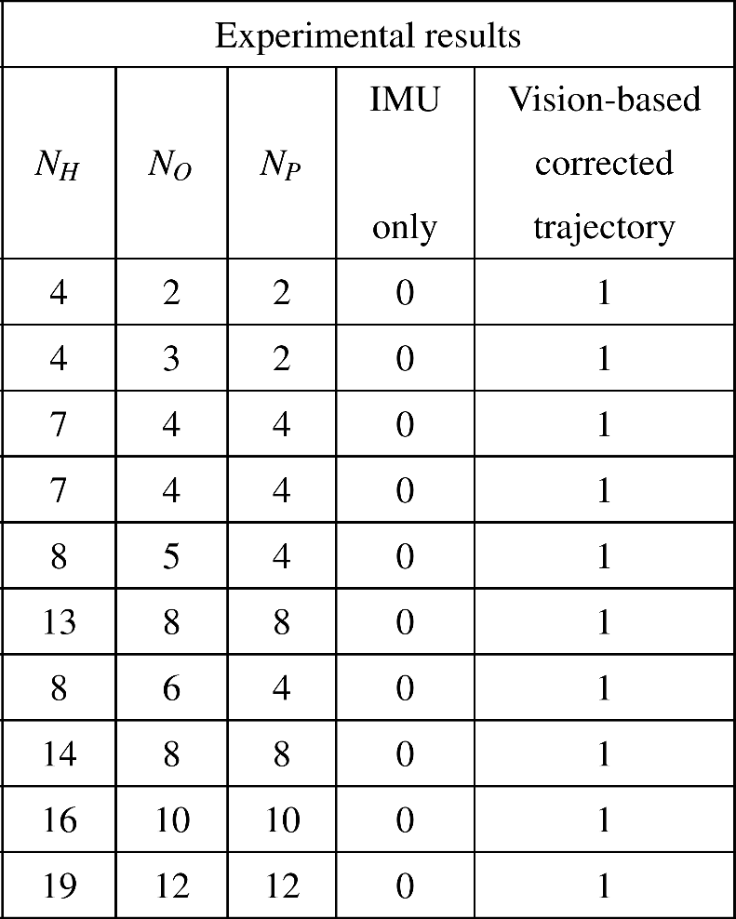
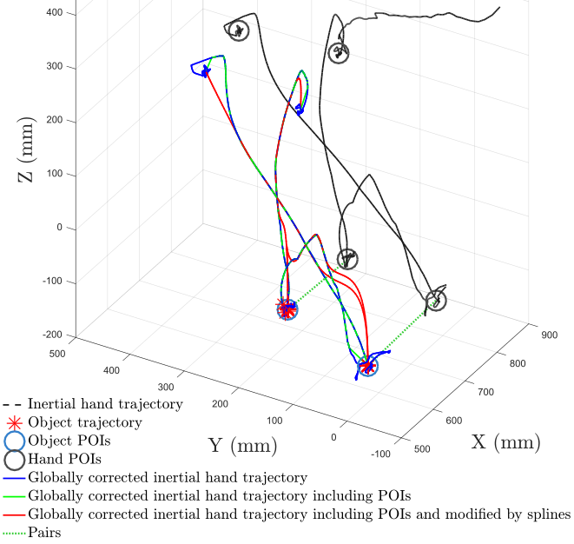
Experimental implementation
Results
Notes:
In all the 10 tasks, the robot succeed to execute the demonstrated task.
The right set of Pairs have been well identified.
( If time )
The figure on the left is a 3D representation of the task 1. It can be mentionned that the inertial trajectory is modified thanks to the POIs detected. The hand points that are with temporal boundary of a POI are replace by the spatial part of the POI.
It can be mentionned that event if a paires would be missing in a task with a large amount of pairs like for task 12; the global correction might be enough to succeed in the execution.

Slide 18
Conclusion & perspectives
Results show the proposed method is suitable for PbD since the robot successfully reproduce the task.
The experimental implementation validates the easiness of use required in PbD.
Better understand parameters and find better way to define the values
Test the method in another context :
tracking tools
other applications than pick and place
Application where kinesthesy fails (e.g. painting, large robot … )
Better robustness with other variables such as gripper state.
Notes:
The easiness of use seems respected and the robot succeed to reproduce the tasks.
So in this context of pick and place, our method would then be suitable for PbD application.
However, A lots of parameter are involved. Even if some are similar because of the scaling, reducing the amount or better understand them would be interesting.
The proposed merging method need to be improved and tested in other context, but results presented here seem to validate the approach of merging inertial human motion measurement with vision based environment measurement for PbD.

Slide 19
Thank you
Notes:
Thank you for your attention.
If you have any question .

Slide 20
Scaling
Scaling:
G and sigma are computed from different data set.
Notes:
Scaled to compare in time and space equally

Slide 21
Method - Pairing
Iterative process to eliminate POIs:
Point set registration by Gaussian Kernel Correlation
Scaling as
Notes:
The iterative process of eliminating unwanted POIs has 2 steps:
Estimating and apply a transformation between hand POIs and Object POIs
Computing the d_mean value which quandtify the closeness of a POIs with the other set of POIs
Eliminating POIs with to high d_mean
Keep iterating until the the two sets of Hand and Object POIs have the same size.

