Slide 1
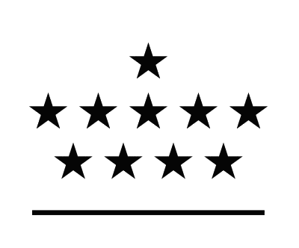

Dep4 Seminar :
Long-term evolution of large-scale magnetic structures on USET images
ROYAL OBSERVATORY
OF BELGIUM
PhD student : Grégory VANDEN BROECK
ROB Supervisors
Frédéric CLETTE
Sabrina BECHET
ULiège Supervisor
Gregor RAUW

Slide 2

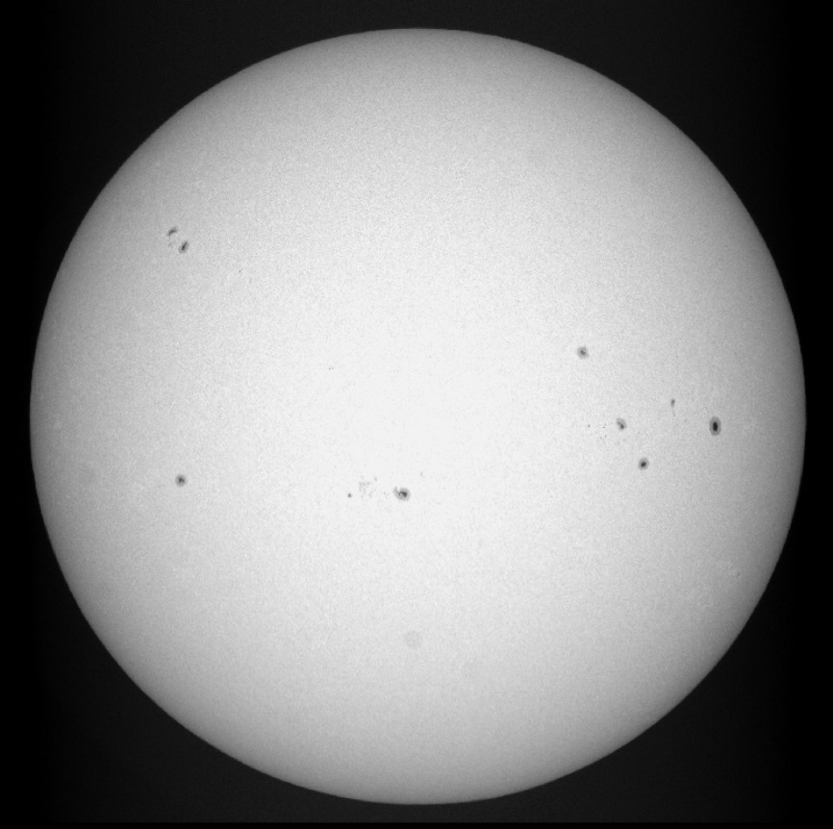
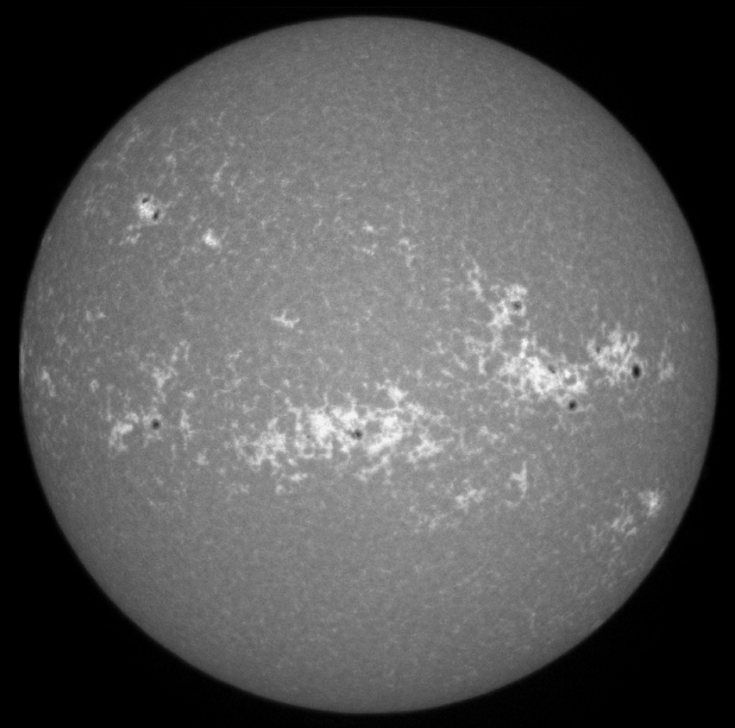
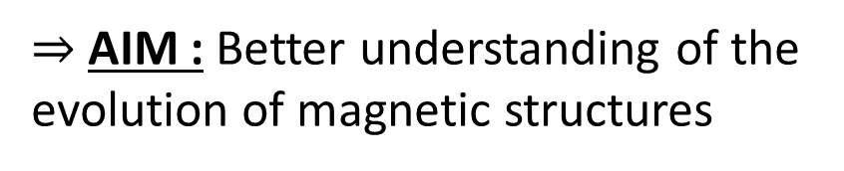
1. Summary
$⇒$ AIM : Better understanding of the evolution of magnetic structures
PHOTOSPHERE
CHROMOSPHERE
Insight in sub-photospheric processes
Understanding of global solar irradiance evolution
Deciphering similar mechanisms in other sun-like stars
Sunspots groups
Bright plages
http://sidc.oma.be/uset/searchForm.php

Slide 3
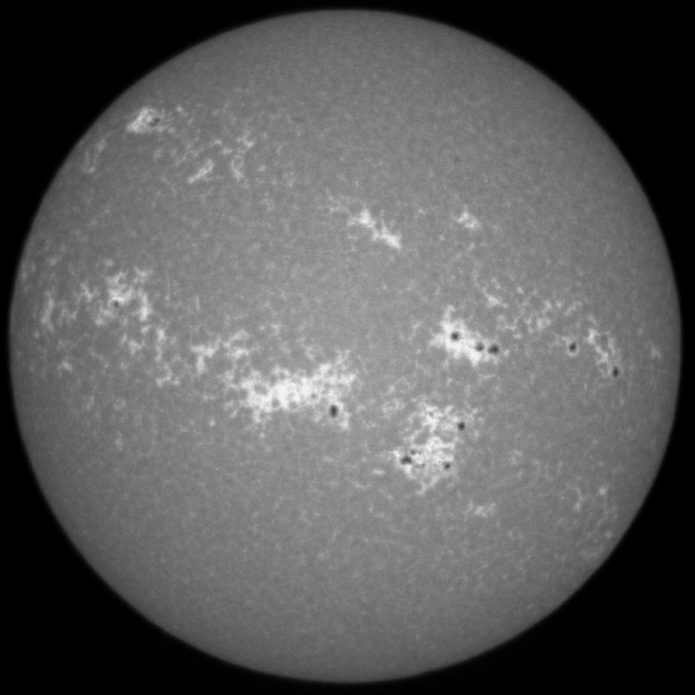
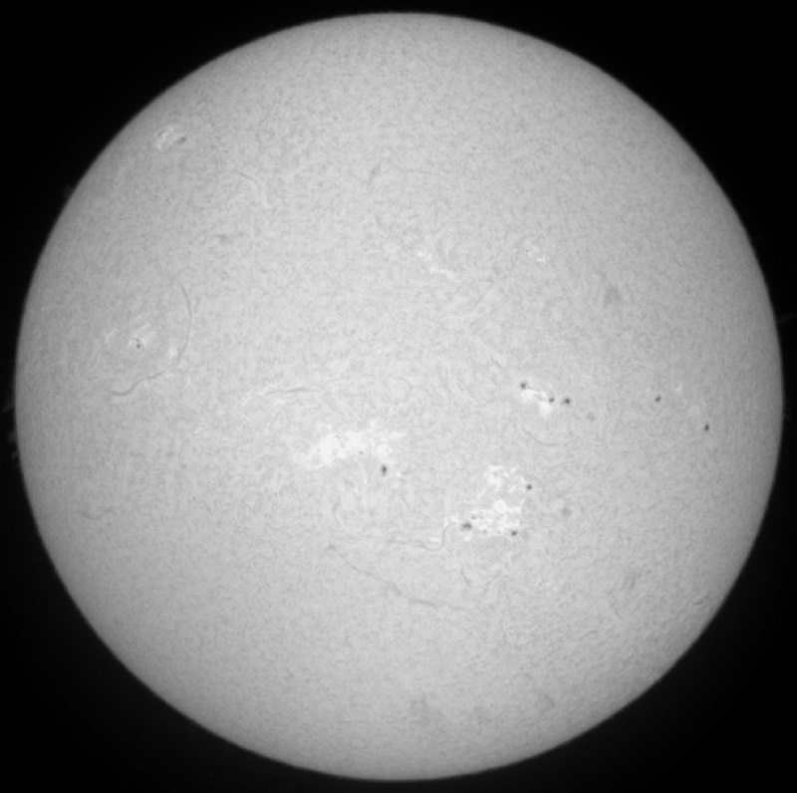
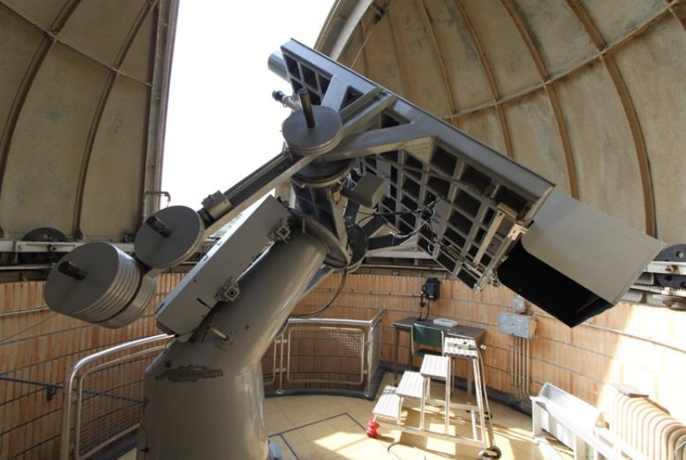
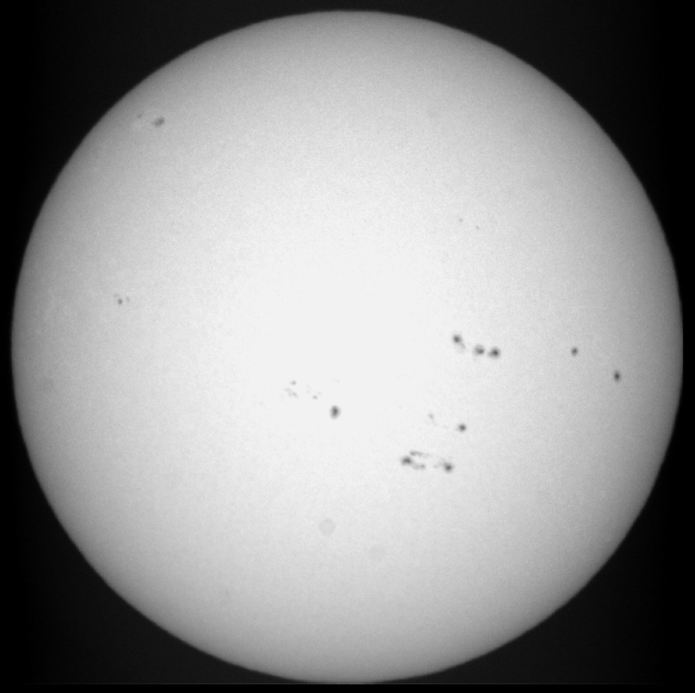
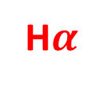
2. Objectives
USET
« Uccle Solar Equatorial Table »
Ca II K
H$α$
Chromosphere
White light
Photosphere
http://www.sidc.be/uset/usetpres.php
http://sidc.oma.be/uset/searchForm.php

Slide 4
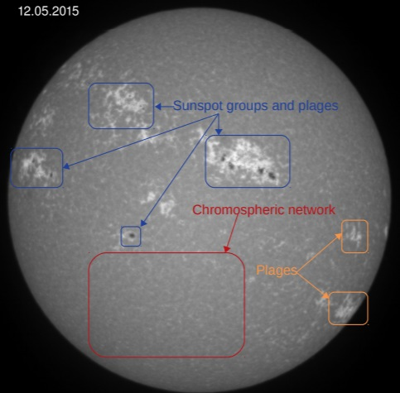
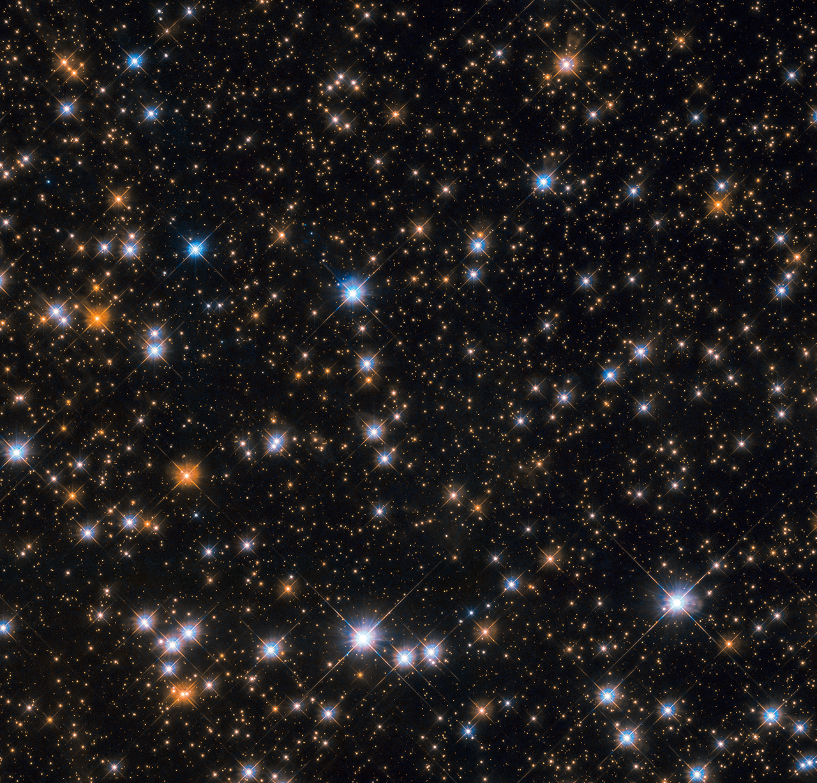
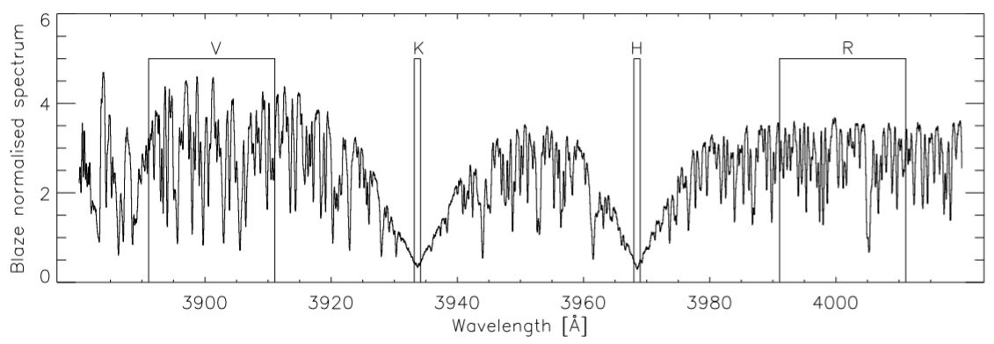

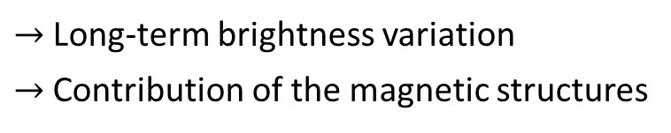
2. Objectives
1) Chromosphere
http://sidc.oma.be/uset/searchForm.php
https://www.nasa.gov/image-feature/goddard/2019/hubble-spots-flock-of-cosmic-ducks
Global intensities
Ca II K
COMPARED TO
Spectral measurements
Mittag, et al. 2016, A&A, 591, A89
$→$ Long-term brightness variation
$→$ Contribution of the magnetic structures
$→$ « Sun seen as a star »

Slide 5
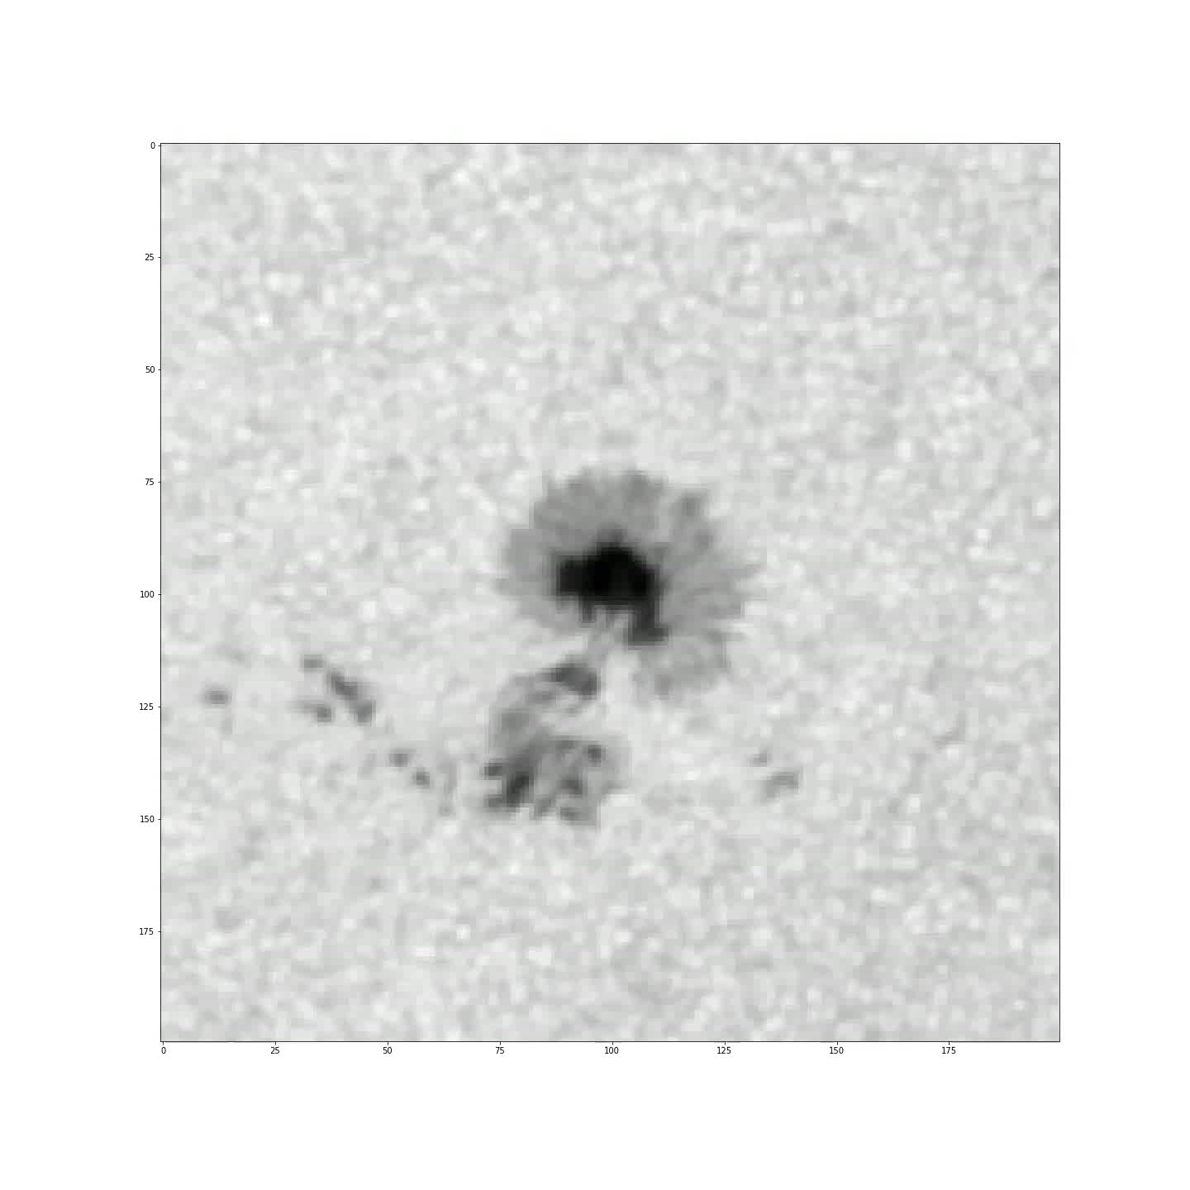
2. Objectives
2) Photosphere
Sunspot proper motion
http://sidc.oma.be/uset/searchForm.php
Suivi d'un groupe pendant deux jours (28.03.2014 -> 29.03.2014). Source images : HMI (satellite SDO)

Slide 6
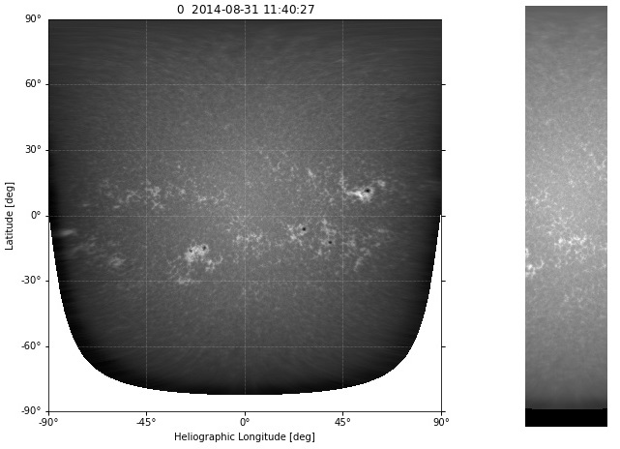

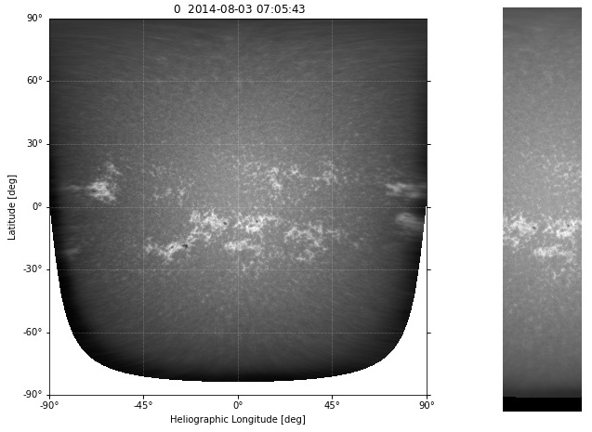
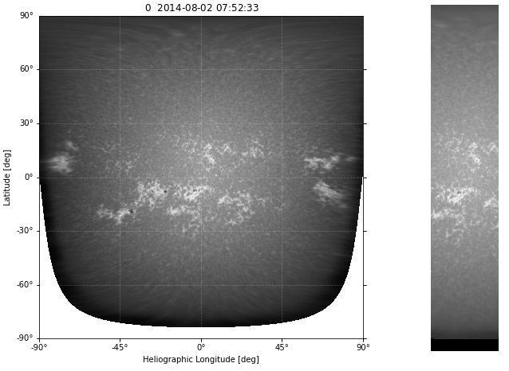
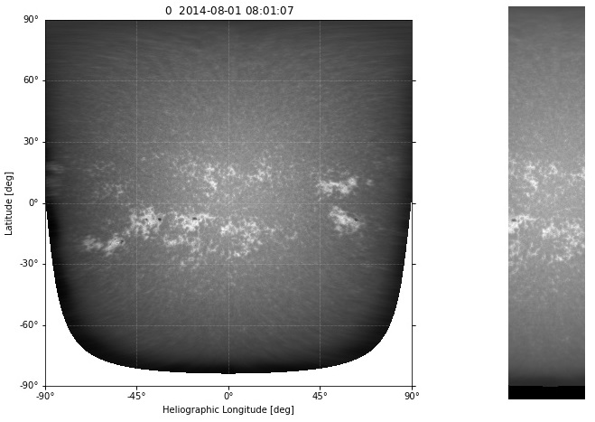
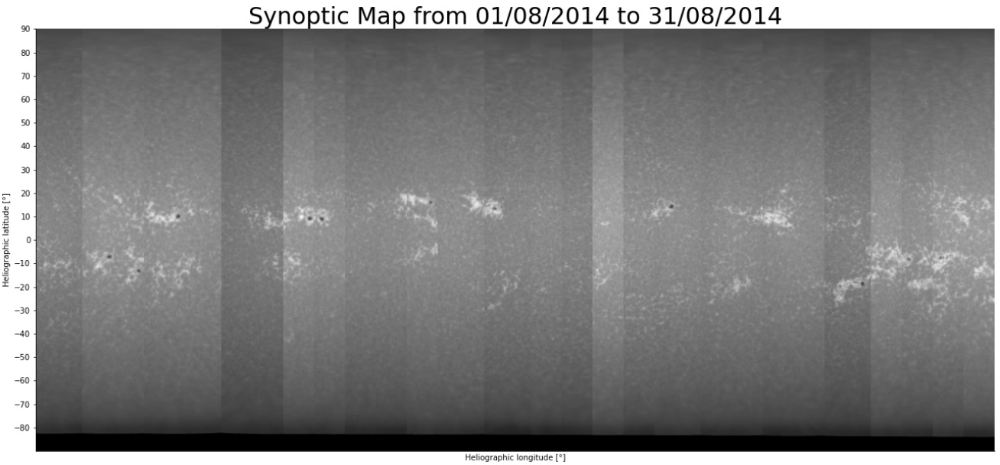
3. Progress and results
1) Construction of synoptic maps
…

Slide 7
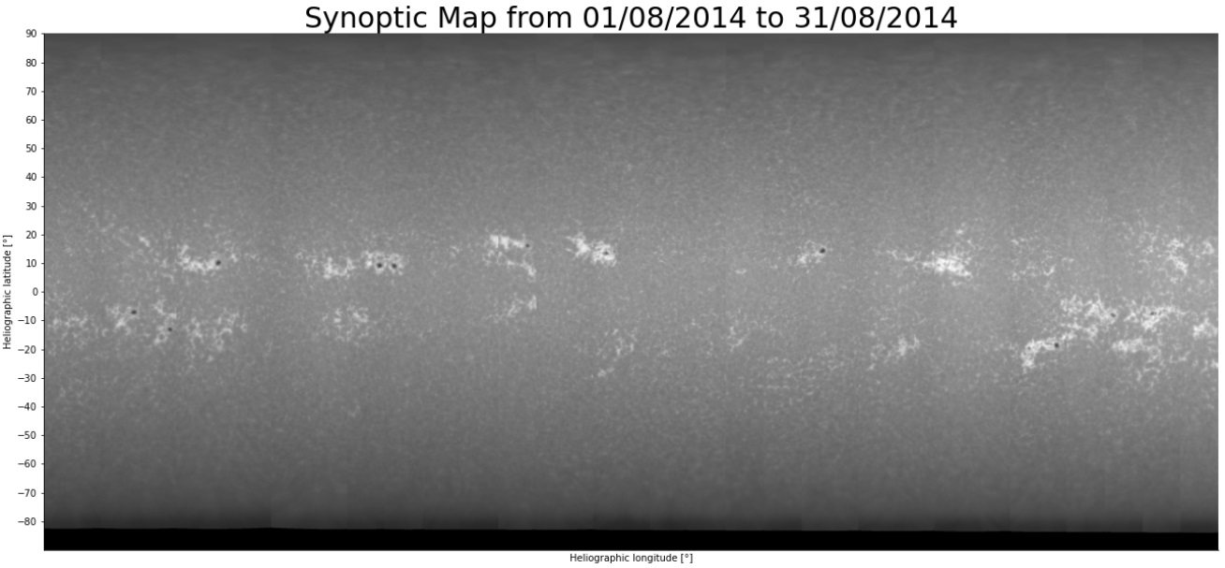
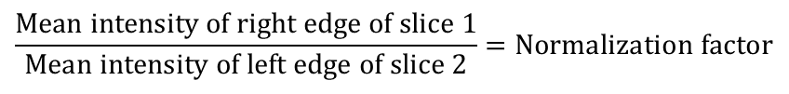
3. Progress and results
1) Construction of synoptic maps - Normalization
Assumption
$$\frac{\text{Mean} \text{intensity} \text{of} \text{right} \text{edge} \text{of} \text{slice}\text{ 1}}{\text{Mean} \text{intensity} \text{of} \text{left} \text{edge} \text{of} \text{slice}\text{ 2}}=\text{Normalization} \text{factor}$$
Testing other ways to normalize

Slide 8
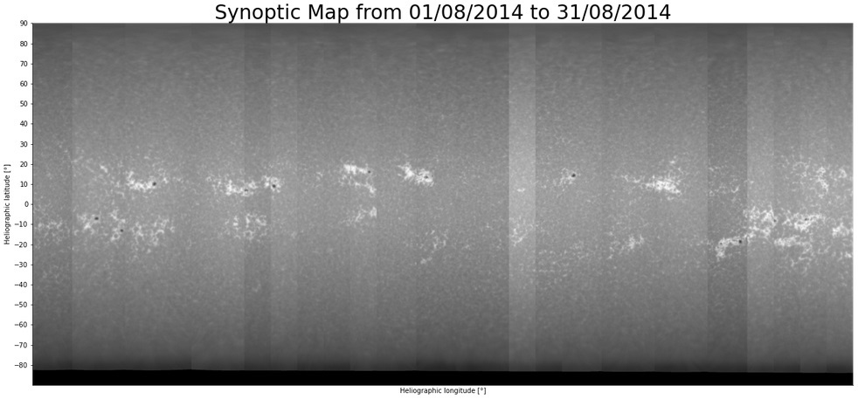
3. Progress and results
1) Construction of synoptic maps - Normalization
OTHER WAYS
Dividing by the maximum intensity
Dividing by the 98th percentile of all intensities
Using the CLV correction and dividing by the maximum intensity
Using the CLV correction and dividing by the 98th percentile of all intensities

Slide 9

3. Progress and results
1) Construction of synoptic maps - Normalization
OTHER WAYS
Dividing by the maximum intensity
Dividing by the 98th percentile of all intensities
Using the CLV correction and dividing by the maximum intensity
Using the CLV correction and dividing by the 98th percentile of all intensities

Slide 10
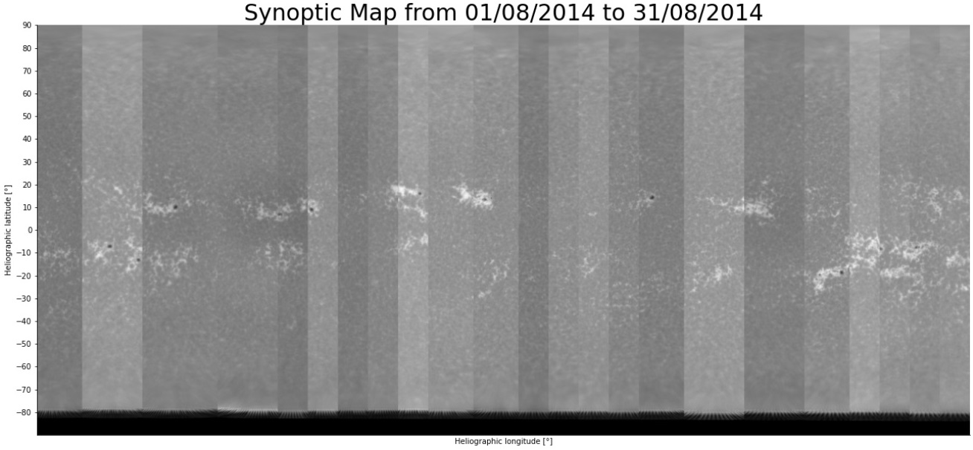
3. Progress and results
1) Construction of synoptic maps - Normalization
OTHER WAYS
Dividing by the maximum intensity
Dividing by the 98th percentile of all intensities
Using the CLV correction and dividing by the maximum intensity
Using the CLV correction and dividing by the 98th percentile of all intensities

Slide 11
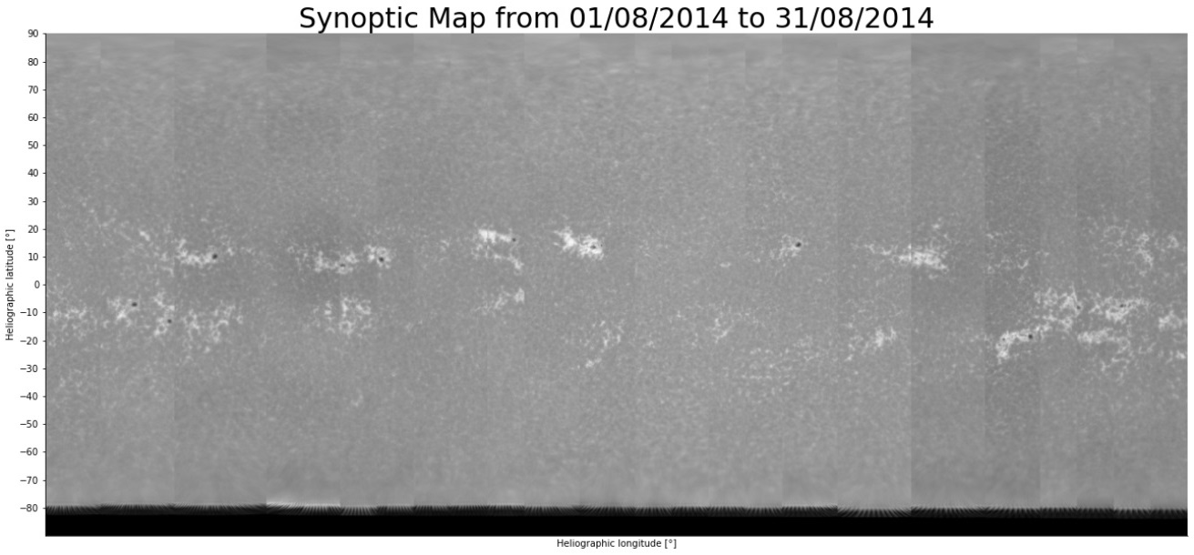
3. Progress and results
1) Construction of synoptic maps - Normalization
OTHER WAYS
Dividing by the maximum intensity
Dividing by the 98th percentile of all intensities
Using the CLV correction and dividing by the maximum intensity
Using the CLV correction and dividing by the 98th percentile of all intensities

Slide 12
3. Progress and results
2) Chromospheric structures segmentation
Plan :
Study the long-term brightness variation of the chromosphere in the Ca II K line
Goal :
Reach a better understanding of the different contributions of those structures
http://sidc.oma.be/uset/searchForm.php

Slide 13
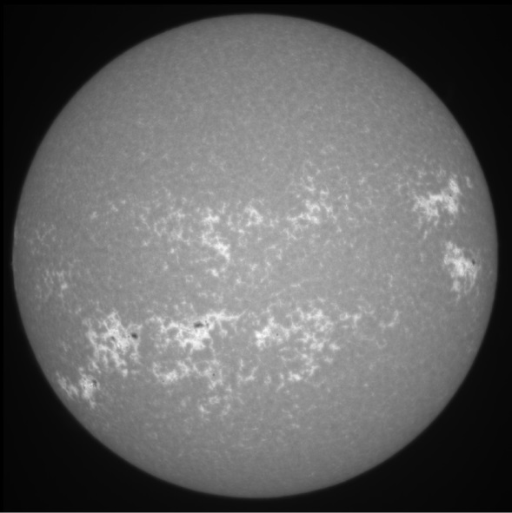
3. Progress and results
2) Chromospheric structures segmentation – CLV correction
Brighter at the center
Darker at the limb
Center-to-Limb
Variation

Slide 14
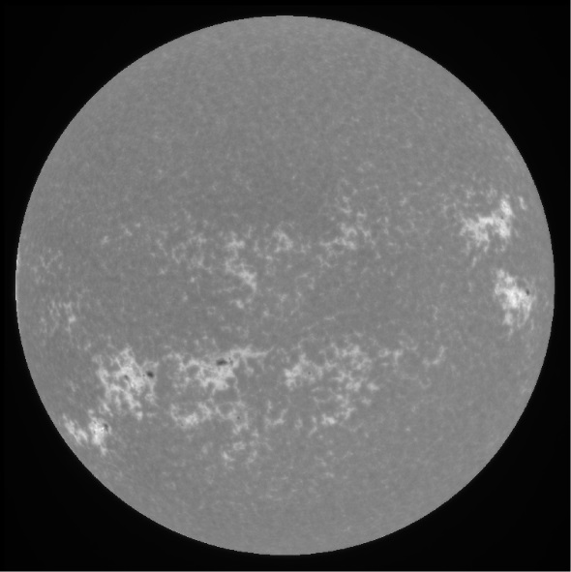
3. Progress and results
2) Chromospheric structures segmentation – CLV correction
AFTER CLV
CORRECTION

Slide 15
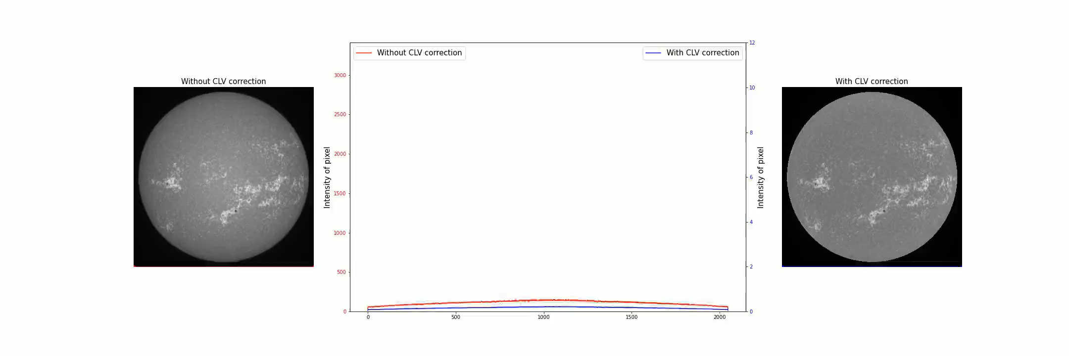
3. Progress and results
2) Chromospheric structures segmentation – Thresholding

Slide 16
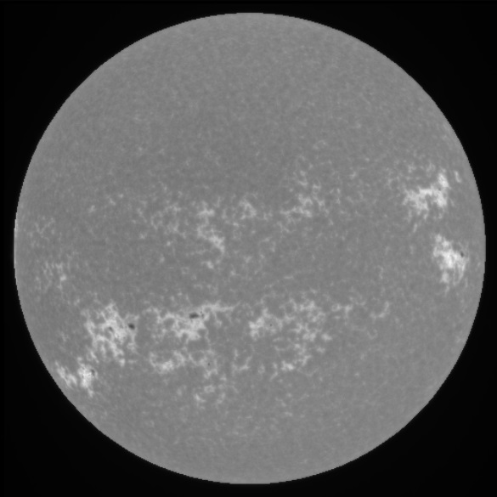
3. Progress and results
2) Chromospheric structures segmentation – Thresholding
Bright plages

Slide 17
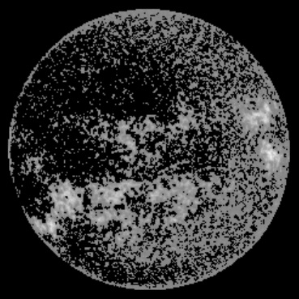
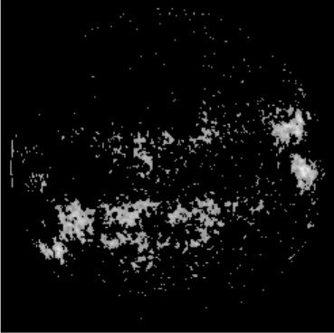
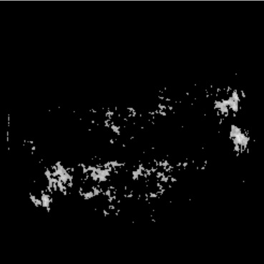
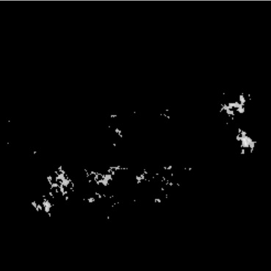
3. Progress and results
2) Chromospheric structures segmentation – Thresholding
Mean intensity
90th percentile
95th percentile
98th percentile

Slide 18
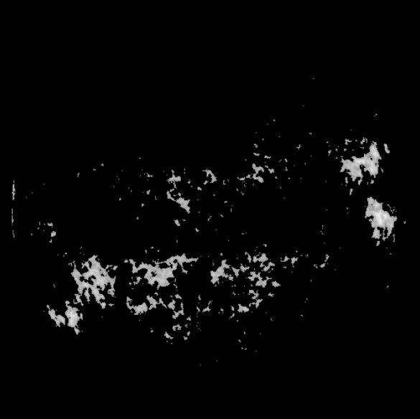
3. Progress and results
2) Chromospheric structures segmentation – Thresholding
Threshold
95th percentile

Slide 19
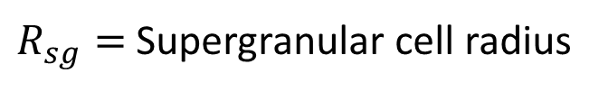
3. Progress and results
2) Chromospheric structures segmentation – Thresholding
$R_{sg}=$ Supergranular cell radius
Not plages
Solution :
Using the size of supergranulation

Slide 20

3. Progress and results
2) Chromospheric structures segmentation – Thresholding
Not plages
FINAL
RESULT

Slide 21
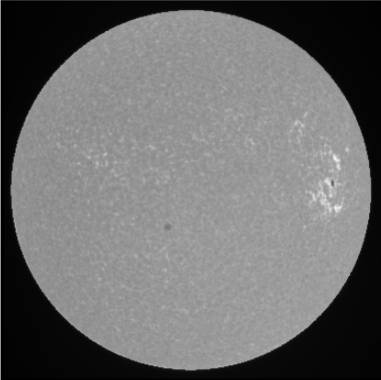
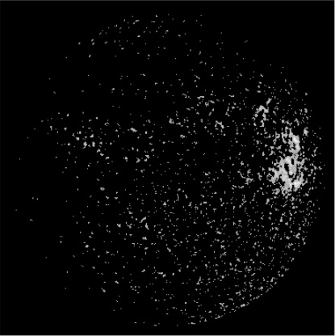
3. Progress and results
2) Chromospheric structures segmentation – Thresholding
Few « single » pixels remaining
High level of activity
Lots of « single » pixels remaining
Low level of activity

Slide 22
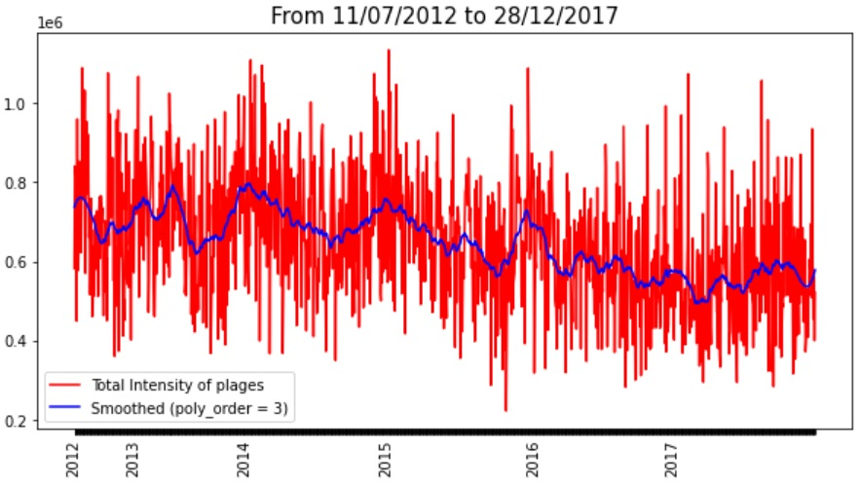
3. Progress and results
2) Chromospheric structures segmentation – Plages intensity
FROM 2012
Plages intensity
TO 2017

Slide 23
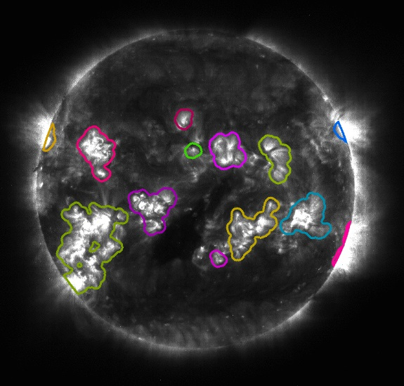
3. Progress and results
2) Chromospheric structures segmentation – SPoCA
SPoCA = algorithm to segment Extreme Ultra Violet (EUV) images
Fuzzy clustering algorithm
Segmentation of 3 different classes :
  Quiet Sun
  Active regions
  Coronal holes
Idea : Using SPoCA for USET Ca II K images
http://sdoatsidc.oma.be/web/sdoatsidc/SoftwareSPoCA

Slide 24
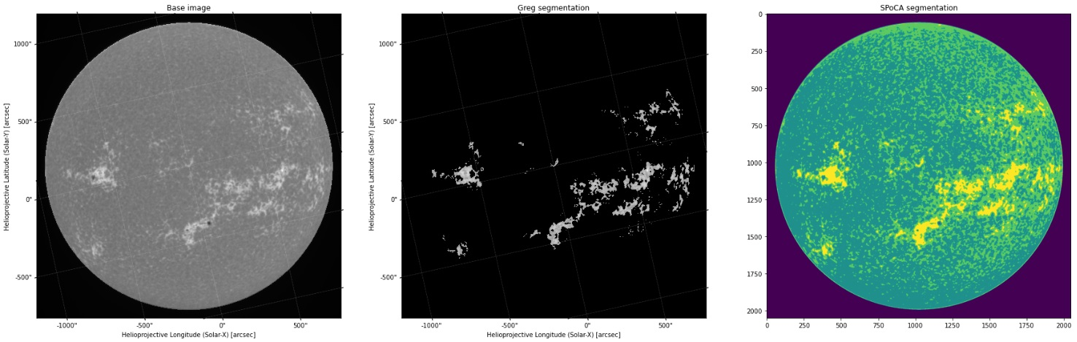
3. Progress and results
2) Chromospheric structures segmentation – SPoCA
Base image
My algorithm
SPoCA algorithm

Slide 25
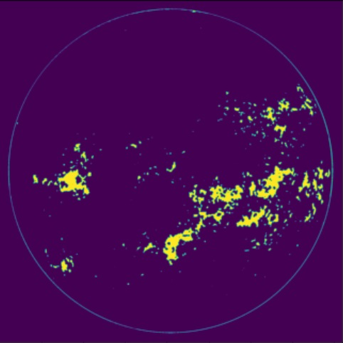
3. Progress and results
2) Chromospheric structures segmentation – SPoCA
Base image
My algorithm
SPoCA algorithm

Slide 26
4. Next steps
Synoptic maps and Sun seen as a star | Chromospheric structures segmentation
Inclination effect on the observed Ca II K emission at a given time Study the brightness variation as seen from any viewing angle during a solar cycle | Contribution of chromospheric structures to the long-term brightness variation Improve segmentation algorithm for different activity level Compare my algorithm with SPoCA Compare the intensity of chromospheric structures with the solar irradiance Study the specific contribution of plages

Slide 27
5. End
Thank you for your attention !

