Slide 1

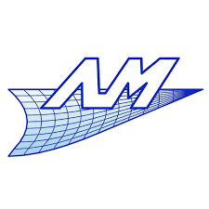


New concepts of lightweight gearbox rear covers made of aluminum and plastic using multi-material topology optimization
Ioanna Koutla*, Pierre Duysinx*, Michael Bruyneel**, Julie Jossieaux**, Philip Eyckens***, Carlos Lopez***
*University of Liège, Aerospace and Mechanical Engineering Department, Liège, Belgium
**GDTech SA, Liège, Belgium
***Flanders Make, Leuven, Belgium
source: © sdecoret / www.fotolia.com
Notes:
Hello, my name is Ioanna Koutla and I am an engineer at the University of Liège in the department of Aerospace and mechanical engineering, more specifically in the automotive engineering group, under the supervision of Prof. Duysinx. Today I am going to present our recent work on a new concept of a gearbox rear cover made of aluminium and plastic, using multi-material topology optomization as a tool.

Slide 2
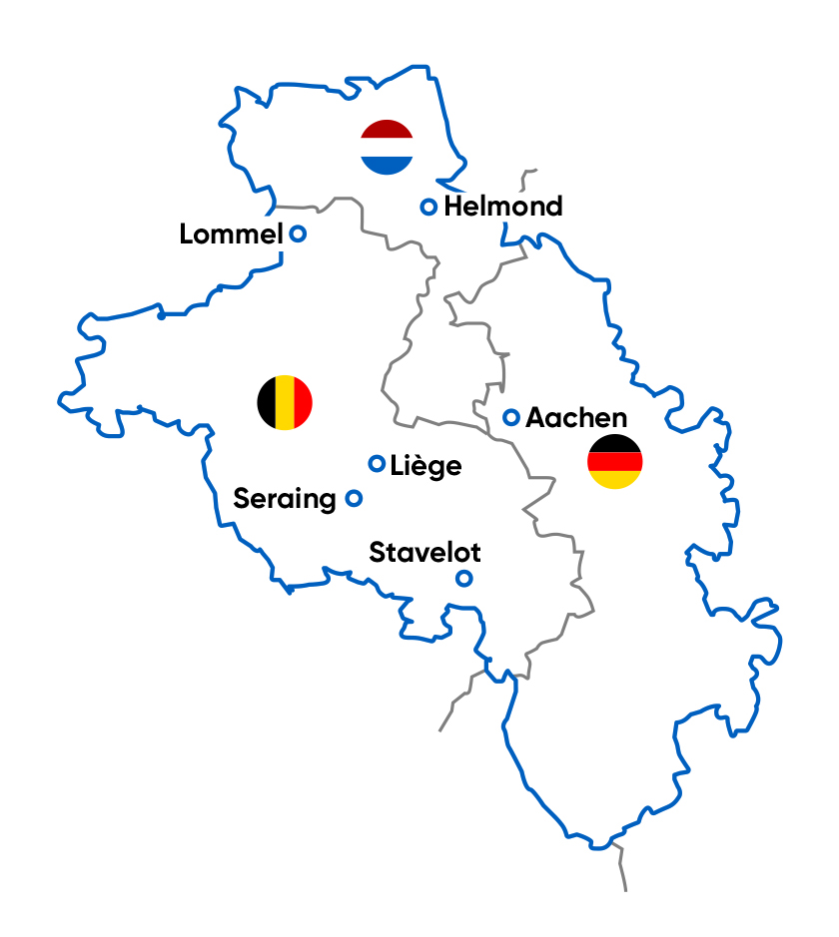


LightVehicle 2025 project
‘Light Vehicle 2025’ is an EU-funded Automotive cross-border project (by Interreg) in the Euregio Meuse-Rhine
Project Objective
Create demonstrators with a weight & CO2 emissions reduction of at least -25%.
Enhance cross-border cooperation of companies all along the value chain.
Project Partners
Co-Financers
Notes:
- This work was part of the Light Vehicle 2025 project which is an EU-funded cross-border project (by Interreg) in the Euregio Meuse-Rhine region, which contains the east of Wallonia and Flanders in Belgiumthe province of Noord-Brabant in the Netherlands and North-Rhine Westphalia in Germany.
- The project’s objective was to create demonstrators with weight and CO2 emissions reduction of at least -25%. In order to achieve that the cross-border cooperation of companies all along the value chain was indispensable and that fulfilled the second objective of the project.
- Five partners worked on this project for 3 years, Flanders Make who led the project, Automotive NL from Netherlands, the University of Liège and Technifutur for Wallonia in Belgium and AMAC for Germany. Several co-Financers contributed to the realization of this project and they are mentioned here.

Slide 3
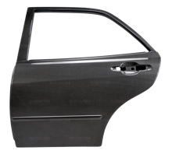
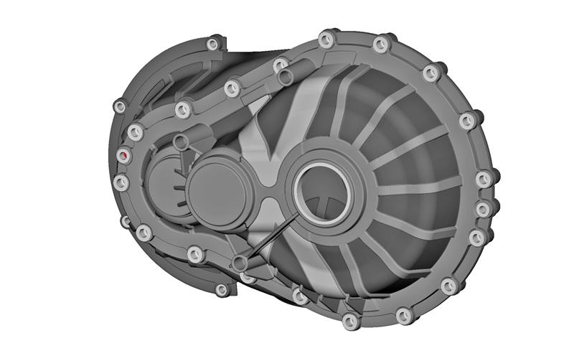

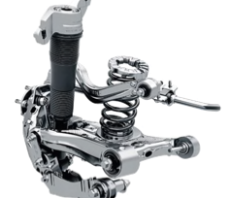
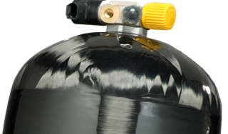
Light Vehicle 2025 Demonstrators
Body
e.g. lightweight door
E-Powertrain
e.g. gearbox housing
Suspension
e.g. anti-roll bar
Energy storage
H2 tank
Notes:
Four demonstrator projects were chosen and the respective woking groups with the participation of companies were created. The demonstrators contained the new conception of a lightweight door, a gearbox housing, an anti-roll bar and a tank for the storage of H2.

Slide 4
Table of contents
Presentation of the case study
Multi-material topology optimization
Multi-blocks topology optimization
New approach: Selection of the optimization domaine using a T-spline as support
New concept for the case study based on TO results
Manufacturability aspects
Conclusions
Notes:
- First the case study will be presented. Then, different features of topological optimization, such as multi-material and multi-block, are studied.
A new approach will also be presented where the selection of the optimization domain was made by using a T-spline as a support.
After the presentation of the TO results the new concept of the case study will be presented, manufacturability aspects will be discussed and the work will close with the conclusions.
Multi-material topological optimization consists in a topological optimization between several materials, with or without the presence of a vacuum, multi-block topological optimization consists of a composition of topological optimizations where the choice between different materials (and vacuum) may differ from a sub-region to the other.

Slide 5
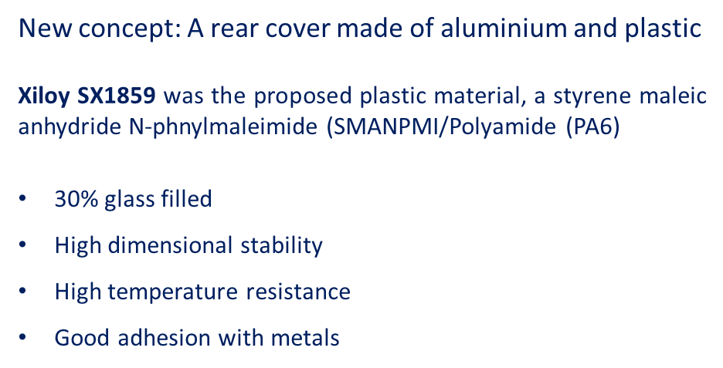


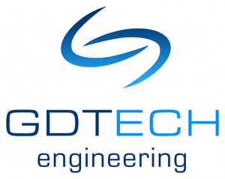



Gearbox rear cover demonstrator
Reference part made of aluminium
Initial weight = 11.7kg
Demo consortium
Notes:
- The demonstrator project of a gearbox rear cover was led by the university of Liège.
- The gearbox cover is usually made of aluminium and produced by die casting. We thought that it would present great interest to try and approach a new concept of a cover made of aluminium and some kind of plastic, in order to reduce its weight.
- A simplified version was used as reference part, using a geometry that was available free online. Chamfers, fillets, holes, etc were not used as they unecessarily complicate the mesh.
The initial weight of the reference part was 11.7 kg.
The plastic proposed for the application by the company Polyscope is the Xiloy SX1859, a material with high dimensional stability, high temperature resistance and good adhesion with metals.
Finally, the consortium of companies who worked together is presented here, companies all along the value chain are contained, from engineering to injection molding simulation and prototyping.

Slide 6
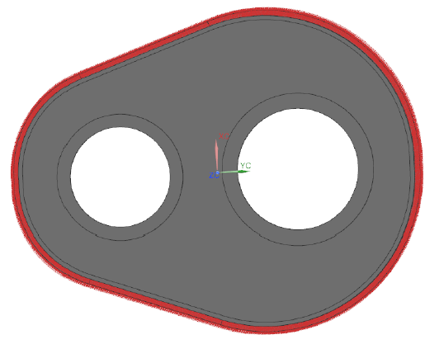
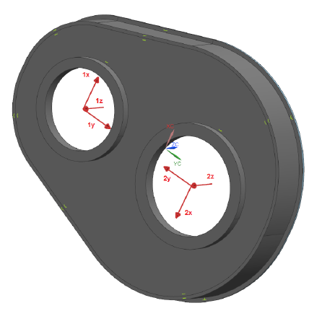
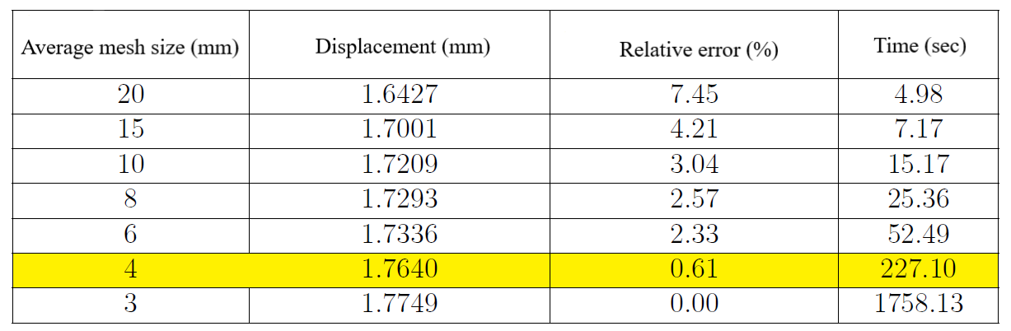
Convergence study for model preparation
Representation of the fixed constraint
Representation of applied forces
Notes:
- The part is fixed all around the flange that is used for the assembly of the two housings of the gearbox, so all the degrees of freedom are blocked.
A single case of general loading is studied in this work. There is a torque that is taken into account in the directions and intensity of the forces as presented here.
- A hexahedral mesh was used, for better quality of elements and better visualization of the results of topological optimizations.
- A convergence study was performed to determine a sufficiently converged mesh in order to get correct results. The first mesh admitting an error of less than 1% is selected, i.e. the one corresponding to an average mesh size of 4mm. Calculation time for a static analysis linked to this average mesh size remains acceptable, less than 4 minutes.

Slide 7
Presentation of the case study
Multi-material topology optimization
Multi-blocks topology optimization
New approach: Selection of the optimization domaine using a T-spline as support
New concept for the case study based on TO results
Manufacturability aspects
Conclusions

Slide 8
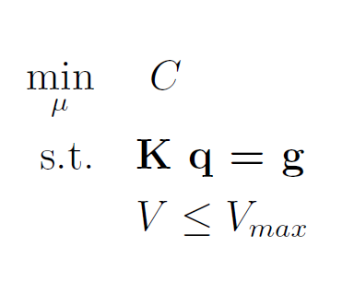

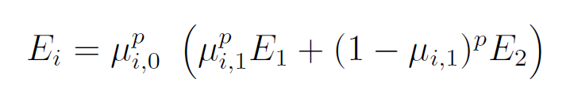



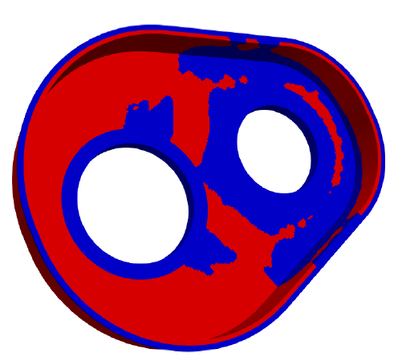
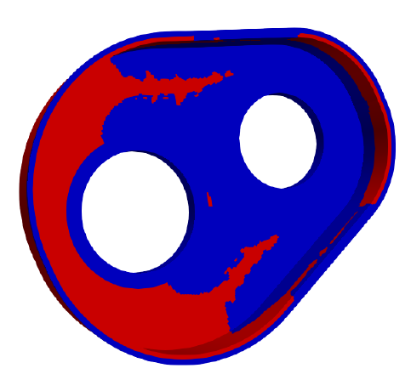
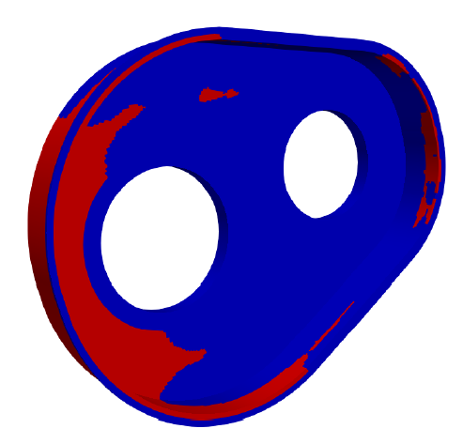
Multi-material topology optimization
(1)
aluminium
plastic
30%aluminium/70%plastic
50%aluminium/50%plastic
70%aluminium/30%plastic
Notes:
First, multi-material topology optimization was performed. An extension of topological optimization to multi-material is defined by introducing a new design variable by element. Indeed, just like in a topological optimization between a material and void, a design variable such as a pseudo-density defines the presence or absence of material. The second variable then introduced is used to select the material of the element considered among the different authorized materials. The two design variables described above can still be penalised according to equation 1.
Several topological optimizations between aluminium and plastic were carried out with the aim of minimizing compliance in all cases. The only difference between these optimizations lies in the volume constraint, ie the maximum percentage of aluminium required.
In the results three optimizations are shown where the quantity of aluminium starts from 30% and increases to 50 and 70% respectively. As it can be observed the algorithm favors greater stiffness, localized around the small bearing housing, where the forces are greatest. When the authorized quantity of aluminium is gretaer than the quantity ecessary to correctly stiffen the small bearing housing, the optimization then promotes the junction between the two bearings and ends, when the quantity of aluminium is important, by stiffening the surroundings of the large bearing housing.

Slide 9
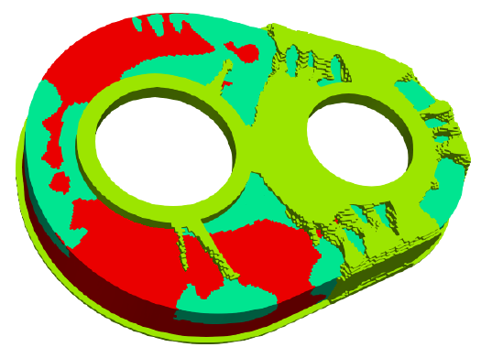
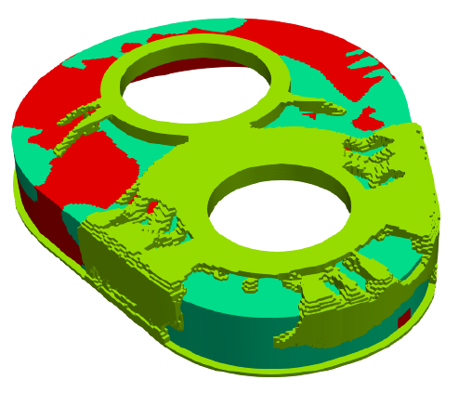
Multi-block topology optimization
Aluminium
Plastic
Aluminium
Void
Block nº1/Inner layer
Block nº2/External layer
aluminium
aluminium
plastic
Offers the necessary sealing against oil leakage
Inner layer: aluminium/plastic (50/50%)
External layer: aluminium/void (20/80%)
Notes:
We continue with multi-block topology optimization. It consists of a composition of topological optimizations where the choice between different materials (and void) may differ from a sub-region to the other.
In our case Block 1, which is actually the inner layer, consists of aluminium and plastic which ensures that there can be no oil leakage.
Then on Block 2, which is the external layer, excess thicknesses are defined as optimization zones between the aluminum and void to obtain stiffeners and stiffen the structure.
Concerning the Block 1 we observe already a difference comparing with the multi-material optimization of 50-50% that we saw previously. As shown in the circled area there is presence of aluminium near the big bearing housing whereas in multi material optimization that area was covered by plastic.

Slide 10
Presentation of the case study
Multi-material topology optimization
Multi-blocks topology optimization
New approach: Selection of the optimization domaine using a T-spline as support
New concept for the case study based on TO results
Manufacturability aspects
Conclusions
Notes:
In the next part a new approach will presented where the selection of the optimization domaine is done using a T-spline as support.

Slide 11
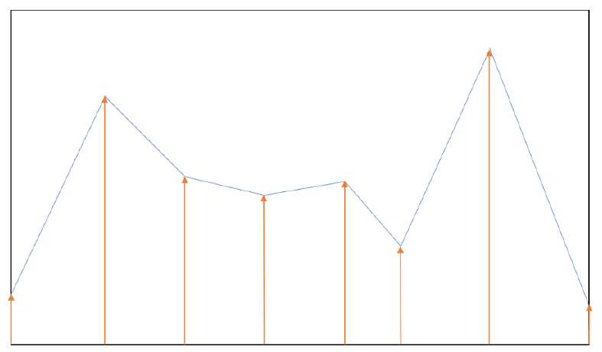
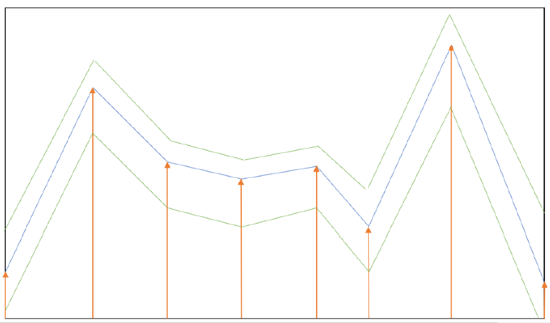
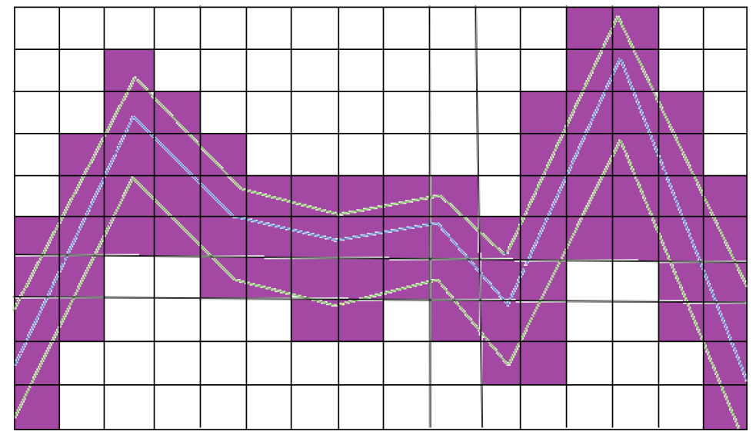
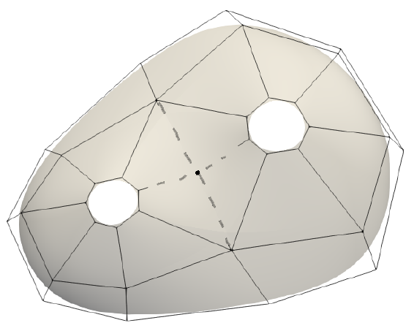
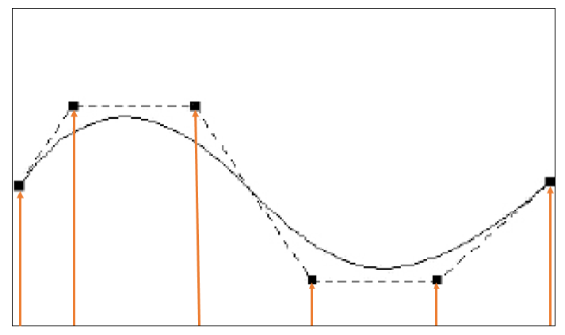
‘Level-sets’ method
(a)
(b)
(c)
The support used for the creation of level-sets is a T-spline
Optimization of the coordinates of the nodes of the T-mesh
T-spline surface generated by T-Mesh.
Notes:
In a bounded domain, defined in black in the first picture, which can admit the freest forms, we define a curve (in blue) such that shown in the diagram in the first picture. From this curve, we can build a level-set, represented with green in the second picture. The boundary of the geometry on which the different optimizations will be performed is then set using this level-set.
Concerning the mesh, the technique, chosen in this study, consists in considering an average position. This average position corresponds to the arithmetic mean of the coordinates of all nodes belonging to the element. If this average position is on the side where the elements are kept, the element remains activated while it is inactivated otherwise. In practice, all the elements in purple as shown in the third picture are concerned by the selection process.
The support used for the creation of the level-sets is a T-spline. A T-spline is defined by control points and the resulting advantage is that the representation of a complex surface requires less control points.
On the resulting domain, both form and topology optimizations can be carried out. The surface generated by this T-mesh is displayed in the last figure.

Slide 12
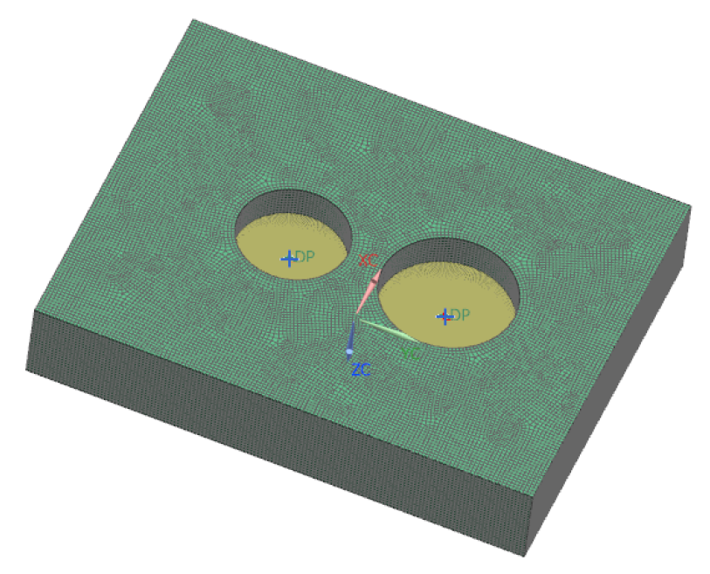
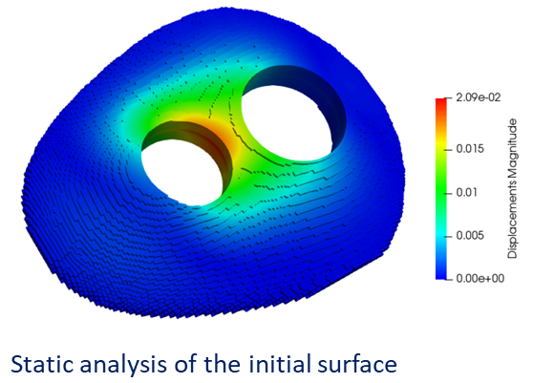
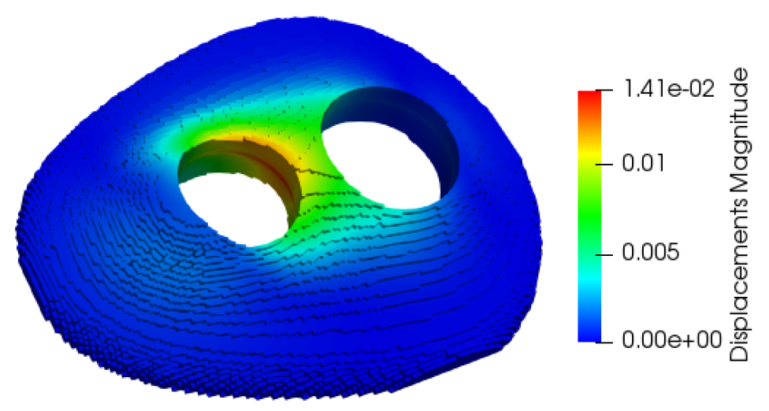
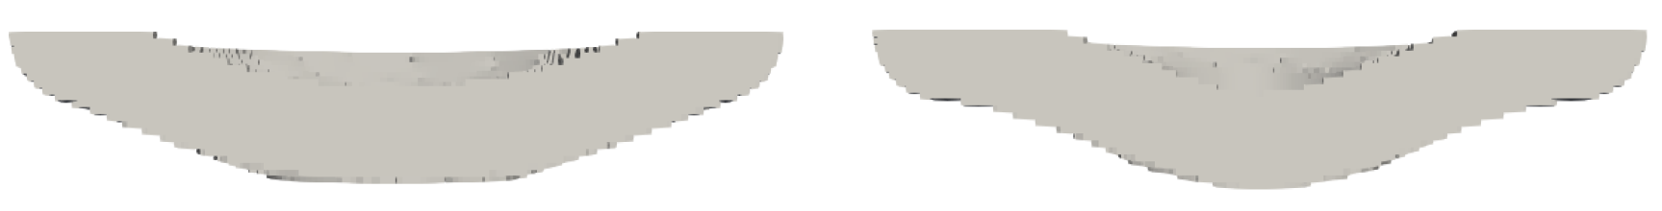
Shape optimization on the domain of the T-splines
Block from which the optimization
area is selected.
Shape optimization on the ‘z’ axis
 | Compliance (J) | Max displacement (mm)
Before optimization | 0.142 | 0.021
After optimization on z | 0.106 (-25.4%) | 0.014 (-32.5%)
After optimization on x, y | 0.137 (-5.0%) | 0.020 (-2.9%)
After optimization on x, y, z | 0.102 (-28.3%) | 0.013 (-36.4%)
Before optimization
After optimization on
the ‘z’ axis
Notes:
A shape optimization was performed in the domain defined by the T-splines.
The first step consists in defining a mesh block in which the T-spline described allows to delimit a layer on which all the shape and / or topological optimizations can be carried out.
The result of the geometry as well as the displacements calculated via a static analysis are shown in the second picture where a displacement of 0.0209 mm is observed.
Starting from this described volume shape optimizations are performed as well as topolology optimizations multi-material and multi-block. The objective is always to minimize the compliance.
A first shape optimization was carried out on all the heights of the controls authorized to move, on the coordinates along the "z" axis.
What is immediately striking is the visual difficulty of realizing a priori the changes in shape and distribution of displacements between the result of the optimization and the initial geometry.
A comparison between the sections of the unoptimized geometry and geometry after optimization let us observe that the shape evolves quite clearly. The optimized shape now matches more like a bell than a dome, as before optimization.
The same shape optimization was carried out on the x, y coordinates and on the x, y, z coordinates and the results are presented on this table.
It can be observed that shape optimization on all coordinates provides the best results in terms of compliance and max displacement.

Slide 13
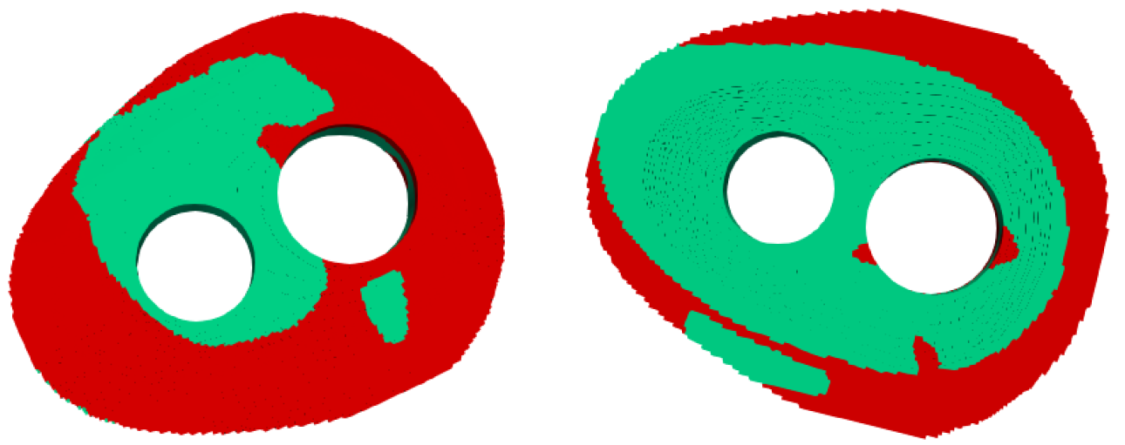
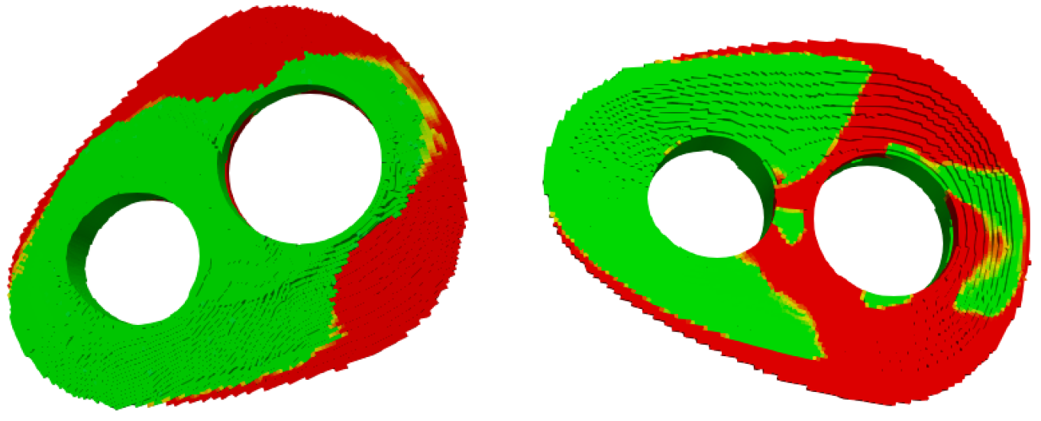
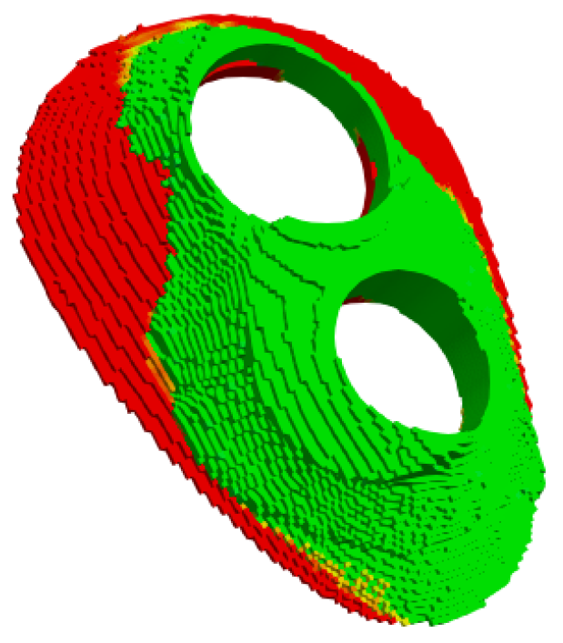
Multi-material & multi-block topology optimization
Compliance is -1.5% comparing to the result of TO with Aluminium/void (50/50%)
aluminium
External view
plastic
Internal view
Aluminium/Plastic (50/50%)
Multi-material & multi-block topology optimization
Inner layer: aluminium/plastic (50/50%)
External layer: aluminium/void (20/80%)
aluminium
plastic
Internal view
External view
Stiffeners
Notes:
Next, multi-material and multi-block topology optimization were performed on the domain defined by the T-splines.
It is observed that the fortification of the inner layer of the structure is privileged over the external layer, especially relatively close to the bearing housings. That persists for an area further away around the small bearing housing. The reinforcement on the external layer of the structure goes primarily through the section between the two holes and the periphery of the small bearing housing. The compliance, comparing to the TO results of aluminium/void 50/50% is 1.5% lower. Here we should remind nevertheless that the scope of adding the plastic is not to reinforce the structure but to ensure the absence of oil leakage.
The most complex case of topological optimization the multi-blocks and multi-material, has been studied again but, this time, on the selected field by the method of the level-sets. In the first block as before there was aluminium/plastic in a proportion of 50/50% in order to ensure the absence of oil leakage and on the second block there was aluminium/void in a proportion of 20/80%.
In the result it can be observed that the reinforcement of the small bearing housing is priority. This reinforcement is carried out over the entire height of the area, from the base to the maximum height of the stiffeners.
Then, the reinforcement between the two bearing housings is also important, but this time is carried out mainly through the stiffeners and little in the inner layer of the structure as was observed in the results of the multi-material mono-block optimization.

Slide 14
Presentation of the case study
Multi-material topology optimization
Multi-blocks topology optimization
New approach: Selection of the optimization domaine using a T-spline as support
New concept for the case study based on TO results
Manufacturability aspects
Conclusions
Notes:
Let’s see now how the study performed with TO contributed to the creation of the new concept of our test case.

Slide 15
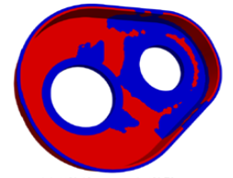
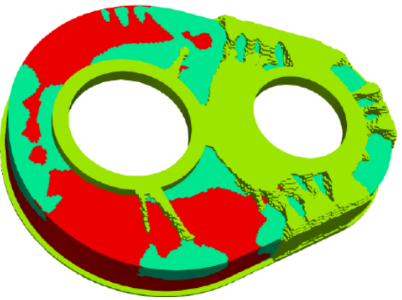
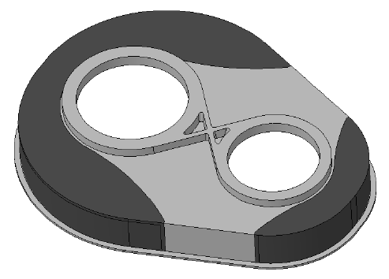
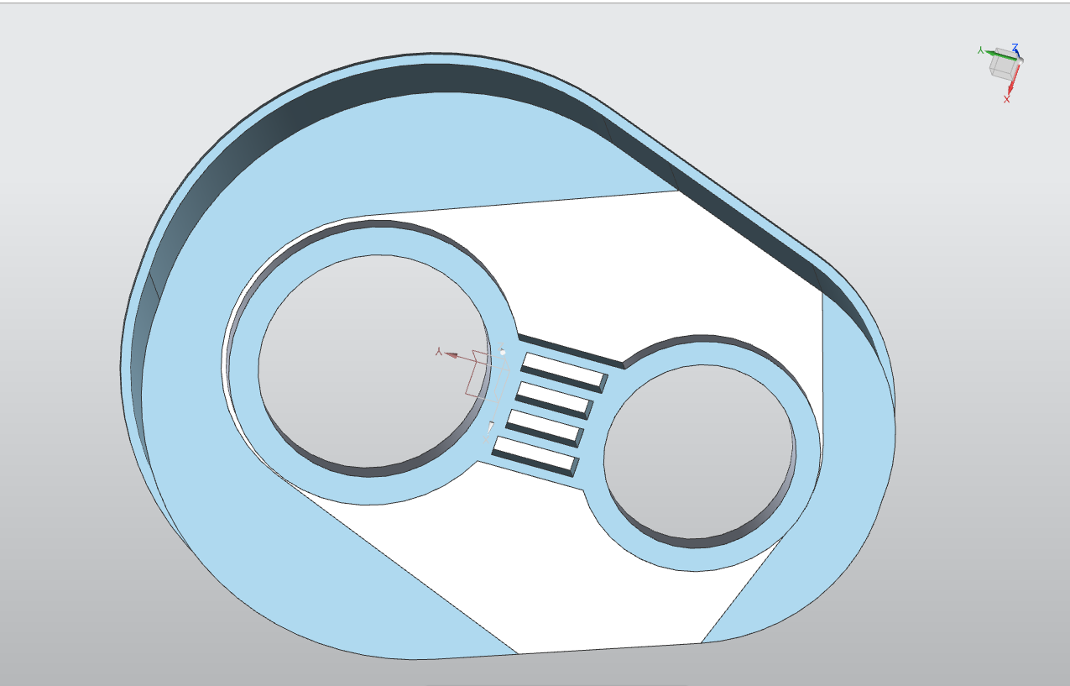
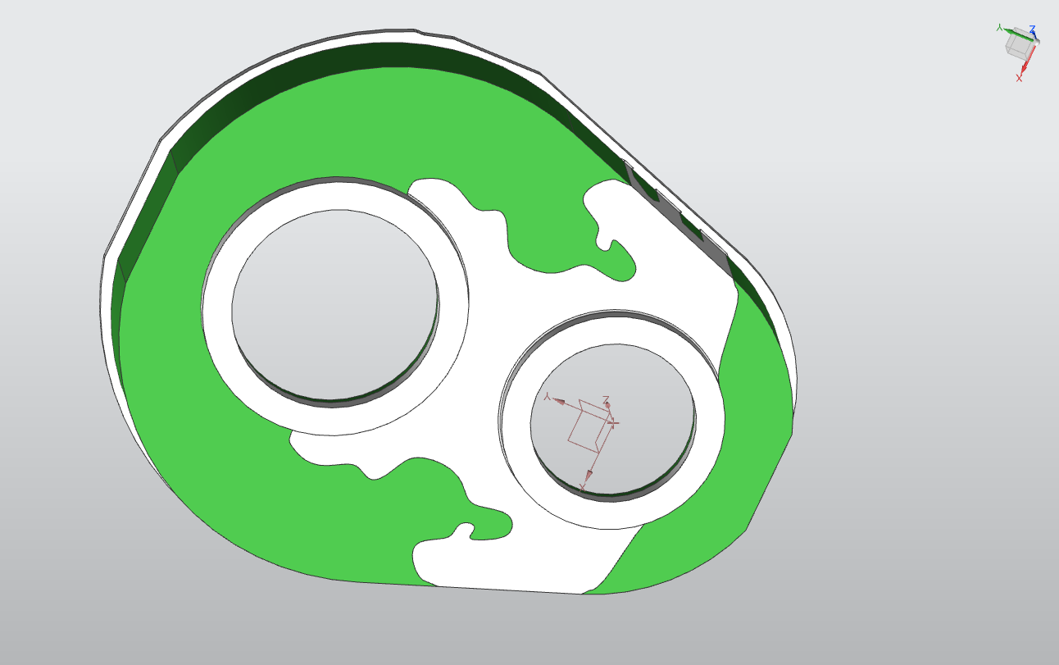
New Concept based on TO results
TO results without stiffeners
TO results with stiffeners
Simplified geometry
30%Al / 70%plastic
50%Al / 50%plastic
Manufacturability constraints of plastic injection molding
Thickness reduction to 5mm, max allowed for plastic injection molding
Addition of stiffener in the area of stress concentration
Plastic
Aluminium
Plastic
Optimised concept
Attempt with reduced thickness & stiffener
Raw result exported from TO
Notes:
In this slide the steps that were followed starting from the reference part until the creation of the new concept, are presented.
Injection molding was selected as manufacturing method for the new concept, therefore several manufacturability constraints had to be taken into consideration when designing the new part.
For example, there was a max thickness of plastic that was allowed for the injection of the plastic, above which there would be cooling issues, there should not exist restricted areas of plastic on the new design, as straight lines as possible and so on.
All constraints were taken into consideration and the new concept was proposed.

Slide 16
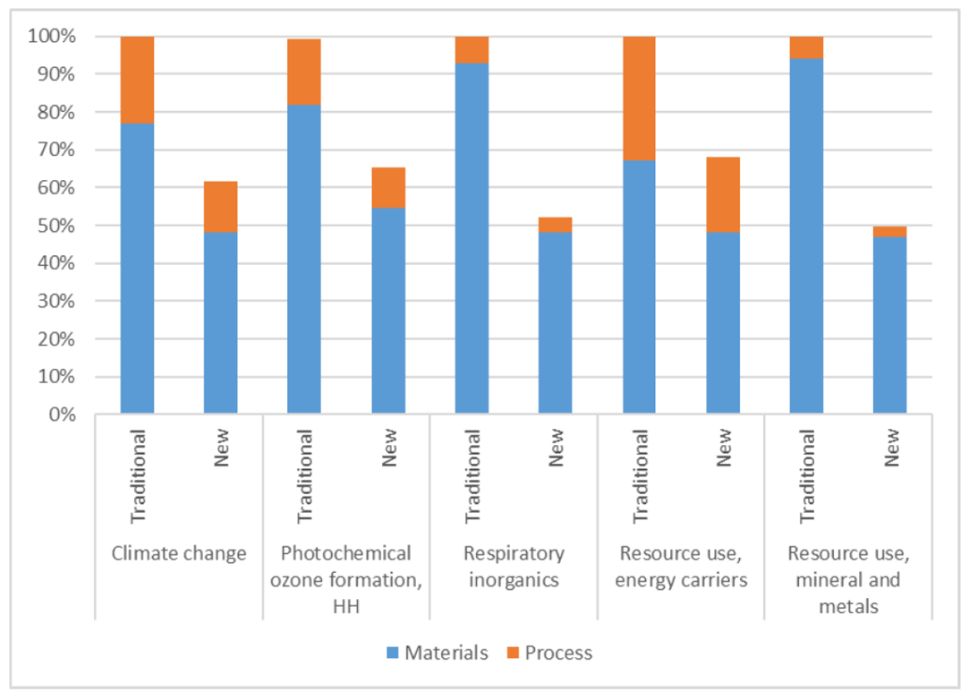
Life Cycle Assessment (LCA)
Total weight reduction of approx. 30%
Simplified geometry
Optimized concept
LCA results - Comparison of the reference and the new concept gearbox cover demo
Notes:
- The total weight reduction that was achieved was of approximately 30%. The results of the LCA were encouraging also as the calculated CO2 emissions decreased by 40%. This can be seen in the diagram presented here were CO2 emissions are represented by ‘climate change’. What is also encouraging is the fact that there was a clear reduction in every category examined apart from the CO2 emissions, like the photochemical ozone formation, respiratory inorganics, resource use, etc.

Slide 17
Presentation of the case study
Multi-material topology optimization
Multi-blocks topology optimization
New approach: Selection of the optimization domaine using a T-spline as support
New concept for the case study based on TO results
Manufacturability aspects
Conclusions
Notes:
- In that section some manufacturability aspects will be presented shortly, regarding the injection molding of the plastic.

Slide 18
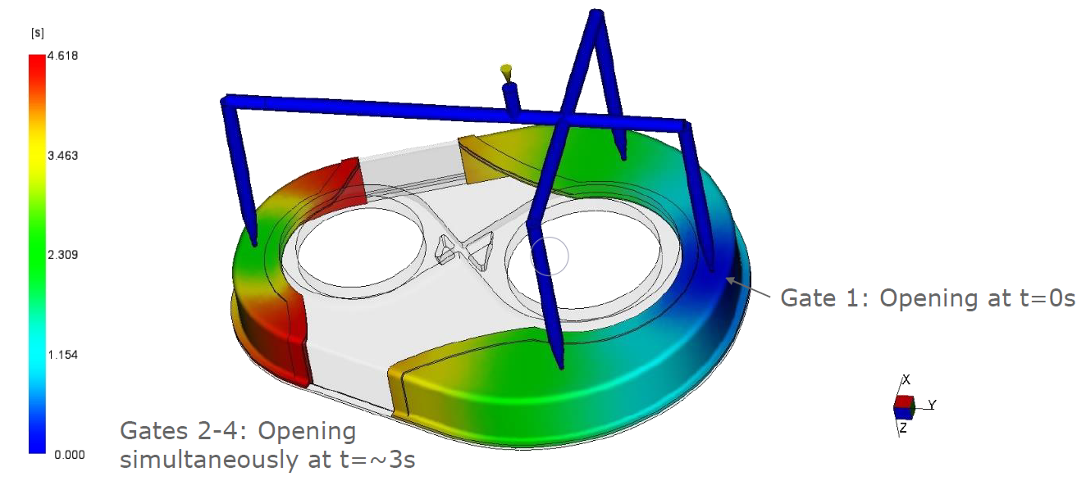
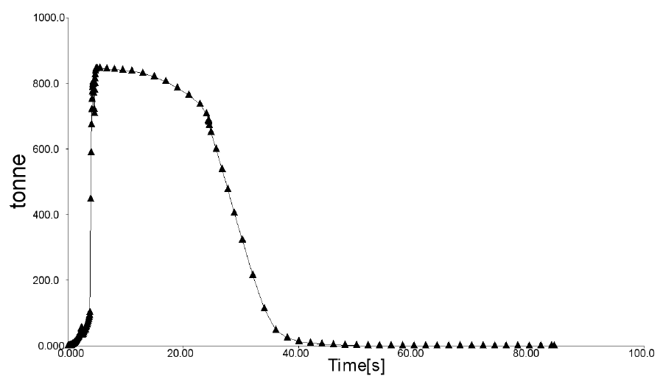
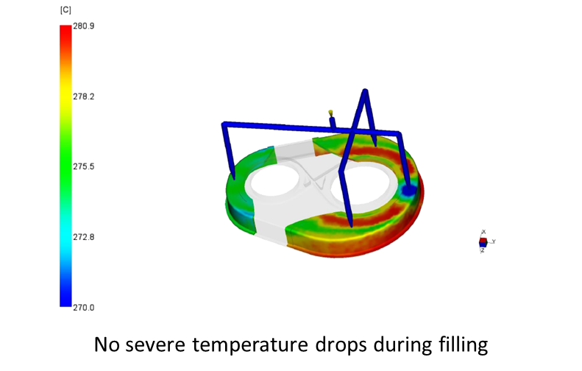
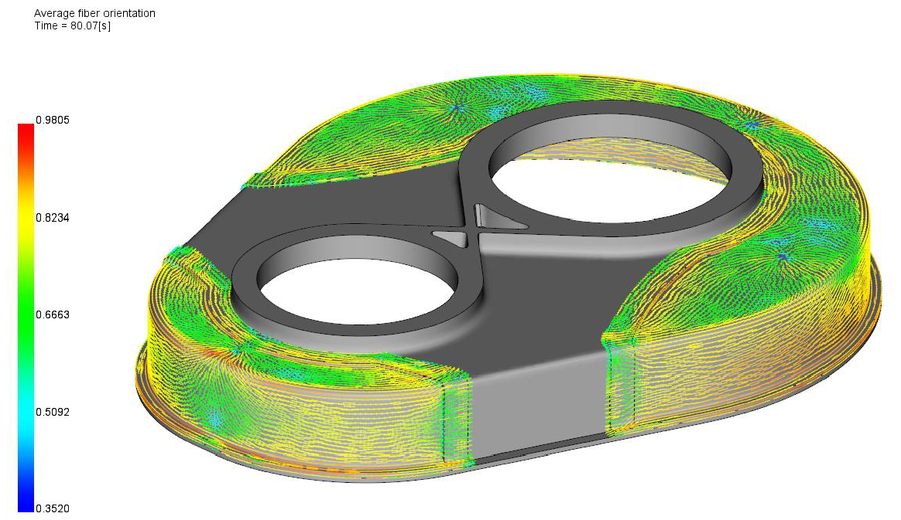
Injection molding of the plastic
Clamp force XY plot
(a)
Clamp force shows that there is no need for a bigger special machine
(c)
Average fiber orientation
(b)
(d)
Notes:
The injection molding of the plastic was simulated using the Moldflow software.
The selection of the number of the injection gates was carefully calculated so that there would be no resulting weld lines. As shown in figure a 4 gates are used and a cascade filling is taking place where the first gate opens at 0 second and the gates 2-4 open simultaneously at 3 sec.
In figure b it can be seen that there are no significant drops during filling and in figure 3 the clamp force shown is well below 1000tn wich means that and ordinary machine would suffice for the injection and no special machine would be needed.
Finally, in figure d a nice average fiber orientation is showcased.

Slide 19
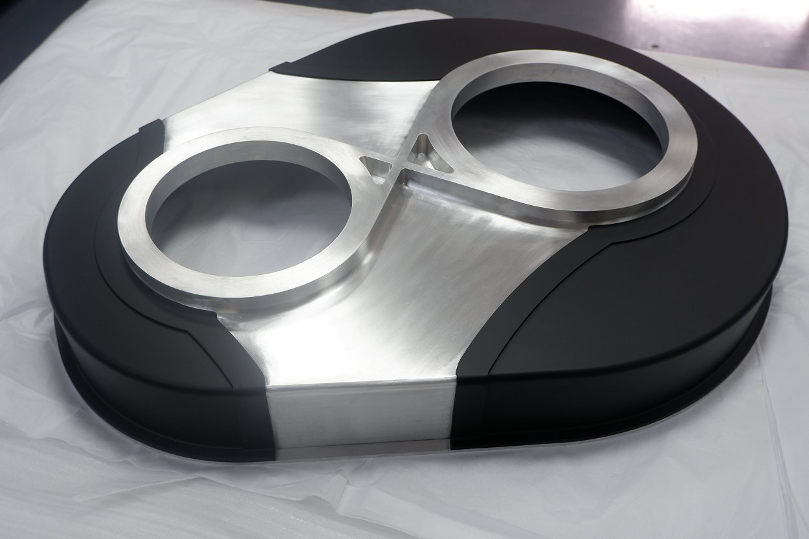
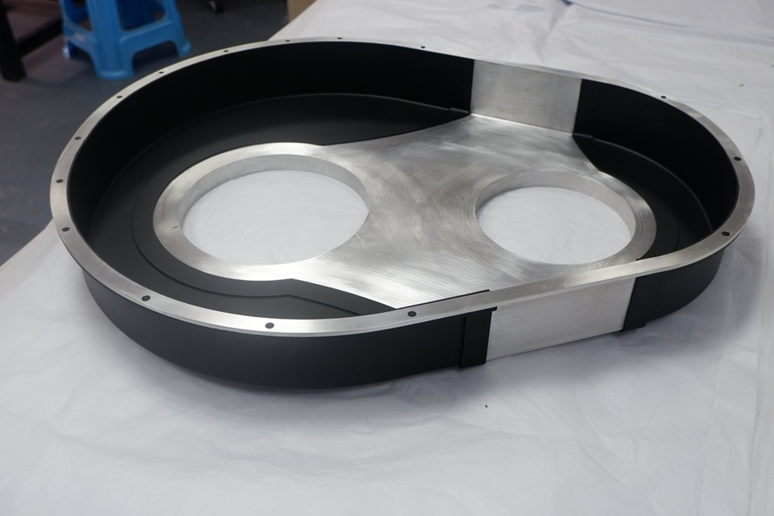
Prototype by vacuum casting
Notes:
- When it came to prototyping, the injection molding was not an option as the cost for the tooling was prohibitive. Another method was used, the vacuum casting, a method that is often used for prototyping and in small series production. A polyurethane with a density similar to that of Xiloy was used. The end result is optically very similar to that of the injection molding and one can perceive the weight reduction and examine in detail the connection of the two materials.

Slide 20
Conclusions
Topology optimization was a very useful tool in this new concept of a lightweight application.
Multi-material topology optimization permitted the conception of a tight gearbox housing, using aluminium and plastic, while reducing weight by almost 30%.
The raw results of topology optimization could not be used directly when redesigning the new part due to manufacturability restrictions of the injection molding production method.
Nevertheless, the results gave a very good indication of where the use of plastic was allowed and facilitated significantly the new design.
Notes:
To conclude:

Slide 21
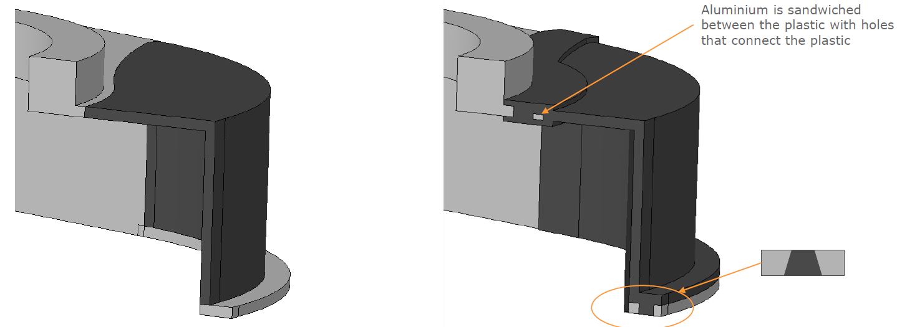
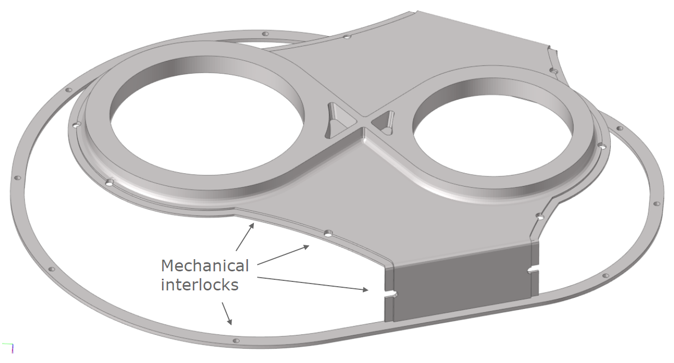
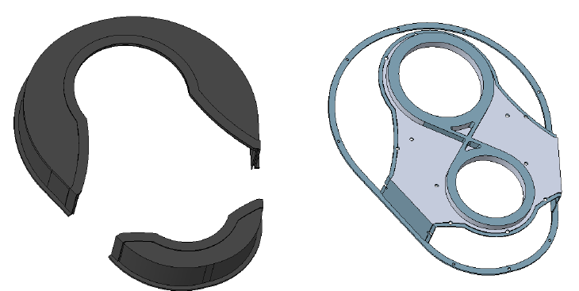
Mechanical interlock connection
Detailed mechanical interlock
Preparation of the metallic part

Slide 22
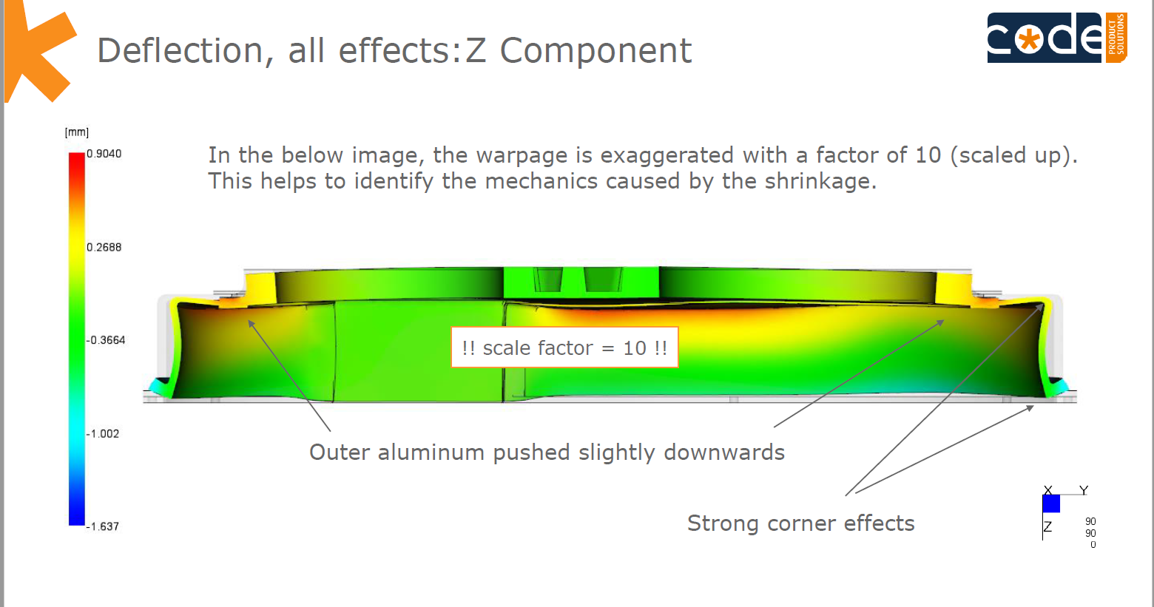
ANEX II: Deflection with a big scale factor

