Slide 1
Une nouveauté dans la prise en charge de l’ostéoporose
Le Romosozumab (Evinity®)
Présentation de la molécule
Efficacité par rapport aux autres traitements disponibles
Place dans la séquence thérapeutique en 2021
Procédure de gestion des risques
Dr Olivier Malaise
M.D., Ph.D.
Service de rhumatologie, CHU de Liège

Slide 2
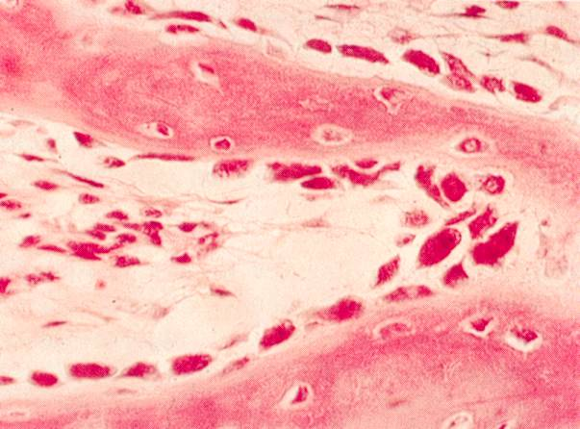
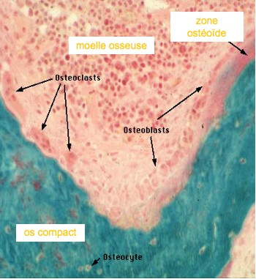
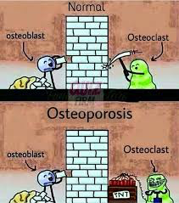
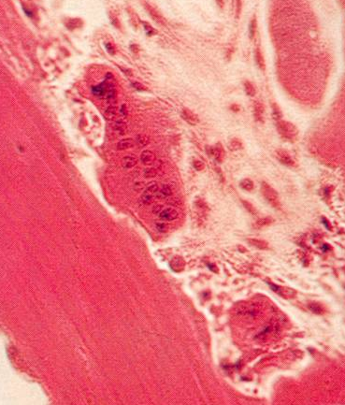
L’OS EST UNE STRUCTURE DYNAMIQUE, avec un équilibre entre deux (trois) types cellulaires : les ostéoblastes (et ostéocytes) vs les ostéoclastes
(et sans doute un rôle méconnu du système vasculaire et immunitaire)
ostéoblastes
ostéocytes
Ostéoclastes

Slide 3
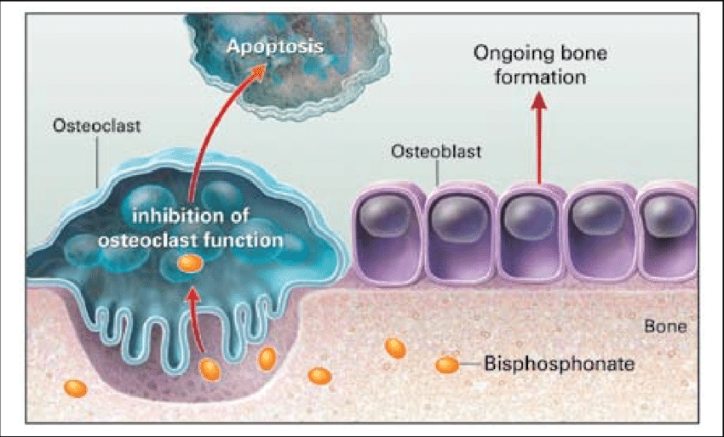
BISPHOSPHONATE : intoxication des ostéoclaste par inhibition de la voie des mévalonates kinases
DENOSUMAB : concept RANK / RANK-L
OPG
RANK
Glucocorticoïdes
PGE₂
Ostéoblaste
RANK-L
TGF-β
Leptine (CART)
Balance RANK-L/OPG
Ostéoclaste
-
-
RANK-L
OPG
+
+
-
+
17-β-oetradiol
TGF-β
Glucocorticoïdes
PTH
PGE₂
Leptine (ADRb2)
Pool d’ostéoclastes actifs
Hofbauer et al, J Bone Min Res 2000; 15: 2-12

Slide 4
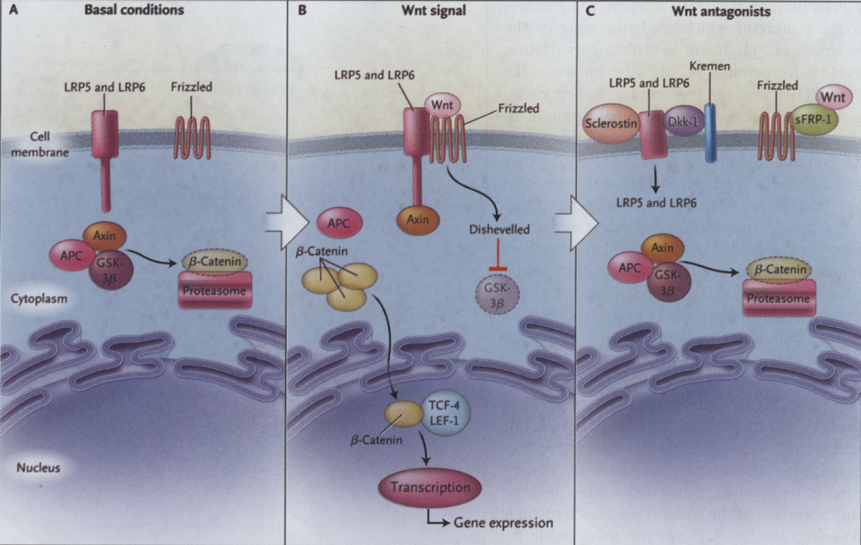
IL EXISTE D’AUTRES VOIES DE SIGNALISATION POUR LES CELLULES OSSEUSES
ACTIVATION DES OSTEOBLASTES
OSTEOFORMATION
Wnt-β-caténine: inhibition par la sclérostine
Canalis E et al. N Engl J Med 2007; 357: 905-16

Slide 5
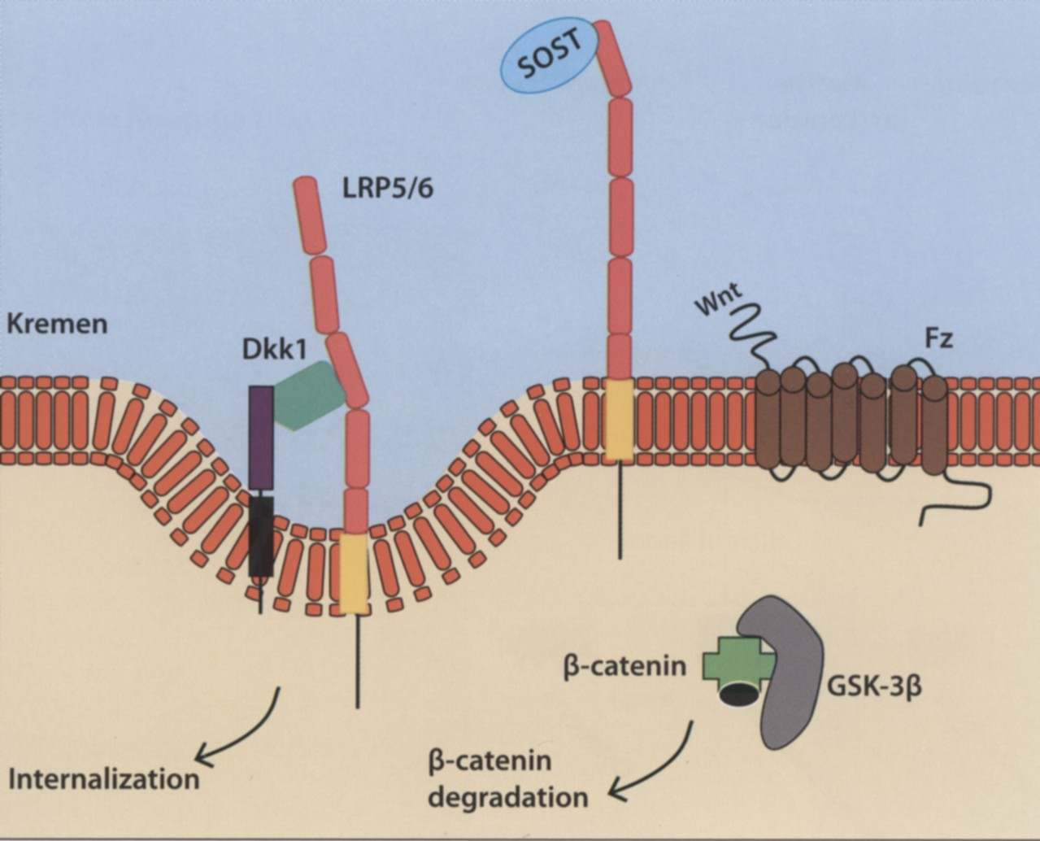
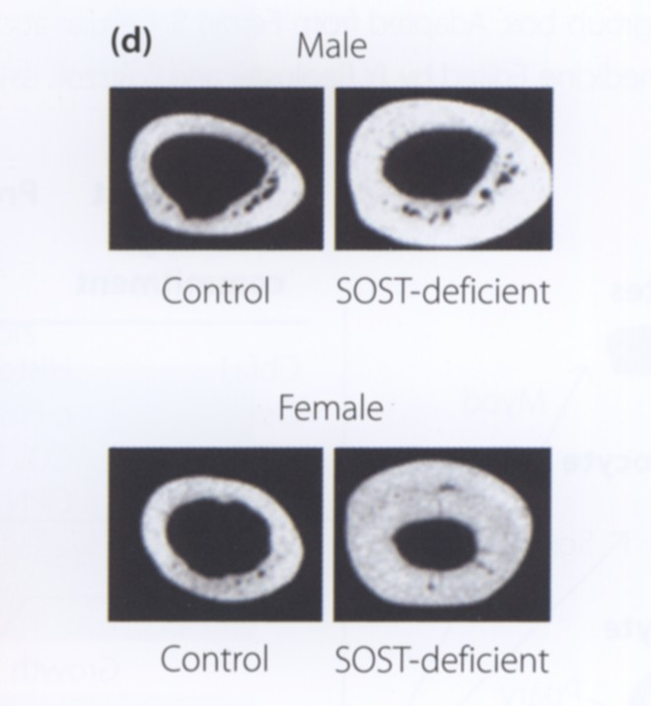
Délétion de la sclérostine
Activation continue de
l’ostéoblastogénèse
Sclérostose
mutation de LRP5/6
Perte de fonction
Syndrome ostéoporose- pseudogliome
Gain de fonction
Phénotype de masse élevée
Souris déficiente en sclérostine
Li X et al. J Bone Miner Res 2008; 23: 860-9

Slide 6
La voie Wnt / sclérostine est impliquée en pathologie humaine
Délétion partielle du gêne de la sclérostine : maladie de van Buchem

Slide 7
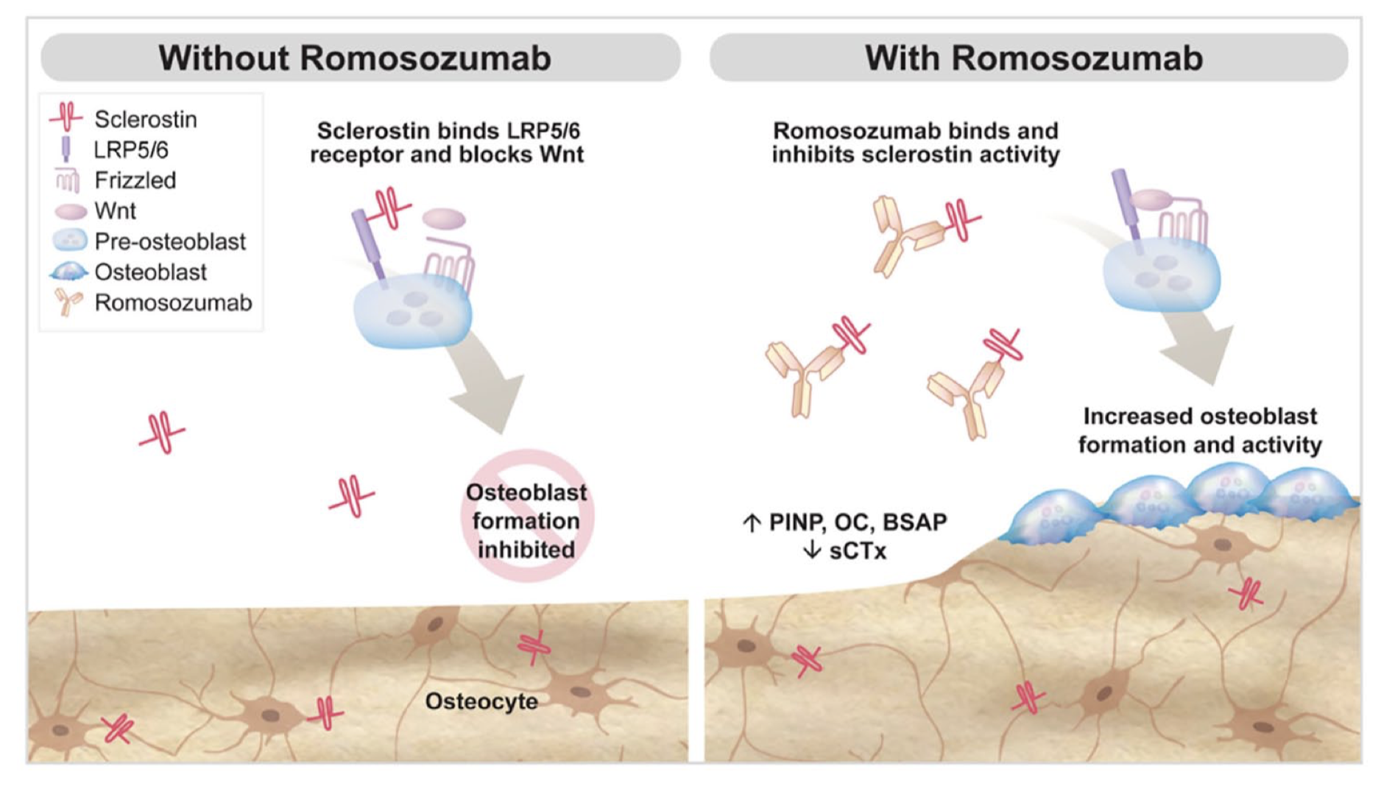
Journal of Pharmacy Technology 2021, Vol. 37(1) 45–52

Slide 8
Le Romosozumab a un effet ostéoformateur, mais également anti-résorptif
P1NP
CTX
Percentage change from baseline vs placebo
+2 weeks
+2 weeks
+2 weeks
Study months
Data from the FRAME study in 7180 postmenopausal women with osteoporosis. Patients received romosozumab 210 mg or placebo once monthly for 12 months followed by open-label denosumab 60 mg every 6 months for 12 months. Coprimary endpoints were the cumulative incidences of new vertebral fracture at 12 months and at 24 months. Serum concentrations of P1NP and CTX were measured in a substudy of 129 patients.¹ P1NP: romosozumab, n = 62; placebo, n = 62; CTX: romosozumab, n = 61; placebo, n = 62. Data presented as bootstrapped median treatment difference and 95% CI.
BL = baseline; CI = confidence interval; CTX = C-terminal telopeptide of type 1 collagen; P1NP = procollagen type 1 N-terminal propeptide.
Adapted from: 1. Cosman F, et al. N Engl J Med 2016;375:1532–43.

Slide 9
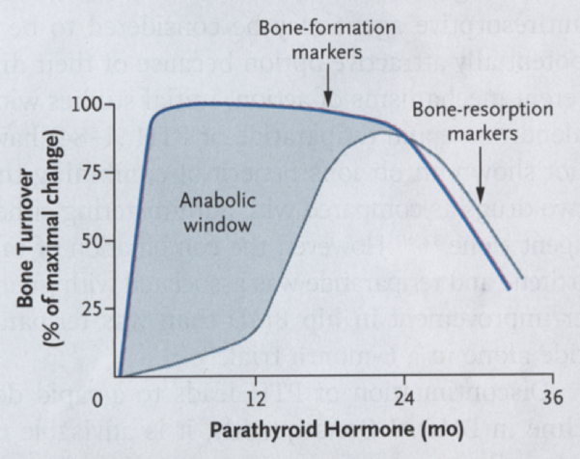
P1NP
CTX
Percentage change from baseline vs placebo
+2 weeks
+2 weeks
+2 weeks
Teriparatide
Denosumab

Slide 10
Le Romosozumab a un effet ostéoformateur, mais également anti-résorptif
PTH, TGF-β, PGE-2, BMPs, E2
1,25 Vitamin D3,
TNF-α, E2 deficiency
Humanised anti-sclerostin
Sclerostin
Sclerostin
Sclerostin
Binds to LRP5/6 co-receptor
Increases osteocytic RANKL production
Sclerostin unable to bind LRP5/6
Decreases osteocytic RANKL production
Blocks Frz activation
Osteoclast activation
Frz activation
Decreases bone resorption
Blocks wnt β-catenin signalling
Increases bone resorption
Activates Wnt β-catenin signalling
Inhibits bone formation
Promotes
bone formation
BMP = bone morphogenetic protein; E2 = oestrogen; Frz = Wnt-frizzled receptor complex; LRP = lipoprotein receptor-related protein; PGE2 = prostaglandin E2; PTH = parathyroid hormone; RANKL = receptor activator of nuclear factor kappa-B ligand; TGF-β = transforming growth factor β; TNF-α = tumour necrosis factor α.
Green = up regulated; red = down regulated.
Description of humanised anti-sclerostin monoclonal antibody: IgG2, human = blue, mouse = red.
Adapted from: Bhattacharyya S, et al. Eur J Pharmacol 2018;826:39–47.

Slide 11
Une nouveauté dans la prise en charge de l’ostéoporose
Le Romosozumab (Evinity®)
Présentation de la molécule
Efficacité par rapport aux autres traitements disponibles
Place dans la séquence thérapeutique en 2021
Procédure de gestion des risques
Dr Olivier Malaise
M.D., Ph.D.
Service de rhumatologie, CHU de Liège

Slide 12
Overview of the Romosozumab Clinical Programme*
PHASE II
(NCT00896532)¹
Efficacy and safety vs alendronate, teriparatide and placebo in postmenopausal women with low BMD (N = 419)
^{Feb 2011}
BRIDGE
(NCT02186171)⁴
Placebo-controlled BMD study in men with osteoporosis (N = 245)
VS PLACEBO (HOMME)
^{Feb 2016}
ARCH
(NCT01631214)⁵
Active-comparator fracture study vs alendronate in postmenopausal women with osteoporosis and high risk of fracture (N = 4093)
Vs BISPHOSPHONATE
^{Feb 2017}
Primary completion date
^{May 2015}
STRUCTURE
(NCT01796301)²
^{Dec 2015}
FRAME
(NCT01575834)³
Active-comparator BMD study vs teriparatide in postmenopausal women with osteoporosis transitioning from alendronate (N = 436)
VS TERIPARATIDE
Placebo-controlled fracture study in postmenopausal women with osteoporosis (N = 7180)
VS PLACEBO
*Not all romosozumab clinical studies listed. BMD = bone mineral density. 1. McClung MR, et al. N Engl J Med 2014;370:412–20; 2. Langdahl BL, et al. Lancet 2017;390:1585–94; 3. Cosman F, et al. N Engl J Med 2016;375:1532–43; 4. Lewiecki EM, et al. J Clin Endocrinol Metab 2018;103:3183–93; 5. Saag KG, et al. N Engl J Med 2017;377:1417–27.

Slide 13
FRAME Phase III Study Design
FRActure study in postmenopausal woMen with ostEoporosis
E
N
R
O
L
L
M
E
N
T
1:1
Double-blind¹
Open-label¹
Extension²
Inclusion¹
Postmenopausal women age 55–90 years
BMD T-score –2.5 to –3.5 at TH or FN
Exclusion¹
BMD T-score <–3.5 at TH or FN
History of hip fracture, or any severe or >2 moderate VFx
Recent OP therapy (washout period varied by agent)
Co-primary endpoints¹
Subject incidence of new VFx through 12 and 24 months
Romosozumab
210 mg SC QM
(n = 3589)
Denosumab
60 mg SC Q6M
Denosumab
60 mg SC Q6M
(n = 3003)
Placebo
SC QM
(n = 3591)
Denosumab
60 mg SC Q6M
Denosumab
60 mg SC Q6M
(n = 3042)
N = 7180
Month
0*
6
12
18
24
30
36
500–1000 mg calcium daily
600–800 IU vitamin D daily
Spine x-rays
DXA
BTMs
*A loading dose of 50,000–60,000 IU vitamin D was given to subjects with a baseline serum 25(OH) vitamin D level of ≤40 ng/mL. BMD = bone mineral density; BTM = bone turnover markers; DXA = dual-energy X-ray absorptiometry; FN = femoral neck; IU = international unit; OP = osteoporosis; QM = monthly; Q6M = every 6 months; TH = total hip; VFx = vertebral fracture.
Adapted from: 1. Cosman F, et al. N Engl J Med 2016;375:1532–43 and 2. Lewiecki EM, et al. J Bone Miner Res 2019;34:419–28, Supplementary Material.

Slide 14
FRAME: Lumbar Spine and Total Hip BMD Through Month 12
Placebo (n = 61)
Romosozumab (n = 65)
Placebo (n = 62)
Romosozumab (n = 66)
Lumbar spine
Total hip
Placebo vs romosozumab
Placebo vs romosozumab
13.3%*
13.3%*
9.7%*
6.8%*
4.7%*
Percentage change from baseline
Δ13.3%
Δ6.8%
Δ9.3%
Δ4.3%
0.4%
0.0%
0.4%
0.0%
Study month
Study month
Data are least square means (95% CI) adjusted for relevant baseline covariates. *p < 0.001 versus placebo. BMD = bone mineral density; CI = confidence interval; ∆ = difference.
Adapted from: Cosman F, et al. N Engl J Med 2016;375:1532–43.

Slide 15
FRAME: Incidence of New Vertebral Fracture Through Month 12
Placebo (n = 3591)
Romosozumab (n = 3589)
RRR = 73%
p < 0.001
Subject incidence (%)
Through Month 12
n/N1* =
59/3322
16/3321
n/N1 = number of subjects with fractures/number of subjects in the primary analysis set for vertebral fractures; p value based on logistic regression model adjusted for age (<75, ≥75) and prevalent vertebral fracture. RRR = relative risk reduction.
Adapted from: Cosman F, et al. N Engl J Med. 2016;375:1532–43.

Slide 16
FRAME: Other Key Fracture Endpoints Through Month 12
Placebo (n = 3591)
Romosozumab (n = 3589)
RRR = 36%
RRR = 25%
Subjects incidence (%)
RRR = 73%
RRR = 40%
RRR = 71%
RRR = 33%
RRR = 46%
Placebo n = | 59 | 90 | 75 | 55 | 63 | 59 | 13
Romosozumab n = | 16 | 58 | 56 | 37 | 38 | 17 | 7
p (nominal) | <0.001 | 0.008 | 0.096 | 0.06 | 0.012 | <0.001 | 0.18
p (adjusted) | <0.001 | 0.008 | 0.096 | 0.096 | NA* | 0.096 | 0.18
Variables to the right of the line are considered exploratory (due to be being tested after non-vertebral fracture) or were not part of testing sequence (i.e. not adjusted for multiplicity).
Major nonvertebral fracture: pelvis, distal femur, proximal tibia, ribs, proximal humerus, forearm and hip, excluding high trauma and pathologic fractures. Major osteoporotic fractures: clinical vertebral, hip, forearm and humerus, excluding pathologic fractures.
*Not part of testing sequence, thus no adjusted p value obtained. OP = osteoporosis; n = number of subjects with fractures.
Adapted from: Cosman F, et al. N Engl J Med 2016;375:1532–43.

Slide 17
FRAME: P1NP and CTX Through Month 24
Placebo-to-denosumab
Romosozumab-to-denosumab
P1NP
CTX
Placebo vs romosozumab
Open-label denosumab
Placebo vs romosozumab
Open-label denosumab
+2 weeks
+2 weeks
+2 weeks
+2 weeks
+2 weeks
+2 weeks
Data are median and interquartile range. Placebo-to-denosumab n = 62; romosozumab-to-denosumab n = 62 (P1NP), n = 61 (CTX).
BL= baseline; CTX = C-terminal telopeptide; P1Np = procollagen type 1 N-terminal propeptide.
Adapted from: Cosman F, et al. N Engl J Med 2016;375:1532–43.

Slide 18
FRAME: Lumbar Spine and Total Hip BMD Through Month 24
Placebo-to-denosumab (n = 61)
Placebo-to-denosumab (n = 62)
Romosozumab-to-denosumab (n = 65)
Romosozumab-to-denosumab (n = 66)
Lumbar spine
Total hip
Placebo vs romosozumab
Open-label denosumab
Placebo vs romosozumab
Open-label denosumab
8.4%*
8.8%*
17.6%*
15.1%*
6.8%*
13.3%*
4.7%*
Δ5.9%
Percentage change from baseline
9.7%*
Δ12.6%
Δ6.8%
2.9%
Δ13.3%
Δ11.8%
5.0%
Δ4.3%
Δ6.8%
1.6%
Δ9.3%
3.3%
0.4%
0.0%
0.4%
0.0%
Study month
Study month
*p < 0.001 compared with placebo. Data are least square means (95% CI) adjusted for relevant baseline covariates. BMD = bone mineral density; CI = confidence interval; ∆ = difference.
Adapted from: Cosman F, et al. N Engl J Med 2016;375:1532–43.

Slide 19
FRAME: Subject Incidence of New Vertebral Fracture Through Month 24
Placebo
Placebo-to-denosumab
Romosozumab
Romosozumab-to-denosumab
RRR = 75%
p < 0.001
RRR = 73%
p < 0.001
Through Month 12
Through Month 24
n/N1 =
59/3322
16/3321
84/3327
21/3325
n/N1 = number of subjects with fractures/number of subjects in the primary analysis set for vertebral fractures; p value based on logistic regression model adjusted for age (<75, ≥75) and prevalent vertebral fracture.
RRR = relative risk reduction.
Adapted from: Cosman F, et al. N Engl J Med 2016;375:1532–43.

Slide 20
FRAME: Subject Enrollment by Geographic Region
Total N = 7180
Adapted from: Cosman F, et al. N Engl J Med 2016;375:1532–43.

Slide 21
FRAME: Latin American Subjects Generally had Low Fracture Risk and a Narrow Range of Baseline FRAX Scores
Rest-of-World
Latin America
Distribution of subjects by 10-year probability of major osteoporotic fracture using FRAX
60
50
40
30
Subjects (%)
20
10
0
3
9
15
21
27
33
39
45
51
57
63
69
75
10-year probability of major osteoporotic fracture
Country-specific FRAX models were used to calculate 10-year probability of fracture risk with the exception of the Dominican Republic and Latvia, where the models from Colombia and Estonia were used.
Adapted from: Cosman F, et al. J Bone Miner Res 2018;33:1407–16.

Slide 22
FRAME: Heterogeneity in Clinical Fracture Rates Observed Across Regions
Romosozumab (n = 3589)
Placebo (n = 3591)
Treatment-by-subgroup interaction
p = 0.029
RRR = 54%
p = 0.006
RRR = -17%
p = 0.590
RRR = 81%
p = 0.003
RRR = 33%
p = 0.370
RRR = -38%
p = 0.710
Romo n/N1 =
25/1550
18/1043
3/482
8/410
4/104
Placebo n/N1 =
21/1534
38/1050
16/497
13/419
2/91
Incidence rate
Romo =
1.6%
1.7%
0.6%
2.0%
3.8%
Placebo =
1.4%
3.6%
3.2%
3.1%
2.2%
Clinical fractures comprised of nonvertebral (88.5%) and symptomatic vertebral fractures
Low enrollment in North America with few events observed
RRR and p values were based on a Cox proportional hazards model, adjusted for age and prevalent vertebral fracture stratification variables. Latin America: Colombia (25.4% of randomised population), Brazil (11.4%), Argentina (2.5%), Dominican Republic (2.4%), Mexico (1.3%). Rest-of-World: Central/Eastern Europe, Western Europe and Australia/New Zealand, Asia Pacific, North America. NE = not estimable; n/N1 = number of subjects with fractures/number of subjects in the analysis set; RRR = relative risk reduction.
Adapted from: Cosman F, et al. J Bone Miner Res 2018;33:1407–16.

Slide 23
One Year of Romosozumab Followed by Two Years of Denosumab Maintains Fracture Risk Reductions: Results of the FRAME Extension Study
M Lewiecki, RV Dinavahi, M Lazaretti-Castro, PR Ebeling, JD Adachi, A Miyauchi, E Gielen, CE Milmont, C Libanati, A Grauer
J Bone Miner Res 2019;34:419–28.

Slide 24
FRAME: Lumbar Spine, Total Hip and Femoral Neck BMD Through Month 36
Romosozumab-to-denosumab (lumbar spine, n = 3169; total hip, femoral neck, n = 3237)
Placebo-to-denosumab (lumbar spine, n = 3176; total hip, femoral neck, n = 3256)
Lumbar spine
Total hip
Femoral neck
Romo vs placebo
Open-label denosumab
Extension denosumab
Romo vs placebo
Open-label denosumab
Extension denosumab
Romo vs placebo
Open-label denosumab
Extension denosumab
18.1%*
16.6%*
13.1%*
Change from baseline (%)
Change from baseline (%)
9.4%*
8.5%*
Change from baseline (%)
8.2%*
6.0%*
7.3%*
7.5%
5.5%*
5.5%
4.2%
0.4%
3.2%
0.3%
2.3%
3.4%
0.3%
Study month
Study month
Study month
Least squares mean percentage change from baseline in BMD and p values were based on ANCOVA model adjusting for treatment, age and prevalent vertebral fracture stratification variables, baseline value, machine type and baseline value-by-machine type interaction, without multiplicity adjustment. Missing values were imputed by the last-observation-carried-forward method, and a sensitivity analysis with the use of a repeated measures model showed similar results.
*Nominal p < 0.001. BMD = bone mineral density; n = number of subjects with a baseline and at least one post-baseline BMD assessment.
Adapted from: Lewiecki EM, et al. J Bone Miner Res 2019;34:419–28.

Slide 25
FRAME: New Vertebral Fracture Incidence Through Month 12, 24 and 36
Placebo (Month 12) or placebo-to-denosumab (Months 24 and 36)
Romosozumab (Month 12) or romosozumab-to-denosumab (Months 24 and 36)
RRR = 66%
p < 0.001
3
RRR = 75%
p < 0.001
2.8%
RRR = 73%
p < 0.001
2.5%
2
Subject incidence (%)
1.8%
1
1.0%
0.5%
0.6%
0
Month 12
Month 24
Month 36
New vertebral fracture
n/N1 =
59/3322
16/3321
84/3327
21/3325
94/3327
32/3327
The RRR was assessed among subjects in the romosozumab group as compared with those in the placebo group at 12 months (end of the double-blind period) and at 24 and 36 months (by which time subjects in both groups had received open-label denosumab for 12 and 24 months, respectively) based on the Mantel-Haenszel method adjusted for age and prevalent vertebral fracture stratification variables. p values were based on a logistic regression model adjusted for age and prevalent vertebral fracture stratification variables. p values for 12-month and 24-month periods are adjusted values based on a sequential testing procedure and nominal for 36 months, without multiplicity adjustment. Data displayed for 12-month and 24-month periods are as reported for the primary analysis.
n = number of subjects with fractures; N1 = number of subjects in the analysis set; RRR = relative risk reduction.
Adapted from: Lewiecki EM, et al. J Bone Miner Res 2019;34:419–28.

Slide 26
FRAME: Time to First Clinical and Nonvertebral Fracture Through Month 36
Romosozumab (n = 3589)
Placebo (n = 3591)
Clinical fractures
Nonvertebral fractures
Romosozumab vs placebo
Open-label denosumab
Extension denosumab
Romosozumab vs placebo
Open-label denosumab
Extension denosumab
7
RRR = 36%
p = 0.008
RRR = 33% p = 0.096
RRR = 27%
P = 0.004
7
RRR = 25% p = 0.096
RRR = 25%
p = 0.057
RRR = 21%
p = 0.039
6
6
5
5
4
4
Subjects experiencing event (%)
3
3
2
2
1
1
0
0
0
12
24
36
0
12
24
36
Study month
Study month
Study month
Romo/DMAb N1 =
3589
3148
2957
2737
3589
3149
2959
2738
Pbo/DMAb N1 =
3591
3132
2941
2738
3591
3144
2956
2750
p values for 12-month and 24-month periods are adjusted values based on a sequential testing procedure and nominal for Month 36. Data displayed for 12-month and 24-month periods are as reported for the primary analysis.
DMAb = denosumab; N1 = number of subjects at risk at the specified time point; Pbo = placebo; Romo = romosozumab; RRR = relative risk reduction.
Adapted from: Lewiecki EM, et al. J Bone Miner Res 2019;34:419–28.

Slide 27
FRAME: Effects of Romosozumab at Month 12 on Bone Mass and Microarchitecture Assessed by μCT
Placebo
Tb.BV% (mean)=16.55 (17.55)
33710003001
Tb.BV% (mean)=17.41 (17.55)
33769002663
Tb.BV% (mean)=18.25 (17.55)
33714004127
Romosozumab
Tb.BV% (mean)=22.04 (21.93)
33723002019
Tb.BV% (mean)=22.18 (21.93)
33743002008
Tb.BV% (mean)=21.21 (21.93)
33740002010
Images are selected from subjects who had Tb.BV% values close to the group mean.
μCT = micro computed tomography; Tb.BV = trabecular bone volume.
1. Chavassieux P, et al. J Bone Miner Res 2019;34:1597–608; 2. Roux J-P, et al. Poster presented at ASBMR 2017, 8–11 Nov, Denver, Colorado US. (#MO0664)

Slide 28
Overview of the Romosozumab Clinical Programme*
PHASE II
(NCT00896532)¹
Efficacy and safety vs alendronate, teriparatide and placebo in postmenopausal women with low BMD (N = 419)
^{Feb 2011}
BRIDGE
(NCT02186171)⁴
Placebo-controlled BMD study in men with osteoporosis (N = 245)
VS PLACEBO (HOMME)
^{Feb 2016}
ARCH
(NCT01631214)⁵
Active-comparator fracture study vs alendronate in postmenopausal women with osteoporosis and high risk of fracture (N = 4093)
Vs BISPHOSPHONATE
^{Feb 2017}
Primary completion date
^{May 2015}
STRUCTURE
(NCT01796301)²
^{Dec 2015}
FRAME
(NCT01575834)³
Active-comparator BMD study vs teriparatide in postmenopausal women with osteoporosis transitioning from alendronate (N = 436)
VS TERIPARATIDE
Placebo-controlled fracture study in postmenopausal women with osteoporosis (N = 7180)
VS PLACEBO
*Not all romosozumab clinical studies listed. BMD = bone mineral density. 1. McClung MR, et al. N Engl J Med 2014;370:412–20; 2. Langdahl BL, et al. Lancet 2017;390:1585–94; 3. Cosman F, et al. N Engl J Med 2016;375:1532–43; 4. Lewiecki EM, et al. J Clin Endocrinol Metab 2018;103:3183–93; 5. Saag KG, et al. N Engl J Med 2017;377:1417–27.

Slide 29
ARCH Phase III Study Design
Active-contRolled fraCture study in postmenopausal women with osteoporosis at High risk of fracture
4093 subjects enrolled
Double-blind
Open-label
Primary analysis*
Romosozumab
210 mg SC QM
(n = 2046)
Alendronate 70 mg PO QW
Alendronate
70 mg PO QW
(n = 2047)
Alendronate 70 mg PO QW
500 to 1000 mg calcium, 600 to 800 IU vitamin D daily
Month
0
6
12
18
24
36
Spine and thoracic x-rays
DXA
BTMs
*Median time on study at primary analysis was 33 months (IQR: 27–40).
BTM = bone turnover marker; DXA = dual-energy x-ray absorptiometry; IQR = interquartile range; IU = international unit; PO = orally; QM = monthly; QW = weekly; SC = subcutaneous.
Adapted from: Saag KG, et al. N Engl J Med 2017;377:1417–27.

Slide 30
ARCH: Key Eligibility Criteria
Inclusion criteria¹ | Postmenopausal women aged 55 to 90 years BMD T-score and fracture history BMD T-score ≤–2.5 at the total hip or femoral neck, and ≥1 moderate or severe vertebral fractures or ≥2 mild vertebral fractures OR BMD T-score ≤–2.0 at the total hip or femoral neck, and ≥2 moderate or severe vertebral fractures or a hip fracture sustained 3–24 months prior to randomisation
Exclusion criteria^{1,2} | Contraindications or signs of intolerance to alendronate Recent use of agents affecting bone metabolism
BMD = bone mineral density.
1. Saag KG, et al. N Engl J Med 2017;377:1417–27; 2. Cosman F, et al. N Engl J Med 2016;375:1532–43.

Slide 31
Substudy ARCH: Percentage Change from Baseline in Lumbar Spine BMD through Month 36
Romosozumab
Romosozumab-to-alendronate
Alendronate
Alendronate-to-alendronate
Lumbar spine†
Romosozumab vs alendronate
Open-label
alendronate
Romosozumab-to-alendronate (n = 84‡)
Alendronate-to-alendronate (n = 79‡)
Percentage change from baseline
Month
Data are least squares means (95% CI). The substudy population was representative of the overall study (data not shown).
*Nominal p < 0.001 (not-adjusted for multiplicity). †ANCOVA model using LOCF adjusted for treatment, presence of severe vertebral fracture at baseline, baseline BMD value, machine type and baseline BMD value-by-machine type interaction. ‡Number of subjects with values at baseline and at least one post-baseline visit at Month 6 or Month 18. ANCOVA = analysis of covariance; BMD = bone mineral density; CI = confidence interval; LOCF = last observation carried forward.
Adapted from: Saag KG, et al. N Engl J Med 2017;377:1417–27.

Slide 32
Substudy ARCH: Percentage Change from Baseline in Lumbar Spine BMD through Month 36
Romosozumab
Romosozumab-to-alendronate
Alendronate
Alendronate-to-alendronate
Lumbar spine†
Romosozumab vs alendronate
Open-label
alendronate
Romosozumab-to-alendronate (n = 84‡)
Alendronate-to-alendronate (n = 79‡)
Percentage change from baseline
Month
Data are least squares means (95% CI). The substudy population was representative of the overall study (data not shown).
*Nominal p < 0.001 (not-adjusted for multiplicity). †ANCOVA model using LOCF adjusted for treatment, presence of severe vertebral fracture at baseline, baseline BMD value, machine type and baseline BMD value-by-machine type interaction. ‡Number of subjects with values at baseline and at least one post-baseline visit at Month 6 or Month 18. ANCOVA = analysis of covariance; BMD = bone mineral density; CI = confidence interval; LOCF = last observation carried forward.
Adapted from: Saag KG, et al. N Engl J Med 2017;377:1417–27.

Slide 33
Primary Endpoint ARCH: Incidence of New Vertebral Fracture Through Month 24
Romosozumab
Alendronate
Romosozumab-to-alendronate
Alendronate-to-alendronate
12 Months*
24 Months*
RRR = 48%‡
p < 0.001
243/2047
RRR = 37%†
p = 0.003
Subjects (%)
Subjects (%)
128/2047
127/2046
82/2046
n/N1 = number of subjects with fractures/number of subjects in the primary analysis set for vertebral fractures. *Missing fracture status was imputed by multiple imputation for patients without observed fracture at an earlier time point. n and % are based on the average across five imputed datasets.
†RRR at 12 months by LOCF: 36% (nominal p = 0.008): Romosozumab: 3.2% (55/1696) vs alendronate: 5.0% (85/1703).
‡RRR at 24 months by LOCF: 50% (nominal p < 0.001): Romosozumab-to-alendronate: 4.1% (74/1825) vs alendronate-to-alendronate: 8.0% (147/1843). LOCF = last observation carried forward; RRR = relative risk reduction.
Adapted from: Saag KG, et al. N Engl J Med 2017;377:1417–27.

Slide 34
ARCH: Incidence of Nonvertebral Fractures* at Primary Analysis
Romosozumab
Romosozumab-to-alendronate
Alendronate
Alendronate-to-alendronate
Primary analysis
20
Romosozumab vs alendronate
Open-label
alendronate
RRR = 19%
p = 0.037
15
% Cumulative incidence
10
5
0
0
6
12
18
24
30
36
42
48
n =
Romo-to-Aln
Aln-to-Aln
Month
2046 | 1867 | 1770
2047 | 1873 | 1743
1693 | 1627 | 1114 | 714 | 350 | 109
1661 | 1590 | 1097 | 697 | 330 | 110
*Secondary endpoint. n = number of subjects at risk for event at time point of interest. Aln = alendronate; Romo = romosozumab; RRR = relative risk reduction.
Adapted from: Saag KG, et al. N Engl J Med 2017;377:1417–27.

Slide 35
ARCH: Other Fracture Endpoints at Primary Analysis
Romosozumab-to-alendronate (n = 2046)
Alendronate-to-alendronate (n = 2047)
RRR = 35%
p < 0.001§
RRR = 27%
p < 0.001§,¶
RRR = 19%
p = 0.037§
n = 392
RRR = 27%
p = 0.004§
RRR = 32% p < 0.001§
Subject incidence (%)
n = 266
RRR = 38%
p = 0.015§
n = 266
n = 198
n = 217
n = 209
n = 178
n = 196
n = 146
n = 146
n = 41
n = 66
*
†
†,‖
†,**
‡,††
‡‡
Romo-to-ALN n = | 198 | 178 | 146 | 41 | 146 | 266
ALN-to-ALN n = | 266 | 217 | 196 | 66 | 209 | 392
P value = | < 0.001 | 0.037 | 0.004 | 0.015 | < 0.001 | < 0.001
*Primary endpoint. †Secondary endpoint. ‡Exploratory endpoint. §Risk ratios and p-values based on a Cox proportional hazards model adjusting for age strata, baseline total hip BMD T-score and presence of severe vertebral fracture at baseline. ¶The nominal p-value for new vertebral fracture at month 24 using the logistic regression model was < 0.001 for clinical fracture at primary analysis using the Cox proportional hazards model described above. The larger of the two p-values is less than 0.05, thus both endpoints were statistically significant using the Hochberg procedure and the statistical testing continued to the secondary endpoints in the testing sequence described previously. ‖Nonvertebral fractures excluded fractures of the skull, facial bones, metacarpals, fingers and toes. Pathologic or high trauma fractures were also excluded. **Major nonvertebral fracture included fractures of the pelvis, distal femur, proximal tibia, ribs, proximal humerus, forearm and hip. ††Major osteoporotic fracture include fractures of the hip, forearm and humerus that are not associated with a pathologic fracture regardless of trauma severity, and clinical vertebral fractures. ‡‡Osteoporotic fractures include any osteoporotic nonvertebral fractures that are not associated with high trauma severity or pathologic fractures and new or worsening vertebral fractures regardless of trauma severity or pathologic fractures. Note: All fracture types, including nonvertebral fractures, excluded severe trauma (except major osteoporotic fractures) or pathologic fractures. Severe trauma was defined as a fall from higher than the height of a stool, chair, first rung on a ladder or equivalent (> 20 inches), or severe trauma other than a fall per investigator judgment.
RRR = relative risk reduction
Adapted from: Saag KG, et al. N Engl J Med 2017;377:1417–27.

Slide 36
Overview of the Romosozumab Clinical Programme*
PHASE II
(NCT00896532)¹
Efficacy and safety vs alendronate, teriparatide and placebo in postmenopausal women with low BMD (N = 419)
^{Feb 2011}
BRIDGE
(NCT02186171)⁴
Placebo-controlled BMD study in men with osteoporosis (N = 245)
VS PLACEBO (HOMME)
^{Feb 2016}
ARCH
(NCT01631214)⁵
Active-comparator fracture study vs alendronate in postmenopausal women with osteoporosis and high risk of fracture (N = 4093)
Vs BISPHOSPHONATE
^{Feb 2017}
Primary completion date
^{May 2015}
STRUCTURE
(NCT01796301)²
^{Dec 2015}
FRAME
(NCT01575834)³
Active-comparator BMD study vs teriparatide in postmenopausal women with osteoporosis transitioning from alendronate (N = 436)
VS TERIPARATIDE
Placebo-controlled fracture study in postmenopausal women with osteoporosis (N = 7180)
VS PLACEBO
*Not all romosozumab clinical studies listed. BMD = bone mineral density. 1. McClung MR, et al. N Engl J Med 2014;370:412–20; 2. Langdahl BL, et al. Lancet 2017;390:1585–94; 3. Cosman F, et al. N Engl J Med 2016;375:1532–43; 4. Lewiecki EM, et al. J Clin Endocrinol Metab 2018;103:3183–93; 5. Saag KG, et al. N Engl J Med 2017;377:1417–27.

Slide 37
STRUCTURE Phase III Study Design
STudy evaluating effect of RomosozUmab Compared with Teriparatide in postmenopaUsal women with osteoporosis at high risk for fracture pReviously treated with bisphosphonatE therapy
Oral bisphosphonate therapy for osteoporosis
ALN 70 MG QW
E
N
R
O
L
L
M
E
N
T
1:1
Open-label
END
OF
S T UDY
Romosozumab 210 mg SC QM
(n = 218)
Teriparatide 20 mcg SC QD
(n = 218)
1 Year
N = 436
3 Years Prior to Screening
Month
0*
3
6
9
12
Calcium (≥ 500 mg)
Vitamin D (≥ 600 IU)
QCT
DXA
BTM
*A loading dose of 50,000–60,000 IU vitamin D was given to subjects in the romosozumab group with a baseline serum vitamin D 25(OH)D level between 50 nmol/L and 100 nmol/L
ALN = alendronate; BTM = bone turnover marker; DXA = dual-energy x-ray absorptiometry; IU = international unit; QCT = quantitative computed tomography; QD = daily; QM = once a month; QW = once a week; SC = subcutaneous.
Adapted from: Langdahl BL, et al. Lancet 2017;390:1585–94.

Slide 38
STRUCTURE: Key Eligibility Criteria
Inclusion criteria | Postmenopausal women age 55 to 90 years BMD T-score ≤ –2.5 at the total hip, femoral neck, or lumbar spine History of nonvertebral fracture after age 50 or vertebral fracture Oral bisphosphonate for ≥3 years
Exclusion criteria | Recent use of agents that affect bone metabolism History of metabolic or bone disease except osteoporosis
BMD = bone mineral density.
Langdahl BL, et al. Lancet 2017;390:1585–94.

Slide 39
STRUCTURE: Percentage Change in Lumbar Spine aBMD by DXA at Months 6 and 12
Teriparatide (n = 209)
Romosozumab (n = 206)
Lumbar spine
9.8%*†
7.2%*†
Mean percentage change from baseline (95% CI)
5.4%*
3.5%*
Months
Data are least-squares means and 95% CI. *p < 0.0001 versus baseline. †p < 0.0001 versus teriparatide.
aBMD = areal bone mineral density; CI = confidence interval; DXA = dual-energy x-ray absorptiometry.
Adapted from: Langdahl BL, et al. Lancet 2017;390:1585–94.

Slide 40
STRUCTURE: Percentage Change in Total Hip and Femoral Neck aBMD by DXA at Months 6 and 12
Teriparatide (n = 209)
Romosozumab (n = 206)
Total hip
Femoral neck
3.2%†‡
2.9%†‡
2.3%†‡
2.1%†‡
Mean percentage change from baseline (95% CI)
–0.2%
–0.5%*
–0.8%*
–1.1%*
0
6
12
0
6
12
Month
Month
Data are least-squares means and 95% CI. *p < 0.05 versus baseline. †p < 0.0001 versus baseline. ‡p < 0.0001 versus teriparatide.
aBMD = areal bone mineral density; CI = confidence interval; DXA = dual-energy x-ray absorptiometry
Adapted from: Langdahl BL, et al. Lancet 2017;390:1585–94.

Slide 41
Evinity®
Efficace à un an contre placebo sur la DMO 2 sites, les fractures vertébrales et la micro-architecture osseuse (population à risque fracturaire modéré)
Efficacité différentielle maintenue à 3 ans après un relai denosumab dans les 2 groupes (et apparition d’un effet sur la hanche et les fractures non-vertébrales)
Efficace à un an contre alendronate sur la DMO 2 sites et les fractures vertébrales et non-vertébrales (population à haut risque fracturaire)
Dès 6 mois, gain différentiel statistique sur la DMO
A 6 mois, 12% de gain de DMO lombaire (vs 3.5%)
Efficacité différentielle maintenue à 3 ans après un relai alendronate dans les 2 groupes
Efficace à un an contre teriparatide sur la DMO aux deux sites (population fracturaire malgré 3 ans de bisphosphonate)

Slide 42
Une nouveauté dans la prise en charge de l’ostéoporose
Le Romosozumab (Evinity®)
Présentation de la molécule
Efficacité par rapport aux autres traitements disponibles
Place dans la séquence thérapeutique en 2021
Procédure de gestion des risques

Slide 43
Limiter les toxiques (tabac, alcool, soda, corticoides …)
Réduire le risque de chute
Supplémentation calcique d’office (sf apports très élevés)
Supplémentation en vitamine D
Alimentation
Produits lactés, anti-oxydants, vitamine K, probiotiques
Protéines animales ou équivalent “à haute valeur assimilable”
Exercice physique aérobie
Hygiène dentaire
SEQUENCE THERAPEUTIQUE « version 2020 »

Slide 44
BISPHOSPHONATE
Si contre-indication / refus d’un inhibiteur de la résorption, envisager SERM
< 70 ans, pas de FR thrombo-embolique, atteinte trabéculaire
Rémanence faible > relai à envisager
Shift / surveillance à 65 – 70 ans
Si « contre-indication à un BPN oral » (oesophagite, GFR < 30 ml/min)
envisager denosumab
Si fracture de hanche, priorité à l’acide zolédronique (reco SFR)
SEQUENCE THERAPEUTIQUE « version 2020 »

Slide 45
BISPHOSPHONATE
Réévaluation à 2 ans : Fracture ? Evolution DMO au col et à la colonne ? Nouveau FR ?
Si échec (fracture après 6 mois de traitement, perte de DMO à la réévaluation à 2 ans, absence de normalisation des valeurs à la hanche, absence de normalisation sur la colonne ?)
Shift bisphosphonate IV (CTX-s hauts, faible compliance)
Teriparatide (si 2 FV dont une sous BPN)
2 x 9 mois, puis relai inhibiteur de la résorption
Denosumab
Si évolution positive
Fenêtre thérapeutique après 5 ans. Réévaluation à 12-18 mois. Pas d’actualité si BPN de faible rémanence.
Si persistance d’un high risk, poursuite jusque 10 ans
SEQUENCE THERAPEUTIQUE « version 2020 »

Slide 46
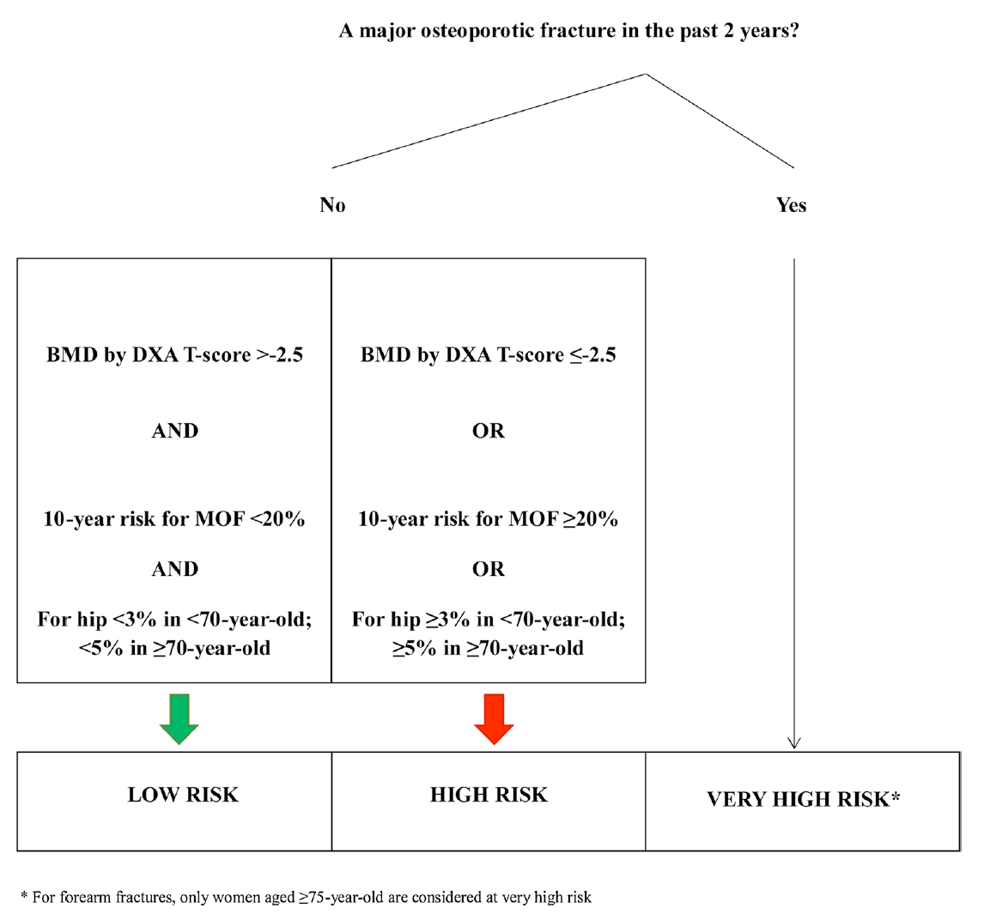
Qui traiter ?
> Ostéoporose post-ménopausique et de l’homme > 50 ans
Belgian Bone Club, actualisation 2020
Vertèbre, bassin, hanche, fémur, humerus
Avant-bras dont poignet si > 75 ans

Slide 47
Pourquoi classifier « fracture OP majeure < 2 ans » comme un « very high risk » ?

Slide 48
Pourquoi proposer un agent anabolique en première ligne ?
Parce que les français le font aussi !
« Quand la France s’enrhume, la Belgique se mouche ». En France, remboursement en première intention du Teriparatide cas de fracture vertébrale (2)

Slide 49
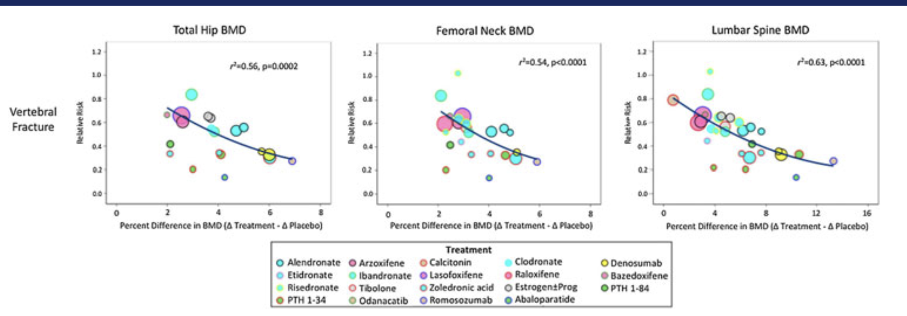
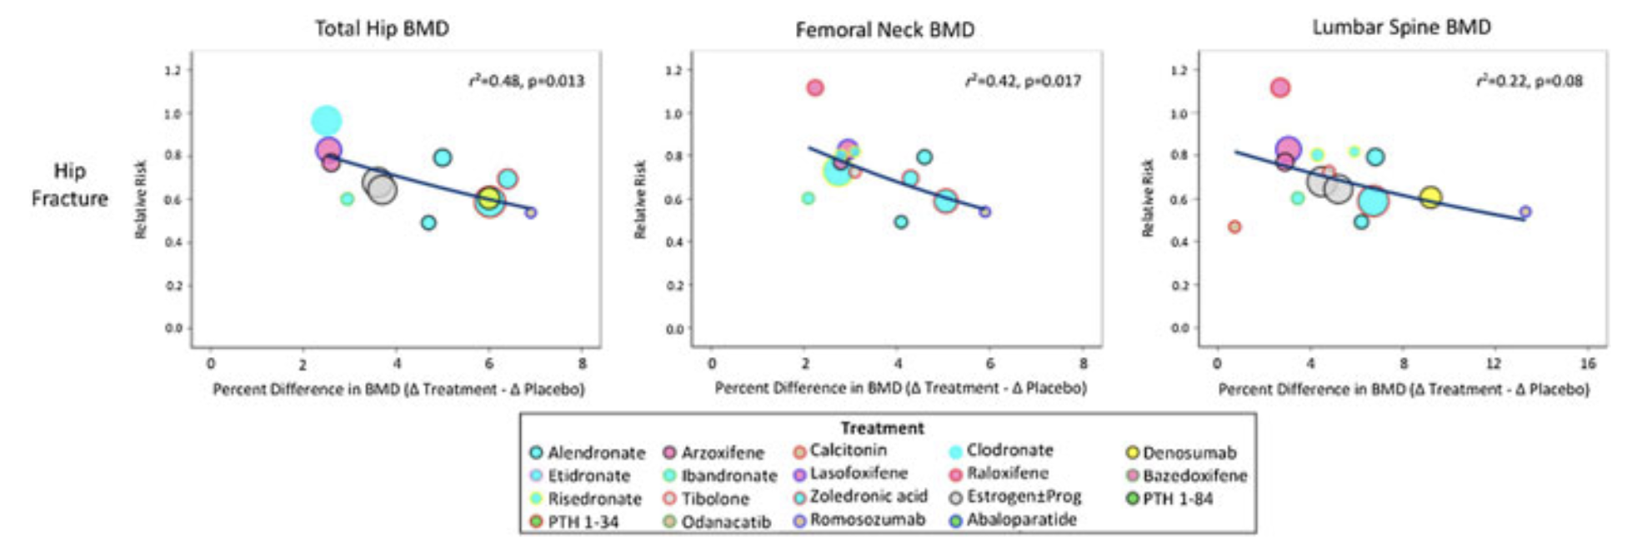
Pourquoi proposer un agent anabolique en première ligne ?
Parce que gagner 12% de DMO lombaire en 6 mois, c’est beaucoup
Et que le lien gain de DMO – réduction du risque des fracture est un lien fort et bien confirmé
https://doi.org/10.1002/jbmr.3641

Slide 50
Pourquoi proposer un agent anabolique en première ligne ?
Parce que le positionnement ancien d’un anabolique “en dernière ligne” n’est pas la meilleure option si l’on veut augmenter la DMO corticale
https://doi.org/10.1002/jbmr.3051

Slide 51
Pourquoi proposer un agent anabolique en première ligne ?
Parce que c’est “cout-efficace”

Slide 52
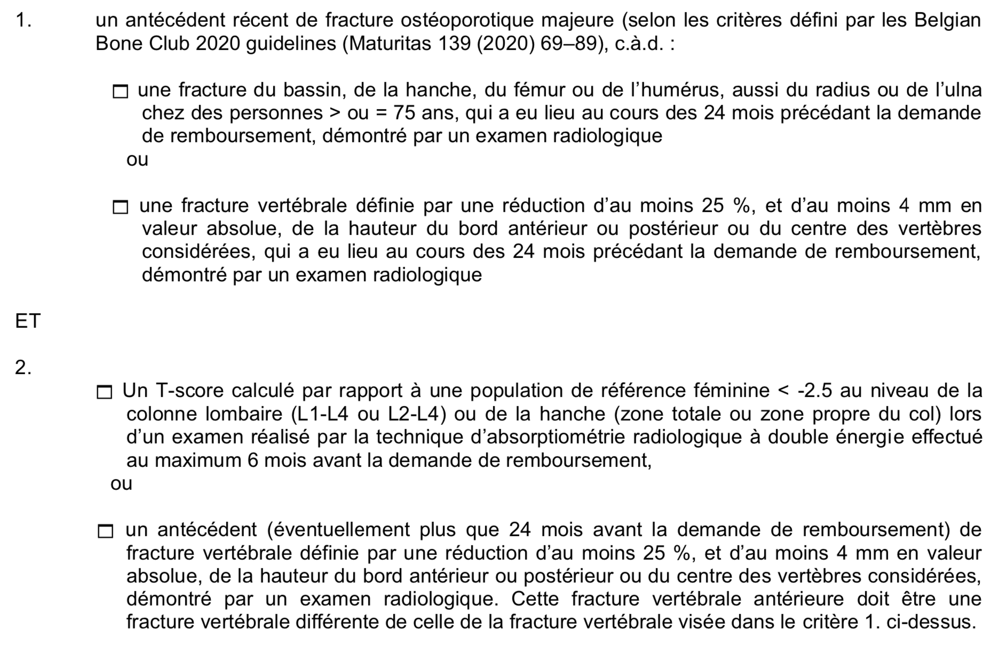
Evinity®
Sous-cutanée, 1/mois, 2 injections de 105 mg chaque mois
1 an, avec suivi par un inhibiteur de la résorption
Prescription par un rhumatologue, physiothérapeute ou spécialiste en médecine interne
Condition = ostéoporose sévère

Slide 53
Evinity®
Sous-cutanée, 1/mois, 2 injections de 105 mg chaque mois
1 an, avec suivi par un inhibiteur de la résorption
Prescription par un rhumatologue, physiothérapeute ou spécialiste en médecine interne
Condition = ostéoporose sévère
Ostéoporose densitométrique non fracturaire : non
Fracture majeure unique sans ostéoporose densitométrique : non
Fracture majeure < 2 ans + ostéoporose densitométrique + : oui
(quelles que soit les lignes de traitements antérieurs)
Fracture majeure < 2 ans + ATCD (quel que soit le timing) de fracture vertébrale (différente de la première fracture) : oui
(quelles que soit les lignes de traitements antérieurs)
Remboursement pour 12 conditionnements de 2 seringues de 105mg

Slide 54
Une nouveauté dans la prise en charge de l’ostéoporose
Le Romosozumab (Evinity®)
Présentation de la molécule
Efficacité par rapport aux autres traitements disponibles
Place dans la séquence thérapeutique en 2021
Procédure de gestion des risques
Dr Olivier Malaise
M.D., Ph.D.
Service de rhumatologie, CHU de Liège

Slide 55
Overview of the Romosozumab Clinical Programme*
PHASE II
(NCT00896532)¹
Efficacy and safety vs alendronate, teriparatide and placebo in postmenopausal women with low BMD (N = 419)
^{Feb 2011}
BRIDGE
(NCT02186171)⁴
Placebo-controlled BMD study in men with osteoporosis (N = 245)
VS PLACEBO (HOMME)
^{Feb 2016}
ARCH
(NCT01631214)⁵
Active-comparator fracture study vs alendronate in postmenopausal women with osteoporosis and high risk of fracture (N = 4093)
Vs BISPHOSPHONATE
^{Feb 2017}
Primary completion date
^{May 2015}
STRUCTURE
(NCT01796301)²
^{Dec 2015}
FRAME
(NCT01575834)³
Active-comparator BMD study vs teriparatide in postmenopausal women with osteoporosis transitioning from alendronate (N = 436)
VS TERIPARATIDE
Placebo-controlled fracture study in postmenopausal women with osteoporosis (N = 7180)
VS PLACEBO
*Not all romosozumab clinical studies listed. BMD = bone mineral density. 1. McClung MR, et al. N Engl J Med 2014;370:412–20; 2. Langdahl BL, et al. Lancet 2017;390:1585–94; 3. Cosman F, et al. N Engl J Med 2016;375:1532–43; 4. Lewiecki EM, et al. J Clin Endocrinol Metab 2018;103:3183–93; 5. Saag KG, et al. N Engl J Med 2017;377:1417–27.

Slide 56
Overview of the Romosozumab Clinical Programme*
PHASE II
(NCT00896532)¹
Efficacy and safety vs alendronate, teriparatide and placebo in postmenopausal women with low BMD (N = 419)
^{Feb 2011}
BRIDGE
(NCT02186171)⁴
Placebo-controlled BMD study in men with osteoporosis (N = 245)
VS PLACEBO (HOMME)
^{Feb 2016}
ARCH
(NCT01631214)⁵
Active-comparator fracture study vs alendronate in postmenopausal women with osteoporosis and high risk of fracture (N = 4093)
Vs BISPHOSPHONATE
^{Feb 2017}
Primary completion date
^{May 2015}
STRUCTURE
(NCT01796301)²
^{Dec 2015}
FRAME
(NCT01575834)³
Active-comparator BMD study vs teriparatide in postmenopausal women with osteoporosis transitioning from alendronate (N = 436)
VS TERIPARATIDE
Placebo-controlled fracture study in postmenopausal women with osteoporosis (N = 7180)
VS PLACEBO
*Not all romosozumab clinical studies listed. BMD = bone mineral density. 1. McClung MR, et al. N Engl J Med 2014;370:412–20; 2. Langdahl BL, et al. Lancet 2017;390:1585–94; 3. Cosman F, et al. N Engl J Med 2016;375:1532–43; 4. Lewiecki EM, et al. J Clin Endocrinol Metab 2018;103:3183–93; 5. Saag KG, et al. N Engl J Med 2017;377:1417–27.

Slide 57
FRAME: Adverse Events of Interest*^{1,2}
Subject incidence | 12-month double-blind period |  | 24-month primary analysis period |  | 36-month final analysis period
 | Romosozumab (n = 3581) n (%) | Placebo (n = 3576) n (%) | Romosozumab-to-denosumab (n = 3581) n (%) | Placebo-to- denosumab (n = 3576) n (%) | Romosozumab-to-denosumab (n = 3581) n (%) | Placebo-to- denosumab (n = 3576) n (%)
Atypical femoral fracture (AFF)† | 1 (<0.1) | 0 (0.0) | 1 (<0.1) | 0 (0.0) | 1 (<0.1) | 0 (0.0)
Hyperostosis | 19 (0.5) | 27 (0.8) | 35 (1.0) | 40 (1.1) | 49 (1.4) | 58 (1.6)
Hypersensitivity | 242 (6.8) | 245 (6.9) | 314 (8.8) | 331 (9.3) | 370 (10.3) | 375 (10.5)
Hypocalcaemia | 1 (<0.1) | 0 (0.0) | 6 (0.2) | 3 (0.1) | 9 (0.3) | 3 (<0.1)
Injection-site reaction | 187 (5.2) | 104 (2.9) | 188 (5.2) | 106 (3.0) | 189 (5.3) | 107 (3.0)
Cancer | 59 (1.6) | 69 (1.9) | 105 (2.9) | 100 (2.8) | 126 (3.5) | 121 (3.4)
Osteoarthritis | 281 (7.8) | 315 (8.8) | 396 (11.1) | 431 (12.1) | 488 (13.6) | 497 (13.9)
Osteonecrosis of the jaw (ONJ)† | 1 (<0.1) | 0 (0.0) | 2 (<0.1) | 0 (0.0) | 2 (<0.1) | 0 (0.0)
The subject incidence rates for the 36-month period include all events that occurred in the 12-month double-blind period and, in addition, all events that occurred in the open-label and extension periods for those subjects who received at least one dose of denosumab.
*Identified by prespecified search strategies using MedDRA version 19.1. Hypocalcaemia, injection-site reaction, osteoarthritis and hyperostosis (preferred term exostosis) include only treatment-emergent adverse events as a result of Amgen-defined MedDRA search strategies. Hypersensitivity and malignancy include only treatment-emergent adverse events as a result of a narrow search/scope in SMQs. Serious cardiovascular events are noted in prior slide. Hyperostosis was an EOI at the time of the study but is no longer an EOI. †Includes adverse events adjudicated positive by an independent adjudication committee.
n = number of subjects randomised and received at least one dose of the study drug in the 12-month double-blind study period
EOI = event of interest; NR = not reported; MedDRA = Medical Dictionary for Regulatory Activities; SMQ = standardised MedDRA query.
1. Cosman F, et al. N Engl J Med 2016;375:1532–43; 2. Lewiecki EM, et al. J Bone Miner Res 2019;34:419–28.

Slide 58
FRAME: Two Cases of Positively Adjudicated Osteonecrosis of the Jaw (ONJ)
Event time to onset | Case description
12 months on study | Received 12 doses of romosozumab Event occurred in the setting of ill-fitting denture use Event resolved
13 months on study | Received 12 doses of romosozumab and one dose of denosumab Event occurred after a tooth extraction with subsequent osteomyelitis of the jaw
Cosman F, et al. N Engl J Med 2016;375:1532–43.

Slide 59
FRAME: Adverse Events^{1,2}
Subject incidence | 12-month double-blind period |  | 24-month primary analysis period |  | 36-month final analysis period
 | Romosozumab (n = 3581) n (%) | Placebo (n = 3576) n (%) | Romosozumab-to-denosumab (n = 3581) n (%) | Placebo-to- denosumab (n = 3576) n (%) | Romosozumab-to-denosumab (n = 3581) n (%) | Placebo-to- denosumab (n = 3576) n (%)
All adverse events | 2806 (78.4) | 2850 (79.7) | 3053 (85.3) | 3069 (85.8) | 3156 (88.1) | 3182 (89.0)
Serious adverse events | 344 (9.6) | 312 (8.7) | 565 (15.8) | 540 (15.1) | 728 (20.3) | 733 (20.5)
Adjudicated cardiovascular serious adverse events* | 44 (1.2) | 41 (1.1) | 82 (2.3) | 79 (2.2) | 128 (3.6) | 124 (3.5)
Deaths | 29 (0.8) | 23 (0.6) | 52 (1.5) | 47 (1.3) | 72 (2.0) | 85 (2.4)
Adjudicated cardiovascular deaths* | 17 (0.5) | 15 (0.4) | 31 (0.9) | 29 (0.8) | 43 (1.2) | 50 (1.4)
Events leading to study discontinuation | 44 (1.2) | 50 (1.4) | 52 (1.5) | 56 (1.6) | 64 (1.8) | 64 (1.8)
The subject incidence rates for the 36-month study period include all events that occurred in the 12-month double-blind period and, in addition, all events that occurred in the open-label and extension periods for those subjects who received at least one dose of denosumab.
*Includes adverse events adjudicated positive by an independent adjudication committee. Cardiovascular deaths include fatal events adjudicated as
cardiovascular-related or undetermined (presumed cardiac-related).
n = number of subjects randomised and received at least one dose of the study drug in the 12-month double-blind study period.
1. Cosman F, et al. N Engl J Med 2016;375:1532–43; 2. Lewiecki EM, et al. J Bone Miner Res 2019;34:419–28.

Slide 60
Overview of the Romosozumab Clinical Programme*
PHASE II
(NCT00896532)¹
Efficacy and safety vs alendronate, teriparatide and placebo in postmenopausal women with low BMD (N = 419)
^{Feb 2011}
BRIDGE
(NCT02186171)⁴
Placebo-controlled BMD study in men with osteoporosis (N = 245)
VS PLACEBO (HOMME)
^{Feb 2016}
ARCH
(NCT01631214)⁵
Active-comparator fracture study vs alendronate in postmenopausal women with osteoporosis and high risk of fracture (N = 4093)
Vs BISPHOSPHONATE
^{Feb 2017}
Primary completion date
^{May 2015}
STRUCTURE
(NCT01796301)²
^{Dec 2015}
FRAME
(NCT01575834)³
Active-comparator BMD study vs teriparatide in postmenopausal women with osteoporosis transitioning from alendronate (N = 436)
VS TERIPARATIDE
Placebo-controlled fracture study in postmenopausal women with osteoporosis (N = 7180)
VS PLACEBO
*Not all romosozumab clinical studies listed. BMD = bone mineral density. 1. McClung MR, et al. N Engl J Med 2014;370:412–20; 2. Langdahl BL, et al. Lancet 2017;390:1585–94; 3. Cosman F, et al. N Engl J Med 2016;375:1532–43; 4. Lewiecki EM, et al. J Clin Endocrinol Metab 2018;103:3183–93; 5. Saag KG, et al. N Engl J Med 2017;377:1417–27.

Slide 61
ARCH: Adverse Events and Events of Interest
Event | Month 12: Double-blind period |  |  | Primary Analysis: Double-blind and open-label period*
 | Romosozumab (n = 2040) | Alendronate (n = 2014) |  | Romosozumab-to- alendronate (n = 2040) | Alendronate-to- alendronate (n = 2014)
Adverse event during treatment | 1544 (75.7%) | 1584 (78.6%) |  | 1766 (86.6%) | 1784 (88.6%)
Back pain† | 186 (9.1%) | 228 (11.3%) |  | 329 (16.1%) | 393 (19.5%)
Nasopharyngitis† | 213 (10.4%) | 218 (10.8%) |  | 363 (17.8%) | 373 (18.5%)
Event leading to discontinuation of trial regimen | 70 (3.4%) | 64 (3.2%) |  | 133 (6.5%) | 146 (7.2%)
Event leading to discontinuation of trial participation | 30 (1.5%) | 27 (1.3%) |  | 47 (2.3%) | 43 (2.1%)
Event of interest‡
Osteoarthritis§ | 138 (6.8%) | 146 (7.2%) |  | 247 (12.1%) | 268 (13.3%)
Hypersensitivity | 122 (6.0%) | 118 (5.9%) |  | 205 (10.0%) | 185 (9.2%)
Injection-site reaction¶ | 90 (4.4%) | 53 (2.6%) |  | 90 (4.4%) | 53 (2.6%)
Cancer | 31 (1.5%) | 28 (1.4%) |  | 84 (4.1%) | 85 (4.2%)
Hyperostosis‖ | 2 (<0.1%) | 12 (0.6%) |  | 23 (1.1%) | 27 (1.3%)
Hypocalcaemia | 1 (<0.1%) | 1 (<0.1%) |  | 4 (0.2%) | 1 (<0.1%)
Atypical femoral fracture** | 0 | 0 |  | 2 (<0.1%) | 4 (0.2%)
Osteonecrosis of the jaw** | 0 | 0 |  | 1 (<0.1%) | 1 (<0.1%)
*Incidence rates at the time of the primary analysis were cumulative and included all events in the double-blind and open-label period (to February 27 2017) in patients who received at least one dose of open-label alendronate.
†Shown are events that occurred in 10% or more of the patients in either group during the double-blind period.
‡Events of interest were those that were identified by prespecified Medical Dictionary for Regulatory Activities search strategies.
§Prespecified events were osteoarthritis, spinal osteoarthritis, exostosis, arthritis, polyarthritis, arthropathy, monoarthritis and interspinous osteoarthritis. ¶The most frequent adverse events of injection-site reactions (occurring in > 0.1% of the patients) in the romosozumab group during the double-blind period included injection-site pain (1.6% of patients), erythema (1.3%), pruritus (0.8%), hemorrhage (0.5%), rash (0.4%) and swelling (0.3%). ‖Prespecified events were exostosis (mostly reported as heel spurs), lumbar spinal stenosis, spinal column stenosis, cervical spinal stenosis, enostosis, extraskeletal ossification and vertebral foraminal stenosis.
**Potential cases of osteonecrosis of the jaw and atypical femoral fracture were adjudicated by independent committees.
Adapted from: Saag KG, et al. N Engl J Med 2017;377:1417–27.

Slide 62
ARCH: Serious Adverse Events
Event | Month 12: Double-blind period |  |  | Primary analysis: Double-blind and open-label period*
 | Romosozumab (n = 2040) | Alendronate (n = 2014) |  | Romosozumab to alendronate (n = 2040) | Alendronate to alendronate (n = 2014)
Serious adverse event | 262 (12.8%) | 278 (13.8%) |  | 586 (28.7%) | 605 (30.0%)
Adjudicated serious cardiovascular (CV) event† | 50 (2.5%) | 38 (1.9%) |  | 133 (6.5%) | 122 (6.1%)
Cardiac ischaemic event | 16 (0.8%) | 6 (0.3%) |  | 30 (1.5%) | 20 (1.0%)
Cerebrovascular event | 16 (0.8%) | 7 (0.3%) |  | 45 (2.2%) | 27 (1.3%)
Heart failure | 4 (0.2%) | 8 (0.4%) |  | 12 (0.6%) | 23 (1.1%)
Death | 17 (0.8%) | 12 (0.6%) |  | 58 (2.8%) | 55 (2.7%)
Noncoronary revascularisation | 3 (0.1%) | 5 (0.2%) |  | 6 (0.3%) | 10 (0.5%)
Peripheral vascular ischaemic event not requiring revascularisation | 0 | 2 (<0.1%) |  | 2 (<0.1%) | 5 (0.2%)
Death | 30 (1.5%) | 21 (1.0%)‡ |  | 90 (4.4%) | 90 (4.5%)‡
*Incidence rates at the time of the primary analysis were cumulative and included all events in the double-blind and open-label period (to February 27 2017) in patients who received at least one dose of open-label alendronate. †Serious CV adverse events were adjudicated by the Duke Clinical Research Institute. CV deaths include fatal events that were adjudicated as being CV-related or undetermined (and, therefore, possibly CV-related). ‡One patient had a non-treatment-related serious adverse event of pneumonia that was incorrectly flagged as death in the primary analysis snapshot and was not included in the analysis of fatal events.
Adapted from: Saag KG, et al. N Engl J Med 2017;377:1417–27.

Slide 63
Aussi des effets secondaires CV avec les oestrogènes, le protelos et l’adenacatib (anti-cathepsin K)
Comment expliquer les effets secondaires cardio-vasculaires?
> Population à plus grand risque ?
> ⬇ du risque avec l’alendronate ?
> sclerostine = régulateur négatif des calcifications vasculaires chez les animaux

Slide 65
EVINITY® fait l’objet d’une surveillance supplémentaire et d’un Plan de Gestion des Risques comme demandé par l’EMA
Le patient doit être informé des risques liés au traitement et recevoir une carte de Surveillance du Patient

Slide 66
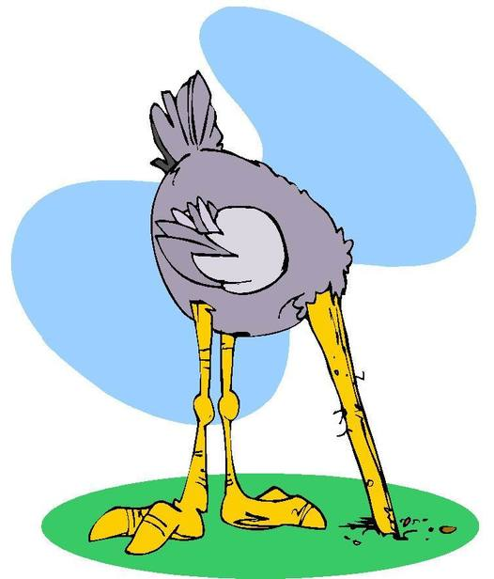
EVINITY® fait l’objet d’une surveillance supplémentaire et d’un Plan de Gestion des Risques comme demandé par l’EMA
Le patient doit être informé des risques liés au traitement et recevoir une carte de Surveillance du Patient
« Balance philosophique »
Expliquer les effets secondaires en détail malgré leur rareté
« Ouvrir la boite de Pandore » et s’exposer à un refus du traitement / compliance basse malgré le risque élevé de fracture
Banaliser les effets secondaires des traitements de l’ostéoporose
« Technique de l’autruche » et s’exposer à une perte de confiance si un événement survient (ou si le patient en entend parler)

Slide 67
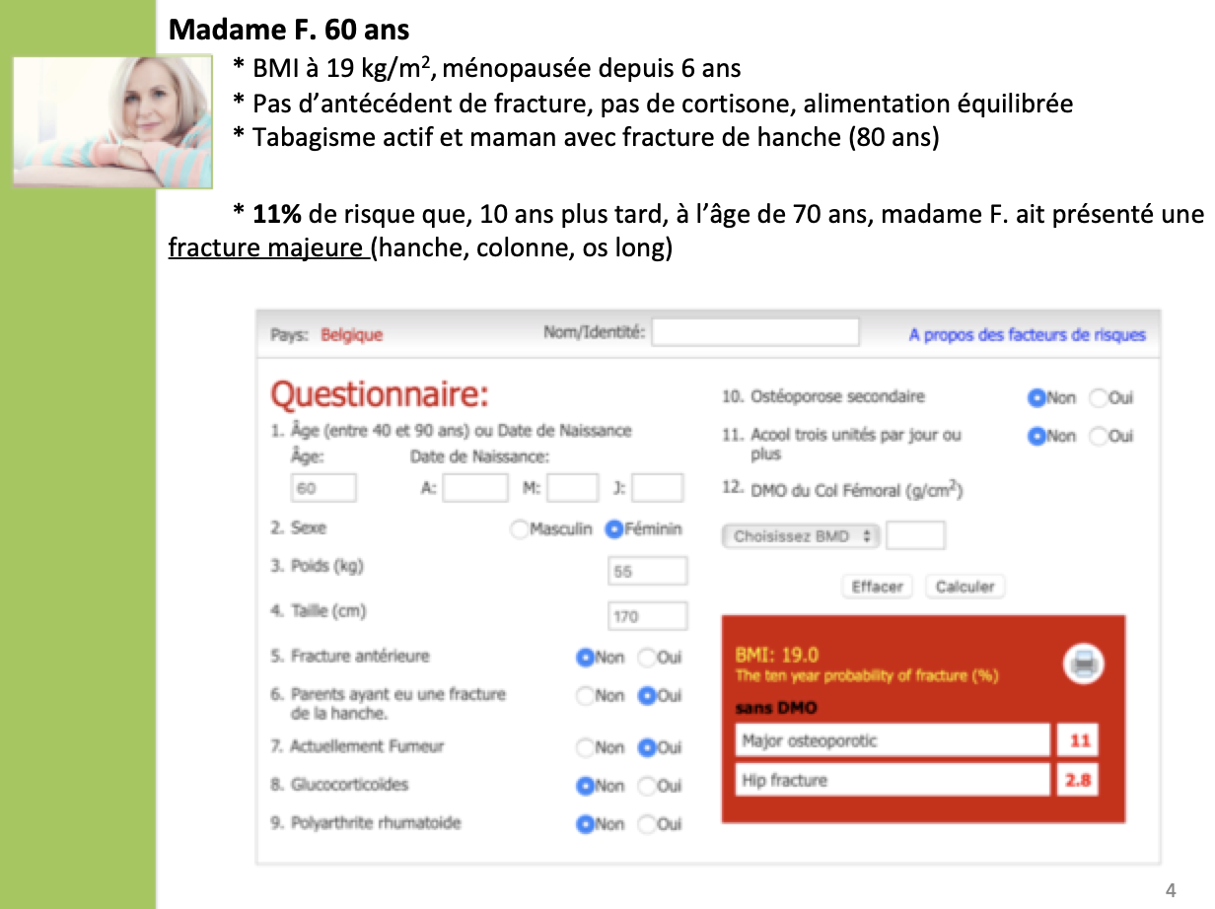
Le patient ne connaît généralement pas son risque réel de fracture ni les conséquences d’une fracture ostéoporotique majeure, et il surestime les capacité du calcium et de la vitamine D à réduire le risque fracturaire
Le patient connaît les effets secondaires via la notice scientifique, via internet ou via un autre praticien
Barrionuevo et al. 2019. Effet sur les fractures vertébrales

Slide 68
EVINITY® fait l’objet d’une surveillance supplémentaire et d’un Plan de Gestion des Risques comme demandé par l’EMA
Le patient doit être informé des risques liés au traitement et recevoir une carte de Surveillance du Patient
Contre-indication en cas d’hypocalcémie
Mesure préalable et correction si nécessaire
Surveillance clinique
Crampes/spasmes ; paresthésies ; contraction du visage ; crises convulsives ; effets neuropsychiatriques
Mesure du calcium si symptômes
GFR < 30 ml/min ou dialyse : majoration du risque et surveillance biologique nécessaire
Rationnel : hypocalcémie transitoire observée dans les essai clinique
Idem Denosumab …

Slide 69
EVINITY® fait l’objet d’une surveillance supplémentaire et d’un Plan de Gestion des Risques comme demandé par l’EMA
Le patient doit être informé des risques liés au traitement et recevoir une carte de Surveillance du Patient
Contre-indication en cas d’hypocalcémie
Contre-indication en cas d’ATCD d’infarctus du myocarde ou d’AVC
Chez les patients sans ATCD, le rapport risque / bénéfice individuel du traitement doit être soigneusement évalué
Tenir compte de la balance « risque de fracture » et « risque cardio-vasculaire »
Maladie CV établie, hyperlipidémie, diabète sucré, tabagisme, insuffisance rénale sévère, âge
Arrêt du traitement si événement cardiovasculaire durant le traitement
Note :
En Belgique, les patients sont de facto à haut risque de fracture vu les critères de remboursement
Idem Raloxifène …
Insuffisant rénal ? Pas de contre-indication en cas de GFR < 30 ml/min …

Slide 70
EVINITY® fait l’objet d’une surveillance supplémentaire et d’un Plan de Gestion des Risques comme demandé par l’EMA
Le patient doit être informé des risques liés au traitement et recevoir une carte de Surveillance du Patient
Contre-indication en cas d’hypocalcémie
Contre-indication en cas d’ATCD d’infarctus du myocarde ou d’AVC
Chez les patients sans ATCD, le rapport risque / bénéfice individuel du traitement doit être soigneusement évalué
Les facteurs de risque pour le développement de l’ostéonécrose de la mâchoire doivent être prises en compte et les mesures préventives doivent être encouragées
Prendre en compte les FR d’ONM au moment de la prescription
Idem bisphosphonate et denosumab
Encourager les patients à
Signaler tout symptôme dentaire
Maintenir une bonne hygiène buccale
Recevoir des examens dentaires réguliers

Slide 71
Rappel des facteurs de risque
Liés aux co-morbidités systémiques
Corticothérapie
Tabagisme actif
Diabète sucré
Irradiation sur la mâchoire
Néoplasie associée / chimiothérapie
Liés à la sphère dentaire
Extraction dentaire ou geste touchant à la trame osseuse
Maladie dentaire ou parodontale pré-existante
Mauvaise hygiène dentaire
Liés au traitement
Dose cumulée (dose par traitement et nombres de doses)
Puissance et potentiel anti-résorptif ?

Slide 72
En conclusion :
Evinity® est un nouvel agent « mixte », qui joue principalement sur l’activation des ostéoblastes, en complexant la sclérostine, régulateur négatif de la voie Wnt
Cette molécule est plus efficace que les autres, dans les circonstances des 3 études pivots
FRAME: 1 an contre placebo, avec relai denosumab
Efficacité sur les fractures vertébrales dans une population à risque fracturaire modéré
ARCH : 1 an contre alendronate, avec relai alendronate
Efficacité complète dans une population à haut risque fracturaire
STRUCTURE : 1 an contre teriparatide, avec ATCD de bisphosphonate
Efficacité complète dans une population à haut risque fracturaire résistant aux bisphosphonates
Au niveau « safety »
Même précautions que les inhibiteurs de la résorption concernant les ONM et les FFA
Même précautions que les inhibiteurs de la résorption sc / iv concernant le risque d’hypocalcémie
Interrogations sur un sur-risque CV chez les patients avec FR CV. Contre-indications adaptées à cette interrogation.

Slide 73
En conclusion :
Evinity® est un nouvel agent « mixte », qui joue principalement sur l’activation des ostéoblastes, en complexant la sclérostine, régulateur négatif de la voie Wnt
Remboursement autorisé si
(1) ATCD de fracture ostéoporotique majeure < 2 ans
ET
(2) OU T-score <2.5 sur la colonne lombaire, la hanche totale ou le col femoral
(2) OU ATCD (différent du point 1) de fracture vertébrale

