Slide 1
University Mohammed First, Faculty of Sciences, Department of Chemistry
International conference on Advanced Materials, Nanosciences and application (ICAMANA 2019)
Oujda
Physico-mechanical behavior of solid waste-bentonite-lime based mixtures
Achraf HARROU ^{1, *}, Elkhadir GHARIBI ¹, Hicham NASIRI ², Meriam EL OUAHABI ³.
¹ Laboratory of Mineral and Analytical Solid Chemistry, Faculty of Sciences, University Mohammed first, Oujda, P.O. Box 60000, Morocco.
² Applied Geoscience Laboratory Faculty of Sciences, University Mohammed first, Oujda, P.O. Box 60000, Morocco.
³ UR Argile, Géochimie et Environnement sédimentaires (AGEs), Département de Géologie, Quartier Agora, Bâtiment, B18, Allée du six Aout, 14, Sart-Tilman, University of Liège, B-4000, Belgium.
Notes:
Hello everyone before presenting my work first I would to thank my University Mohammed First, Faculty of Sciences, Department of Chemistry for the organization of this International Conference on Advanced Materials, Nanosciences and Application (ICAMANA 2019) dear professor, dear student dear assistance, I’m honor to present my work intituled Physico-mechanical behavior of solid waste-bentonite-lime based mixtures This work is realized in the laboratory of solid mineral and analytical chemistry under the direction of Mr Gharibi Elkhadir.

Slide 2
Plan :
Introduction / Problematic
Materials and Methods
Results and Discussion
Conclusion and Perspective
Notes:
For the plan of this representation consists the following points
I will start with the intrduciton and the problematic of PG and Steel slag and the environmental impact for both waste
for the 2nd point consists the materials and methods used
then the results and discussion *
and I will finished with the conclusion and perspective

Slide 3
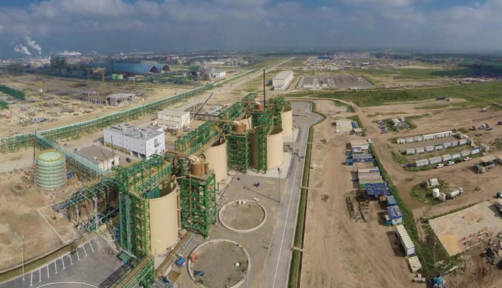
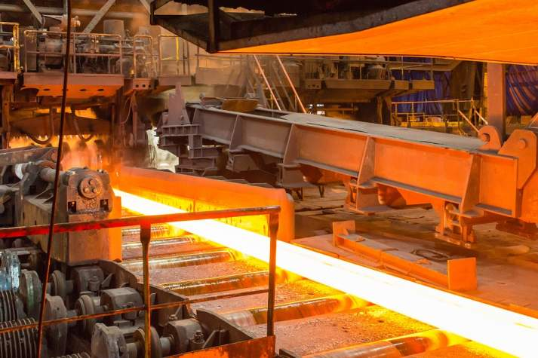
Introduction / Problematic
Increasing industrial production generates a large quantity of solid wastes, which has interest valorization and waste management investigations.
Phosphogypsum (PG) is a waste by-product of the phosphates industry. In Morocco OCP (Jorf Lasfar) generates more than 15 million tons per year this qunatity is throwing into the sea and steel manufacturing company (SONASID) produces steel slag (Ss) waste 150 000 tons per year.
Terminal station at Jorf Lasfar
Steel Industry Jorf Lasfar
Notes:
Recently, increasing industrial production generates a large quantity of solid wastes, which has interest valorization and waste management investigations [1, 2, 3]. Phosphogypsum (PG) is a waste by-product of the phosphates industry. In Morocco Chérifien Phosphates Office OCP located (Jorf Lasfar) generates more than 15 million tons per year this qunatity is throwing into the sea and steel manufacturing company (SONASID) produces steel slag (SC) waste 150 000 one hundred and fifty thousand tons per year.

Slide 4
Introduction / Problematic
PG contains toxic elements for ecosystems and human health, including heavy metals and radionuclides. PG may also contaminate surface and groundwater sources.
The Phosphogypsum (PG) of chemical formula: CaSO₄, 2H₂O, is produced by the phosphate industry according to the following chemical reaction :
Ca₅(PO₄)₃X + 5 H₂SO₄ + 10 H₂O → 3 H₃PO₄ + 5 (CaSO₄, 2H₂O) + HX
Dans X=OH, F, Cl,Br.
The study aims to reduce this industrial waste by incorporate them into bentonite and lime mixture. The main objective is also to enhance the uniaxial strength of the wastes-bentonite-lime based mixtures.
Notes:
And this wates specialy aPhosphogypsum contains toxic elements for ecosystems and human health, including heavy metals and radionuclides. PG may also contaminate surface water and groundwater sources
The Phosphogypsum (PG) with the chemical formula: CaSO₄, 2H₂O, is produced by the phosphate industry according to the following chemical reaction :

Slide 5
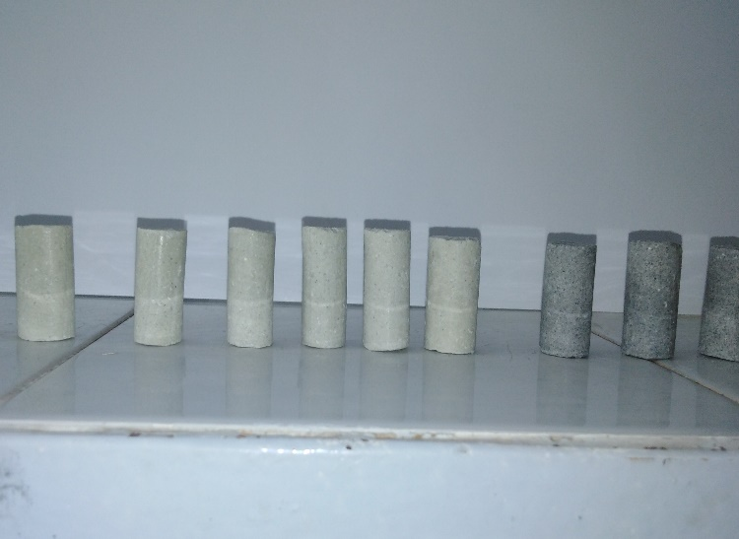
Materials and Methods
The mixture are compound by the following constitutions :
7,14,28 days
+46% water
Bentonite (B)
+
steel slag(Ss)
+
Phosphogypsum (PG)
+
Lime
solid mixture test tube
The mixture study :
Bentonite-Lime (BC)
Bentonite-Lime-Phosphogypsum (BCPG)
Bentonite-Lime-Phosphogypsum-Steel Slag (BCPGSs)
The compressive uniaxial strength (UCS)

Slide 6
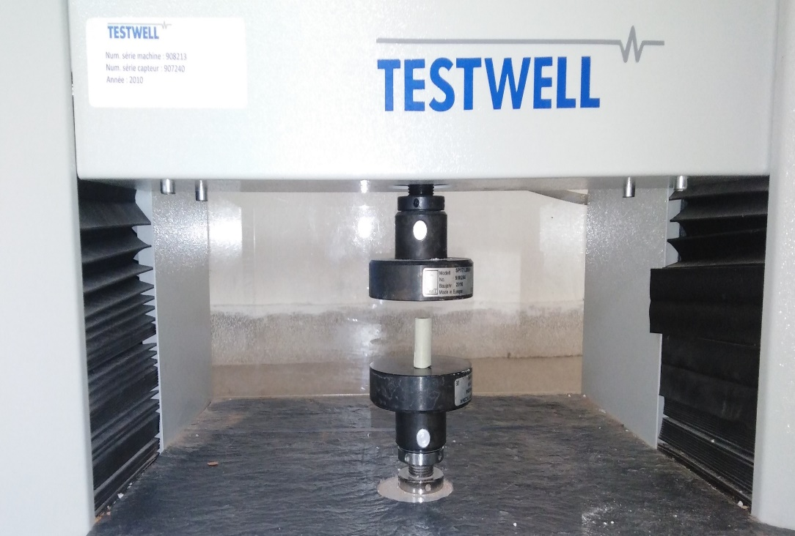
Materials and Methods
Uniaxial Compressive Strength (UCS) :
UCS indicate strength of a rock material
UCS is used to test falling behavior of rock material
In laboratory a instrument and checked when it crack (fail)
UCS is important test to avoid unintended event

Slide 7
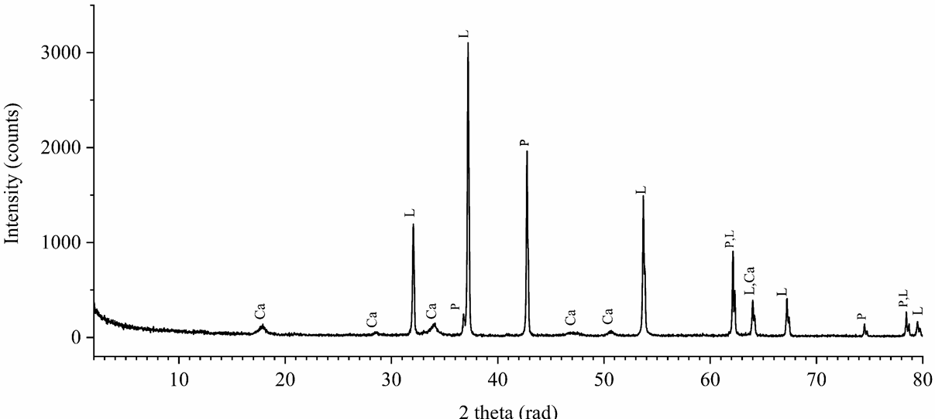
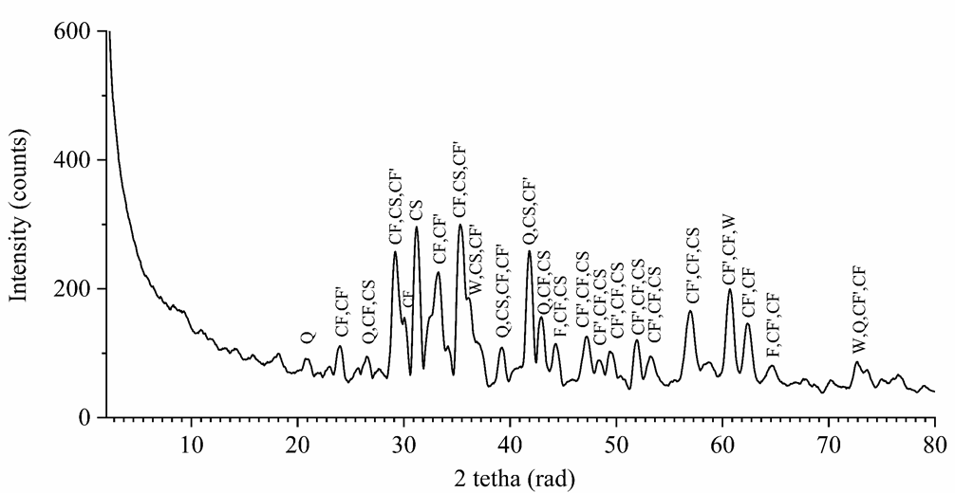
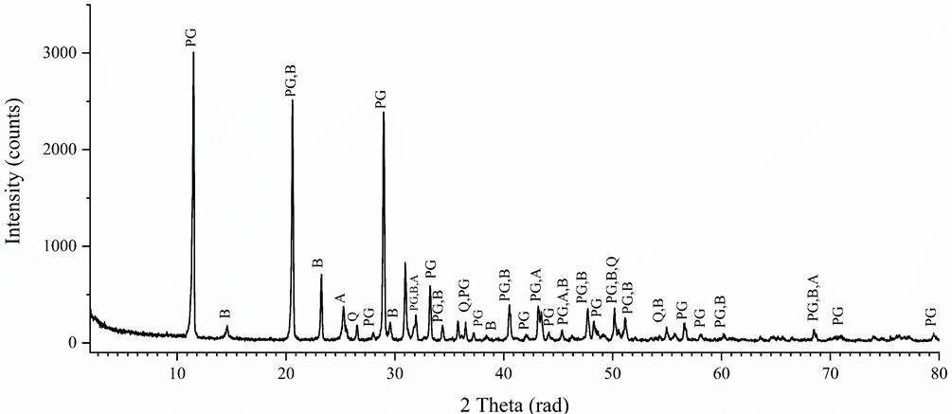
Materials and Methods
Raw Bentonite (RB)
Lime (L)
Steel Slag (Ss)
Gypsum (PG)

Slide 8
Materials and Methods
DRX | Index | Mineral name | Chemical formula
Raw Bentonite (RB) | M | Montmorilonite-Ca (15A) | Ca_{0.2}(Al,Mg)₂Si₄O₁₀(OH)₂ ,4H₂O
 | M’ | Montmorilonite-Na (15A) | Na_{0,3}(Al,Mg)₂Si₄O₁₀(OH)₂ ,4H₂O
 | F | Feldspar potasian Feldspar (K-component) Feldspar (Na-component) | K₅Na₅AlSi₃O₈ K(AlSi₃O₈) Na(AlSi₃O₈)
 | Q | Quartz | SiO₂
 | Ca | Ca: Calcite | CaCO₃
Lime (L) | P | P: Periclase | MgO
 | L | L: Lime | CaO
 | Ca | Ca: Calcium Hydroxide | Ca(OH)₂
DRX | Index | Mineral name | Chemical formula
Gypsum (PG) | PG | Gypsum | CaSO₄,2H₂O
 | Q | Quartz | SiO₂
 | A | Anhydrite | CaSO₄
 | B | Bassanite | CaSO₄,1/2H₂O
Steel Slag (Ss) | F | Iron | Fe
 | Q | Quartz | SiO₂
 | W | Wustite | FeO₂
 | CF | Calcium Iron Oxide | CaFe₂O₄
 | CS | Calcium Silicate | Ca₂SiO₄
 | CF' | Srebrodolskite | Fe₂O₃(CaO)₂

Slide 9
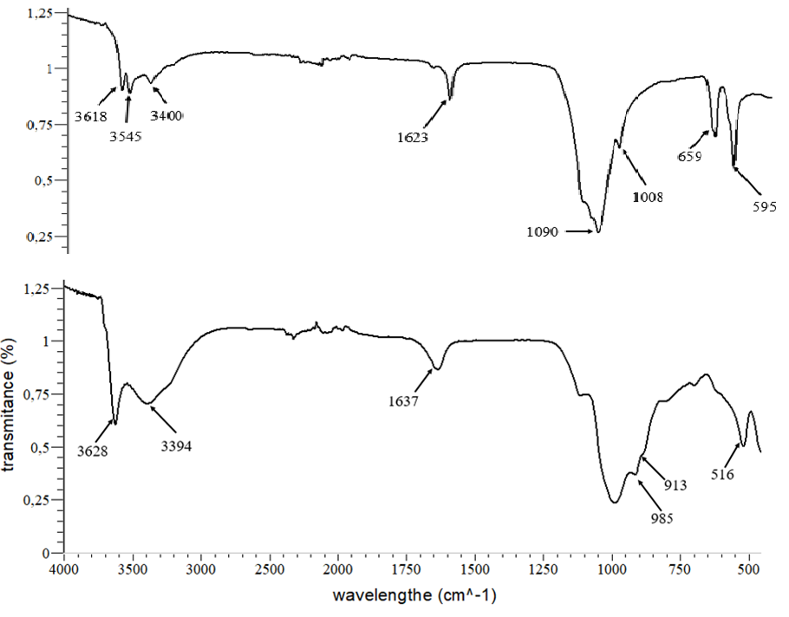
Materials and Methods
Band (cm⁻¹) | Bentonite | Gypsume CaSO₄,2H₂O | Anhydrite CaSO₄ | Bassanite CaSO₄, 1/2H₂O
H₂O stretch | 3650-3600 | 3640-3230 | ----- | 3640-3230
H₂O Vibration | 1623 | 1623 | 1623 | 1637
Si-O | 1030 | ----- | ----- | -----
AL-O Si-O | 400-600 | ----- | ----- | -----
SO₄ v₃ | ----- | 1197-1154 | 1169-1157 | 1195-1154
SO₄ v₁ | ----- | 1012 | 1015 | 1005
SO₄ v₄ | ----- | 673 | 687 | 663
SO₄ v₄ | ----- | 604 | 619 | 598
SO₄ v₂ | ----- | 470 | 510 | 490
Gypsum (PG)
Raw Bentonite (RB)
Notes:
As shown in Figure 5, the characteristic absorption peaks were showed in the IR spectra of the original Ca-Bent: a broad and strong -OH stretching vibration peak in 3650cm⁻¹~3600cm⁻¹, and the -OH stretching vibration peak near 1640cm⁻¹, both of them are the representation of crystalline water in bentonite lattice.

Slide 10
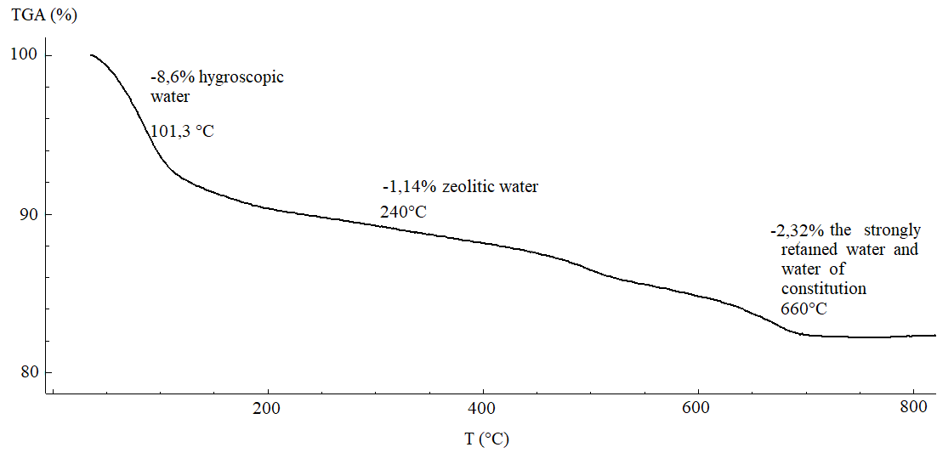
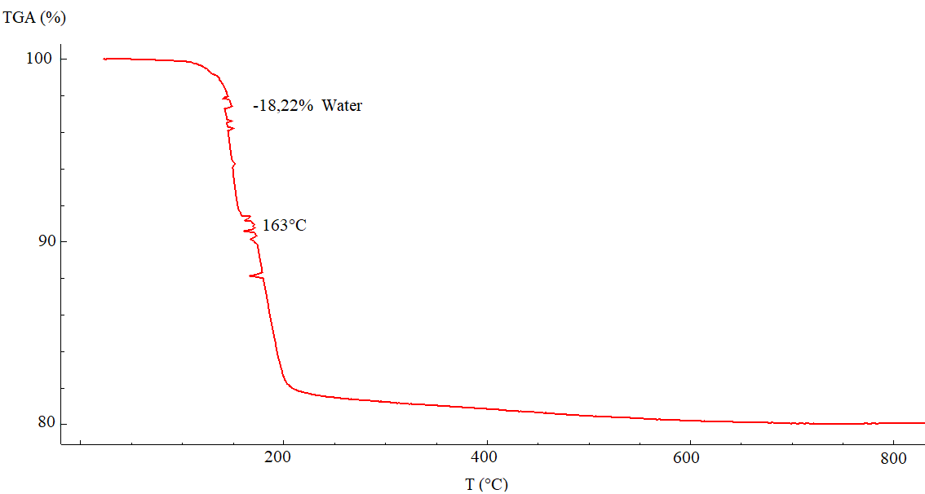
Materials and Methods
Raw Bentonite (RB)
Gypsum (PG)

Slide 11
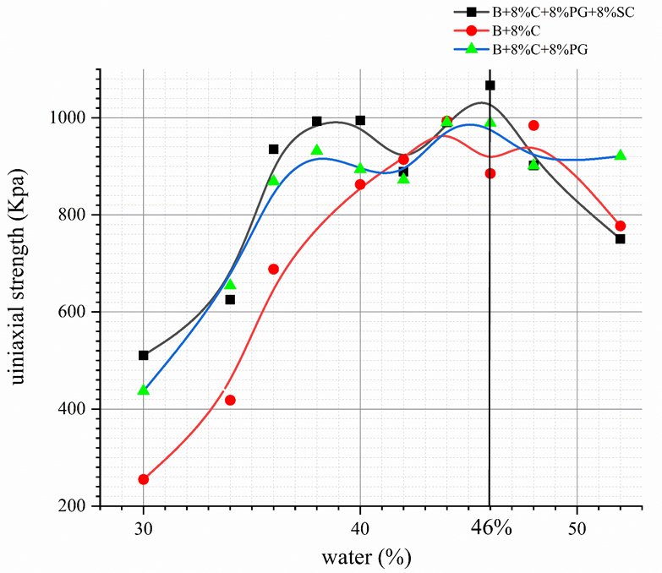
Water content in Mexture
Water content for the different mixture :
The increasing of uniaxial strength (Kpa) withe the addition of water can be explained by the distabilization of bentonite and formation of CSH calcium-silicate hydrates and ettringite.
The water optimum is about of 46 %.
The mechanism of hydrating of different mixture have detailed in the following figure :
Contact W,C
Suspension
Setting
Hardening
For 28 days

Slide 12
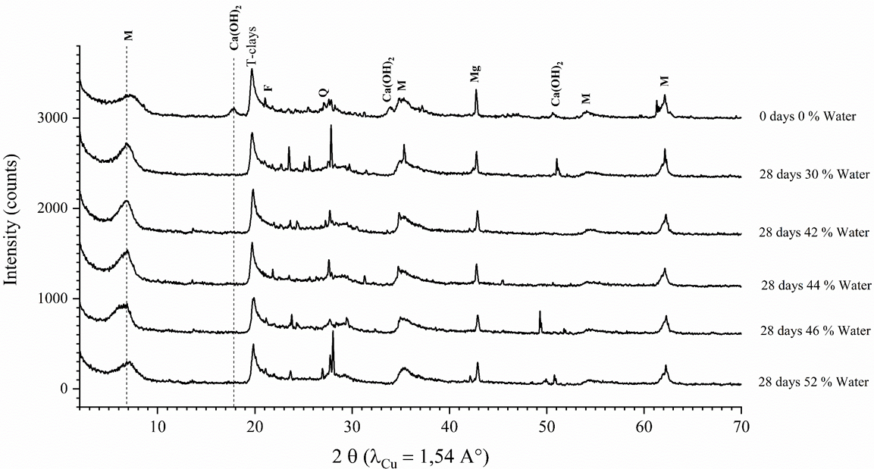
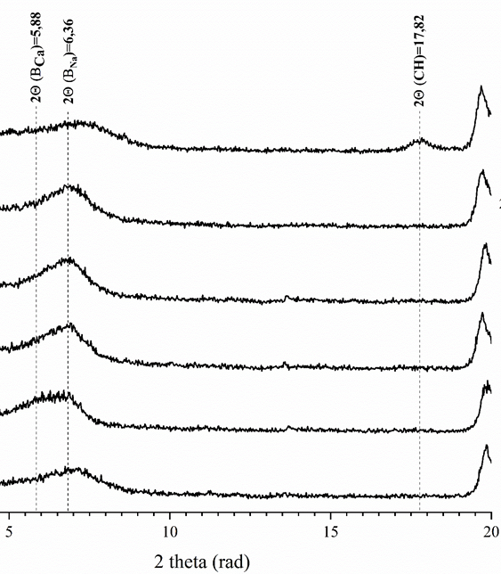
Study of mixture Bentonite-lime :
The consummation of portlandite Ca(OH)₂
2-20$θ$
Bent-Na unstable
1
1
water add
Bent-Na + Ca²⁺
Bent-Ca + Na⁺
Bent-Ca stable
2
2

Slide 13
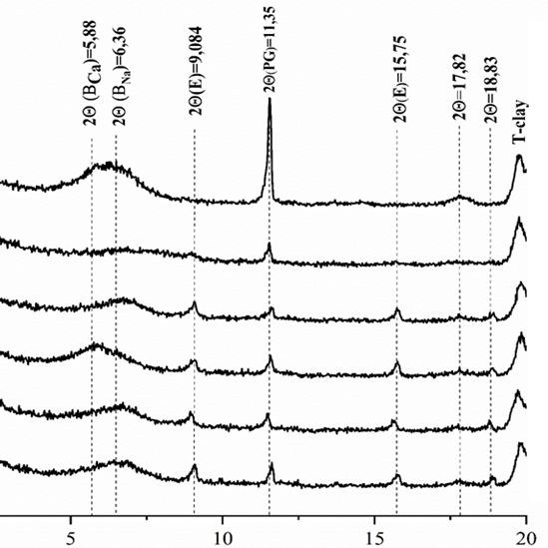
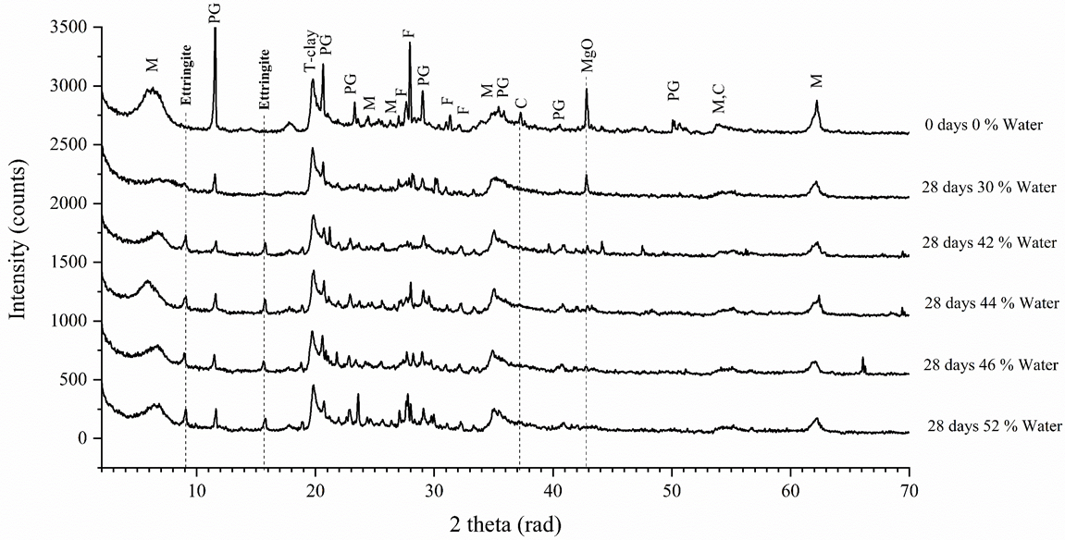
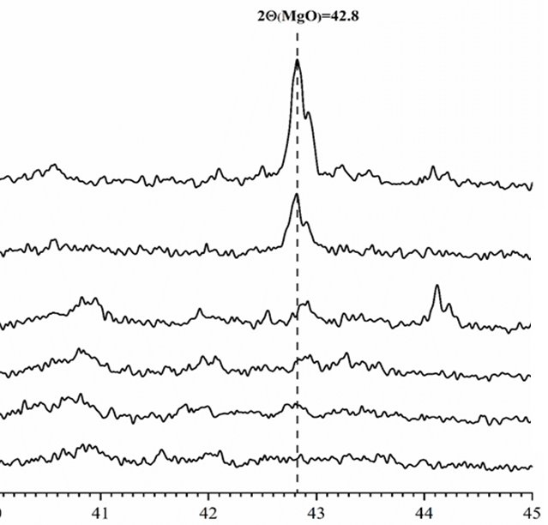
Study of mixture Bentonite-lime-PG :
2-20$θ$
40-45$θ$
2-20$θ$
40-45$θ$

Slide 14
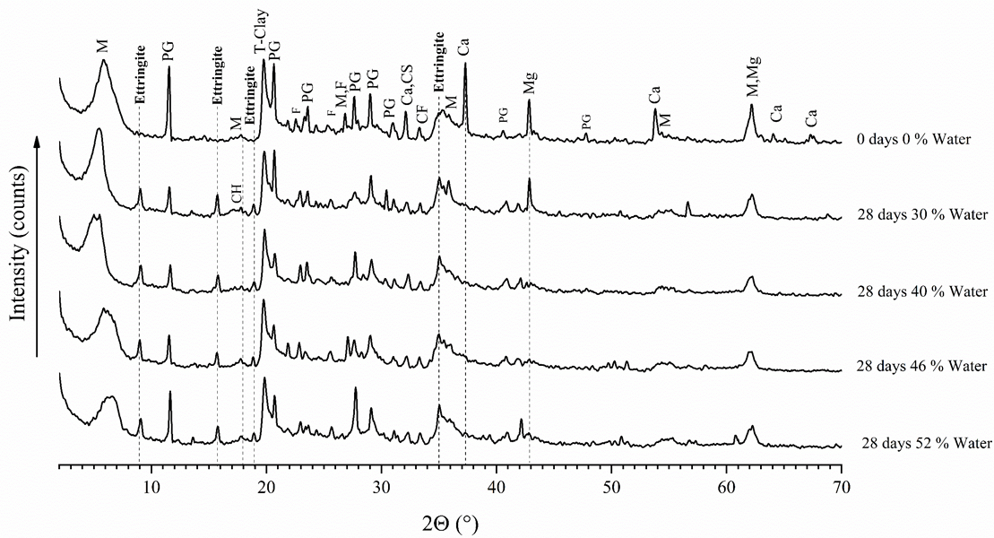
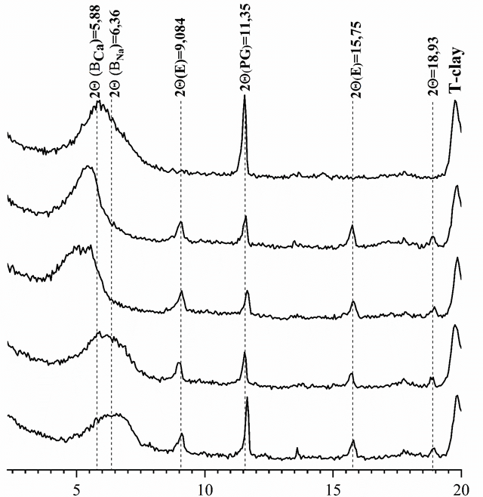
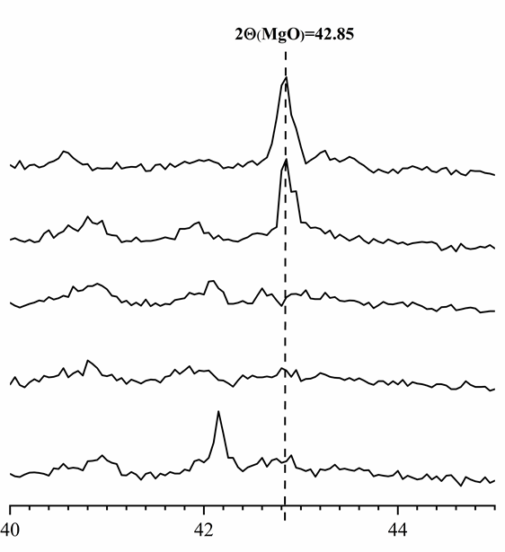
Study of mixture Bentonite-lime-PG-SC :
2-20$θ$
40-45$θ$
2-20$θ$
40-45$θ$

Slide 15
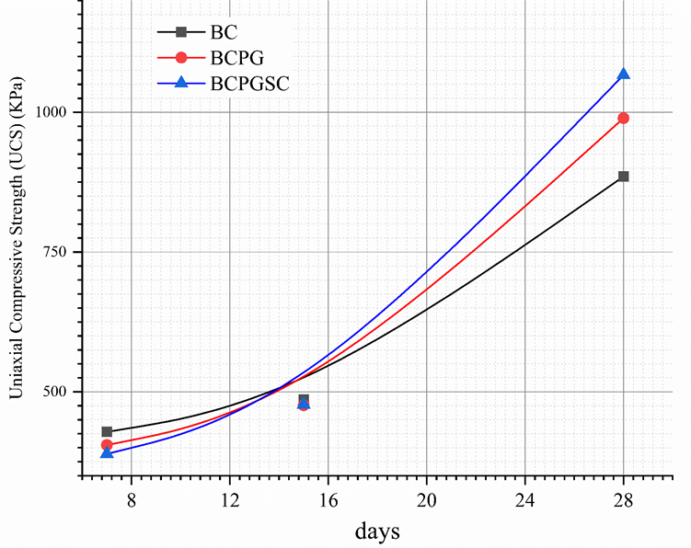
Study of Iimpact of time in mixture
The uniaxial compressive strength (Kpa) increases with hydration time.
First the UCS of The bentonite-Lime mixture (BC) is higher then the other mixture.
The time spent and the UCS of the both mixture BCPG and BCPGSs increases
Finally at 28 days the UCS of BCPGSs is superior then the BC and BCPG mixture and this results can be explained by the presence of the Ss which will weld the particle between as and consequently the increasing compression

Slide 16
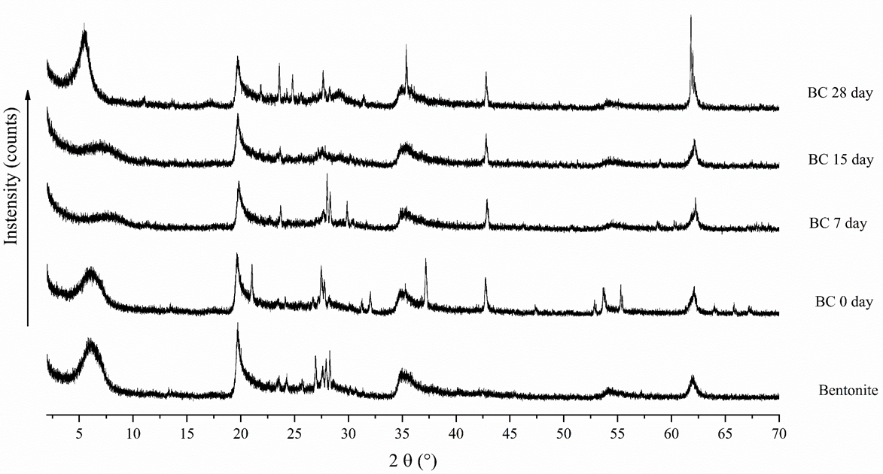
Study of Impact of time in mixture of BC

Slide 17
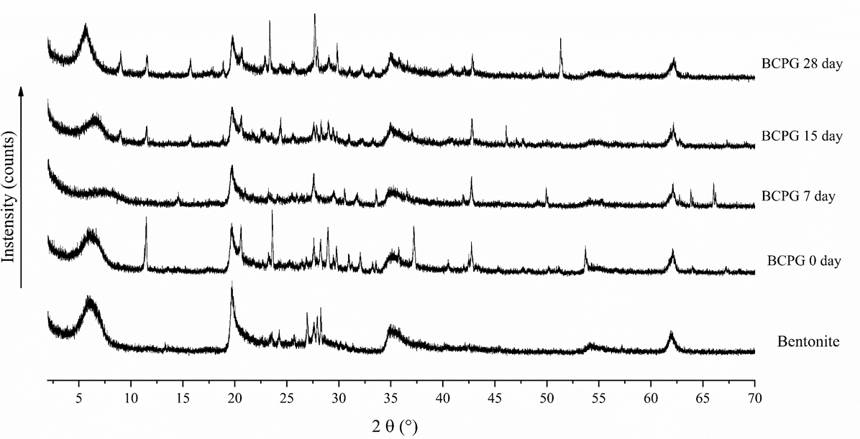
Study of Impact of time in mixture BCPG

Slide 18
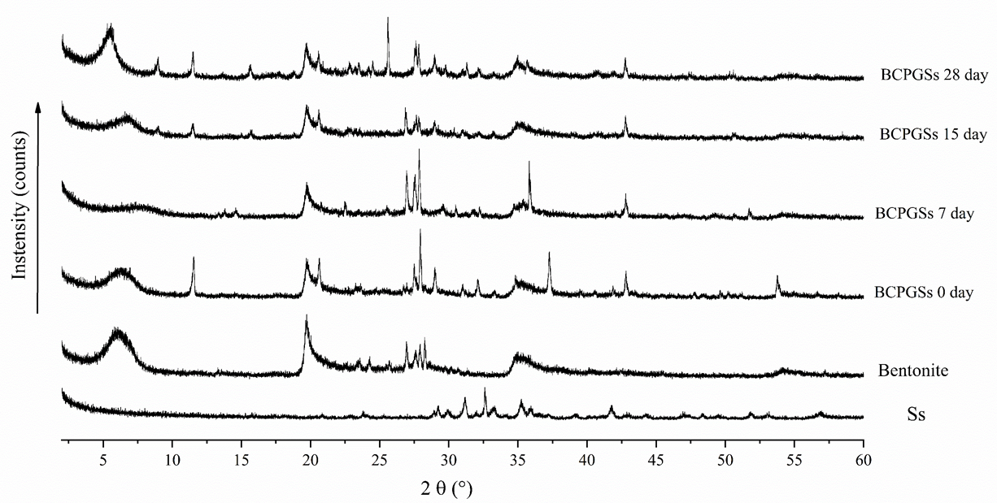
Study of Impact of time in mixture BCPGSs

