Slide 1
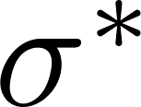
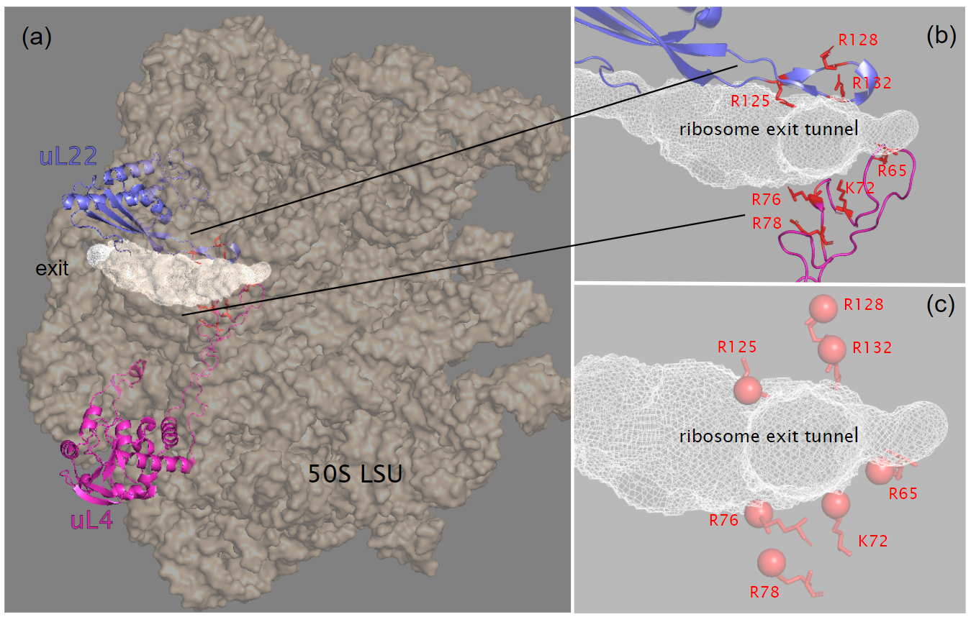
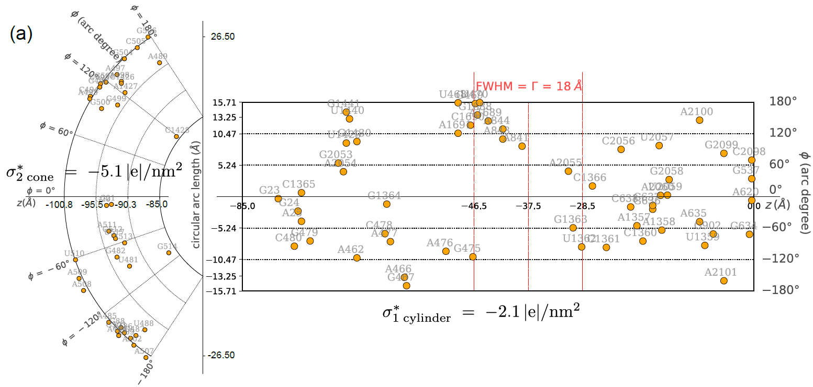
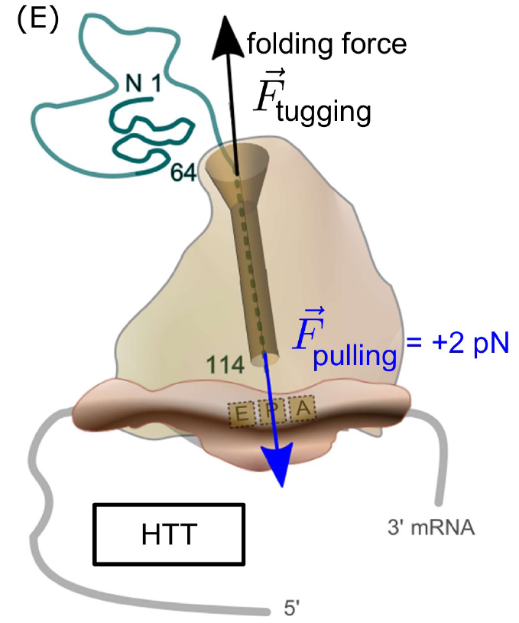
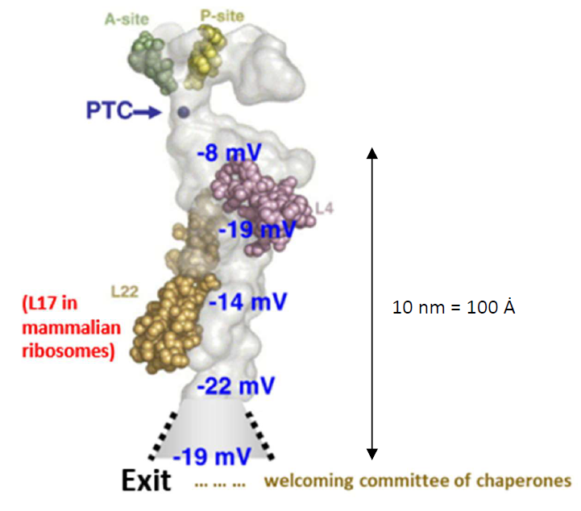
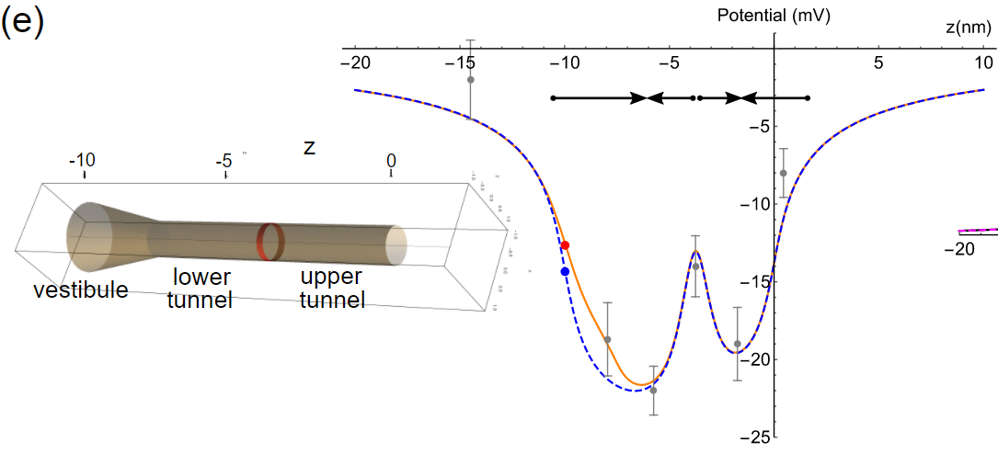
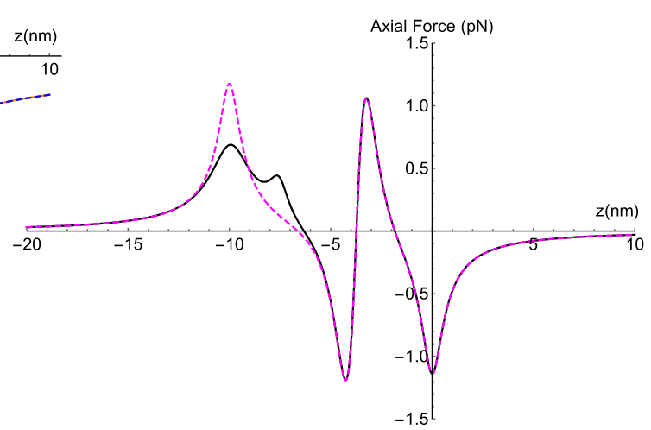
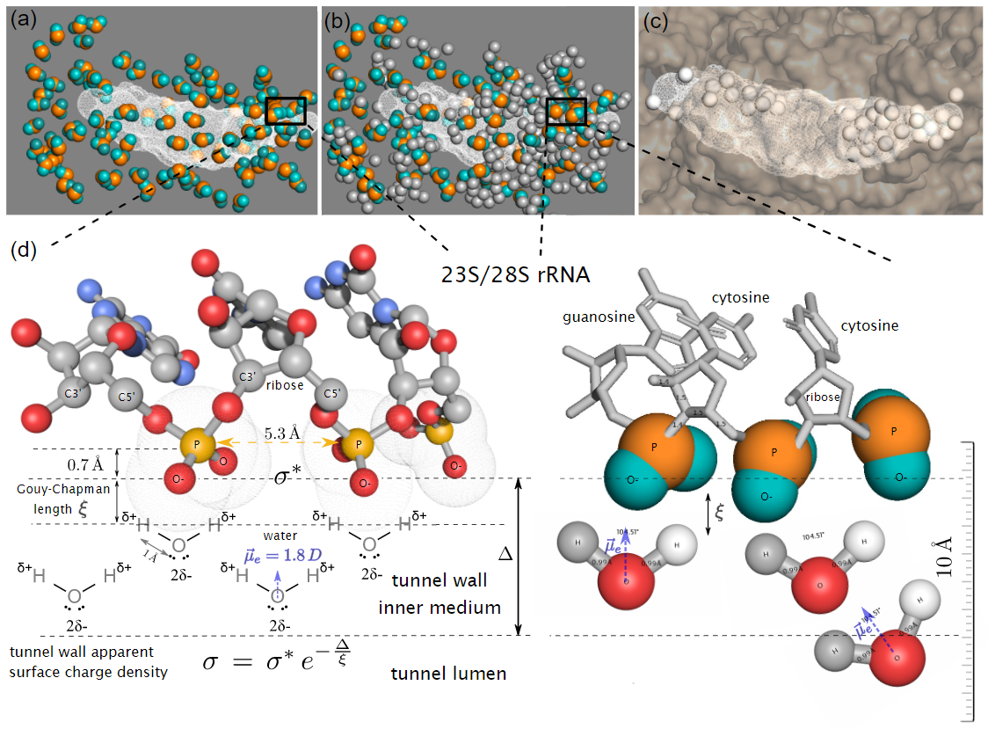
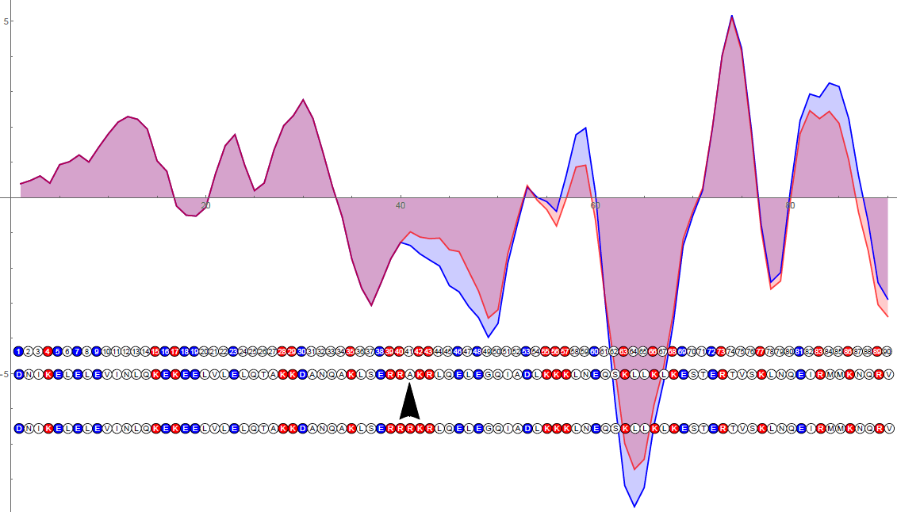
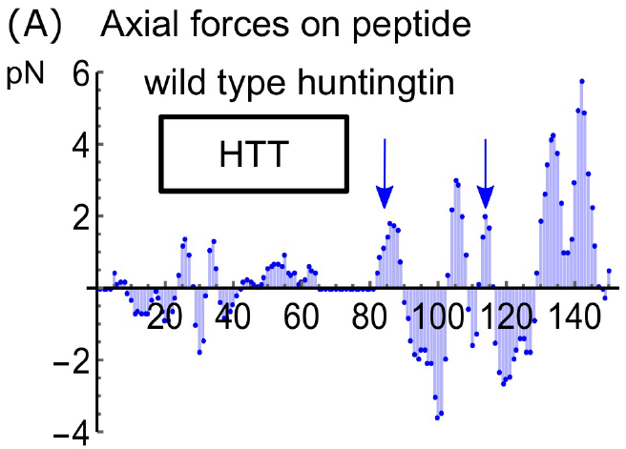
Ribosome exit tunnel electrostatics
Marc Joiret^{1,}, Francesca Rapino², Pierre Close², Liesbet Geris¹
¹Biomechanics Research Unit, GIGA In Silico Medicine, Liege University, Belgium;
²Cancer Signaling, GIGA Stem Cells, Liege University, Belgium
INTRODUCTION
Ribosome Elongation Rate There is a great variation in ribosomal velocity along even a single transcript What determines how fast a transcript is processed by a ribosome is not completely resolved [1] Changes in the local translation rate along mRNA have been implicated in health and disease [2]: Protein specific activity and folding Correct localization of protein Neurodegenerative diseases and cancers | Key Determinants of Elongation Rate Charged amino acids distribution in the nascent protein and electrostatic interaction with the ribosome exit tunnel Adaptation of codon usage to tRNA pool Codon ordering and tRNA recycling tRNA wobble base enzymatic modifications Proline incorporation delay mRNA secondary structure melting delay Ribosomes resource pool | Aim of this study Relate the tunnel geometry and media properties such as surface charge density and dielectric response heterogeneity to the electrostatic potential profile inside the exit tunnel Map the charged groups that are close to the tunnel inner surface from X-Ray crystallography Investigate the source of electrostatic screening Refine TASEP model of protein synthesis [3,4]
MATERIALS & METHODS
Ribosome large subunit X-Ray crystallography data mining :
Our approach is to 2D map the charged groups (phosphate moieties of 23S/28S rRNA) on the idealized cylindrical surface and
conical surface of the ribosome exit tunnel (+ charged aa residues)
Specifically, we calculate the bare surface charge densities
Mapping the phosphate moieties
(orange disks) on the tunnel surface
Mapping and counting charged
aa residues at constriction site
Electrostatic potential model of ribosome exit tunnel and axial forces profile
Ribosome exit tunnel [5, 6]
RESULTS AND PERSPECTIVES
Biophysics :
There is a strong electrostatic screening in the tunnel inner wall due to water molecules (not mobile ions) best modelled by the Gouy-Chapman screening theory.
The modelling of the tunnel with idealized shapes, phenomenological parameters and Gouy-Chapman screening length correctly capture the observed electrostatic potential.
Axial forces (pN) profile on nascent peptide as a function of residue position at the PTC
Computational Biology Perspectives :
The ribosome exit tunnel electrostatic interaction model will refine TASEP, improve protein elongation rate prediction, provide better fitting to protein relative expression abundance levels and RiboSeq data results and shed light on co-translational folding.
REFERENCES
CONTACT
[1] Charneski et al, 2013, PLoS Biol, 11(3) [2] Rapino et al, 2021, Nature Communications, 558 [3] Zur&Tuller, 2016, Nucl. Acid Res., 44(19) [4] Sharma et al., 2018, Phys. Rev. E; 97 [5] Voss et al., 2006, J. Mol. Biol., 360(4) [6] Lu et al, 2007, J. Mol. Biol., 371(5)
GIGA in silico medicine, Université de Liège
M. Joiret: marc.joiret@uliege.be ; L. Geris: liesbet.geris@uliege.be ; http://www.biomech.ulg.ac.be/
This poster was presented in the Protein Synthesis and Translational Control conference at EMBO, Heidelberg, 7-10 September 2021. We acknowledge the FNRS-FWO EOS grant n° 30480119 (Join-t-against-Osteoarthritis) and the European Research Council under the European Union's Horizon 2020 Framework Program (H2020/2014-2020) /ERC grant agreement n°772418 (INSITE).

