Slide 1

Temporal constraints on sleep & cognition
Christina Schmidt
CRC in Vivo Imaging
Sleep & Chronobiology lab
University of Liège
CSC Seminar – March 3rd 2021
Sleep and Cognition Laboratory | Centre for Sleep and Cognition
Yong Loo Lin School of Medicine, NUS

Slide 2
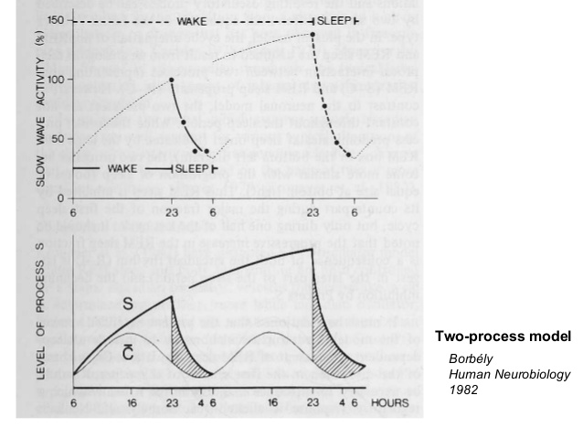
A temporal framework for sleep and wakefulness
The two-process model of sleep and wake regulation
Impact on cognition
Impact on cerebral correlates
Inter-individual differences: Aging
Borbély, 1982, Daan & Borbély 1984
Notes:
I’m mainly interested in the importance of temporal organization of sleep-wake regulation for cognition and its cerebral correlates. The theoretical ground of most of my research projects are based on the two-process model of SW regulation. In the last three decades this model has served as a major conceptual framework in sleep research. It has been applied widely in studies to dissect individual differences in sleep regulation. The model posits that a homeostatic process (Process S) interacts with a process controlled by the circadian pacemaker (Process C), with time‐courses derived from physiological and behavioural variables. The model simulates successfully the timing and intensity of sleep in diverse experimental protocols and has also been shown to sucessfully explain temporal modulations in cognition and its cerebral correlates. I was particularly interested in the impact of process C, endogenuous circadian clock on cognition and underlying brain responses, how the latter is can explain inter-individual moduation in response to sleep loss for example.

Slide 3
The 2-processes of sleep-wake regulation
Homeostatic process
Sleep propensity
0
4
8
12
16/0
4
8/0
4
8
12
16/0
4
8
Wakefulness (h)
Sleep (h)
Wakefulness (h)
Sleep (h)
Borbély, 1982; Dijk 1994
Notes:
Sleep-wake cycle is regulated on the one hand by a sleep-homeostatic process, mirrored in the increase of sleep pressure during time awake, and a decrease/degradation of sleep pressure during sleep.
The quality of sleep and wakefulness, and accordingly also the quality of our cognitive performance is further regulated by a second process: the circadian process. It maximally promotes wakefulness in the evening shortly before habitual bedtime and sleep at the end of the night.
This circadian signal modulates the impact of sleep pressure. Thus, during sleep deprivation cognitive performance is influenced by both sleep pressure and circadian sleep-wake promotion. Accordingly, at the behavioral level, we oberserve…

Slide 4
The 2-processes of sleep-wake regulation
Homeostatic process
Circadian process
Time of day (h)
8
12
16
20
24
4
8
12
16
20
24
4
8
Sleep propensity
Circadian signal
0
4
8
12
16/0
4
8/0
4
8
12
16/0
4
8
Wakefulness (h)
Sleep (h)
Wakefulness (h)
Sleep (h)
Borbély, 1982; Dijk 1994
Notes:
The quality of sleep and wakefulness, and accordingly also the quality of our cognitive performance is further regulated by a second process: the circadian process. It maximally promotes wakefulness in the evening shortly before habitual bedtime and sleep at the end of the night.
This circadian signal modulates the impact of sleep pressure.

Slide 5
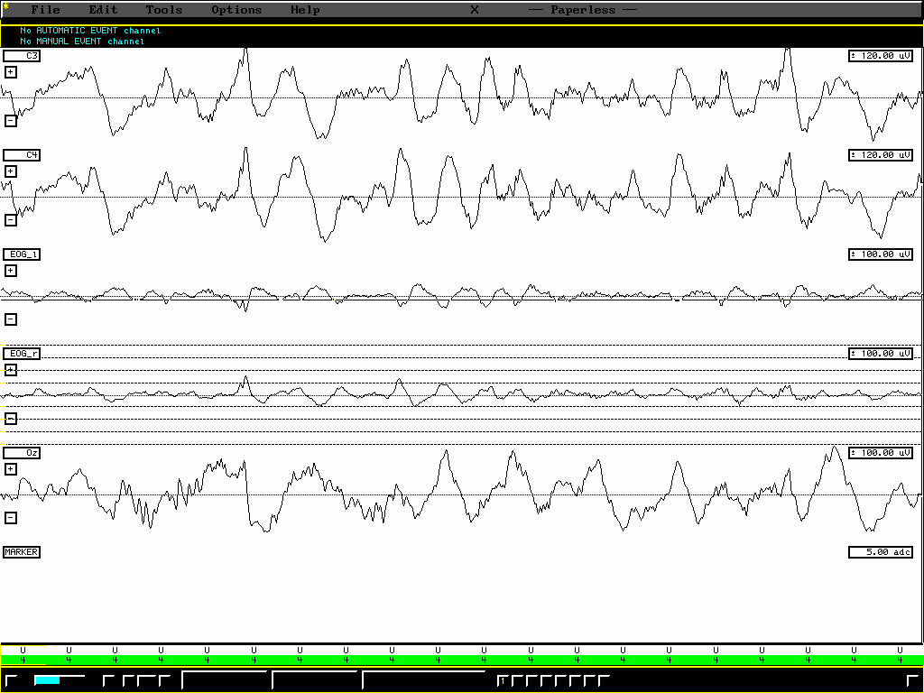
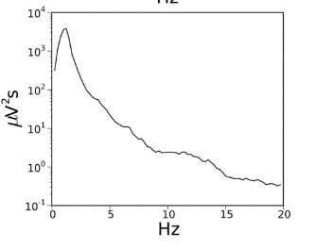
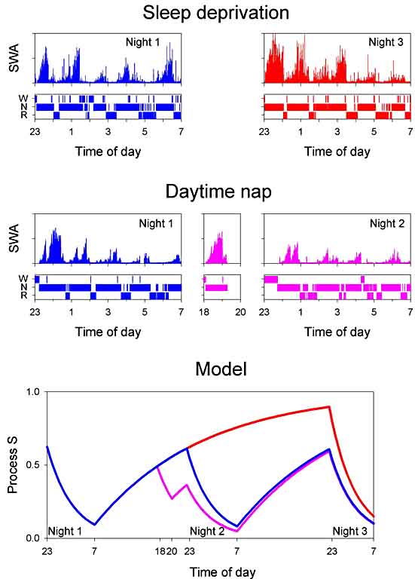
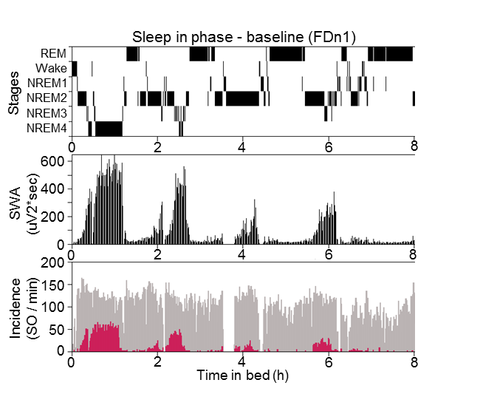
Slow Waves as a marker of sleep homeostasis
Lazar et al., 2015
Notes:
Slow waves, high-amplitude, low frequency oscillation occuring during NREM sleep and thus highly prevalent first part, dissipative process, exponential decay. Reactive to sleep homeostatic condition (SD vs NAP)

Slide 6
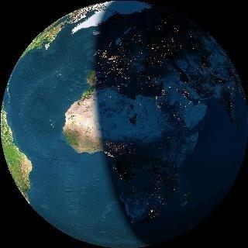
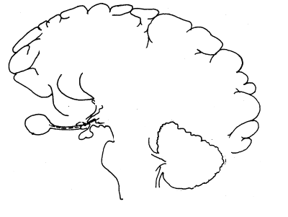





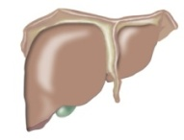
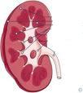


Exogenuous – Endogenuous clocks
24-h rhythms
Endogenuous circadian rhythms
Eye
SCN = master clock
Retina
«Zeitgeber»
Entrainment
Dijk et al. J Physiol 1997
SYNCHRONISATION
Oscillation in organs
Oscillation in cells (genes)
Bromundt, PhD thesis
Notes:
Indeed, sleep-wake rhythms stay under the strong influence of endogneuous circadian rhythmicity. The masterclock of these rhythms are located in the SCN of the anterior hypothalamus. This structure orchestrates or synchronizes circadian rhythms throughout a wide range of body functions, ranging from organs to oscillators at the cellular level. Circadian rhythms present a period of about 24 hours. They are synchronized on an exact 24-h period through what is named Zeitgebers. The strongest timegiver in this perspective represents the light-dark cycle. The adaptation of the endogenuous circadian rhythm to the external 24-hour rhythm through such photic imputs from the ld cycle is called entrainnment. Other, non-phtic cues also have the ability to entrain the circadian rhythms. Food, physical or socio-professional activity.

Slide 7
Timing and history of sleep and wakefulness can modify neurobehavioral function
Neurobehavioral function
Light-Dark Cycle
Social/Behavioural Factors
Circadian Photoreception
Sleep-Wake
Circadian
Homeostat
Biological time
Sleep-wake history
Modified from Dijk & Lockley 2002
Notes:
Timing and history can modify neurobehaviorla as appraised and re-appraised and re-re-appraised by the 2-process model of sleep and wake regulation. In this model C and S…Linear increase, superimposed with nearly-24 endogenuous modulation of sleep or wake propensity, consolidated bouts …
This model accounts for the duration, timing and quality of sleep

Slide 8
Protocols to Investigate the Influence of the Circadian and Homeostatic Process in Humans
Forced Desynchrony protocol (FD)
Constant Routine (CR):
- Sleep deprivation
- Ultra-short sleep wake cycle protocols

Slide 9
Human sleep cycles are generated by internal clocks
Timing of Sleep Episodes in a Bunker
1
Entrained
τ = 24.0 hrs
10
20
Consecutive Days in Bunker
Free run
30
40
τ = 25.3 hrs
50
24
12
24
12
24
Modified from Aschoff, 1965
Time of Day (h)
Aschoff J. Science 1965; 148: 1427–1432
Notes:
In humans, early evidences of the existence of endogenuous circadian rhythms have been collected in so called bunker experiments. In these experiments, volunteers and with them, the experimenters lived under conditions in which the previsously mentionned Zeitgeber or timegivers were absent. Under those conditions. This Figure represents a single case, who lived under entrained conditions for the first 20 days (bright light conditions). Under these conditions, the period the circadian rhythm was 24 hours, consisting in about 8 hours of sleep (in yellow) followed or preceded by 16 hours of wakefulness, occuring every time at the same time of the day (24-8). However, from day 20 on, the subject lived under constant dim light conditions. Under these conditions, the circa. Period was no more synchronized to exactly 24 hours and adopted its endogenuous period, here in this case 25.3 hours, it starts to free run. Aschoff concluded that humans — like the plants investigated by de Mairan — have endogenous circadian cycles.

Slide 10
Forced Desynchrony Protocol
Triple-raster plot of a 25-day
28-h rest-activity cycle
(18.7 of scheduled wakefulness and 9.3 h of scheduled sleep)
Notes:
This protocol was adapted by the sleep researchers of the Boston group who systematically tested human participants in isolated conditions by applying the FD protocol. This Figure represents a triple-raster plot of a 25-day forced desynchrony protocol. Each successive 24-h period is plotted next to and beneath each other. Black bars indicate sleep, white spaces wakefulness. The subjects were placed on a 28-h rest-activity cycle and light-dark cycle during which the they were scheduled to be awake for 18.7 h (light <15 lux) and asleep for 9.3 h (light <0.03 lux). The black bars indicate the distribution of scheduled sleep episodes throughout the protocol. Dashed lines indicate the fitted maximum of the endogenous circadian melatonin rhythm across days, which drifted to a later phase position relative to clock time. In this example the intrinsic circadian period of the melatonin rhythm was assumed to be 24.2 h.
The data are plotted with respect to clock time. Right-hand panel: Triple-raster plot of a 25-day
forced desynchrony protocol. In this example the subjects were placed on a 28-h rest-activity
cycle and light-dark cycle during which the subjects were scheduled to be awake for 18.7 h and
asleep for 9.3 h.
FD : The forced desynchrony paradigm
Under normal, so-called entrained conditions, the
sleep–wake cycle and the circadian rhythms of
various physiological and cognitive functions are synchronizedwith
each other andwith the diurnal light–
dark cycle. In humans, the timing of sleep and wakefulness
is such that the main sleep episode usually
starts on the falling limb of the CBT rhythm, while
sleep termination in the morning coincides with the
rising portion of theCBT rhythm. This synchronism
makes it impossible to disentangle the respective contributions
of the circadian and homeostatic processes
under entrained conditions.
During a forced desynchrony (FD) protocol, subjects
are isolated from the usual time givers (i.e.,
Zeitgebers) and are exposed for weeks to an artificial
sleep/wake schedule with a “day” duration that is significantly
shorter (e.g., 19 hr) or longer (e.g., 28 hr)
than the normal 24-hr day. As “days” are passing
by, the procedure forces a progressive desynchronization
of the artificial sleep–wake cycle from the
endogenous circadian cycle. Indeed, the endogenous
circadian pacemaker becomes unable to keep track of
the imposed, extreme sleep–wake cycle and consequently
starts to follow its own rhythm, it starts “free running” (Kleitman, 1987; see
Figure 2). This paradigm has the unique advantage
to truly separate the influence of homeostatic sleep
pressure from that of the circadian pacemaker.
However, the disadvantage of the FD protocol is
that the technique is extremely time consuming and
difficult, since subjects have to be kept for weeks in
a room strictly isolated from the usual external circadian
synchronizers (i.e., the Zeitgebers) such as daily
light and temperature variations, but also from culturally
and socially related cues (for instance, meal times
or sounds typically associated with the beginning or
the end of a day’s work).

Slide 11
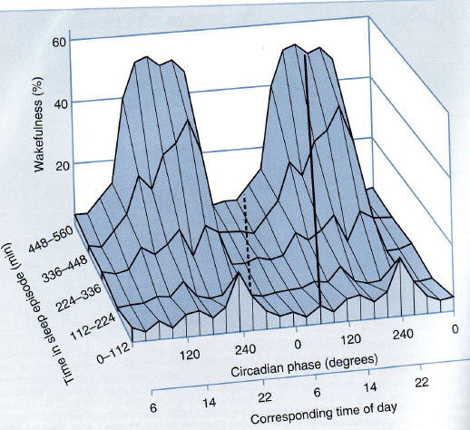
Functional significance of the phase relationship between the circadian and homeostatic sleep propensity rhythm
Dijk & Czeisler, 1994
Notes:
This kind of protocol allows to investigate thus sleep parameters under different homeostatic sleep pressure conditions at virtually all circadian phases. A typical output of such kind of studies is plotted in the 3D plot in which the amount of wakefulness during a sleep episode is plotted in function of circadian phase (also translated into corresponding time of day) and time spent in the sleep episode for example. It tells us firstly, that the amount of wakefulness within a sleep episode varies according to circadian phase, and that the amplitude of this circadian modulation depends on the time spent in the sleep episode. In other words, at the beginning of the sleep episode, subjects are present relatively few amount of waekfulness in all circadian phases (expect a 22h00, where we can see a little increase even at the beginning of the sleep episode. However, more we spent time in the sleep episode, more the amount of wakefulness presents a circadian pattern, such that at 240d or at 22 in the evening, we spent half of the time in wakefulness, indicating very non-optimal sleep efficiency. Functionally, this means that if sleep is scheduled at a circadian phase, corresponding to the biological day under entrained conditions, we are unable to achieve a consolidated 8-hour period of sleep, even if we spent 18 hours awake before (control for the homeostatic process).
Functional significance of the phase relationship between the circadian and homeostatic sleep propensity rhythm. This Figure illustrates sleep consolidation as a function of both circadian face and time since start of the sleep episode. Trajectories that are traversed during a normal nocturnal sleep epsidode and during a sleep episode initiated a few hours after the temperature nadir, which is typical scenario for night shift work, are indicated. Obviously, only when sleep is initiated close to the wake maintenance zone can sleep be maintenained for 8h or more.

Slide 12
Circadian rhythm of wake propensity associates with melatonin rhythm
wake maintenance zone
Sleep
opening of sleep gate
Modified from Dijk et al. J Physiol 1997

Slide 13
Separation of Circadian and Homeostatic Modulation of Neurobehavioral Function
CBT min
Wake Sleep Wake
-1
Impairment
Karolinska
0
Sleepiness Scale
1
Psychomotor Vigilance
-30
Median reaction time
0
30
3
0
Cognitive Performance
(# of Attempts in an Addition Task)
-3
0.5
0.0
Probed Recall Memory
(# of correct Word Pairs)
-0.5
0
120
240
0
120
240
0
3.3
13.3
3.3
13.3
Circadian Phase
Elapsed Time Awake
Modified from Wyatt et al. 1999
Notes:
The forced desynchrony protocol has also allowed to separate the influence of circadian and homeostatic modulations in diffferent neurobehavioral functions, such as subjective sleepiness, Psychomotore Vigilance or memory performance. As you can see on the right panel, when plotted according to circadian phase, XXXX …

Slide 14
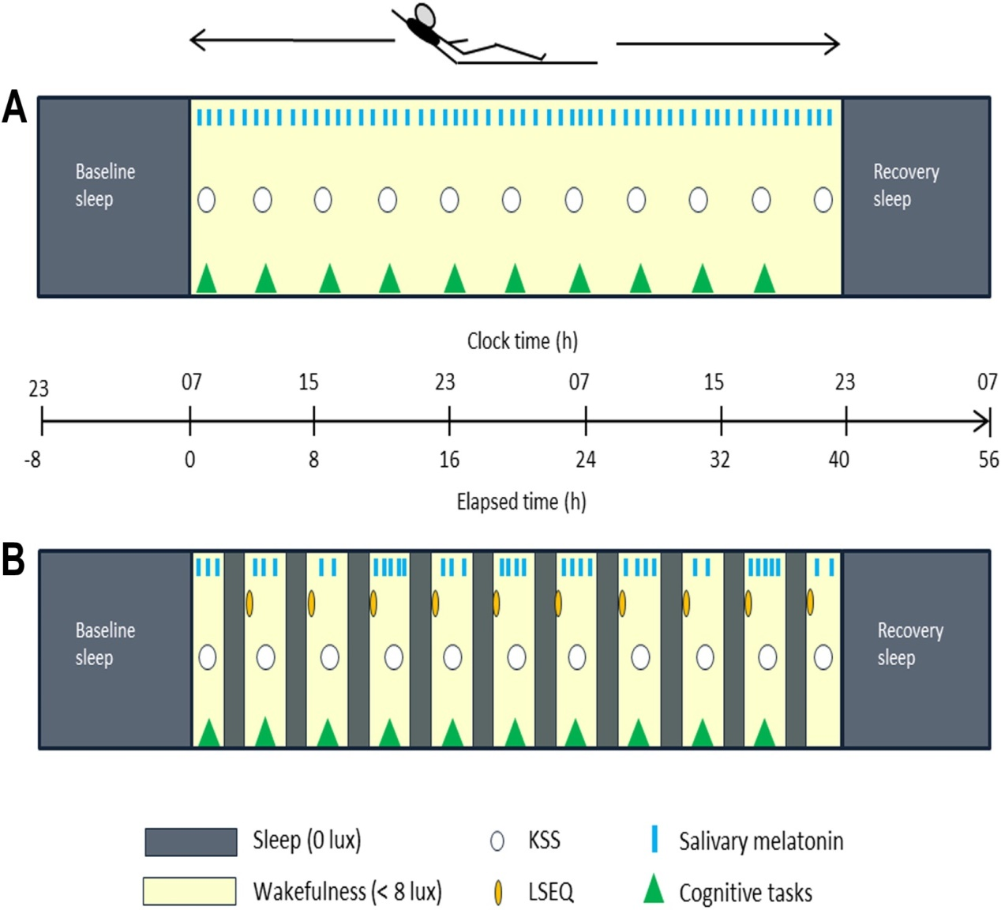
Constant Routine Protocol
Brain imaging (fMRI)
e.g. Maire et al., 2014, 2018
Notes:
Assessing the clock in humans is not so obvious and needs specific experimental protocols. During the past 4 years, we mainly applied this experimental setting to assess clock outputs in humans. First to assess 24 rhythmsxxx, second: unmask clock outputs. Constant routine. Two versions, looking at circadian time courses under different sleep pressure levels (wake/behavior/cognition and sleep with NP). I got trained to perform these studies in CH, added fMRI to assess time courses in brain responses underlying vigilant attention/working memory. fMRI, than inter-individual variation (genetic tool)

Slide 15
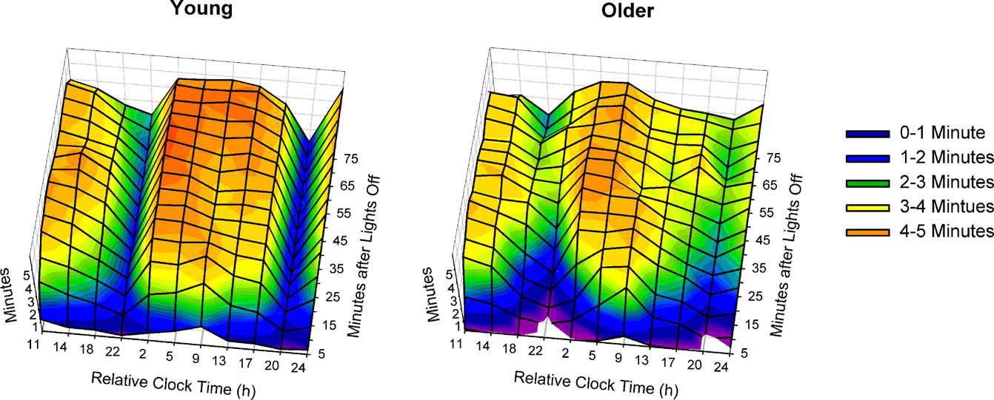
Circadian and Sleep-Wake dependent Modulation of the Sleep efficiency
Münch et al., 2005
Notes:
The ultrashort sleep-wake cycle protocols allows you thus to look at sleep (nap opportunities) at different circadian phases and can give you information such as plotted here in the Figure representing a quasi three-dimensional plots of TST within the nap opportunities. The x-axis represents the averaged mid-nap clock times and the y-axis the time course within the respective naps (3–4 min). The z-axis specifies the amount of sleep (TST) per 5 min bin of each nap (min). Short-wavelength colors (blue, green) illustrate less sleep, longer wavelength colors (yellow, orange), more sleep.

Slide 16
Circadian and Sleep-Wake dependent Modulation in physiology & behavior
Karolinska Sleepiness Scale
Slow Eye Movements
Time into protocol (hours)
Time into protocol (h)
Psychomotor Vigilance (PVT)
Sleep deprivation
Nap
Maire et al., 2014
Time into protocol (hours)

Slide 17
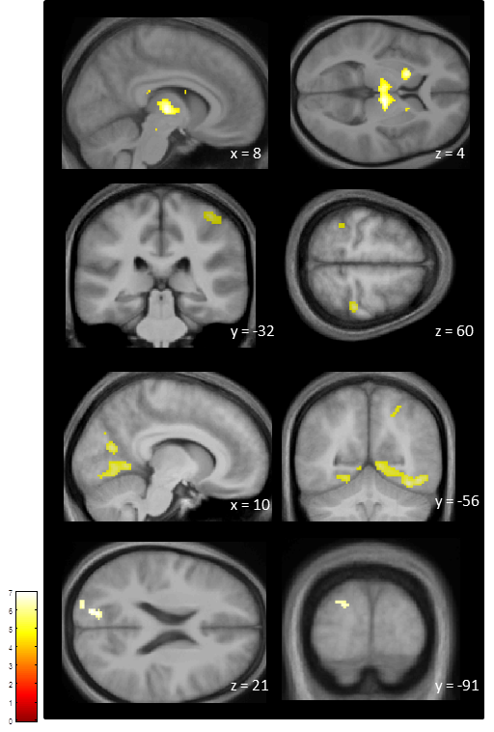

Modulation in task-related BOLD responses
Circadian and Sleep-Wake dependent Modulation in task-related BOLD responses (vigilance)
FWE-corrected over the entire brain volume
Maire et al., 2018
Notes:
We indeed found subcortical regions, namely the thalamus and the putamen, showing an increase in activity during the biological night and a stabilisation during the subsequent biological day. These regions were therefore basically following the interactional slope under high but not low sleep pressure, where activity remained relatively stable.
Tha: dorsomedial part, bilateral
Putamen bilateral
Tha also showed homeostatic slope +, slightly different coordinates but still dorsomedial part bilateral

Slide 18
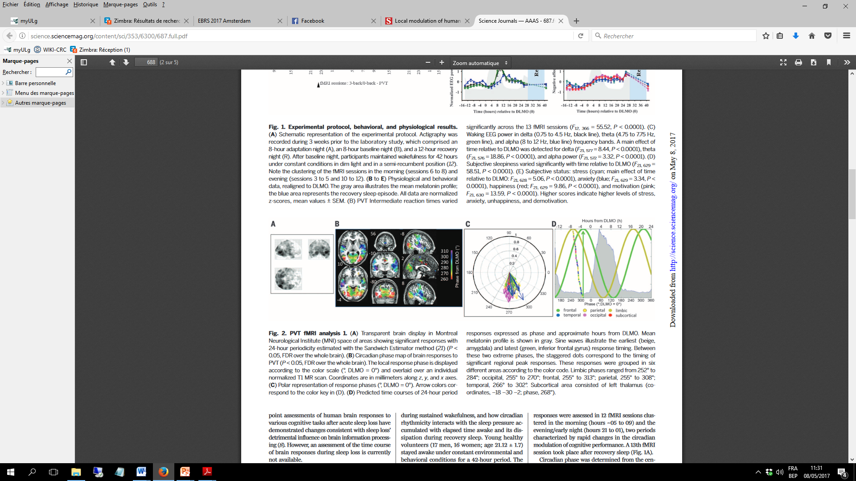
Local modulation of human brain responses by circadian rhythmicity and sleep debt
Muto et al., 2016
Notes:
CCL on brain impact, than Transition via « aging brain = vulnerable »

Slide 19
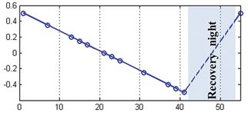


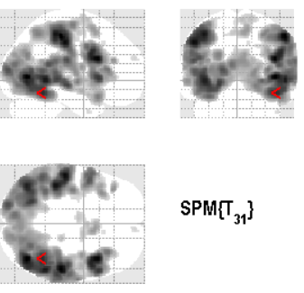
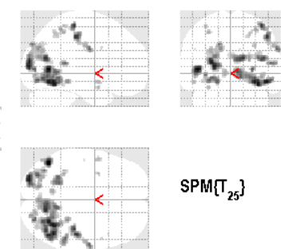
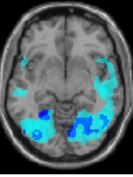
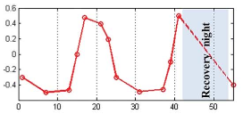
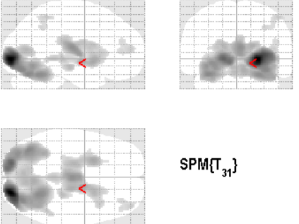
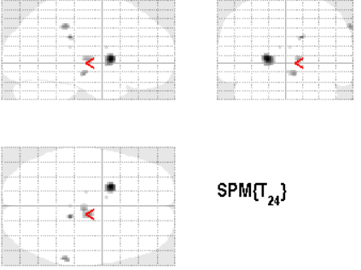
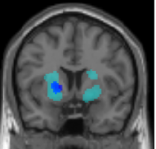
Circadian and Sleep-Wake dependent Modulation in task-related BOLD responses (vigilance)
Modified from Muto et al., 2016, Maire et al., 2018
P<0.05 (FWE-corrected over entire brain volume)
Notes:
What about the cerebral correlates
Linear
Access to two data sets, recalculated same contrasts, difference between studies
Glass brain, statistical map, darkest = higest t-values, strongest effects.
Linear slope (as a reflection of linear increase of homeostatic sleep pressure): large set of cortical, particulalr occipital-motor regions (local use, visual task)
Melatonin (as a reflection of circadian process: thalamus-putamen: increased activation during night time

Slide 20
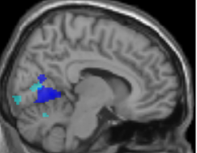
Interaction between circadian and homeostatic processes: Sleepiness
(Sustained attention)
Inferior occipital lobe
4.0
Parameter estimates (a.u.)
2.0
0.0
15
5
10
20
25
30
35
40
Elapsed time into protocol
Reduced, use-dependent sensitivity of the visual cortex to sensory stimuli?
Local modulation of cerebral responses to circadian phase?
5.0
Parameter estimates (a.u.)
2.5
0.0
-12
-6
0
6
12
18
Hours from DLMO
Modified from Muto et al., 2016, Maire et al., 2018
Notes:
Interactive modulation: sleepiness (T-)
Occipital: reduced sensitivity of primary sensory cortices bottom-up inputs27,28. Similarly, reduced occipital cortex activation might result from reduced sensitivity of the visual cortex to sensory stimuli, with possible use-dependent effects29,30,31. Concomitantly, a local modulation of cerebral circadian phase may occur4, potentially in response to task-related requirements

Slide 21
Sleep homeostasis and circadian timing system
=
Powerful modulators of human brain function
Cognitive & brain aging?

Slide 22
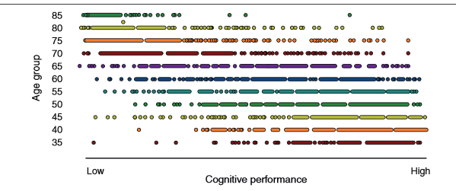
Brain Aging
Nyberg, 2012
Notes:
Large-scale population-based studies revealed that increasing inter-individual variability characterizes the ageing process as much as the mere cognitive decline .

Slide 23
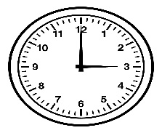
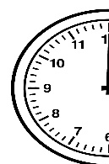

Sleep-wake regulation & brain aging
Brain Aging
Notes:
The role of circadian clock function on shaping human cognitive ageing has been widely underestimated. This appears surprising, not only because its widespread implication and regulation of brain function, but also because temporal organisation of neural activity is a mainstay of neuroscience. Maintaining temporal coordination of multiple oscillators increases the fitness of an organism and provides it with the most efficient response to the environment . As such, the appropriate temporal framework of sleep and wake states, orchestrated through circadian rhythmicity, putatively represents one of the most important factors able to modulate an individual’s cognitive ageing trajectory

Slide 24
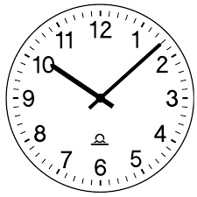
Shift toward morningness with increasing age
Evening type
5
4
3
Morning
type
10
20
30
40
50
60
Age (years)
Roenneberg et al., 2008

Slide 25
„Silencing“ of the clock with increasing age
Young (20-35)
30
Older (55-75)
20
Melatonin (pg/ml)
10
0
9
13
16
20
24
4
7
11
15
19
22
Time of day (h)
Münch et al., 2005

Slide 26
Reduced modulation in behavior
Subjective sleepiness
Younger
Older
Schmidt et al., unpublished
Notes:
Overall: younger felt sleepier than older, sleep deprivation induced higher sleepiness levels than nap protocol and a flattened circadian profile was detected under low sleep pressure conditions in the aged, compared to the young.

Slide 27

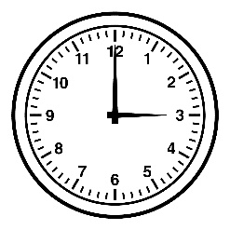


Sleep-wake regulation & brain aging?
= Sleep during the night/wakefulness during the day
= Sleep and wakefulness inadequately distributed over the 24-hour cycle

Slide 28
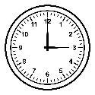
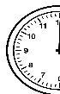

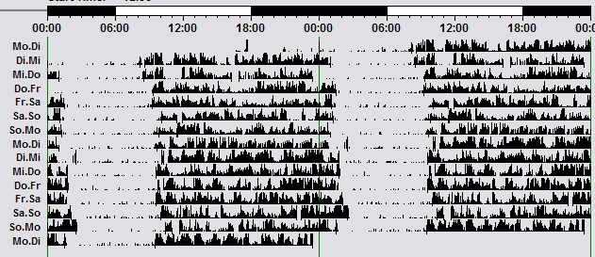
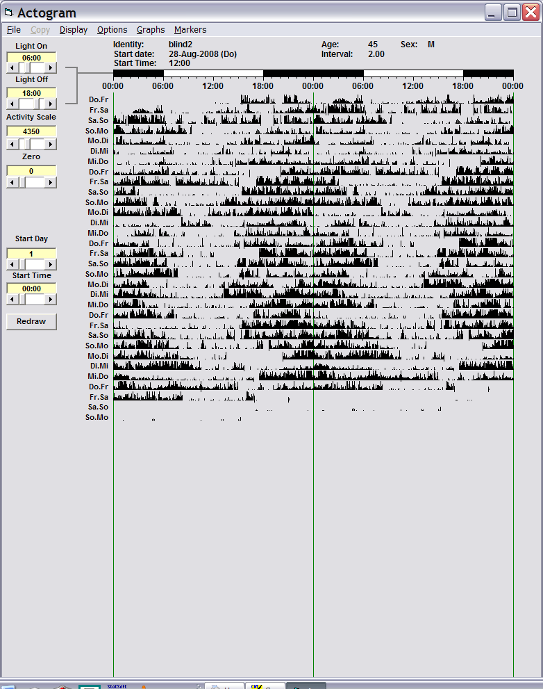
Sleep-wake fragmentation & brain aging?
Cognition
Sleep-Wake Cycle
Sleep-Wake Cycle Fragmentation
Notes:
Is timing is sometimes more important than the dose (quantity and quality)?

Slide 29
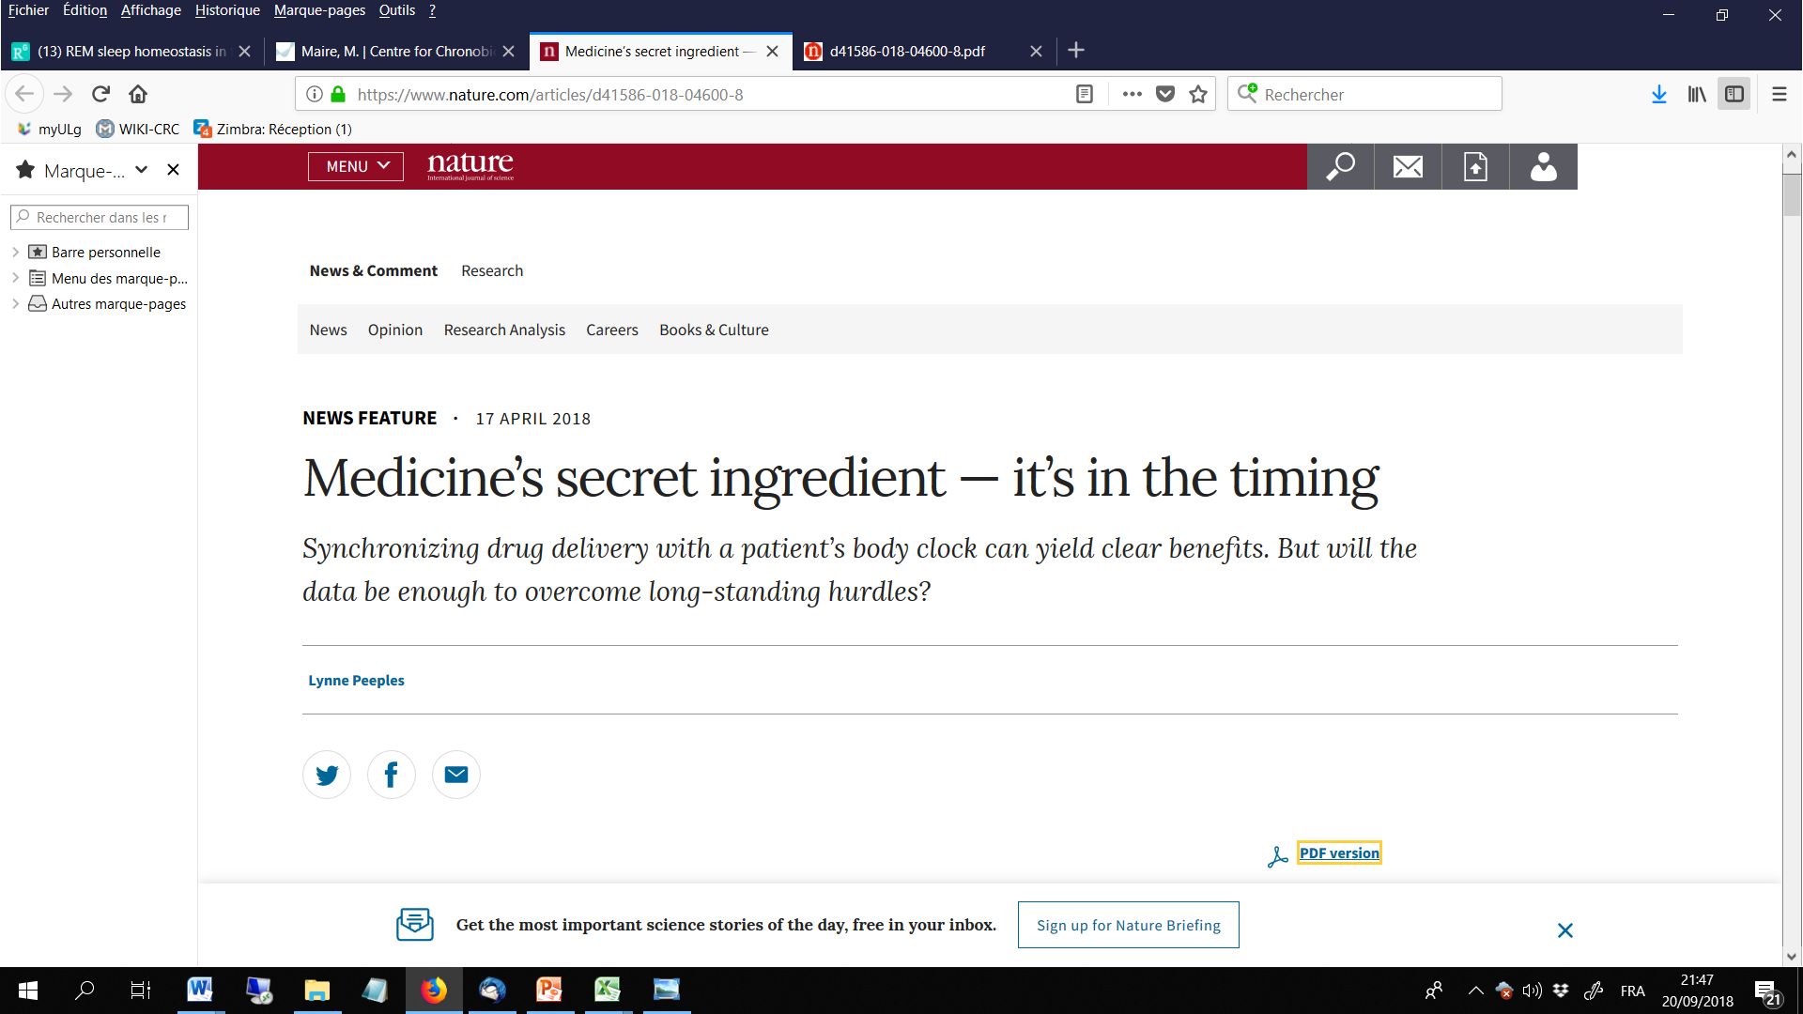
A temporal framework for sleep and wakefulness regulation
« We have found that the timing is sometimes more important than the dose »
[Francis Lévi]
Notes:
Same question for sleep ?

Slide 30
Brain Aging
Day = wake
Night = sleep
HUMANS?
Cognition
Internal clock
Notes:
Animal models show that inducing arrhythmic behavior by manipulating the clock leads to reduced memory performance. Now, in humans, we don’t really know about it. We can’t just break the clock and look at the consequences. You have to find another way to instrumentalize the link. Basically at the difference from my last proposal, were I was also interested in the relations between cognition, brain ageing and sleep-wake fragmentation, I think that the current project definitively adds a scientific value by having found a tool by which I can assess the impact of the clock on cognition in ageing.

Slide 31
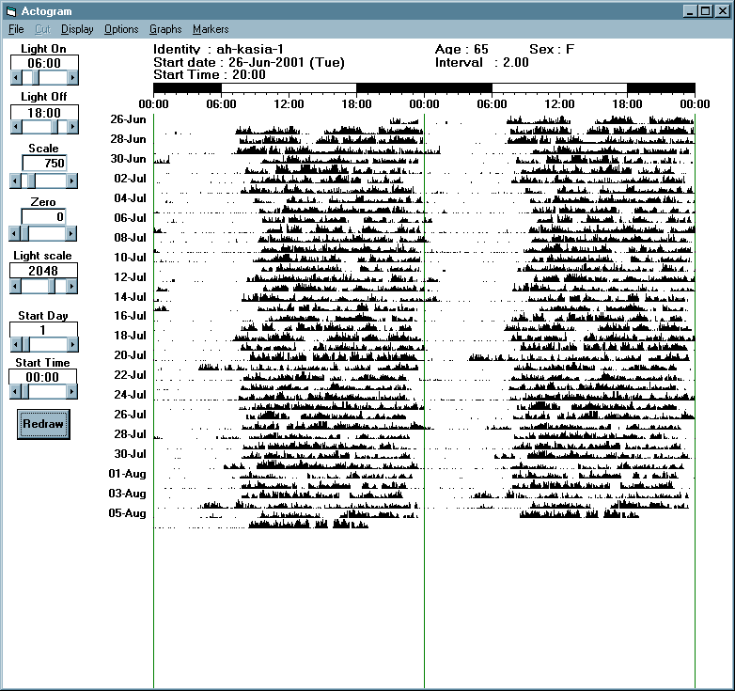
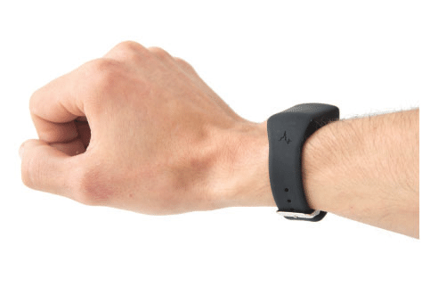
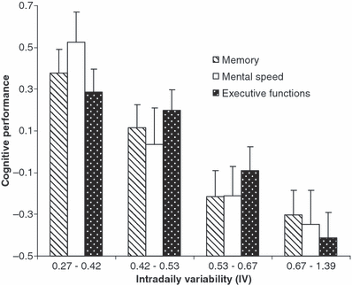
Sleep-wake fragmentation & brain aging?
24
24
24
Oostermann et al., 2009
Notes:
Within this context, actimetry or in other words, the ambulatory assessment of rest-activity cycles represents a powerfull tool and has already been widely used in sleep research. Eus was one of the firs to exgract circadian rhythm parameters such IV, which have been associated with cognition in the aged. Data on a reduced pool of our current study further reveals that this measure is associated with SWS, meaning xxxx

Slide 32

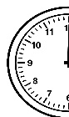




To nap or not to nap ?
COGNAP
CONTEXT of napping
Chronic
Aged brain
NAPPING
Epidemiological evidence (e.g.Cross et al., 2015)
Internal clock
= Sleep during the night/wakefulness during the day
→ Diurnality
Chronic napping = sleep during the day

Slide 33
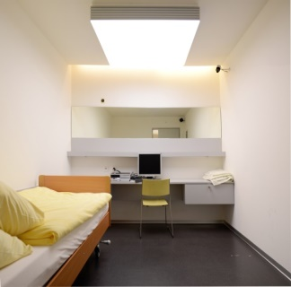
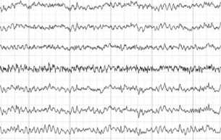
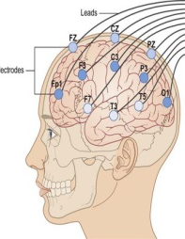

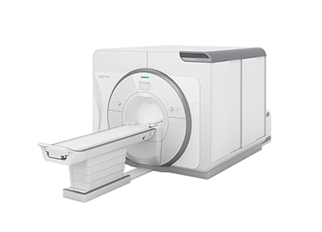
Working hypotheses & techniques
1
Napping affects the internal clock
Multiple nap CR
N = 120 (healthy retired)
[80 nappers, 40 no-nappers]
Age: 65-80 years
Current N = 78
2
Age-related changes in brain & cognition
Cognitive phenotyping
(episodic memory, executive functions, attention)
Functional and structural MRI
+ intervention/follow-up

Slide 34
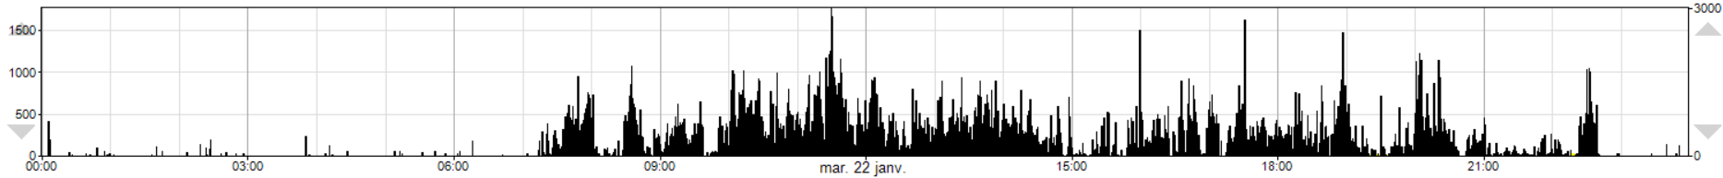
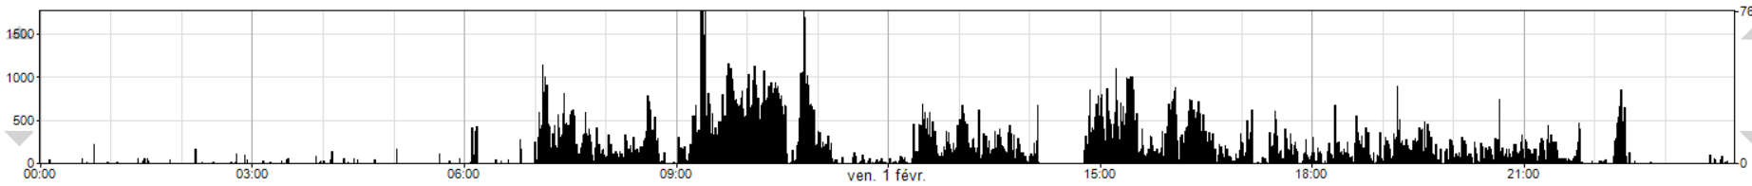
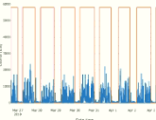
Nap phenotyping: Actimetry
Continuous period of wakefulness
Napping
PyActigraphy (Hammad et al., 2020): Open-source python package for actigraphy data visualisation and analysis
Nap report:
Duration
Frequency
Timing (activity onset, activity offset, circadian phase marker (DLMO))
Notes:
Usual rest-activity rhythm (RaR) variables & Sleep regularity index (SRI)
• Sleep fragmentation via state transition probability (kAR & kRA)
• Singular spectrum analysis (SSA): inspect circadian/ultradian components

Slide 35
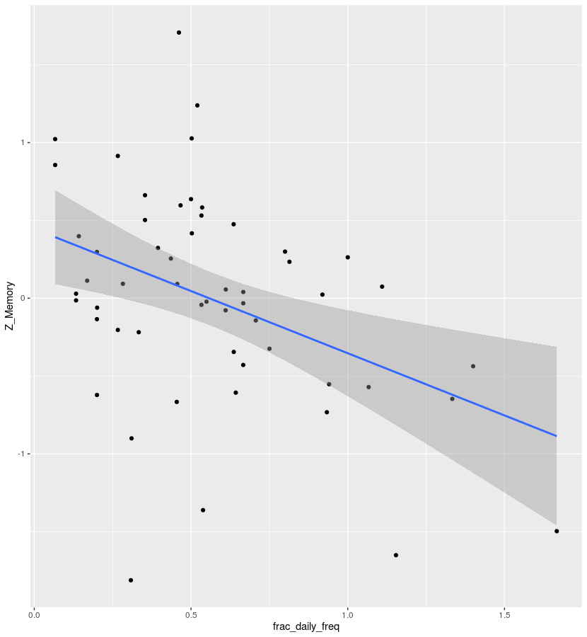
Impact of nap phenotype on cognition in the aged?
(n = 59, 45 nappers)
Episodic memory performance
1
Episodic memory
(z-composite)
0
-1
0
0.5
1
1.5
Nap frequency
(daily average)
Notes:
nombre de siestes détectées sur tout l'enregistrement / durée de
l'enregistrement (en jour).

Slide 36
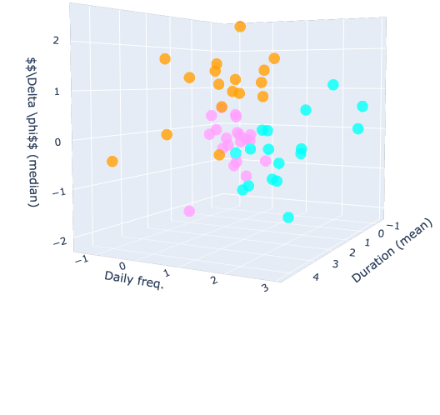
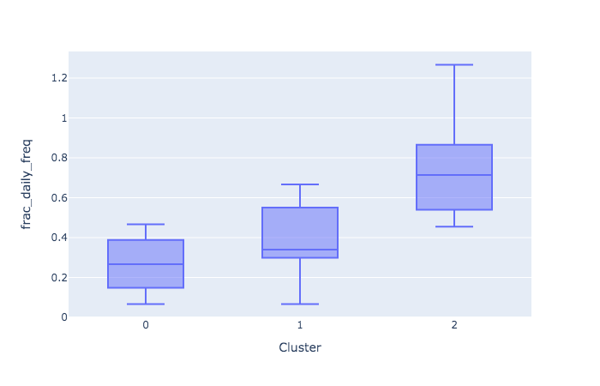
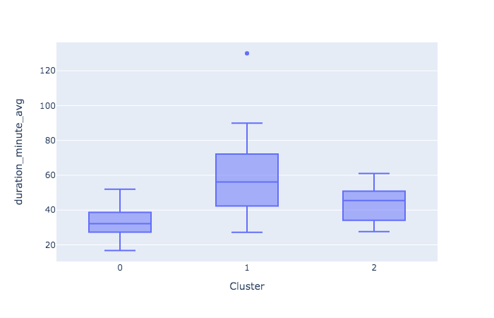
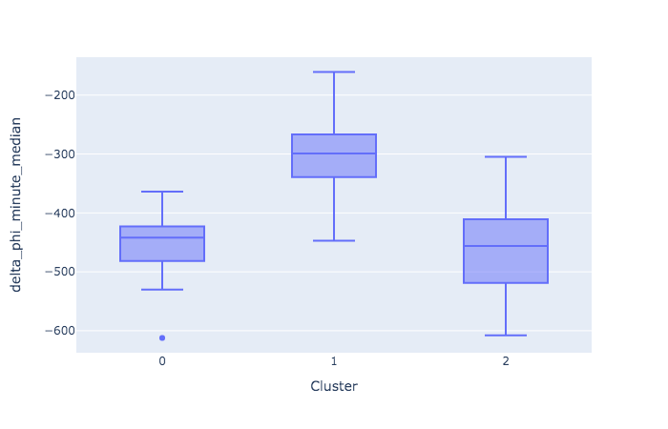
Impact of nap phenotype on cognition in the aged?
Clustering (k-means)
Timing (from DLMO)
Duration
Frequency
Frequency
Duration
Timing
Reyt, Hammad, Schmidt et al., in preparation
Notes:
nombre de siestes détectées sur tout l'enregistrement / durée de
l'enregistrement (en jour).
J'ai appelé cela "fractional" car le nombre de jour n'est pas
nécessairement entier. Si c'est 3 jours et 8 heures, alors la durée est
de 3.333. Histoire de ne pas biaser les enregistrements qui se finissent
le matin par rapport à ceux qui se finissent en fin de journée.
Détail mineur; vu que l'on regarde les siestes à un moment précis
(12h-18h par ex), même si l'enregistrement "déborde" jusqu'à 22h le
dernier jour, il n'y a pas de possibilité d'ajouter une sieste en
regardant dans la tranche horaire '18h-22h' par rapport à un
enregistrement qui s'arrêterait à 18h. Mais la durée de cet
enregistrement est plus longue de 4h donc la fraction est légèrement
plus basse. Mais c'est un détail mineur car sur 7 jours, 4h représente
4h/168h = 1/42 ~ 2.5%. Bref, ce n'est pas grave mais comme cela tu sais
tout!

Slide 37
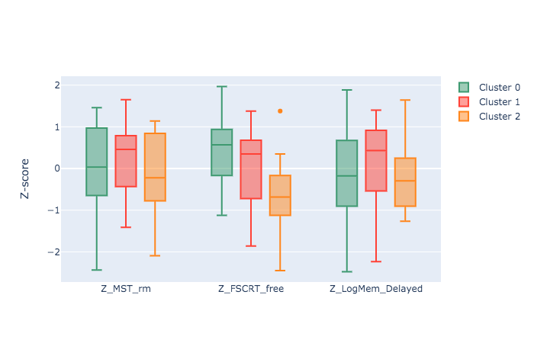
Impact of nap phenotype on cognition in the aged?
Clustering (k-means)
Timing (from DLMO)
Z-score
Duration
Frequency
Frequency
Duration
Timing
Reyt, Hammad, Schmidt et al., in preparation

Slide 38



Frequent napping: Impact on daily « sleep » profile
Average daily sleep profile (normalized and anchored to DLMO)
Impact of nap frequency?
Association with sleep markers?
Daytime rest (composite)

Slide 39
Impact of nap phenotype on cerebral correlates in the aged?
Preliminary data
Sternberg task in a 3T MRI scanner
K Q B L G F
k
Working memory (WM) load: 2 (low load) to 7 (high load) letters

Slide 40






Impact of nap phenotype on cerebral correlates in the aged?
High vs low daytime rest (1st vs 4th quartile):
n = 13 by group
1.0
Low wake fragmentation (LWF)
High wake fragmentation (HWF)
*
0.9
0.8
Increased BOLD-activation in LWF compared to HWF at the highest memory load (p_{FWE-corr} < 0.05)
0.7
2
3
4
5
6
7
Functional compensation through attentional network?
Working memory load (items)

Slide 41
Perspectives
Sleep regulation as a factor for modulating the individual’s cognitive aging trajectory?
Act on cognition through sleep (timing)
- Sleep context
- Age of the population
- Cognitive domain

Slide 42








University of Liège
Marion Baillet
Michele Deantoni
Gregory Hammad
Alexia Lesoinne
Mathilde Reyt
Vincenzo Muto
Pierre Maquet
Christophe Philipps
Gilles Vandewalle
Fabienne Collette
Giulia Gaggioni
Daphné Chylinksi
Cathérine Hagelstein
Ekatherina Koshmanova
Justinas Narbutas
Maxime Van Eegroo
Center for Chronobiology, UPK of Basel
Christian Cajochen
Micheline Maire
Carolin Reichert

Slide 43
Zoom link: https://nus-sg.zoom.us/j/82923358720?pwd=VSt5VGpaRTVENTlPN2x3N3paK2daUT09
Meeting ID: 829 2335 8720
Meeting Password: 195559

Slide 44



Age-related changes in cognition
Compensation: recruitment of neural resources in response to relatively high cognitive demand
Low cognitive demand
High cognitive demand
Young
Old
Schneider-Garces et al., 2009

