Slide 1
Essential oils in agro-food industries: from traditional uses to new applications.
Cooperation Agreement--National Demonstration Base for Talent Introduction
Institute of Food Science and Technology, Chinese Academy of Agricultural Sciences
21st of December 2021
Prof. Marie-Laure FAUCONNIER
Laboratory of Chemistry of Natural Molecules
Gembloux Agro-Bio Tech
University of Liège (Belgium)
www.eohubbio.eu

Slide 2
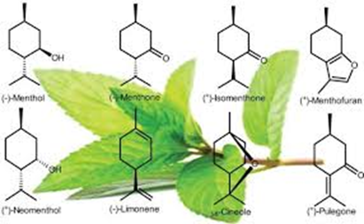
Essential oils in agro-food industries: from traditional uses to new applications.
Definition of Eos
Extraction techniques
Composition
Main Eos in the world market
Traditional uses of Eos
Traditional uses of Eos in food industries
Legislation of Eos
New applications of Eos
New applications of Eos in agro-food industries
Advantages / disadvantages

Slide 3
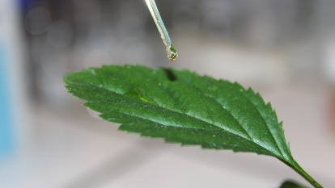
Essential oils in agro-food industries: from traditional uses to new applications.
Definition of Eos
Essential oils are complex mixtures of volatile compounds produced by living organisms and isolated by physical means only (pressing and distillation) from a whole plant or a plant part of known taxonomic origin.
A plant extract obtained by solvent extraction (like vanilla) or by supercritical CO₂ is NOT an essential oil !
Essential oils are NOT oils (like peanut oils)
Does all the plants are essential oils bearing plants?
Yes theoretically
No in fact
- typical and unique blend of volatiles (rose, lavender)
- secretion and accumulation in specialized anatomical structures (e.g. trichomes)

Slide 4
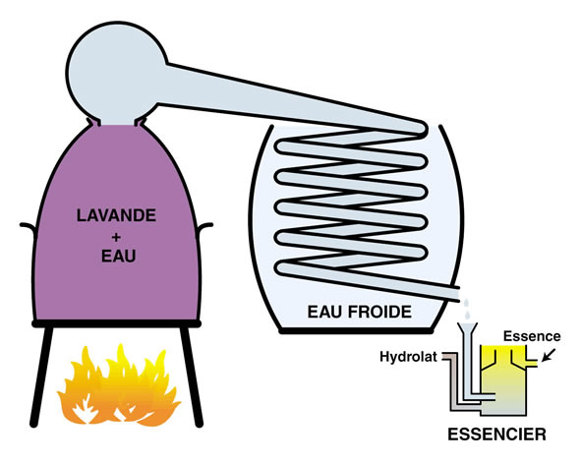
Essential oils in agro-food industries: from traditional uses to new applications.
Extraction techniques:
Hydrodistillation:
very simple
not expensive
direct contact with plant material

Slide 5
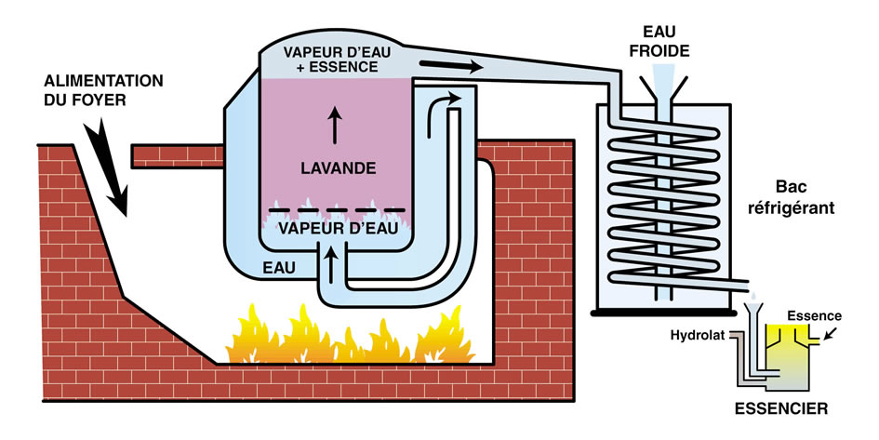
Essential oils in agro-food industries: from traditional uses to new applications.
Extraction techniques:
Steam distillation:
more complex
more expensive
no direct contact with plant material

Slide 6
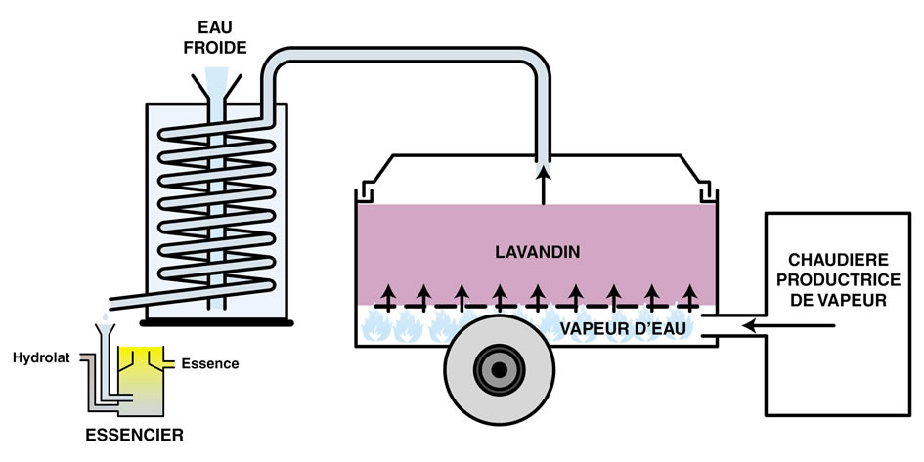
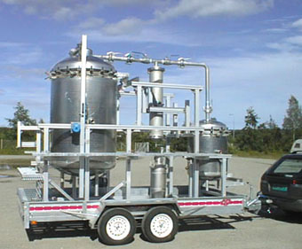
Essential oils in agro-food industries: from traditional uses to new applications.
Extraction techniques:
In field steam distillation:
of practical use
direct distillation after harvest
limited volume

Slide 7
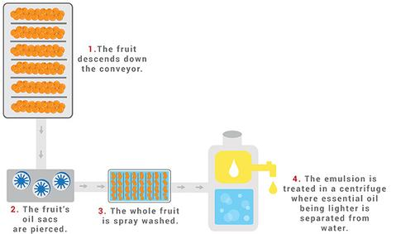
Essential oils in agro-food industries: from traditional uses to new applications.
Extraction techniques:
Pressing:
used for citrus Eos
Eos contain non volatile compounds
not expensive

Slide 8
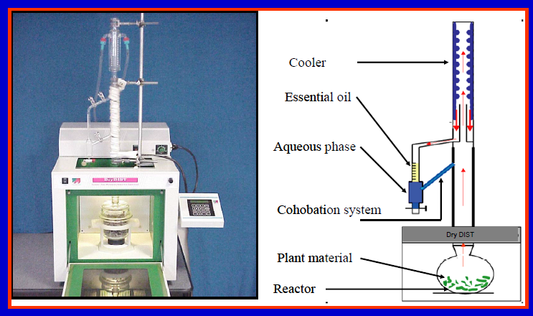
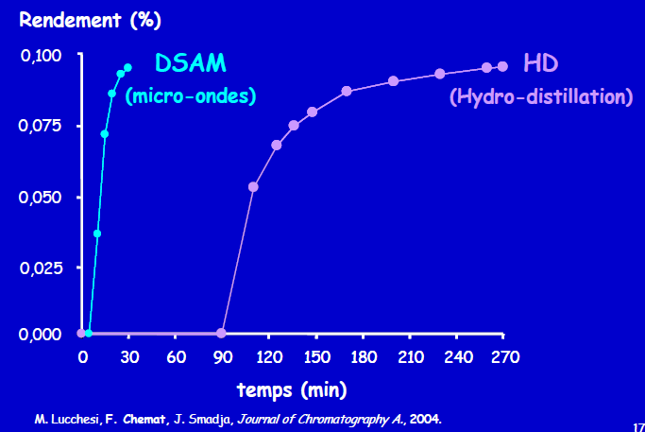
Essential oils in agro-food industries: from traditional uses to new applications.
Microwave Assisted Distillation (1-5l)
Extraction techniques:

Slide 9
Essential oils in agro-food industries: from traditional uses to new applications.
Microwave Hydrodiffusion Gravity (HMG)
Extraction techniques:

Slide 10
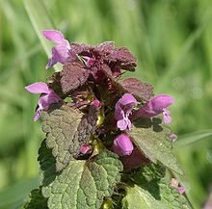
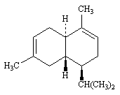
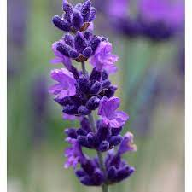
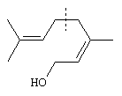
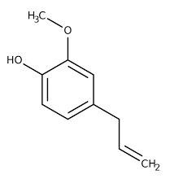
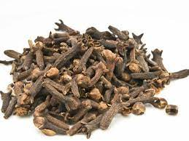
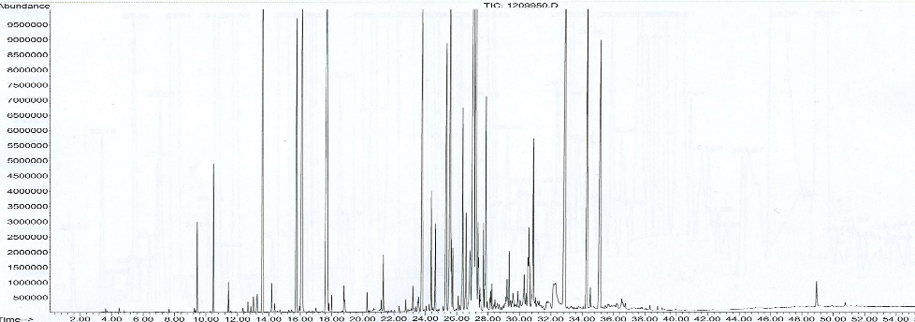
Essential oils in agro-food industries: from traditional uses to new applications.
Composition:
Mainly three pathways
Mevalonate ➔ sesquiterpenes
Methyl-erythritol ➔ mono and diterpenes
Shikimic ➔ phenylpropenes
But also :
Acid
Alcohol
Ketones
Esters
S and N containing compounds
➔ very complex composition e.g. ylang ylang EO : > 450 compounds

Slide 11
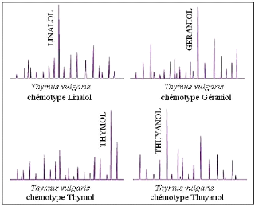
Essential oils in agro-food industries: from traditional uses to new applications.
Composition:
Depends on the organ (cinnamon leaves: eugenol, cinnamon bark: cinnamaldehyde, cinnammon roots: camphor)
Depends on the season
Depends on the climate-soil-distillation (terroir effect)
Presence of pathogens
Chemotypes
Thyme: 7 chemotypes
Linalol
Géraniol
Thymol
Thujanol
Carvacrol
α-terpinéol
Hydrate de sabinène

Slide 12
Essential oils in agro-food industries: from traditional uses to new applications.
Main EOS in the world market (2021)
3000 Eos described but 300 on the market
Orange (soft drinks, sweets, fragrances)
Cornmint (oral care, chewing gum, confectionery, fragrances)
Peppermint (oral care, chewing gum, confectionery, liquors, tobacco)
Eucalyptus (oral care, chewing gum, confectionery, fragrances, pharmaceutical)
Lemon (soft drinks, sweets, fragrances, household products)
Citronella (perfumery, toiletries, household products)
Clove leaf (condiment, sweets, pharmaceuticals, tobacco, household products
Spearmint (oral care, chewing gum, confectionery)
Cedarwood (perfumery, toiletries, household products)
Lime (soft drinks, sweets, diary, fragrances)
Lavandin (perfumery, cosmetics, toiletries)

Slide 13
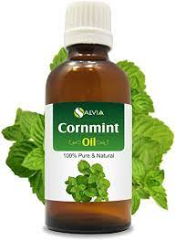
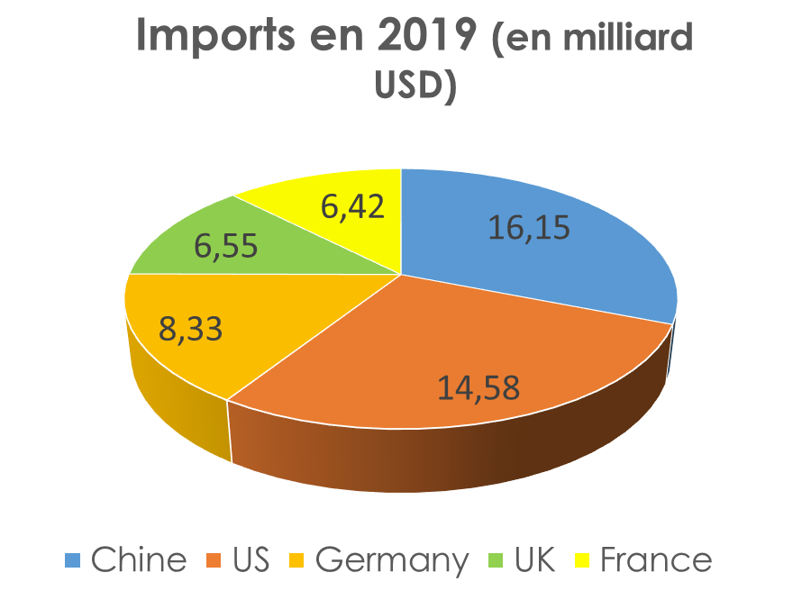
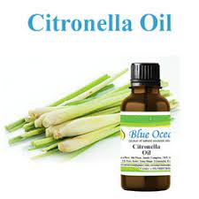
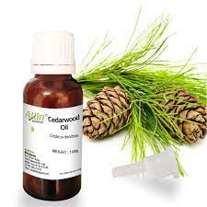
Essential oils in agro-food industries: from traditional uses to new applications.
Main EOS in the world market (2021)
China top essential oil production :
Cornmint
Peppermint
Eucalyptus
Citronella
Spearmint
Cedarwood
Litsea cubeba

Slide 14
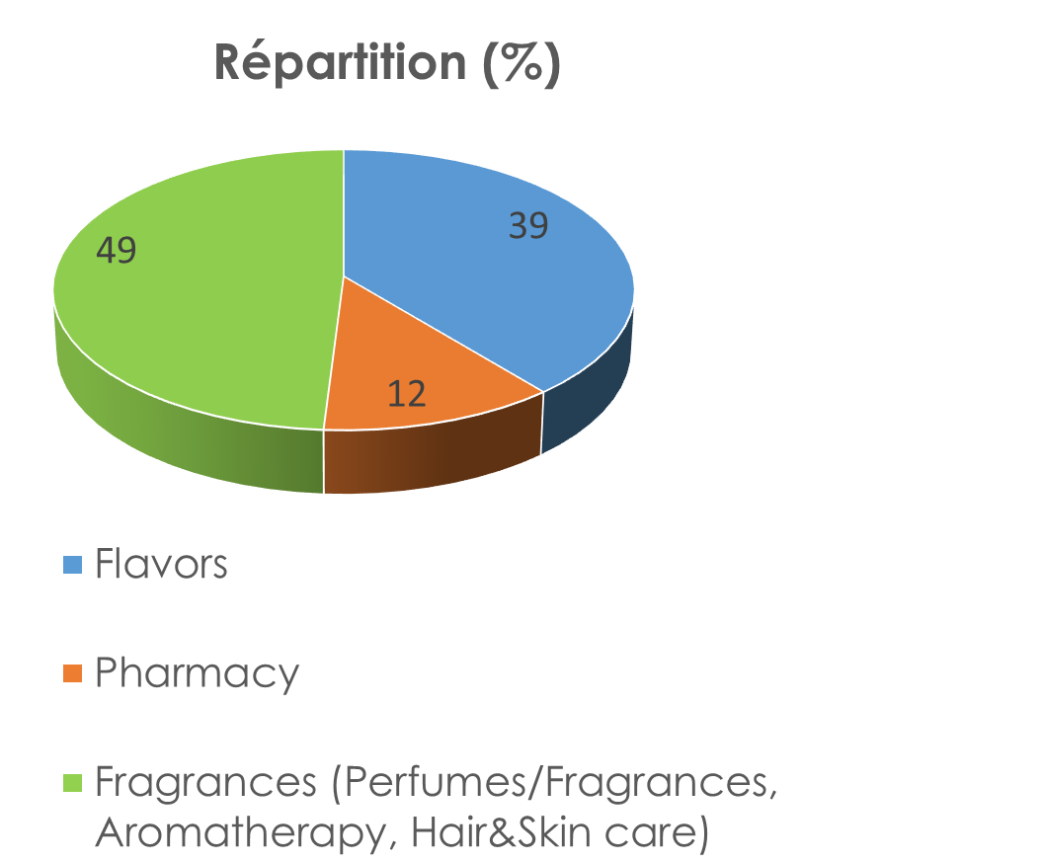
Essential oils in agro-food industries: from traditional uses to new applications.
Eos traditional uses
Cosmetics & Perfumes
Aromatherapy
Aroma
Pharmacy
Household products
Additives
Biocides (agronomy/ veterinary/food)
Insecticide
Fongicide
Bactericide
Virucide
Nematicide
Acaricide
Anti-sprouting
Builiding block for chemical synthesis

Slide 15
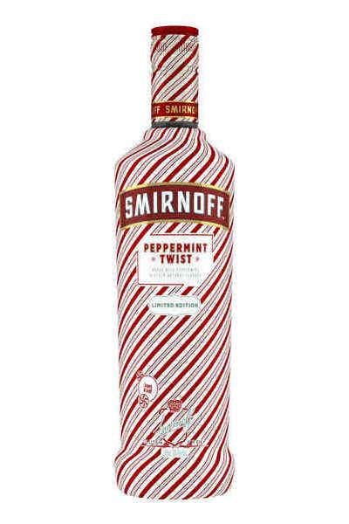
Essential oils in agro-food industries: from traditional uses to new applications.
Eos traditional uses in agro-food industries: flavor
(decreasing market position of EOs in food products)
Flavor:
Solution in ethanol
Emulsion (gum arabic)
Maltodextrin
Food product | Flavor dosage (%) | EO content in flavor (%)
1. Alcoholic beverage | 0,05-0,15 | 3-100
2. Soft drinks | 0,10-0,15 | 2-5
3. Sweets (confectionery, chocolate) | 0,15-0,25 | 1-100
4. Bakery (cake, biscuits, …) | 0,10-0,25 | 1-50
5. Ice creams | 0,10-0,30 | 2-100
6. Dairy products, desserts | 0,05-0,25 | 1-50
7. Meat and fish products | 0,10-0,25 | 10-20
8. Sauces, ketchup, condiments | 0,10-0,50 | 2-10
9. Food concentrates | 0,10-0,50 | 1-25
10. Snacks | 0,10-0,15 | 2-20

Slide 16
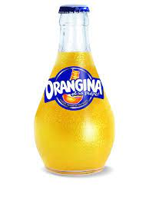
Essential oils in agro-food industries: from traditional uses to new applications.
Formula of an orange aroma ready to be diluted
Category | Name
Flavor preparation | Concentrated orange EO
 | Deterpenated orange EO
 | Citronella EO
Flavor compounds | Linalool
 | Ethyl butyrate
 | Citral
 | Nerol
Solvent | Ethanol
Additive | Alpha-tocopherol, BHA
Flavor is not an additive but an ingredient

Slide 17
Essential oils in agro-food industries: from traditional uses to new applications.
Food legislation for Eos (european legislation)
Legislation different depending on uses
Cosmetics : Regulation (EC) N°1223/2009
Food : Regulation (EC) N°1334/2008
Pharmacy : Directive 2004/24/CE
Flavourings” shall mean products: not intended to be consumed as such, which are added to food in order to impart or modify odour and/or taste ➔ not to increase preservation !
Not to be added as such in food
Beta asarone, Agaric acid, Estragol, Aloin, Hydrocyanic acid, Capsaicine, Menthofuran, Hypericine, Methyl eugenol, Teucrine A, Pulegone, Thujone, Quassine Coumarin Safrol
Substance | Example EO | Food product (mg/kg) | Beverage (mg/kg) | Restrictions (mg/kg)
Pulegone | Mentha pulegium | 25 | 100 | Mint beverage (250) Mint sweeties (350)

Slide 18
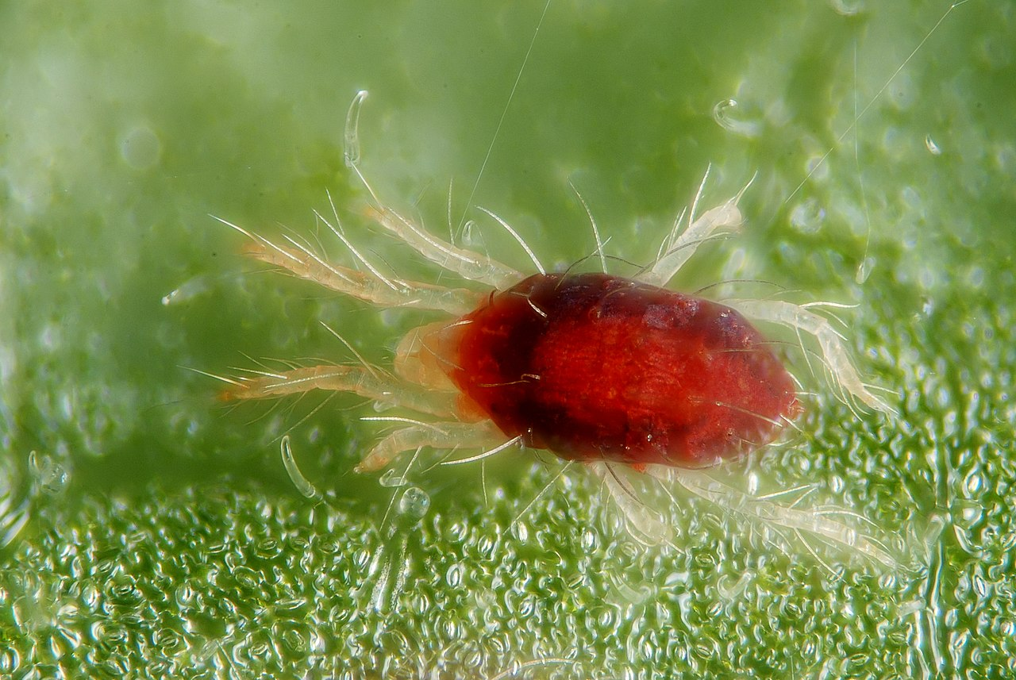
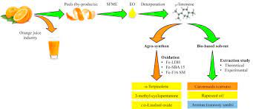
Essential oils in agro-food industries: from traditional uses to new applications.
New applications of Eos
1) Due to the biocide properties: a lot of applications in agronomy (number of references in Google Scholar)
Insecticide (GS 106 000)
Herbicide (GS 56 600)
Bactericide-fongicide (GS 68 200)
Acaricide-nématicide (GS 25 000)
Decrease the use of conventional pesticides (replacement of glyphosate)
Reduce resistance due to complex composition and mode of actions
Due to their volatility: decrease the residue in agri-food products
Good degradability ➔ no soil pollution
Reduced effect on non target organisms
2) As building block to replace fosil ressources or as green solvent (limonene)

Slide 19
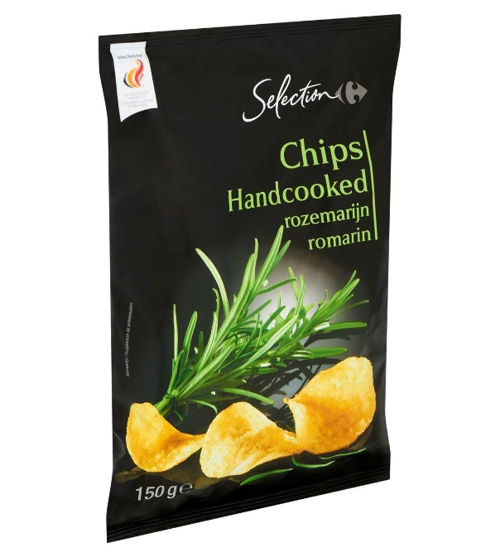
Essential oils in agro-food industries: from traditional uses to new applications.
New applications of Eos as preservative / increase self live
Due to its anti-oxidant, bactericide and fungicide activities EOs are used as preservatives in food industries to increase self live.
Taking into account legislation it is “limit” as the objective is not to modify the flavor BUT to increase self-live.
Example of Rosmarinus EOs
Added to sliced beef extend self-live up to 15 days
(in combination with high O2 athmosphere)
Microencapsulated Rosmarinus EO increases self-live of
cheese, fresh truit, lam slices
Rosmarinus Eo is used to decrease oil oxidation in potato chips

Slide 20
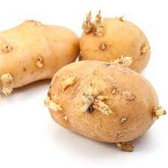
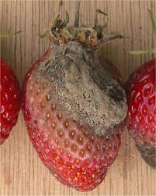
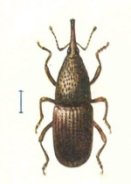
Essential oils in agro-food industries: from traditional uses to new applications.
New applications of Eo in post-harvest treatment
Carvone (caraway EO) is used as anti-sprouting agent on potato tubers
Essential oils are used to avoid botrytis on strawberries, also inhibition of Aspergillus flavus (aflatoxin B1)
Essential oils are used in cereals silo to avoid insects damages

Slide 21
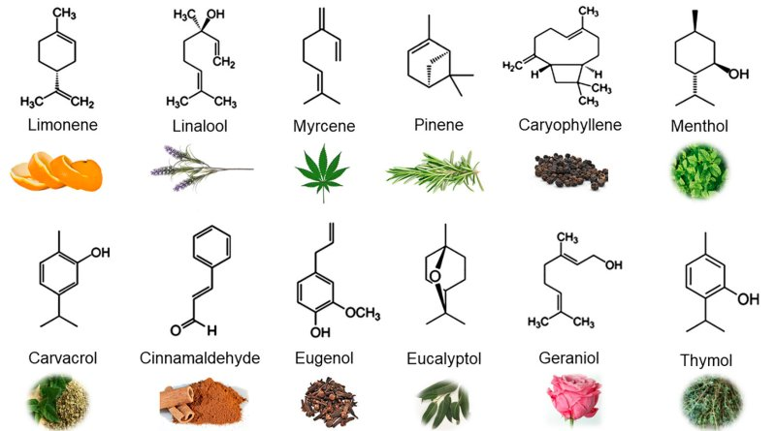
Essential oils in agro-food industries: from traditional uses to new applications.
New applications of Eo in packaging
To obtained a slow and controlled relaese of Eos, encapsulation is used (alginate, chitosan, cyclodextrins, arabic gum). Ex chitosan containing clove EO ➔ pomergranate; chitosan-lemongrass EO ➔ guava

Slide 22
Essential oils in agro-food industries: from traditional uses to new applications.
New applications of Eo in packaging
biodegradable polylactic acid nanocapsules ➔ increase self live of fresh fruits (apple, persimmon, peach, ..)
Also starch-gellan films against Alternaria, Botrytis

Slide 23
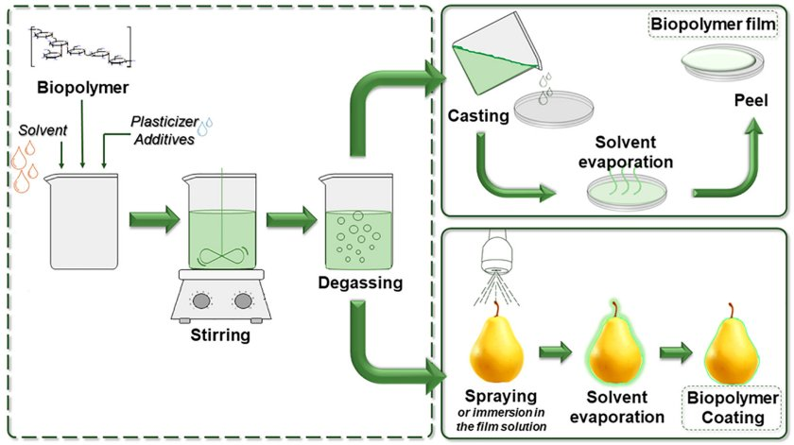
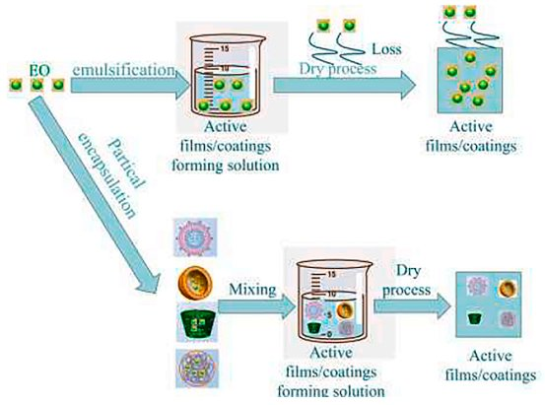
Essential oils in agro-food industries: from traditional uses to new applications.
New applications of Eo in packaging
Inclusion of Eos into polyethylene films by extrusion: increase pork meat self-life
Use of multilayer packaging (polyurethane adhesive with cinnamon EO)
Polyolefin containg EO ➔ degradable packaging for fruits and vegetables
Edible films (gelatin capsules)

Slide 24
Essential oils in agro-food industries: from traditional uses to new applications.
Advantages / inconvenients of Eos
Price
Disponibility
Variability of composition
Flavor
Volatility
Regulatory
Phytotoxicity
In vitro study mainly
Poor understanding of action mode
Good acceptability by consumers
Generally healthy
Complex composition (resistance limited)
Volatility
➔ So many researches to be performed!

Slide 25
Essential oils in agro-food industries: from traditional uses to new applications.
Thank you for your attention!

