Slide 1
Honouring humans as gods
Ritual construction and critical discourse in the Hellenistic and Roman periods
Luca Lorenzon - aspirant FRS-F.N.R.S., ULiège (luca.lorenzon@uliege.be)
the 11th Day on Belgian Archaeological Research in the Ancient Greek World
10 décembre 2021 – Musées royaux d’art et d’Histoire

Slide 2
Introduction to the cult of human beings during the Hellenistic and Imperial periods
Bridging the gap between literary and epigraphic sources
Honouring the deceased as gods: the contribution of funerary epigrams

Slide 3
Categorizing the divine
Plutarch, On the Failure of Oracles, 415b
Ἡσίοδος δὲ καθαρῶς καὶ διωρισμένως πρῶτος ἐξέθηκε τῶν λογικῶν τέσσαρα γένη, θεοὺς εἶτα δαίμονας εἶθ’ ἥρωας τὸ δ’ἐπὶ πᾶσιν ἀνθρώπους.
Hesiod, clearly and distinctly, established a classification of rational beings into four categories: first the gods, then the daimones, then the heroes and finally the men.
Men
Heroes
Gods
Daimones

Slide 4
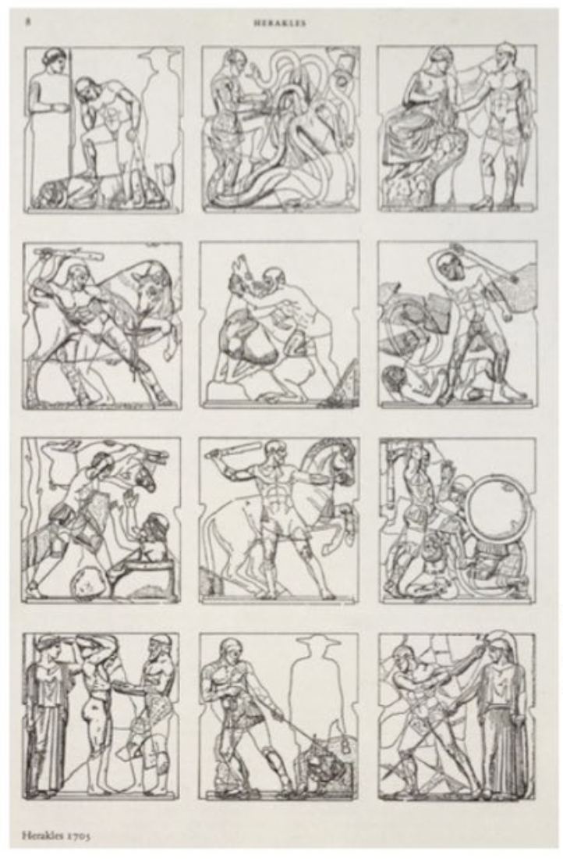
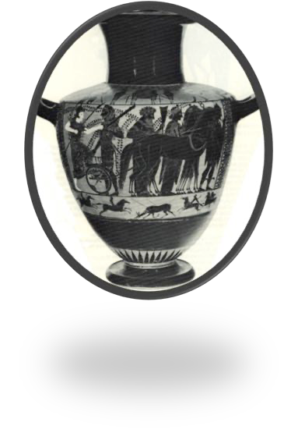
The fluidity of the categories
Herakles’ apotheosis (Louvre)
Metopes of the Temple of Zeus in Olympia, 5th century BC

Slide 5
Herodotus, II, 44 : Τὰ μέν νυν ἱστορημένα δηλοῖ σαφέως παλαιὸν θεὸν Ἡρακλέα ἐόντα· καὶ δοκέουσι δέ μοι οὗτοι ὀρθότατα Ἑλλήνων ποιέειν, οἳ διξὰ Ἡράκλεια ἱδρυσάμενοι ἔκτηνται, καὶ τῷ μὲν ὡς ἀθανάτῳ Ὀλυμπίῳ δὲ ἐπωνυμίην θύουσι, τῷ δὲ ἑτέρῳ ὡς ἥρωι ἐναγίζουσι.
This research clearly proves that Herakles is an ancient god: also the Greeks, who erected two temples at Herakles, seem tome to have acted very wisely. They offer sacrifices to one, whom they have called Olympian, as to an immortal, and make funerary offerings to the other, as to a hero.

Slide 6
Τί θεός ; Τὸ κρατοῦν. Τί βασιλεύς ; ἰσόθεος Τί ἀθάνατον ; τὸ ἀγήρατον | What is a god? Power. What is a king? Equal to god. What is immortality? Lack of old age.
P. Heidelberg, 1716 v.
Political/diplomatical dimension
Religious dimension

Slide 7
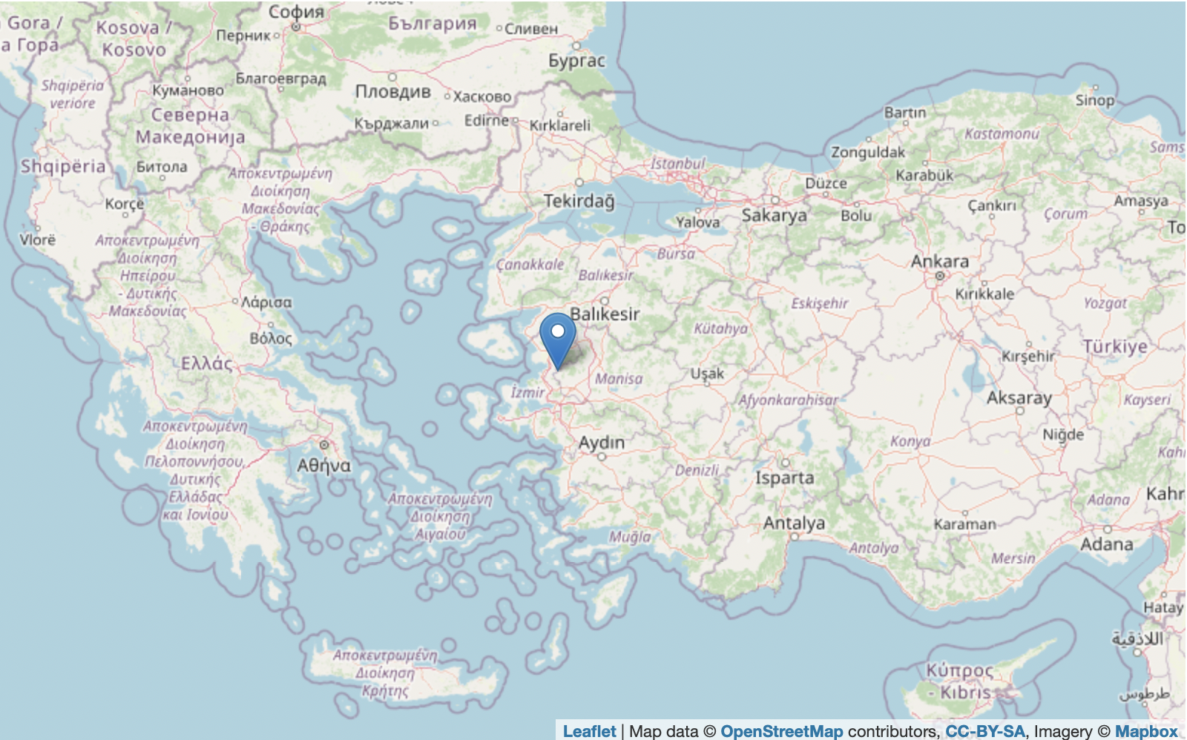
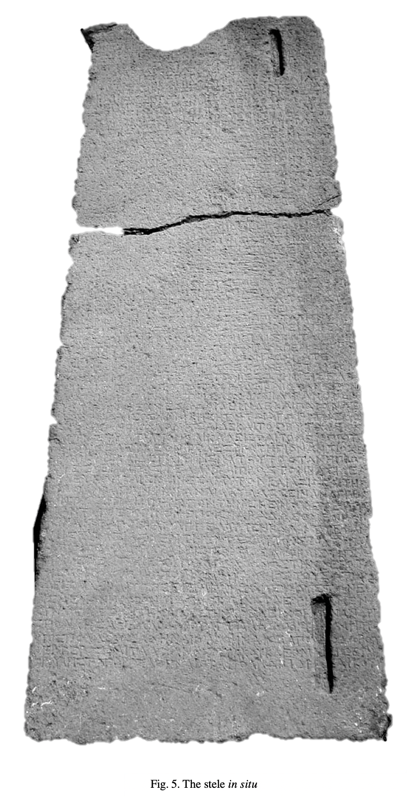
Aigai
SEG 59, 1406 (CGRN 137) ; 281 BC
https://topostext.org/place/388273PAig

Slide 8
Aigai
SEG 59, 1406 (CGRN 137) lines 1-11 ; 281 BC
[...] and well (?) [...] for Seleukos and Antiochos [...]. And so that for all time as (?) by men the appropriate (viz. gratitude) for their benefactions (e.g. may be showed), with which Seleukos and Antiochos (5) who are may be honoured as gods manifest, a temple as beautiful as possible is to be built adjacent to the enclosure of Apollo and the place is to be surrounded by a precinct and two statues as beautiful as possible are to be consecrated, identified with inscriptions as "Seleukos" and (10) "Antiochos", and in front of the temple are to be erected a statue and an altar of the Soteira.
[..?..] [... κ]αὶ καλῶ[ς ....⁷...]ΝΑΙ Σελεύκωι κ[αὶ] Ἀντιόχωι [....⁸....]Ε· ἵνα δὲ καὶ εἰς τὸν π[ά]- [ν]τα χρόνον [.]Σ ὑπ᾿ ἀν[θ]ρώπων τὴν κ[α]ταξίαν [τ]ῶν εὐεργετημάτων, ἧι θεοὶ οἱ ἐ[πι]φανέ[ν]- [τε]ς τιμῶνται Σέλευκος καὶ Ἀντ[ίο]χος, να- [ό]ν τε οἰκοδομῆσαι ὡς κάλλιστ[ον] πρὸς τῶ- [ι] περιβόλωι τοῦ Ἀπόλλωνος καὶ [τό]πον πε- [ρι]βαλέσθαι καὶ ἀγάλματα ἀναθ[εῖ]ναι δύ- [ο] ὡς κάλλιστα, ἐπιγράψαντας "Σέ[λ]ευκον" κ- αὶ "Ἀντίοχον", καὶ πρὸ τοῦ ναοῦ στῆσαι ἄγα- [λ]μα καὶ βωμὸν τῆς Σωτείρας·

Slide 9
2. Bridging the gap between literary and epigraphic sources
The cult of human beings used to be perceived as:
a degeneration of Greek religion of the Classical period
an influence from eastern populations
a tool used for religious propaganda (< influence of a Judeo-Christian research environment)
To sum up: Influence of polemical literary sources
Habicht Ch. 1956, Gottmenschentum und griechische Städte, Munich (Zetemata, 14).
Habicht Ch., 2017³, Divine Honors for Mortal Men in Greek Cities: The Early Cases, Ann Arbor.

Slide 10
PHRC (Practicalities of Hellenistic Ruler Cults) (http://phrc.it/)

Slide 11
The focus of the epigraphic documentation is entirely pragmatic
→ The efficacy of the process of embedding rituals for new human recipients within the religious life of a community
Lack of theoretical reflections about the implications of granting cultic honours with regard to the mutual positioning of the honoured humans and the divine sphere
Where do we find discursive treatments of this topic?
Literary sources
“Faire c’est croire” ➔ Concealing actions and statements

Slide 12
3. Honouring the deceased as gods: the contribution of funerary epigrams
Ciceron, Att., 12.36.1:
Fanum fieri volo; neque hoc mihi eripi potest. Sepulcri similitudinem effugere non tam propter poenam legis studeo, quam ut maxime adsequar ἀποθέωσιν. Quod poteram, si in ipsa villa facerem : sed, ut saepe locuti sumus, commutationes dominorum reformido. In agro ubicumque fecero, mihi videor adsequi posse, ut posteritas habeat religionem. Hae meae tibi ineptiae (fateor enim) ferendae sunt. Nam habeo, ne me quidem ipsum, quicum tam audacter communicem, quam te.
I want a shrine to be made, nor is it possible to dissuade me from this. I am zealous to avoid the likeness of a tomb, not so much because of the threat of legal punishment but so that I might most greatly achieve apotheosis. And this aim I would be able to achieve, if I constructed the shrine in the villa itself; but, as we have often discussed, I am afraid of future changes of ownership. If I construct it anywhere in the field, it seems to me that I will be able to assure that future generations might have religious duty to the shrine. You must endure these (I’ll admit) silly fancies of mine; for I have no one, not even my own self, with whom I can communicate so boldly as with you.

Slide 13
Some Greek precedents
Apotheosis in Egypt: OGIS 56A and 56B (lines 56-57: ἐν ὧι ἡ ἀποθέωσις αὐ[τῆς]ἐν ἀρχῆι ἐγενήθη); Prose sur Pierre 42, 43, 44 (lines 26-27: ἀπὸ βορρᾶ τάφων̣ τῶν ἀποθειουμένων ἱερῶν ζῴων); P.Tebt I, 15 (line 78: ἐπὶ τῶν ἀποτεθεωμένων). Cf. also Pfeiffer, Callimachus, vol. 1 frag 228; Theocritus 17.46; Ps. Call.3.32.4-7.
MDAI(A) 33 (1908) 381,3, line 10: [μετὰ δὲ τὴν τῶν β]ασιλέων ἀποθέωσιν. Euphemism for death?
SEG 57, 1188, lines 25-29: οἵτινες συμ|μείξαντες Ἁρπάλωι καὶ Ἀθηνοδώρωι τάς | τε ἐψηφισμένας τιμὰς ἀποδώσουσιν καὶ | παρακαλέσουσιν αὐτοὺς μετρίως ἐνεγκεῖν | τὴν ἀποθέωσιν.
➔ These examples underline the innovative nature of Cicero’s initiative

Slide 14
The apotheosis/consecratio of the Roman emperors
Herodian, IV, 3 :
Ἔθος γάρ ἐστι Ῥωμαίοις ἐκθειάζειν βασιλέων τοὺς ἐπὶ παισὶ {ἢ} διαδόχοις τελευτήσαντας· τήν τε τοιαύτην τιμὴν ἀποθέωσιν καλοῦσιν. (…) Τούτων δὲ συντελεσθέντων λαβὼν λαμπάδα ὁ τὴν βασιλείαν διαδεξάμενος προσφέρει τῷ οἰκήματι, οἵ τε λοιποὶ πανταχόθεν πῦρ περιτιθέασι· πάντα δὲ ῥᾷστα ἀνάπτεται καὶ εὐμαρῶς ὑπὸ τοῦ πυρός, φρυγάνων τε πλήθους καὶ θυμιαμάτων ἐπινηθέντος. Ἐκ δὲ τοῦ τελευταίου καὶ βραχυτάτου κατασκευάσματος, ὥσπερ ἀπό τινος ἐπάλξεως, ἀετὸς ἀφίεται σὺν τῷ πυρὶ ἀνελευσόμενος ἐς τὸν αἰθέρα, ὃς φέρειν ἀπὸ γῆς ἐς οὐρανὸν τὴν τοῦ βασιλέως ψυχὴν πιστεύεται ὑπὸ Ῥωμαίων· καὶ ἐξ ἐκείνου μετὰ τῶν λοιπῶν θεῶν θρησκεύεται.
It is the Roman custom to elevate to divine status those emperors who at their death leave sons or designated successors; they call this honor apotheosis. (…) When these rites have been completed, the emperor's successor puts a torch to the structure, after which the people set it on fire on all sides. The flames easily and quickly consume the enormous pile of fire-wood and fragrant stuffs. From the topmost and smallest story, as if from a battlement, an eagle flies forth, soaring with the flames into the sky; the Romans believe that this eagle carries the soul of the emperor from the earth up to heaven. Thereafter the emperor is worshiped with the rest of the gods.

Slide 15
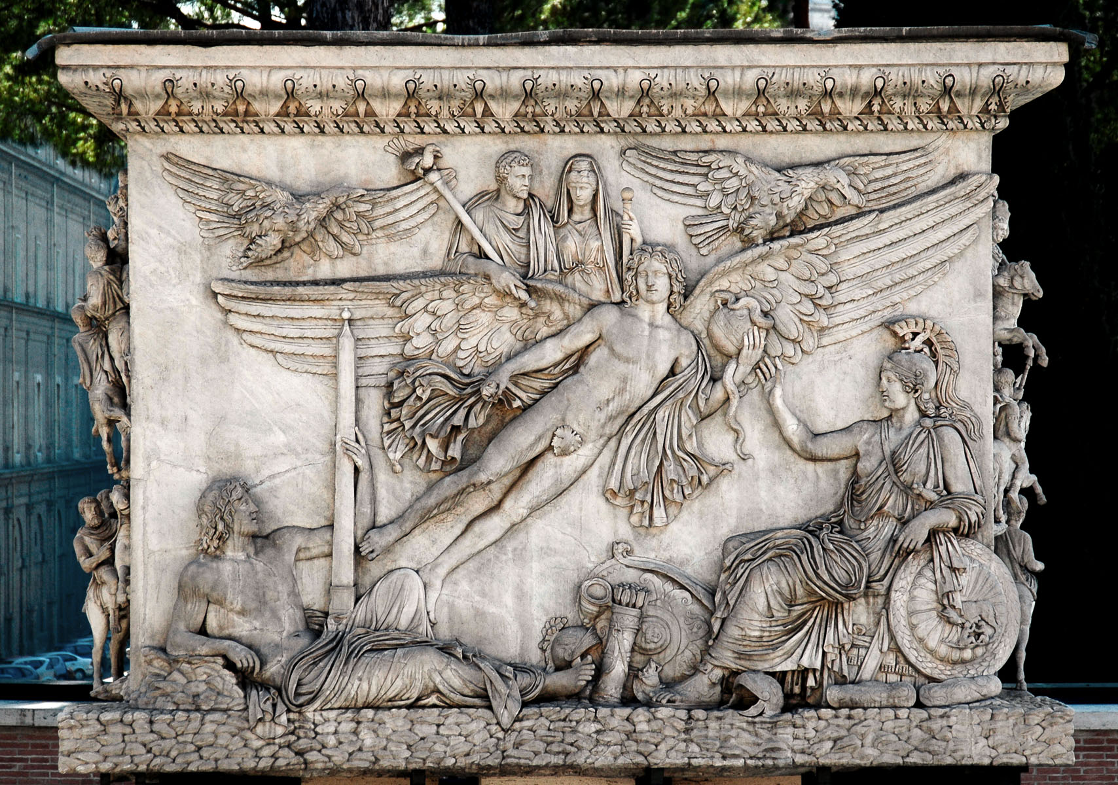
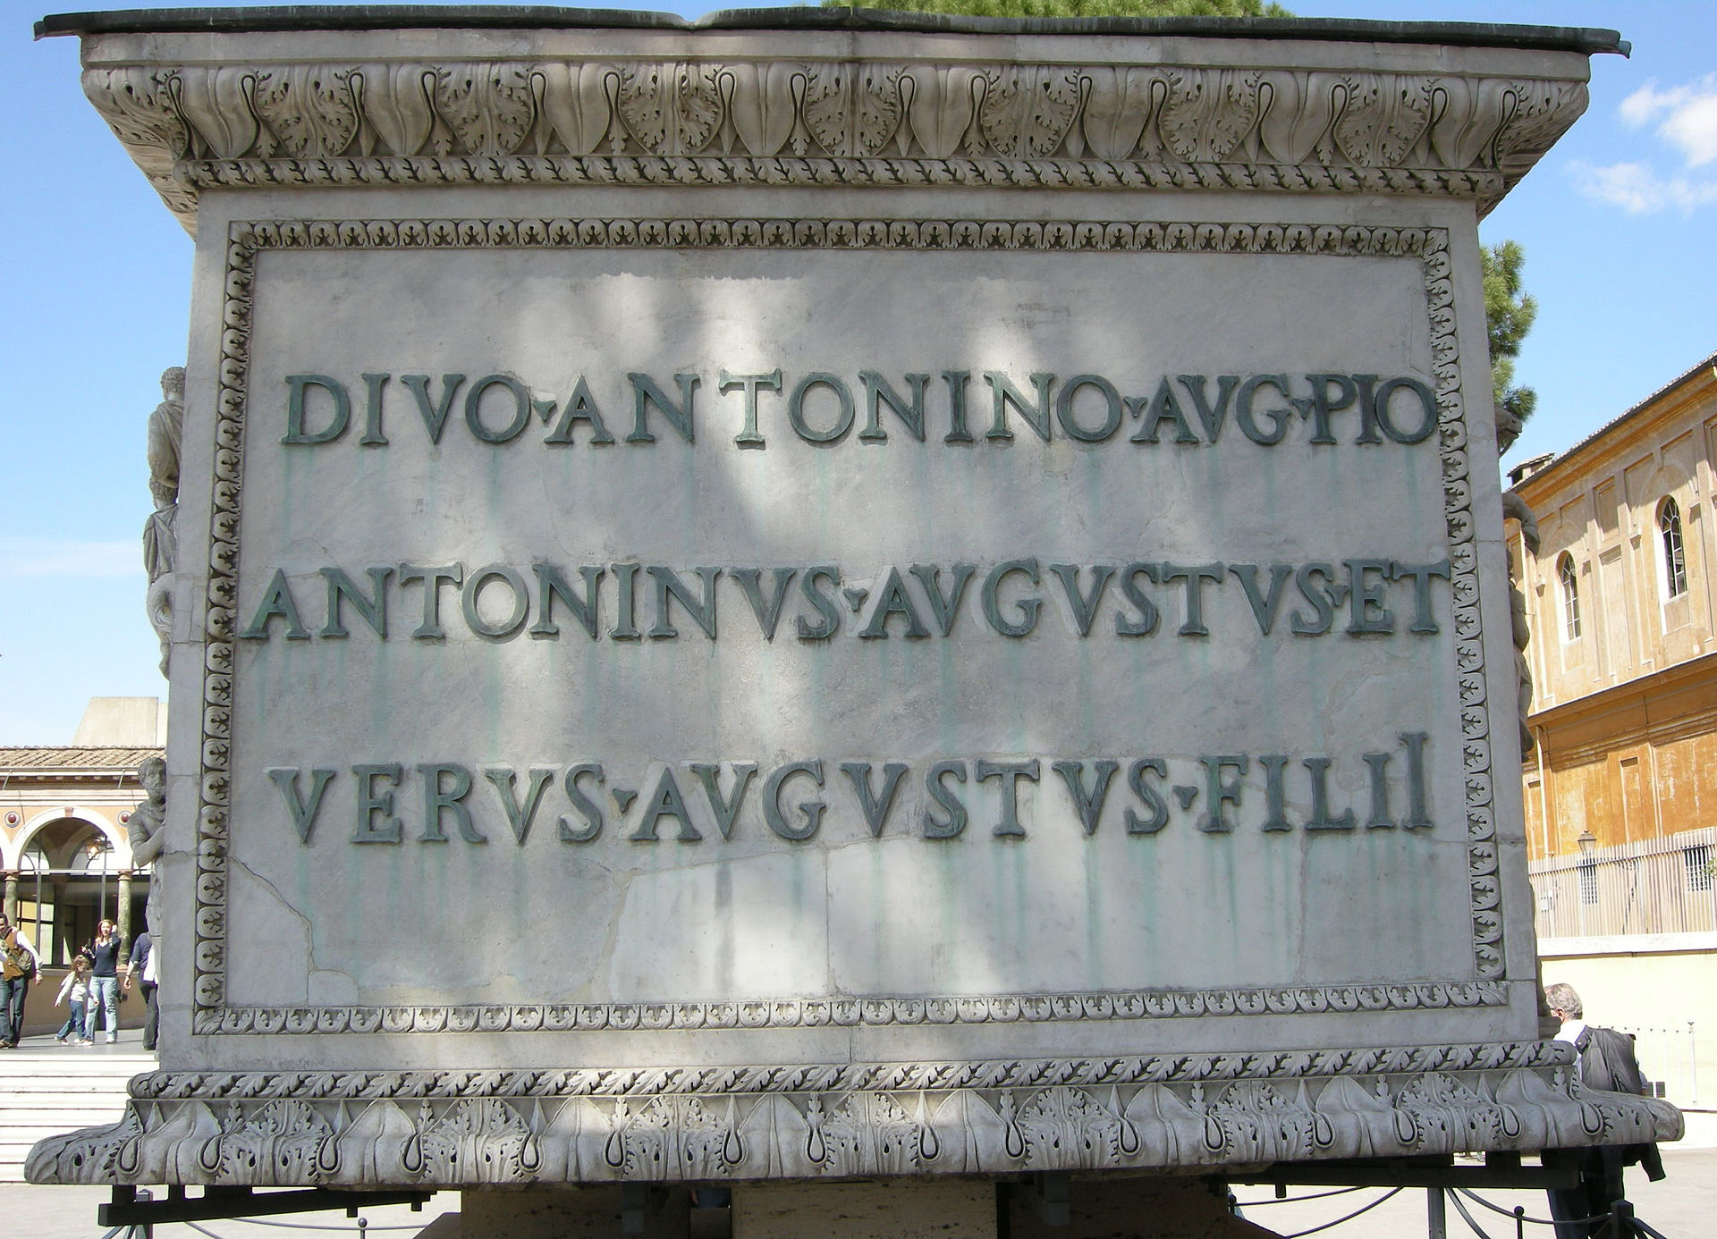
The apotheosis/consecratio of the Roman emperors
Decursio relief, base of the Column of Antoninus Pius, 161 AD
Inv. No. 5115.
Rome, Vatican Museums, Cortile delle Corazze
DIVO ANTONINO AVG(usto)
PIO ANTONINVS AVGVSTVS ET VERVS AVGVSTVS FILII

Slide 16
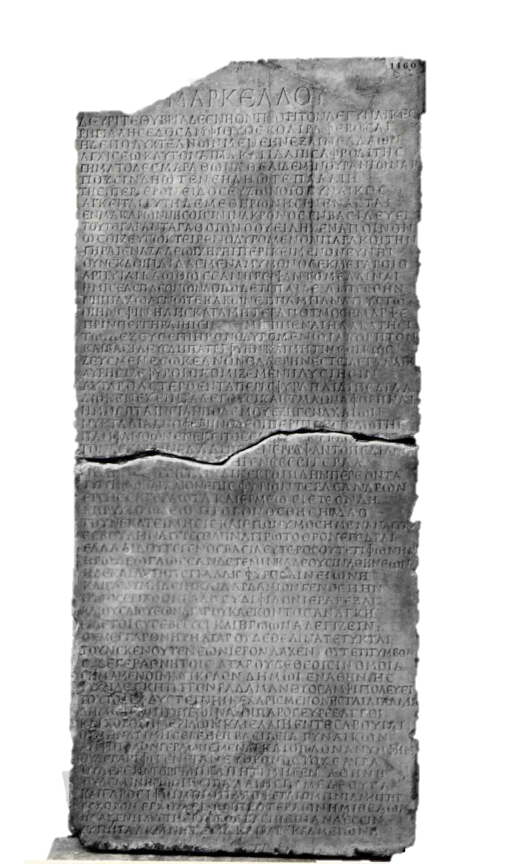
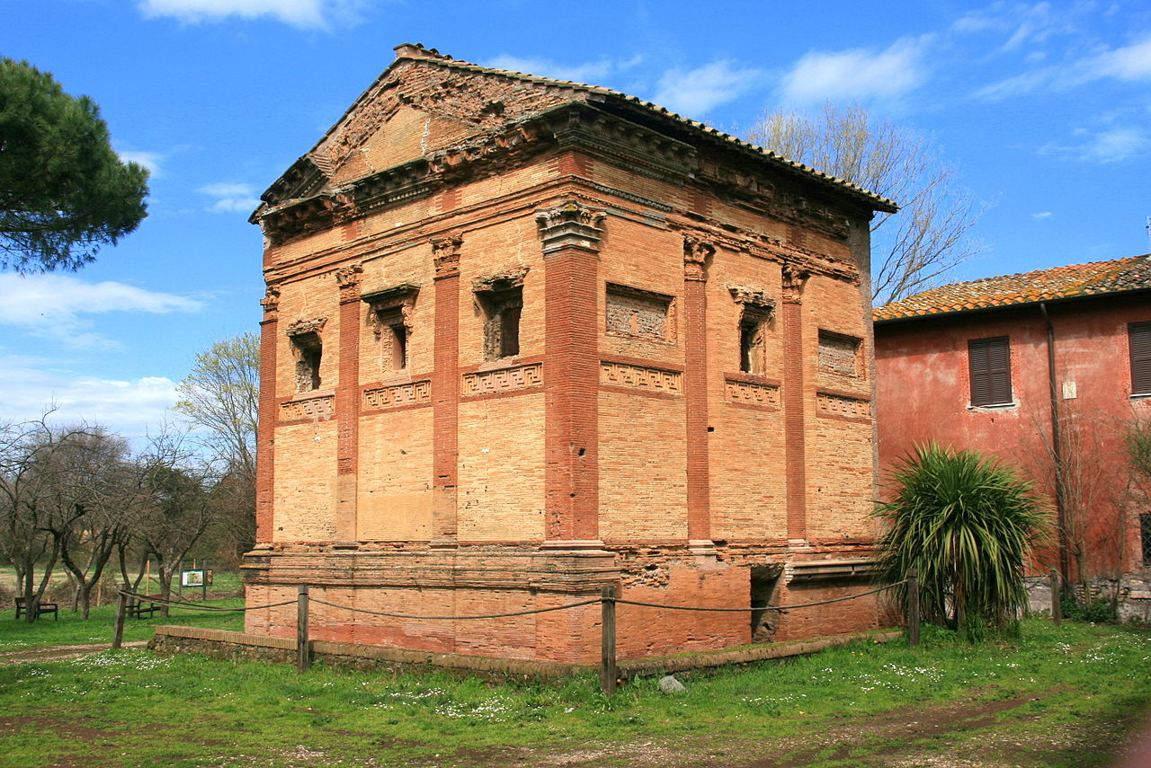
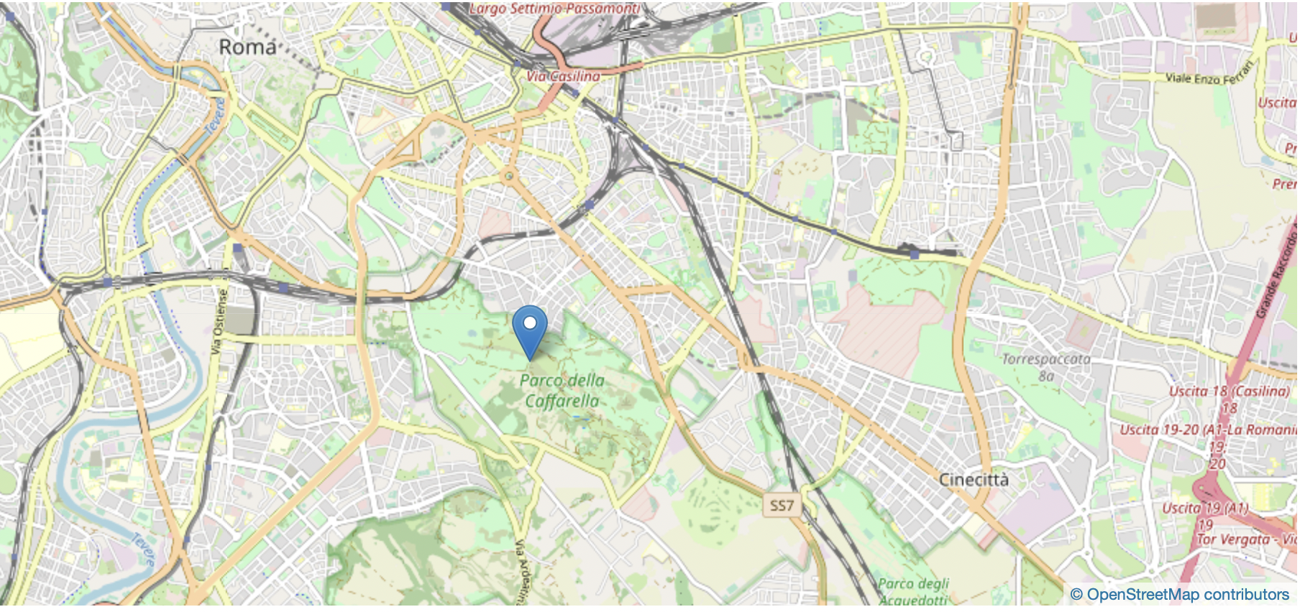
Annia Regilla’s funery epitaph
IG XIV 1389, ; 161 AD, Rome

Slide 17
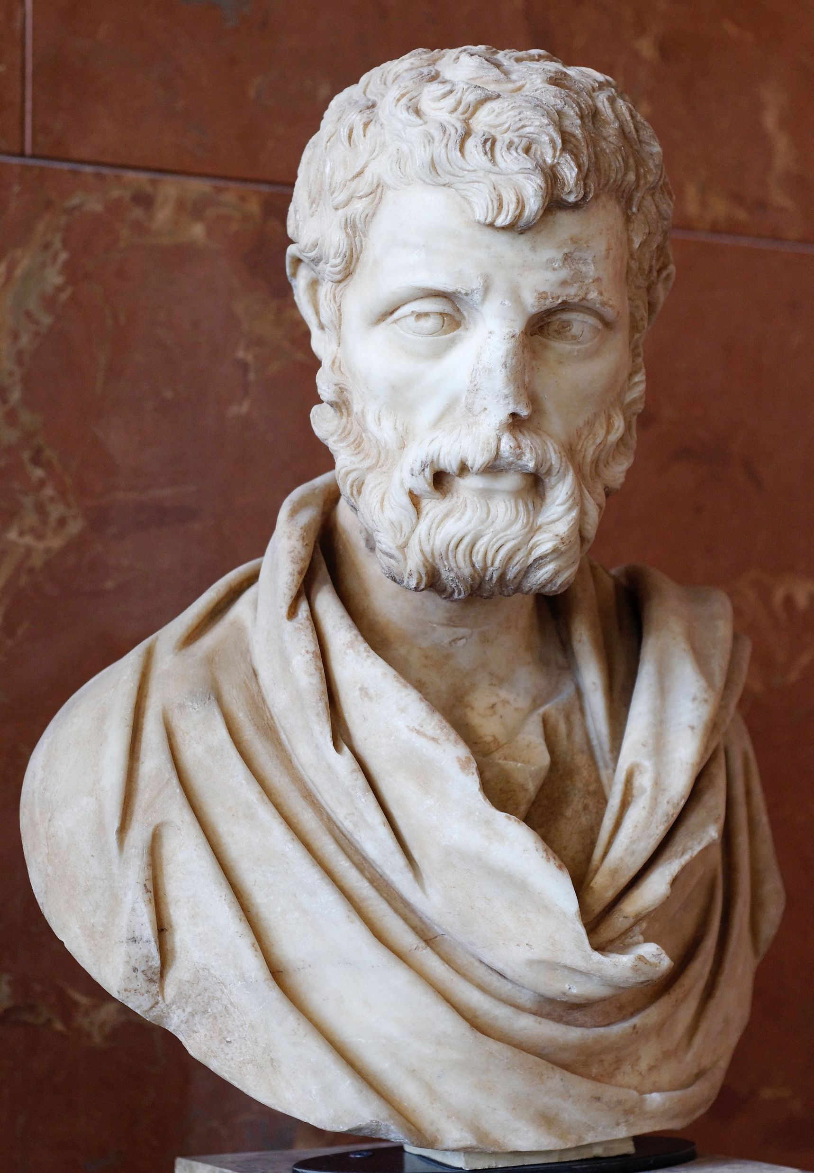
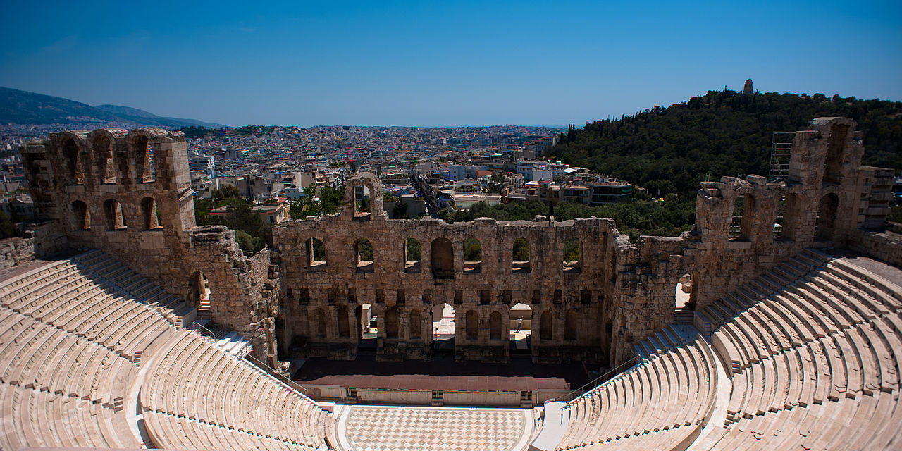
Herodes Atticus
Lines 36-37 : Ἑλλάδι δ’ οὔτε γένος βασιλεύτερος οὔτε τι φωνὴν Ἡρώδεω
In Greece there is no family or reputation more royal than Herodes’.
161 AD, Louvre
Odeon of Herodes Atticus, Athens

Slide 18
Annia Regilla’s funery epitaph
IG XIV 1389, lines 40-45 ; 161 AD, Rome
σύ δ’, ἰ φίλον, ἱερὰ ῥέξαι
καὶ θῦσαι· θυέων ἀτὰρ οὐκ ἀέκοντος ἀνάγκη,
ε<ὖ> δέ τοι εὐσεβέεσσι καὶ ἡρώων ἀλεγίζειν.
οὐ μὲγ γὰρ θνητή, ἀτὰρ οὐδὲ θέαινα τέτυκται·
τοὔνεκεν οὔτε νεὼν ἱερὸν λάχεν οὔτε τι τύμβον.
οὐδὲ γέρα θνητοῖς, ἀτὰρ οὐδὲ θεοῖσιν ὅμοια.
As for you [the reader], if you are willing, please go and make sacrifices and burn them. But it is necessary that the one who sacrifices be not unwilling. It is good for the pious to also care about heroes. For she [Regilla] is neither mortal, nor divine. Therefore she has neither sacred temple nor tomb, neither honours for mortals, nor honours like those for the divine.

Slide 19
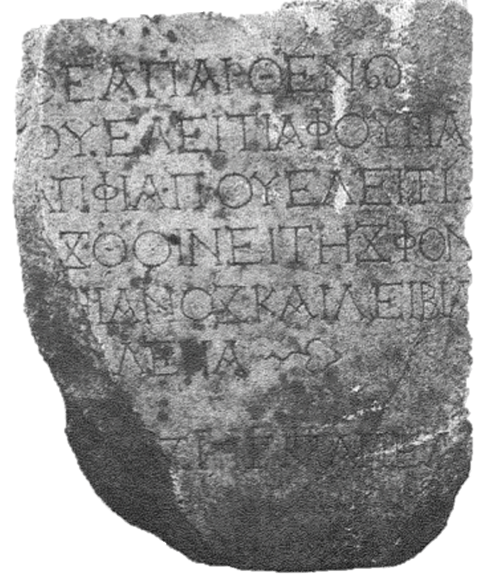
Funerary dedication to Velitia the virgin goddess
Malay-Petzl 2017 n°17, p. 59-60 ; Phrygia, 165/166 AD
Θεᾷ παρθένῳ
Οὐελειτίᾳ Φουρίᾳ
Ἀπφίᾳ Π. Οὐελειτί-
[ο]ς Θοινείτης Φον-
[τ]ηιανὸς καὶ Λειβία
[Οὐα]λερία. leaf
Vac.
[Ἔτου]ς ρqς’, μη(νὸς) Ἀπελ-
[λαίου …]
To the virgin goddess Velitia Furia Apphia. Publius Velitius Thynetes and Livia [Va]leria. Year 196, in the month Appel[laios]

Slide 20
Two possibly compatible hypotheses
During the second century, the deification of the non-imperial deceased occurs only in remote provinces of the empire, such as Phrygia.
Deification of the deceased does not take place in the circles closest to the emperor, but spreads to the lower strata of society.
Gradual and sporadic emergence during the II century AD
Expansion of the practice during the III century AD

Slide 21
Funerary epitaph of Eitheos and Olympias
IGUR III 1226 ; Rome, III/IV c. AD
ἱερὸς οὗτος ὁ χῶρος, ὃν Αἰνείας ἀγανόφρων
εἵσαθ’ ἑοῦ ἑτάροιο σεβάσμιον Ἠιθέοιο,
πάντα παλαιγενέεσσιν ἀλινκίου ἡρώεσσιν,
κάλλος τε ἠνορέην τ’ ἀγανοφρο<σ>ύν̣ην τε νόον τε.
[ἐ]νθάδε δ’ ἐ[νναί]ει καὶ Ὀλυμπιάς, εἱμερόεσσα
Ἠιθέοιο δάμαρ καὶ ἀδελφεὴ Αἰνείαο,
ἣ πάσας παράμ[ι]ψ[ε] φιλάνδρους ἡρωίνας,
Ἄλκηστιν πινυτῇ, μορφῇ δ’ ἐρατώπιδα Λήδην.
τοῦτ’ ἐτύμως νῆσοι μακάρων πέδον, ἔνθα τε φῶτες
εὐσεβέες ναίουσι δικαιότατοί τ’ ἀγανοί τε,
οἳ <ξ>υνὸν ζώοντες ἔχον βίον ἀλλήλοισιν
σὺν κόσμῳ σοφίῃ τε δικαιοσύνῃ τε καὶ αἰδοῖ.
ἀγγέλλω τάδε βωμός, ὃν Αἰνείας ἀνέθηκεν,
ὄφρα κε κυδαίνωνται ὑπ’ ἀντιθέοις γεράεσσιν
πᾶσιν ἐν αἰώνεσσιν ὑπ’ εὐσεβίῃσιν ἑταίρων.
This sacred ground, which Aeneas graciously dedicated to his companion Eitheos, in all matter similar to the heroes of the past, beautiful in his virility, kindness and intelligence. Here lies also Olympias, the fascinating wife of Eitheos and sister of Aeneas, who surpassed the heroines of conjugal love: Alcestis by wisdom, and Leda with a seductive face by beauty. On this island of the blessed live the pious, the most just and kindest beings, those who, when they were alive, lived a life in common with one another in order, wisdom, justice and dignity. I, the altar which Aeneas set up, declare these facts so that they may be honored for ever with offerings worthy of the gods by the most pious of their companions.

Slide 22
Menander rhetor
ΠΕΡΙ ΠΑΡΑΜΥΘΗΤΙΚΟΥ, 414, 21-27:
συγγενὴς γὰρ οὖσα τοῦ θείου ἡ ψυχὴ κἀκεῖθεν κατιοῦσα σπεύδει πάλιν ἄνω πρὸς τὸ συγγενές· οὕτω καὶ τὴν Ἑλένην, οὕτω καὶ τοὺς Διοσκούρους καὶ τὸν Ἡρακλέα λέγουσιν συμπολιτεύεσθαι μετὰ τῶν θεῶν· ὑμνῶμεν οὖν αὐτὸν ὡς ἥρωα, μᾶλλον δὲ ὡς θεὸν αὐτὸν μακαρίσωμεν, εἰκόνας γράψωμεν, ἱλασκώμεθα ὡς δαίμονα.
For the soul, being kin to the divine and coming down from on high to earth, makes haste back again to its kindred. Thus they say Helen and the Dioscuri and Heracles share the community of the gods. Let us therefore sing his praises as a hero, or rather bless him as a god, make paintings of him, placate him as a superhuman being.

Slide 23
What are the reasons for this expansion of the practice of post-mortem divine honors?
Diffusion to different strata of society of the model of the emperor’s apotheosis
Simultaneous expansion, in the second and third centuries, of the category of “heroes” to the deceased
Divine cult of Antinous

Slide 24
Thank you for your attention !
Luca Lorenzon - aspirant FRS-F.N.R.S., ULiège (luca.lorenzon@uliege.be)
the 11th Day on Belgian Archaeological Research in the Ancient Greek World
10 décembre 2021 – Musées royaux d’art et d’Histoire

