Slide 1
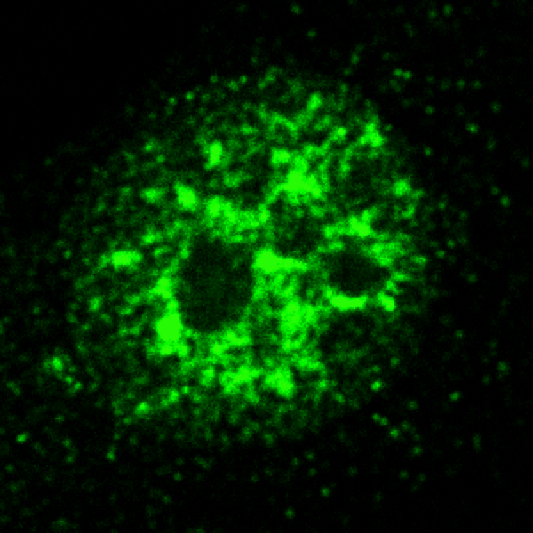
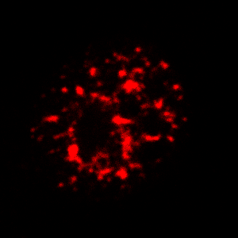
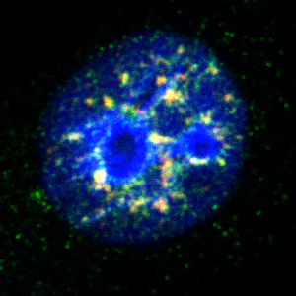
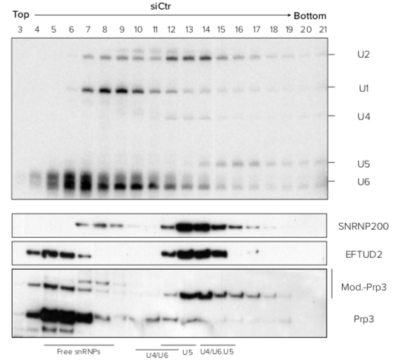
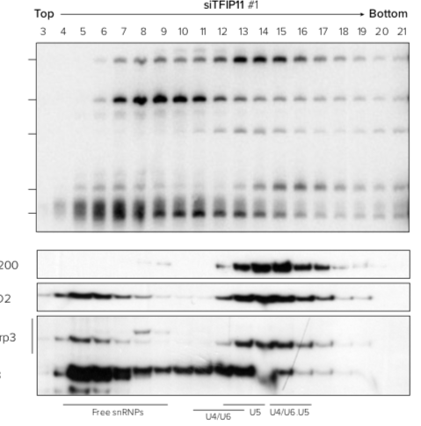
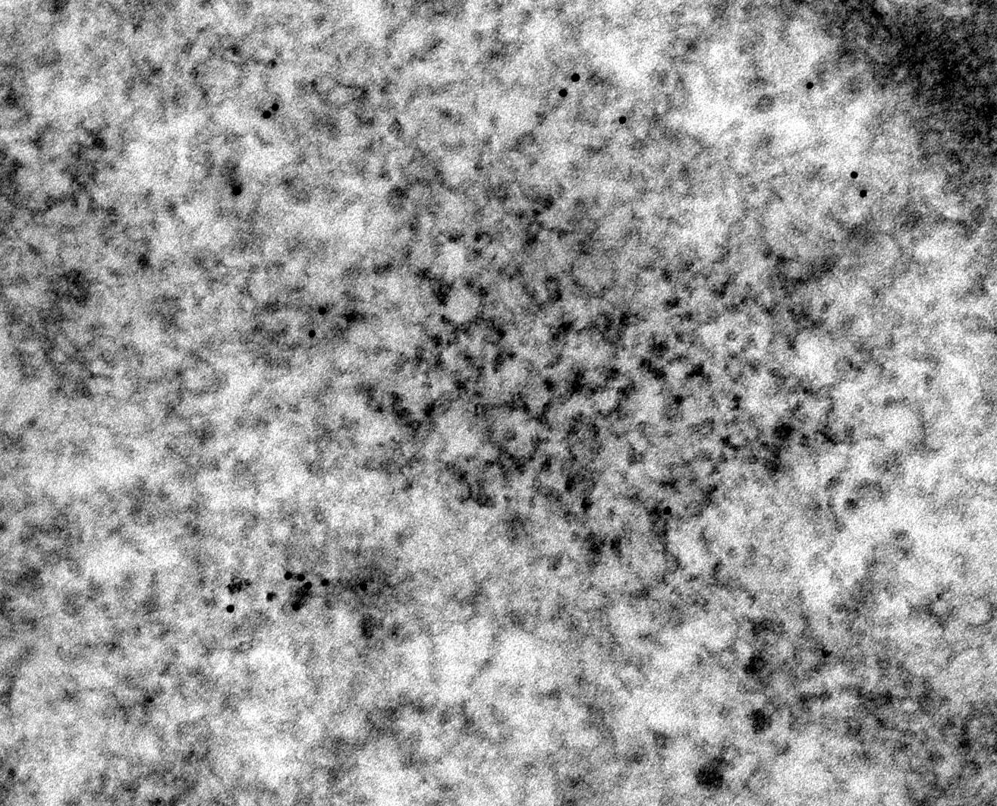
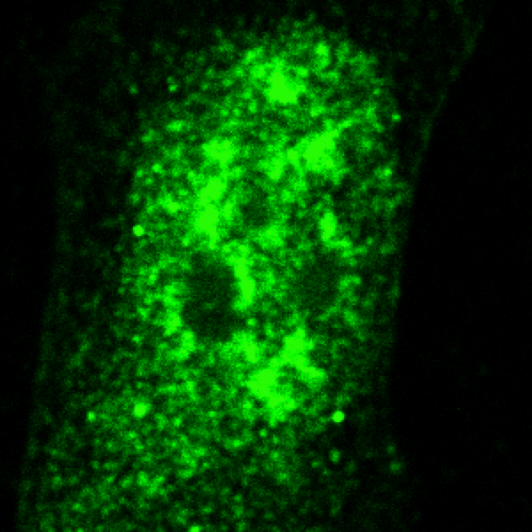
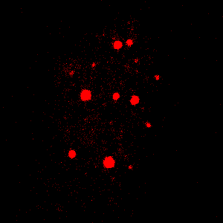
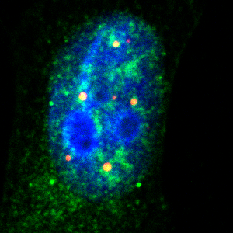
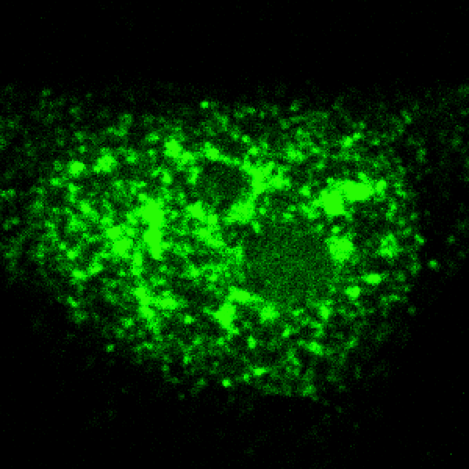
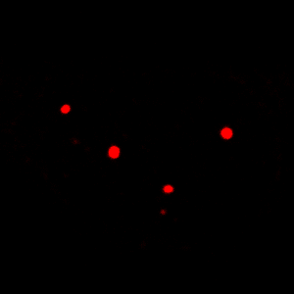
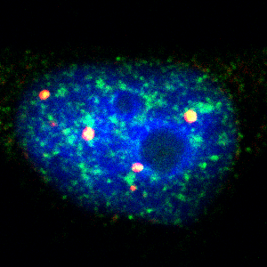
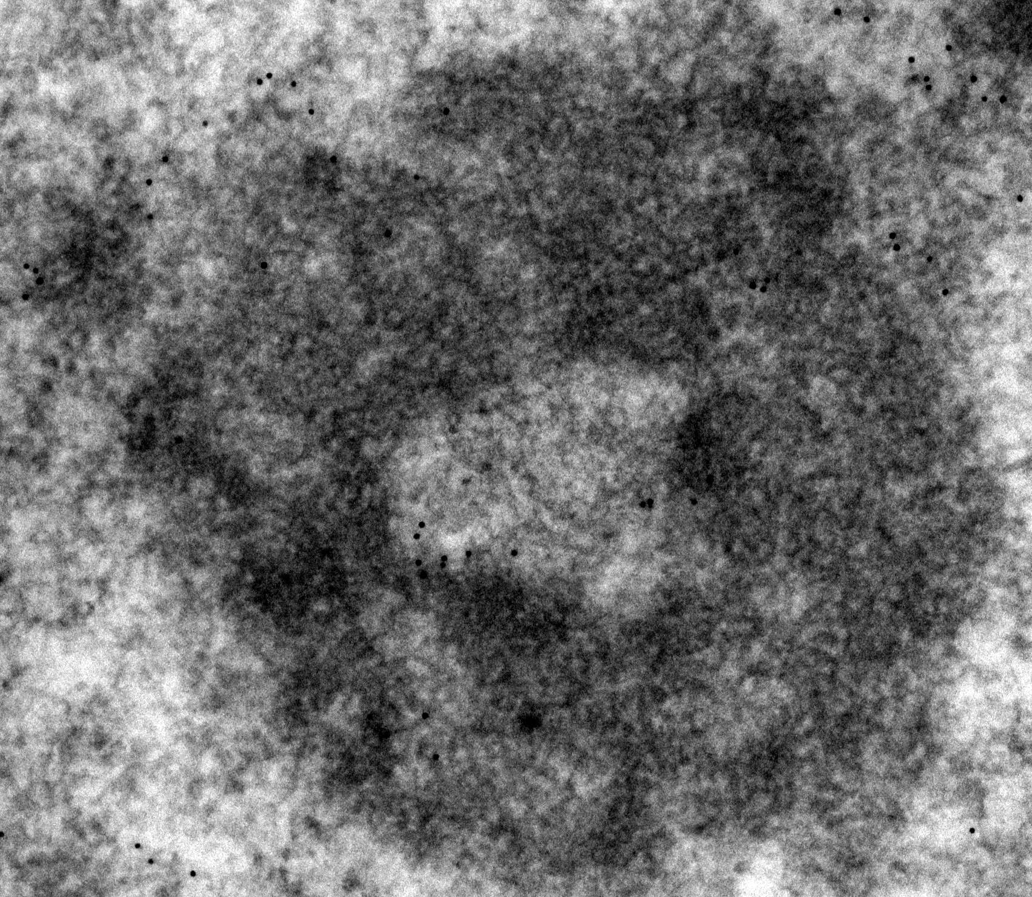
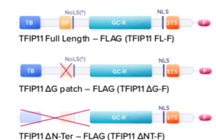
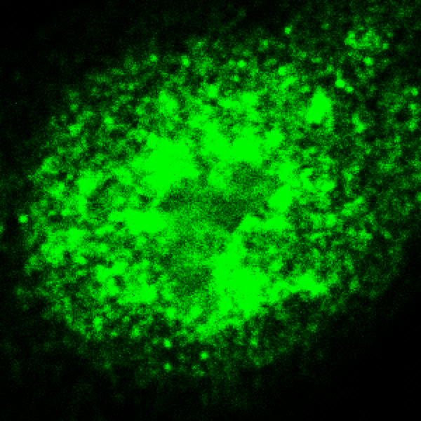
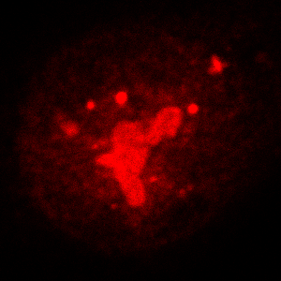
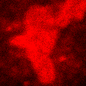
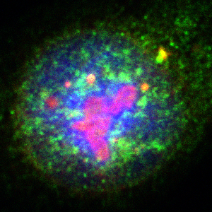
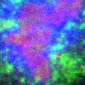
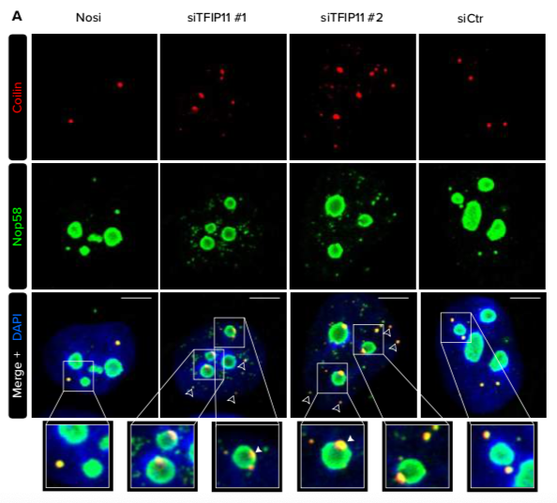
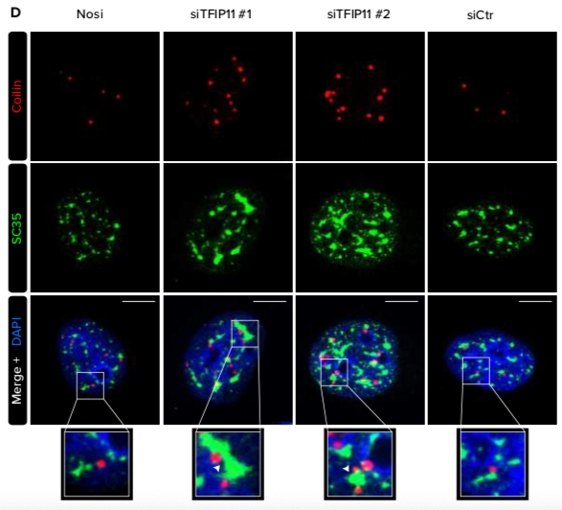
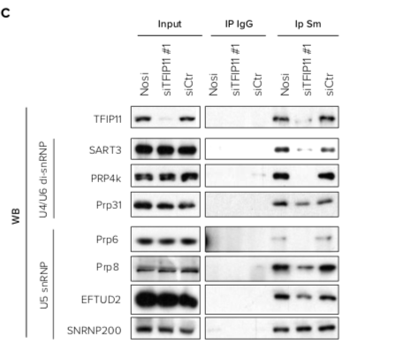
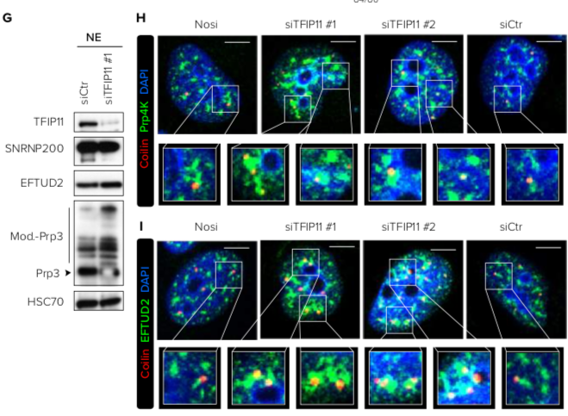
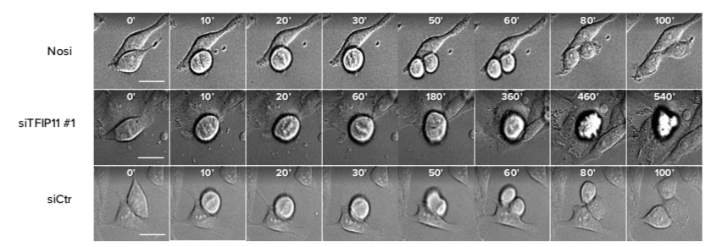
DHX15-independent roles for TFIP11 in U6 snRNA
modification, U4/U6.U5 tri-snRNP assembly and pre-mRNA
splicing fidelity
Sarah Hanache, Amandine Duchemin, Tina O’Grady, Agnès Mereau, Marc Thiry, Ludivine Wacheul, Catherine Michaux, Eric Perpete, Eric Hervouet, Paul Peixoto, Felix G.M. Ernst, Yann Audic, Franck Dequiedt, Denis L.J. Lafontaine and Denis Mottet
BACKGROUND
2’O-methylation is the most common modification of U6 snRNA, the core catalytic element of the spliceosome. How this modification is regulated is still uncharacterized. Here we report that the splicing factor TFIP11 localizes to Cajal bodies and nucleoli and is a critical factor for the assembly of mature U4/U6.U5 tri-snRNPs and for proper 2’-O-methylation of U6 snRNA. Strikingly, this function is independent of the RNA helicase DHX15, as described in yeast. Mechanistically, TFIP11 controls the association of U6 with Fibrillarin and associated snoRNAs, regulating by this the 2’O-methylation of U6, U4/U6.U5 stability and spliceosome assembly.
AIM OF THIS STUDY
1) Identification of the role of TFIP11 in splicing and spliceosome regulation
2) Identification of the mechanism(s) implicated in this regulation
TFIP11 localizes in nuclear speckles, CBs and nucleoli and interacts with coilin via its N-terminal IDP region.
TFIP11 knockdown affects U4/U6.U5 tri-snRNP stability, spliceosome assembly
RESULTS
TFIP11
SC35
Merge DAPI
E
TFIP11
Coilin
Merge DAPI
PF
IGC
TFIP11
SMN
Merge DAPI
GC
F
TFIP11
FBL
Merge DAPI
FC
DFC
TFIP11 binds snRNAs, scaRNAs and snoRNAs and shares common targets with coilin
TFIP11 regulates 2’O-methylation of U6
TFIP11 Knockdown induces intron retention of cell cycle
related genes and affects their expression
TFIP11 knockdown effects alters CB and nucleoli structure and U4/U6.U5 tri-snRNP stability
Cell-cycle related genes
NXF1
THOC6
SMC4
SORORIN
CENPE
PCR VALIDATION
TFIP11 Knockdown induces cell cycle arrest
CONCLUSION
TFIP11 regulates the 2’O-methylation of U6, U4/U6.U5 stability and spliceosome assembly.
TFIP11 ensures splicing fidelity and regulates cell cycle.
Sarah.Hanache@student.uliege.be

