Slide 1
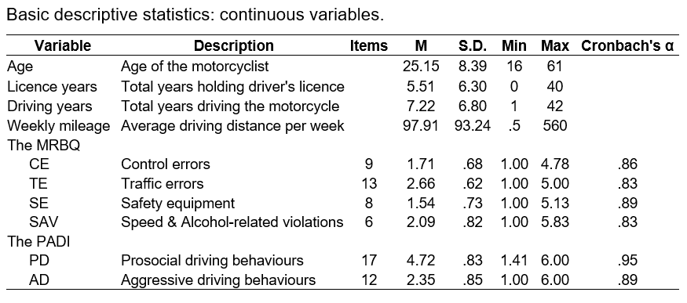
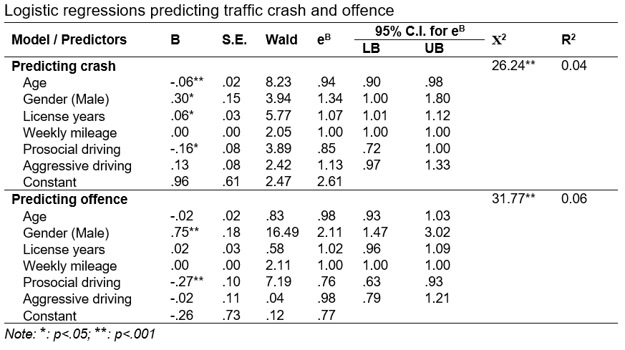
Prosocial and Aggressive driving behaviours and driving-related outcomes in Vietnam
Hiep Trung Bui
buitrunghiep@doct.uliege.be (+84) 935.743555
PARTNERS
RESEARCH INFORMATION
Besides demonstrating the detrimental impacts of risky driving behaviours, evidence-based positive justifications for promoting prosocial driving might be conducive to traffic safety.
This study provides further insights into the current traffic situation in Vietnam by validating the Vietnamese version of the Prosocial and Aggressive Driving Inventory (PADI) and study the relationships between PADI and driving-related outcomes.
The results highlighted the benefits of prosocial driving in reducing traffic issues in Vietnam.
1. CONTEXT
Road safety is a major concern worldwide, especially in motorcycle-dependent nations with high numbers of traffic fatalities.
In 2020, 6,575 Vietnamese people died on the roads, and nearly 90% of victims were motorcyclists.
The roles of Prosocial and Aggressive driving in predicting motorcyclists’ traffic incidents has not received enough attention.
Research into Prosocial and Aggressive driving is needed to effectively develop practical guidelines that enhance road safety.
2. GOALS
Validating the factor structure of the Vietnamese version of Prosocial and Aggressive Driving Inventory (PADI);
Exploring the relationships between the PADI and driving outcomes (accident involvements, traffic violations, and other types of aberrant driving behaviours).
3. METHODOLOGY
Vietnamese PADI's factor structure was explored by the Principal component analysis and Varimax rotation techniques.
The relationships between demographic factors, driving information, PADI, and the Motorcycle Rider Behaviour Questionnaire (MRBQ) subscales were examined using Bivariate correlations.
Hierarchical multiple regressions were applied to determine if the addition of PADI's factors improved the prediction of aberrant driving behaviours over and above background variables alone.
Binomial logistic regressions were applied to ascertain the effects of background variables, Prosocial driving, Aggressive driving on the likelihood of on-road crashes and violations among Vietnamese motorcyclists.
4. RESULTS
5. CONCLUSIONS
The Vietnamese PADI had a stable two-dimensional structure with 29 items and was conceptually similar to prior versions researched in the USA, China and Germany.
In term of Vietnamese motorcyclists, this study revealed that:
Riders scored higher on Prosocial driving were less likely to have negative driving outcomes (crashes, offences);
Aggressive driving did not significantly predict crashes and penalised violations;
Age was a negative predictor of Traffic errors and a positive predictor of Safety equipment using;
Men were more likely to be involved in road accidents or receive traffic citations than women;
Weekly mileage was a positive predictor of Traffic errors and Speed & Alcohol-related violations; however, this variable did not reach statistically significant levels for predicting traffic crashes or violations;
In conclusion, this research was necessary to understand the benefits of Prosocial driving, and new traffic safety programs should concentrate more on Prosocial driving to promote on-road safety in Vietnam.

