Slide 1


FIRST DEVELOPMENT OF A GAS SENSOR ARRAY FOR AMMONIA EMISSION MONITORING FROM GRASSLANDS
Marie SCHEUREN; Anne-Claude ROMAIN
Sensing of Atmospheres and Monitoring (SAM-Lab), Department of Environmental Sciences and Management,
Research Unit SPHERES
University of Liege, - Avenue de Longwy 185, 6700 Arlon (Belgium). mscheuren@uliege.be
9th IWA Odour & VOC/Air Emission Conference
26-27 October 2021 Bilbao, Spain

Slide 2
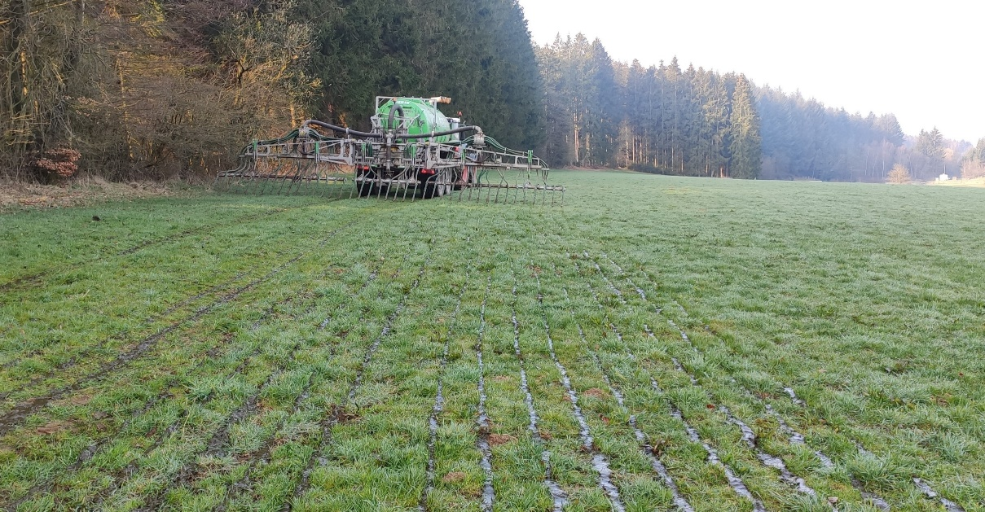
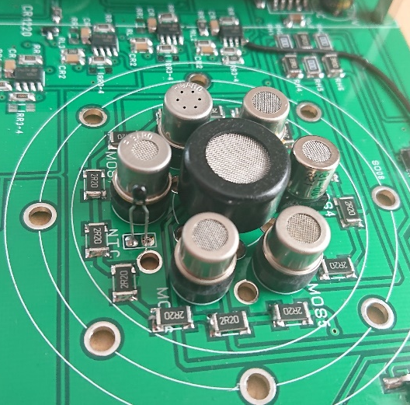
Introduction
Agriculture is the main source of ammonia emissions
93% of total EU emissions
Due to soil fertilisation and livestock manure storage
This study focuses on ammonia emissions caused by nitrogen fertilisation of grassland
Objective
Development of a metal oxide sensor array for real time ammonia concentrations and odour measurement
Dynamic olfactometry to measure odour
Acid-soaked filters to determine NH₃ concentration

Slide 3
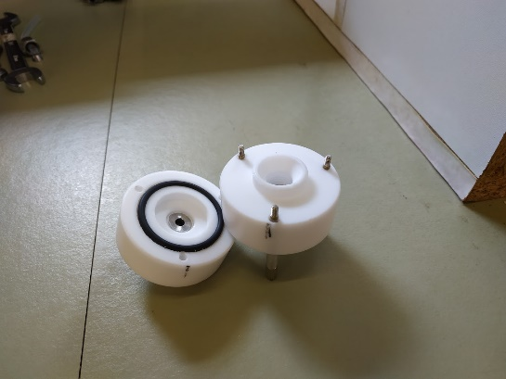
Materials and methods
Acid soaked filters
Material
Filters are placed in a custom-made Teflon sealed chamber
+12% solution of citric acid in methanol
Efficiency tests of the filters in the lab
Several ammonia concentrations (gas cylinders)
Various humidity values
(Dilution unit consisting of mass flow controllers (MFC))
The filters are exposed to ambient air 60 minutes
during outdoor experiments

Slide 4
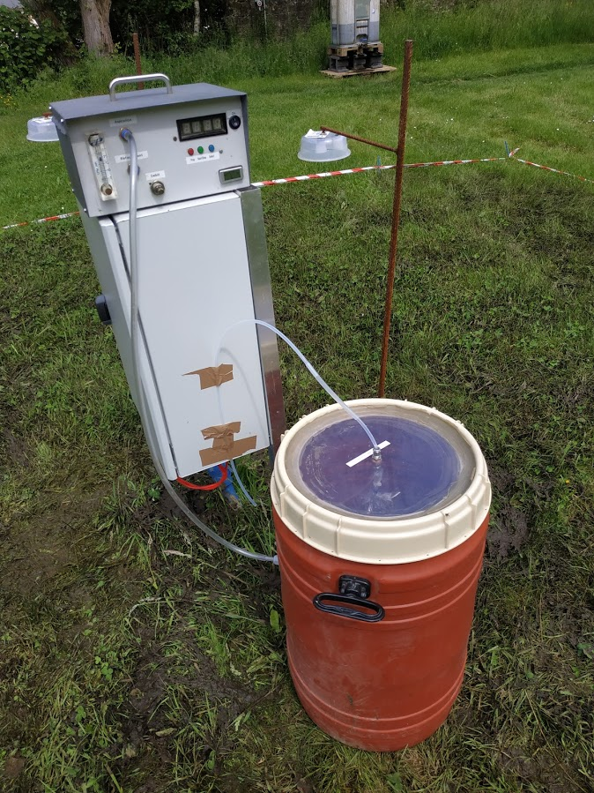
Materials and methods
Odour sample
Dynamic olfactometry according to the European standard EN 13725
Olfasense TO evolution olfactometer
4 panelists
Max. 2 hours storage
Sampling every 3 hours
during the first 6 hours after fertilizer spreading and
at 9:00 the second and the third day

Slide 5
Materials and methods
Metal oxide sensor array
Sensors selected for their sensitivity to ammonia
Placed in a hermetic PTFE chamber with temperature controlled at 50°C
Temperature and humidity monitoring
Ambient air sucks through the chamber at 200 ml/min
(2 devices)
Sensors | Compound specified by the manufacturer | Concentration (ppm) specified by the manufacturer
TGS 2602 | NH₃, H₂S, COV | 1-30
TGS826 | NH₃ | 30-300
SB-53-01 | NH₃ | -
GGS4330 | NH₃ | -
TGS 2620 | COV | 50-5000
GGS 2330 | CO, H₂, C₂H₅OH | 1-1000

Slide 6
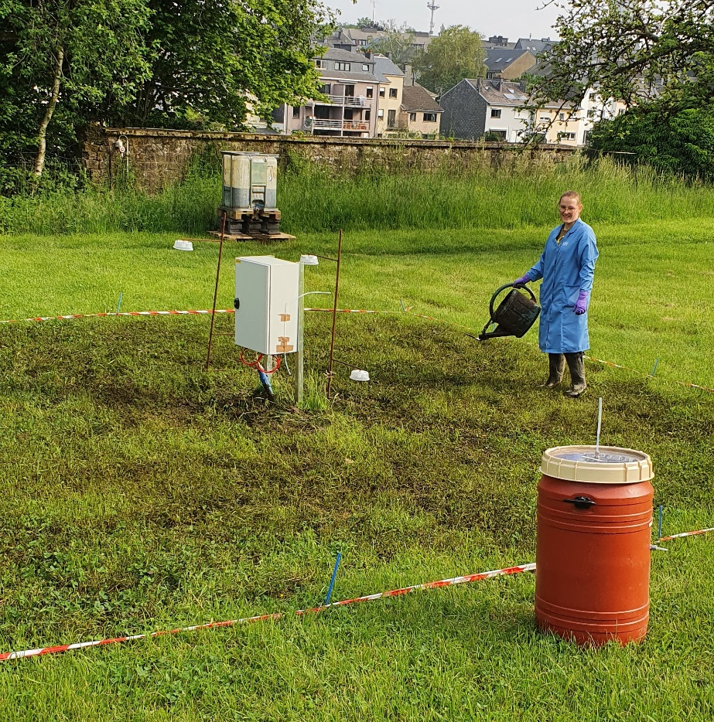
Material and methods
Outdoor experiments
50 m² grassland
Fertilisation of 100 nitrogen units of cattle slurry
Air intake of all samples at a height of 30 cm
June 2021
The study site is equipped with a weather station

Slide 7
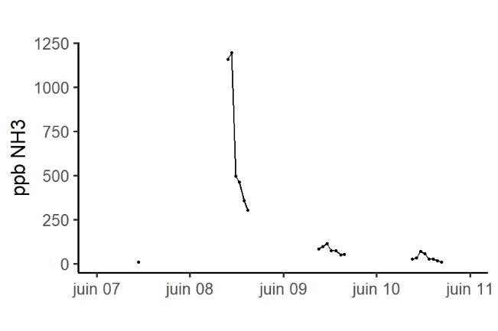
Results Ammonia concentration
Efficiency tests of the filters
Efficient trapping of ammonia in the air (in the lab)
R2 = 0.99
Filters: Outdoor experiment
Before fertilisation ~10 ppb
After fertilisation
2 first hours ~1 ppm
Succeeding days, the concentration decreased below 100 ppb with a peak around 12 o’clock
~ 12 o’clock

Slide 8
Results Odour concentration
Sampling (and measurement) day | Odour (uo_{E}/m³) | Standard deviation | Ammonia (ppb) | Time after fertilisation
08/06/2021 09:00 | 572 | 333 | 1158 | Few minutes
08/06/2021 12:00 | 641 | 390 | 462 | 3 hours
08/06/2021 15:00 | 564 | 231 | 302 | 6 hours
09/06/2021 09:00 | 212 | 234 | 83 | 24 hours
10/06/2021 09:00 | 232 | 216 | 26 | 48 hours
First odour concentration (just after spreading) too low regarding the high NH₃ value (1158 ppbv);
Except for very high value of NH₃, a trend between odour and NH₃ is observed
→ NH₃ is not the main contributor of odour but could be a good indicator of spreading odour when NH₃ is not too high

Slide 9
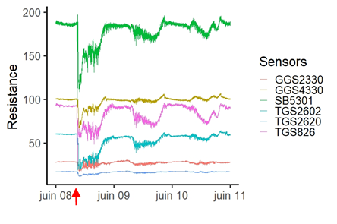
Results Metal oxide sensor array response
Outdoor experiment
Day 1
Resistance (R) variation due to the fertilisation
R increase in accordance with the emission decrease
Day 2
Slightly signal decreases
Day 3
Signal seems similar to days before fertilisation
Fertilisation

Slide 10
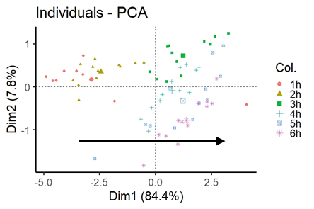
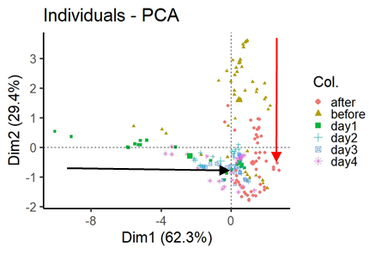
Results Metal oxide sensor array response
PCA analysis (raw R values in kohms)
Day 1: 69 obs. 6 variables (value every 5 minutes)
First 6 hours after fertilisation
Campaign : 193 obs. 6 variables (hourly median)
3 days before + 6 days after
PC 1 (Dim1) = time evolution of the signal
PC 1 (Dim1) = air composition
PC 2 (Dim2) = impact of humidity

Slide 11
Conclusions
Ammonia concentration
Day 1: first two hours, NH₃ increases to ~1 ppm, fast decrease to low level (<500 ppb)
Day 2: value of ~ 100 ppb
Day 3: level similar to background (<20 ppb)
Peak at about 12 o'clock on the second and third day after fertilisation = temperature and sunshine
Odour concentration
Day 1: High concentration with low increase at 12 o'clock
Day 2 and 3: lower as day 1
Metal oxide sensor array
Correlation with NH₃ concentration
No direct link with the odour concentration but with the chemical composition
Acid soaked filters = good tool for ammonia concentration validation
Metal oxide sensor array = promising tool for low cost ammonia real time monitoring
Next step
Repeat the tests and increase the dataset
Quantification algorithm development from sensors signals

Slide 12
Thank you for your kind attention

Slide 13
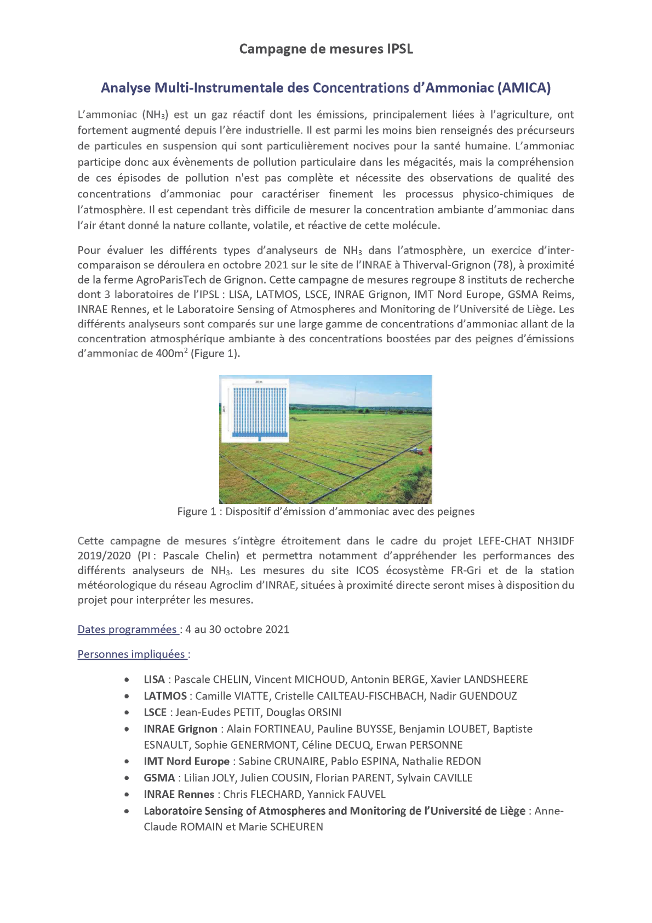



Acknowledgements to
Intercomparison campaign with various analysers

