Slide 1
Automatic Detection of Trypanosomosis in Thick Blood Smears Using Image Pre-processing and Deep Learning
12th International Conference on
Intelligent Human Computer Interaction (IHCI) 2020
24-26 November 2020, EXCO-Daegu, South Korea
Authors:
TaeWoo Jung ¹, Esla Timothy Anzaku ^{2,4}, Utzu Özbulak ^{2,4},
Stefan Magez ^{3,5}, Arnout Van Messem ^{2,6}, Wesley DeNeve ^{2,4}
¹ Ghent University Global Campus ⁴ Department of Electronics and Information Systems
² Center for Biotech Data Science ⁵ Department of Biochemistry and Microbiology
³ Center for Biomedical Research ⁶ Department of Applied Mathematics

Slide 2
outline
Introduction
Objectives
Experimental setup
Experimental results
Conclusions and future work

Slide 3
1. introduction

Slide 4
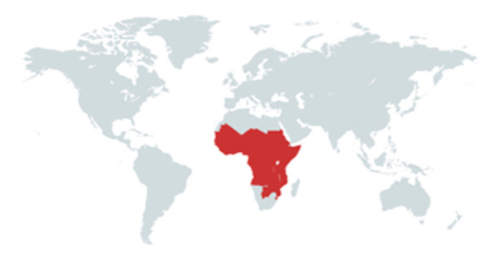
Trypanosomosis
Trypanosoma brucei
Can infect both humans and animals
Sub-Sahara African continent
Tsetse fly = mode of transmission
Human infective subspecies
T. b. gambiense and T. b. rhodesiense
Human trypanosomosis symptoms
1st stage: fever, headache, body ache and lymph node inflammation
2nd stage: behavioral changes, sleep disturbance and lethargy

Slide 5
Difficulties in Treatment
No vaccine available
Variable surface glycoprotein (VSG)
Highly immunogenic
Altering VSG expression = Escaping the host immune system
Chemotherapy
Drugs available to treat different stages of infection
E.g.: Nifurtimox (2nd stage of T. b gambiense infection)
Severe side effects
Encephalitis and mortality
Rely solely on

Slide 6
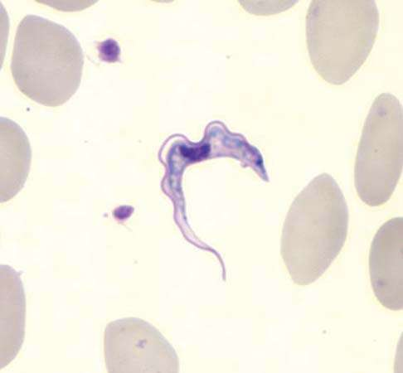
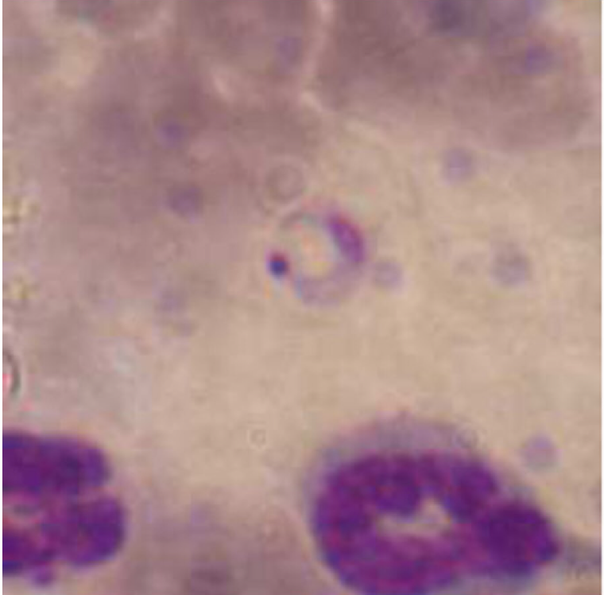
Difficulties in Diagnosis
Direct method
Manual microscopic examination
E.g.: Examination of Giemsa or Wright stained blood smears
Labor intensive and prone to error
Indirect methods
PCR assays, in-vitro cultivation and ELISA
Expensive and cumbersome
(Standard)
Giemsa stain
Wright stain

Slide 7
Automatic Detection
Existing machine learning-based models
Classification (stained blood smears)
Segmentation (stained blood smears)
Motion-based cell-counting (in-vitro cultivation)
Staining and in-vitro cultivation
Still laborious and time-consuming
Available deep learning-based models
Classification model is not available
No attempts to use unstained blood smears
Giemsa stain RGB
Unstained RGB

Slide 8
2. Objectives

Slide 9
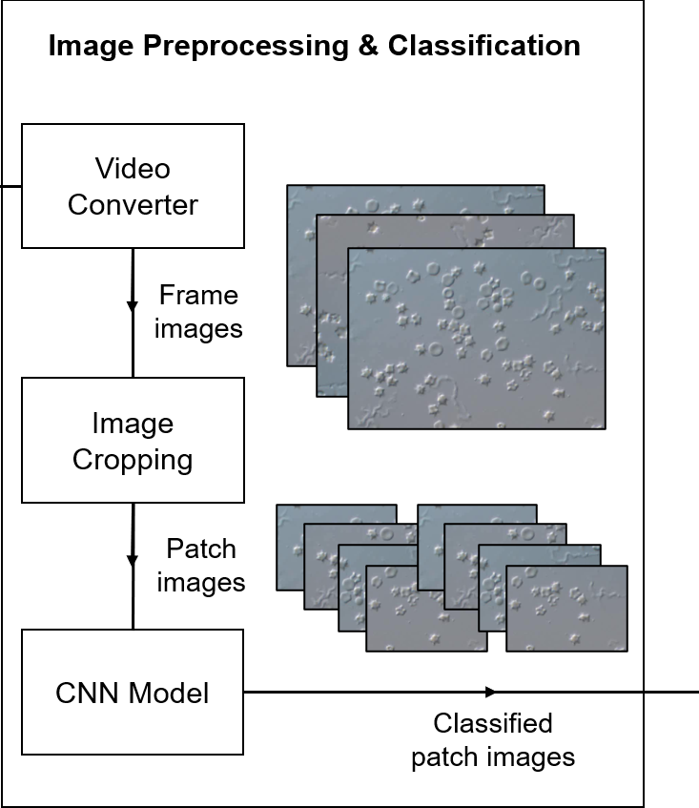
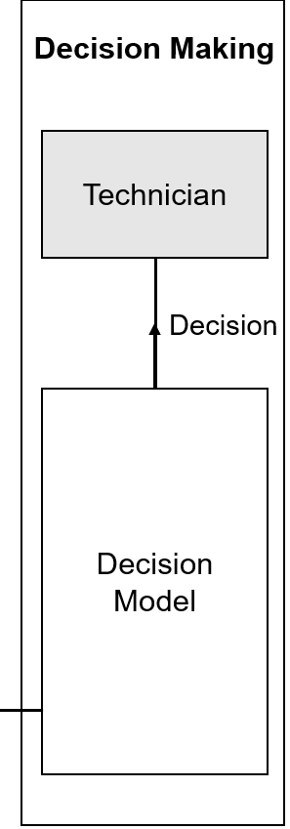
Proposed Framework

Slide 10
3. Experimental setup

Slide 11
Overall workflow
Data acquisition
Image preprocessing
CNN model training
CNN model evaluation

Slide 12
Data Acquisition
Sample collection
Host: C57BL/6 (2 mice)
Parasite: T. b. brucei
Microscope setup
IX83 inverted microscope (Olympus)
20X magnification
Video properties
Resolution: 1360x1024 pixels
20 frames per second
Non-infected
Infected
Thick blood smears
11 microscope videos (negative)
12 microscope videos (positive)

Slide 13
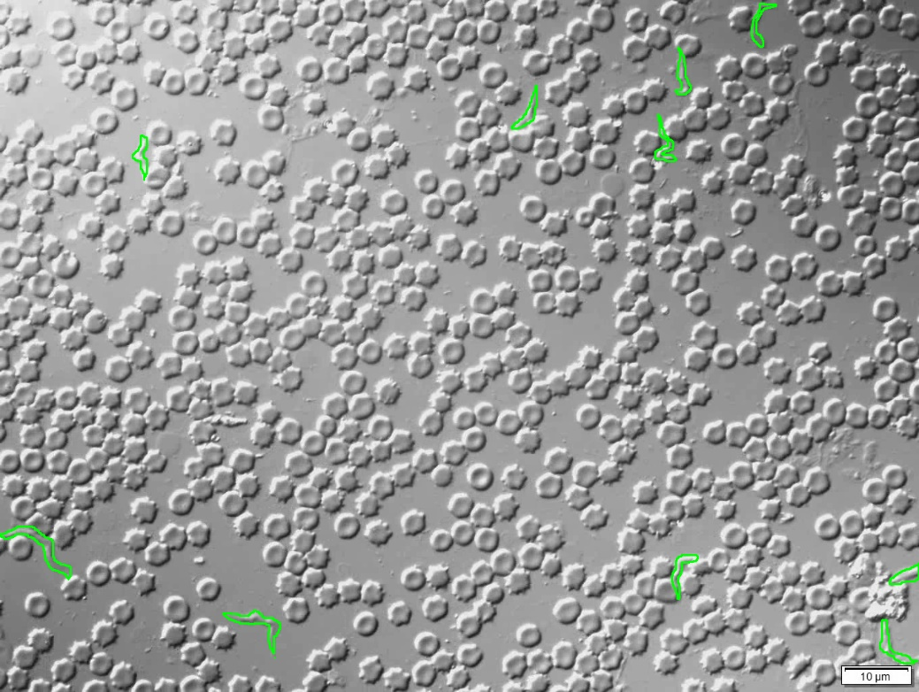
Image Pre-processing – Preparation
Image extraction
Odd numbered frames
1360x1024 pixels, RGB
Binary mask
6 positive videos
Manually created using
LabelBox
iPadOS 13.5.1 Photos
Contours drawn around T. brucei
Generated binary mask

Slide 14
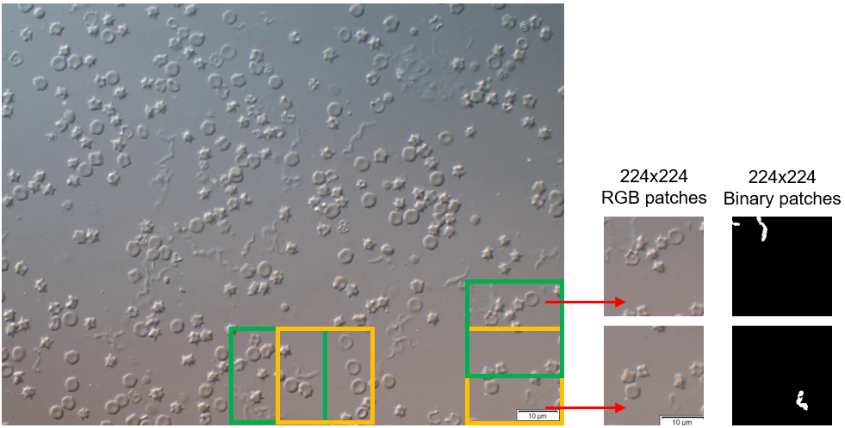
Image Pre-processing – Image cropping
Horizontal overlap of 112 pixels
Corresponding binary patches

Slide 15
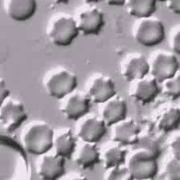
Image Pre-processing – Patch Selection
Region of Interest (ROI)
Region of the image with visible parasites
$$ROI \left(\%\right)=\frac{Total number of white pixels in binary patch}{Total number of pixels in binary patch}×100\%$$
RGB patch used
RGB patch not used
ROI threshold = 2%
ROI threshold = 5%
RGB patch
Binary mask patch, ROI (%) = 4.96%

Slide 16
IMAGE Pre-processing – Dataset
5 balanced datasets
Negative patches > positive patches (requires data balancing)
Split into train/validation/test sets
 | ROI threshold (%)
Dataset | Video 1 | Video 2 | Video 3 | Video 4 | Video 5 | Video 6
T1 | 5.50 | 3.60 | 2.80 | 9.30 | 9.40 | 2.40
T2 | 6.00 | 4.00 | 3.20 | 10.30 | 10.00 | 3.00
T3 | 6.50 | 4.50 | 3.60 | 11.30 | 10.75 | 3.60
T4 | 7.13 | 5.10 | 4.00 | 12.50 | 11.50 | 4.00
T5 | 8.00 | 5.85 | 4.50 | 14.65 | 12.50 | 4.70
Increasing ROI threshold
Different ROI threshold for each video

Slide 17
Model Training
Training setup
Training
2 models with different optimizers per dataset
Accuracy and cross-entropy loss calculated for training and validation
Model selection criteria: validation accuracy
Optimizers | Adam | SGD
Learning rate | 0.001 | 0.01
Weight decay | 0 | 1x10⁻⁴
Momentum | - | 0.9
Loss function | Cross entropy loss
CNN architecture | ResNet18
Batch size | 128
Epoch | 200
Input size | 224x224x3
+ Learning rate scheduler for SGD
Common settings

Slide 18
Model Evaluation
Performance metrics
Measure the performance of models based on accuracy, positive predictive value (PPV), negative predictive value (NPV), sensitivity and specificity
Accuracy $=\frac{TP+TN}{TP + FN+TN+FP}$
Sensitivity $=\frac{TP}{TP + FN}$
Specificity $=\frac{TN}{TN + FP}$
NPV $=\frac{TN}{TN + FN}$
PPV $=\frac{TP}{TP + FP}$

Slide 19
4. Experimental Results

Slide 20
Quantitative Analysis
Model | Validation Accuracy | Test Accuracy | Sensitivity | Specificity | PPV | NPV
T1 Adam | 0.679 | 0.651 | 0.721 | 0.581 | 0.633 | 0.676
T2 Adam | 0.661 | 0.649 | 0.703 | 0.594 | 0.634 | 0.667
T3 Adam | 0.666 | 0.626 | 0.665 | 0.588 | 0.617 | 0.637
T4 Adam | 0.662 | 0.633 | 0.636 | 0.630 | 0.632 | 0.634
T5 Adam | 0.686 | 0.677 | 0.688 | 0.665 | 0.673 | 0.681
T1 SGD | 0.665 | 0.626 | 0.674 | 0.578 | 0.615 | 0.640
T2 SGD | 0.668 | 0.632 | 0.697 | 0.566 | 0.617 | 0.652
T3 SGD | 0.649 | 0.675 | 0.690 | 0.660 | 0.670 | 0.680
T4 SGD | 0.677 | 0.685 | 0.690 | 0.680 | 0.683 | 0.687
T5 SGD | 0.708 | 0.679 | 0.706 | 0.651 | 0.670 | 0.689

Slide 21
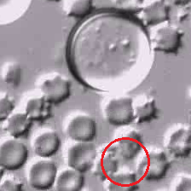
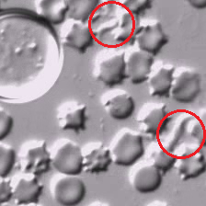
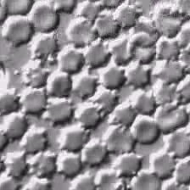
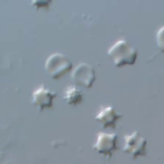
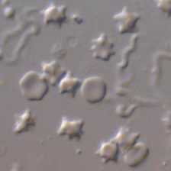
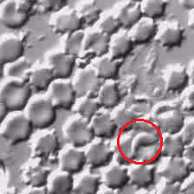
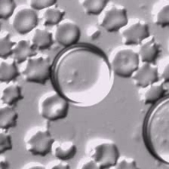
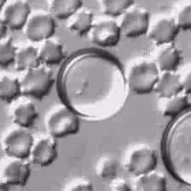
Qualitative Analysis
Positive patches
Negative patches
Correctly classified patches
True positive
True negative
Incorrectly classified patches
False negative
False positive
Regions with parasites

Slide 22
5. Conclusions and future work

Slide 23
ConclusionS
CNN classification models
Classify patches according to parasite presence
Room for improvement
Dataset preparation strategy
Model performance sensitive to ROI thresholding
ROI percentage of input patches matters
Further optimization required

Slide 24
Contributions
Contributions
Showed feasibility of automatic detection of Trypanosoma parasites
Deep learning-based classification
Unstained blood smears
Importance of dataset preparation strategy
ROI percentage of input images matters
Proposed a potential dataset preparation strategy
Effective training of classification models

Slide 25
Future work
Limitations
Positive images from a single mouse (infected)
Data leakage between train/validation/test sets
Not sufficient for real-life application yet
Future work
Improve representative power of our dataset
Optimization of image cropping strategy
Improve sample variety
Improve image cropping

Slide 26
References
Faria, J.R. (2016). Automatic Detection of Trypanosomes on the Blood Stream (Master’s thesis). [Online] Available: https://www.semanticscholar.org/paper/Automatic-Detection-of-Trypanosomes-on-the-Blood-Faria/a622a3b9be0264f5e8210feab7bea9322a4cf4a3
Goodfellow, I., Bengio, Y., & Courville, A. (2016). Deep learning. Cambridge, MA: The MIT Press.
He, K., Zhang, X., Ren, S., & Sun, J. (2016). Deep residual learning for image recognition. In Proceedings of the IEEE conference on computer vision and pattern recognition (pp. 770-778).
Jung, T. (2020, June). Trypanosomosis Detection. Retrieved from https://github.com/TaeWooJung/Trypanosomosis_detection.
Ojeda-Pat, A., Martin-Gonzalez, A., & Soberanis-Mukul, R. (2020, March). Convolutional Neural Network U-Net for Trypanosoma cruzi Segmentation. In International Symposium on Intelligent Computing Systems (pp. 118-131). Springer, Cham.
PyTorch documentation. (n.d.). Retrieved from https://pytorch.org/docs/stable/index.html
Radwanska, M., Vereecke, N., Deleeuw, V., Pinto, J., & Magez, S. (2018). Salivarian Trypanosomosis: A review of parasites involved, their global distribution and their interaction with the innate and adaptive mammalian host immune system. Frontiers in immunology, 9(2253).
Soberanis-Mukul, R., Uc-Cetina, V., Brito-Loeza, C., & Ruiz-Piña, H. (2013). An automatic algorithm for the detection of Trypanosoma cruzi parasites in blood sample images. Computer methods and programs in biomedicine, 112(3), 633-639.
Stevens, E., & Antiga, L. (2019). Deep Learning with PyTorch Essential Excerpts. Manning.
Steverding, D. (2010). The development of drugs for treatment of sleeping sickness: a historical review. Parasites & vectors, 3(15).
Takagi, Y., Nosato, H., Doi, M., Furukawa, K., & Sakanashi, H. (2019). Development of a motion-based cell-counting system for Trypanosoma parasite using a pattern recognition approach. BioTechniques, 66(4), 179-185.
The Center for Food Security and Public Health. (2018, October) African Animal Trypanosomiasis. Retrieved from: http://www.cfsph.iastate.edu/Factsheets/pdfs/trypanosomiasis_african.pdf
The Editors of Encyclopaedia Britannica. (2020, February 14). Sleeping sickness. Retrieved from https://www.britannica.com/science/sleeping-sickness
Vilchez, C. (2019). Examination of the Peripheral Blood Film and Correlation With the Complete Blood Count. Rodak's Hematology-E-Book: Clinical Principles and Applications (pp. 201-205). Elsevier Health Sciences.

Slide 27
Thank you for listening! Any questions?
TaeWoo Jung | taewoojung7@gmail.com
Esla Timothy Anzaku | eslatimothy.anzaku@ugent.be
Utzu Özbulak | utku.ozbulak@ugent.be
Stefan Magez | stefan.magez@ugent.be
Arnout Van Messem | arnout.vanmessem@ugent.be
Wesley De Neve | wesley.deneve@ugent.be

