Slide 1
Towards a quantitative analysis of class activation mapping for deep learning-BASED computer-aided diagnosis
SPIE Medical Imaging Conference
February 15-19, 2021
Hanul Kang
Bachelor of Science in Molecular Biotechnology
Center for Biotech Data Science, Ghent University Global Campus, Incheon, Korea
Hanul Kang, Ho-min Park, Yuju Ahn, Arnout Van Messem, Wesley De Neve
Notes:
Hello everyone. My name is Hanul Kang from Ghent University Global Campus. I will be presenting our research which is on “quantitative analysis of class activation mapping for deep learning-based computer-aided diagnosis.”

Slide 2
OUTLINE
Introduction
Experimental setup
Experimental results
Conclusions & future work
Notes:
I will first begin with brief introduction, how the experiment is conducted, and its results, and conclude together with suggestions for future work

Slide 3
introduction

Slide 4
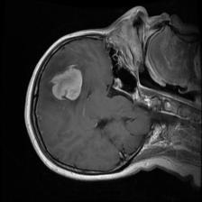
deep learning IN medical image analysis
Classification
Abnormality detection
Segmentation
Presence of abnormality
Different types of abnormality
Highlighted pixels instead of a bounding box
Aims at helping medical experts with disease diagnosis and patient treatment
Notes:
Deep learning can be applied for medical image analysis. It can be used to classify either presence or absence of abnormality, or different types of abnormality found in an medical image. An abnormality can also be detected by drawing a bounding box around it. If specific image pixels are highlighted instead of a box, it is called “segmentation”. These methods can help medical experts in their decision making for diagnosis and treatment for a patient.

Slide 5
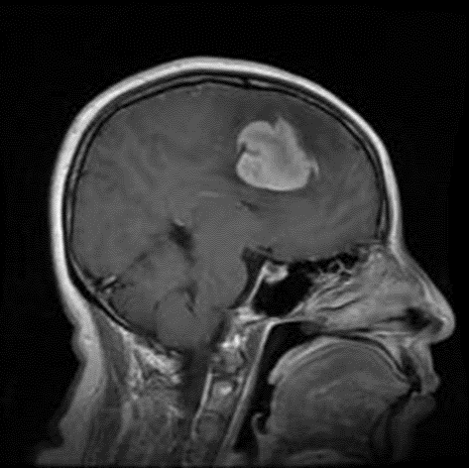
A Cnn IS A black-box model
Input image
Output
Black box
Meningioma: 0.97
Glioma: 0.02
Pituitary tumor: 0.01
The input and output of a CNN-based predictive model is known but the internal functioning is unknown
Notes:
Convolutional neural network, CNN in short, is a deep learning model that is commonly used for image analysis. CNN is known as a black box model because the internal working process of the model is unknown. In the case of CNN for classification, it takes in an input image and generates probabilities of classes. The class having the highest probability will be the final output.

Slide 6
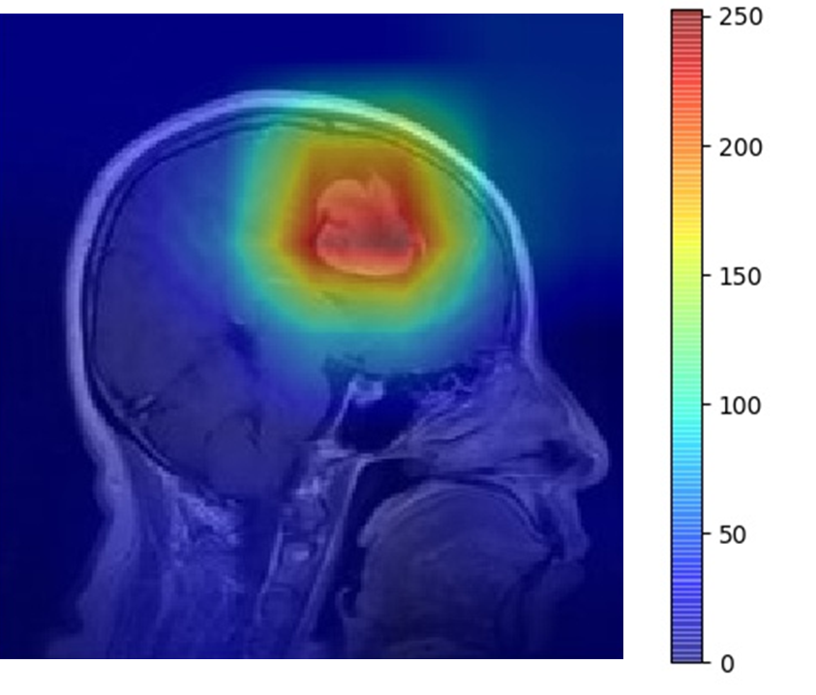
Visualizing the model
Input image
Heatmap
Output
Meningioma: 0.97
Glioma: 0.02
Pituitary tumor: 0.01
Highlight areas within an input image
The most informative regions for a predicted class
Visual understanding of the predictions made by a deep learning model
Notes:
To understand the CNN, visualization can be used. This type of visualization is a heatmap representation which highlights an area in red that is the most informative region for a predicted class. This way, we could understand how a prediction is made by the deep learning model. A visualization method we focused on is called (next slide)

Slide 7
Class activation mapping (cam)
n feature maps
101 | 51 | 65 | 99 | 134 | 155
122 | 65 | 75 | 105 | 130 | 145
156 | 82 | 79 | 112 | 131 | 139
188 | 105 | 77 | 119 | 136 | 133
190 | 108 | 66 | 123 | 146 | 132
164 | 83 | 48 | 124 | 158 | 135
101 | 51 | 65 | 99 | 134 | 155
122 | 65 | 75 | 105 | 130 | 145
156 | 82 | 79 | 112 | 131 | 139
188 | 105 | 77 | 119 | 136 | 133
190 | 108 | 66 | 123 | 146 | 132
164 | 83 | 48 | 124 | 158 | 135
101 | 51 | 65 | 99 | 134 | 155
122 | 65 | 75 | 105 | 130 | 145
156 | 82 | 79 | 112 | 131 | 139
188 | 105 | 77 | 119 | 136 | 133
190 | 108 | 66 | 123 | 146 | 132
164 | 83 | 48 | 124 | 158 | 135
101 | 51 | 65 | 99 | 134 | 155
122 | 65 | 75 | 105 | 130 | 145
156 | 82 | 79 | 112 | 131 | 139
188 | 105 | 77 | 119 | 136 | 133
190 | 108 | 66 | 123 | 146 | 132
164 | 83 | 48 | 124 | 158 | 135
101 | 51 | 65 | 99 | 134 | 155
122 | 65 | 75 | 105 | 130 | 145
156 | 82 | 79 | 112 | 131 | 139
188 | 105 | 77 | 119 | 136 | 133
190 | 108 | 66 | 123 | 146 | 132
164 | 83 | 48 | 124 | 158 | 135
116
101 | 51 | 65 | 99 | 134 | 155
122 | 65 | 75 | 105 | 130 | 145
156 | 82 | 79 | 112 | 131 | 139
188 | 105 | 77 | 119 | 136 | 133
190 | 108 | 66 | 123 | 146 | 132
164 | 83 | 48 | 124 | 158 | 135
116
116
116
116
116
GAP
Output of GAP
Feature map of final convolutional layer
Visualize the last convolutional layer of a model
Requires Global Average Pooling (GAP) before the final output layer
Weighted sum of feature maps with GAP weights → class-specific heatmap (e.g., dog)
Weight: measure of importance given to a class of interest
Zhou, B., Khosla, A., Lapedriza, A., Oliva, A. and Torralba, A., 2016. Learning deep features for discriminative localization. In Proceedings of the IEEE Conference on Computer Vision and Pattern Recognition (pp. 2921-2929).
Notes:
“Class activation mapping” or CAM in short. CAM is a method to visualize feature maps of the last convolutional layer. It requires a “global average pooling” layer at the end. At this step, entire values in a feature map is averaged and is done for every feature maps. Then they are multiplied with the weights, which is the measure of importance, and added altogether to obtain a heatmap of a target class. In this case, dog is a target class and a heatmap is highlighting the dog in an image.

Slide 8
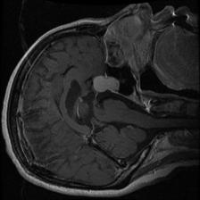
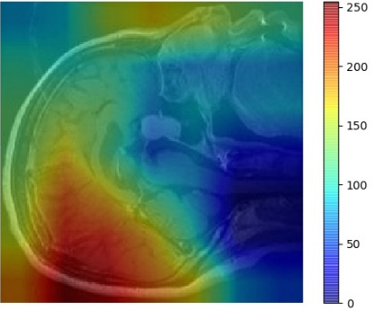
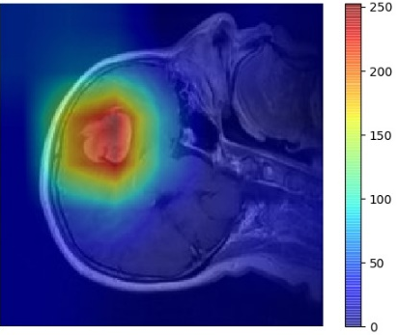
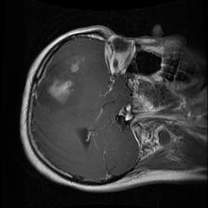
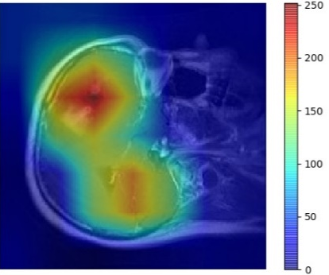
What can Visualization do?
Visualizing a deep learning model can provide useful information:
Qualitative analysis of a deep learning model
Human
Human
Machine
Machine
> Better performance
Understand problem in model
= Equal performance
Trust and confidence in user
< Better performance
Suggestion for better decision
Machine
Human
What human sees
What machine sees
What human sees
What machine sees
What human sees
What machine sees
Machine failed to detect tumor
Machine can be used to verify decision made by user
Machine can detect
all possible abnormalities
Notes:
Visualization can provide useful information about the model. First, if a model performs poorly, we can understand errors in the model. In this case, the model has problem in detecting a tumor correctly.
Second, if a model can perform as good as human, it can be used to cross-check the decision made by an user.
And if a model outperforms human, it can suggest for better decision by showing any additional observation that is missed by the user.
Many cases in medical application, visualization is only used to check if the model is working or not. Thus, it is used as qualitative analysis method on deep learning model.

Slide 9
quantitative analysis using cam
To what extent can CAM also enable a quantitative understanding of a CNN-based classification model that is used for the purpose of medical image analysis?
Creation of segmentation masks out of class activation maps
Binarization using thresholding methods
Use of Intersection-over-Union (IoU) to measure similarity between a CAM-based segmentation mask and the corresponding segmentation ground truth
Notes:
Beyond a qualitative analysis, we wanted to find out if CAM as a visualization tool can be used for quantitative analysis of a classification model for the purpose of medical image analysis
For this, a segmentation mask is created from class activation map via binarization.
Then, we can quantify how much a CAM-based segmentation is similar to an actual ground truth by using a metric called “Intersection-over-Union”

Slide 10
Experimental setup

Slide 11
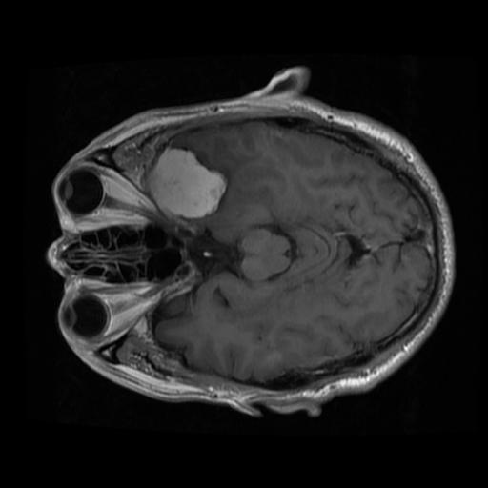
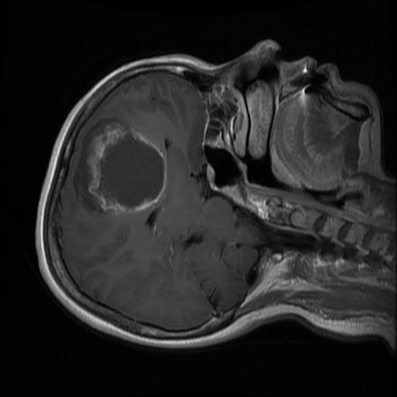
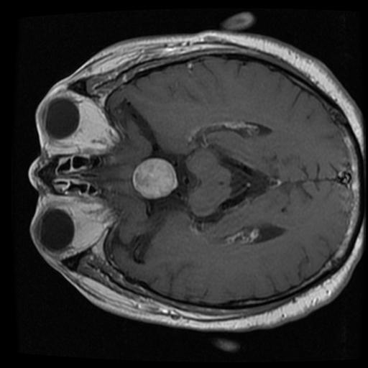
dataset
Meningioma
Tumor found in between skull and brain
Publicly available brain MRI images
3,064 brain tumor images
3 types of brain tumor:
Meningioma (708 images)
Glioma (1,426 images)
Pituitary tumor (930 images)
Class imbalance
Meningioma (23%)
Glioma (47%)
Pituitary tumor (30%)
Glioma
Tumor growing inside brain
Pituitary tumor
Tumor found near center of brain
Notes:
The dataset we used is brain MRI images that is publicly available. It consists of 3,064 images of brain tumor having 3 types:
Meningioma is a tumor located at the surrounding of the brain
Glioma is located inside the brain
And pituitary tumor is located at the center of the brain
Class imbalance is present

Slide 12
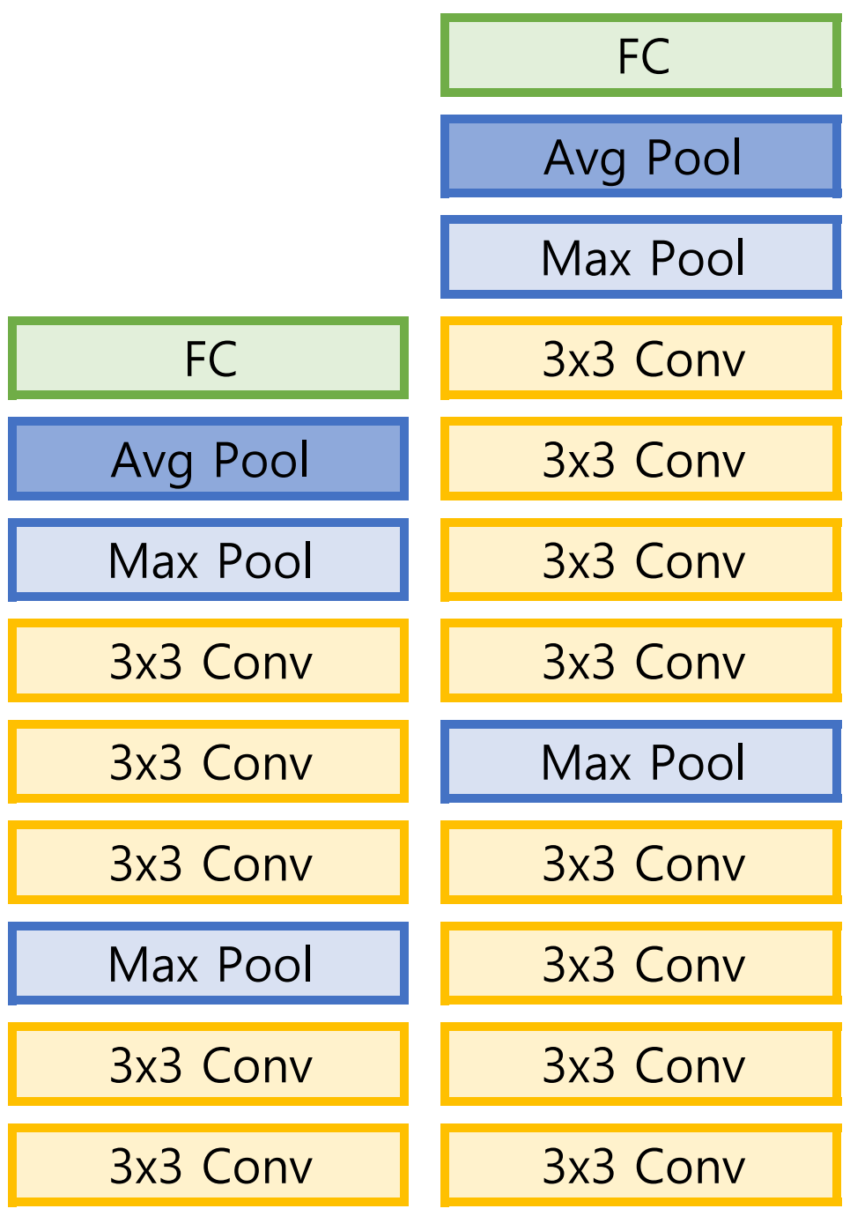
Classification Models
3 standard models:
AlexNet
VGG-16
VGG-19
All the models are pre-trained on ImageNet, having 1,000 classes
3 modified models:
Modified AlexNet
Modified VGG-16
Modified VGG-19
AlexNet VGG-16 VGG-19
Notes:
Total of 6 CNN classification models are used. 3 are standard/normal models of AlexNet, VGG-16, and VGG-19. And 3 are modified models which we call as Modified AlexNet, Modified VGG-16, and Modified VGG-19.
All the models we used are pre-trained on ImageNet which are natural images having 1,000 classes.

Slide 13
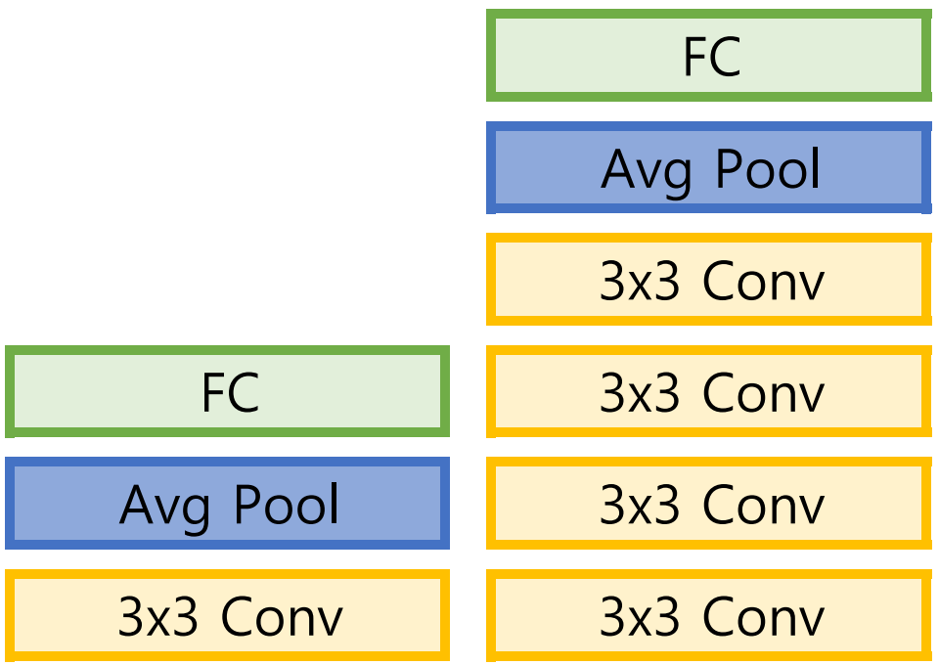
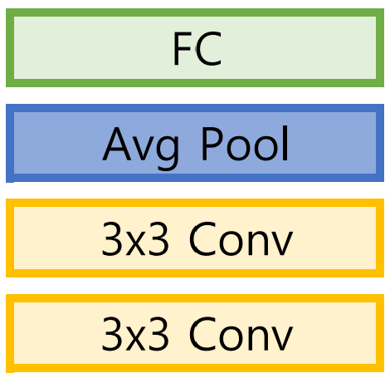
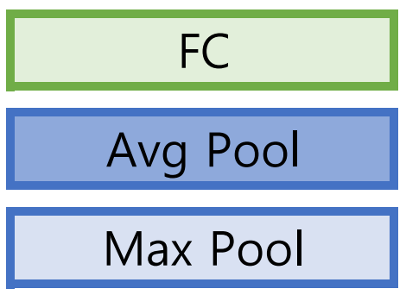
Classification Models
3 standard models:
AlexNet
VGG-16
VGG-19
All the models are pre-trained on ImageNet, having 1,000 classes
Common model modifications:
GAP: required to use CAM
Final classifier layer: needs to support 3 classes
Additional model modifications:
Removal of Max Pooling layer
Addition of Convolutional layer
3 modified models:
Modified AlexNet
Modified VGG-16
Modified VGG-19
Modified AlexNet Modified VGG-16 Modified VGG-19
AlexNet VGG-16 VGG-19
Notes:
In all 6 classification models, common modification is applied to fit our data. Which are:
Addition of GAP/average pooling layer in AlexNet, changes the size of the target output image from 7x7 to 1x1
And change the final classifier layer to have output of 3 classes instead of 1,000 classes
For modified models, additional modifications are made. Here, the final max pooling layer is replaced with two convolutional layers for AlexNet, and one convolutional layer for each VGG networks.

Slide 14
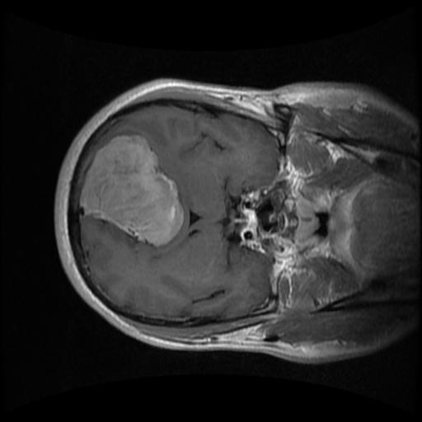
CAM-based Segmentation
Generate heatmap using CAM
Convert heatmap into a segmentation mask
Binarization using a threshold
CAM
Binarization
Input image
Heatmap
CAM-based segmentation mask

Slide 15
Binarization
Extraction of a brain tumor from the background at a threshold value T
The chosen threshold values are:
200
225
90th percentile (Q90)
95th percentile (Q95)
Otsu
Binary segmentation mask $M∈R^{w×h}$ is obtained as a result
Pixel values range from 0 (black) to 255 (white)
$$M_{ij}=\left\{\begin{aligned}255, if H_{ij}^{(c)}>T \\ 0, if H_{ij}^{(c)}≤T\end{aligned}\right., i=1,…,w;j=1,…,h$$

Slide 16
Intersection-over-union (IoU)
Measures how much a segmentation mask matches with the ground truth
IoU score:
0 = no overlap
1 = perfect match
CAM-based segmentation mask
Overlap
Ground truth
$$IoU=\frac{Area of Intersection}{Area of Union}=\frac{green}{red+green+yellow}$$
Notes:
Then the generated segmentation mask is compared with its actual ground truth and we can measure how much they overlap using a metric called intersection over union, IoU in short.
IoU is computed as area of intersection over area of union. This way we can evaluate how well the model is able to segment a brain tumor where IoU score will be 0 if there are no overlap between the model prediction and the ground truth, and score of 1 if perfect match
For easier understanding, different areas are displayed in different colors.

Slide 17
Experimental results

Slide 18
Classification results
All six classification models have a high mean accuracy, precision, recall, and F1 score, coming with a value of at least 84%
The classification accuracy of all networks ranges from 86% to 91%
1% difference between standard and modified networks
Modified VGG-16 is the best overall classification model
Networks | Accuracy | Precision | Recall | F1 score
AlexNet | 0.86 (0.11) | 0.85 (0.13) | 0.85 (0.12) | 0.84 (0.12)
VGG-16 | 0.90 (0.11) | 0.89 (0.12) | 0.88 (0.12) | 0.89 (0.12)
VGG-19 | 0.90 (0.12) | 0.89 (0.11) | 0.89 (0.10) | 0.89 (0.11)
Modified AlexNet | 0.86 (0.13) | 0.84 (0.13) | 0.85 (0.13) | 0.84 (0.13)
Modified VGG-16 | 0.91 (0.12) | 0.90 (0.12) | 0.90 (0.11) | 0.90 (0.12)
Modified VGG-19 | 0.89 (0.12) | 0.89 (0.12) | 0.88 (0.12) | 0.89 (0.12)
Notes:
Even though class imbalance data is used, the predictions made by our models are not biased

Slide 19
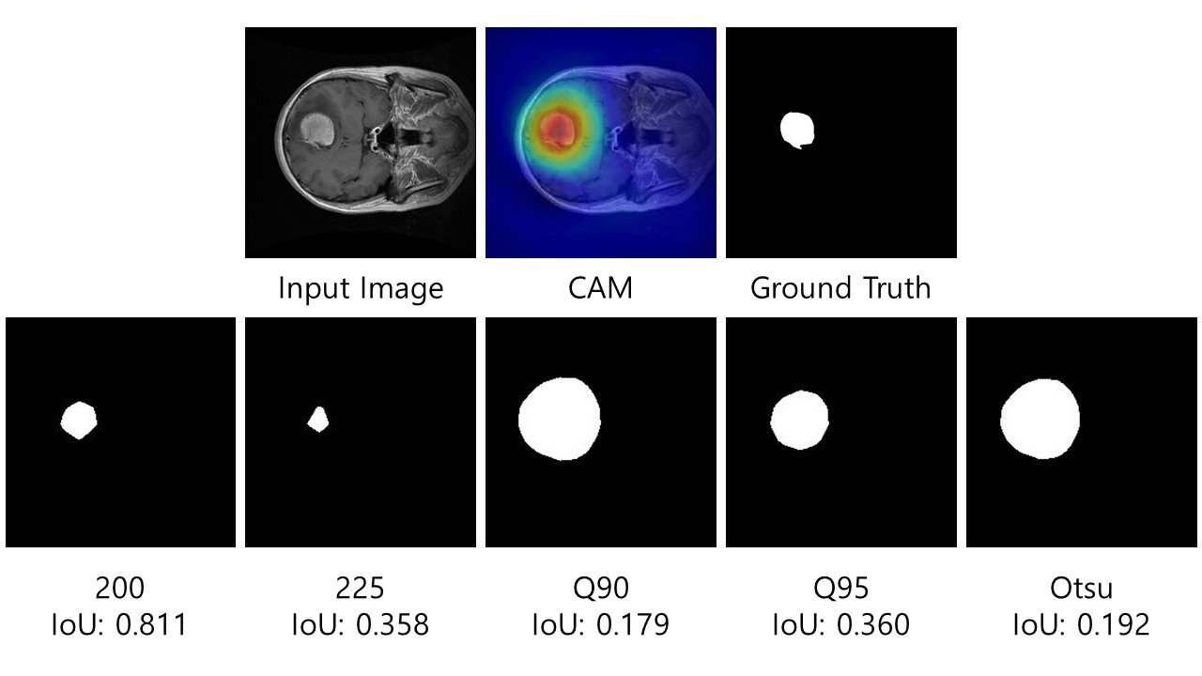
Segmentation BY A classification model
Threshold of 200/255 comes with the highest mean IoU (mIoU)
mIoU at 200/255 is between 0.021 (AlexNet) and 0.122 (Modified VGG-16)

Slide 20
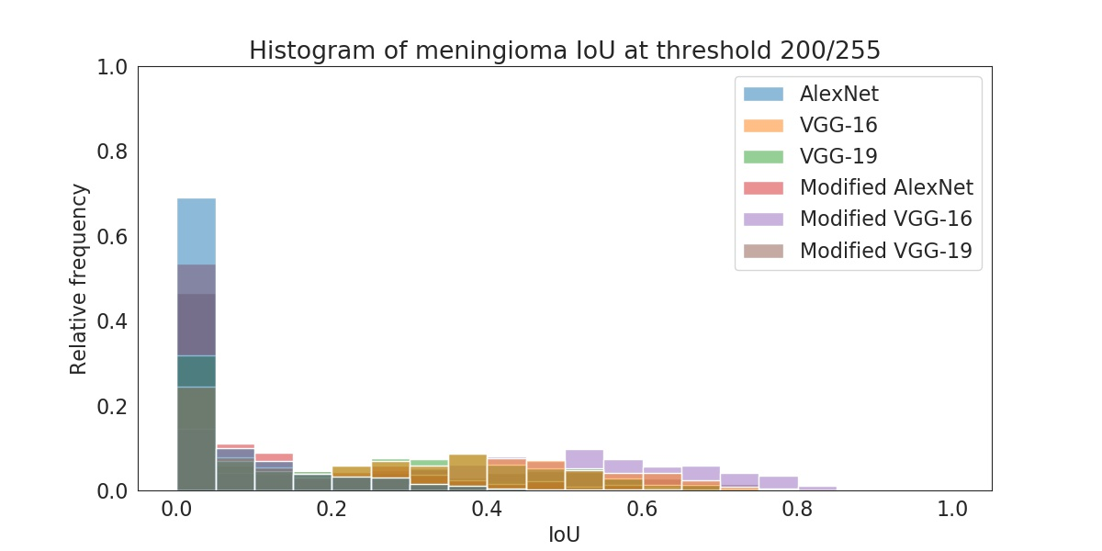
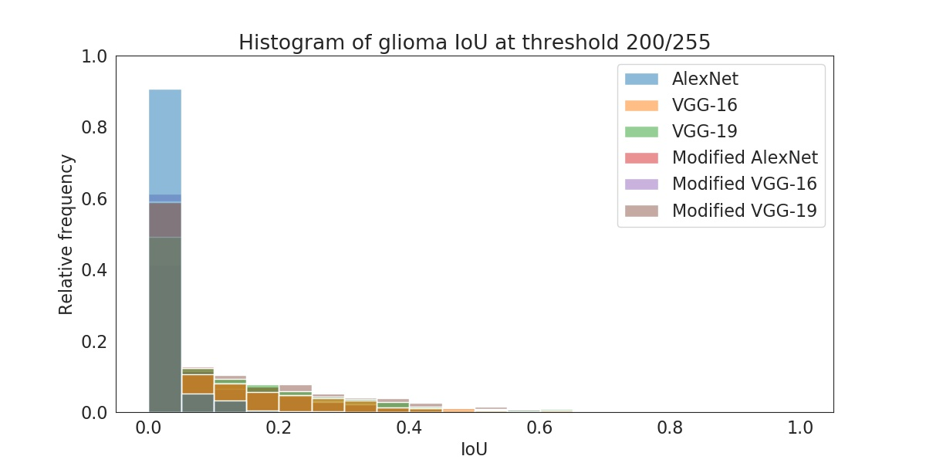
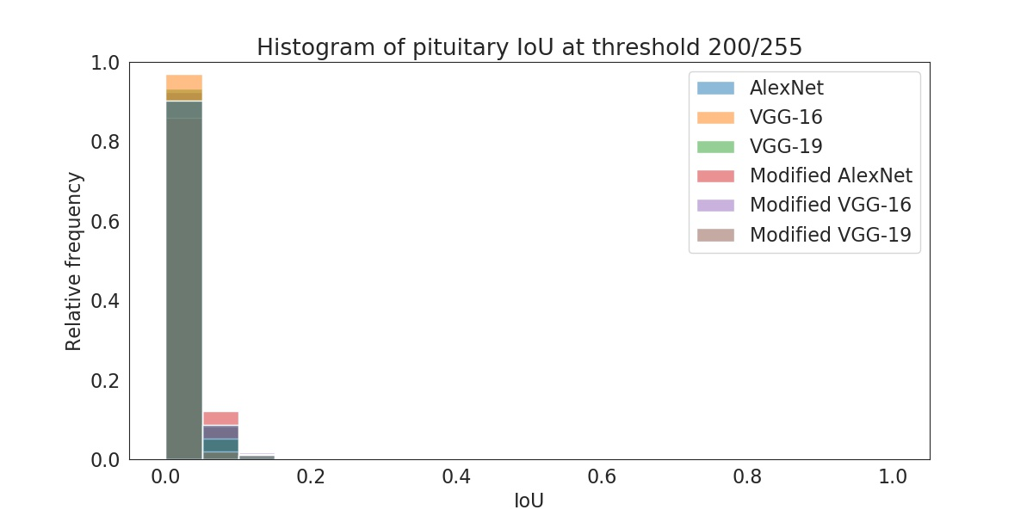
Segmentation BY A classification model
Large difference in mIoU per class
mIoU for meningioma was the highest, followed by glioma, and then by pituitary tumor
IoU distribution per tumor class:
Highest peak at the first bin (IoU ranges from 0 to 0.05) for all classes
None of the pituitary tumors has an IoU higher than 0.23

Slide 21
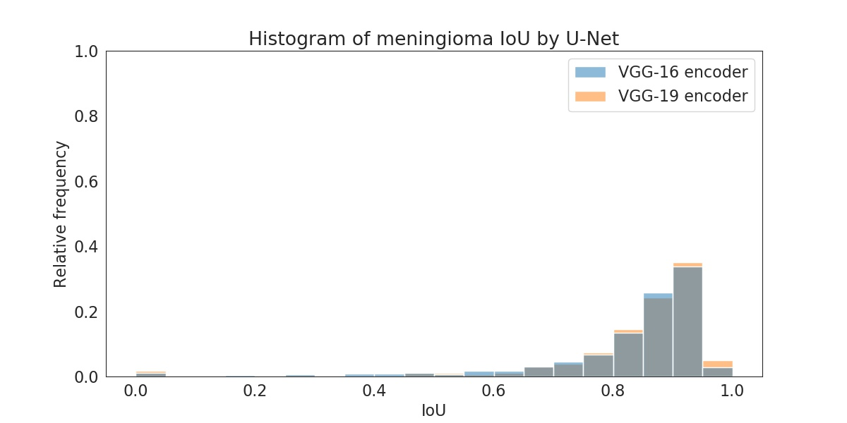
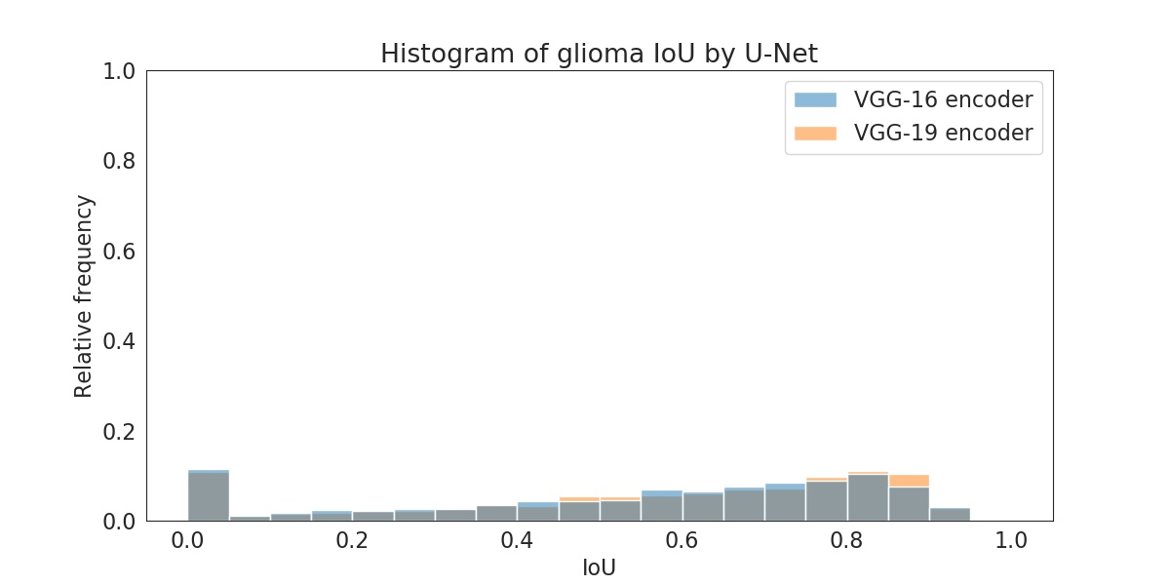
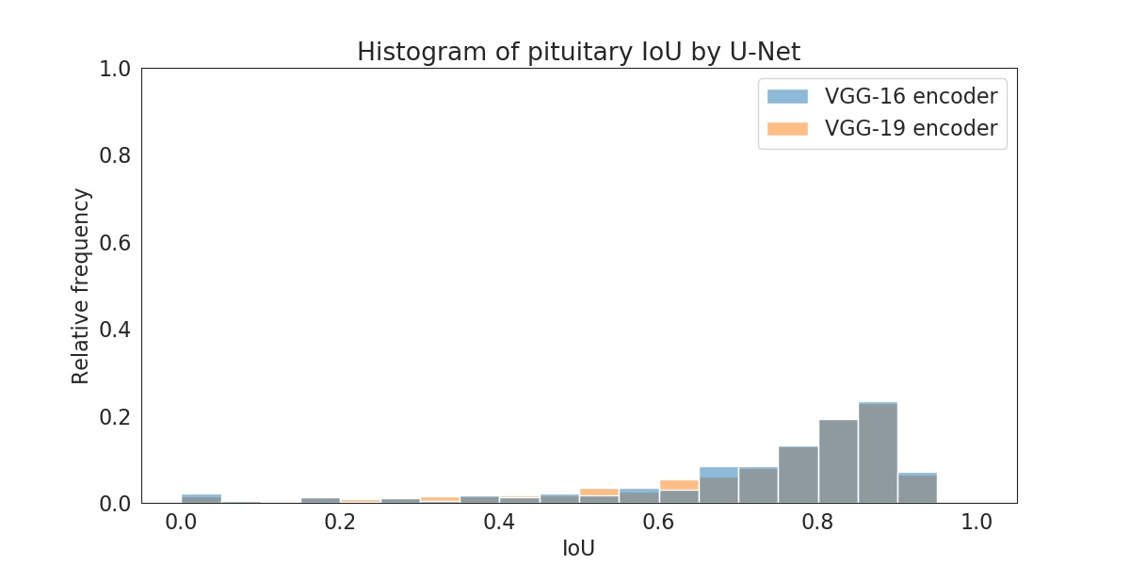
Segmentation BY A segmentation model
U-Net, a segmentation model, is trained using the following encoders:
VGG-16
VGG-19
IoU distribution per tumor class:
Positively skewed
Many instances with high IoU
mIoU obtained by U-Net:
0.666 (VGG-16 encoder)
0.673 (VGG-19 encoder)

Slide 22
Qualitative analysis FOR low IoU
Meningioma
Highlights border areas
Models are trained to look around the brain to find meningioma

Slide 23
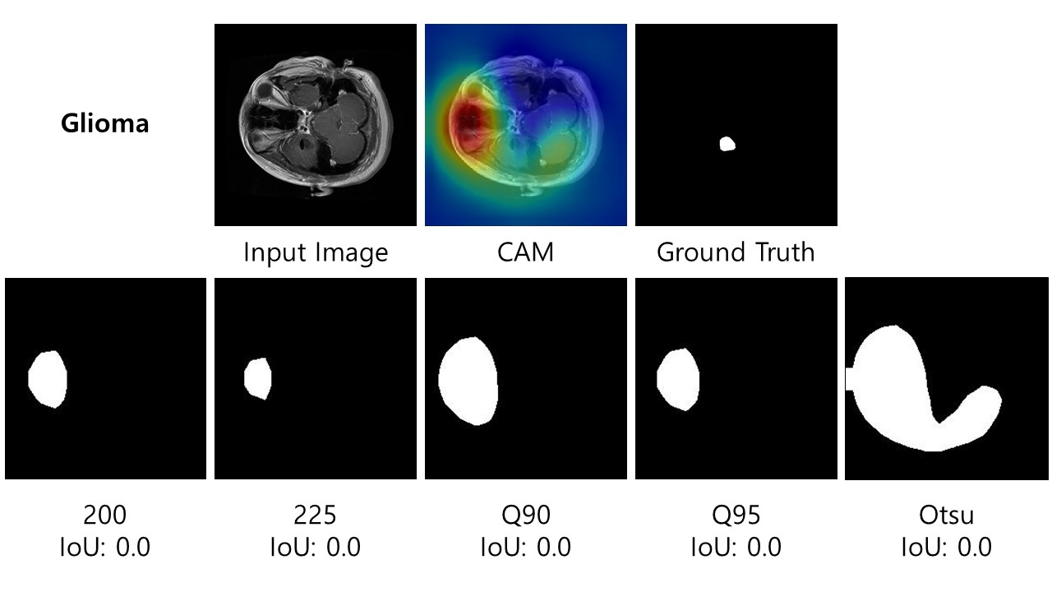
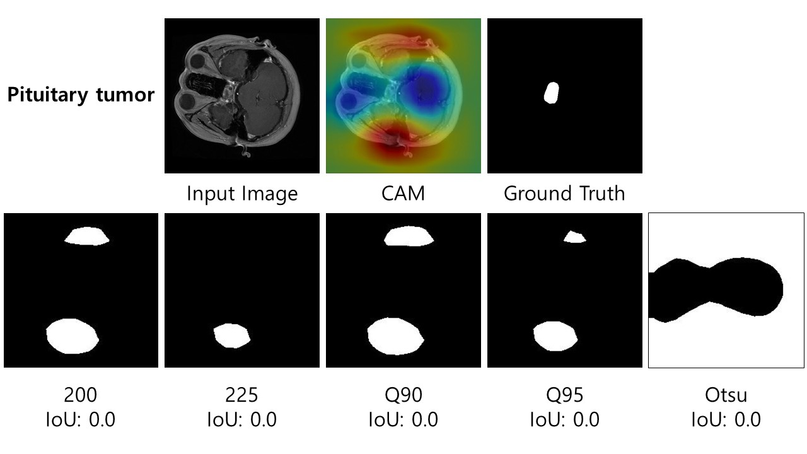
Qualitative analysis FOR low IoU
Meningioma
Highlights border areas
Models are trained to look around the brain to find meningioma
Glioma and pituitary tumor
Highlights the entire brain
Highlights organs (i.e., eyes and ears)
Models have difficulties in distinguishing glioma and pituitary tumors

Slide 24
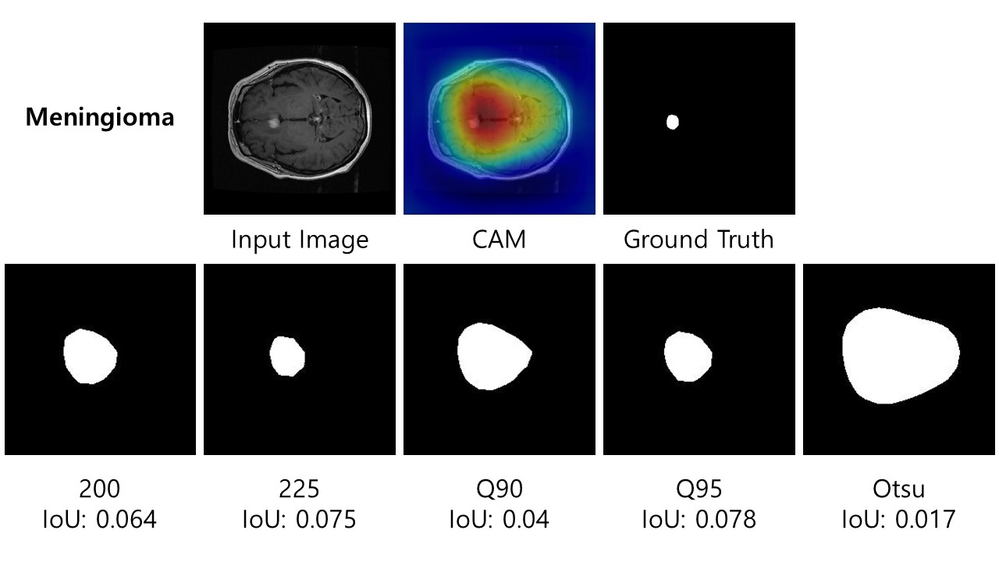
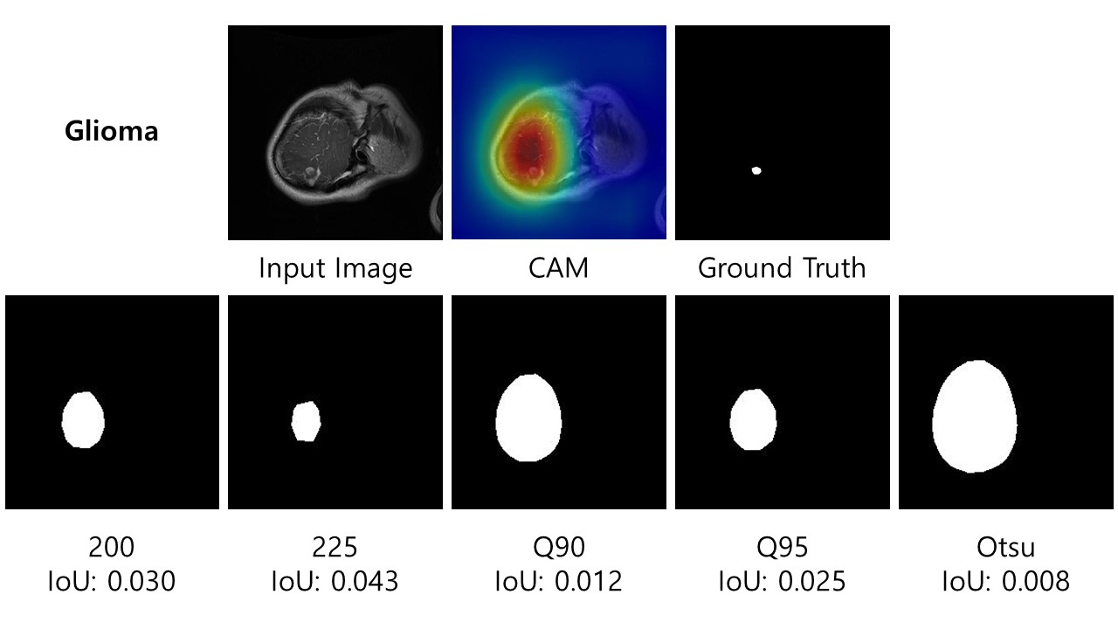
Qualitative analysis FOR low IoU
Another cause of low IoU:
Large segmented area in comparison to the actual ground truth
A correct but less precise segmentation results in a low IoU

Slide 25
Conclusions and future work

Slide 26
conclusions
Segmentation can be conducted using a classification model and CAM
However, segmentation needs to be done in a careful way since CAM learns from class labels and not from pixel-wise labels
CAM-based segmentation facilitates quantitative analysis through the use of IoU
A high classification effectiveness can still be paired with a low segmentation effectiveness
Modified VGG-16 has a classification effectiveness of 90.8% but an mIoU of only 12.2%
A predictive model does not always focus on the correct areas in an image to perform classification

Slide 27
Future work
Use weighted loss to mitigate the influence of imbalance
Give more weight to the minority class and less weight to the majority class
Use of other CNN models (e.g., ResNet and DenseNet)
Use of other visualization methods (e.g., Grad-CAM++ and GAIN)
Use of explanation techniques (e.g., LIME and SHAP)
Use of a Conditional Random Field to refine the segmentation masks produced by a classification model

