Slide 1
Box-Scan: An efficient and effective algorithm for box dimension measurement in conveyor systems using a single RGB-D camera
7th IIAE International Conference on Industrial Application Engineering 2019
Ho-min Park, Arnout Van Messem, Wesley De Neve Kitakyushu, Japan | 28-03-2019

Slide 2
Introduction
Proposed Approach
Implementation
Performance Evaluation
Conclusions & Future Work

Slide 3
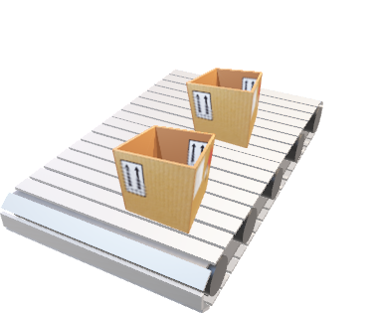
Introduction
Logistics industry
uses boxes for protecting, loading, and packaging
box dimension measurement can increase effectiveness (e.g., stock optimization)
Requirements for box dimension measurement
conveyor system is continuously operating
people use the conveyor system at a constant speed
certain error tolerance (paper boxes may be deformed)

Slide 4
Model Cercumstances
Real-time box dimension measurement on a moving conveyor belt using a single RGB-D camera (black rectangle)

Slide 5
System flow diagram
Object
Conveyor System
IR-ray
RGB-D Camera
RGB-D frame
Computer System
ROI Measurement (Algorithm 1)
State Transition Control (Algorithm 2)
Depth
frame
System frame
Buffer
Object size
Notes:
System flow diagram. The proposed system consists of an RGB-D camera and a computer. The RGB-D camera first captures RGB-D images of the conveyor surface, sending these images to the system frame buffer. Our algorithm retrieves depth frames from the buffer at a speed of 10 to 20 FPS. As soon as an object has completely passed through the ROI, the state control algorithm executes the SaveOutput() procedure and sends the result to the target system. The system subsequently gets a depth frame from the RGB-D camera and determines the three dimensions of the object.

Slide 6
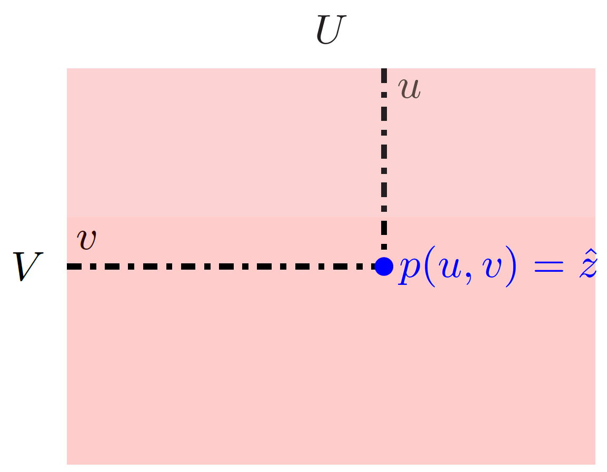
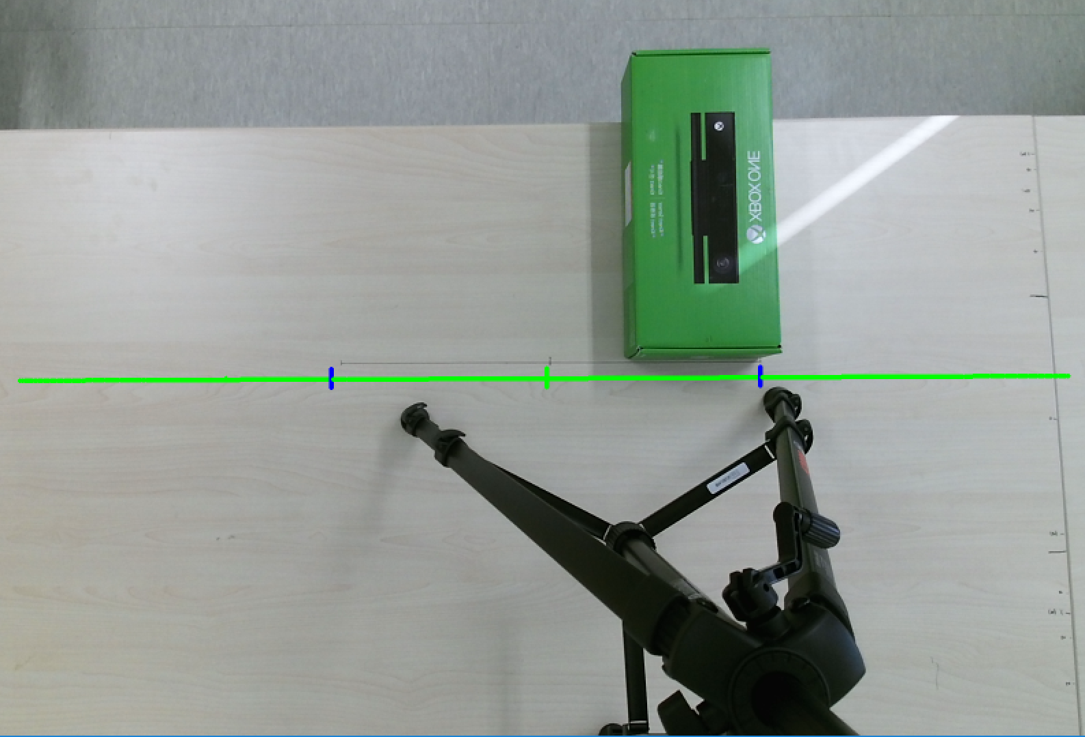
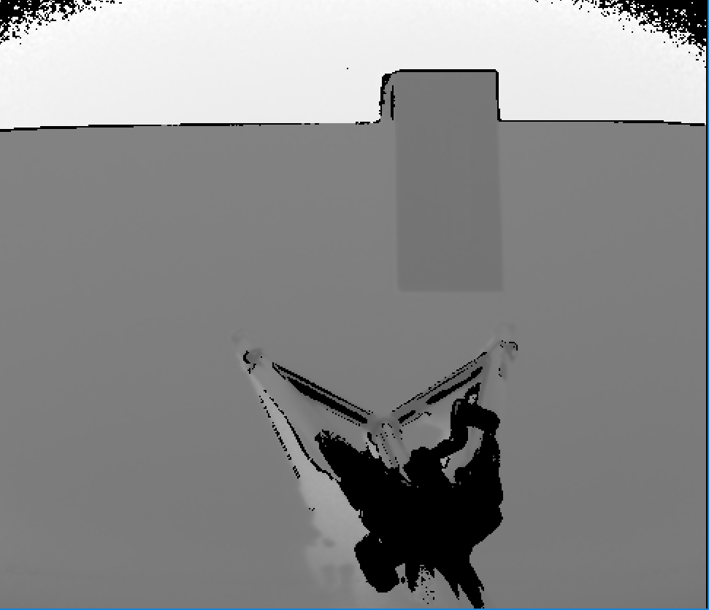
Rgb-D(Depth) sourcE
Floor(far)
Floor(far)
Table(near)
Table(near)
box
box
$\hat{z}$: distance value
(a)
(b)
(c)
Depth frame
Notes:
The depth frame consists of V rows and U columns, as shown in Fig. 1(b). Each element of the depth frame stores an estimated distance value ^z. Given the availability of distance values, we can easily convert each 2-D point in the depth frame into a 3-D point in the real world, with the 3-D coordinate system originating from the IR-receiver.

Slide 7
Method(1/2)
Region-of-Interest (ROI)
contains the interesting points of the depth frame
in this paper: a central line that crosses the depth frame
point $p\left(u,v\right)∈ROI$
State function $s$
$s_{t}\left(u,v\right)=\left\{\begin{aligned}&1\left(excited\right), if d\left(p_{t−1}\left(u,v\right),p_{t}\left(u,v\right)\right)>ε_{d} \\ &0\left(stable\right), otherwise \end{aligned}\right.$
$d\left(p_{a},p_{b}\right):$ distance between point $a$ and point $b$
$ε_{d}$: distance threshold
Stable
Excited
Notes:
The first step deploys a Region-of-Interest (ROI) processing procedure, only extracting those parts from the depth frames of the RGB-D camera that are necessary for performing box dimension measurement, making it possible to significantly reduce the computational complexity.

Slide 8
Method(2/2)
Number of exited points
$N_{excited}(ROI) = \sum_{\left(u,v\right)∈ ROI}{\left. s(u,v\right)}$
Subsets of $ROI$ at time $t$
$\left.E_{t}=\{p_{t}(u,v):s_{t}(u,v)=1, p_{t}(u,v)∈ {ROI}_{t} \right\}$
$\left.S_{t} =\{ p_{t}(u,v):s_{t}(u,v)=0, p_{t}(u,v)∈ {ROI}_{t} \right\}$
$N\left({ROI}_{t}\right)= \left|E_{t}\right|+ \left|S_{t}\right|$
$N({ROI}_{0}) = |S_{0}|$ for initial time($t=0$)
(1)
(2)
(3)
Notes:
A point $p\left(u,v\right)∈ROI$, located on the conveyor surface, is stable at first. This means that the distance between the ROI point $p_{t}(u, v)$ in the current depth frame t and the same ROI point $p_{t+1}(u, v)$ in the next depth frame $t+1$ is smaller than $ε_{d}$. The threshold $ϵ_{d}$ is used to determine whether an object is present or absent on the conveyor surface below the RGB-D camera. If an object passes through the ROI, some of the points in the ROI will have a distance difference that is greater than $ε_{d}$. We say that these points are in an excited state. We subsequently define $s_{t}$ as the state of a point at time $t$:

Slide 9
Box-scan: Algorithm 1 & 2
Algorithm 1 ROI-measurement
Algorithm 2 State Transition Control
1: | Procedure ROI-Measurement()
2: | height $←0$
3: | width(length) $←0$
4: | D$← ∅$
5: | // height by averaging distances
6: | for all $p_{E_{t}}\left(u,v\right), p_{S_{0}}\left(u,v\right)$ where $p\left(u,v\right)∈E_{t}$ do
7: | $D←$ Distance ($p_{E_{t}}\left(u,v\right),p_{S_{0}}(u,v))∪D$
8: | end for
9: | height $←(\sum_{d∈D}{d}) / |D|$
10: | // width(length) by finding maximum distance within $E_{t}$
11: | $E_{r}←RANSAC−LineFitting(E_{t})$
12: | for all $p_{i}∈E_{r}$ do
13: | for all $p_{j}∈ E_{r}$ do
14: | width(length) $←$ Max(width(length), Distance($p_{i},p_{j}$))
15: | end for
16: | end for
17: | return width(length), height
18: | end procedure
19: | Procedure Distance ($p, q$)
20: | Convert 2-D points $p$ and $q$ into 3-D points $p’$ and $q’$
21: | return Euclidean distance between $p’$ and $q’$
22: | end procedure
1: | procedure State-Control ($N_{row},N_{col}$)
2: | $S_{row}, S_{col}, E_{row}, E_{col}, H, W, L, ROI_{row},ROI_{col}←∅$
3: | $state, excited, height, width, length ←∅$
4: | $ϵ_{N}←10,ε_{d}←0.05$
5: | while true do
6: | $f ←getDepthFrame()$
7: | ${ROI}_{row},ROW_{col} ←Get−ROI(N_{row},N_{col})$
8: | $excited ←N_{excited}(ROI_{col}) (1)$
9: | if state = 0 then
10: | $S_{row},S_{col}←(3)$
11: | $state←1$
12: | end if
13: | if $state = 1$ then
14: | if $excited >ϵ_{N}$ then
15: | $state$ $←2$
16: | $height, width, length←0$
17: | end if
18: | end if
19: | if $state = 2$ then
20: | if $excited>ϵ_{N}$ then
21: | $E_{row},E_{col}←(2)$
22: | height, width $←ROI−Measurement(E_{row},S_{row})$
23: | height, length $←ROI−Measurement(E_{col},S_{col})$
24: | $H←height∪H, W←width∪W, L←length∪L$
25: | else
26: | SaveOutput (H, W, L)
27: | $state←1$
28: | end if
29: | end if
30: | end while
31: | end procedure
32: | procedure Get-ROI($f, N_{row},N_{col})$
33: | ${ROI}_{row}, ROI_{col}←∅$
34: | ${ROI}_{row}←\{p\left(u,v\right)|v=N_{col}/2, 0≤u<N_{row},p\left(u,v\right)∈f \}$
35: | ${ROI}_{col}←\left\{p\left(u,v\right)\right|0≤v<N_{row},p\left(u,v\right)∈f, v=N_{col}/2\}$
36: | return ${ROI}_{row}, {ROI}_{col}$
37: | end procedure

Slide 10
State Transition Diagram
Notes:
The system starts from the state S0 and then moves to S1 when performing the transition Initialize(t1), going through the transition Idle(t2) until a box reaches the ROI. As soon as a box reaches the ROI, the system transitions into the state S2 and starts executing Algorithm 2 for dimension measurement. As soon as the box has completely passed through the ROI, the system stores the box dimensions, returning to state S1.

Slide 11
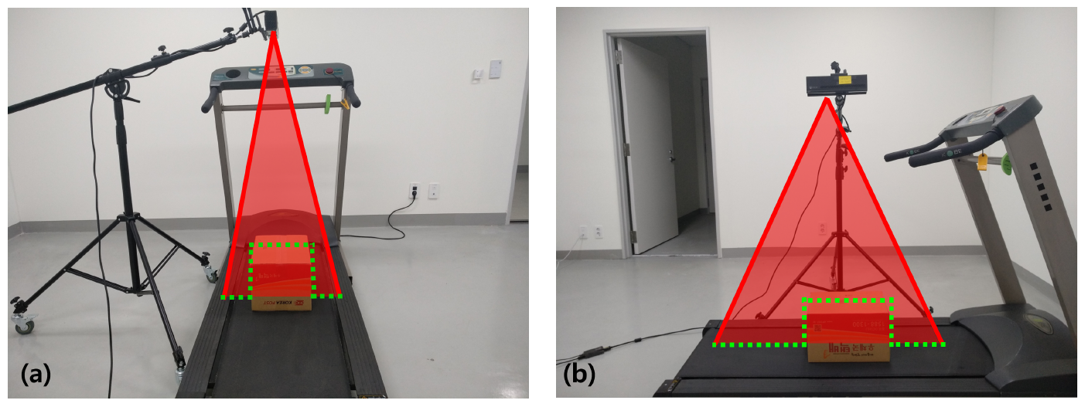
Physical View
External view of the prototype
(a) $ROI_{col}$: width & height measurement
(b) $ROI_{row}$: length & height measurement

Slide 12
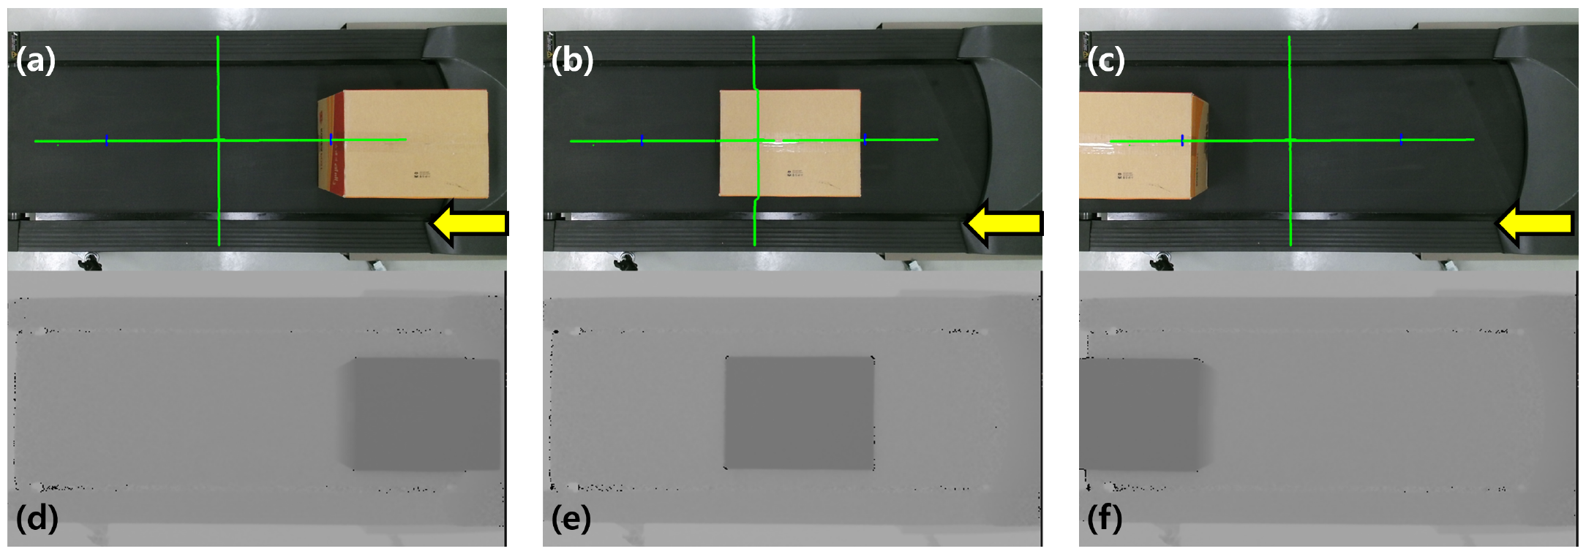
Camera View
Internal view of the prototype
Color Frame
Depth frame

Slide 13
Evaluation meatric and Method
Average/Maximum values of Absolution/Relative error
Method
different types of EMS postal box
ground truth: hand measured value after assembly
N=10 | Absolute error | Relative error
Average Error | $$e_{avg}=\frac{1}{N}\sum_{i=1}^{N}{|y_{i}−{\hat{y}}_{i}|}$$ | $$e_{R,avg} =\frac{ e_{avg}}{\hat{y}}×100$$
Maximum Error | $$e_{max}=\max_{i=1…N}{|y_{i}−{\hat{y}}_{i}|}$$ | $$e_{R,max} =\frac{ e_{avg}}{\hat{y}}×100$$

Slide 14
Performance(Width)
Width estimation (in mm) at a conveyor speed of 3.4km/h
Average ~2% maximum ~5% of relative error
Box Class | Standard Size | Measured Size after Assembly | Estimated Size | Avg Error |  | Max Error
 |  |  |  | Absolute | Relative | Absolute | Relative
1 | 190 | 192 | 195.09 | 3.09$±$2.27 | 1.61 | 8.60 | 4.48
2 | 180 | 191 | 193.07 | 4.29$±4.44$ | 1.93 | 7.70 | 4.03
2-1 | 250 | 263 | 265.98 | 4.91$±2.55$ | 1.19 | 6.55 | 2.49
3 | 250 | 261 | 265.56 | 4.71$±3.52$ | 1.80 | 10.62 | 4.07
4 | 310 | 322 | 325.26 | 5.40$±6.49$ | 1.67 | 15.30 | 4.75

Slide 15
Performance(Height)
Height estimation (in mm) at a conveyor speed of 3.4km/h
Average ~3% maximum ~4% of relative error
Box Class | Standard Size | Measured Size after Assembly | Estimated Size | Avg Error |  | Max Error
 |  |  |  | Absolute | Relative | Absolute | Relative
1 | 90 | 92 | 89.92 | 2.07$±0.44$ | 2.25 | 2.88 | 3.13
2 | 150 | 154 | 151.83 | 2.16$±0.65$ | 1.40 | 3.11 | 2.01
2-1 | 100 | 106 | 102.97 | 3.13$±0.56$ | 2.85 | 3.92 | 3.70
3 | 210 | 216 | 212.58 | 3.41$±0.70$ | 1.57 | 4.19 | 1.94
4 | 280 | 292 | 288.07 | 3.92$±0.57$ | 1.34 | 4.88 | 1.67

Slide 16
Performance(Length)
Length estimation (in mm) at a conveyor speed of 3.4km/h
Average ~2% maximum ~5% of relative error
Box Class | Standard Size | Measured Size after Assembly | Estimated Size | Avg Error |  | Max Error
 |  |  |  | Absolute | Relative | Absolute | Relative
1 | 220 | 219 | 221.67 | 2.76$±1.35$ | 1.26 | 4.10 | 1.87
2 | 270 | 273 | 273.21 | 4.91$±5.99$ | 1.80 | 10.32 | 3.78
2-1 | 350 | 358 | 360.29 | 3.02$±5.21$ | 1.25 | 10.66 | 2.97
3 | 340 | 338 | 342.66 | 4.66$±2.94$ | 1.37 | 11.54 | 3.41
4 | 410 | 413 | 418.34 | 7.80$±8.29$ | 1.90 | 17.92 | 4.34

Slide 17
Error per spped(Average)
The average relative error is less than 5% at ~3.8km/h
Notes:
Relative average error of the dimension measurements as a function of the conveyor speed, with errors being less than 5% at all conveyor speeds. When the conveyor speed exceeds 3.4~km/h, the relative average error of the width and the length increases significantly.

Slide 18
Error per spped(Maximum)
Up to 3.4 km / h, the average maximum error is within 6%
At 3.8 km / h, the error increases significantly
Notes:
Relative maximum error of the dimension measurements as a function of the conveyor speed, with errors being less than 5% at all conveyor speeds, with the exception of a conveyor speed of 3.8~km/h. When the conveyor speeds exceeds 3.4~km/h, the relative maximum error of the width and the length increases significantly.

Slide 19
Conclusion
Box-Scan
measurement of object dimensions on a moving conveyor belt
only needs one RGB-D camera
two-level algorithm in support of automatic transitions
fast (0.1 sec @ 1m/s) and accurate ($e_{REL}<0.05$)
Future work
investigate accuracy per distance relationship
angle of entry of a box
Notes:
In this paper, we have proposed Box-Scan, a novel box dimension measurement algorithm in support of logistics automation. We presented a two-level algorithm, with the low-level algorithm being responsible for box dimension measurement and the high-level algorithm being responsible for system state management, transitioning between a measurement state and an idle state, depending on the presence or absence of a box on a moving conveyor. We integrated the proposed algorithm into a functional prototype, using commodity hardware: a single RGB-D camera and a desktop PC. Our experimental results demonstrate that our measurement approach can determine the dimensions of a box located on a conveyor belt moving at a speed of up to 3.4 km/h with a maximum relative error of 5%. This result is similar or better than the state-of-the-art, while only using a single RGB-D camera in an operational environment that is more challenging (that is, an environment using a higher conveyor speed). Moreover, the proposed algorithm is able to generate box dimension measurements within about 0.1 seconds after a box has left the region-of-interest monitored by our RGB-D camera.
We can identify two major directions for future research, further improving the proposed algorithm. First, the higher the camera, the larger the area covered by the camera. This allows the algorithm to measure larger objects, but conversely, the area covered by each point is also larger, resulting in a lower accuracy. Therefore, it would be of interest to investigate the relation between accuracy, camera distance, and measurable size limits. Second, the angle of entry of a box. The current scenario assumes that all objects are cuboids and that each side is either parallel or perpendicular to the conveyor plane. In practice, this assumption can be enforced by installing a physical guide on the conveyor, or we can relax this assumption by enhancing the algorithm proposed in this paper.

Slide 20
Ho-min Park Ph.D. student Center for biotech data science | Internet technology and data science lab E homin.park@ugent.be T +82 32 626 4326 M +82 10 4731 3162 www.ugent.be
Ghent University @ugent Ghent University

