Slide 1
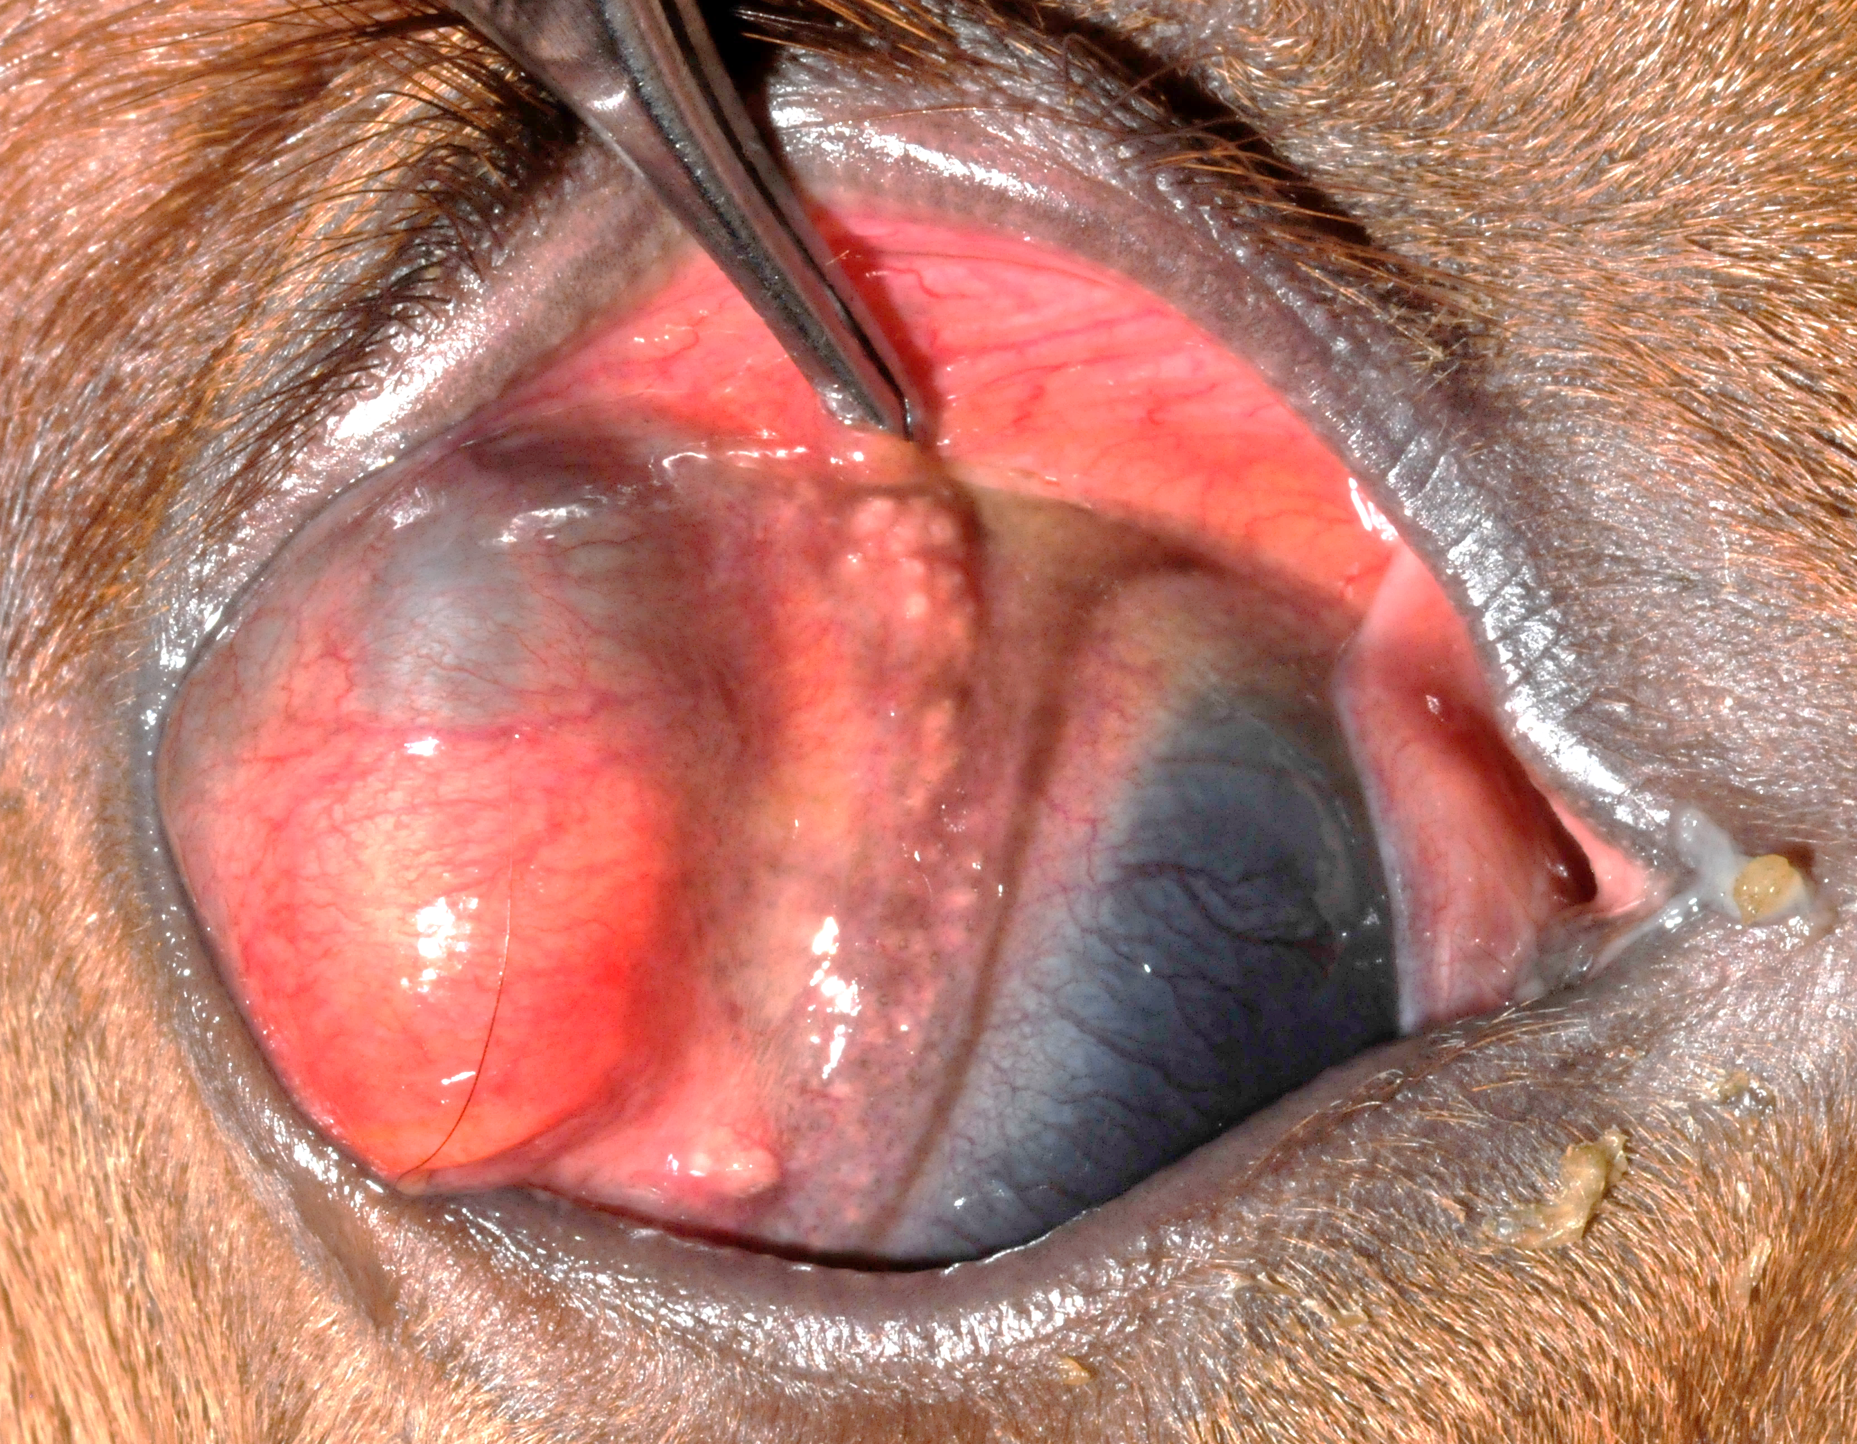
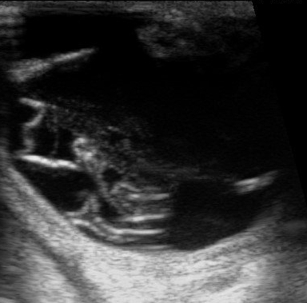
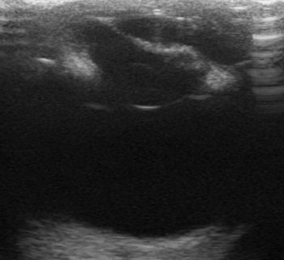
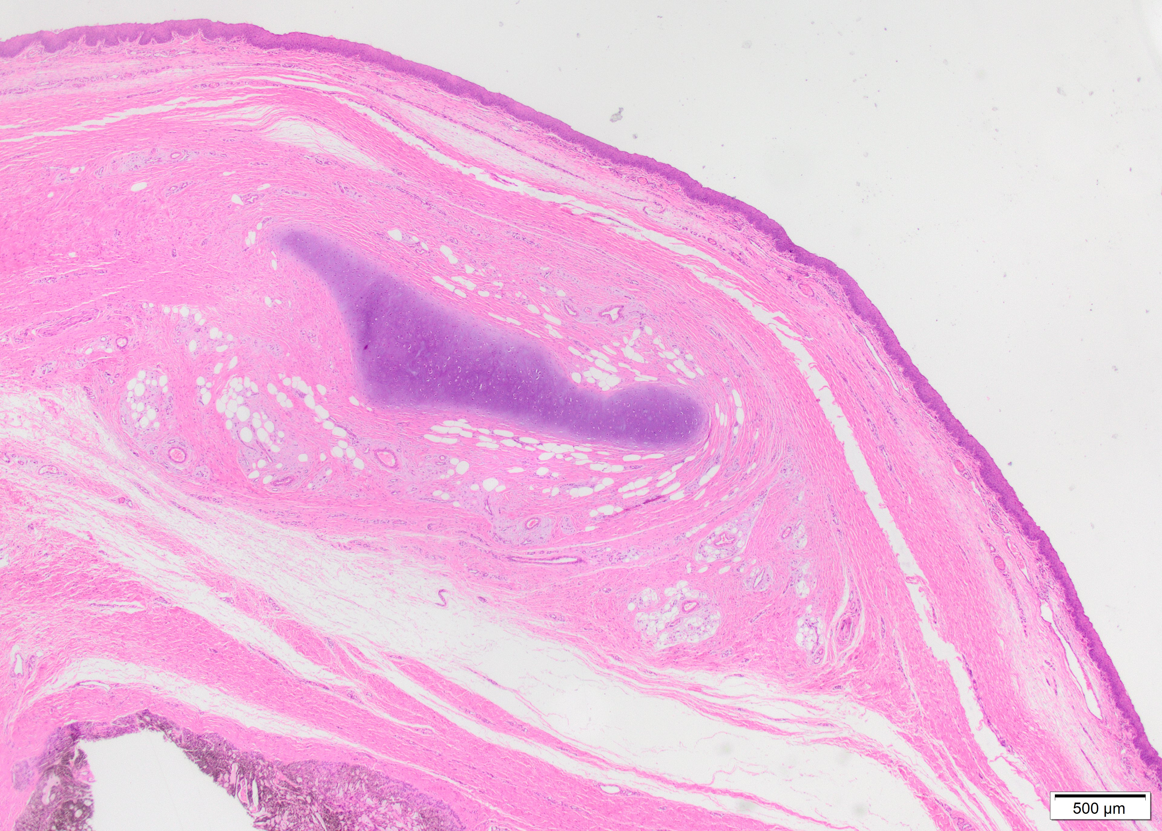
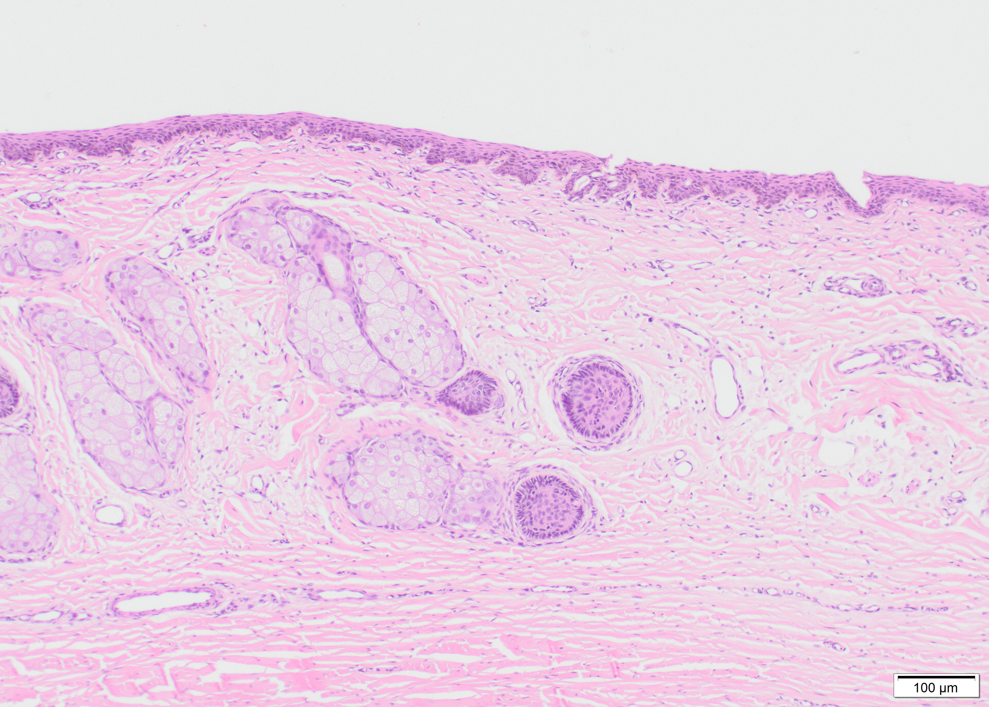
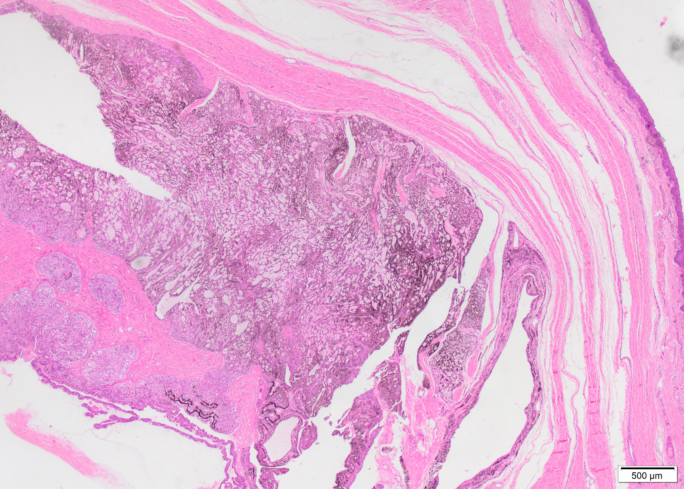
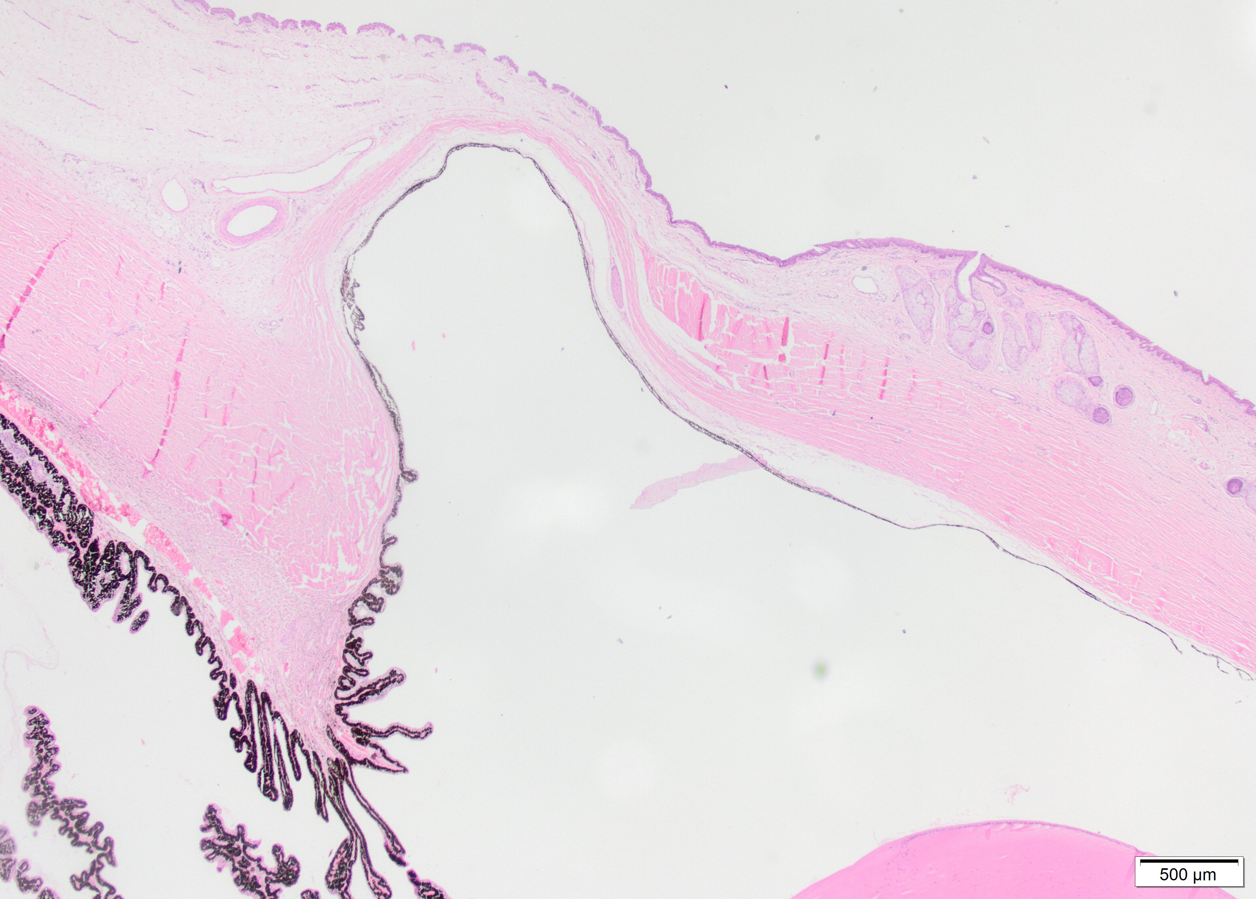
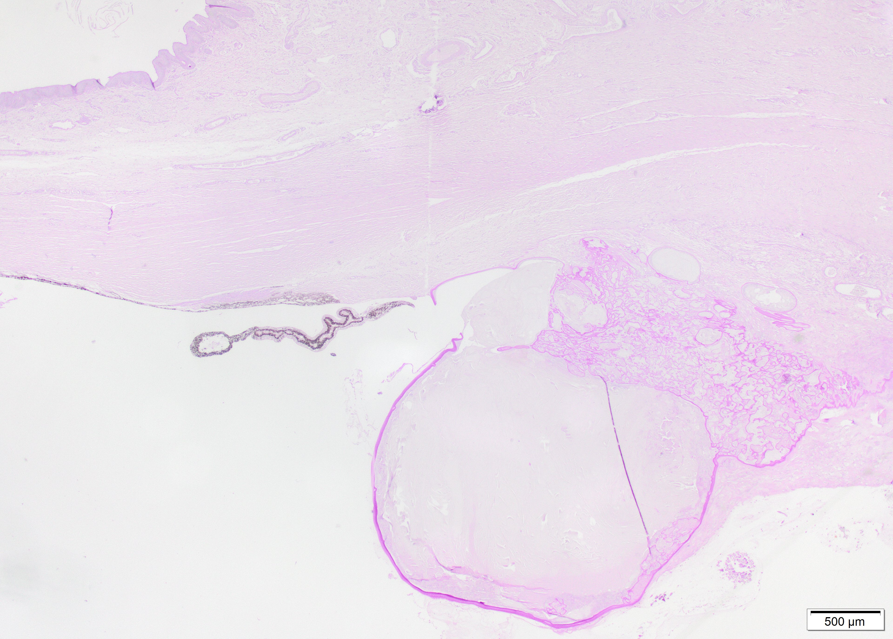
SEVERE MULTIPLE BILATERAL CONGENITAL OCULAR ABNORMALITIES CAUSING BLINDNESS IN A WARMBLOOD FOAL
E. Vercruysse¹, C. Naranjo², F.Narinx¹, A. Sauvage¹, M. Vandersmissen¹, M. Grauwels¹, S. Monclin¹
¹ University of Liège, Faculté de Medicine Vétérinaire, Clinique Vétérinaire Universitaire, Liège, Belgium
² IDEXX Laboratories, Veterinary Pathology, Barcelona, Spain
Purpose: To describe a case of bilateral choristoma, anterior segment cleavage syndrome and severe anterior segment dysgenesis in a foal.
Methods: A 3-day-old foal was presented to the equine clinic of the University of Liège for investigation of bilateral ocular congenital abnormalities without any other clinical signs. It was the fifth foal of the mare and both gestation and foaling had been unremarkable. Ophthalmological examination, ocular ultrasound and, following euthanasia, histopathology of both globes were performed.
Results:
Ophthalmic examination
The right eye (OD) revealed a dermoid dividing the cornea vertically in two segments with a mass at the level of the dorsal bulbar conjunctiva. Evaluation of the intraocular structures was not possible due to its extent.
The left eye (OS) showed a smaller dermoid at the level of the dorsal limbus with two small pigmented masses at its dorsal rim. The anterior chamber was narrow and the iris was attached to the cornea in the nasal quadrant. The lens revealed a posterior cortical cataract and the fundus was not assessable (Fig.1).
Ultrasound
Scleral ectasia was suspected in the dorsal region, more severe in OD than OS. In OD, the lens was abnormally small and displaced anteriorly (Fig.2).
Histopathology
A choristoma in the peripheral cornea of both eyes was observed, showing elements typical of skin, skeletal muscle and cartilage (Fig.3). A severe anterior segment dysgenesis was detected (OD>OS) in which the abnormal anterior uvea was adherent to the posterior surface of the cornea. Descemet's membrane was not identified (Fig.4). Remnants of lens with markedly wrinkled and redundant lens capsule were noted OD (Fig.5). The retina OD is detached without loss of its layers.
OD
OS
OD
OS
Fig. 1. Dermoid with anterior segment dysgenesis OD and anterior segment cleavage syndrome OS
N
N
T
*
T
SM
C
A
SG
OD
OS
Fig. 2. Ultrasonographic images of both eyes with a narrow anterior chamber. The lens OD is abnormal in shape and size (*) with disorganized vitreous/suspected retinal detachment. The iris OS is anteriorly attached to the cornea in the nasal quadrant. N: nasal, T: temporal.
OD
B
OS
Fig. 3. Choristoma with stratified epithelium, fibrovascular stroma, adipocytes (A) and sebaceous glands (SG). There is presence of cartilage deposit (C) and skeletal muscle (SM) OD (H&E coloration).
SS
C
CB
CB
AC
*
AC
MC
*
OD
AC
OS
Fig. 4. Adjacent to the choristoma (*) OD, the ciliary body (CB), is markedly disorganized forming small nests, cords, trabeculae and tubular structures. Adjacent to the choristoma OS, a scleral staphyloma (SS) is present with absence of Descemet’s membrane and and a thin layer of uveal tissue was directly plated against the back of the corneal stroma. AC: anterior chamber (H&E coloration).
Fig. 5. Remnants of lens with markedly wrinkled and redundant lens-capsule like membranes and mineralized content (MC) in the connective tissue subtending the area of the choristoma OD. C: cornea, AC: anterior chamber (PAS coloration).
Discussion: Ocular choristomas in horses are rarely reported in literature. They have been described in a group of related Quarter horses in association with iridal hypoplasia (1) and cataracts and in a Thoroughbred foal with bilateral multiple ocular developmental defects (2). Similar to the latter, our foal suffered bilateral anterior segment abnormalities and choristomas. In contrast, our foal did not show any signs of retinal dysplasia or optic nerve hypoplasia. Moreover, scleral ectasia was present which has, to the authors’ knowledge, not yet been reported as a congenital abnormality in horses.
Conclusions: The authors document an unusual case of congenital bilateral blindness in a foal with severe anterior segment dysgenesis, choristoma and focal anterior scleral ectasia.
References:
1. Joyce JR, Martin JE, Storts RW, Skow L. 1990. Iridial hypoplasia (aniridia) accompanied by limbic dermoids and cataracts in a group of related quarterhorses. Equine Vet J Suppl. 10, 26-8.
2. Baumgartner WA, Storey ES, Paulsen DB. 2009. Bilateral intraocular glandular choristomas in a Thoroughbred foal. Vet Ophthalmol. 12, 106-14.
ECVO Online meeting 20th – 23rd May 2021
Notes:
Images 300dpi
Mettre en dicom
Prendre avec mi dicom export
Horos fichier exporter vers tiff
Dupliquer
Recadrer
Choisir la taille
Puis mettre dans 300 dpi

