Slide 1
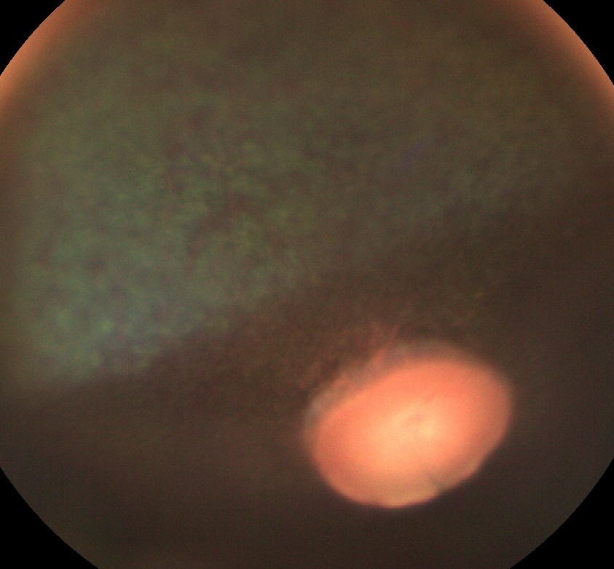
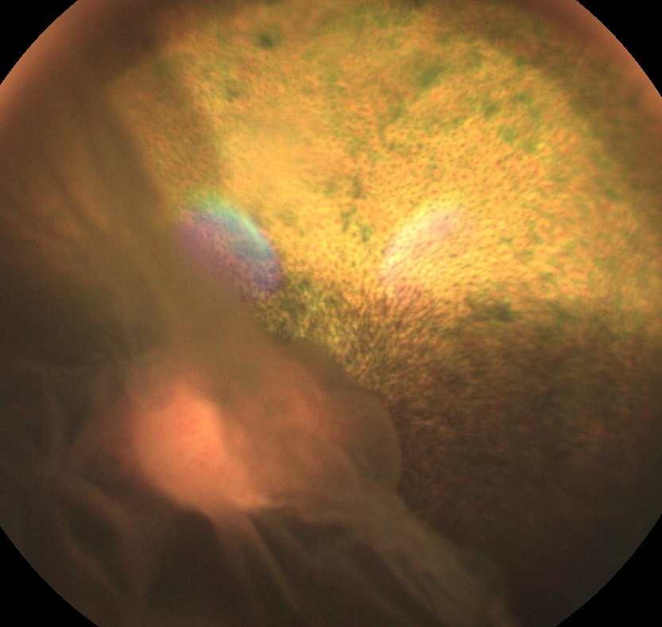
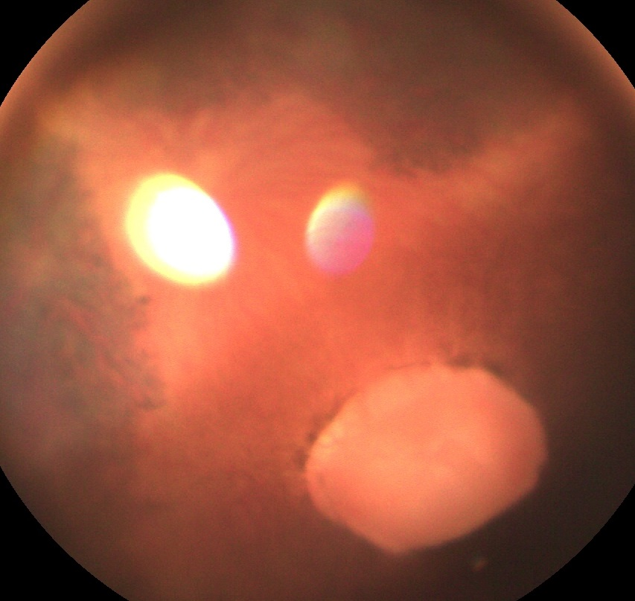
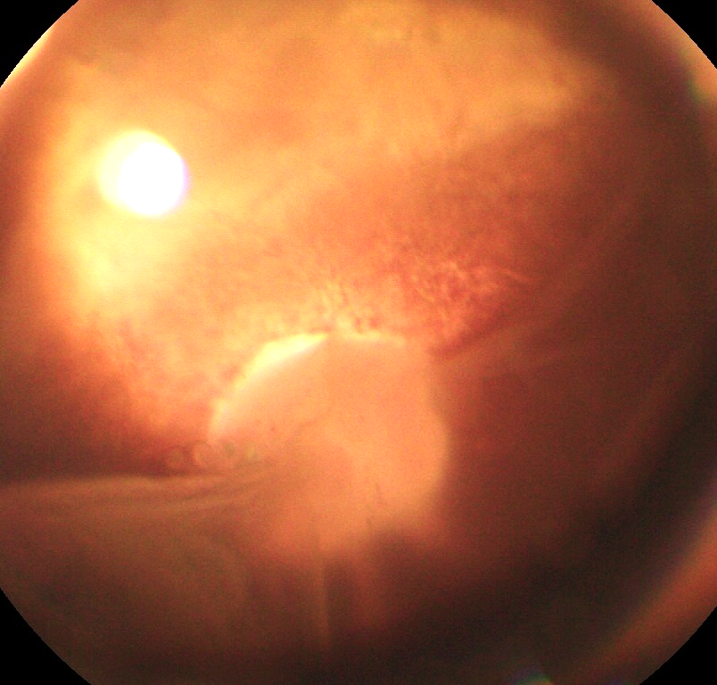
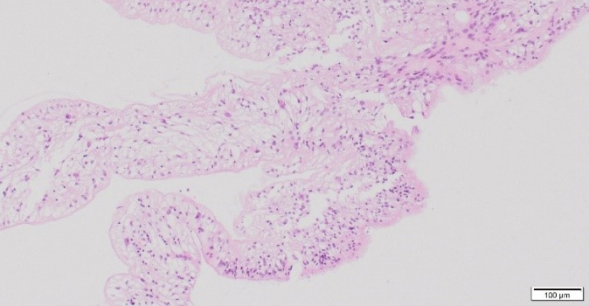
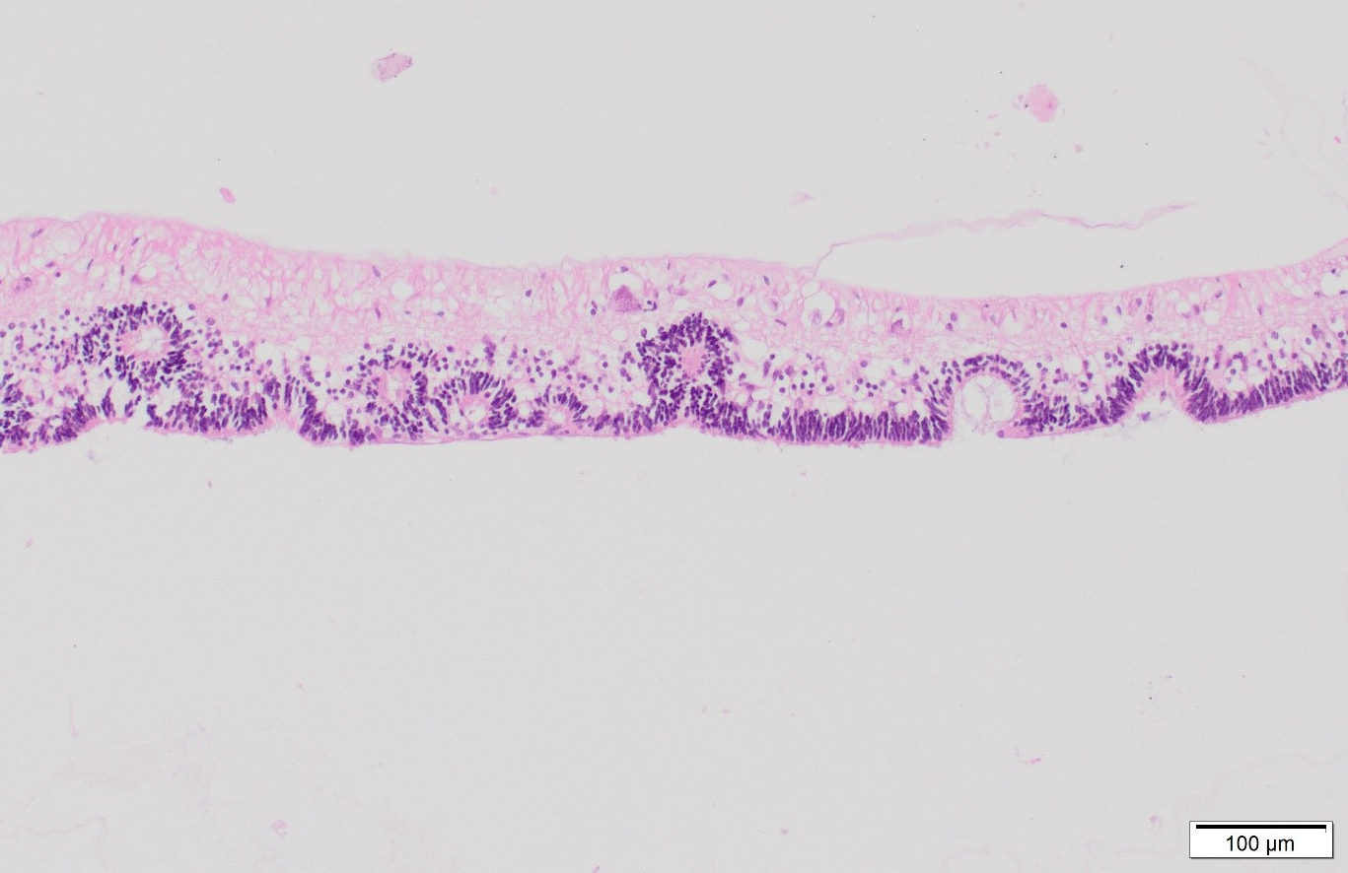
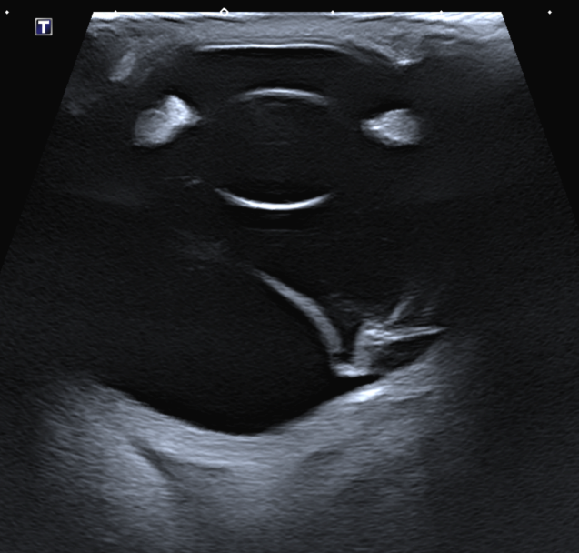
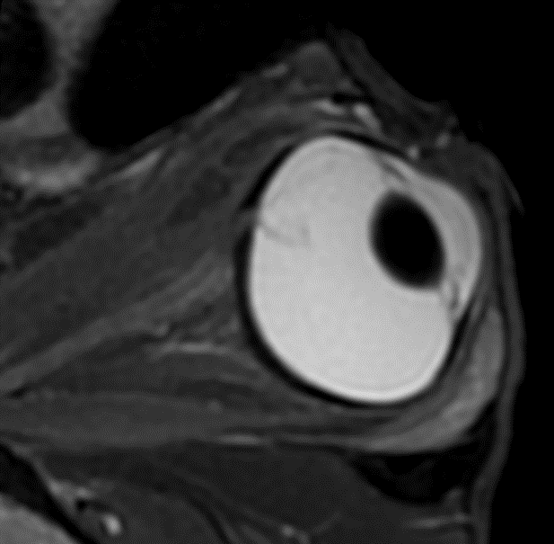
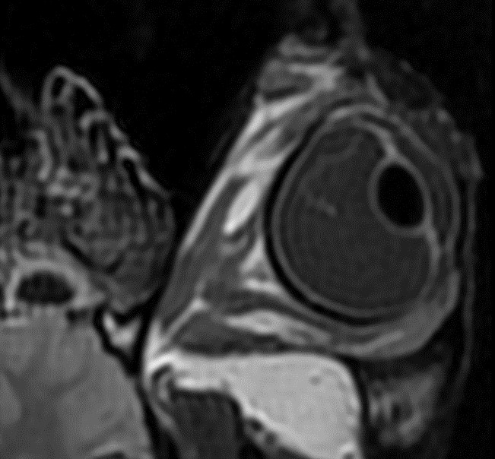
RETINAL DETACHMENT SECONDARY TO VITREORETINOPATHY IN TWO CLOSELY RELATED WARMBLOOD HORSES
E. Vercruysse¹, C. Naranjo², F.Narinx¹, A. Sauvage¹, M. Vandersmissen¹, M. Grauwels¹, S. Monclin¹
¹ University of Liège, Faculté de Medicine Vétérinaire, Clinique Vétérinaire Universitaire, Liège, Belgium
² IDEXX Laboratories, Veterinary Pathology, Barcelona, Spain
Purpose: to describe the clinical, diagnostic imaging and histopathological findings of two visually impaired closely related horses and to identify a possible cause.
Methods: Two young Warmblood horses, with a common dam and sire, were presented to our ophthalmology department for investigation of impaired vision. Information collected included physical and ophthalmic examination findings, results of electroretinogram, ocular ultrasound, magnetic resonance imaging, genetic testing for multiple congenital ocular anomalies (MCOA) and histopathology.
Results:
Ophthalmic examination
Both horses revealed an absent menace response and a complete retinal detachment (RD) in the left eye (OS) (Fig.1) and vitreous synaeresis in both eyes (OU). There were no ocular surface or anterior segment abnormalities seen before and after pupil dilatation in case 1. In case 2, an incipient posterior cortical cataract was present OS, and the equator of the lens was visible after pupil dilatation OU.
Electroretinography
ERG results were comparable for both horses and were within normal limits for the right eyes (OD) compared to published ERG values (1). In both animals, OS had a flat ERG tracing with no recordable wave forms (Fig. 2).
Ocular ultrasound
Ultrasound confirmed the complete RD in both OS (Fig.3A) and revealed hyperechoic vitreous floaters compatible with vitreous degeneration in the 4 eyes.
Magnetic resonance imaging
Complete RD was evident in both OS, more conspicuously on T2W and FLAIR sequences (Fig.3B, 2C).
Genetic testing
The most affected horse tested negative for the mutation in the PMEL17 gene, which serves as a genetic marker for multiple congenital ocular anomalies (MCOA).
Histopathology
Histopathologic examination revealed changes, more obvious OS than OD in both horses, and more severe in case 2 compared to case 1. The most pronounced abnormality was the detached retina OS associated with retinal tear (Fig.4). The presence of a cataract OS was confirmed in case 2. No obvious features of congenital cataract such as a thickened or arborized capsule were noted. Therefor it was interpreted as an acquired cataract. Cartilaginous metaplasia of the central posterior sclera was noted in both left eyes.
Case 1 OD
Case 1 OS
A
B
A
Case 2 OD
Case 2 OS
C
D
Fig. 1. Fundus photographs of normal (A,C) and detached retina with partial tearing of the dorsal retina ( ) with a scrolled and wrinkled appearance (B,D).
OD
OS
µV
µV
mS
mS
Fig. 2. Electroretinography results of a normal OD and a flat tracing OS of case 1.
D V
V
V
A
B
D
D
Fig. 4. Detached retina OS case 1. (A) central area of the retina mainly composed of glial tissue and marked loss of all its layers. (B) Peripheral retina displays all its layers but there is marked disorganization, with some rosettes formed by the outer nuclear layer extending into the inner nuclear layer consistent with retina dysplasia (H&E coloration).
A
B
C
Fig. 3. (A) Transpalpebral ultrasound of OS longitudinal axis of case 1. A “seagull sign” is visible in the vitreous. (B) T2W oblique plane image of case 1 OS highlighting the hypointense RD ( ). (C) FLAIR frontal plane MRI image of case 1 OS showing the hyperintense RD within the vitreous body ( ).
Discussion: In horses, congenital RD is mostly associated with MCOA (2) and acquired RD is most frequently associated with ERU and blunt trauma (3). Both MCOA, ERU and trauma were excluded in our horses.
In humans, different types of inherited congenital abnormalities of the vitreous and retina (vitreoretinopathy) are described. They are all characterized by the presence of severe degeneration or maldevelopment of the vitreous, early onset progressive cataract, and an increased predisposition to RD (4). Certain canine breeds (e.g. Brussels Griffon, Chihuahua, Chinese Crested, Havanese, Italian Greyhound, Shih Tzu, Whippet) are predisposed to RD due to a primary breakdown of the vitreous hydrogel (5,6).
Histopathological examination in our horses revealed changes consistent with retinal dysplasia with extensive areas of malformation or lack of development of the retinal layers. The vitreous synaeresis found on ophthalmic examination in relationship with a retinal dysplasia believed to have facilitated the retinal detachment and tear.
Conclusion: In these two horses, retinal detachment has likely been caused by the congenital posterior segment abnormalities of the vitreous and the retina. A vitreoretinopathy is highly suspected and is possibly hereditary in these closely related siblings.
References:
Ben-Shlomo G, Plummer C, Barrie K, Brooks D. 2012. Characterization of the normal dark adaptation curve of the horse. Vet. Ophthalmol. 15, 42–45.
Andersson LS, Axelsson J, Dubielzig RR, Lindgren G, Ekesten B. 2011. Multiple congenital ocular anomalies in Iceland horses. BMC Vet. Res. 7, 21.
Matz-Rensing K. 1996. Retinal detachment in horses. Equine. Vet. J. 28, 111–116. Strobel BW, Wilkie DA, Gilger BC. 2007. Retinal detachment in horses: 40 cases (1998–2005). Vet. Ophthalmol. 10, 380–385.
Edwards AO. 2008. Clinical features of the congenital vitreoretinopathies. Eye. 22, 1233-1242.
Boeve MH, Stades FC. 2013. Diseases and surgery of the canine vitreous. In Veterinary Ophthalmology, 5th Eds., Ames, Iowa, Gelatt, K.N., Gilger, B.C., Kern, T.J., MI: Wiley Blackwell, pp: 1287-1302.
Papaioannou NG, Dubielzig RR. 2013. Histopathological and immunohistochemical features of vitreoretinopathy in Shih Tzu Dogs. J. Comp. Path. 148, 230-235.
ECVO Online meeting 20th – 23rd May 2021
Notes:
Images 300dpi
Mettre en dicom
Prendre avec mi dicom export
Horos fichier exporter vers tiff
Dupliquer
Recadrer
Choisir la taille
Puis mettre dans 300 dpi

