Slide 1
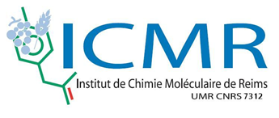
Cinnamon essential oil encapsulation: controlled release for biosourced pesticides
Chloé Maes
S. Bouquillon
M.-L. Fauconnier

Slide 2
1. Context
Lots of pesticides are toxic and pollutant
Need to keep the yields and protect crops
Natural alternatives for synthetic pesticides
Essential oils have lots of bioactivities
but their volatility can be limiting
Improve their perfomance by the encapsulation with controlled release
Bruggen, V., & Jr, J. (2017). Environmental and health effects of the herbicide glyphosate. Science of the Total Environment, 616617, 255–268.

Slide 3
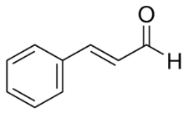
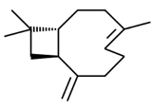
1. Context
Cinnamon EO composition
70% trans-cinnamaldehyde 12% β-caryophyllene 11% Eugenol 8% Linalool
Controlled release
Emulsification
Coarcevation
Spray drying
Complexation
Ionique Gelation
Nanoprecipitation
Active film
Biopesticide release
toxicity
efficiency
0
Time (day)
7
Lins, L.; Dal Maso, S.; Foncoux, B.; Kamili, A.; Laurin, Y.; Genva, M.; Jijakli, M.H.; De Clerck, C.; Fauconnier, M.L.; Deleu, M. Insights into the Relationships Between Herbicide Activities, Molecular Structure and Membrane Interaction of Cinnamon and Citronella Essential Oils Components. Int. J. Mol. Sci. 2019, 20, 4007.

Slide 4
1. CONTEXT
Innovation : use of dendrimers as new encapsulation matrix
- tree structure
- encapsulation behavior
Glycerodendrimer Polypropylenimine 3rd generation
Menot, B., Salmon, L., & Bouquillon, S. (2015). Platinum Nanoparticles Stabilized by Glycerodendrimers: Synthesis and Application to the Hydrogenation of α,β-Unsaturated Ketones under Mild Conditions. EJ of Inorganic Chemistry, 2015(27), 4518–4523.
Balieu, S., Cadiou, C., Martinez, A., Nuzillard, J. M., Oudart, J. B., Maquart, F. X., Chuburu, F., & Bouquillon, S. (2013). Encapsulation of contrast imaging agents by polypropyleneimine-based dendrimers. Journal of Biomedical Materials Research - Part A, 101 A(3), 613–621.

Slide 5
3. Encapsulation
A) Method
+
Vortex
2mM GD-PPI-3 aqueous solution
SH-GC-MS analysis :
Total retention yield
r (%) = ( 1 - $\frac{\sum{A_{D}}}{\sum{A_{0}}})$x 100
A_{D} : area under peaks with dendrimers
A₀ : area under peaks without dendrimers (control)
EO
+
Vortex
$H_{2}$O
EO
Kfoury, M., Auezova, L., Greige-Gerges, H., & Fourmentin, S. (2015). Promising applications of cyclodextrins in food: Improvement of essential oils retention, controlled release and antiradical activity. Carbohydrate Polymers, 131, 264–272.

Slide 6
3. Encapsulations
$A_{D}$ and $A_{0}$ overlay of cinnamon EO encapsulation with GD-PPI-3 solution

Slide 7
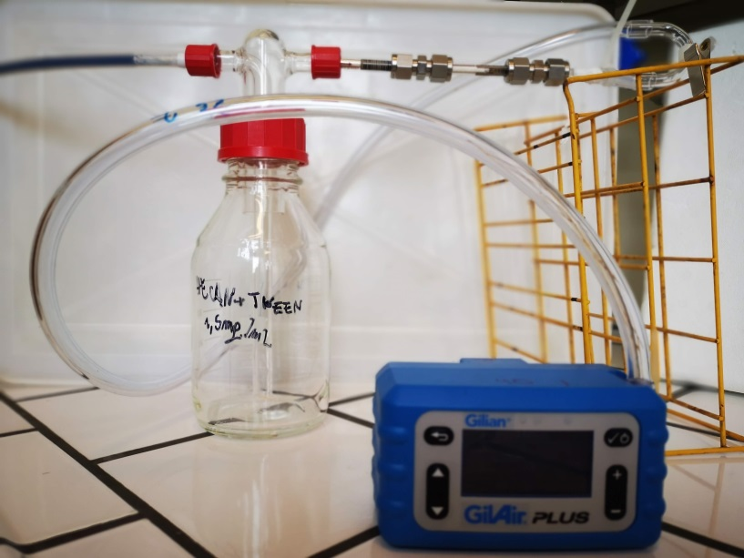
3. Encapsulations
C) Etude du relargage dynamique
Charcoal
Cartridge
Pump
: Air
Samples
Heuskin, S., Lorge, S., Godin, B., Leroy, P., Frère, I., Verheggen, F. J., Haubruge, E., Wathelet, J.-P., Mestdagh, M., Hance, T., & Lognay, G. (2012). Optimisation of a semiochemical slow-release alginate formulation attractive towards Aphidius ervi Haliday parasitoids. Pest Management Science, 68(1), 127–136.

Slide 8
3. Encapsulations
C) Controlled release
Effect of encapsulation on the release of trans-cinnamaldehyde from a solution of cinnamon EO at 500 mg/L at 20 °C: (X) free; (-) encapsulated by 2mM GD-PPI-3; (+) encapsulated by 2mM GD-PPI-3 2mM after 8 weeks of preservation at RT in dark

Slide 9
4. Interactions
A) Microscopy
Volume (%)
Particle size diameter (µm)
GD-PPI-3 2mM / HE Can 5mg/mL

Slide 10
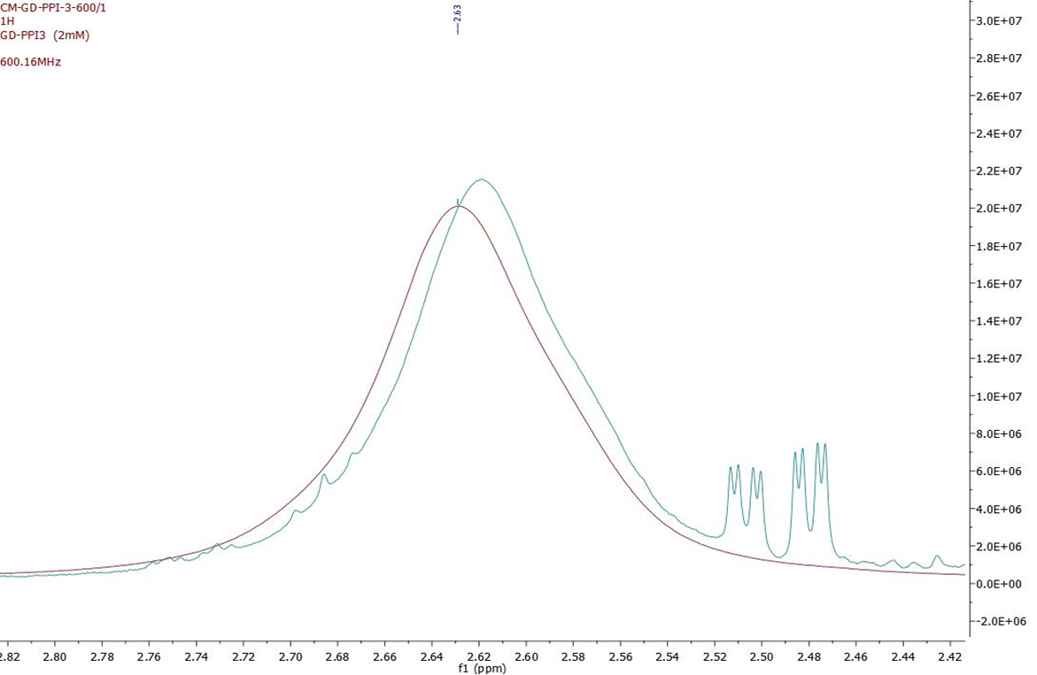
4. Interactions
B) NMRs
Overlay ¹H de GD-PPI-3 alone and GD-PPI-3 encapsulation

Slide 11
4. Interactions
A
B
C
Hypothetical structures of the encapsulation of cinnamon EO (yellow) within GD-PPI-3 (blue): (A) core-shell structure; (B) internal encapsulation; (C) matrix system

Slide 12
5. Biological assays
A) Germination inhibition
Ben Kaab, S., Rebey, I. B., Hanafi, M., Berhal, C., Fauconnier, M. L., De Clerck, C., Ksouri, R., & Jijakli, H. (2019). Rosmarinus officinalis essential oil as an effective antifungal and herbicidal agent. Spanish Journal of Agricultural Research, 17(2), e1006.

Slide 13
5. Biological assays
A) Germination inhibition
Histogram of the rate of germination of A. thaliana seeds treated with formulations preserved for 1 and 8 weeks: control, free CIN EO (500 mg/L), encapsulated CIN EO (500 mg/L) within 2mM GD-PPI-3
Ben Kaab, S., Rebey, I. B., Hanafi, M., Berhal, C., Fauconnier, M. L., De Clerck, C., Ksouri, R., & Jijakli, H. (2019). Rosmarinus officinalis essential oil as an effective antifungal and herbicidal agent. Spanish Journal of Agricultural Research, 17(2), e1006.

Slide 14
6. Conclusion
Development of a new bio-based phytosanitary product in progress:
New encapsulation matrix for bio-based essential oils
Optimized method
Study of the properties of the product in progress (release, effective concentrations, toxicities, uses, etc.)
Fundamental study of the encapsulation in progress (interaction and organization between molecules)
Technology useful for other applications: insecticides, fungicides, ... (depending on the properties of essential oils)

Slide 15
Thanks for your attention
Chloe,maes@uliege,BE

