Slide 1




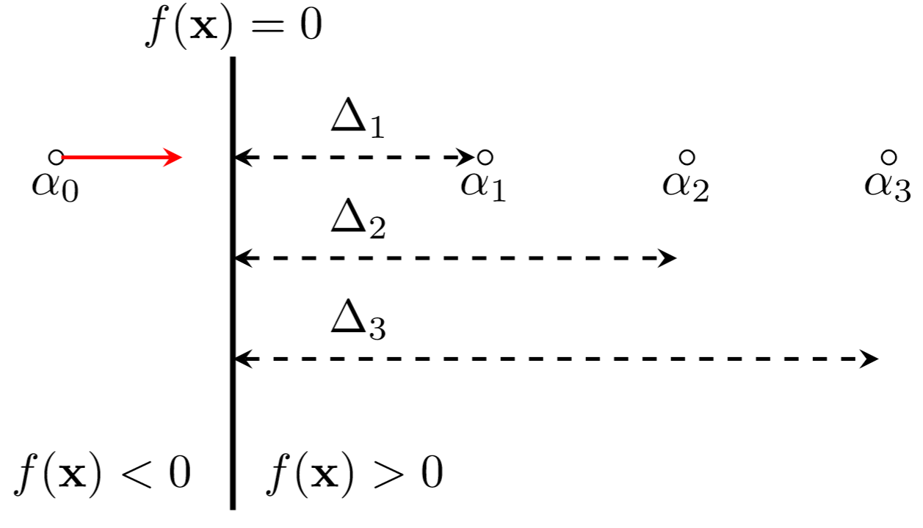
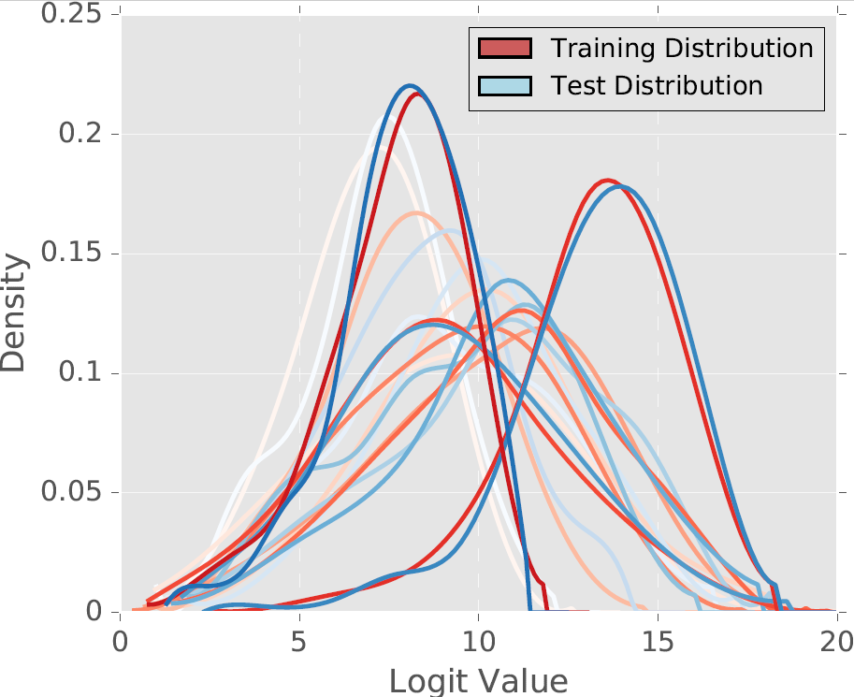
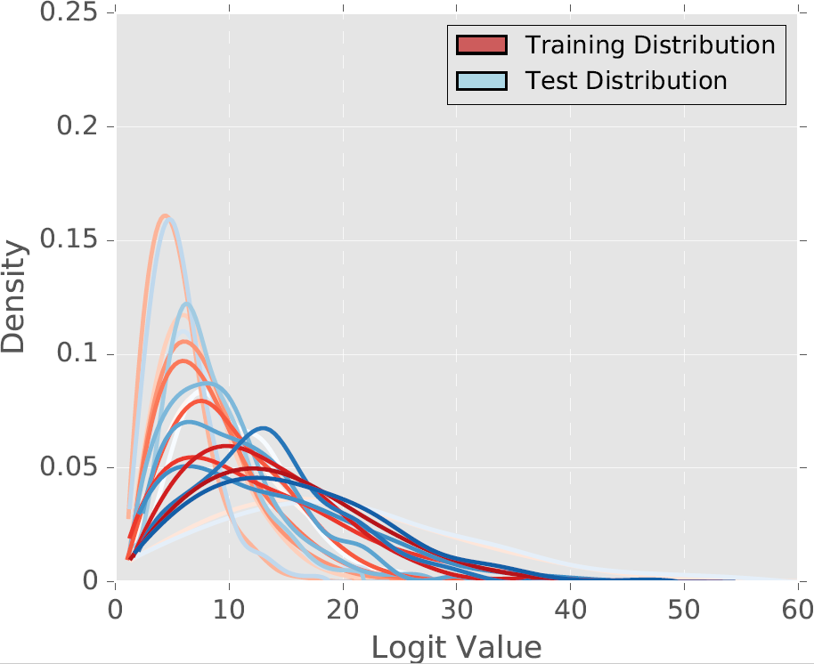
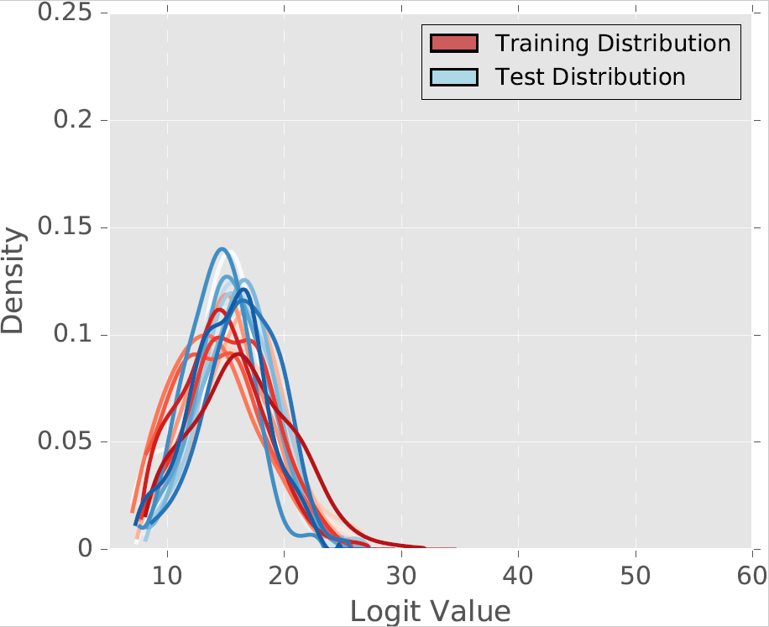
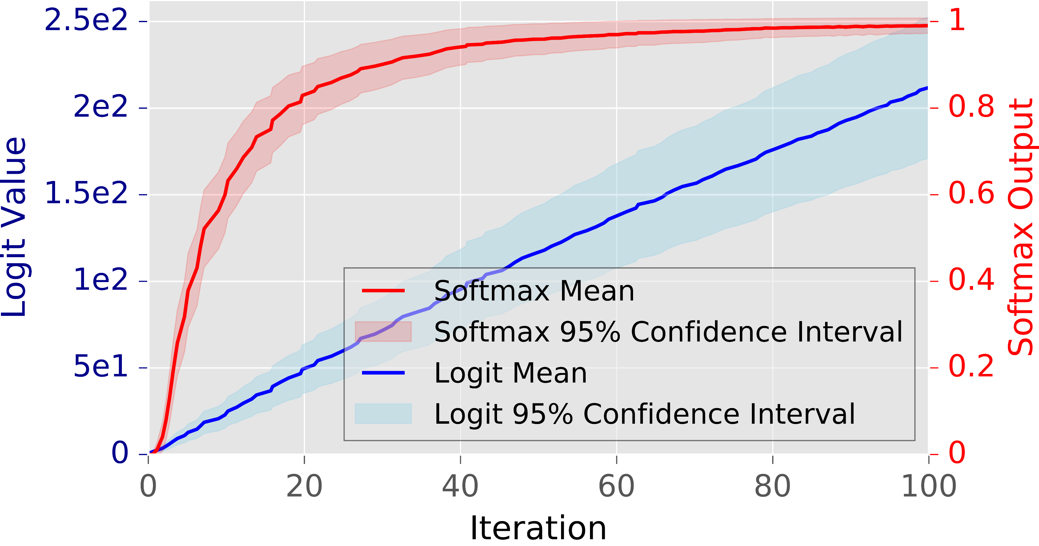
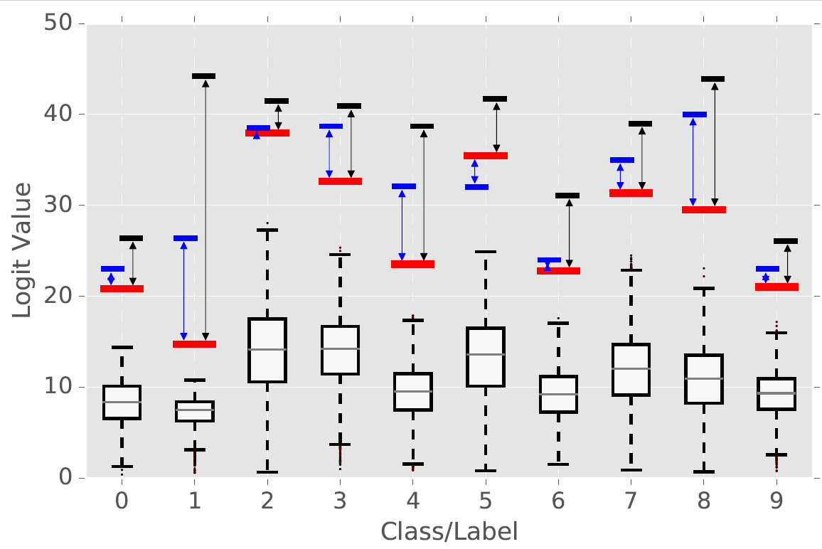
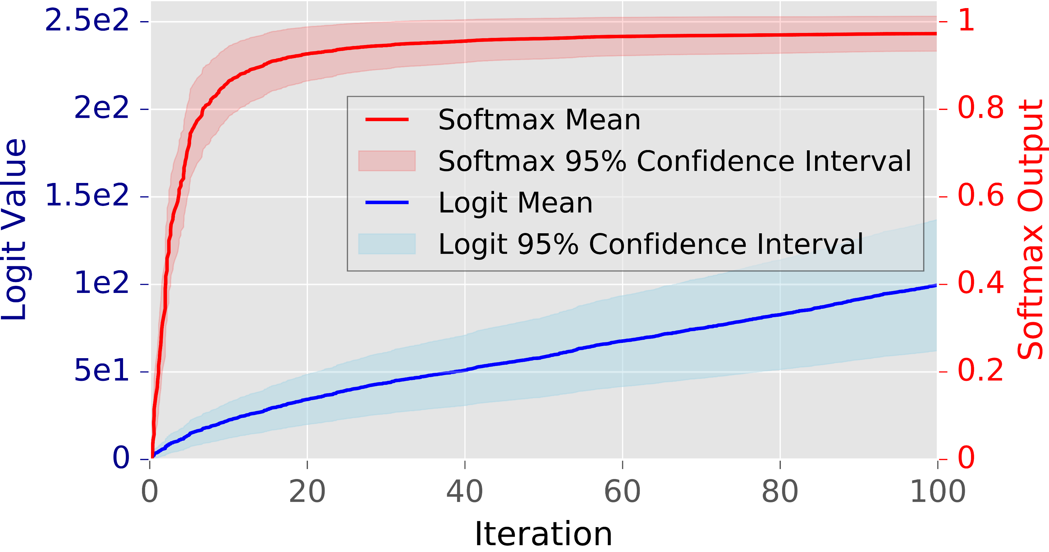
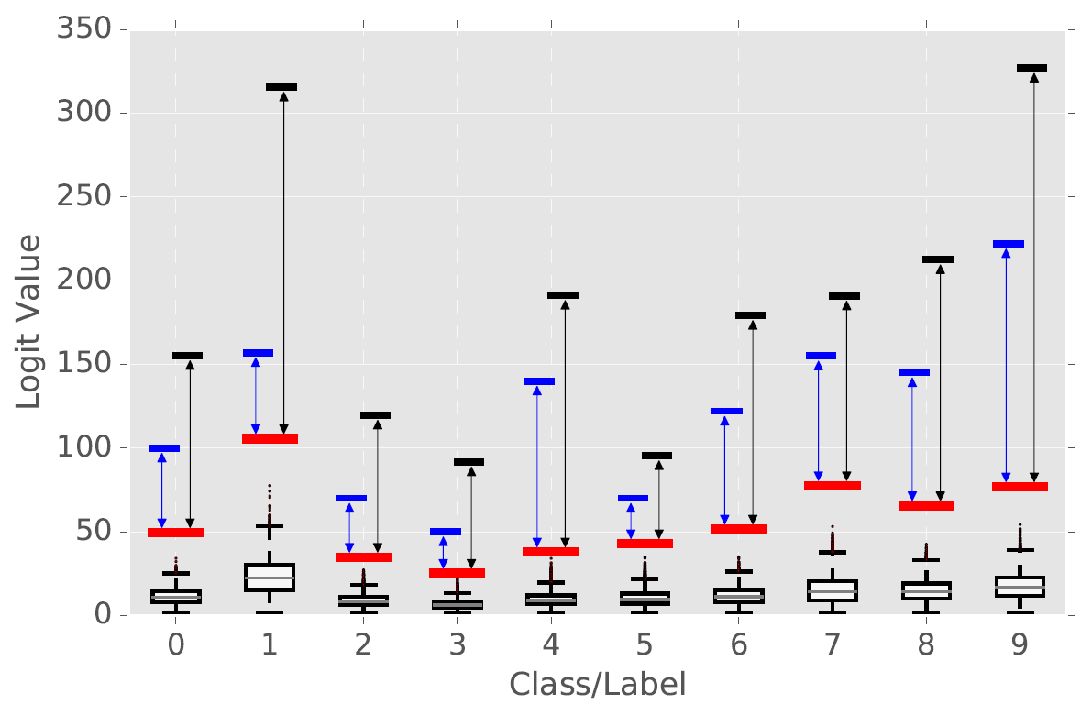
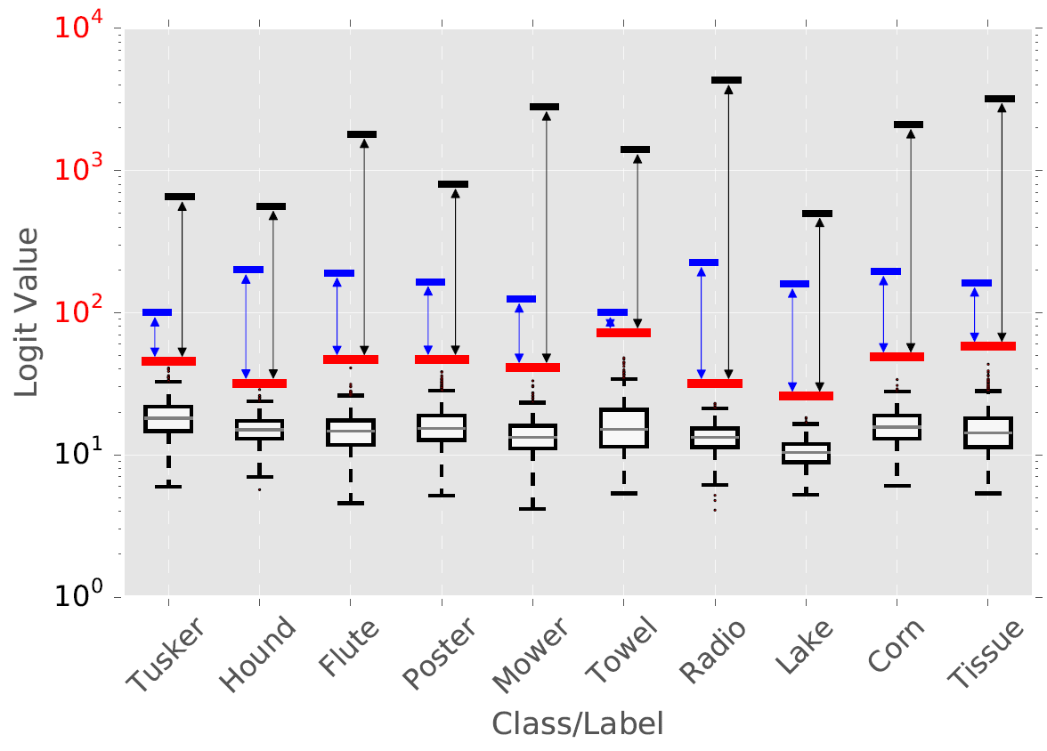


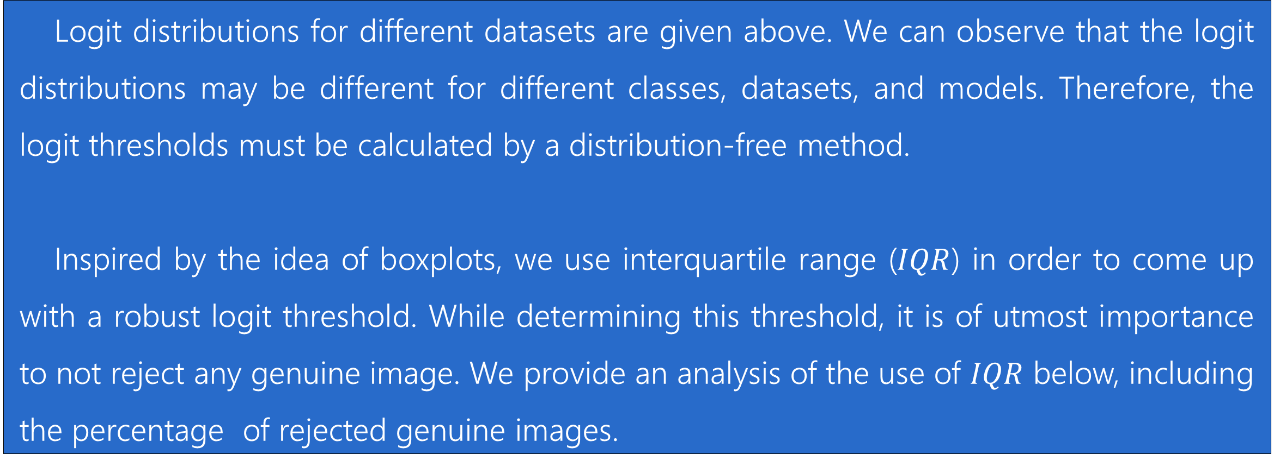
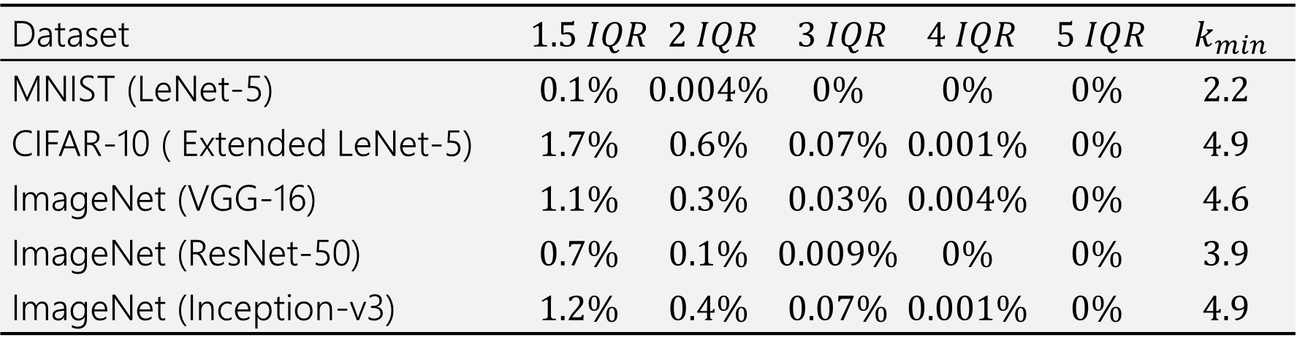
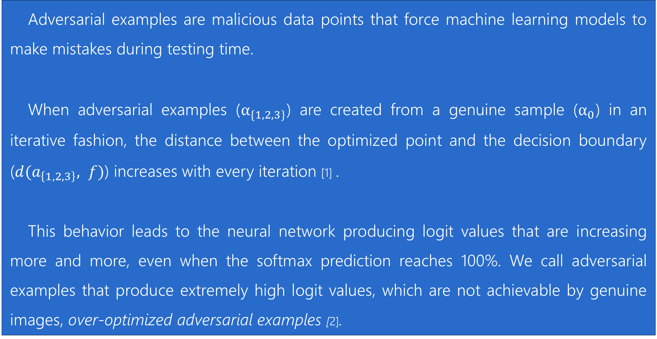
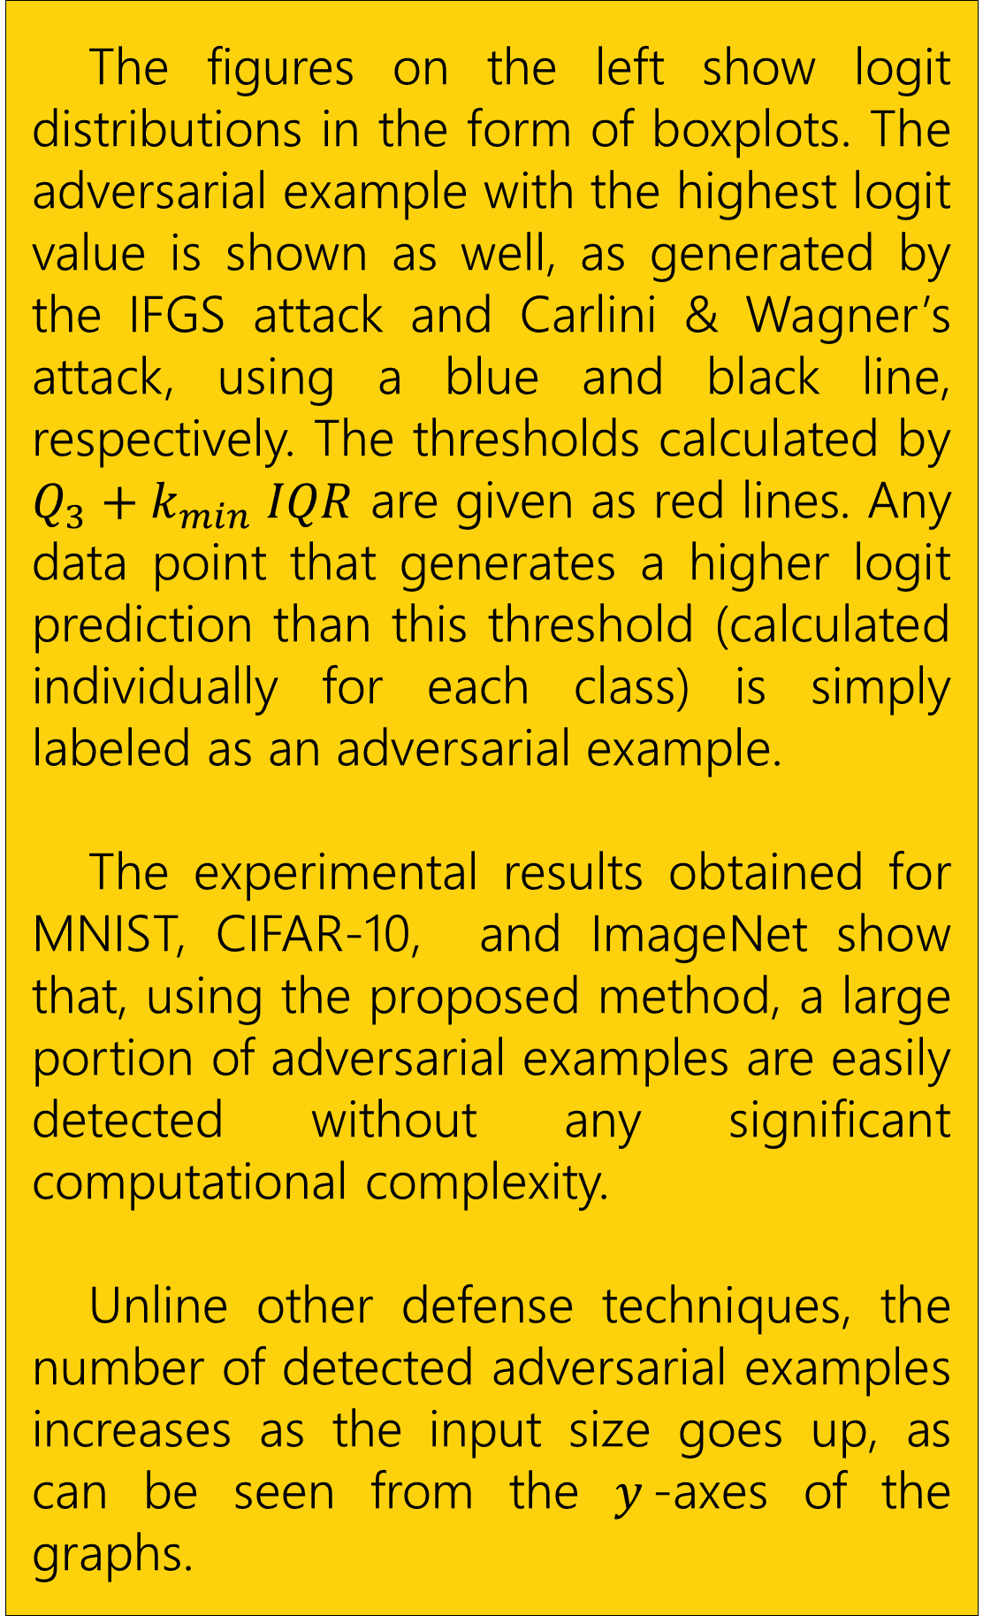
Not All Adversarial Examples Require a Complex Defense: Identifying Over-optimized Adversarial Examples with IQR-based Logit Thresholding
${\text{Utku} \text{Ozbulak}}^{1, 3}$ ${\text{Arnout} \text{Van} \text{Messem}}^{2, 3}$ ${\text{Wesley} \text{De} \text{Neve}}^{1, 3}$
$^{1}$Department of Electronics and Information Systems, Ghent University, Ghent, Belgium
$^{2}$Department of Applied Mathematics, Computer Science and Statistics, Ghent University, Ghent, Belgium
$^{3}$Center for Biotech Data Science, Ghent University Global Campus, Incheon, South Korea
What is an over-optimized adversarial example?
Detecting adversarial examples with logit thresholding
Adversarial examples are malicious data points that force machine learning models to make mistakes during testing time.
When adversarial examples ($α_{\{1,2,3\}}$) are created from a genuine sample ($α_{0}$) in an iterative fashion, the distance between the optimized point and the decision boundary ($d(a_{\left\{1,2,3\right\}}, f)$) increases with every iteration [1] .
This behavior leads to the neural network producing logit values that are increasing more and more, even when the softmax prediction reaches 100%. We call adversarial examples that produce extremely high logit values, which are not achievable by genuine images, over-optimized adversarial examples [2].
MNIST [5]
CIFAR-10 [6]
ImageNet [7]
Logit distributions for different datasets are given above. We can observe that the logit distributions may be different for different classes, datasets, and models. Therefore, the logit thresholds must be calculated by a distribution-free method.
Inspired by the idea of boxplots, we use interquartile range ($IQR$) in order to come up with a robust logit threshold. While determining this threshold, it is of utmost importance to not reject any genuine image. We provide an analysis of the use of $IQR$ below, including the percentage of rejected genuine images.
Dataset | $$1.5 IQR$$ | $$2 IQR$$ | $$3 IQR$$ | $$4 IQR$$ | $$5 IQR$$ | $$k_{min}$$
MNIST (LeNet-5) | $$0.1\%$$ | $$0.004\%$$ | $$0\%$$ | $$0\%$$ | $$0\%$$ | $$2.2$$
CIFAR-10 ( Extended LeNet-5) | $$1.7\%$$ | $$0.6\%$$ | $$0.07\%$$ | $$0.001\%$$ | $$0\%$$ | $$4.9$$
ImageNet (VGG-16) | $$1.1\%$$ | $$0.3\%$$ | $$0.03\%$$ | $$0.004\%$$ | $$0\%$$ | $$4.6$$
ImageNet (ResNet-50) | $$0.7\%$$ | $$0.1\%$$ | $$0.009\%$$ | $$0\%$$ | $$0\%$$ | $$3.9$$
ImageNet (Inception-v3) | $$1.2\%$$ | $$0.4\%$$ | $$0.07\%$$ | $$0.001\%$$ | $$0\%$$ | $$4.9$$
The graphs to the right show the Logit-Softmax relation for adversarial examples generated by (top) the Iterative Fast Gradient Sign attack and (bottom) Carlini & Wagner’s Attack [3,4].
The values shown in these graphs are obtained from 1000 adversarial optimizations for ImageNet samples [7].
The figures on the left show logit distributions in the form of boxplots. The adversarial example with the highest logit value is shown as well, as generated by the IFGS attack and Carlini & Wagner’s attack, using a blue and black line, respectively. The thresholds calculated by ${Q_{3}+k}_{min} IQR$ are given as red lines. Any data point that generates a higher logit prediction than this threshold (calculated individually for each class) is simply labeled as an adversarial example.
The experimental results obtained for MNIST, CIFAR-10, and ImageNet show that, using the proposed method, a large portion of adversarial examples are easily detected without any significant computational complexity.
Unline other defense techniques, the number of detected adversarial examples increases as the input size goes up, as can be seen from the $y$-axes of the graphs.
MNIST [5]
Based on the observations made above, we experiment with the idea of using logits as a first line of defense against adversarial examples that produce substantially high logit values. This first line of defense rejects any data point that produces higher logit value than a specified threshold value.
CIFAR-10 [6]
[1] M. Seyed-Mohsen et al., DeepFool: A Simple and Accurate Method to Fool Deep Neural Networks.
[2] U. Ozbulak et al., How the Softmax Output is Misleading for Evaluating the Strength of Adversarial Examples.
[3] A. Kurakin et al., Adversarial Examples in the Physical World.
[4] N. Carlini et al., Towards Evaluating the Robustness of Neural Networks.
[5] Y. LeCun et al., Gradient-based Learning Applied to Document Recognition
[6] A. Krizhevsky et al., Learning Multiple Layers of Features from Tiny Images
[7] O. Russakovsky et al., ImageNet Large Scale Visual Recognition Challenge
utku.ozbulak@ugent.be
github.com/utkuozbulak
ImageNet [7]
Ghent University Global Campus, Korea

