Slide 1
Genetic parameters for milk urea concentration in Dual-Purpose Belgian Blue cattle
Atashi H.^{1,2}, Bastin C.³, Chen Y.¹, Vanderick S.¹, Wilmot H.^{1,4} and Gengler N.¹
¹University of Liège – Gembloux Agro-Bio Tech (ULiège-GxABT), Belgium
²Shiraz University, Shiraz, Iran
³Walloon Breeders Association (awé), Belgium
⁴National Fund for Scientific Research (FNRS), Belgium

Slide 2
Introduction

Slide 3
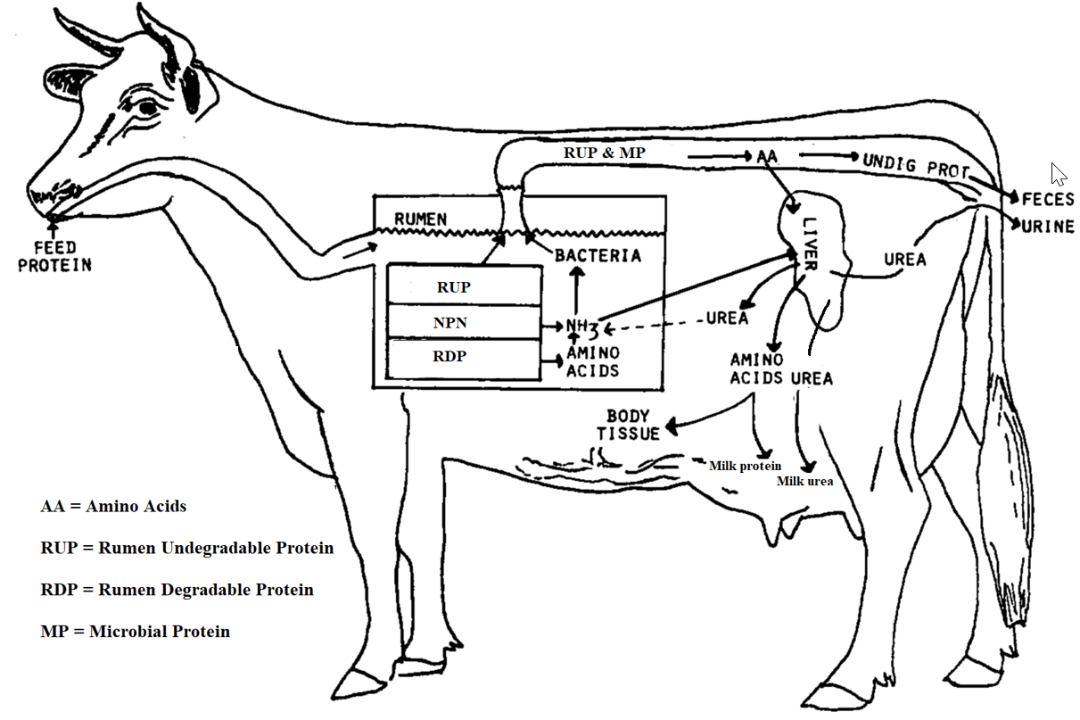
Where does milk urea come from?
Degradation of RDP results in ammonia (main source of N for MP)
When ammonia is high or the bacteria can not capture it, the ammonia is absorbed/transferred into the bloodstream
Liver converts toxic ammonia to urea (blood urea nitrogen (BUN))
BUN is recycled to the rumen via saliva, secreted in milk, or excreted through urine

Slide 4
Milk urea as a management tool?
MU concentration
is a common tool for evaluation of the N efficiency, diet composition and feeding disorders (e.g., high levels of MU indicate overfeeding crude protein and high rumen N balance relative to microbial demand)
the possibility of using MU predictions in management perspectives in Holstein cows was described previously (Bastin et al., 2009)

Slide 5
Interest in milk urea modelling ?
Milk urea (MU) is
a normal non-protein nitrogen (NPN) component in milk
very easy to record ➔ standard mid-infrared (MIR) based prediction
included as a standard part in most milk recording systems
correlated with milk yield and milk compositions as well as reproductive performance, longevity, and health in dairy cows
linked to technological properties of milk

Slide 6
Genetic selection to decrease N excretion ?
Reducing N excretion by dairy cattle is desirable due to global concerns about the agricultural contribution to environmental pollution
Nitrogen is released into the environment through the feces and urine as undigested N fractions and as the end products of N metabolism
Urine urea nitrogen is difficult to measure; but is correlated with milk urea (MU) nitrogen

Slide 7
Dual purpose Belgian Blue Breed
Belgian Blue breed (BBB) originated in central and upper Belgium in the 19th century, from crossing local Belgian dairy cattle with Shorthorns
BBB now composed of two strains:
Beef Belgian Blue
Dual-Purpose Belgian Blue (DPBB)
DPBB cattle has been only moderately selected for milk production
But has a high local importance and its milk is associated to specific quality (e.g., higher unsaturated / saturated fatty acid ratio)

Slide 8
Aims of the study
The major aims of this study were using data on DPBB cows
to estimate genetic parameters for MU and its genetic correlation with milk yield traits using a random regression (RR) test‐day models (TDM)
to evaluate the possibility of genetic selection to decrease MU which is of great importance for decreasing N excretion and increasing animal health and production
A secondary aim is the preparation of MU based decision support tools in DPBB farms

Slide 9
Data and models
Edited data: 29,693 test-day records of 4,437 lactations (1st, 2nd) on 2,498 animals
Collected from 2014 to 2020 distributed in 49 herds in the Walloon Region of Belgium:
Milk yield (MY), fat yield (FY), protein yield (PY)
Fat percentage (FP), protein percentage (PP)
Milk urea (MU)
MT multiple-lactation random regression (RR) test-day ssGBLUP animal model
First and second lactation with 4 traits:
MY, FY, PY and MU
MY, FP, PP and MU
Genotypes: 1,699 animals (639 males and 1060 females)
Usable SNP: 28,427 located on 29 autosomal chromosomes

Slide 10
Results and Discussion

Slide 11
Descriptive statistics
 | Number of records | Mean (mg/dL ) | SD
Parity 1 | 16,935 | 22.9 | 10.07
Parity 2 | 12,758 | 22.3 | 10.07

Slide 12
Factors affecting MU concentration
Herd, calving year, calving season, age at the first calving, lactation stage, and parity
The mean MU in the first parity was a bit higher than that in the second parity
De Roos and De Jong (2006)
Rzewuska and Strabel (2013)

Slide 13
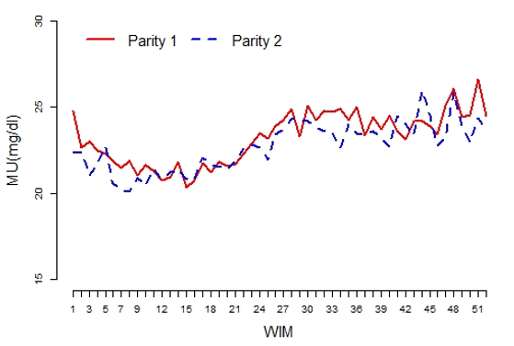
Milk urea over the lactation
The MU was high at the beginning of lactation, decreased by increasing weeks in milk (WIM), then increased by increasing WIM to the end of the lactation.

Slide 14
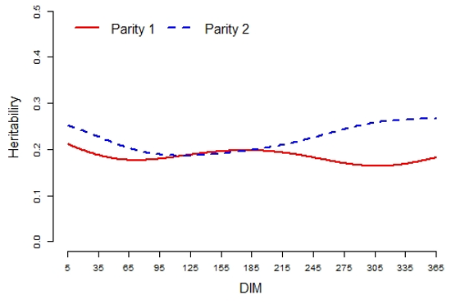
Heritability of MU
 | Mean | Range
Parity 1 | 0.18 | 0.16 to 0.21
Parity 2 | 0.22 | 0.19 to 0.27
Literature:
0.44 to 0.59 in Canadian Holstein (Wood et al., 2003)
0.17 in Italian Brown Swiss (Samore et al., 2007)
0.22 in Polish Holstein (Rzewuska and Strabel 2013)

Slide 15
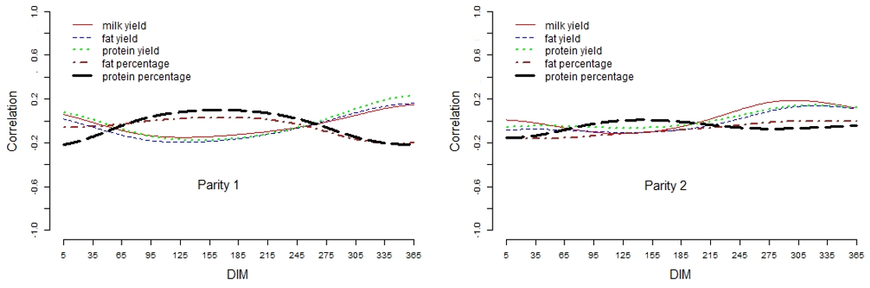
Genetic correlations with milk traits
 | MY | FY | PY | FP | PP
Parity 1 | -0.05 | -0.07 | -0.03 | -0.05 | -0.03
Parity 2 | 0.02 | -0.02 | -0.01 | -0.08 | -0.05

Slide 16
Conclusion
Moderate heritability found for MU
Weak genetic correlations found with milk yield traits
Indicates that selection on MU is possible with limited effects on lactation performance
However, relationships between MU and other important traits such as longevity, metabolic diseases, and fertility are still needed
first results (under press) obtained in the Walloon Holstein population showing a potential link between lower MU and lower fertility and longevity

Slide 17
Implications and Perspectives
MU available on a large scale ⬅ MIR prediction
Heritabilities and genetic correlations validate breeding opportunities
Use of adapted models beyond breeding
DPBB large scale genotypes ➔ potential for SNP-assisted MU prediction
Perspectives beyond breeding
use of MU in management perspectives to monitor:
Feeding
N efficiency
Welfare of cows
Product quality

Slide 18
















Acknowledgements
Support throughout the Futurospectre and partnerships
CECI Consortium for computational resources
Service Public de Wallonie (SPW, Belgium) (in particular the WALLeSmart project)
National Fund for Scientific Research
Support by different European Projects
And thanks to our many other national and international partners!
The content of the presentation reflects only the view of the authors; the Community is not liable for any use that may be made of the information contained in this presentation.

Slide 19
Thank you
Hadi.atashi@uliege.be

