Slide 1



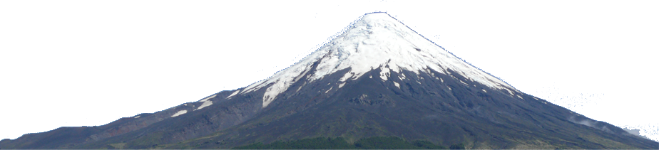


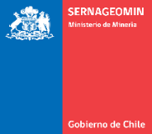

Insights on mantle melting below Osorno Volcano (Southern Volcanic Zone, Chile)
September 2021- Geologica Belgica - Tervuren
Tonin Bechon (ULG), Melvyn Billon (ULG), Olivier Namur (KUL), Olivier Bolle (ULG), Paul Fugmann (ULG), Jacqueline Vander Auwera (ULG)
Notes:
Provided presentation time is 15 minutes + 5 minutes discussion.
Presentation slides must be either in PowerPoint software (*.ppt and *.pptx) or in PDF format.
A laptop (no Mac) will be available in each rooms as well as a beamer; it will not be possible to use your own computer.
Authors are invited to send their presentation the day before. If this is not possible, you are kindly asked to upload it directly in the respective lecture room 30 minutes prior to the time block of the session.
Slides are in English language
Assistance will be provided in each room

Slide 2
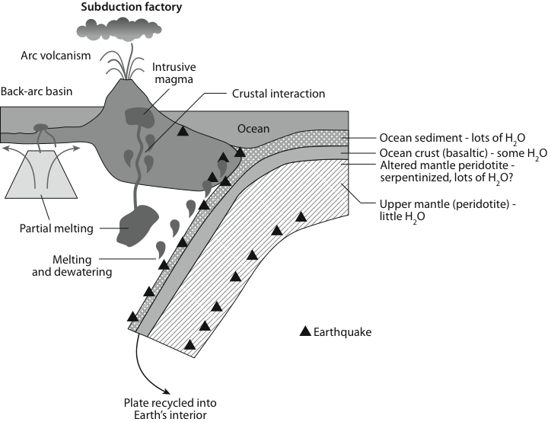
To better understand arc magmatism we need to Constrain:
Langmuir et Broecker, 2012 ↓
magma genesis and conditions of mantle melting processes
magma transport
storage
differentiation processes at each step
Notes:
Present main problems in arc settings.
Saying that we will focus on mantle conditions and magma genesis here which is difficult to access.

Slide 3
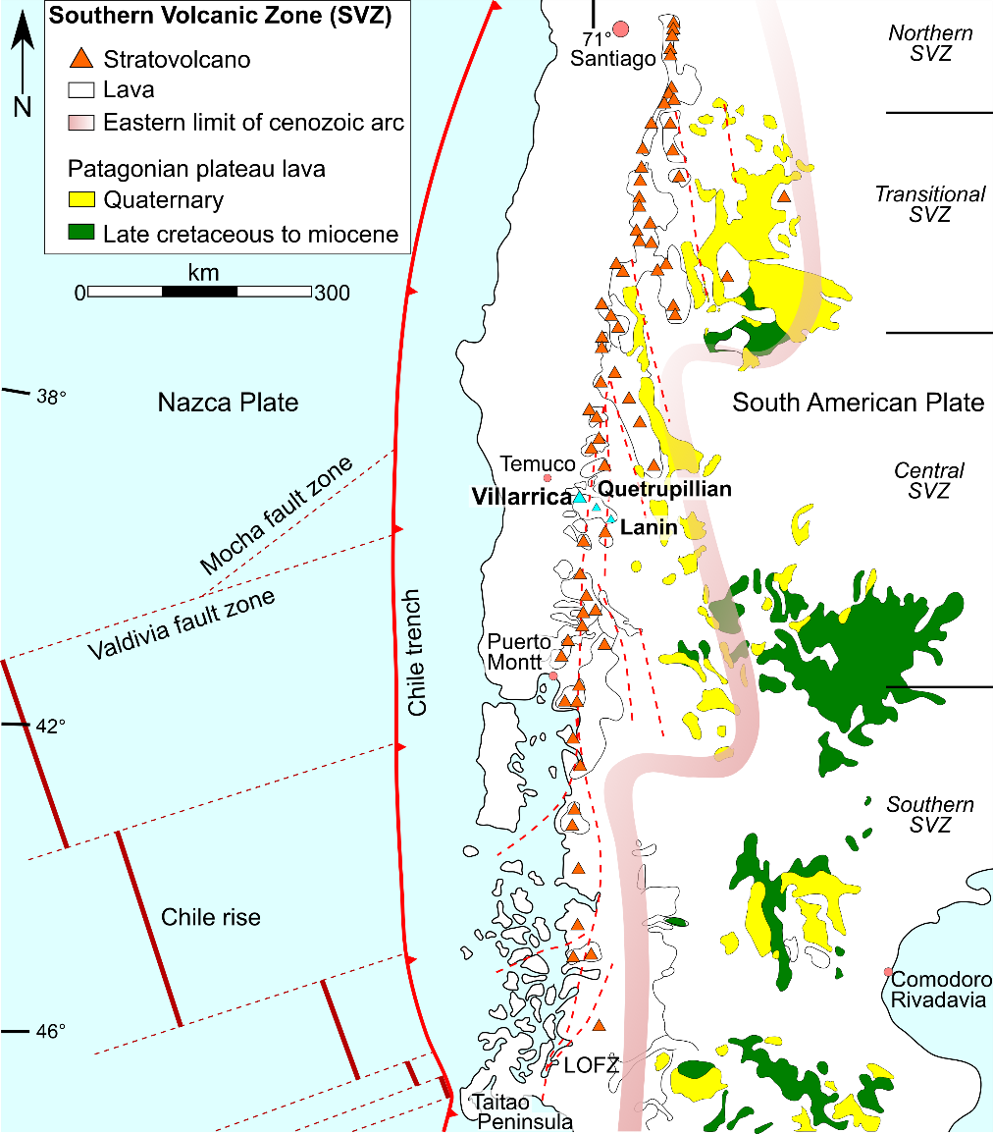
Southern Volcanic Zone (chile)
Continental crust thinning from north (50km) to south (30km) (Tassara & Echaurren, 2012)
Presence of the Linquiñe-Ofqui Fault Zone (LOFZ) a major transcrustal fault zone in the South
Near-primary magmas have been reported in the past (Moreno et al., 2010; Mc Gee et al., 2019; Tassara et al., 2020)
Modified after Stern et al., 2007 ↑
Notes:
Present the SVZ in chile. The thinning crust allow to study the effect of the crust thickness on arc magmatism. Conditions (LOFZ, Thin crust, PM) for studying the mantle source are gathered in the CSVZ-SSVZ. Osorno will be the target.

Slide 4
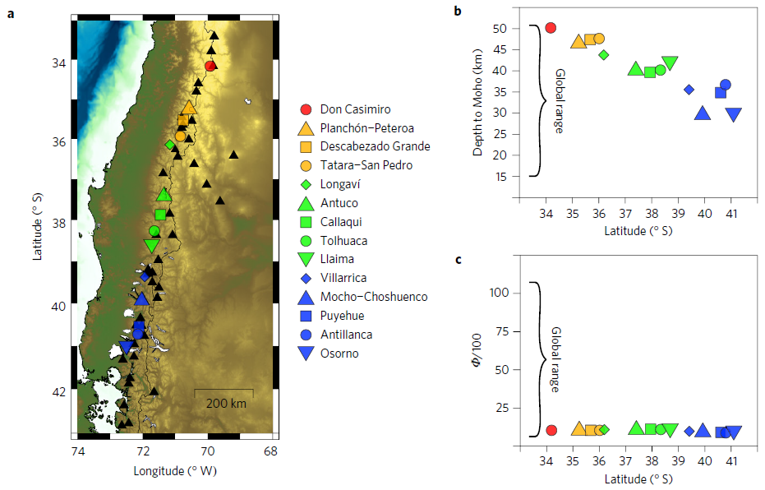
Southern Volcanic Zone (chile)
Turner et al., 2016 ↓
Continental crust thinning from north (50km) to south (30km) (Tassara & Echaurren, 2012)
Presence of the Linquiñe-Ofqui Fault Zone (LOFZ) a major transcrustal fault zone in the South
Near-primary magmas have been reported in the past (Moreno et al., 2010; Mc Gee et al., 2019; Tassara et al., 2020)
Modified after Stern et al., 2007 ↑
Notes:
Present the SVZ in chile. The thinning crust allow to study the effect of the crust thickness on arc magmatism. Conditions (LOFZ, Thin crust, PM) for studying the mantle source are gathered in the CSVZ-SSVZ. Osorno will be the target.

Slide 5
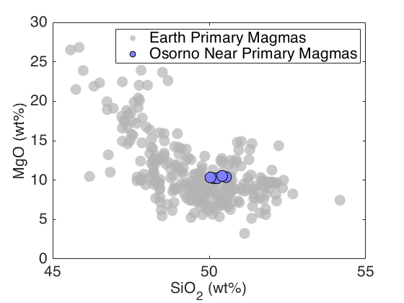
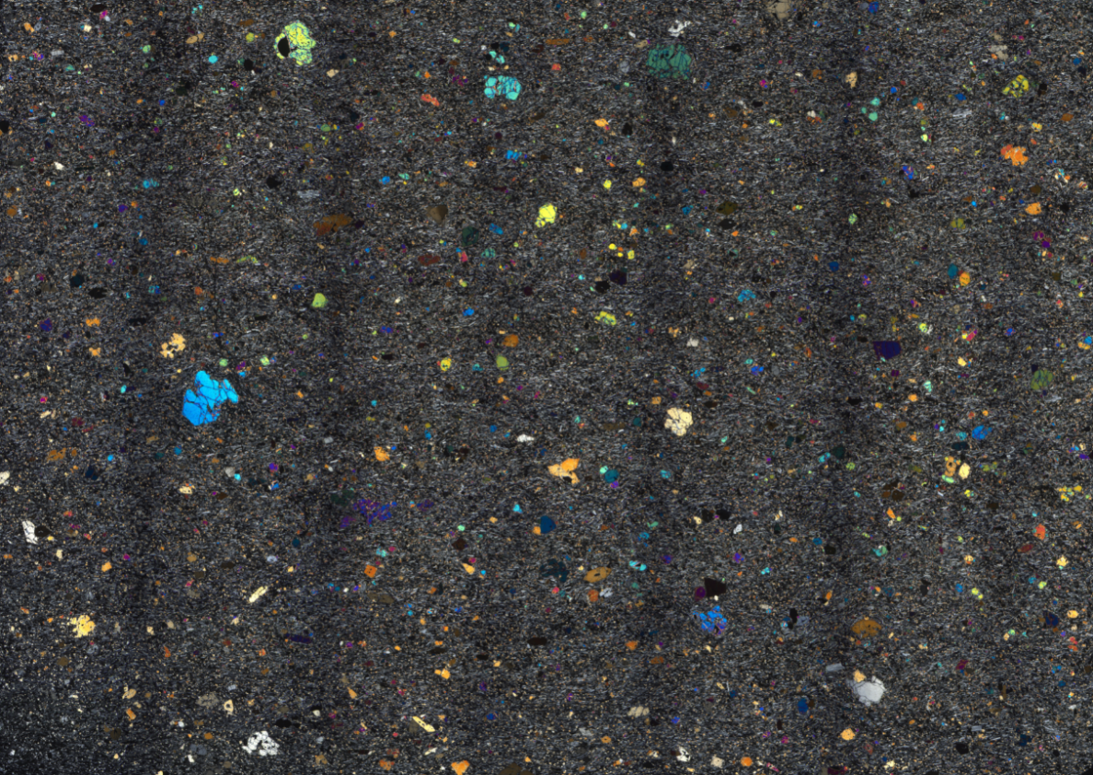
Osorno (near-)Primary magmas
Data in grey Ganne et Feng, 2017 ↓
OS83 thin section scan ↓
~3cm
Primary magma (PM) = magma in equilibrium with mantle source ; Near-PM = PM that ascended directly to the surface while undergoing through little fractionation
Notes:
PM compos, no accumulation because no clusters and chromites are present in the matrix or in olivines

Slide 6
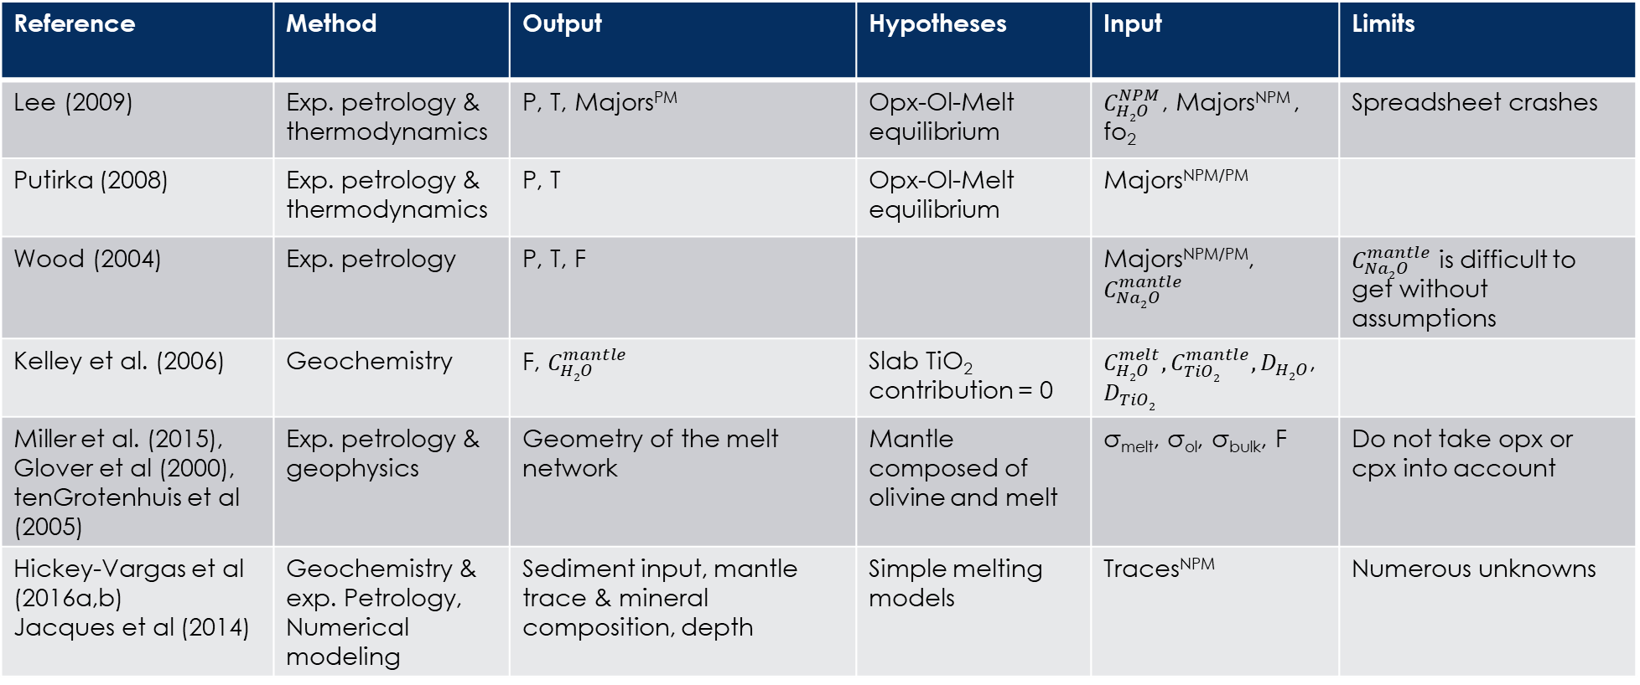
Method
Reference | Method | Output | Hypotheses | Input | Limits
Lee (2009) | Exp. petrology & thermodynamics | P, T, Majors^{PM} | Opx-Ol-Melt equilibrium | $C_{H2O}^{NPM}$, Majors^{NPM} , fo₂ | Spreadsheet crashes
Putirka (2008) | Exp. petrology & thermodynamics | P, T | Opx-Ol-Melt equilibrium | Majors^{NPM/PM}
Wood (2004) | Exp. petrology | P, T, F |  | Majors^{NPM/PM}, $C_{Na2O}^{mantle}$ | $C_{Na2O}^{mantle}$ is difficult to get without assumptions
Kelley et al. (2006) | Geochemistry | F, $C_{H2O}^{mantle}$ | Slab TiO₂ contribution = 0 | $C_{H2O}^{melt}, C_{TiO2}^{mantle}, D_{H2O}$, $D_{TiO2}$
Miller et al. (2015), Glover et al (2000), tenGrotenhuis et al (2005) | Exp. petrology & geophysics | Geometry of the melt network | Mantle composed of olivine and melt | σ_{melt}, σ_{ol}, σ_{bulk}, F | Do not take opx or cpx into account
Hickey-Vargas et al (2016a,b) Jacques et al (2014) | Geochemistry & exp. Petrology, Numerical modeling | Sediment input, mantle trace & mineral composition, depth | Simple melting models | Traces^{NPM} | Numerous unknowns
T= Temperature; P= Pressure; F= Melting rate; $C_{Y}^{X}=concentration of Y in phase X$; PM= primary magma; NPM= near-PM magma; Majors = major elements; σ_{Z}$=electrical con$ductivity of phase Z; D_{i} = melt/mantle bulk partition coefficient of element i
Notes:
Several methods used. Present possible outputs expected + hypotheses and limits.

Slide 7
Method
Langmuir et Broecker, 2012 ↓
Geothermobarometric model: P, T, F (Lee et al, 2009; Putirka 2008, Wood 2004)
Trace element geochemistry: source composition (sediment, fluids, mantle inputs), F, Mantle H₂O (Kelley et al., 2006; Hickey Vargas et al., 2016)
Electrical conductivity: Geometry of melt with mantle rocks (Miller et al., 2015; Glover et al., 2000; tenGrotenhuis et al., 2005)
Notes:
Several methods used. Present possible outputs expected + hypotheses and limits.

Slide 8
Results/Discussion
Study case : OSORNO
Notes:
Show results

Slide 9
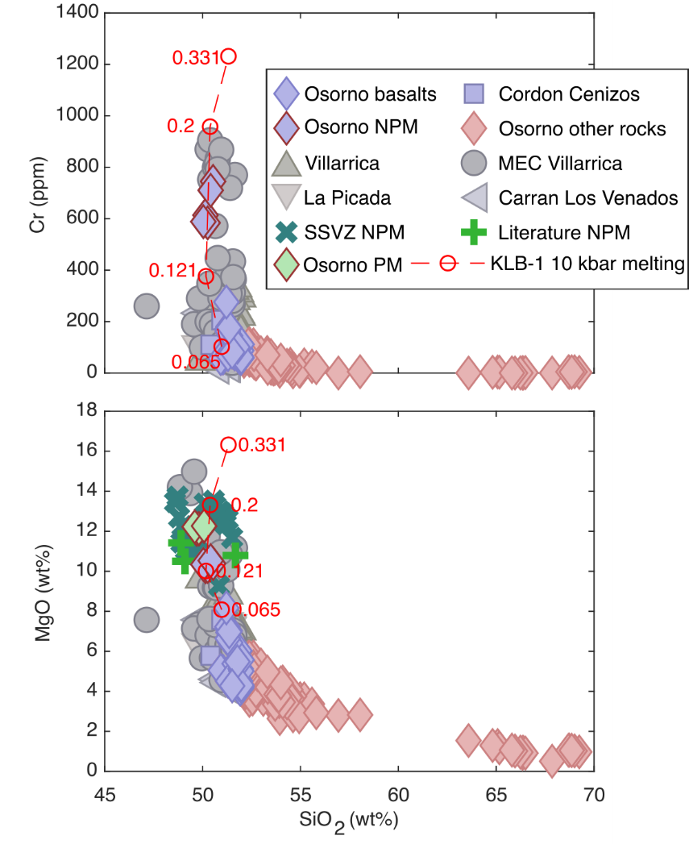
Calculated Primary magmas (PM)
Equations from Lee et al (2009)
+5% olivine in Near-PM (NPM) to be in equilibrium with the mantle (PM)
MgO between 12.04-12.29 wt% for PMs
Anhydrous experimental data of Hirose and Kushiro (1993) (KLB-1) predicts a 10-20% melting rate of a peridotite (lherzolite)
Modified after Bechon et al., (submitted) ←
Notes:
Present the Primary magmas from Osorno in the SVZ setting. Present F from Hirose and Kushiro

Slide 10
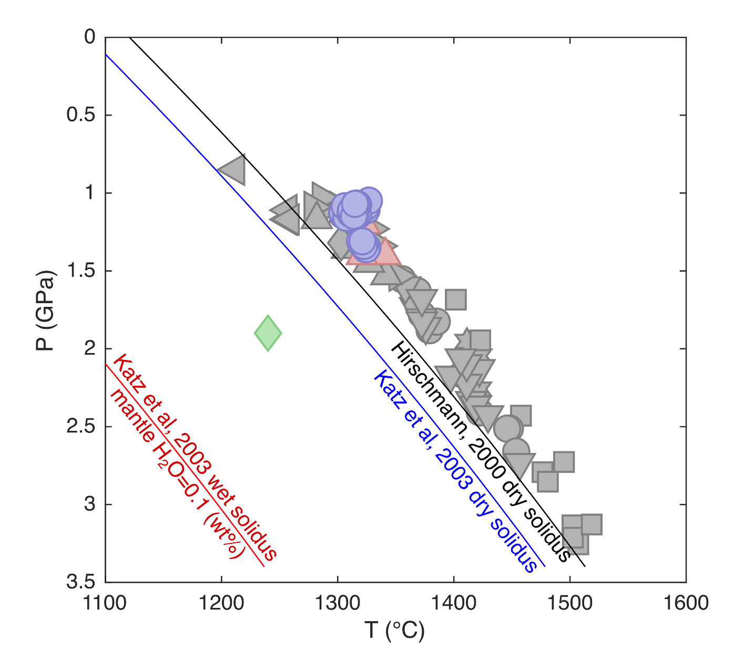
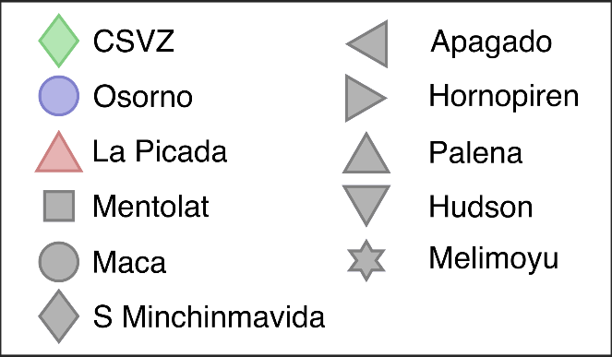
Pressure, Temperature
Modified after Bechon et al., submitted ↓
Equations from Lee et al. (2009) and Putirka (2008) give a last mantle equilibrium at :
P = 10.5 - 13.5 kbar (34-43 km)
T = 1304 - 1325 °C
Notes:
Show that results are beyond anhydrous solidi implying likely adiabatic melting.

Slide 11
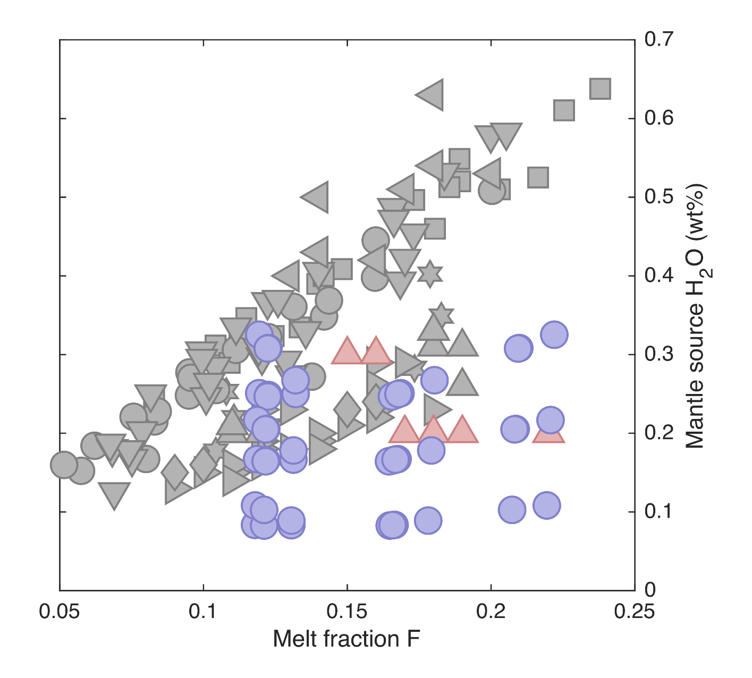
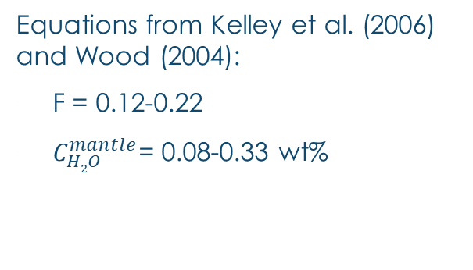
Melt fraction (F) & mantle H2O
Modified after Bechon et al., submitted ↓
Equations from Kelley et al. (2006) and Wood (2004):
F = 0.12-0.22
$C_{H2O}^{mantle}$= 0.08-0.33 wt%
Notes:
Slightly hydrated mantle and F: 12-22 wt%

Slide 12
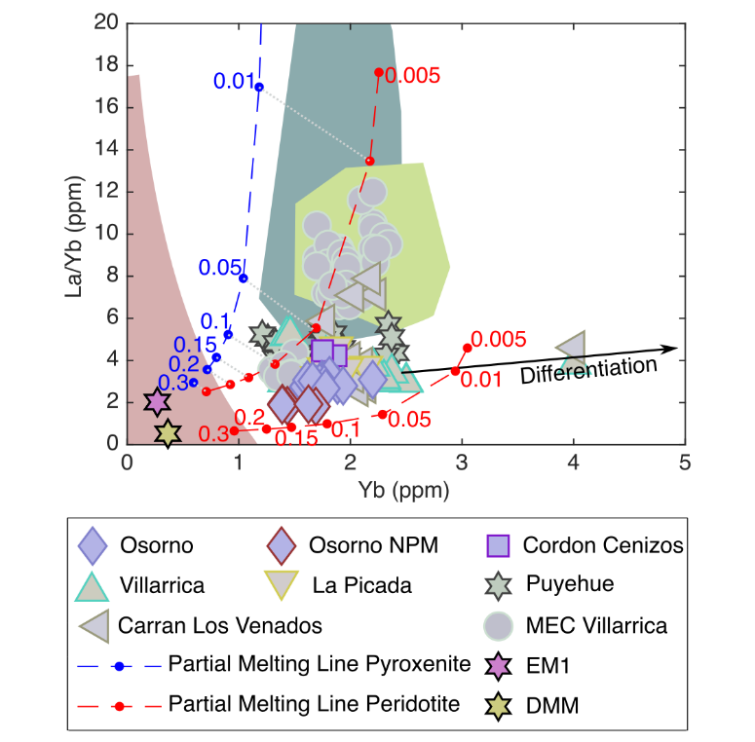
MANTLE Source of CSVZ basalts
Bechon et al. (submitted) ↓, BA= back arc
BA mantle xenolith
BA basalt
Trench sediment
Below CSVZ, 2 sources were identified by Turner et al (2017):
  EM1 (enriched mantle)
  DMM (depleted mantle)
Modal in equilibrium batch melting equations were used Hickey Vargas et al. (2016)
Osorno is the product of melting from the most depleted end member.
Notes:
2 sources :
-La/Yb vs Yb of basalts from CSVZ
-EM & DMM
-modal batch melting of a depleted peridotite
-modal batch melting of an enriched peridotite or pyroxenite
-Osorno NPM are consistent with 10-20 wt% DMM melting

Slide 13
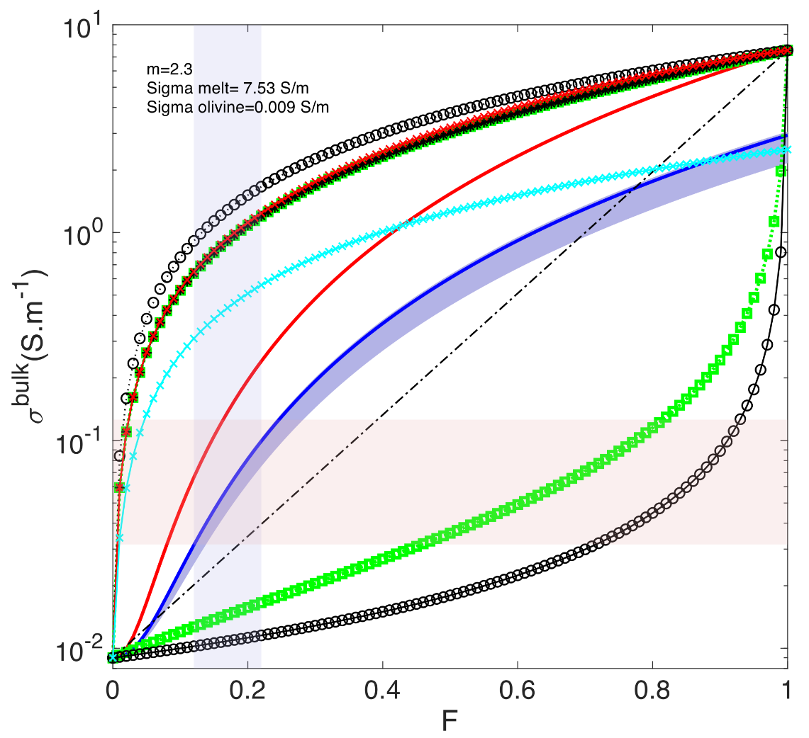
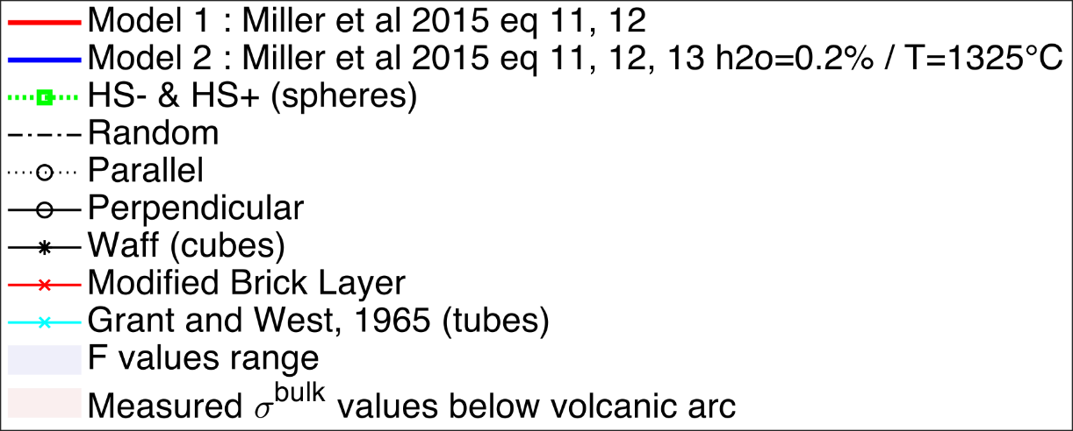
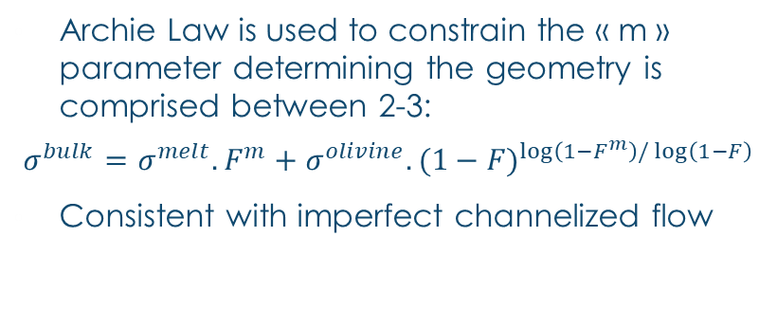
Melting geometry and electrical conductivity
m≈1.2
m≈1.2
m≤1
Archie Law is used to constrain the « m » parameter determining the geometry is comprised between 2-3:
$$σ^{bulk}=σ^{melt}.F^{m}+σ^{olivine}.{(1−F)}^{\log\left(1−F^{m}\right)/\log\left(1−F\right)}$$
Consistent with imperfect channelized flow
m≈1.6
Models from Miller et al. 2015, tenGrotenhuis et al. 2005, Glover at al. (2000) ↓
m≈3.5
σ^{bulk} and F respectively from Brasse 2011 and Bechon et al (submitted)
m≈4-5
Notes:
-Geophysics measure electrical conductivity which depends on melt fraction (F) and melting geometry.
-The melt (orange) is a better current conveyor than olivine (green) and the geometry of melting will strongly influence the measured output.
-Present rapidly the various models.
-We don’t know the real geometry but Archie Law estimate the geometry through the “m” parameter. Show m for models.
-Previously estimated F, measured resistivity below Villarrica (no data for Osorno).
- The intersection represent the targeted area and can be achieved using m=2-3 which implies +/- a weakly channelized flow.

Slide 14
Conclusion
Study case : OSORNO
Notes:
Geochemistry can provide Data (XXX) in specific location (primary magmas necessary) but is limited for other kind of informations or precisions. Better constraining mantle source melting requires an interdisciplinary study

Slide 15
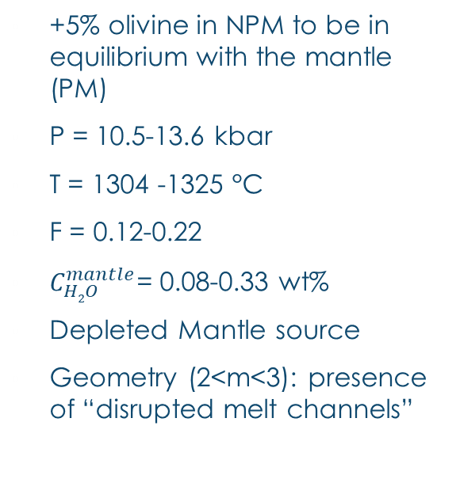
Overview
Upper crust
Continental Crust
Shallow
Crustal
storage
2-3 kbar (6-8 km),
Bechon et al
(submitted)
Lower crust
+5% olivine in NPM to be in equilibrium with the mantle (PM)
P = 10.5-13.6 kbar
T = 1304 -1325 °C
F = 0.12-0.22
$C_{H2O}^{mantle}$= 0.08-0.33 wt%
Depleted Mantle source
Geometry (2<m<3): presence of “disrupted melt channels”
Possible adiabatic melting
10.5-13.5 kbar (34-43 km)
Last Mantle Equilibrium
Lithos. Mantle
Flux melting
Mantle Wedge
19 kbar (59 km),
Jacques et al (2014)
Asthen. Mantle
H2O flux
Slab
Notes:
Sum up

Slide 16
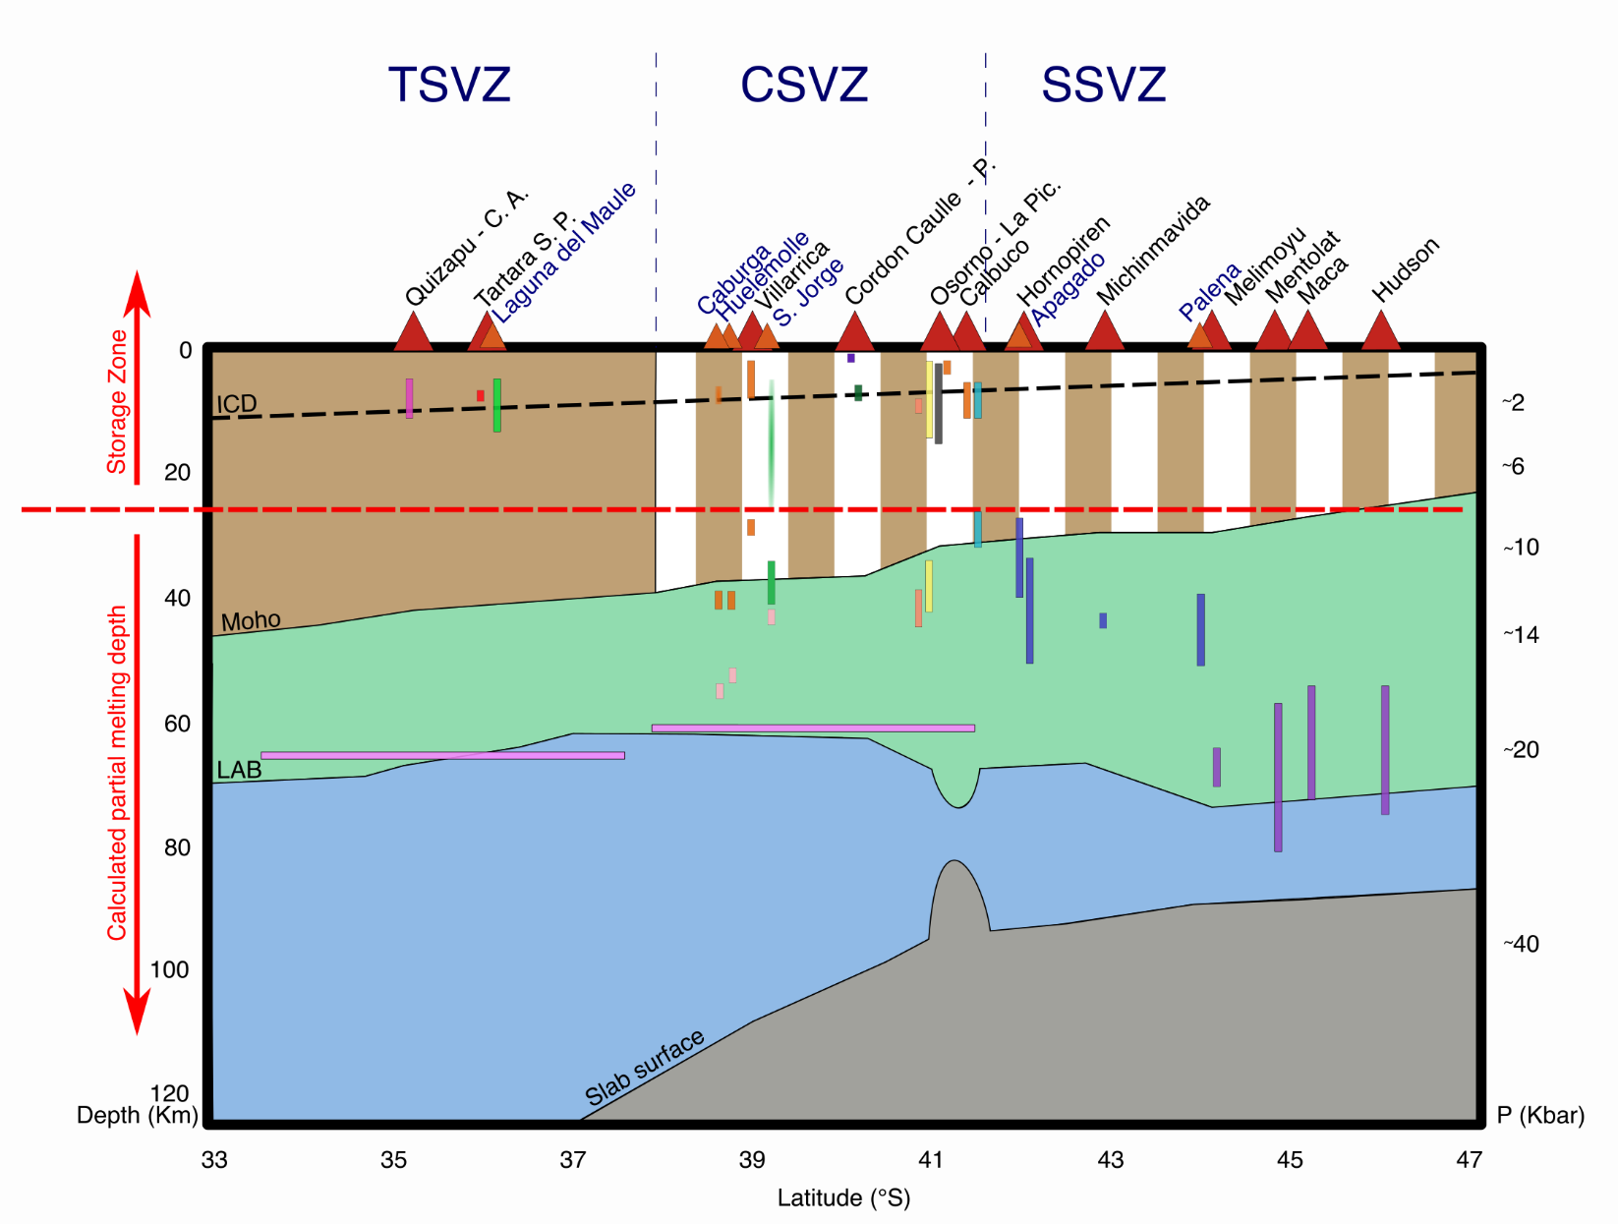
At larger scale

Slide 17
Thank you for your attention
360° panorama with view on the principal cone of Osorno (left under the clouds), La Picada (center-right) and Todos Los Santos lake (right) from one of the 1790 scoria cone.

Slide 18
Bechon T., Billon M., Namur O., Bolle O., Fugmann P., Foucart H., Devidal J-L., Delmelle N., Vander Auwera J. (Submitted). Eruptive products at Osorno (Central SouthernVolcanic Zone, Chile, 41.10°S) were produced by differentiation from a damp primary magma to dacite in the shallow crust. Geochemistry, Geophysics, Geosystems.
Bjerg, E. A., Ntaflos, T., Thöni, M., Aliani, P., & Labudia, C. H. (2009). Heterogeneous Lithospheric Mantle beneath Northern Patagonia: Evidence from Prahuaniyeu Garnet- and Spinel-Peridotites. Journal of Petrology, 50(7), 1267–1298. https://doi.org/10.1093/petrology/egp021
Brasse, H. (2011). Electromagnetic Images of the South and Central American Subduction Zones. In E. Petrovský, D. Ivers, T. Harinarayana, & E. Herrero-Bervera (Eds.), The Earth’s Magnetic Interior (pp. 43–81). Dordrecht: Springer Netherlands. https://doi.org/10.1007/978-94-007-0323-0_4
Bucchi, F., Lara, L. E., & Gutiérrez, F. (2015). The Carrán–Los Venados volcanic field and its relationship with coeval and nearby polygenetic volcanism in an intra-arc setting. Journal of Volcanology and Geothermal Research, 308, 70–81. https://doi.org/10.1016/j.jvolgeores.2015.10.013
Ganne, J., & Feng, X. (2017). Primary magmas and mantle temperatures through time. Geochemistry, Geophysics, Geosystems, 18(3), 872–888. https://doi.org/10.1002/2016GC006787
Gerlach, D. C. (1985). GEOCHEMISTRY AND PETROLOGY OF RECENT VOLCANICS OF THE PUYEHUE-CORDON CAULLE AREA, CHILE (40.5 0S), 401.
Glover, P. W. J., Hole, M. J., & Pous, J. (2000). A modified Archie’s law for two conducting phases. Earth and Planetary Science Letters, 180(3), 369–383. https://doi.org/10.1016/S0012-821X(00)00168-0
ten Grotenhuis, S. M., Drury, M. R., Spiers, C. J., & Peach, C. J. (2005). Melt distribution in olivine rocks based on electrical conductivity measurements. Journal of Geophysical Research: Solid Earth, 110(B12). https://doi.org/10.1029/2004JB003462
Hickey-Vargas, R., Sun, M., & Holbik, S. (2016). Geochemistry of basalts from small eruptive centers near Villarrica stratovolcano, Chile: Evidence for lithospheric mantle components in continental arc magmas. Geochimica et Cosmochimica Acta, 185, 358–382. https://doi.org/10.1016/j.gca.2016.03.033
Hickey-Vargas, Rosemary, Holbik, S., Tormey, D., Frey, F. A., & Moreno Roa, H. (2016). Basaltic rocks from the Andean Southern Volcanic Zone: Insights from the comparison of along-strike and small-scale geochemical variations and their sources. Lithos, 258–259, 115–132. https://doi.org/10.1016/j.lithos.2016.04.014
Hirose, K., & Kushiro, I. (1993). Partial melting of dry peridotites at high pressures: Determination of compositions of melts segregated from peridotite using aggregates of diamond. Earth and Planetary Science Letters, 114(4), 477–489. https://doi.org/10.1016/0012-821X(93)90077-M
Hirschmann, M. M. (2000). Mantle solidus: Experimental constraints and the effects of peridotite composition: MANTLE SOLIDUS. Geochemistry, Geophysics, Geosystems, 1(10), n/a-n/a. https://doi.org/10.1029/2000GC000070
Jacques, G., Hoernle, K., Gill, J., Wehrmann, H., Bindeman, I., & Lara, L. E. (2014). Geochemical variations in the Central Southern Volcanic Zone, Chile (38–43°S): The role of fluids in generating arc magmas. Chemical Geology, 371, 27–45. https://doi.org/10.1016/j.chemgeo.2014.01.015
Jalowitzki, T., Gervasoni, F., Conceição, R. V., Orihashi, Y., Bertotto, G. W., Sumino, H., et al. (2017). Slab-derived components in the subcontinental lithospheric mantle beneath Chilean Patagonia: Geochemistry and Sr–Nd–Pb isotopes of mantle xenoliths and host basalt. Lithos, 292–293, 179–197. https://doi.org/10.1016/j.lithos.2017.09.008
Katz, R. F., Spiegelman, M., & Langmuir, C. H. (2003). A new parameterization of hydrous mantle melting. Geochemistry, Geophysics, Geosystems, 4(9). https://doi.org/10.1029/2002GC000433
Kay, S. M., Ardolino, A. A., Gorring, M. L., & Ramos, V. A. (2007). The Somuncura Large Igneous Province in Patagonia: Interaction of a Transient Mantle Thermal Anomaly with a Subducting Slab. Journal of Petrology, 48(1), 43–77. https://doi.org/10.1093/petrology/egl053
Kelley, K. A., Plank, T., Grove, T. L., Stolper, E. M., Newman, S., & Hauri, E. (2006). Mantle melting as a function of water content beneath back-arc basins. Journal of Geophysical Research: Solid Earth, 111(B9). https://doi.org/10.1029/2005JB003732
Kilian, R., & Behrmann, J. H. (2003). Geochemical constraints on the sources of Southern Chile Trench sediments and their recycling in arc magmas of the Southern Andes. Journal of the Geological Society, 160(1), 57–70. https://doi.org/10.1144/0016-764901-143
Langmuir, C. H., & Broecker, W. (2012). Chapter 12. Linking the Layers: Solid Earth, Liquid Ocean, and Gaseous Atmosphere. In How to Build a Habitable Planet: The Story of Earth from the Big Bang to Humankind - Revised and Expanded Edition (pp. 349–382). Princeton University Press. https://doi.org/10.1515/9781400841974-013
Lee, C.-T. A., Luffi, P., Plank, T., Dalton, H., & Leeman, W. P. (2009). Constraints on the depths and temperatures of basaltic magma generation on Earth and other terrestrial planets using new thermobarometers for mafic magmas. Earth and Planetary Science Letters, 279(1), 20–33. https://doi.org/10.1016/j.epsl.2008.12.020
Lopez-Escobar, L., Cembrano, J., & Moreno, H. (1995). Geochemistry and tectonics of the Chilean Southern Andes basaltic Quaternary volcanism (37-46°S). Andean Geology, 22(2), 219–234. https://doi.org/10.5027/andgeoV22n2-a06
Lucassen, F., Wiedicke, M., & Franz, G. (2010). Complete recycling of a magmatic arc: evidence from chemical and isotopic composition of Quaternary trench sediments in Chile (36°–40°S). Int J Earth Sci, 15.
McGee, L., Morgado, E., Brahm, R., Parada, M.-Á., Vinet, N., Lara, L. E., et al. (2019). Stratigraphically controlled sampling captures the onset of highly fluid-fluxed melting at San Jorge volcano, Southern Volcanic Zone, Chile. Contributions to Mineralogy and Petrology, 174(12), 102. https://doi.org/10.1007/s00410-019-1643-x
McGee, L. E., Brahm, R., Rowe, M. C., Handley, H. K., Morgado, E., Lara, L. E., et al. (2017). A geochemical approach to distinguishing competing tectono-magmatic processes preserved in small eruptive centres. Contributions to Mineralogy and Petrology, 172(6), 44. https://doi.org/10.1007/s00410-017-1360-2
Miller, K. J., Montési, L. G. J., & Zhu, W. (2015). Estimates of olivine–basaltic melt electrical conductivity using a digital rock physics approach. Earth and Planetary Science Letters, 432, 332–341. https://doi.org/10.1016/j.epsl.2015.10.004
Moreno Roa, H., Lara, L. E., & Orozco, G. (2010). Geologia del volcan Osorno. SERNAGEOMIN.
Morgado, E., Parada, M. A., Contreras, C., Castruccio, A., Gutiérrez, F., & McGee, L. E. (2015). Contrasting records from mantle to surface of Holocene lavas of two nearby arc volcanic complexes: Caburgua-Huelemolle Small Eruptive Centers and Villarrica Volcano, Southern Chile. Journal of Volcanology and Geothermal Research, 306, 1–16. https://doi.org/10.1016/j.jvolgeores.2015.09.023
Morgado, E., Parada, M. A., Morgan, D. J., Gutiérrez, F., Castruccio, A., & Contreras, C. (2017). Transient shallow reservoirs beneath small eruptive centres: Constraints from Mg-Fe interdiffusion in olivine. Journal of Volcanology and Geothermal Research, 347, 327–336. https://doi.org/10.1016/j.jvolgeores.2017.10.002
Mundl, A., Ntaflos, T., Ackerman, L., Bizimis, M., Bjerg, E. A., Wegner, W., & Hauzenberger, C. A. (2016). Geochemical and Os–Hf–Nd–Sr Isotopic Characterization of North Patagonian Mantle Xenoliths: Implications for Extensive Melt Extraction and Percolation Processes. Journal of Petrology, 57(4), 685–715. https://doi.org/10.1093/petrology/egv048
Pizarro, C., Parada, M. A., Contreras, C., & Morgado, E. (2019). Cryptic magma recharge associated with the most voluminous 20th century eruptions (1921, 1948 and 1971) at Villarrica Volcano. Journal of Volcanology and Geothermal Research, 384, 48–63. https://doi.org/10.1016/j.jvolgeores.2019.07.001
Putirka, K. D. (2008). Thermometers and Barometers for Volcanic Systems. Reviews in Mineralogy and Geochemistry, 69(1), 61–120. https://doi.org/10.2138/rmg.2008.69.3
Rivalenti, G., Mazzucchelli, M., Laurora, A., Ciuffi, S. I. A., Zanetti, A., Vannucci, R., & Cingolani, C. A. (2004). The backarc mantle lithosphere in Patagonia, South America. Journal of South American Earth Sciences, 17(2), 121–152. https://doi.org/10.1016/j.jsames.2004.05.009
Salters, V. J. M., & Stracke, A. (2004). Composition of the depleted mantle. Geochemistry, Geophysics, Geosystems, 5(5). https://doi.org/10.1029/2003GC000597
Singer, B. S., Jicha, B. R., Harper, M. A., Naranjo, J. A., Lara, L. E., & Moreno-Roa, H. (2008). Eruptive history, geochronology, and magmatic evolution of the Puyehue-Cordón Caulle volcanic complex, ChileEvolution of the Puyehue-Cordón Caulle volcanic complex, Chile. GSA Bulletin, 120(5–6), 599–618. https://doi.org/10.1130/B26276.1
Stern, C., Roa, H., Lopez-Escobar, L., Clavero, J., Lara, L., Naranjo, J., et al. (2007). Chapter 5. Chilean volcanoes The Geology of Chile. In Geological Society Special Publication (pp. 147–178). https://doi.org/10.1144/GOCH
Tassara, A., & Echaurren, A. (2012). Anatomy of the Andean subduction zone: three-dimensional density model upgraded and compared against global-scale models. Geophysical Journal International, 189(1), 161–168. https://doi.org/10.1111/j.1365-246X.2012.05397.x
Tassara, S., Reich, M., Cannatelli, C., Konecke, B. A., Kausel, D., Morata, D., et al. (2020). Post-melting oxidation of highly primitive basalts from the southern Andes. Geochimica et Cosmochimica Acta. https://doi.org/10.1016/j.gca.2020.01.042
Turner, S. J., Langmuir, C. H., Katz, R. F., Dungan, M. A., & Escrig, S. (2016). Parental arc magma compositions dominantly controlled by mantle-wedge thermal structure. Nature Geoscience, 9(10), 772–776. https://doi.org/10.1038/ngeo2788
Turner, S. J., Langmuir, C. H., Dungan, M. A., & Escrig, S. (2017). The importance of mantle wedge heterogeneity to subduction zone magmatism and the origin of EM1. Earth and Planetary Science Letters, 472, 216–228. https://doi.org/10.1016/j.epsl.2017.04.051
Vander Auwera, J., Namur, O., Dutrieux, A., Wilkinson, C. M., Ganerød, M., Coumont, V., & Bolle, O. (2019). Mantle Melting and Magmatic Processes Under La Picada Stratovolcano (CSVZ, Chile). Journal of Petrology, 60(5), 907–944. https://doi.org/10.1093/petrology/egz020
Watt, S. F. L., Pyle, D. M., Mather, T. A., & Naranjo, J. A. (2013). Arc magma compositions controlled by linked thermal and chemical gradients above the subducting slab. Geophysical Research Letters, 40(11), 2550–2556. https://doi.org/10.1002/grl.50513
Weller, D. J., & Stern, C. R. (2018). Along-strike variability of primitive magmas (major and volatile elements) inferred from olivine-hosted melt inclusions, southernmost Andean Southern Volcanic Zone, Chile. Lithos, 296–299, 233–244. https://doi.org/10.1016/j.lithos.2017.11.009
Wood, B. J. (2004). Melting of fertile peridotite with variable amounts of H2O. Washington DC American Geophysical Union Geophysical Monograph Series, 150, 69–80. https://doi.org/10.1029/150GM07
Workman, R. K., & Hart, S. R. (2005). Major and trace element composition of the depleted MORB mantle (DMM). Earth and Planetary Science Letters, 231(1–2), 53–72. https://doi.org/10.1016/j.epsl.2004.12.005

