Slide 1

EGOS – European Group for Organizational Studies
Sub-theme 02: New Actors, Responsibilities, and Forms of Organizing in the Age of Digital Transformations
08-07-2021
BRASSART Chloé, Ph.D candidate
HEC - LENTIC

Slide 2
Paper in progress:
regulation of the taxi sector in Brussels: understanding an institutional change from a conventionalist perspective
Topic | Methods | Contribution
How do the discourses of institutional stakeholders shape the emerging regulation of the taxi sector, beyond the formal structuration of the field? - Institutional perspectives of regulation | Semi-structured interviews of key stakeholders - Sociology of conventions (Gomez, 2006) - Discourse analysis with NVIVO software | Explore the concept of regulation as a process and not as an outcome of decision-making ; - Understand the transformation of the normative framework, beyond the formal/informal dichotomy; - Study the new forms of work as a social construction, focusing on the interactions among actors

Slide 3
contextual element of the research
Disruptive entry of new economic actors
Change of market dynamics
Regional reform I progress of the paid passenger transport sector
Lawsuit against Uber in progress

Slide 4
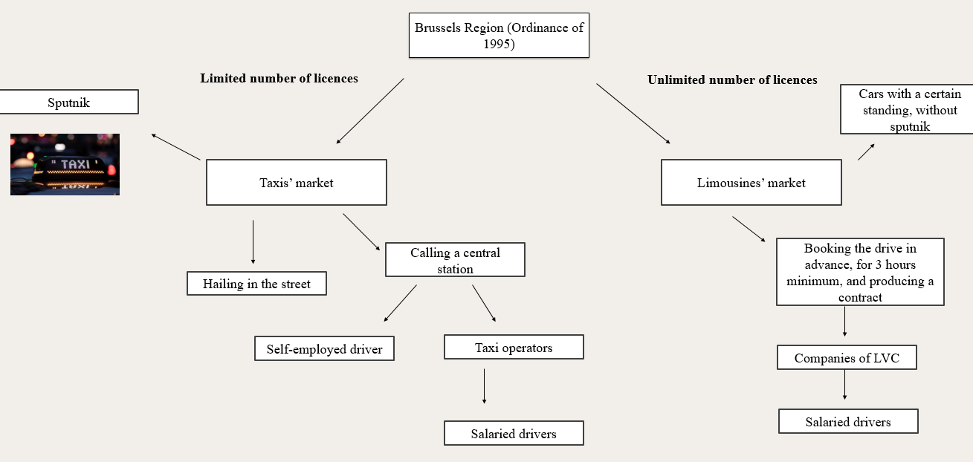

Slide 5
Ecosystem of the paid passenger transport sector with driver
Government
Minister President of Brussels in charge of the reform of the sector of paid transport of persons with driver
Advisory committee
The advisory committee is composed of different representatives (e.g. associations of cab operators, trade unions, users' organizations, the Brussels Mobility Administration, professional associations of drivers, advisor to the minister).
New digital players
The new stakeholders considered to have disrupted the pre-established sector are notably Uber, Husk, Heetch, ... platforms linking customer and user according to a collaborative market economy

Slide 6
Interviews | Role and institution | Advisory committee
Anonym 1 | Representative in a Trade Union
Anonym 2 | President of professional group
Anonym 3 | Director of Public service of transport
Anonym 4 | Mobility manager in a company
Anonym 5 | Economist at the central economic council
Anonym 6 | Administrator of a Professional association
Anonym 7 | Director at a public transportation service
Anonym 8 | Administrator of a Professional association
Anonym 9 | Representative in a Trade union
Anonym 10 | Coordinator in a Trade union
Anonym 11 | CEO at a Central station
Anonym 12 | Director at the Administration of Bruxelles mobility
Anonym 13 | CEO of a taxi Company
Anonym 14 | Minister's advisor at a Ministerial Cabinet
Anonym 15 | Permanent in a Trade union
Anonym 16 | Member of the Disciplinary board
Anonym 17 | Economist expert
Anonym 18 | CEO of a Plateform
Anonym 19 | CEO at a Central station
Anonym 20 | Director of Bruxelles mobility
Anonym 21 | Permanent in a Trade union
Anonym 22 | Président of a Professionnal Association
Anonym 23 | Director of a Plateform
Anonym 24 | Minister's advisor at a Ministerial Cabinet
Anonym 25 | Administrator of a Professionnal Association

Slide 7
Discourse analysis NVIVO – coding process (Beaud & Weber,
2010)
What are the objects of the controversy and the envisaged regulation
Vertical analysis: identify the subjects of the debates in court and identify the elements relating to the way in which they envisage regulating them
Horizontal analysis: compare the way actors mobilize these elements in their justification process
How these elements are mobilized in the justification processes

Slide 8
Results – part 1
> The first level of results reveals a polarized vision of three discursive registers (i.e. the market, work and mobility) governed by two representations of regulation (i.e. autonomous and heteronomous).

Slide 9
Autonomy of the regulation | Heteronomy of the regulation
MARKET
Open fare |  | Fixed fee
Deleting numerus clausus |  | Maintaining/increasing current numerus clausus
Unification of paid passenger transportation services, commodification |  | Segmentation of paid passenger transportation services, market niches
Principle: competition as a vector of service quality |  | Principle: economic viability of the operators
WORK
Open access to the profession |  | Standardized process for access to the profession
Algorithmic management (access, match-making, fees, etc. monitored by the platform) |  | Administrative management
Activity based on individual responsibility (entrepreneurship) |  | Activity based on collective responsibility (labour market)
Principle: flexibility and freedom |  | Principle: protection and safety at work
MOBILITY
Natural complementarity between the different transportation modes |  | Forced integration of the different transportation modes (specific roles and privileges for each of them)
Transport accessibility |  | Transport safety
Technology-based expertise |  | Field expertise (territorial knowledge, professionalism)
Principle: trust in digital innovation |  | Principle: holistic urban development policy, political arbitration

Slide 10
Results – part 2
-> The second level of results emphasise on the justification processes of the discourses interviewees.
These processes are based on one prevailing register of conventions (described above) and uses the two other registers to support the argumentation;
The three different view reveals the three different ways of defining and conceiving informal practices and the adequacy of the formal structure
The expansionist view | The combinatory view | The exclusive view
Notion of (in)formality and (in)adequation of the formal structure

