Slide 1


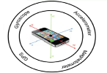
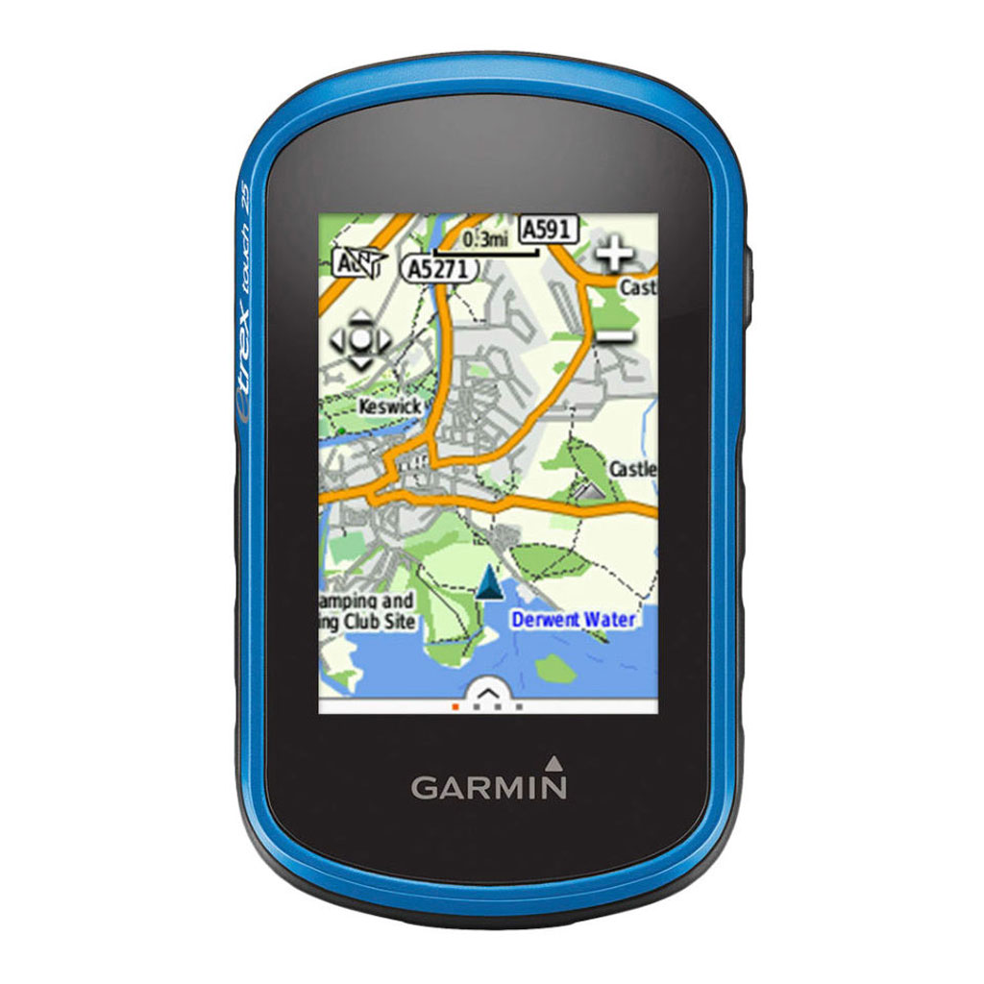
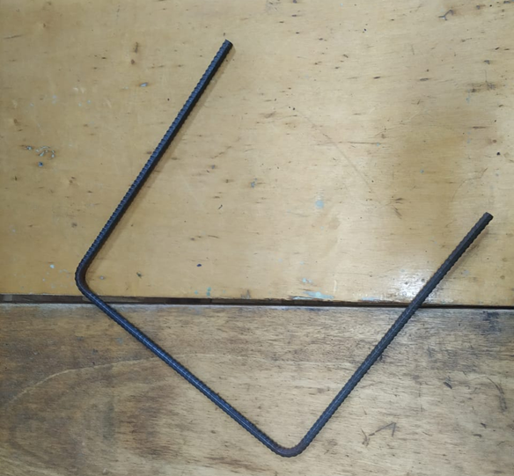
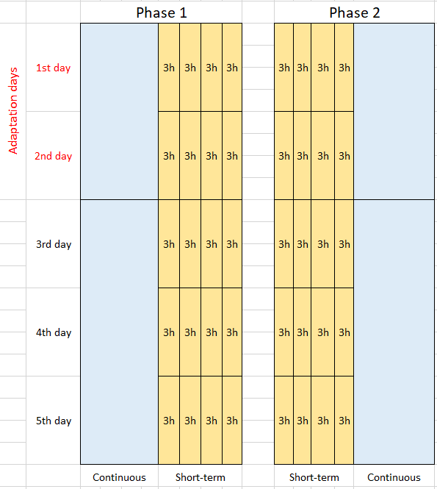
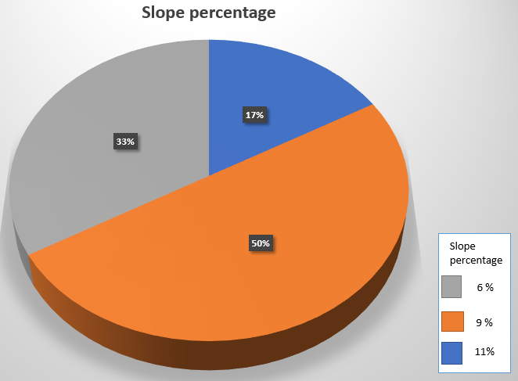
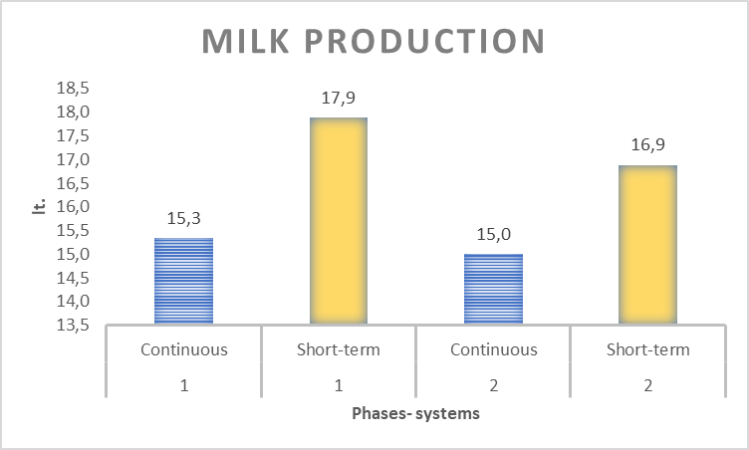
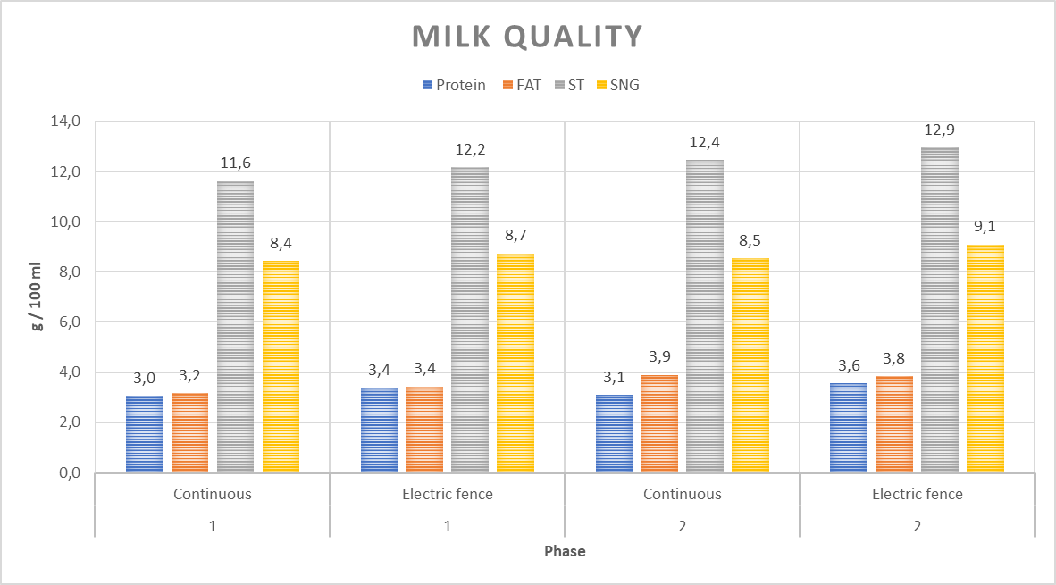
Evaluation of ingestive behavior as a function of forage supply in dairy production, under two systems of rotation with slope in paddocks
E. Castro Muñoz, G. F. Da Silva Neto, A.L.H. Andriamandroso, L. Ron, C. Montufar, F. Lebeau, J. Bindelle.
The ingestive behavior of grazing animals is modulated by the vegetation characteristics, topography and the type of stocking method. Understanding these relationships is a key lever for adequate grazing management. This research was carried out in the summer of 2019, at the Rumipamba Experimental Teaching Academic Center of the Central University of Ecuador. It aimed to evaluate the impact of two contrasting stocking methods of dairy cows grazing a pasture with an average of slope> 8.5%. Four dairy cows were set to graze a 0.4 ha paddock for 5 days for continuous stocking methods, while for the electric fence methods the dairy cows were restricted to 0.2 ha and the fence was moved uphill every 3 hours, repeating this process four times a day. Cow were equipped with activity sensors for 12h per day. The whole procedure was repeated 2 times after realizing an equalization cuts and both paddocks, a rest time of 30 days and a random reassignment of paddocks to one of the treatments.
RESEARCH QUESTIONS
What are the impacts of rotation systems on the feeding behavior of livestock with slope?
What is the relationship between the two types of rotation with milk production with the slope?
What is the relationship between the two types of rotation and the quality of milk with the slope?
What is the pasture availability with respect to the two types of rotation?
TOOLS
Inertial measurement unit (IMU) iPhone 5s. App SENSOR DATA
Global Positioning System
Handmade quadrant
Rising plate meter (RPM), for biomass determination
RESULTS
The cows showed a difference in terms of the percentage of grazing p = 0.0072, being higher with the electric fence (55% of the measurement time). From rising-plate-meter estimates of available biomass along the grazing periods, we calculated despite similar forage allowances (electric fence = 48.06 kg DM / cow x d and continuous = 48.21 DM / cow x d) a higher forage intake was obtained in the electric fence treatment (17.5 kg DM /cow x d) compared the continuous stocking (15.7 kg DM / cow x d) (P = 0.006). In terms of milk production animals grazing under the differences electrical fence stocking method tended (P = 0.0985) to produce more milk (17.39 kg d-1 ) than those grazing in the continuous system (15.16 kg d-1) due to the influence of the slope (p = 0.05), while for milk quality the protein content was higher for the electric fence (33.7 g/l) than the continuous method (30.5 g/l) (p = 0.039). None of the other milk properties (fat, total solids, non-fatty solids) differed between methods (p> 0.05).
1. Food behavior of the dairy cow
2. Milk production by type of rotation and phase
4. Milk quality by type of rotation and phase
3. Forage supply in two types of rotation
CONCLUSIONS
It is concluded that, despite having offered similar forage allowance, grass consumption was different, milk production presented numerical differences in volume and significant differences in quality, so there is a partial influence of the slope in the rotation systems with respect to production.

