Slide 1


AEBR Cross-Border School
1st block : Cross-Border Spatial Planning
Introduction to the field of Cross-border spatial planning
Sylvain Marbehant, Lepur, University of Liège

Slide 2
Spatial Planning in Border Regions
An emerging field

Slide 3
Spatial planning in european Border Regions
Spatial Planning ?
"Regional/spatial planning gives geographical expression to the economic, social, cultural and ecological policies of society. It is at the same time a scientific discipline, an administrative technique and a policy developed as an interdisciplinary and comprehensive approach directed towards a balanced regional development and the physical organisation of space according to an overall strategy.“ (CEMAT Conference, 1983)

Slide 4
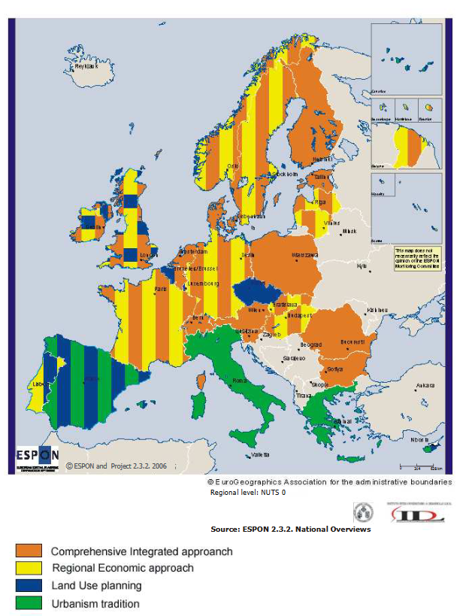
Spatial planning in european Border Regions
About 30% of all the European populations live closed to national borders.
More than 2.000.000 cross-border workers.
No existing and unified EU policy regarding spatial planning

Slide 5
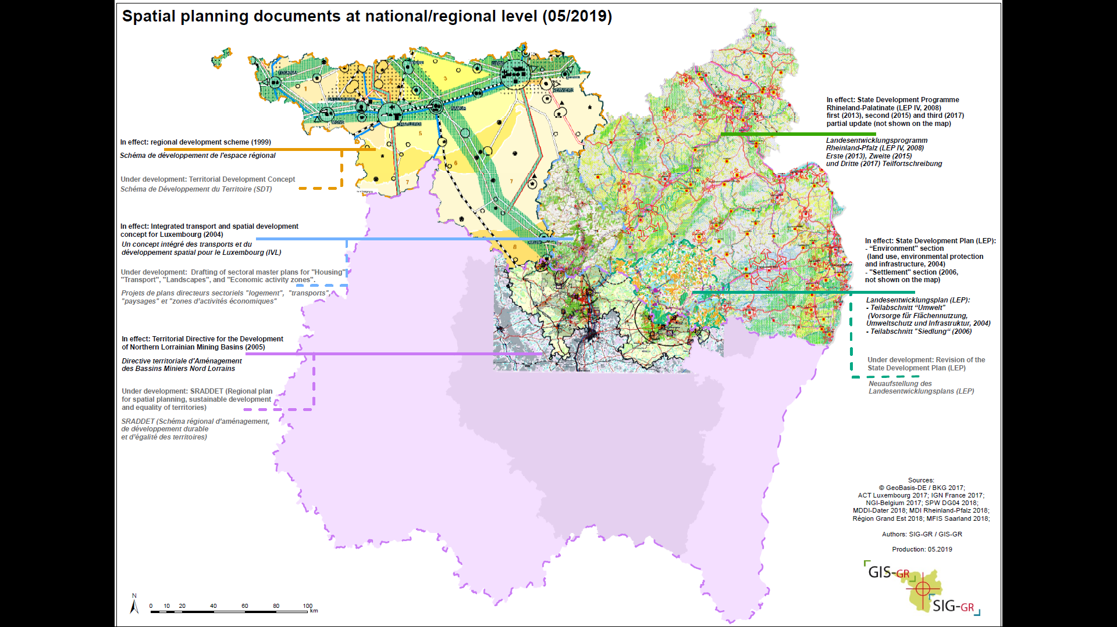
Spatial planning in european Border Regions

Slide 6
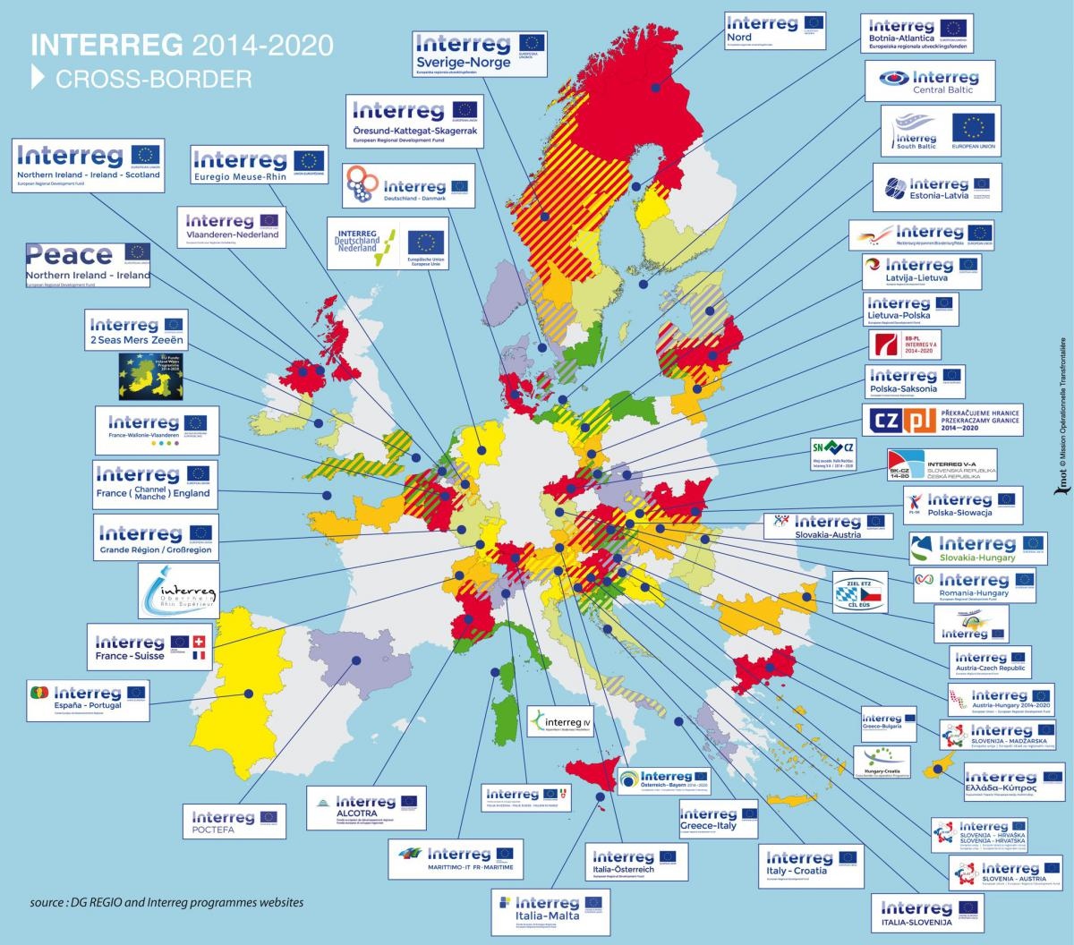
Spatial planning in european Border Regions
An emerging field…
Smooth and non-legally binding influence from EU planning Policies on national and regional levels
First INTERREG Programm in 1989
Territorial cohesion across borders (Green Paper for Territorial Cohesion, 2008)

Slide 7
Cross-border territorial issues

Slide 8
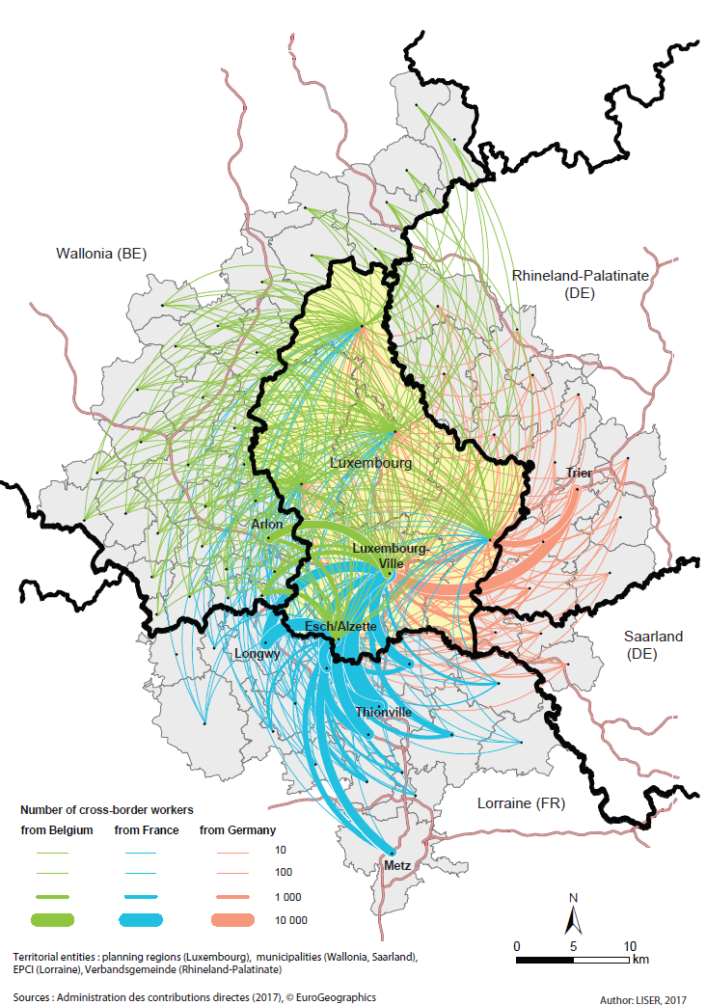
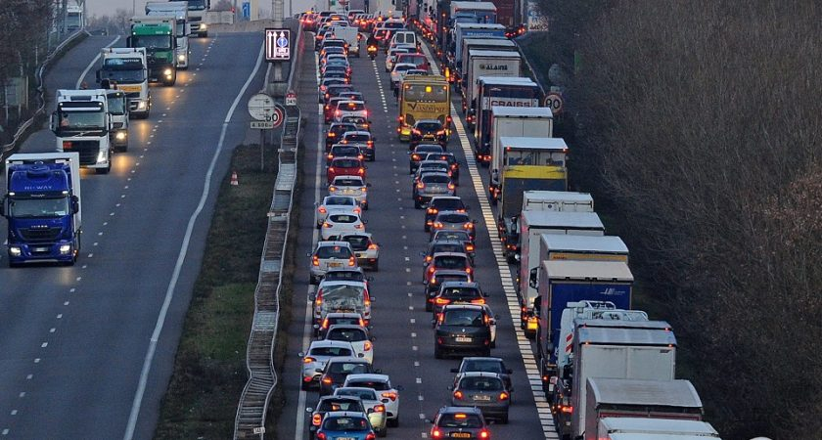
Cross border territorial issues
Transport for cross-border commuters
© Hervé Montaigu

Slide 9
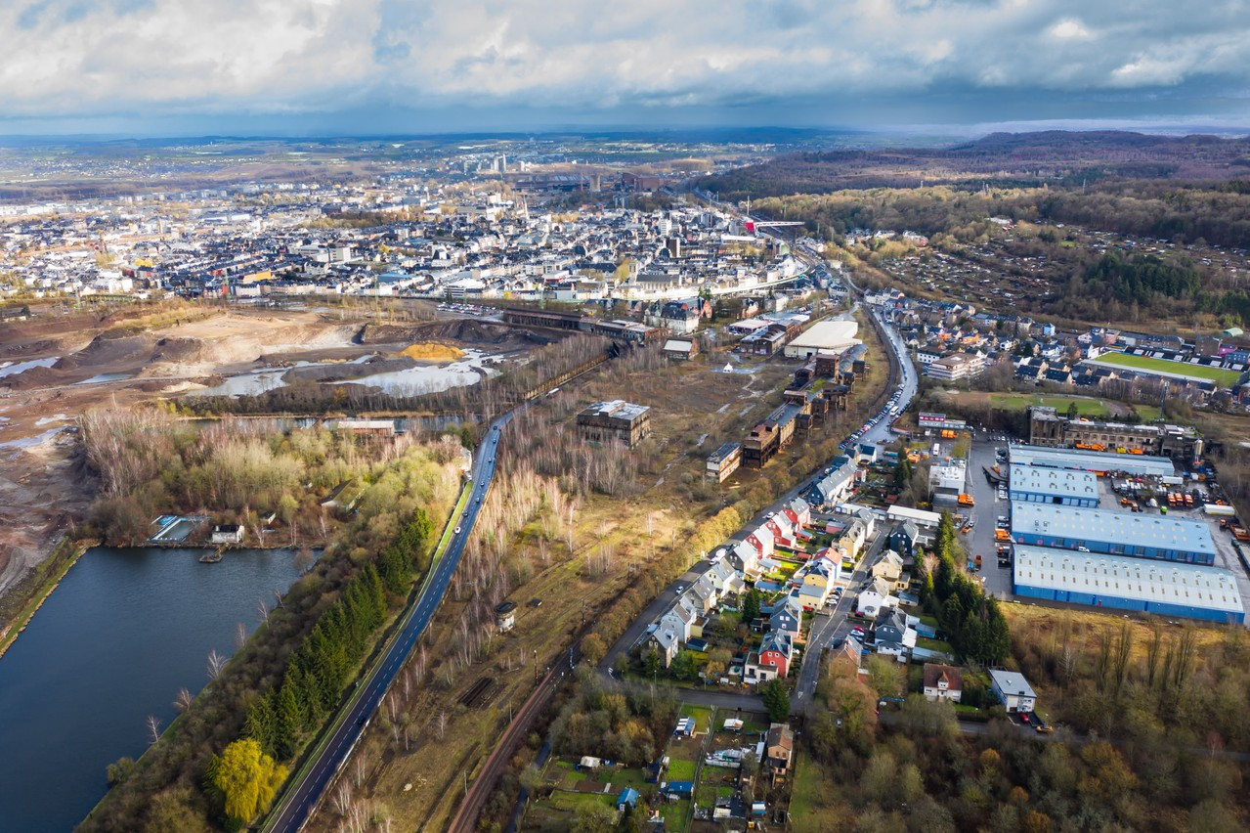
Cross border territorial issues
Reconversion of large industrial wastelands and other land ressources
Brownfields of Rout Lëns to be converted near Esch-sur-Alzette.
© Nader Ghavami & Paperjam)

Slide 10
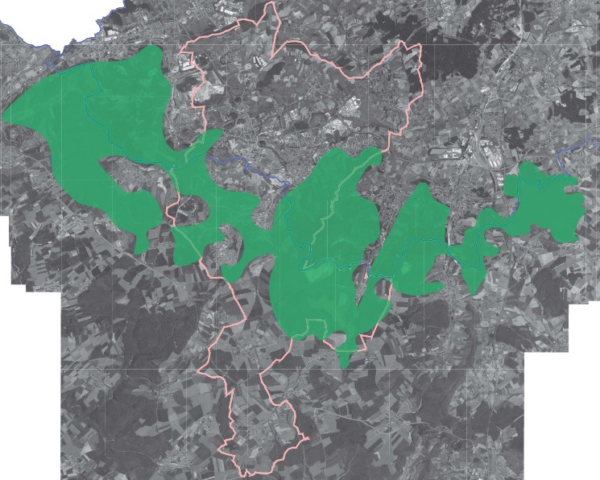
Cross border territorial issues
Management and protection of natural heritage and green areas
In green, the ecologicol corridor crossing the franco-Luxembourg border. In pink, the area of the GECT Alzette-Belval (Groupement Européen de Coopération Transfrontalière).
© GECT Alzette-Belval

Slide 11
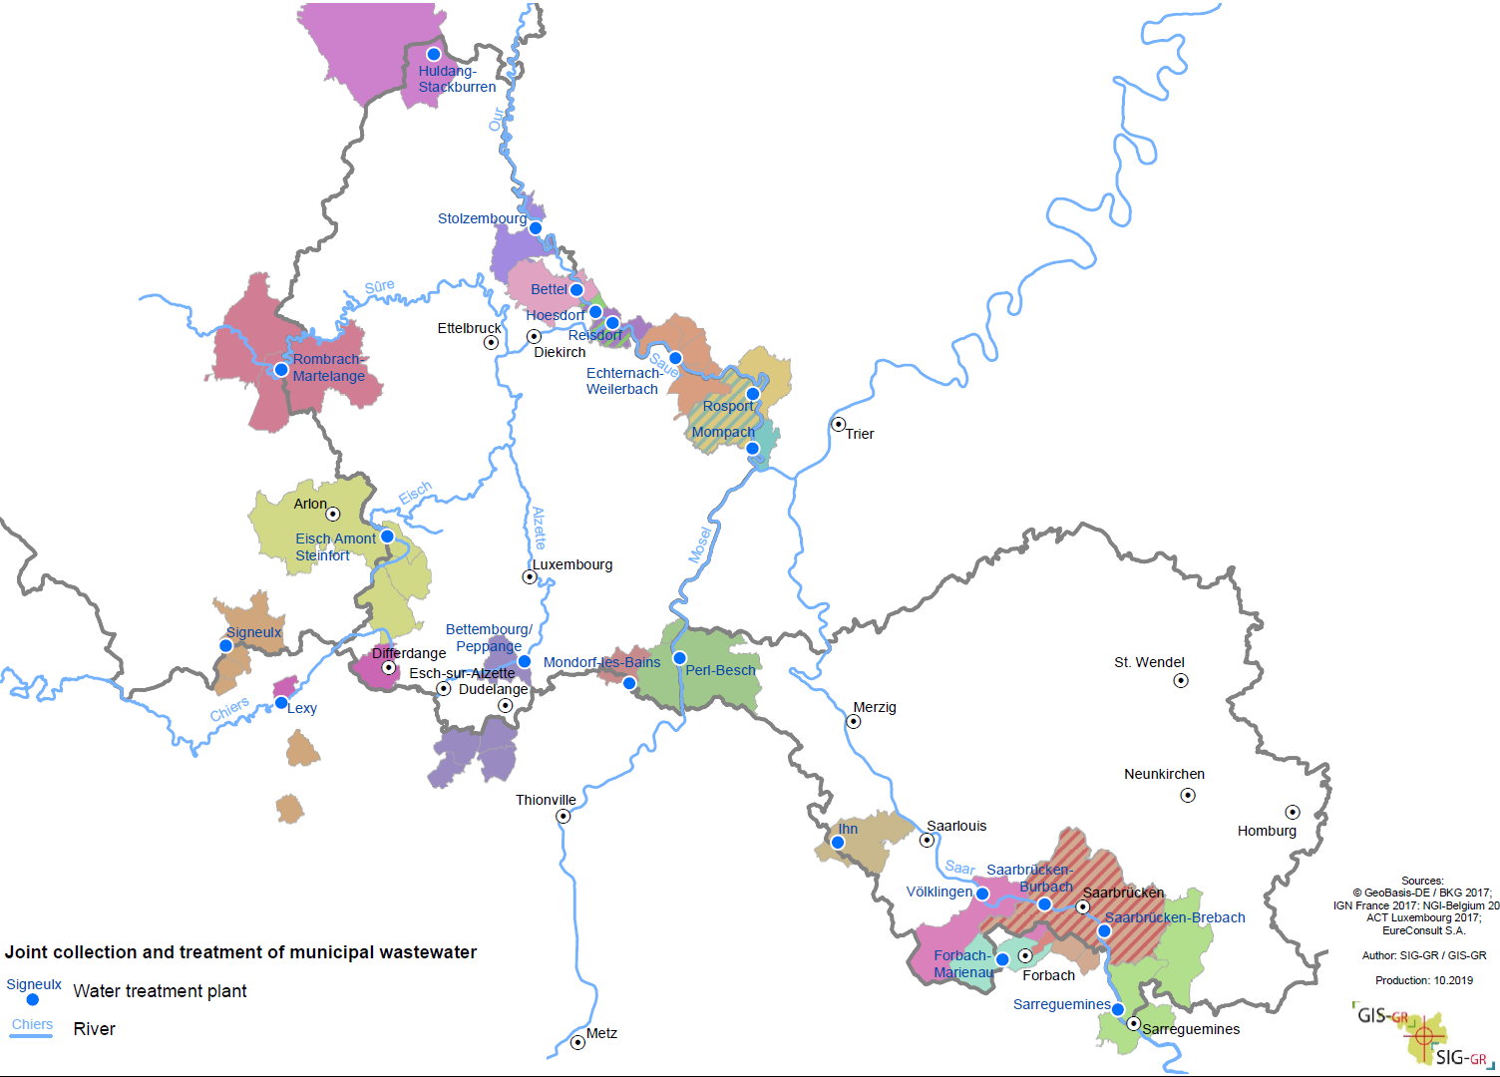
Cross border territorial issues
Waste treatment and water distribution

Slide 12
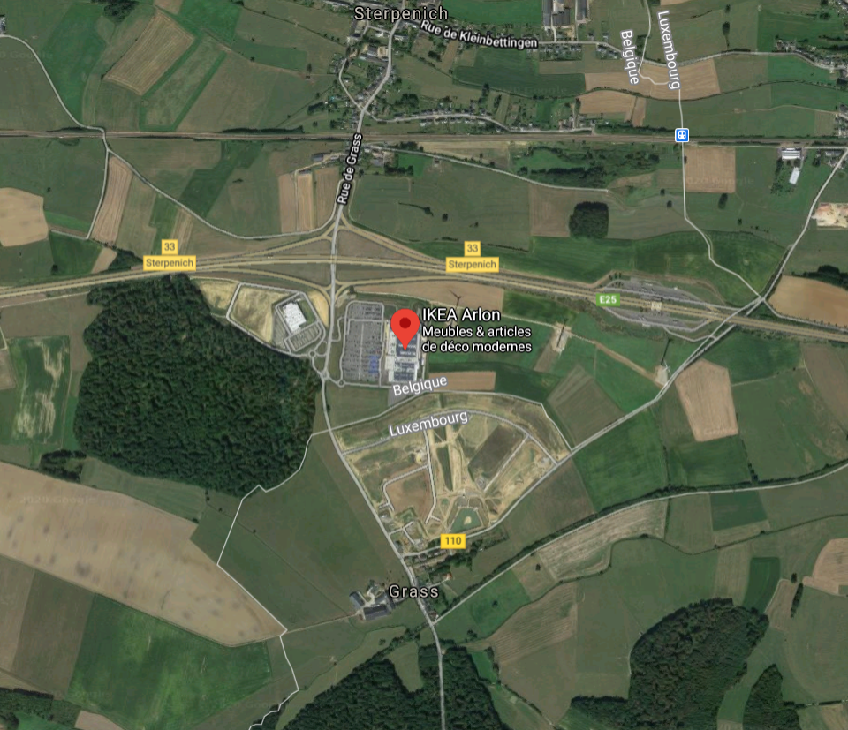
Cross border territorial issues
Large scale industrial and commercial developments
« Ikea effect » in the South-west of Arlon, Belgium
© Google maps

Slide 13
The « Spatial Planning » Working Group

Slide 14
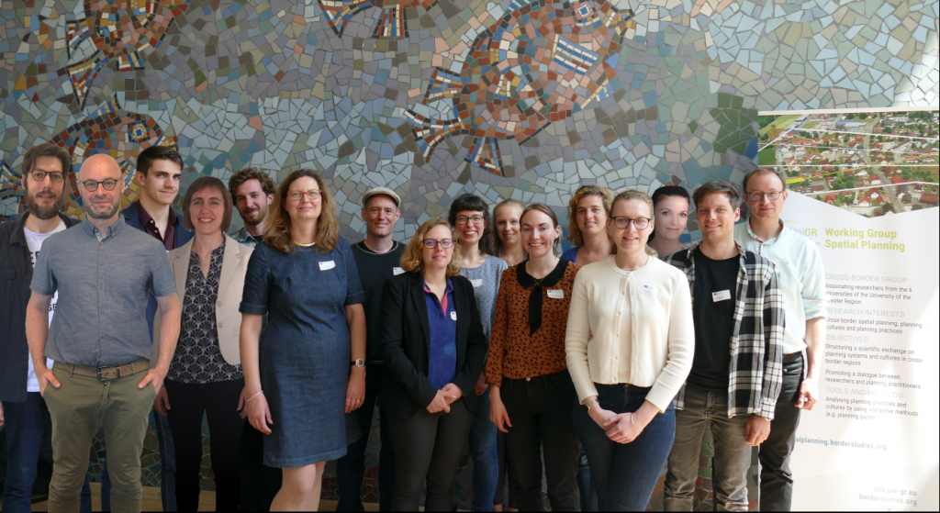
The « Spatial Planning » Working Group
Research focus :
Cross-border spatial planning and its challenges
Planning cultures and practices
Transnational and intercultural learning
Spatial development in the Greater Region Saar-Lor-Lux+

Slide 15
The « Spatial Planning » Working Group
Objectives:
Development of scientific exchange on planning systems and cultures in border areas
Promoting dialogue between planners and researchers
Mediation of intercultural competences in the education and training of spatial planners
Development of cross-border teaching materials and establishment of regular between the planning faculties in the Greater Region

Slide 16
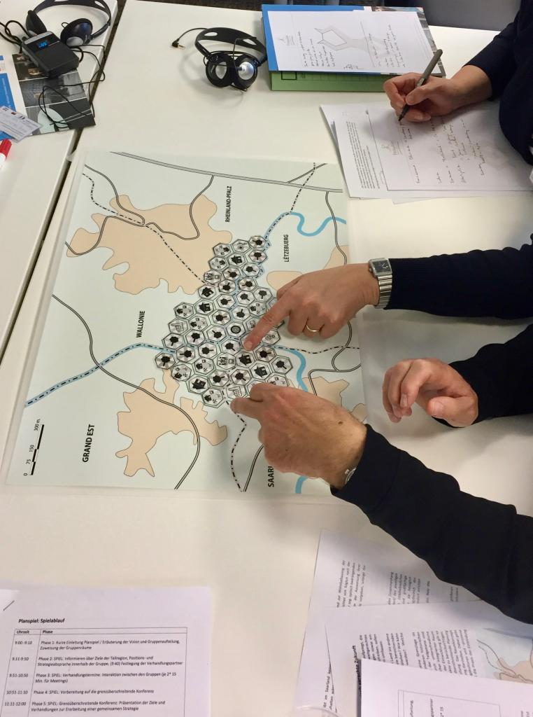
The « Spatial Planning » Working Group
Elaboration and implementation of simulation games with planners and students
Interactive seminars with live surveys
Mobilisation of networks and mutual learning of academic visions from the 6 regions of the Greater Region

Slide 17
Questions & answers

Slide 18
Question 1

Slide 19
Question 2

Slide 20
Question 3

Slide 21
Question 4

Slide 22
Question 5

Slide 23
Questions & answers

Slide 24
Topic 1

Slide 25
Topic 2

Slide 26
Topic 3

