Slide 1
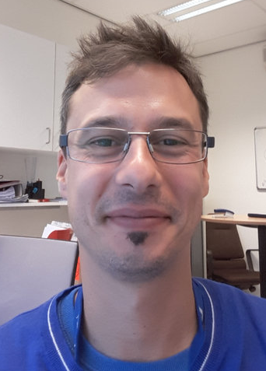
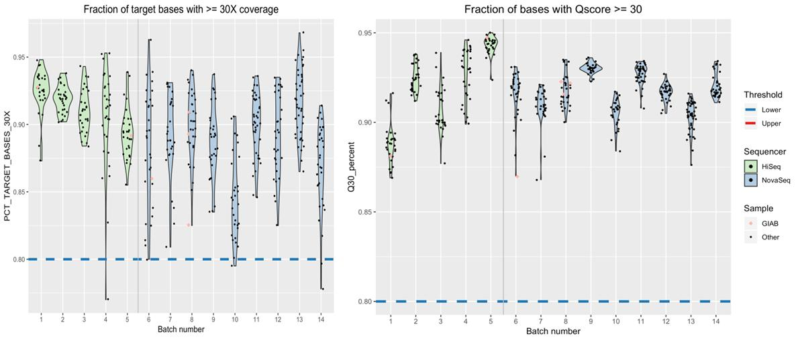
Hematopoietic Malignancies with Germline Predisposition Diagnosis with Filtered Whole Exome Sequencing and in silico Panel Analysis
Fernandez-Carazo, Rafael; Koopmansch, Benjamin; Palmeira, Leonor, Charloteaux, Benoit; Lambert, Frédéric
Department of Human Genetics, CHU Liege. 4000. Liege. Belgium.
Introduction
In the frame of the development of new analytical methods for the diagnostic of patients suffering of suspected inherited malignancies with poor access to rapid diagnosis due to a restricted number of analytical sites or the current use of non-comprehensive targeted panels, we developed a new NGS panel for the analysis of several haematological diseases based on a filtered whole exome sequencing approach.
We aim to provide physicians with a comprehensive diagnostic panel for the diagnostic work-up of patients affected (or suspected to be affected) by inherited haematological malignancies and related diseases enhancing the patient’s chances to benefit from a personalized medicine approach; together with a view to increase the knowledge about those (rare) conditions.
Materials and Methods
Myelodysplasic Syndromes
Acute Myeloid Leukemia
Inherited Bone Marrow Failure Syndromes
Fanconi Anemia
Diamond Blackfan Anemia
Dyskeratosis Congenita
Telomeropathies
Severe Congenital Neutropenia
Haematological diseases
Clinical exome is sequenced with the SureSelect Human Exome V6 (Agilent®), recovering information for about 20k genes, representing ca. 180k exons.
Validation process involved the analysis of 7 GIAB NA12878 replicates for performance metrics assessment. Gold standard SNPs defined by GA4GH consortium have been validated (High Confidence Regions ). Quality assessment (13 Quality Criteria) was performed on a validation cohort of 459 patients.
85 full (exonic) genes have been included in the set of genes validated in house. Deep intronic regions and UTRs with relevant clinical significance have been specially included (RETL1, TERC).
A variant filter based on an in house pipeline tree (Alissa Interpret, Agilent®) for the flagging of retained variants has been designed. Variants are categorized following
the ACMG guidelines for the interpretation of inherited variants and reported in the context of the patient malignancies.
.
Classification tree
Results
Sensitivity and precision, based on 7 GIAB replicates, show good performances (94.3 and 98.3%, respectively) regarding SNPs from AgilentExomeV6.0 baits ∩ GIAB High Confidence Regions.
96% out of the full (459) validation cohort fits with all the validation criteria. Only 4% failed for one single criteria.
Indels between 0-15bp showed sensitivity= 71.8% and precision =83.2%
Minimal coverage has been set up at 30X, spanning exons +/-15b.
.
Case studies
Patient: Fanconi anemia
Two case studies are illustrated as an example. Patient 1 showed typical Fanconi Anemia phenotype. Patient 2 showed a typical Dyskeratosis Congenita phenotype. Both patients were addressed to the CHU Liege for molecular analysis for improved diagnostics..
Patient: Dyskeratosis Congenita
Phenotype:hypoplasia of the thumbs, developmental delay, obesity,…
Phenotype: classic triad phenotype. Pulmonary fibroses non smoker
Conclusion
Inherited Haematological Malignancies are a heterogeneous group of malignancies not yet fully understood and in constant evolution. In this context, flexibility is a key concept to avoid analytical obsolescence. Due to the wide range of genes covered by the WES approach, significant genes could be further updated, with a minimal effort, to the panel.
Our analytical pipeline considers the analysis of single patients, corroboration of relevant inherited germline mutations from fibroblasts and/or trio analysis including first or second relatives. Applications cover from simple diagnostic from single patients to familiar studies or donor compatibility analysis.
Familial genetics: Far relative parents
Familial genetics: Triad in father, grand-father and sister
C16orf57, CTC1, DKC1, NOLA3 (NOP10), NHP2, RTEL1, TERC, TERT, WRAP53 (TCAB1), TINF2
BRCA1(FANCS), BRCA2 (FANCD1), BRIP1 (FANCJ), ERCC4 (FANCQ), FANCA, FANCB, FANCC, FANCD2, FANCE, FANCF, FANCG, FANCI, FANCL, PALB2 (FANCN), RAD51 (FANCR), RAD51C (FANCO), UBE2T (FANCT), SLX4 (FANCP),
Retained variants: 94
Reported variants: FANCG
c.115C>T; p(Arg39*); exon 2 ; Homozygous
ACMG classification : pathogenic
Retained variants: 121
Reported variants: DKC1
c.1177A>T ;p(Ile393Phe); exon 12 ; Hemizygous
ACMG classification : pathogenic
REFERENCES
Zook et al. 2019, Nature Biotechnology; Richards et al. 2015, Genetics in Medicine ; Bluteau et al. 2019, Blood ; Guidugli et al. 2017, Leukemia ; Churpek et al. 2018, Blood; Nalepa & Clapp. 2018, Nature Reviews.
Contact person
Rafael Fernandez Carazo: rfernandez@chuliege.be

