Slide 1
CASE REPORT: the use of optical genome mapping (Bionano) to understand a complex mechanism of a KMT2A rearrangement in an AML case.
Céline Lété¹, Geneviève Ameye², Pablo Beckers¹, Lucienne Michaux², Vincent Bours, Mauricette Jamar¹, Jolien De Bie², Barbara Dewaele², Catherine Menten¹
¹Human genetics, CHU Liège, Belgium
²Center for Human Genetics , UZ Leuven, Belgium
Catherine Menten and Barbara Dewaele
Cytogenetic lab, human genetic, CHU Liège, Belgium

Slide 2
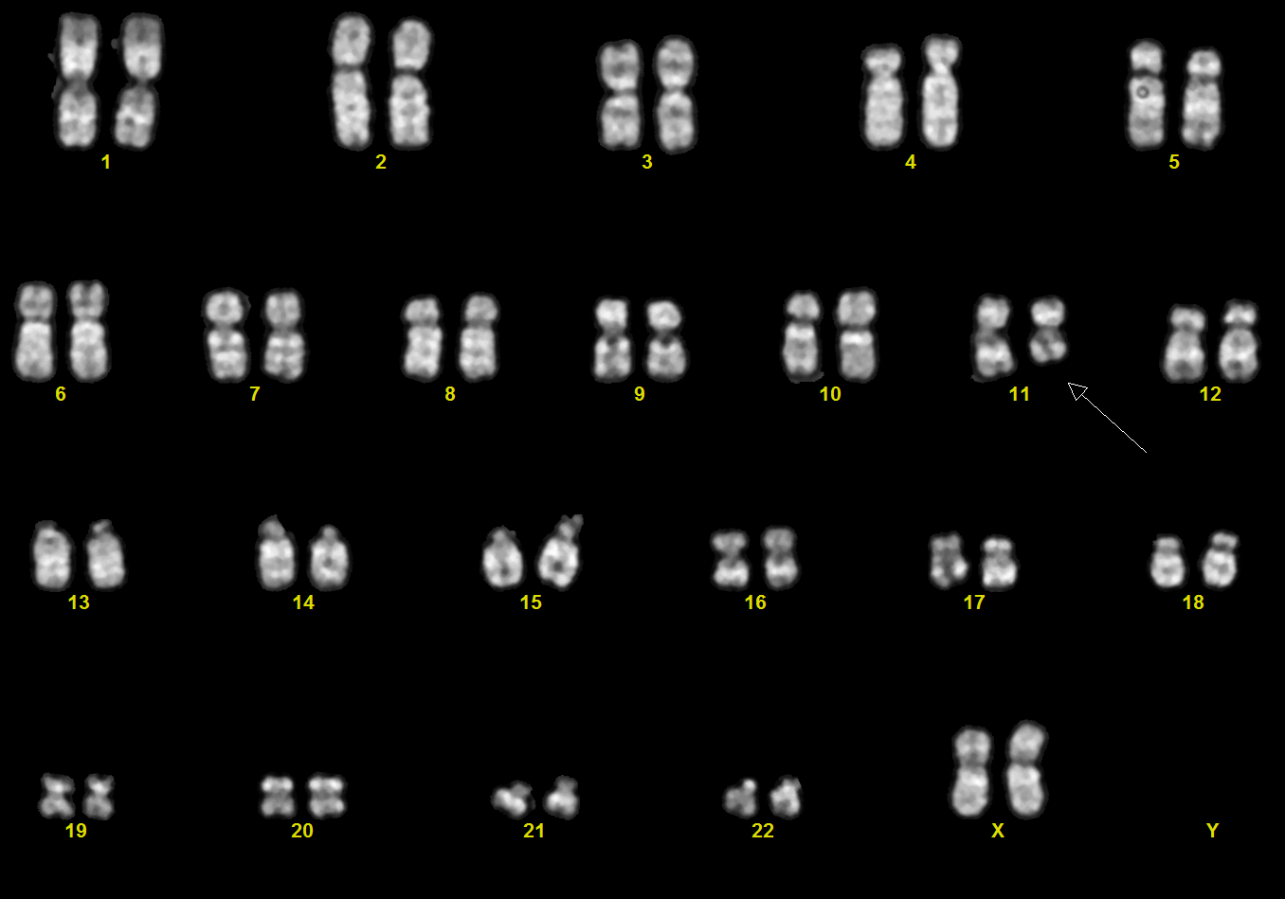
Introduction : the diagnosis of AML M5 (FAB classification) was established after cytology and cytometry analysis in an eighty-six year old woman with 46% myeloblasts in the bone marrow.
A
B
Content
A : standard karyotype Q-banding : 46,XX,t(10;11)(p12;q23)
B : specific KMTA FISH (break apart probe, Vysis)
Standard karyotype shows a translocation t(10;11)(p12;q23) in seventeen mitoses. KMT2A rearrangement was confirmed by FISH analysis using a gene specific break apart probe. However, the observation of informative metaphases shows that the KMT2A rearrangement is located on the short arm of a derivative chromosome 10.

Slide 3
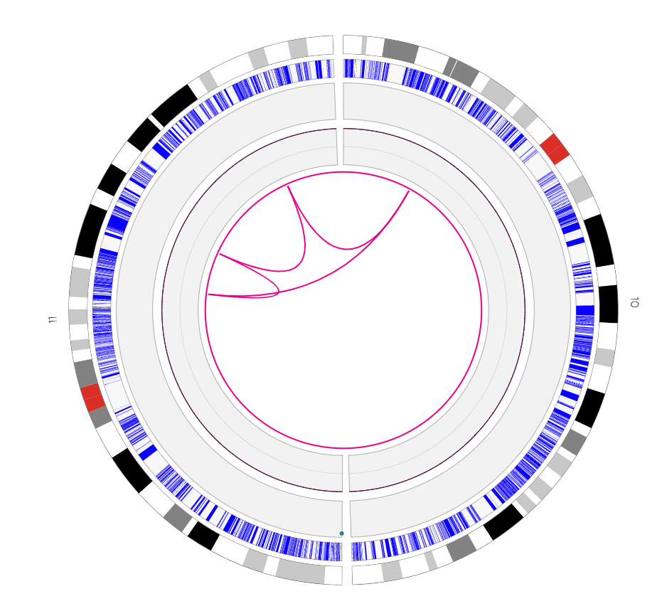
Aim : MLLT10 fusion is known to result from an inversion which can occur either before or after the t(10;11) translocation. An RT-PCR Hemavision test would have been informative, but was not possible due to the lack of RNA. Optical genome mapping (OGM) is a new, “all in one”, technique allowing the genome-wide detailed characterization of most structural rearrangements (balanced or not) .
Results :
1. Ultra long DNA fragments (>150kb) extracted from bone marrow were labeled then linearised using Saphyr (Bionano Genomics).
Then, the pattern was compared with reference genome via OGM technique, showing pseudodiploïd karyotype with complex aberrations involving a MLLT10-KMT2A rearrangement.
Chromosome 10 (right) and 11 (left) ( Bionano Access (Genome build GRCh37/hg19)) after bio-computing analyses using « De Novo Assembly » (coverage 150x), « Rare variant » (coverage 300x) and « Copy Number Analysis » (coverage 300x) pipelines .
Catherine Menten and Barbara Dewaele
Cytogenetic lab, human genetic, CHU Liège, Belgium

Slide 4
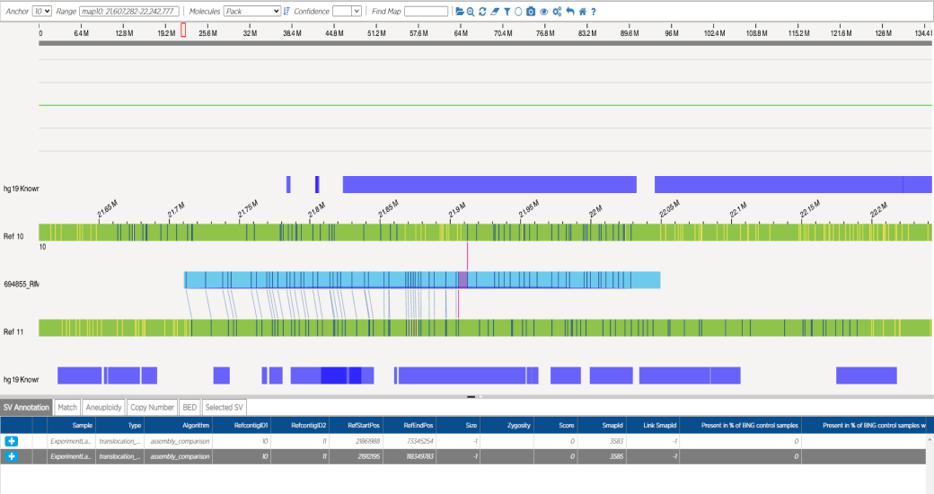
Results : 2. After independent analyses, we observed two inversions inside the long arm of one chromosome 11 and two translocations between the short arm of one chromosome 10 and the long arm of chromosome 11 which ultimately lead to the fusion of the genes KMT2A and MLLT10.
A
C
10p12.31
11q14.2
MLLT10
TMEM135
KMT2A
KMT2A
11q23.3
11q23.3
B
10p12.31
D
11q13.4
MLLT10
FAM168A
RAB6A
PLEKHB1
PLEKHB1
FAM168A
RAB6A
TMEM135
11q13.4
11q14.2
A : t(10;11)(p12.31;q23.3)(21912195;118349783)
B : t(10;11)(p12.31;q13.4)(21861988;73345254)
C : inv(11)(q14.2q23.3)(86854533_118364657inv)
D : inv(11)(q13.4q14.2)(73340798_86847507inv)
Catherine Menten and Barbara Dewaele
Cytogenetic lab, human genetic, CHU Liège, Belgium

Slide 5
Conclusion : OGM technique allowed us to observe a KMT2A-MLLT10 fusion resulting from several anomalies involving chromosome 10 and 11:
ogm\[GRCh37\]
t(10;11)(p12.31;q13.4)(21861988;73345254), [MLLT10-PLEKHB1]
t(10;11)(p12.31;q23.3)(21912195;118349783), [MLLT10-KMT2A]
inv(11)(q13.4q14.2)(73340798_86847507inv),
inv(11)(q14.2q23.3)(86854533_118364657inv)
We conclude that the analysis of this AML case nicely illustrates the value of OGM to resolve complex aberrations using only one assay.
Catherine Menten and Barbara Dewaele
Cytogenetic lab, human genetic, CHU Liège, Belgium

