Slide 1
Intimate Partner Violence: impact, processes, evolution and related public policies in Belgium
Analysing IPV policies through their instrumentation
Aline Thiry et Catherine Fallon, Spiral ULiège

Slide 2
Main steps :
Collaborative instruments and information sharing
The approach : policy instruments
Methodology : a Delphi survey with field actors
Judiciarisation : the « nul tolerance »

Slide 3
The instruments of public policy (Governing by instruments, Lascoumes & LeGales, 2007)
Technologies of government are substantiated under the form of assemblage of diverse and heterogenous actors and resources (legal, administrative, professional, financial, etc).
➔ Instruments are technical : they have to fill specific functions, according to policy objectives
➔ Instruments are social : they carry a concrete concept of the politics/society relationship, as well as meanings and representations, supporting some behaviours and privileging some actors.
An instrument organizes specific social & power relations
➔ Looking at "instruments at work" means analyzing their specific outputs and the power relations and forms of social control they organize through the materiality of public actions.

Slide 4
Analysis of instruments of public policy as dynamic translation process:
Instruments are produced through a series of steps of translation
➔ coordinating heterogeneous actors : stabilizing associations
➔ producing representations, contributing to describe and categorize the social
➔ values and beliefs are mobilised through the social interactions;
➔ Conditions of emergence contribute to shape the instrument : an historic approach is necessary
Analysing the development of instruments helps understand the patterns of transformation of a specific policy regime
How is the problematisation of the stakes being defined ? What is at stake and what is ignored ?
Design of public action tools results from a dynamic process to better link problematisation and actors.
Reinterpretation means calling into question the "network actor" which are bearing a specific implementation instrument

Slide 5
Policy instrument: an example
The Istanbul Convention is a policy instrument ➔ it bears a specific representation about the causality of the IPV with due attention to inequality of power position between men and women
The Grevio reports are communication techniques ➔ define lines of intervention towards specific actors
In Belgium the NGO’s are supportive to this vision in the French speaking region but not in Flanders …
Who are the actors ?
Who gets involved and who is ignored
What is their representation about the social situation? About the problem?
What values and beliefs are mobilized through the social interactions;
What information and which model is mobilized ?
➔ Conditions of emergence contribute to shape the instrument : an historic approach is necessary

Slide 6
Delphi survey : Collecting data on problematisation dynamics and actors’ mobilisation
The Delphi technique is iterative anonymous participatory technique:
Who participate ? “experts” as professionals and as experts of experience
Why iterative ? to organize a form of “dialogue”
Why anonymous ? to avoid domination and decrease social pressure
Organized in 4 steps :
Understand the domain; identify the “experts”, exploratory interviews
Define the questions for the 1st round and leave room for surprises.
The Feedback loop : Feedback of the information gathered to the participants with the 2d round of questions (controlled feedback process): participants can react, comment, adjust their position,
The final report is fed back for consideration to respondents

Slide 7
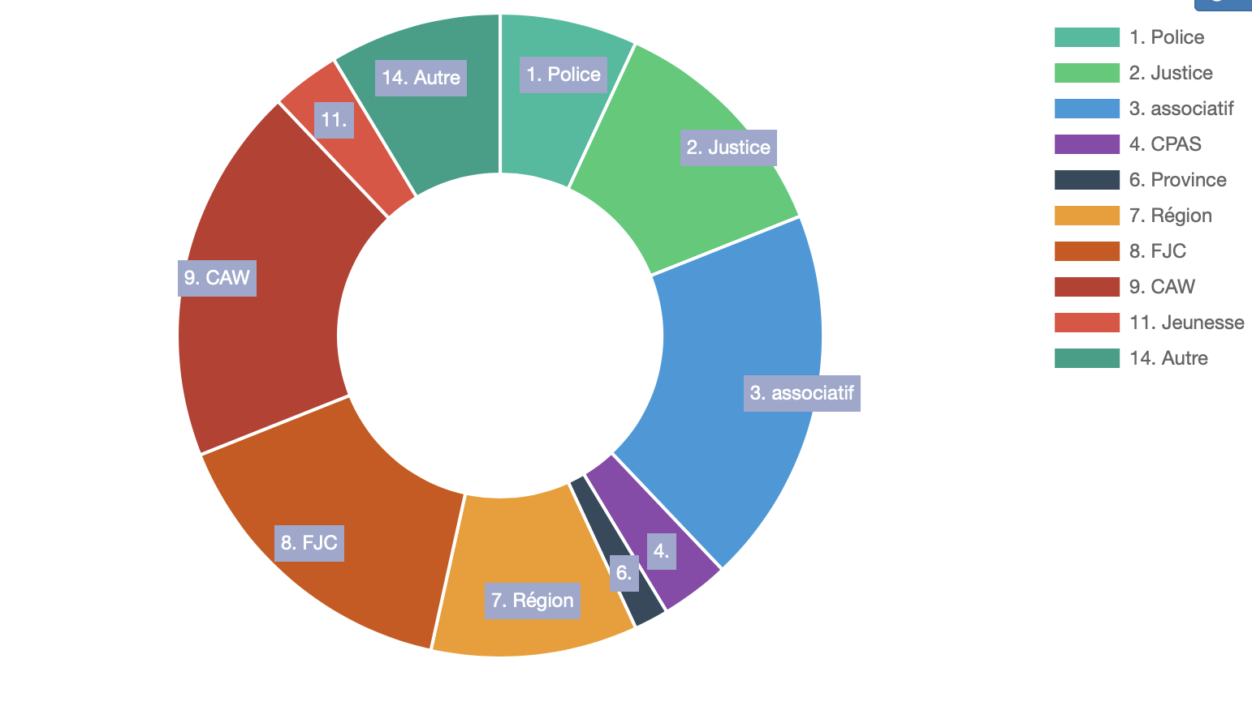
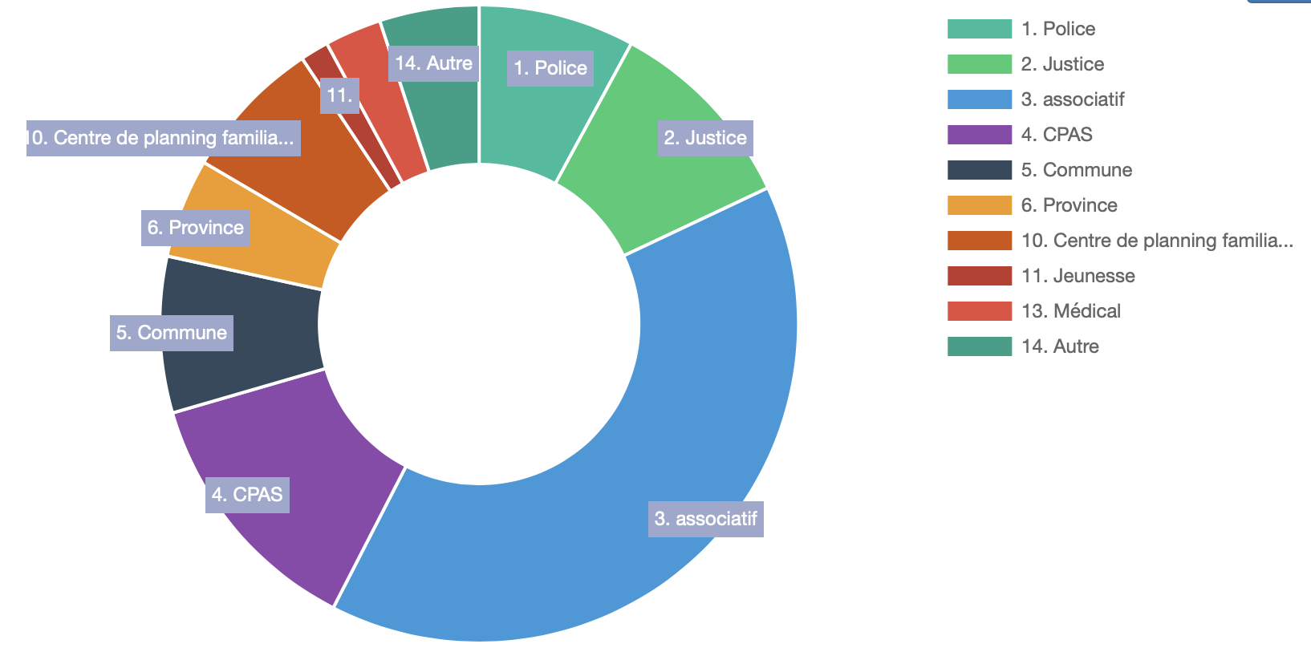
Delphi Survey 2020-2021
The survey was sent to operators in the judiciary system, police, social intervention, administration. The experts invited had been identified as “in charge “ of questions of violence against women.
219 actives respondants answered the questions from different sectors
NL
FR

Slide 8
Framing the issue of IPV : at federal level
Historically the issue is closely linked to feminist NGO’s.
1989 : possibility of “rapes” between partners in the penal code.
2001 : the issue is in the federal plan about addressing violence
A key moment is 2006 : a policy discourse on “Tolerance 0” at the level of the police and justice
How to define, identify and address IPV?
Increase intersectorial collaboration on the issue
The police must send all plainstif to the prosecutor and always ensure a follow up.
A key moment is the pilot of “Family Justice Centers” in Flanders

Slide 9
Ensuring multi-frames with IPV :
How to ensure coordination & collaboration between actors on the field :
Police – Justice
Services and NGO’s in the psycho-médico-social sector
➔ Flanders : less independant organisations in the social sectors (CAW)
Two experiences with « family justice centers » ➔ organising cooperation at the initiative of the prosecutor
➔ In Wallonia :there are many organisations :
Feminist associations moblising a femimnist frame
Other associations speaking of « partners violence » (to cover more situations)

Slide 10
Flanders and Wallonia : 2 social configurations
Convention d’Istanbul : prévenir / protéger / poursuivre les violences (comme violences fondées sur le genre)
National Action Plan : 2001 violences contre les femmes ➔ 2004 entre partenaires ➔ 2015 fondées sur le genre
Federal Justice + police (Col 4/2006) : protect the victim and punish the author
Interdisciplinary (Ketenaanpak)
2 active Familie Justice Centers
Coordinated by the prosecutor
No interdisciplinarity
asbl
asbl
asbl
CAW:
Symetric approach to IPV
asbl
OCMW
asbl
asbl
asbl
asbl
asbl
CPAS ?
Depolitisation of social work
➔ family wellbeing

Slide 11
The vision about « Tolerance Zero » :
Even if it is still a reference in terms of police/justice intervention, it is not really applied in the field: great disparity in practices between judicial districts and police areas, also depending on the people who are handling the case.
Are the expectations of the justice system exagerated?
Critics point to problems at several levels:
- The question of proof, which leads de facto to a re-characterisation of the criminal act. For example: the requirement of a medical certificate
- the legal means : disposal number of legal tools that still have to be applied within a strict legal framework + lack of means at the disposal of the justice / police system + long (and slow) process
- No victim protection measures take into account the long term

Slide 12
Some concluding points
in recent years, new measures have been put in place which show a strengthening of the protective role of justice (temporary residence ban, chain approach, etc.)
In Flanders, justice actors play a central role in the collaboration with the CAW and the police. In Wallonia, the associations refuse that the justice system takes this leading role.
In the field, the framing influences the way the problem is handled
There is no position of neutrality: the instruments are not neutral and it is the analyst's job to deconstruct the invisibility

Slide 13
Thank you for your attention! Aline.Thiry@uliege.be

Slide 14
One country, Two systems …
Convention d’Istanbul : prévenir / protéger / poursuivre les violences (comme violences fondées sur le genre)
PAN (et IEFH) : 2001 violences contre les femmes ➔ 2004 entre partenaires ➔ 2015 fondées sur le genre
Justice (Col 4/2006) : protéger / punir les comportements punissables dans des rapports interpersonnels
Interdisciplinary (Ketenaanpak)
2 active Familie Justice Centers
No interdisciplinarity
asbl
asbl
asbl
CAW
asbl
OCMW
asbl
asbl
asbl
asbl
asbl
CPAS ?

