Slide 1
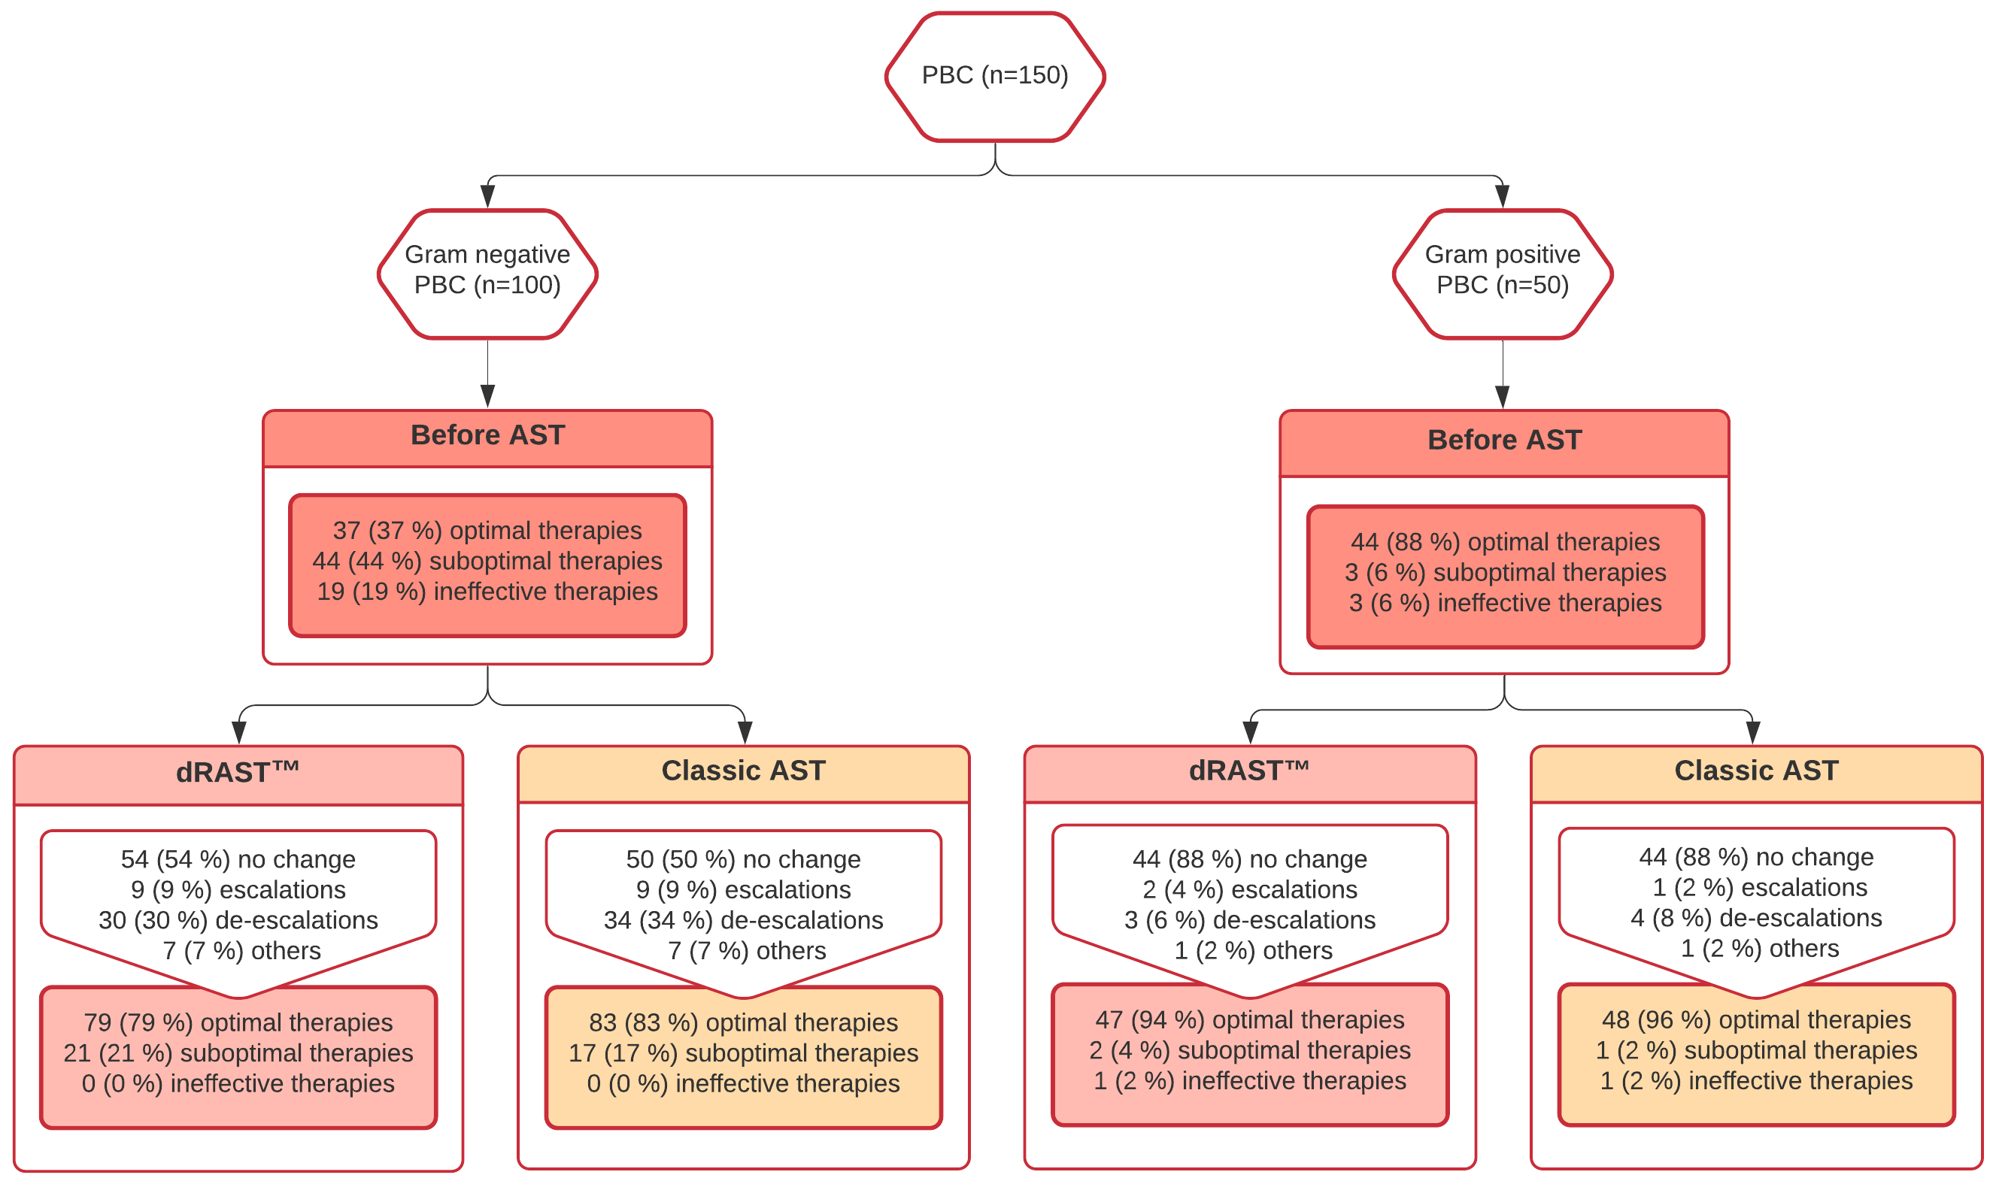
Clinical impact of a direct Rapid Antimicrobial Susceptibility Testing
(dRASTTM) in administration of optimal therapy in patients with bloodstream infection
C. FONTAINE¹, N. CATARIN¹, C. MEEX¹, C. VERCHEVAL², F. MACLOT¹, MP. HAYETTE¹, J. DESCY¹
¹ Department of Clinical Microbiology, and Center for interdisciplinary Research on Medicines (CIRM), University of Liege, Liege, Belgium
² Department of Clinical Pharmacy, University Hospital of Liege, Liege (Belgium)
Introduction
A critical step to reduce mortality during sepsis is the administration of an adequate antibiotic agent. However, to adjust empirical therapy, clinicians need identification of the microorganism and antimicrobial susceptibility testing (AST). The direct rapid AST from QuantaMatrix (dRAST™) provides AST with minimal inhibitory concentrations directly from positive blood culture (PBC) within 6 hours.
Results
As shown in Figure 1, adaptation in OT according to AST (dRASTTM and Vitek®2) occurred in 46% of Gram-negative PBC and in 8% of Gram-positive PBC. 37% of empirical therapies of Gram-negative PBC and 88% of empirical therapies of Gram-positive PBC were already optimal before AST. In total the dRAST™ allowed the adaptation in OT of 61,7% (29/47) of suboptimal empirical therapies, while 70,2% (33/47) for classic AST. On the other hand, 81,8% (18/22) of ineffective empirical therapies were adjusted in OT for both AST.
As shown in Tables 2 and 3, for patients with an adaptation of treatment in OT based on AST (n=50), TTR and TTCT were significantly lower with dRAST™ (p<0,001). Moreover the time saved was bigger for Gram-positive PBC (40:18 ± 12:33) than for Gram-negative PBC (18:08 ± 08:18).
AIM
This retrospective study aimed to evaluate the potential impact of dRAST™ in the administration of optimal therapy (OT) to patients with bloodstream infection (BSI).
MethodS
We compared, among 150 patients, « Time to result » (TTR) and « Time to change therapy » (TTCT) between dRAST™ and classic AST (Vitek®2) :
As this retrospective study is a simulation, time between AST result and adaptation of the therapy would be the same for both type of AST, then TTCT = TTR for classic AST and TTCT = TTR during open hours of the laboratory (9 am to 6 pm) or TTCT = TTR + number of hours until 9 am the next day outside the laboratory's opening hours for dRAST™
We reviewed and classified antimicrobial therapies into 3 categories before AST result, at the time of dRAST™ result, and at the time of classic AST result.
The therapy at the time of dRAST™ result is the antibiotic that should have been administered based on dRAST™.
From these treatment categories, we concluded the amount of:
Figure 1. Treatment categories before AST result, at the time of dRASTTM result and at the time of classic AST result (Vitek®2) and escalations, de-escalations, no change, or others in adaptation of therapy with dRASTTM and with classic AST.
Conclusions
For Gram positive PBC, the dRAST™ has a limited utility like classic AST. Indeed other tests are often sufficient to adjust therapy in OT: screening for methicillin-resistant Staphylococcus aureus and vancomycin-resistant enterococci, identification by MALDI-TOF and rapid detection of resistance markers like pbp2a. In contrast, for Gram negative PBC, there was a higher proportion of treatment adjustments according to AST, which were significantly faster with dRAST™. In conclusion, for BSI requiring therapeutic adaptation, the dRAST™ allows a faster administration of optimal therapy.
References
Kim JH, Kim TS, Song SH, et al. Direct rapid antibiotic susceptibility test (dRAST) for blood culture and its potential usefulness in clinical practice. J Med Microbiol 2018; 67: 325–31.
Kim JH, Kim TS, Jung HG, et al. Prospective evaluation of a rapid antimicrobial susceptibility test (QMAC-dRAST) for selecting optimal targeted antibiotics in positive blood culture. J Antimicrob Chemother 2019; 74: 2255–60.
Choi J, Jeong HY, Lee GY, et al. Direct, rapid antimicrobial susceptibility test from positive blood cultures based on microscopic imaging analysis. Sci Rep 2017; 7: 1–13.
Acknowledgements
The dRAST V2.5 system and reagents used in this study were kindly provided by QuantaMatrix Inc.
CONTACT INFORMATION
C.Fontaine@chuliege.be
julie.descy@chuliege.be

