Slide 1
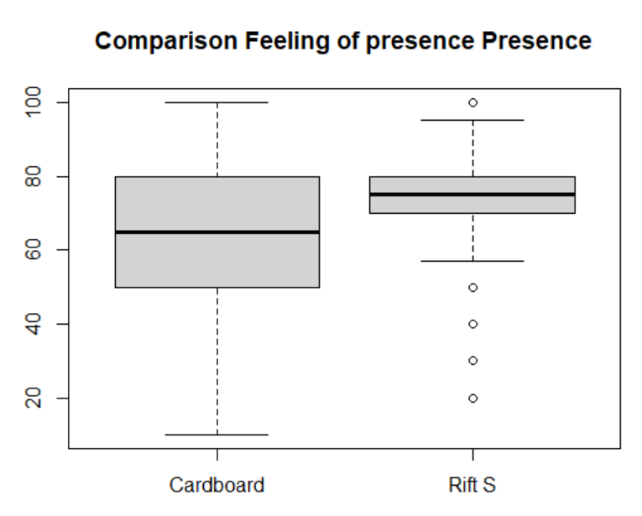
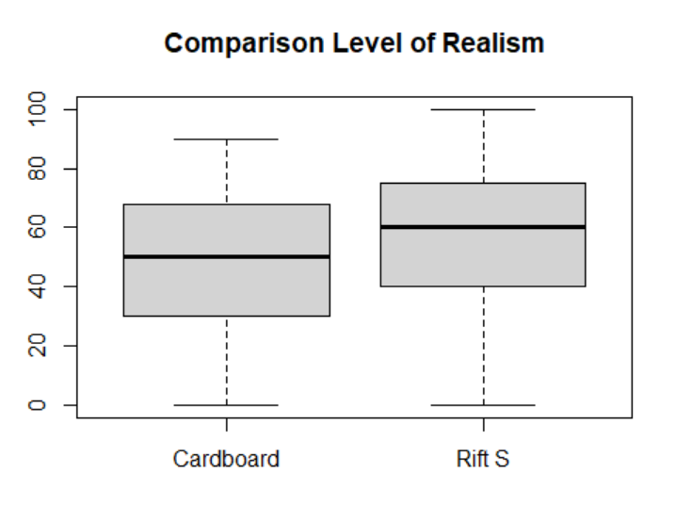
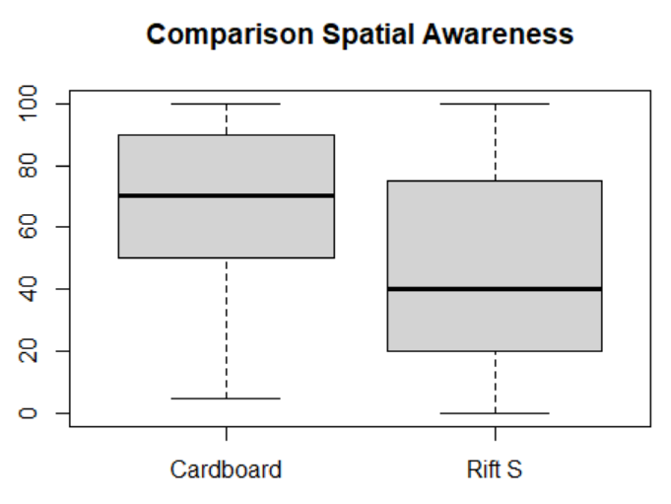
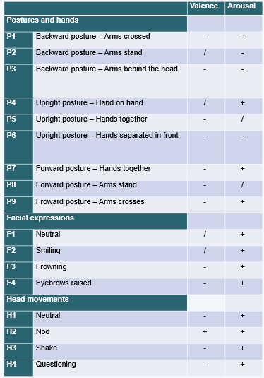
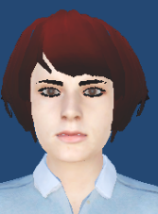
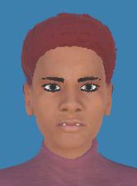
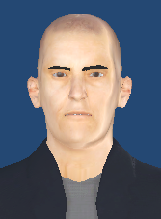
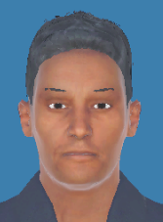
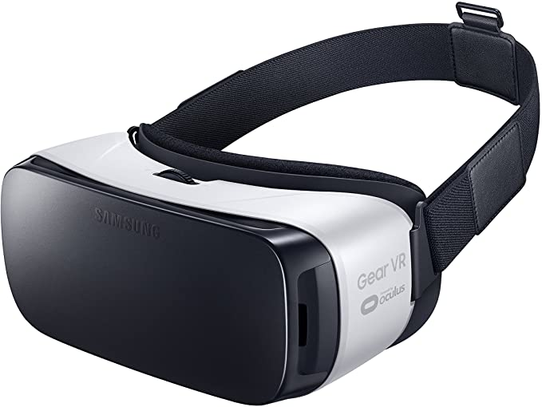
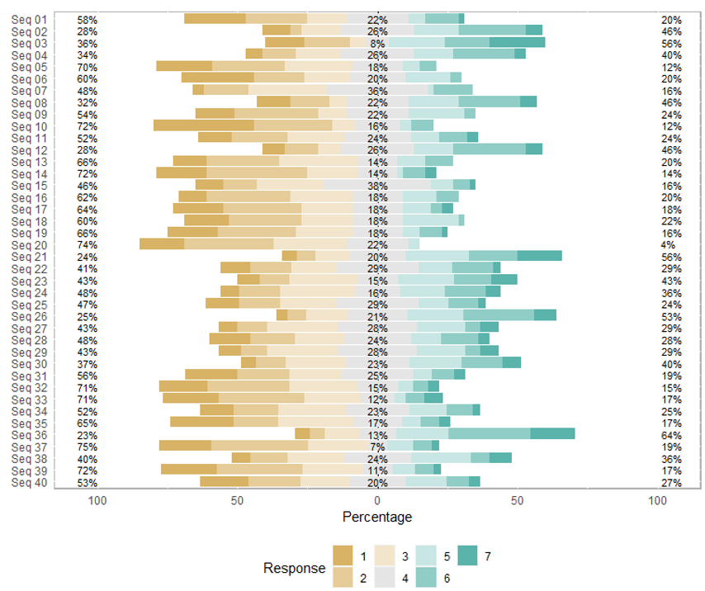
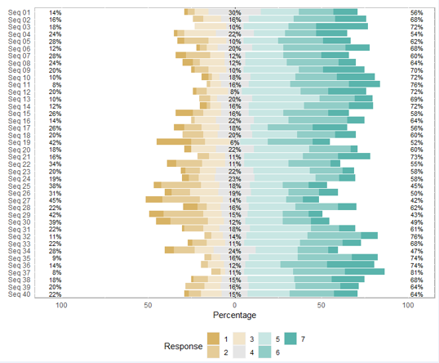
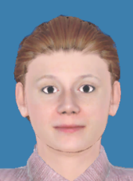
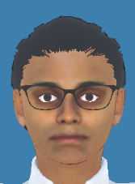
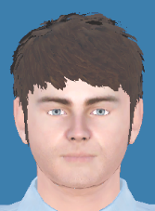
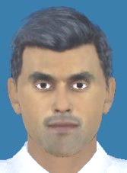
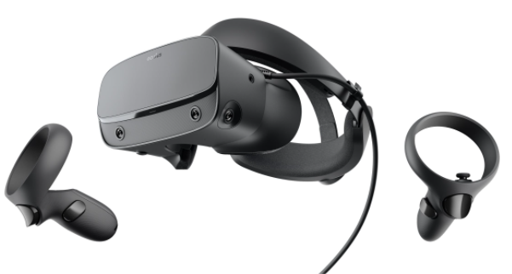
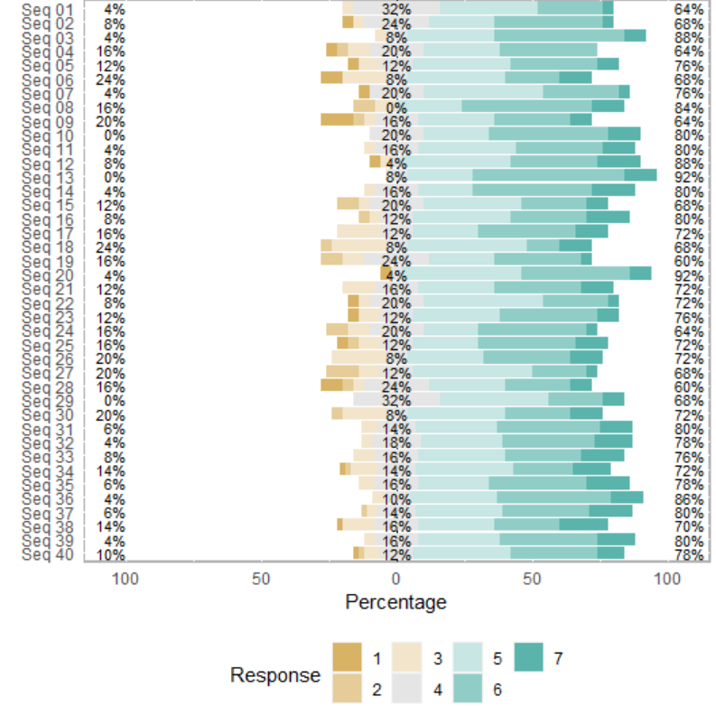
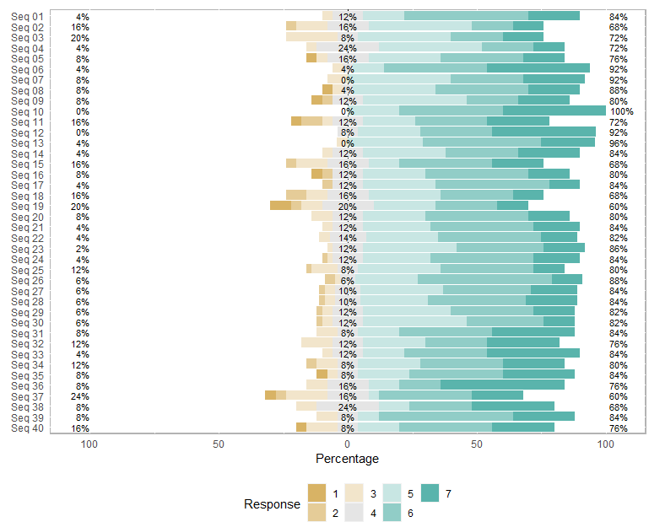
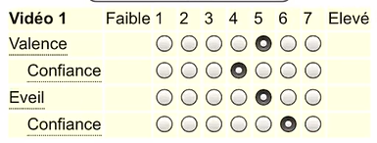
SpeakInVR : validation of a virtual audience
Etienne, E..ª, Leclercq, A-L. ^{bcd}, Remacle, A.^{b,} , Schyns, M.ª
ªQuantOM , HEC Liège, University of Liège
^{b} Département de Logopédie, Université de Liège
^{c} Unité de Recherche Enfances
^{d} Clinique Psychologique et Logopédique de l’Université de Liège
Introduction • • • • • • • • • • • • • • • • • • • • • • •
Attitudes and VR environments • • • • • • • • • • • •
Attitudes: 144 possible combinations of posture, facial expression and head movements.
The VR environment:
•
Results • • • • • • • • • • • • • • • • • • • • • • • • • • • •
Consequences on public speaking performances
Training in front of a interactive audience in VR
Level of valence and arousal associated with each parameter
Comparison of the quality of immersion between low-end and high-end headsets
Social anxiety
Sketched models
Photorealistic models
Attitudes and the levels of valence and arousal associated
Contributions (this work) • • • • • • • • • • • • • • •
Understanding how some attitudes of a virtual audience are perceived in Virtual Reality (valence – arousal)
Study of the quality of immersion and of the feeling of presence in VR:
VR headsets (low-end VS high-end)
Photorealistic models VS sketched models
Gender and complexion
Creation of a library of animated avatars associated with some levels of arousal and valence to be used in a VR training environment.
Contributions (mid-term) • • • • • • • • • • • • • •
Training environment where the virtual audience will react appropriately to the speech; either on the therapist demand and/or automatically (artificial intelligence)
Low-end headset = cardboard Gear
High-end headset = Rift S
Valence per sequence
Arousal per sequence
Comparison of the condfidence level between sketched and photorealistic models
Survey • • • • • • • • • • • • • • • • • • • • • • • • • • •
125 participants
40 sequences of attitudes were tested
7-point Likert scale
QP-UQO questionnaire
Confidence level per sequence for sketched models
Confidence level per sequence for photorealistic
models
Conclusions • • • • • • • • • • • • • • • • • • • • • • • • • • • • • •
First step into a long-term project.
Creation of a library of avatar attitudes associated with some levels of valence and arousal.
Results for sketched and photorealistic models are similar in terms of assessing valence and arousal but the confidence level is improved when using photorealistic models.
Results for cardboard and Rift S are similar in terms of assessing valence and arousal but the quality of immersion (the impression of being there, appraising the experience as being real, the feeling of being in the physical office instead of the virtual environment) is improved when using high-end Headset.
Hypotheses • • • • • • • • • • • • • • • • • • • • • • • •
H1: Arousal: more facial expressions and more head movements lead to higher arousal.
H2: Valence: smiles, nods are associated with positive valence; frowns, head shakes with negative valence; eyebrow raises are mostly neutral.
H3: High-quality headsets deliver a better experience and have a positive impact on presence.
H4: Photorealistic avatars improve the user's confidence level
Definitions • • • • • • • • • • • • • • • • • • • • • • • •
Valence: corresponds to how positively or negatively the person feels toward the speaker or the presentation
Arousal: audience member's level of alertness
References • • • • • • • • • • • • • • • • • • • • • • • • • • • • • • • • • • • • • • • • • • • • •
[1] Chollet, M., & Scherer, S. (2017). Perception of virtual audiences. IEEE computer graphics and applications, 37(4), 50-59.
[2] Chollet, M., Wörtwein, T., Morency, L. P., Shapiro, A., & Scherer, S. (2015, September). Exploring feedback strategies to improve public speaking: an interactive virtual audience framework. In Proceedings of the 2015 ACM International Joint Conference on Pervasive and Ubiquitous Computing (pp. 1143-1154).
[3] Slater, M. (2003). A note on presence terminology. Presence connect, 3(3), 1-5.
[4] Wallach, H. S., Safir, M. P., & Bar-Zvi, M. (2009). Virtual reality cognitive behavior therapy for public speaking anxiety: a randomized clinical trial. Behavior modification, 33(3), 314-338.
[5] Wiederhold, B. K., & Bouchard, S. (2014). Advances in virtual reality and anxiety disorders. Springer.
BAPS 2021 – UCLouvain, Belgium –28th May 2021 Contact: elodie.etienne@uliege.be

