Slide 1
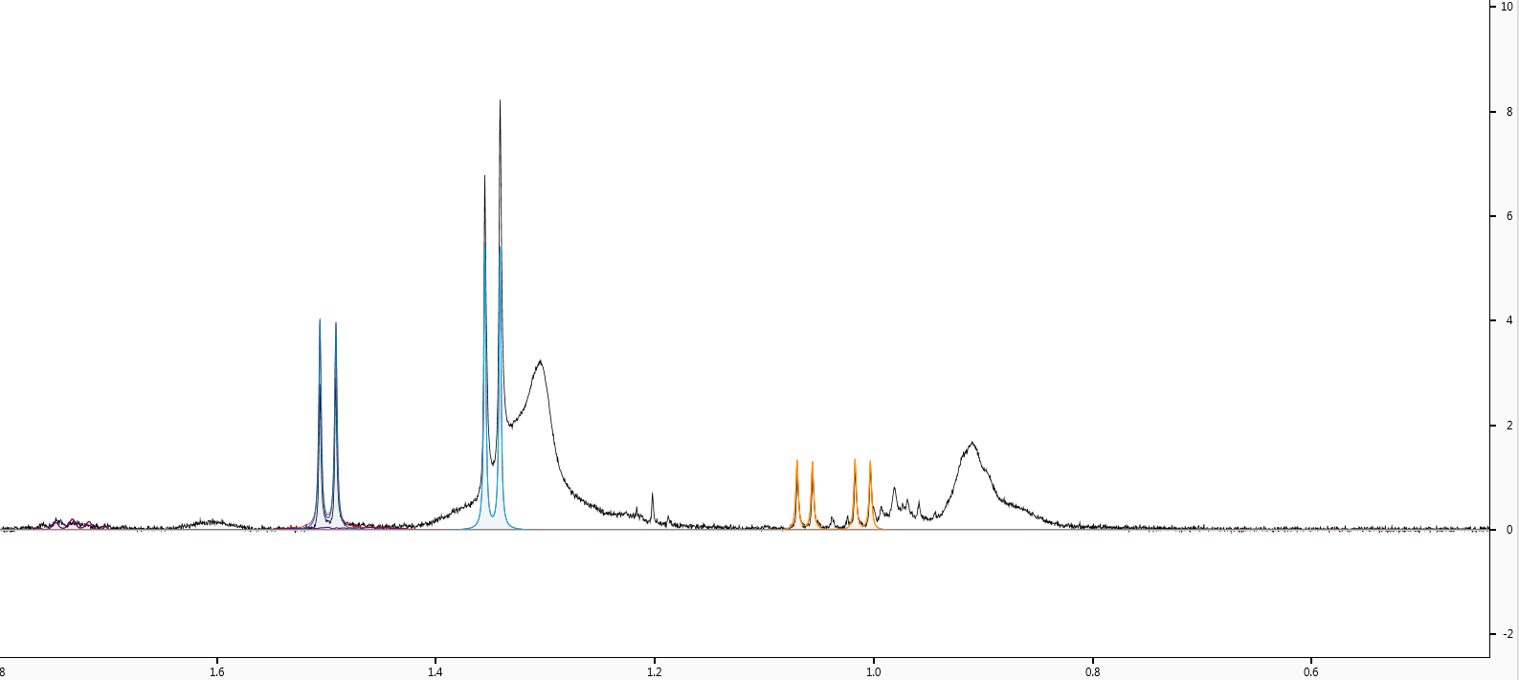
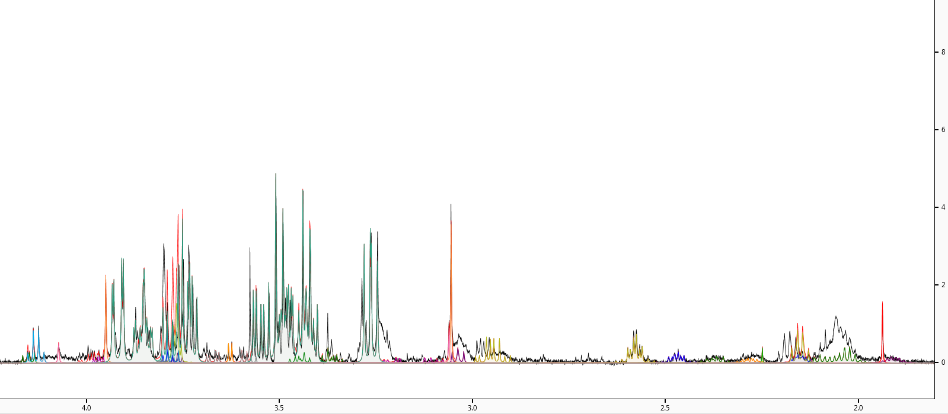
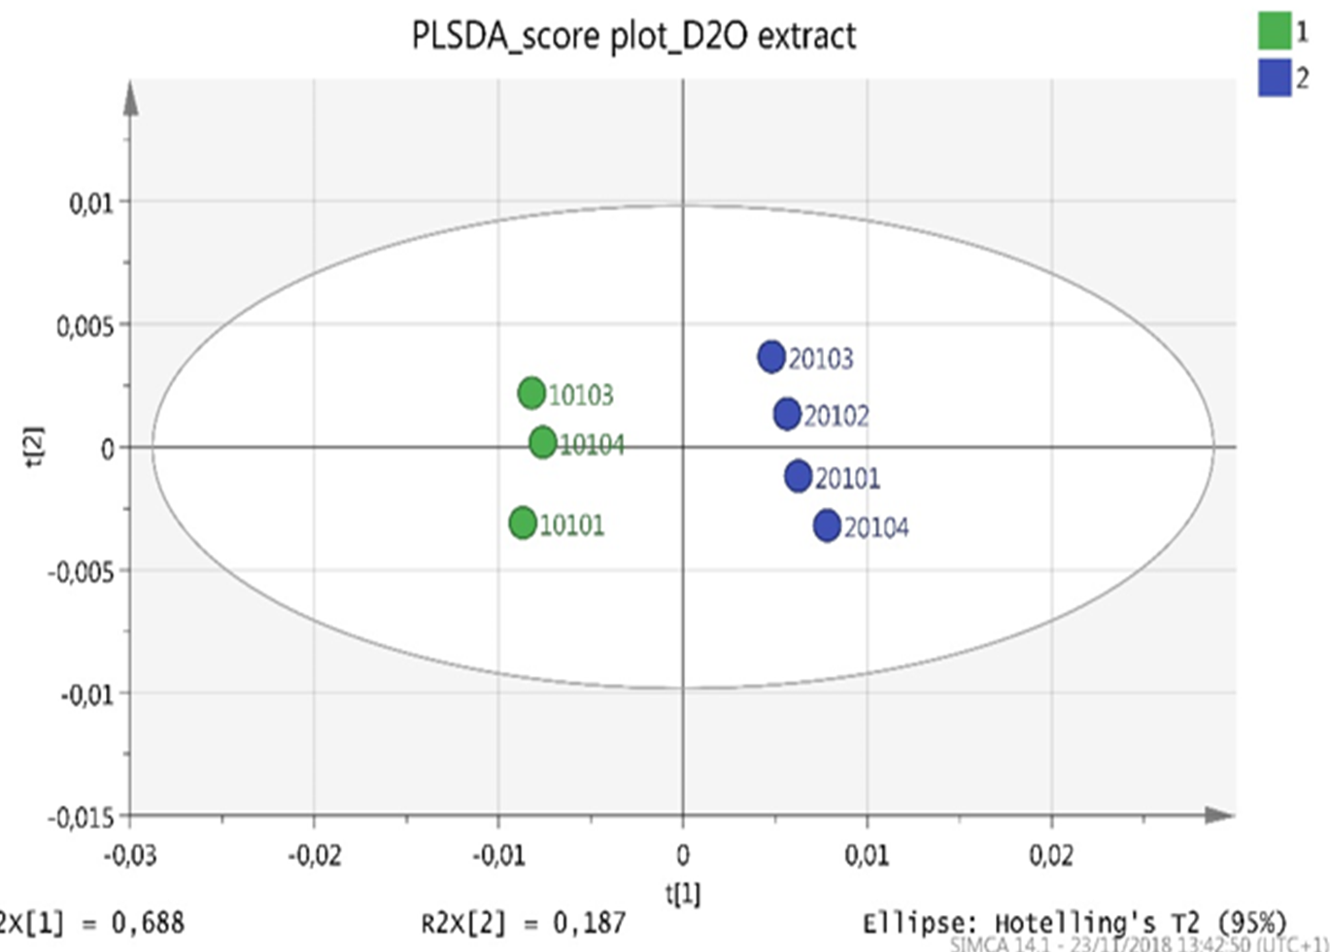
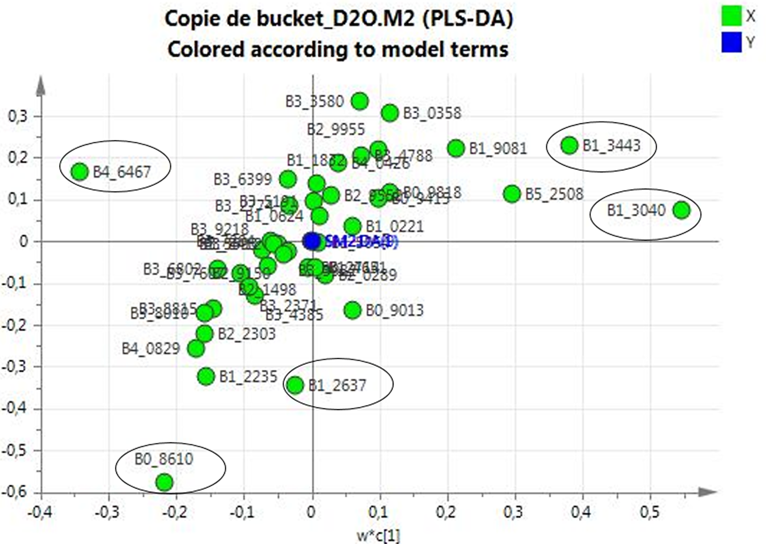
Study of Dried Blood Spots Sampling
for NMR Based Metabolomics
CIRILLO A.¹ , ARSLAN D.², DEGOTTE G.², PIROTTE B.², SCHOUMACHER M.¹ , DE TULLIO P.¹
¹Center for Interdisciplinary Research on Medicines, Metabolomics Group, University of Liège, Pharmacy Tower (B36), Sart-Tilman, B-4000 Liège, Belgium
²Center for Interdisciplinary Research on Medicines, Laboratory of Pharmaceutical Chemistry, Pharmacy Tower (B36), Sart-Tilman, B-4000 Liège, Belgium
Results
Extraction protocol and ¹H-NMR analysis
Introduction
Several extraction conditions have been evaluated. The method that led to the best extraction results is the following:
20µL of whole blood were deposed on the DBS device. After dryness, samples were punched out and extracted by 200µL of D₂O with a 30 min shaking. 150µl of the extracts were withdraw and prepared for the ¹H-NMR analysis in a 3 mm tube. Different sequences were also tested and the CPMG sequence was chosen (fig.1), the number of scan was also optimized in order to obtain the best signal to noise /ratio.
Metabolomics is part of “omics” sciences that involves the study of complete set of small molecules called “metabolites” present in cells, tissues and biofluids of living systems. It help to better describe the organism’s status and the influence of internal and external factors. This field of “omics” sciences represents a useful tool to identify biomarkers linked to precise physio-pathological conditions that can be used for the development of a personalized medicine approach in the treatment and the patient’s follow-up. By focusing on a fast and simple biofluids analysis through a NMR platform, we propose the use of Dried Blood Spot (DBS) as device for an non-invasive and poorly time-consuming blood samples collection and analysis.
Figure 1: protocol applied for the sample extraction and NMR analysis
By using CHENOMX software, it was possible to identify and quantify 15 metabolites (fig.2) .
Methodology
In order to verify the applicability of DBS to NMR-based metabolomics, our study was based on 2 different approaches: the first one deals with the extraction step of the metabolites from DBS in way to maximize the number and the quantity of extracted molecules, the second one deals with the optimization of NMR parameters that allow to obtain the best and useful spectral data. The reproducibility of our protocol was evaluated by measuring several DBS samples coming from two individuals. Furthermore, as a proof of concept, we applied it on a real case study composed by 6 subjects in fasting and non fasting condition in order to discriminate the individuals on the basis of their metabolomic profile.
Figure 2 CHENOMX spectra in which are shown the identified metabolites coming from the extraction of 20µL of blood deposed on DBS device.
2nd study : six subject and two conditions (fasting/non fasting)
1st study: assessing reproducibility
As proof of the concept, the method was applied to a real case study, by taking 6 subjects of different gender, age, lifestyle in fasting and non fasting condition and by comparing it to direct serum analysis in way to prove its applicability. The multivariate analysis on serum samples with both PCA and PLS-DA showed that a clear separation occurred between individuals on the basis of fasting and non fasting conditions. As expected and illustrated by the loadings, the separation between the two groups are mainly related to the glucose spectral zone. (fig 4a-4b).
8 samples coming from two individuals (male and female) were analyzed using the developed protocol. Multivariate statistical analysis on the first small group was performed in way to assess the reproducibility of the method to make distinction between DBS samples coming from two individuals. From the PCA score plot (R²=0,9251) we were able to spot the loadings responsive for the separation (fig. 3a-3b); a PLS-DA model (Q²=0,9637) was performed on the same cohort in order to maximize the separation between the clusters (in green the female, in blue the male) and to obtain the VIP score plot that represent variables making possible the separation between male and female subject’s samples (fig. 3c) .
a
b
a
b
Figure 4 (a): PLS-DA model on sera shows clearly the separation between the two conditions independently from the intra-group variability; (b) from the loading plot is possible to underling all the variables carrying out the separation are due to glucose signals in NMR spectrum
c
d
In contrast, the result obtained by DBS extracts are less convincing and highlighted the incapability and the weakness of the method to separate subjects on the basis of the two conditions (fig. 5a-5b).
a
b
Figure 3 (a) PCA model performed on the two subjects ( in green the female/in blue the male) showing the possibility to clearly distinguish them; (b) the loadings plot give us information about which features are important for the clustering; ( c) PLS-DA score plot highlight the separation between groups by a priori knowledge (d) the VIP score show the features important for the separation with the relative standard deviation
Figure 5 (a) The PLS-DA plot performed on DBS extract highlight how the superimposed classes are not respected because of the high sample intra variability and the lower metabolites recovery; (b) loading plot of the DBS extract model in fasting/no fasting conditions
Conclusions
This study demonstrates that the results obtained with DBS samples is not optimal for untargeted NMR-based metabolomics analysis of blood samples. Indeed, due to the low volume of blood, the recovery of metabolites was less effective than in plasma or serum and the obtained metabolomics profile exhibited a low signal to noise ratio which had an impact on the quality of the multivariate results. Moreover, in a real case study, the discrimination between fasting and non fasting individuals are poorly effective. The development of an easy and poorly invasive device to collect and store blood samples remains a great challenges and is clearly a important milestone that must be taken in order to apply metabolomics in the field of personalized medicine.

