Slide 1


Questioning the independence of medicine in Belgium
What definition(s) of influence in medical training and R&D?
STS Italia 2021; Dis/Entangling Technoscience; Open Track
Lucas Bechoux, University of Liège, SPIRAL research center

Slide 2
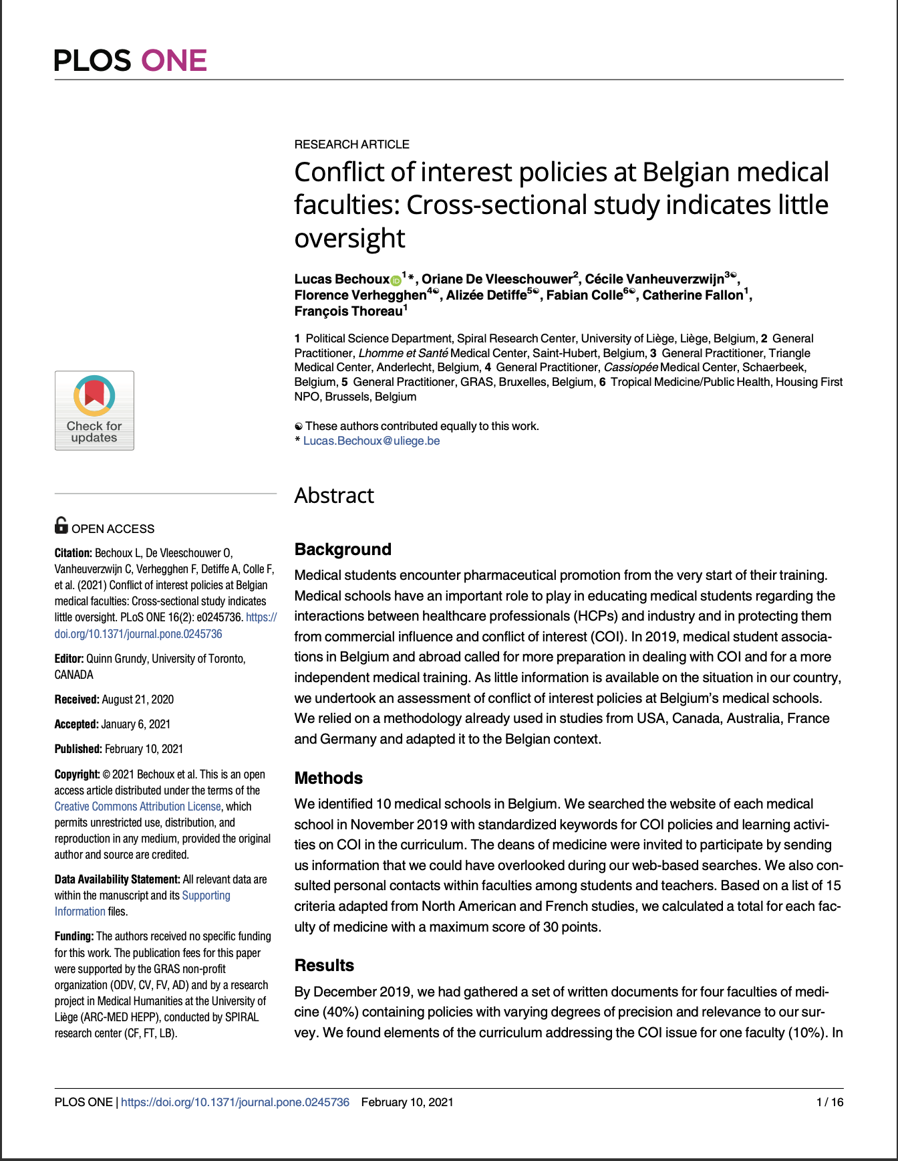
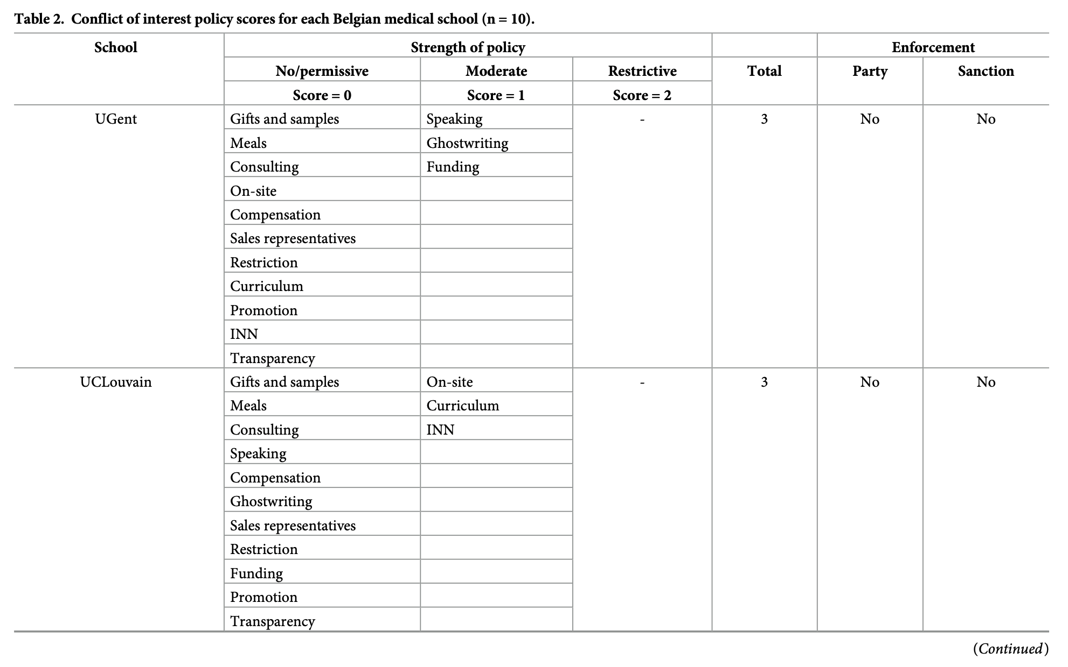
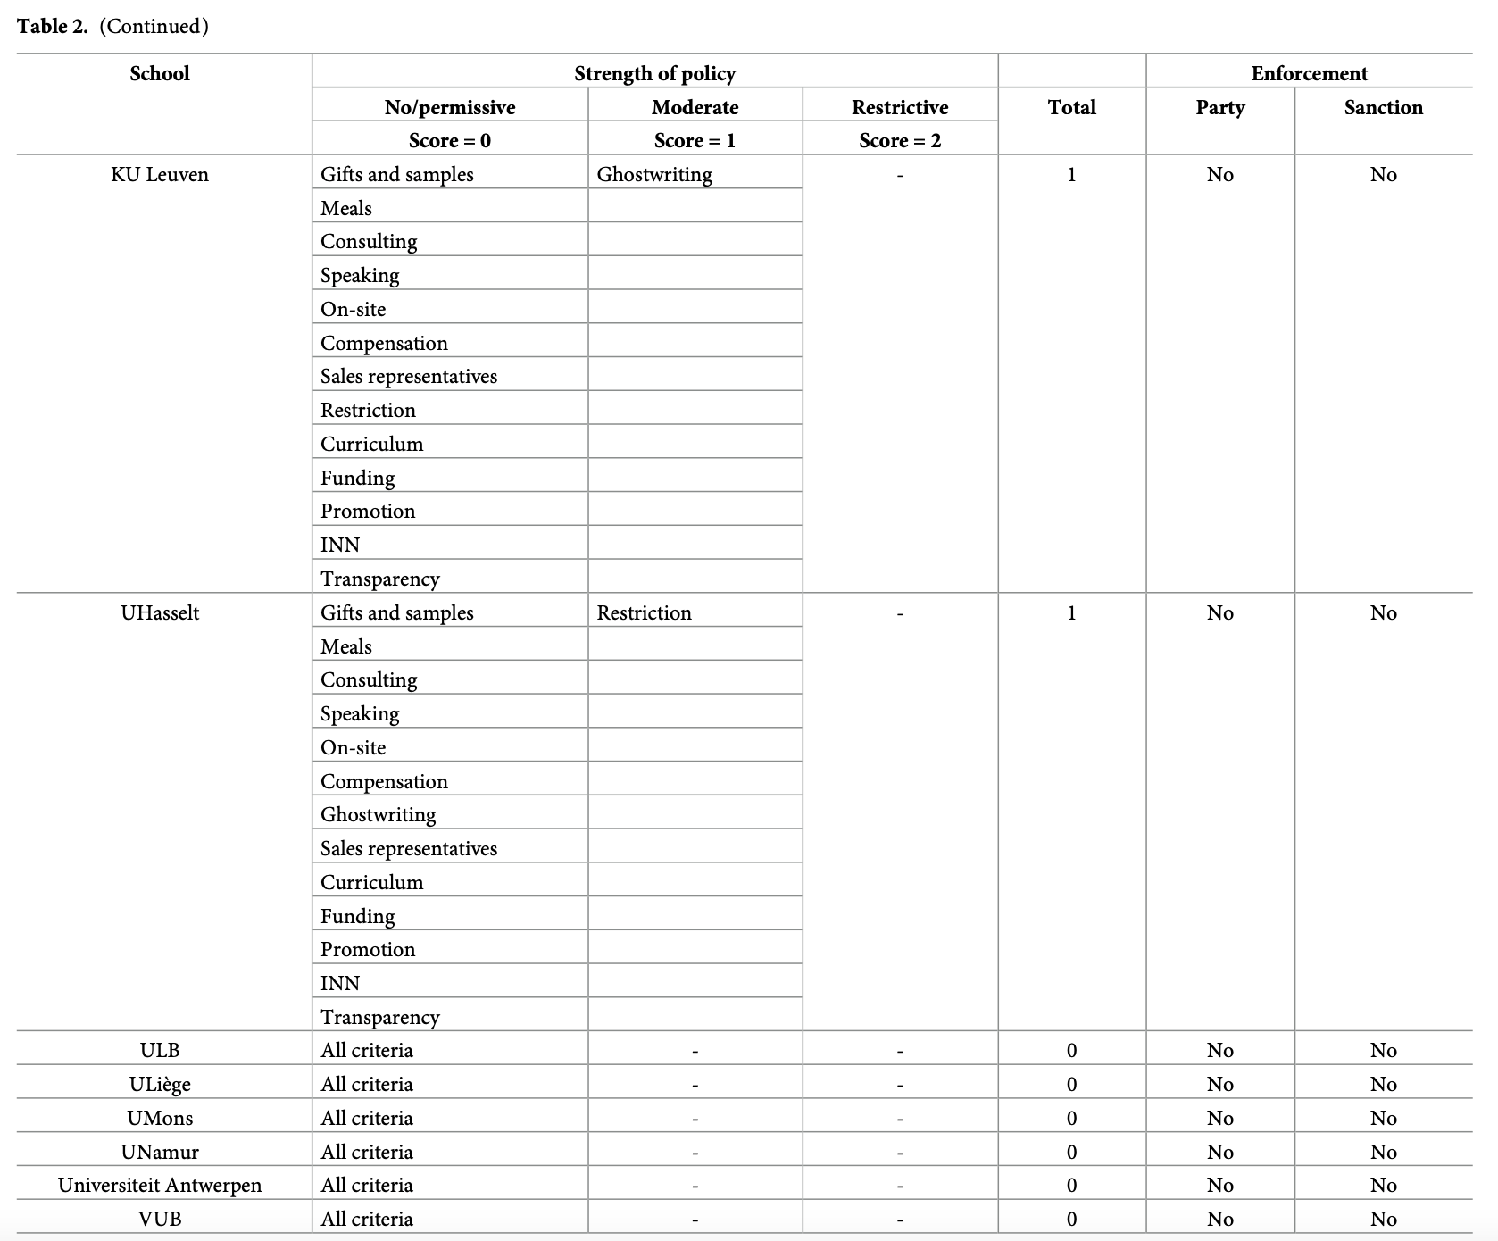

Slide 3
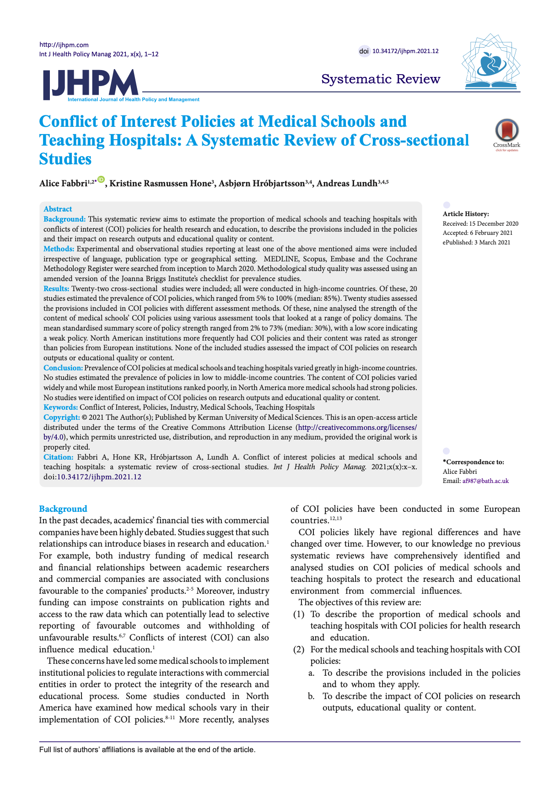
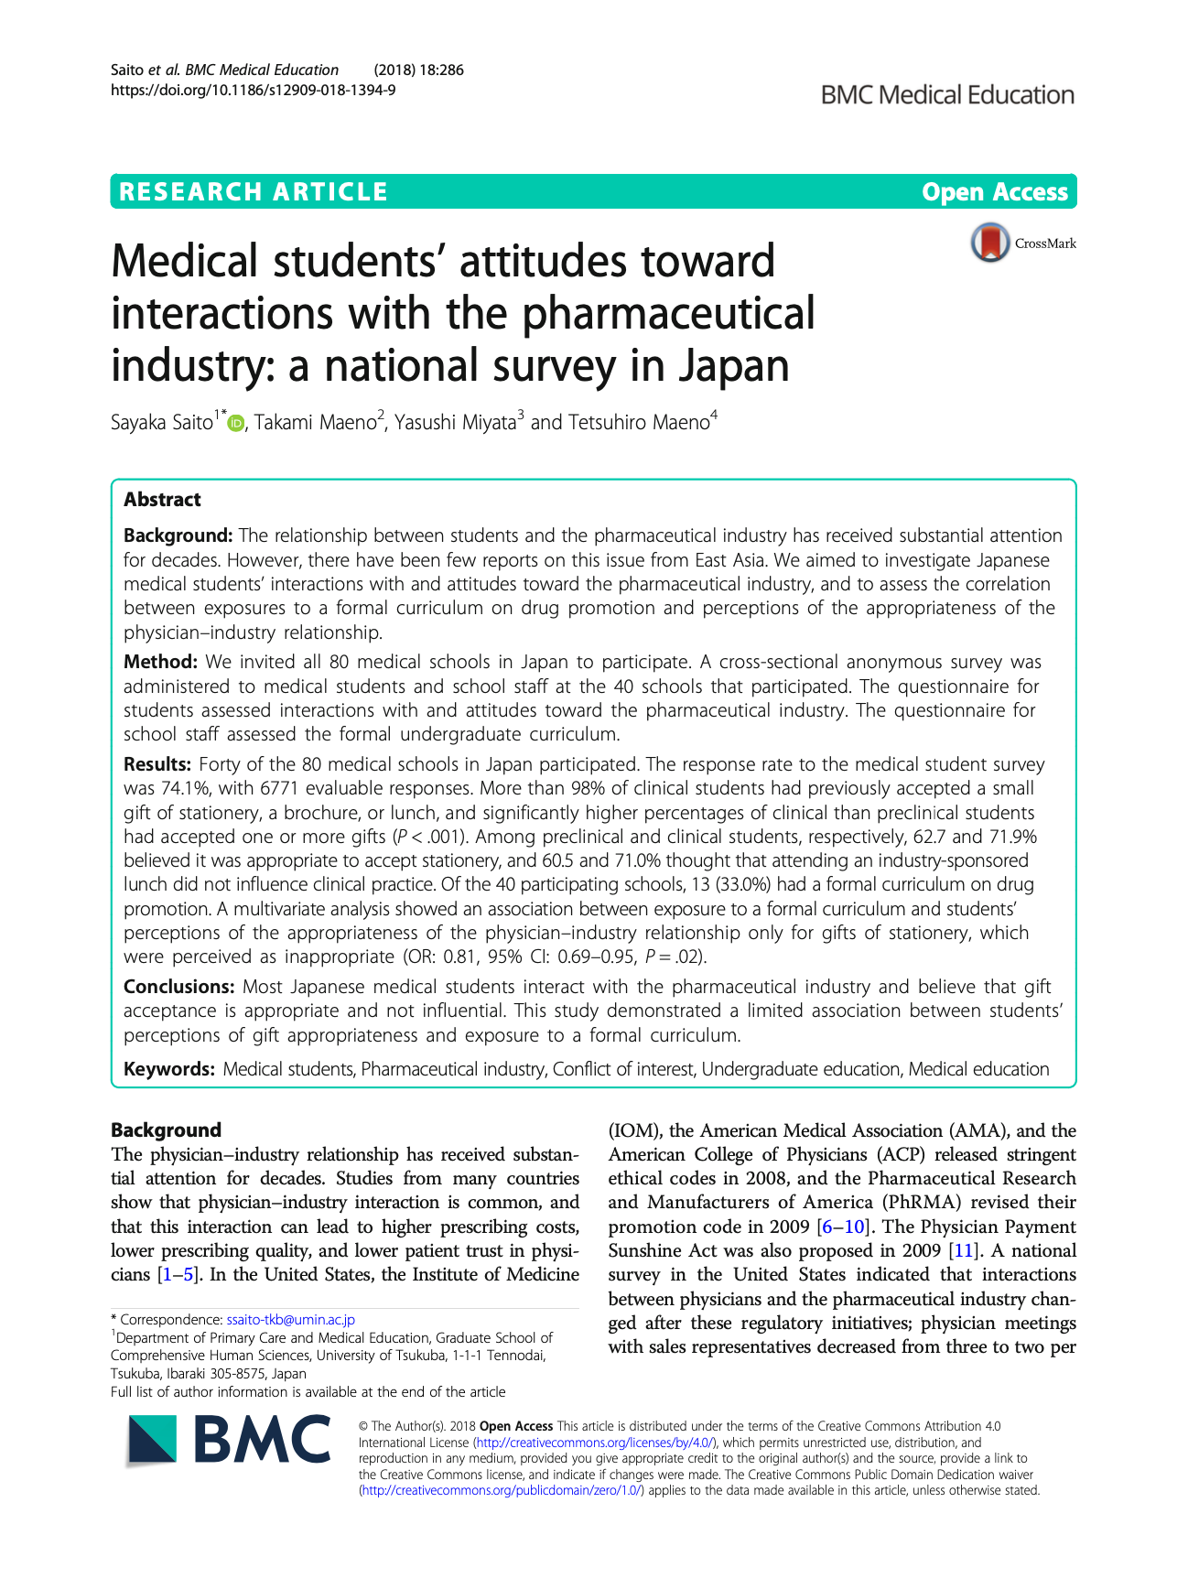
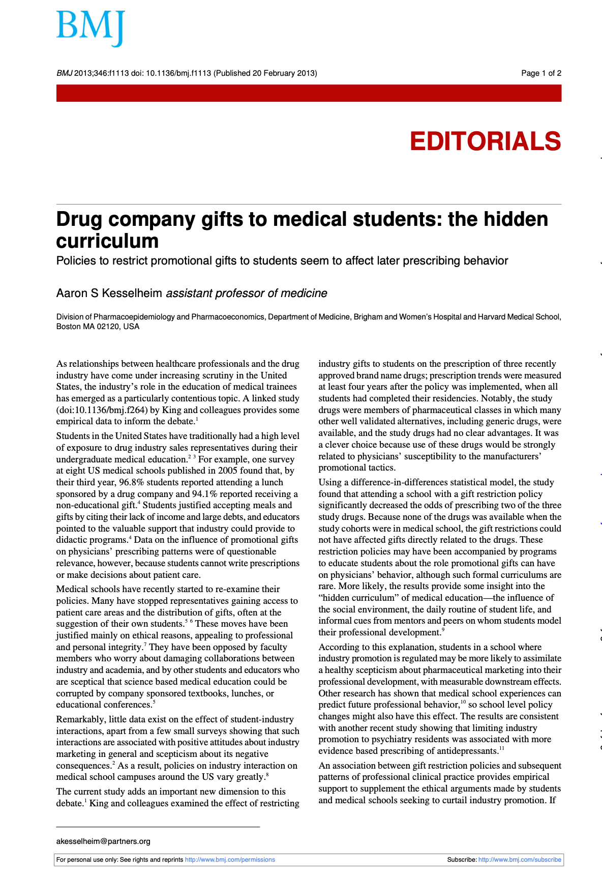
-> Exposure to pharmaceutical promotion is associated with changes in the quality, quantity, frequency and cost of prescribing practices.

Slide 4
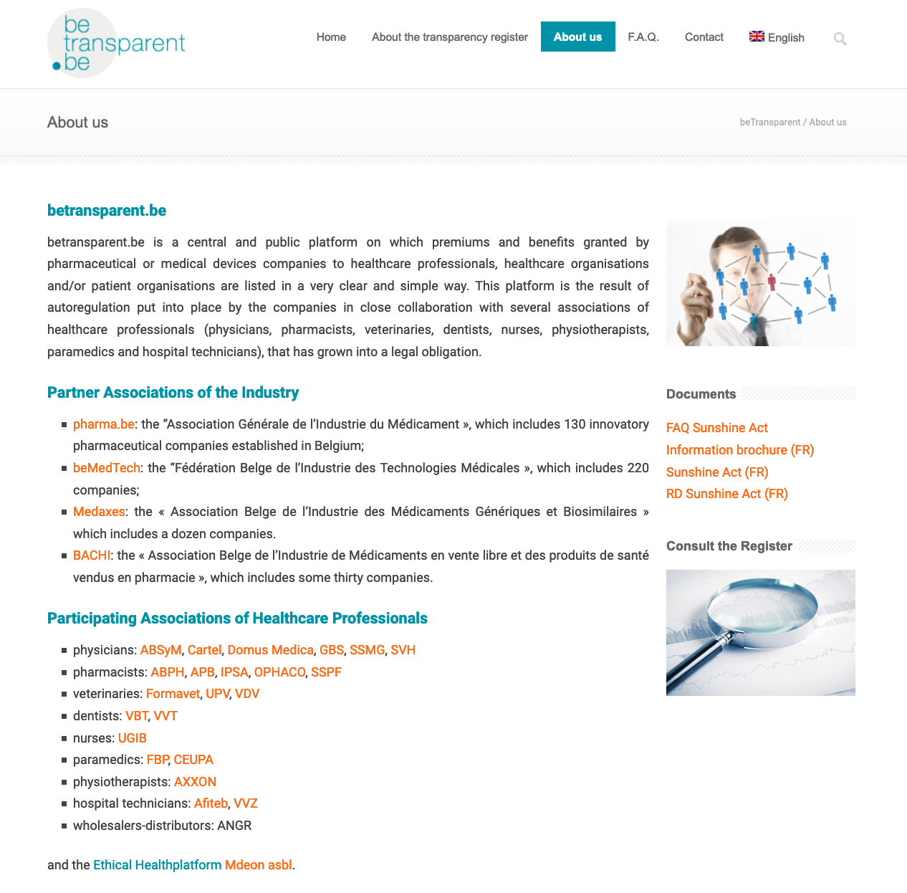
« As an important step towards an even greater transparency, the transparency obligation was given, on the initiative of the Minister of Social Affairs and Healthcare, Maggie De Block, a legal anchoring in the Belgian Sunshine Act. »
Self-regulating mechanism
Legal obligation since 2017 (Sunshine Act)
Directly transposed from EFPIA recommendations

Slide 5
Is transparency the solution?
Structural and systemic dimension of influence
Is the public trained to analyze the information?
A flood of information
Circumvention strategies: subcontracting, outsourcing, etc.
In fact: business as usual

Slide 6
Thanks for your attention
Do you have any questions, comments or suggestions?

