Slide 1
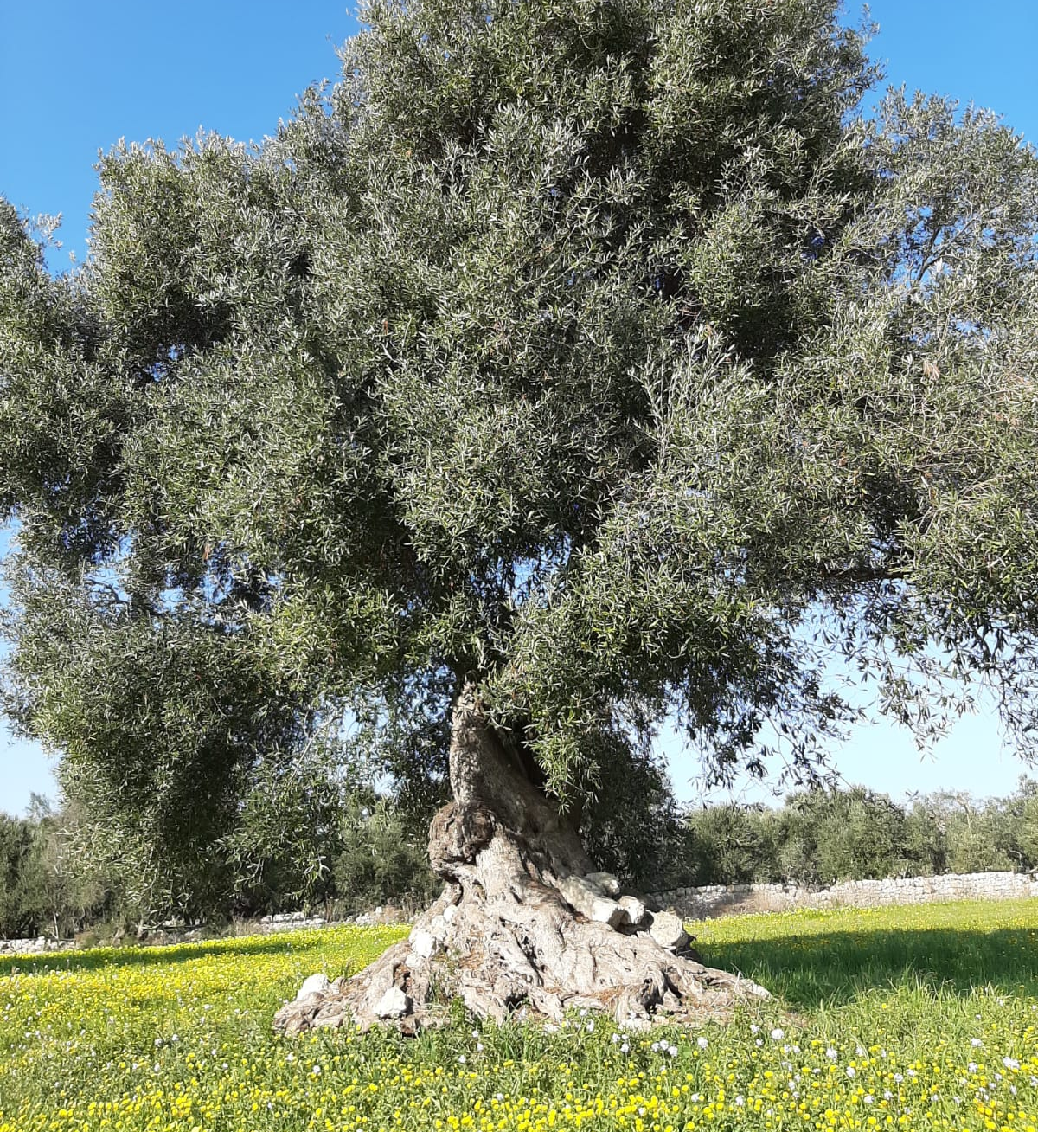
Discords around heritage landscapes: A comparative study of Apulia and Wallonia
PhD candidate Lauriano Pepe (Université de Liège) – Prof. Margherita Ciervo (Università di Foggia) – Prof. Serge Schmitz (Université de Liège)

Slide 2
Why talk about ‘discords’ around heritage landscapes ?
Landscapes
Uses
Actions
Use
Use
Action
Action
Values
Action
Use
Value
Value
Value
‘The landscape is a key element of individual and social well-being and its protection, management and planning entail rights and responsibilities for everyone’ (Council of Europe, 2000: p.1)
What are real rights and responsibilities of population in protectionist policies?

Slide 3
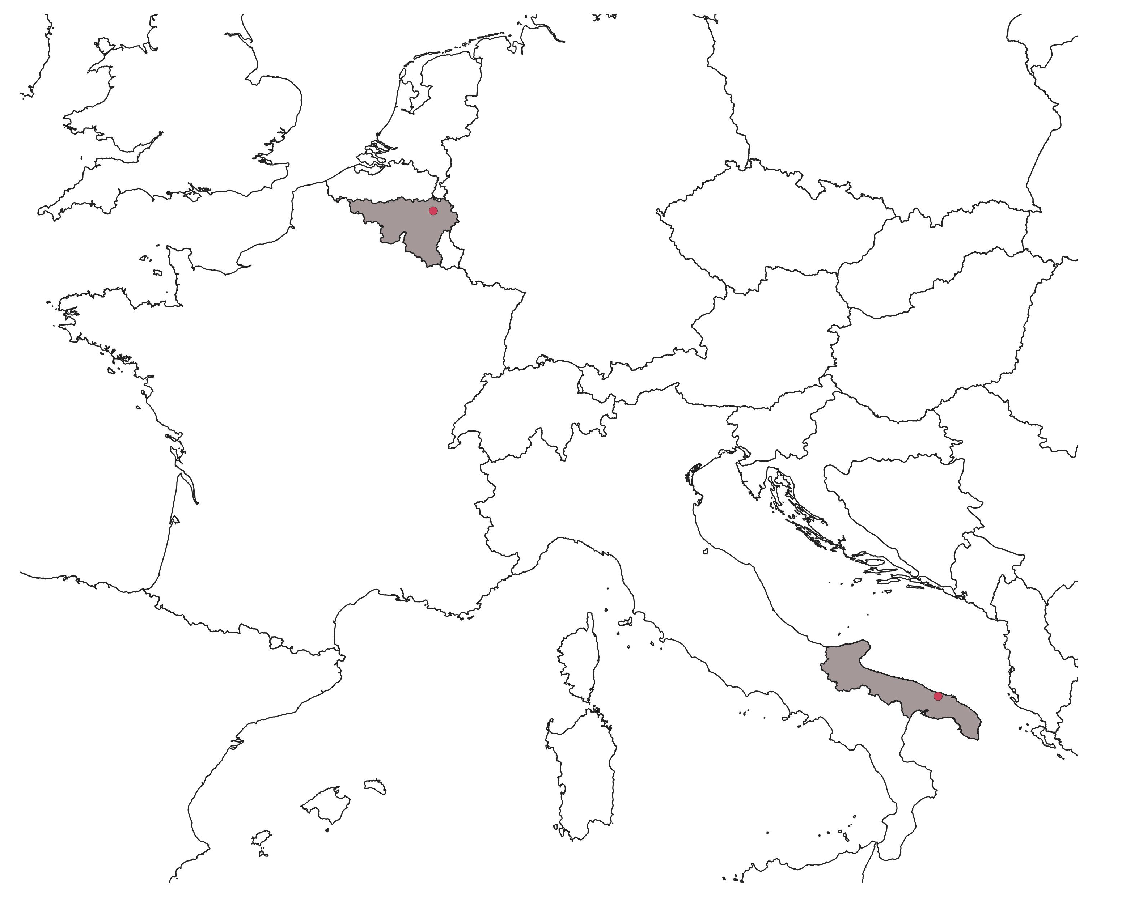
Analysis of two case studies based on three key elements:
The protection tools ;
The role of the population in the decision-making process ;
How the population experiences these protection intentions.
Legislative documents
Interviews/ oral survey
Previously studies

Slide 4
Heritage and landscape : a mosaic of protection tools
The cases of ‘Boucle de l’Ourthe’ and ‘Valle d’Itria’
In conclusion, what are rights and responsibilities ?

Slide 5
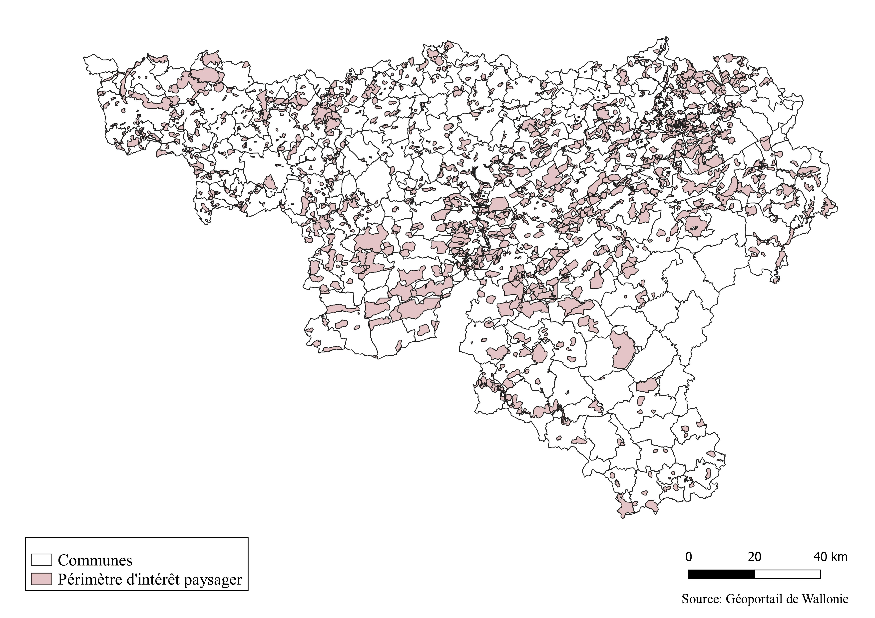
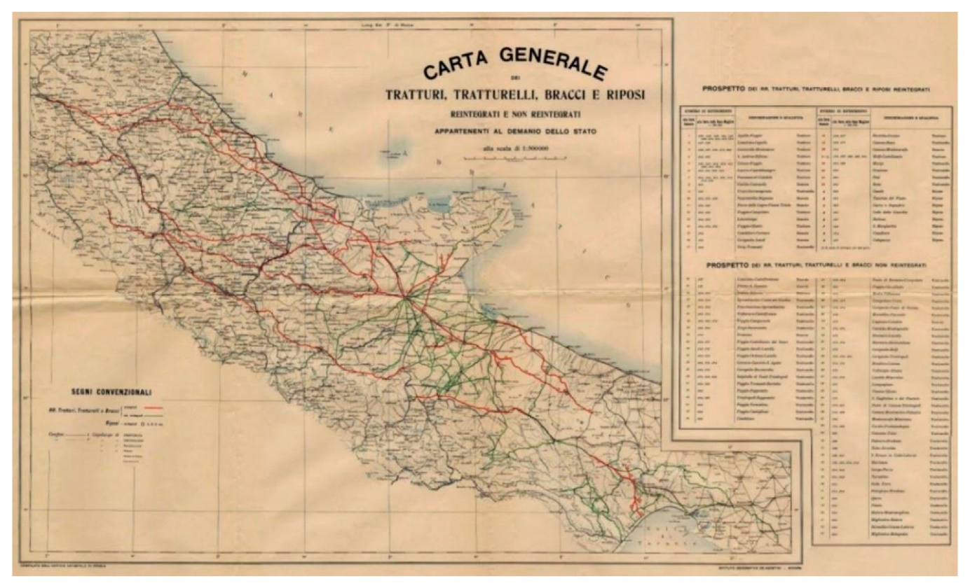
1. Heritage and landscape: a mosaic of protection tools
In Wallonia
In Apulia
Three main protection systems:
1. Land-use planning: Landscape interest perimeters ;
2. Heritage conservation: Landscape justification ;
3. Nature conservation: Nature reserves, Natura 2000, Natural parks.
Protection system in ‘Piano Paesaggistico Territoriale’ (PPTR):
‘Beni Paesaggistici’ (Codice dei beni culturali e del paesaggio):
Areas of considerable public interest ;
Sites protected by law: Natural parks, Nature reserves…
2. ‘Ulteriori Contesti Paesaggistici’:

Slide 6
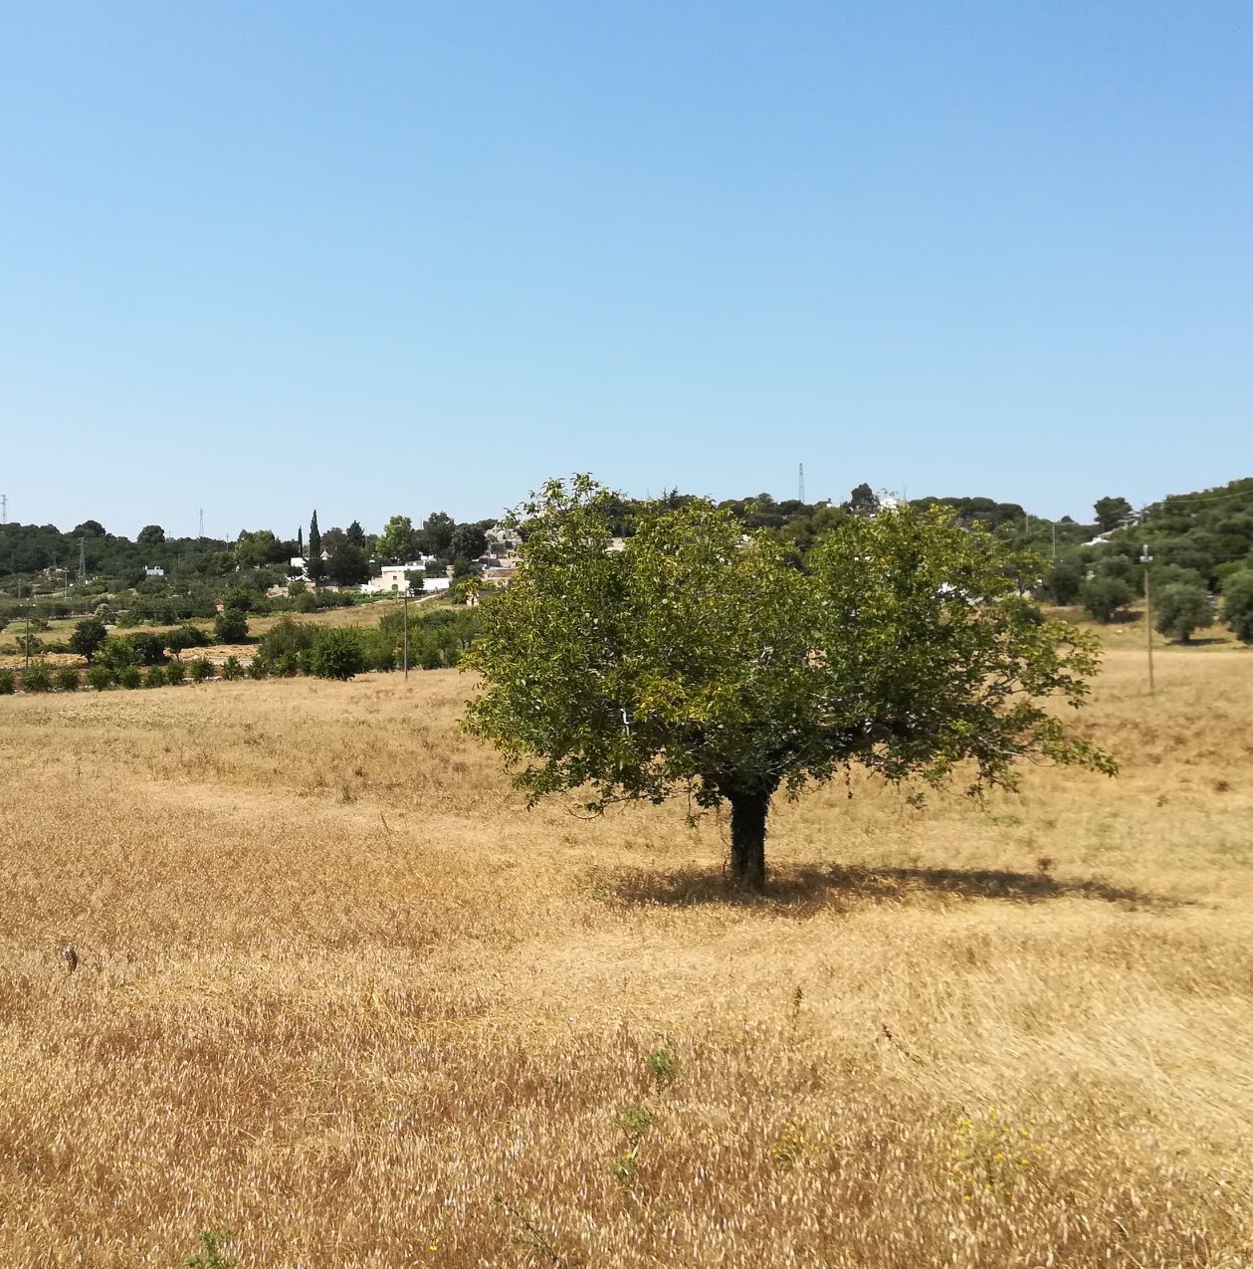
2. The cases of ‘Boucle de l’Ourthe’ and ‘Valle d’Itria’
Boucle de l’Ourthe
Valle d’Itria

Slide 7
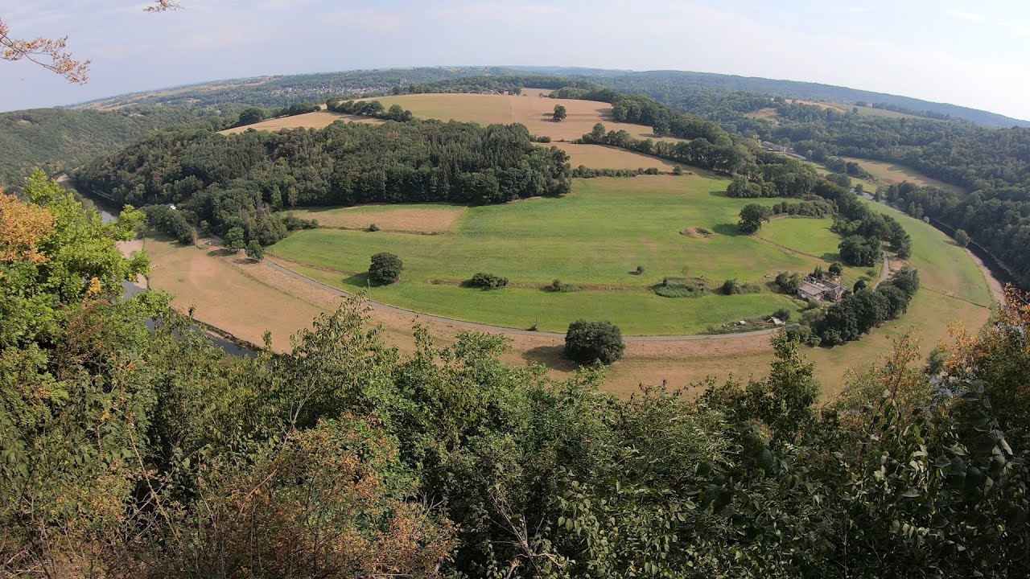
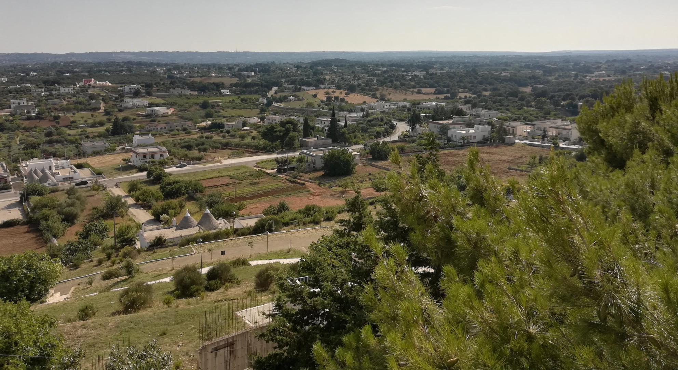
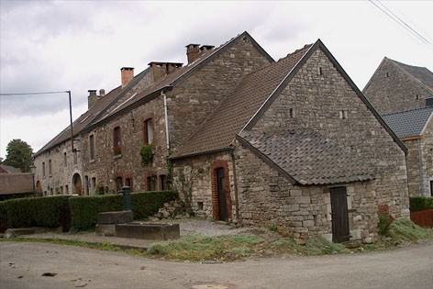
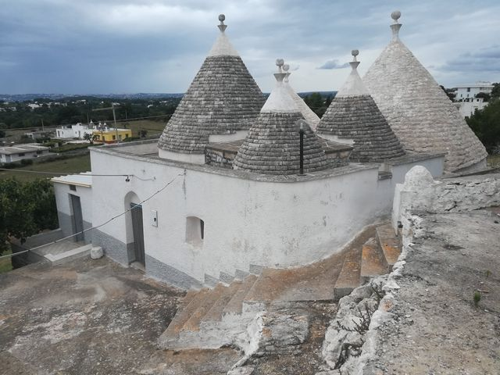
2. The cases of ‘Boucle de l’Ourthe’ and ‘Valle d’Itria’
Boucle de l’Ourthe
Valle d’Itria

Slide 8
2. The cases of ‘Boucle de l’Ourthe’ and ‘Valle d’Itria’
a. Protection tools

Slide 9
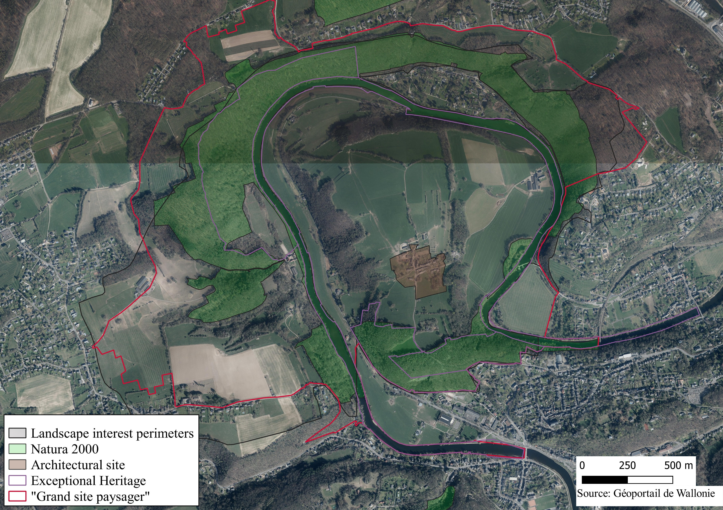
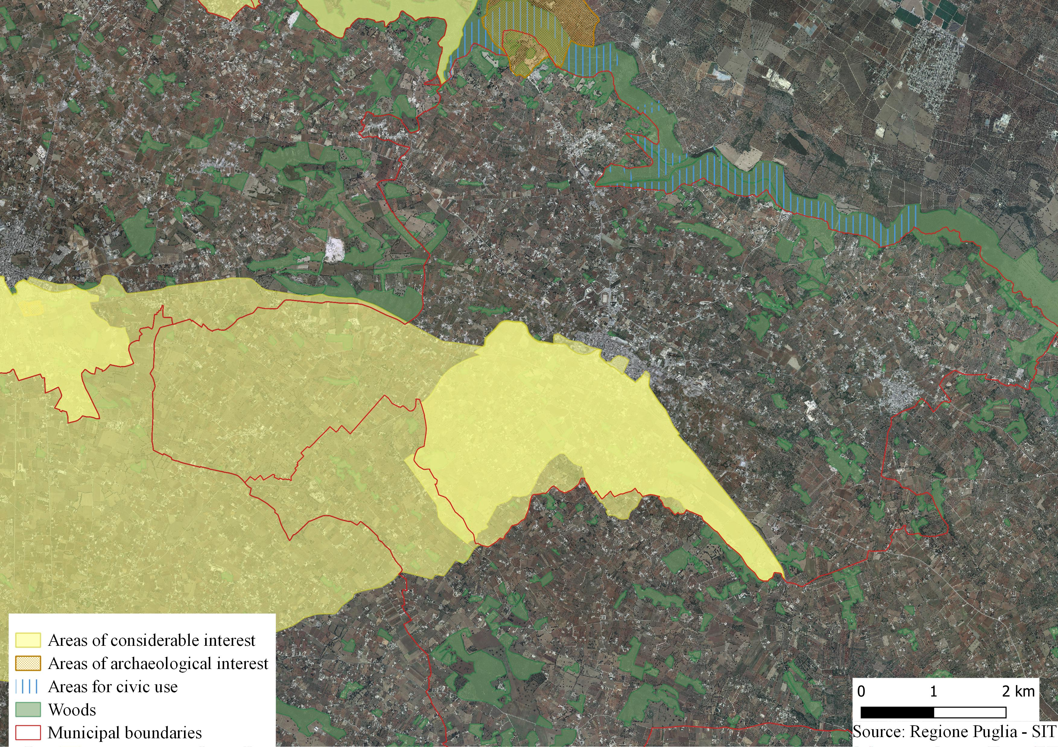
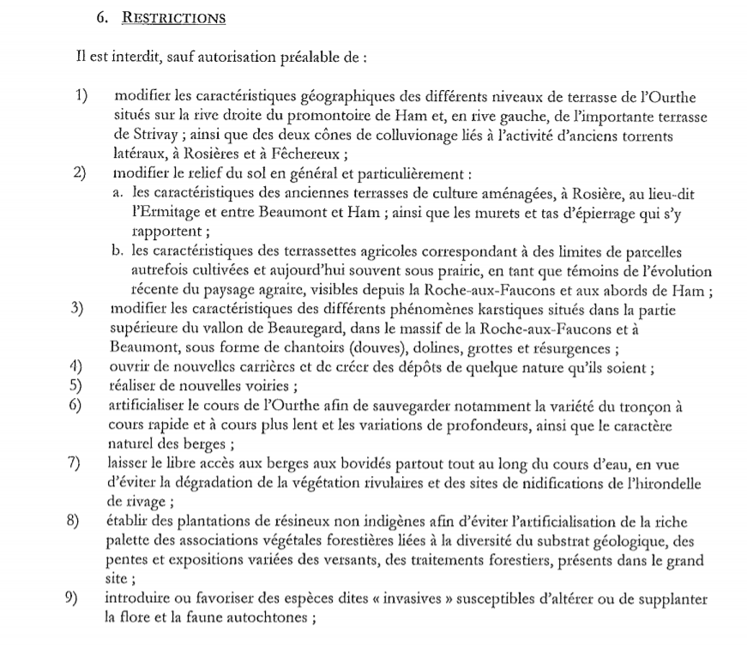
2. The cases of ‘Boucle de l’Ourthe’ and ‘Valle d’Itria’
a. Protection tools
Several elements already protected and classified
New tools ‘Grand Site Paysager’ (2015) & PPTR (‘Ulteriori Contesti’) (2013) -> Interest is to preserve the overall harmony → New restrictions and guidelines
Boucle de l’Ourthe
Valle d’Itria (Cisternino)

Slide 10
2. The cases of ‘Boucle de l’Ourthe’ and ‘Valle d’Itria’
b. Public participation

Slide 11
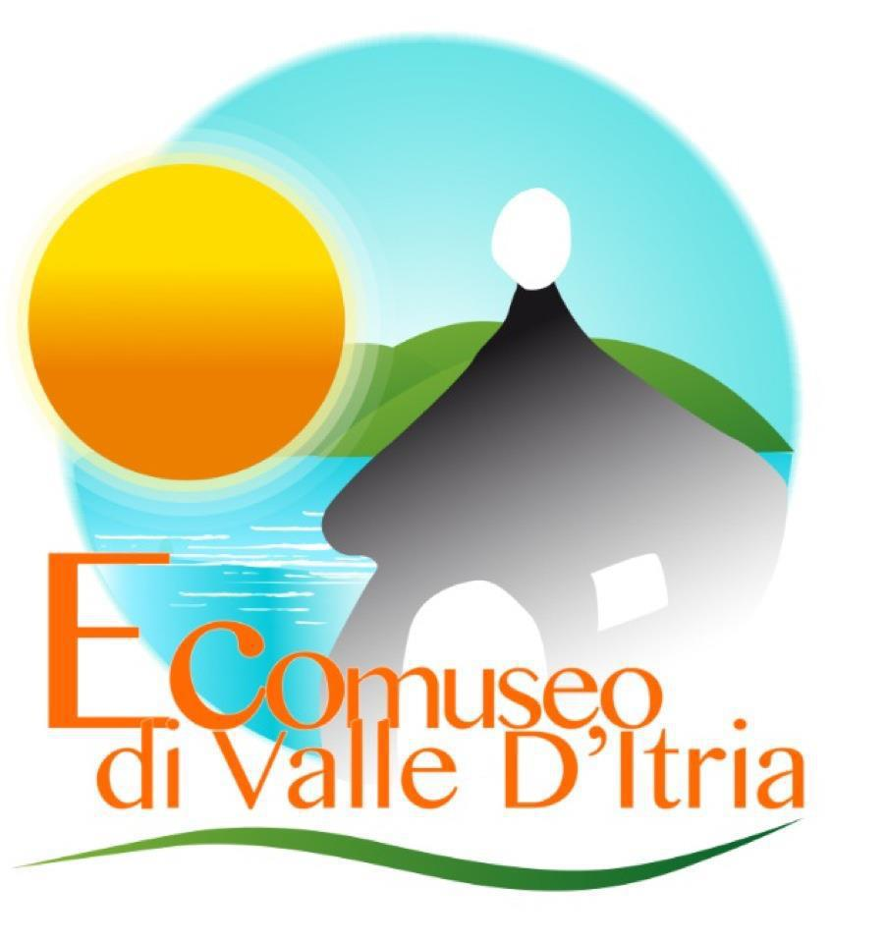
2. The cases of ‘Boucle de l’Ourthe’ and ‘Valle d’Itria’
b. Public participation
‘Top-Down’ approach
Scientific/governmental interests
Population
In Wallonia
In Apulia
Public survey
→ ‘Most are happy about the possible classification’;
→ ‘Vert & Vie’ association.
‘Produzione sociale del Piano’
→‘Atlante delle segnalazioni del Piano’ ;
→ Thematic technical meetings ;
→ ‘Ecomuseo di Valle d’Itria’.
?
‘Gestione sociale del paesaggio’ ?

Slide 12
2. The cases of ‘Boucle de l’Ourthe’ and ‘Valle d’Itria’
c. Experience intentions of protection

Slide 13
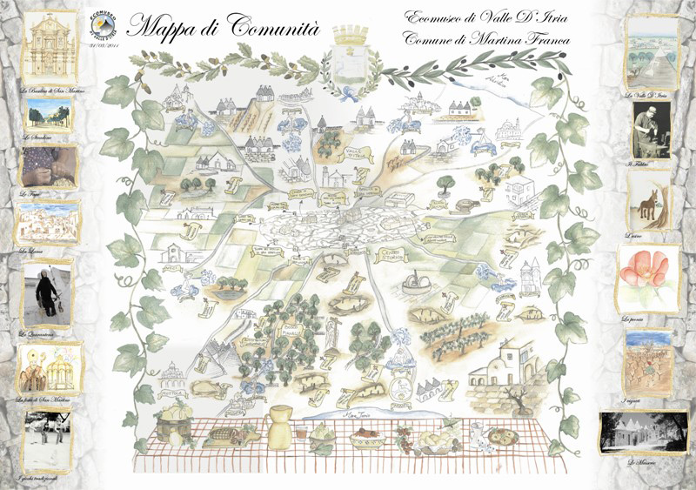
2. The cases of ‘Boucle de l’Ourthe’ and ‘Valle d’Itria’
c. Experience intentions of protection
Low knowledge about classification ‘Grand Site Paysager’ or landscape plan:
→ Lack of promotion/information ;
→ Lack of local interest.
Population is doubtful about the future of landscape:
→ What consequences will have the label ‘Grand Site Paysager’? ;
→ Landscape plan is an appropriate tool? (Tool too conservationist V.S. Tool not enough useful).
Gap between the ‘scientific’ values and the ‘inhabitants’ values.

Slide 14
3. In conclusion, what are rights and responsibilities?

Slide 15
3. In conclusion, what are rights and responsibilities?
Intertwining landscape and heritage in Wallonia ≠ Intertwining landscape and heritage in Apulia.
In Wallonia: ‘exceptional’ vision of landscape ;
In Apulia: ‘Structural’ and ‘territorial’ vision.
Rights and responsibilities of population:
Inhabitants more awareness about added-value of quality landscape ;
But not ‘equipped’ (Often limited to recognition phase and inventories).
→ What is the future of protected landscapes ?

Slide 17
Bibliography
Antrop, M., & Van Eetvelde, V. (2019). Territory and/or Scenery : Concepts and Prospects of Western Landscape Research. In L. Mueller & F. Eulenstein (Eds.), Current Trends in Landscape Research (pp. 3-39). Cham, Switzerland: Springer.
Brown, J., Mitchell, N., & Beresford, M. (2005). The Protected Landscapes Approach. Linking Nature, Culture and Community. Gland, Switzerland and Cambridge: IUCN.
Ciervo, M., & Cerreti, C. (2020). Landscape Grabbing. A New Concept for Geographical Analysis? Geotema, Supplemento, 2020, 123-130. Retrieved from https://www.ageiweb.it/geotema/supplemento2020_ciervo_cerreti/.
Council of Europe (2000). European Landscape Convention. Retrieved from https://www.coe.int/fr/web/conventions/full-list/-/conventions/rms/090000168008062a.
Egoz, S., Jørgensen, K., & Ruggeri, D. (2018). Defining Landscape Democracy. A Path to Spatial Justice. Cheltenham, UK: Edward Elgar Publishing.
Harvey, D. (2015). Landscape and heritage: trajectories and consequences. Landscape Research, 40:8, 911-924. doi:10.1080/01426397.2014.967668.
Hernández-Morcillo, M., Bieling, C., Bürgi, M., Lieskovsky, J., Palang, H., Printsmann, A., Schulp, C.J.E., Verburg, P.H., & Plieninger, T. (2017). Priority questions for the science, policy and practice of cultural landscapes in Europe. Landscape Ecology, 32, 2083-2096. doi: 10.1007/s10980-017-0524-9.
Olwig, K. R., & Mitchell, D. (2009). Justice, Power and the Political Landscape. London: Routledge.
Sánchez, M.L., Cabrera, A.T., & Del Pulgar, M.L.G. (2020). Guidelines from the heritage field for the integration of landscape and heritage planning: A systematic literature review. Landscape and Urban Planning, 204:103931.doi:10.1016/j.landurbplan.2020.103931.
Schmitz, S., & Bruckmann, L. (2020). The quest for new tools to preserve rural heritage landscapes. Documents d’Anàlisi Geogràfica, 66:2, 445-463. doi: 10.5565/rev/dag.593.

Slide 18
Appendices

Slide 19
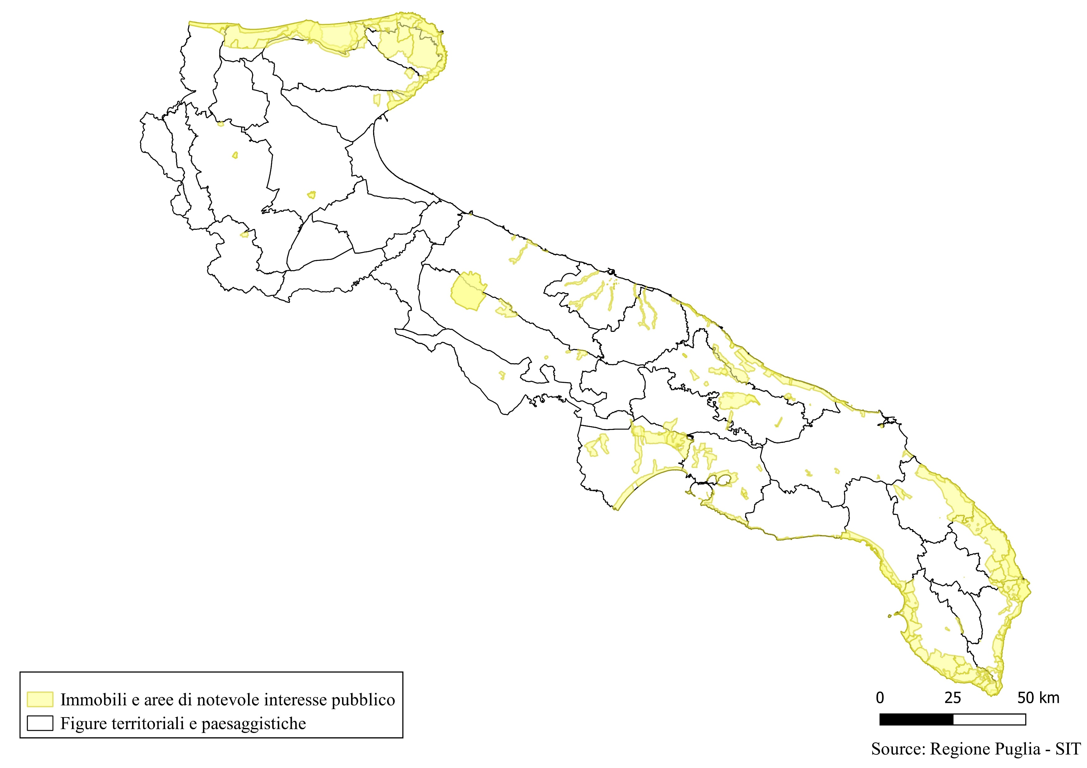
2. Landscape protection: a mosaic of protection tools
In Wallonia
In Apulia
Landscape interest perimeters:
« Aree di notevole interesse pubblico »:

Slide 20
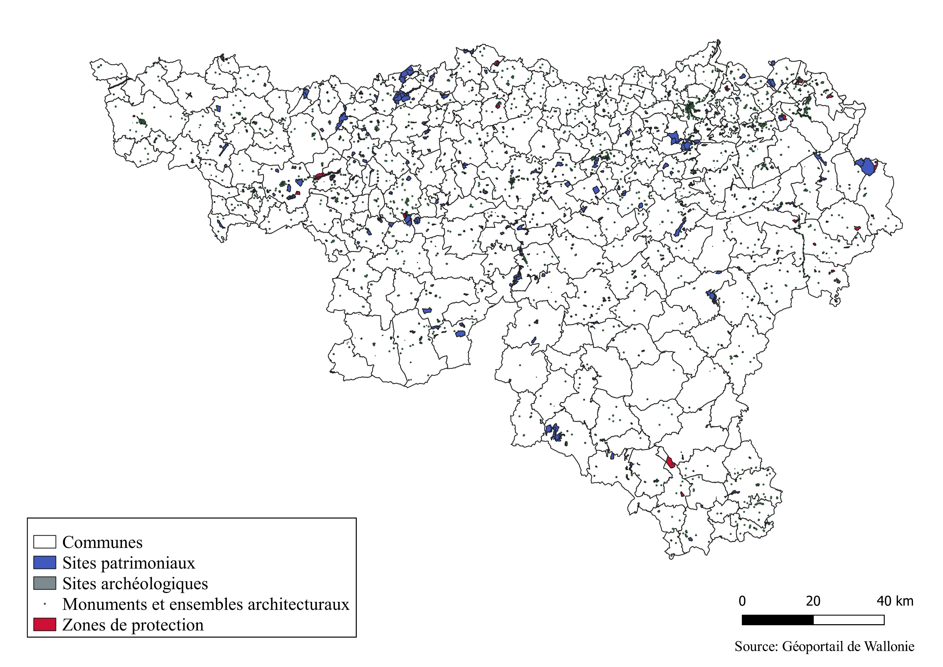
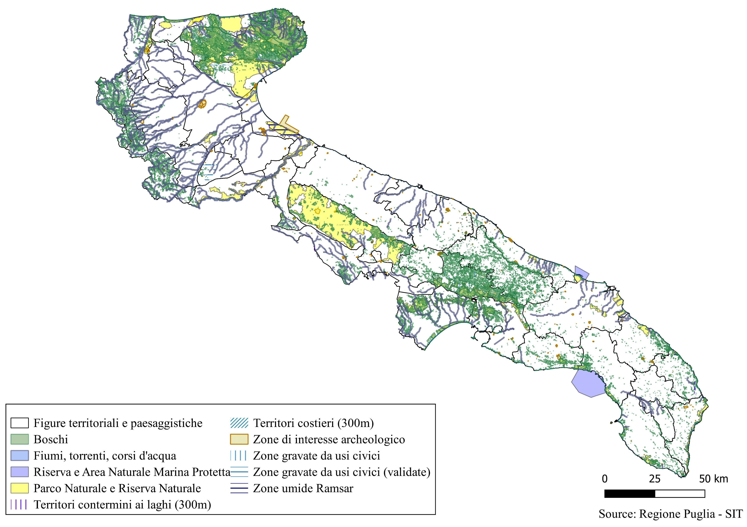
2. Landscape protection: a mosaic of protection tools
In Wallonia
In Apulia
Heritage conservation :
« Aree tutelate per Legge »:

Slide 21
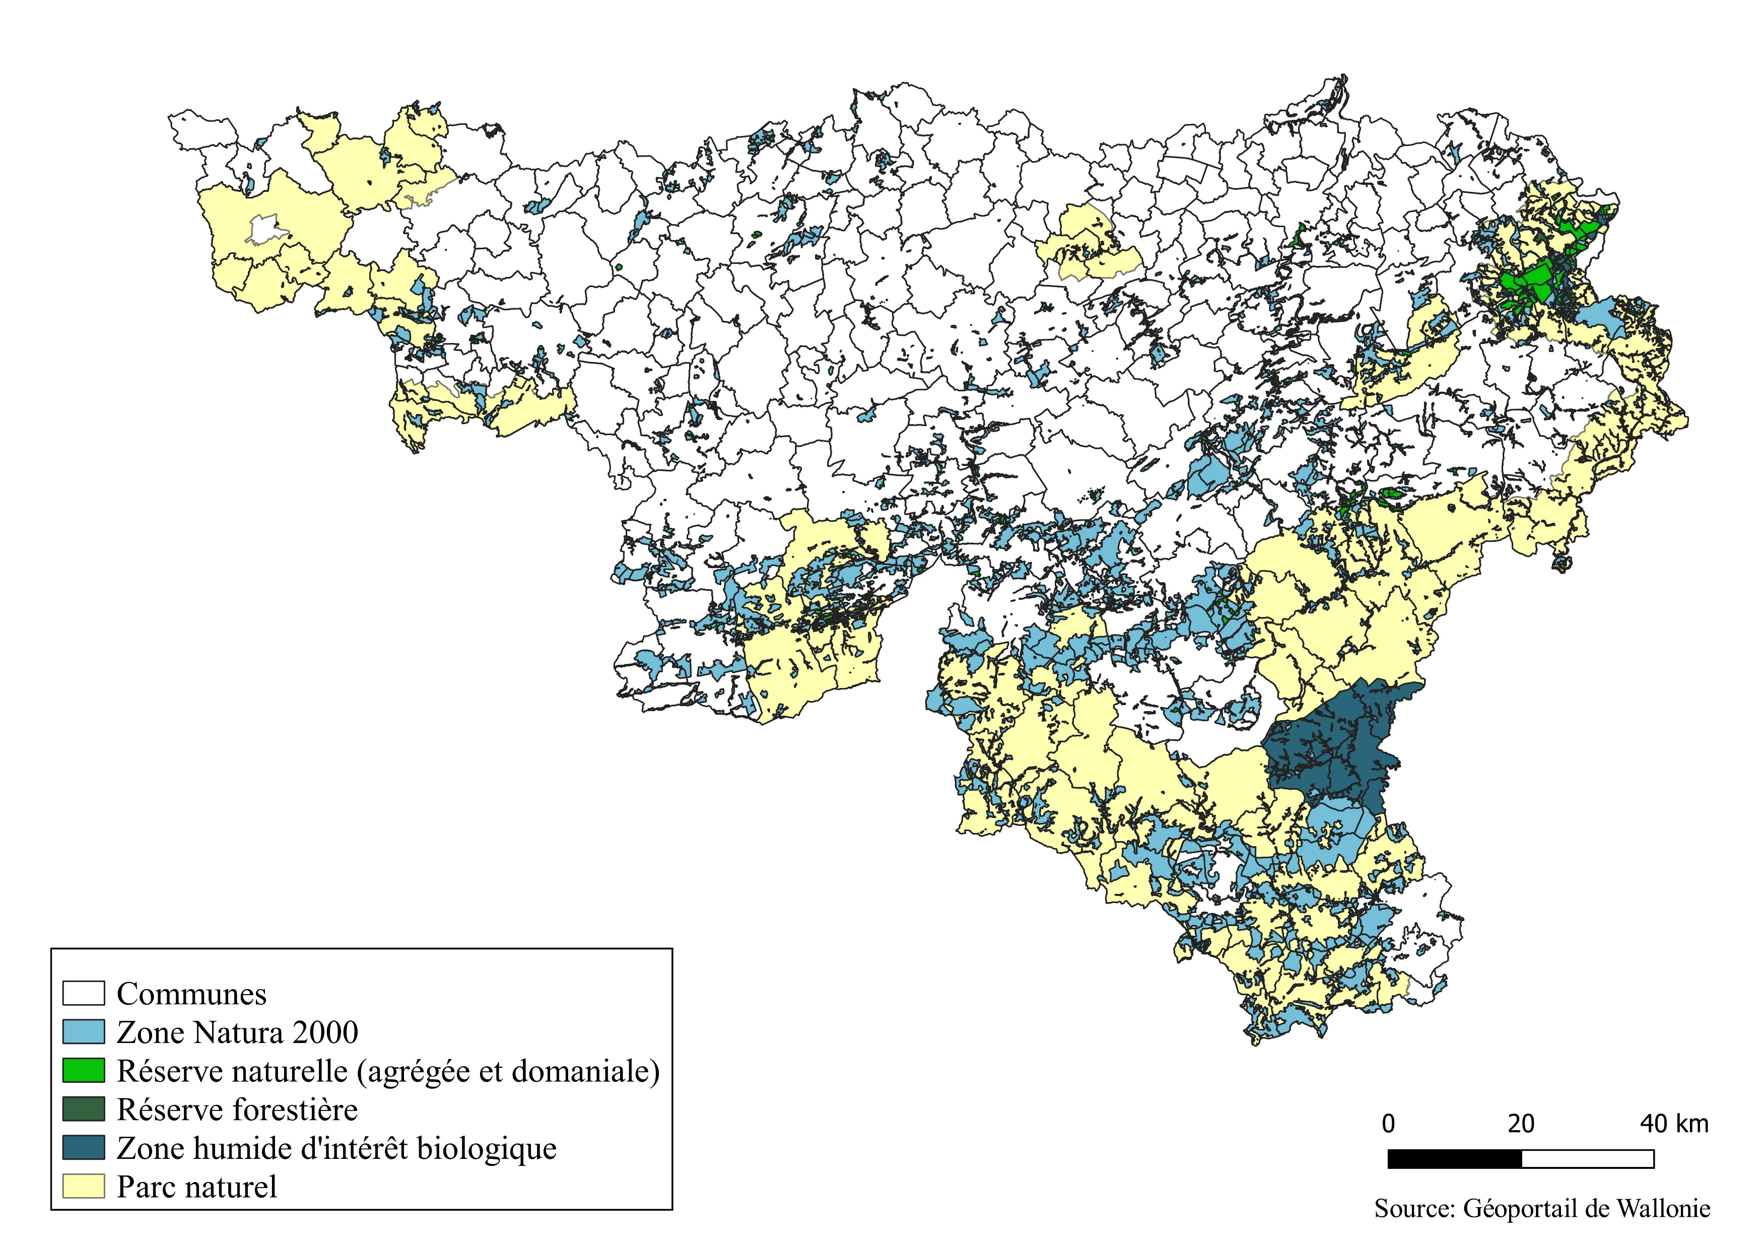
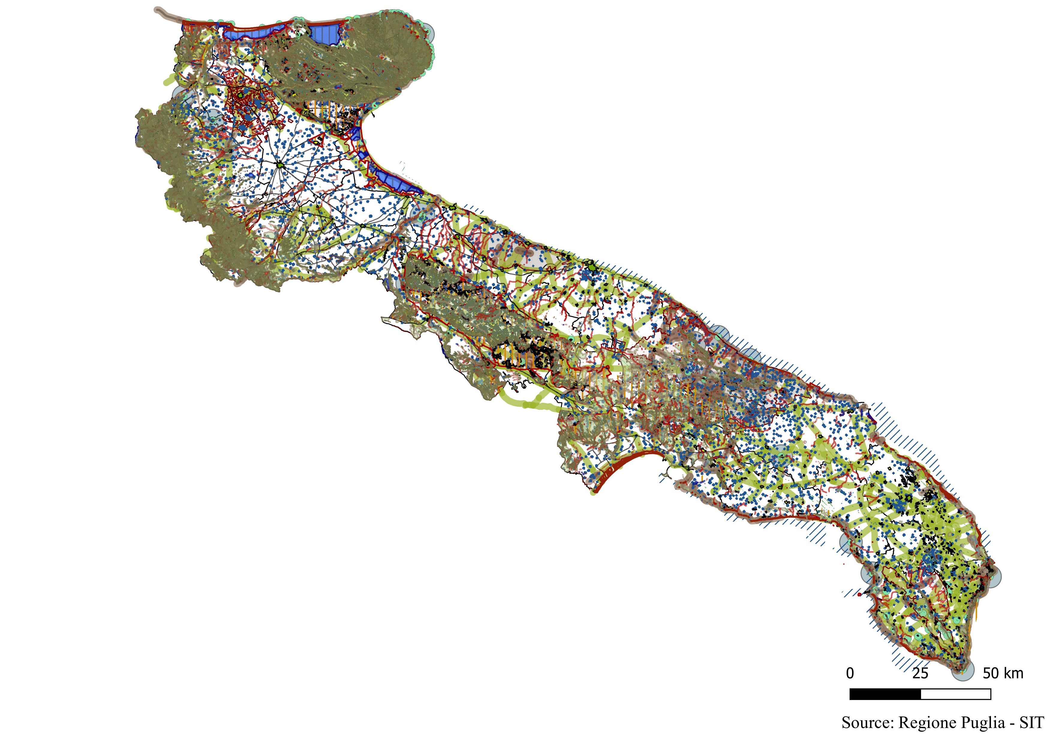
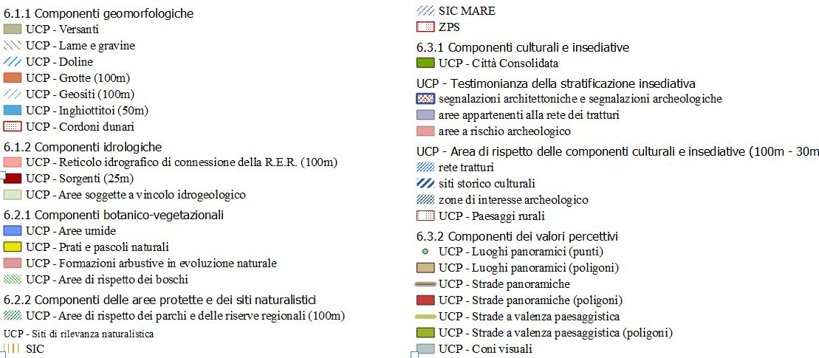
2. Landscape protection: a mosaic of protection tools
In Wallonia
In Apulia
Nature conservation :
« Ulteriori contesti paesaggistici »:

Slide 22
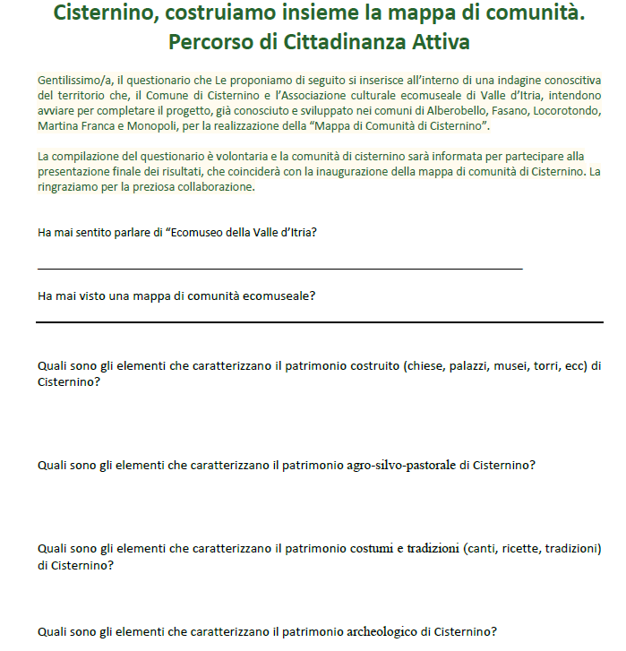
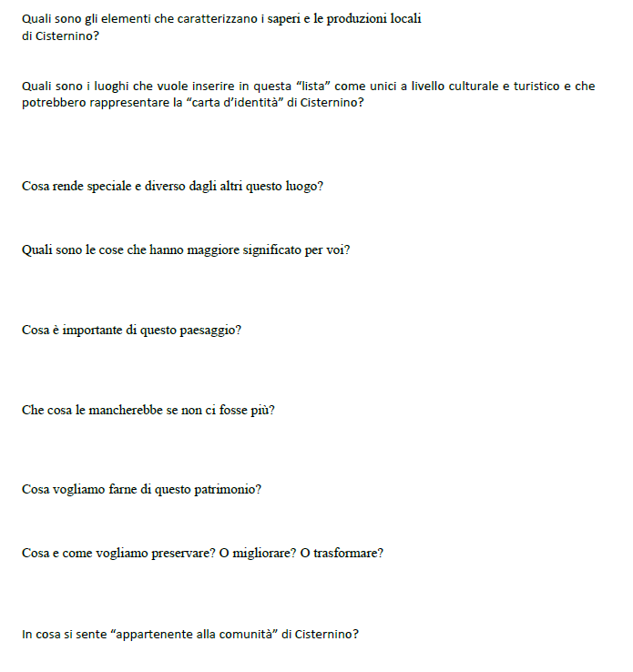

Slide 23
