Slide 1





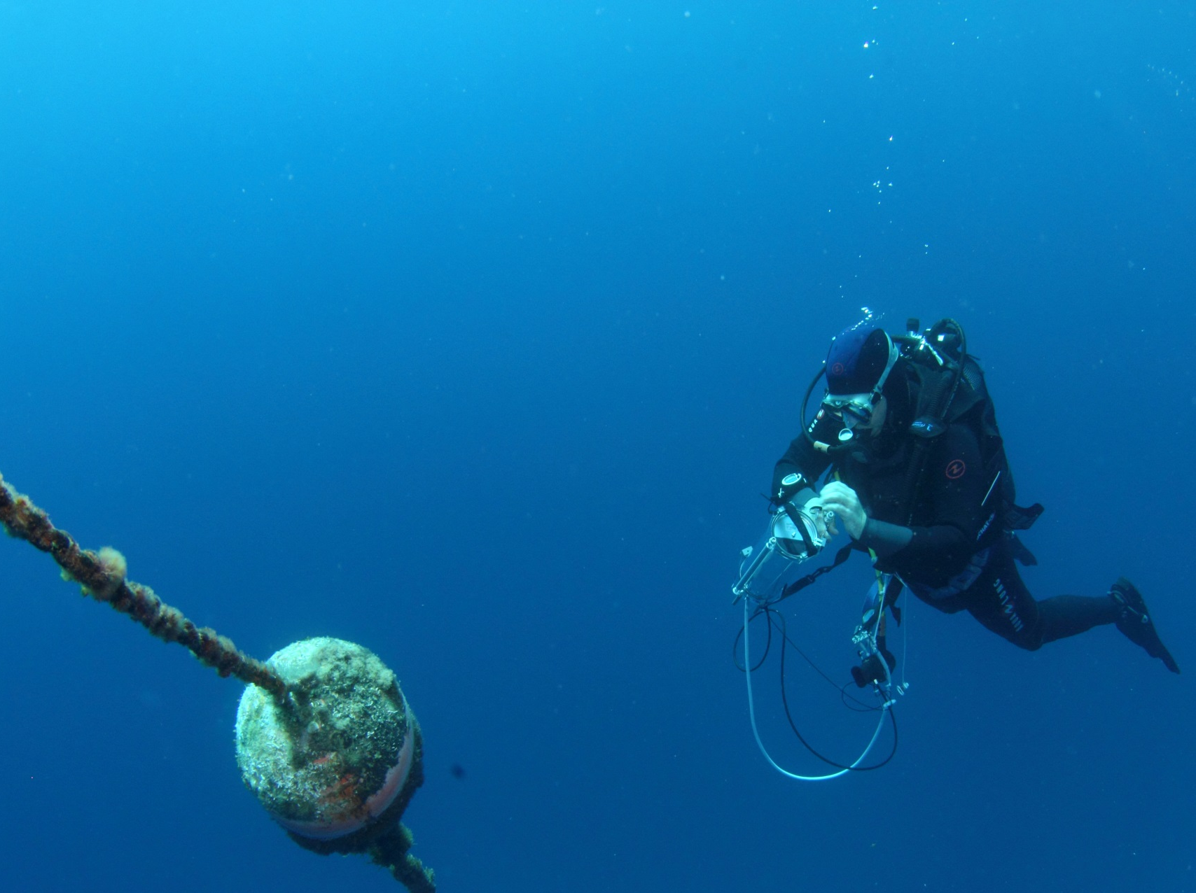


Experimental assessment of light decrease on the biology of Posidonia oceanica
Richir J., Luyckx A., Champenois W., Chou L., Corato A., Descy J.-P., Gobert S., Leduc M., Lutts S., Pfündel E., Walz S.,
Borges A.V.
18-05-2021,
Liège

Slide 2
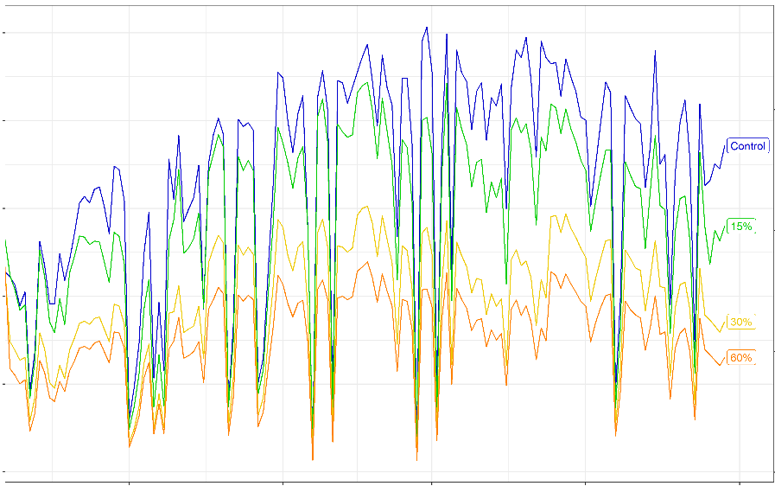
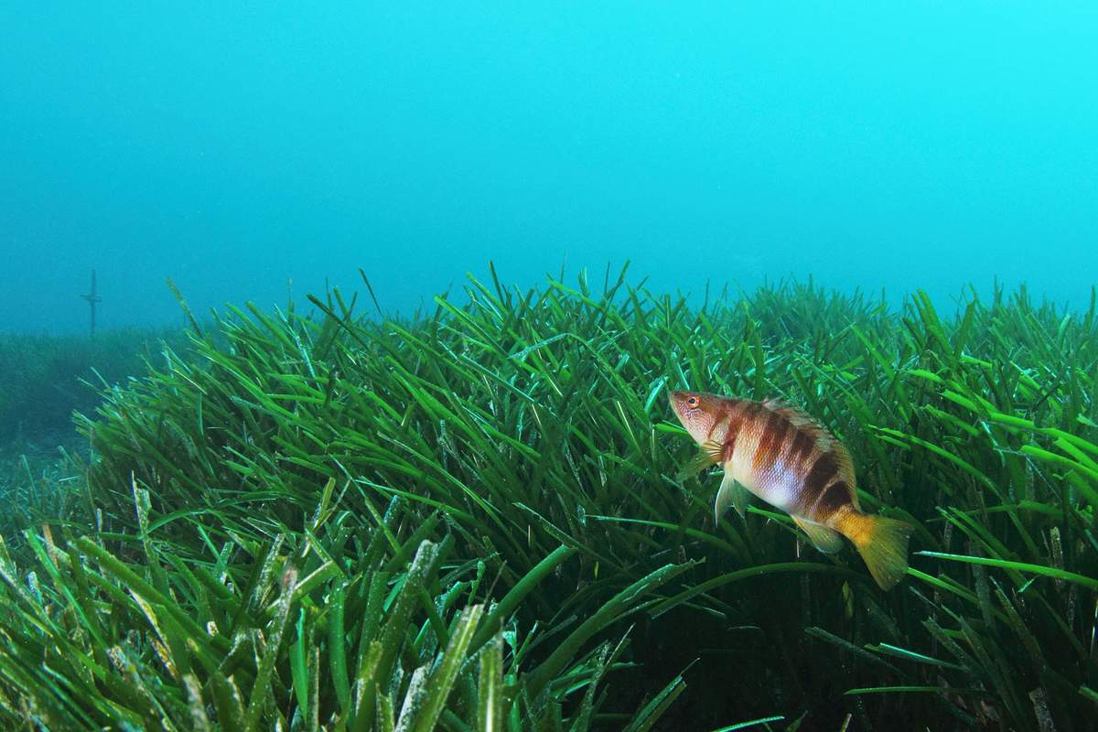
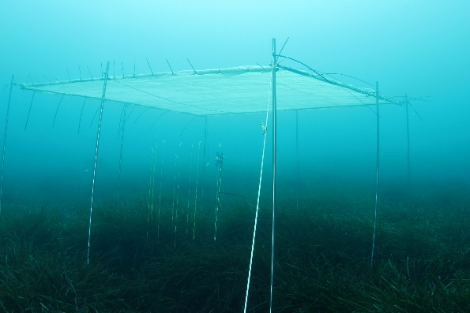
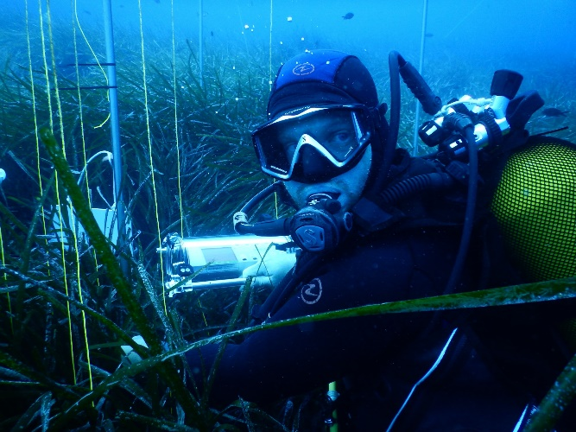
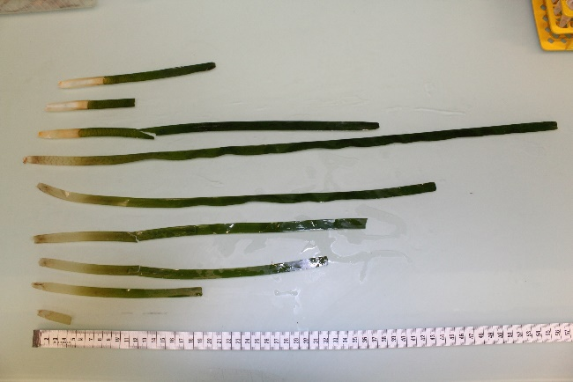
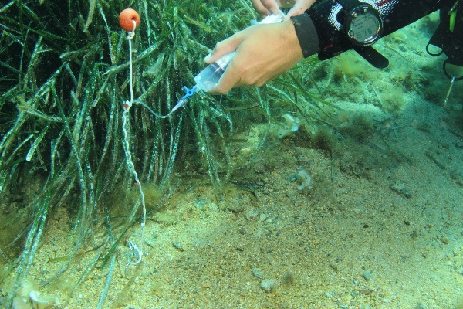
Seagrasses & light
500
400
300
PAR (µmol s⁻¹ m⁻²)
200
100
0
May 1
Jun 1
Jul 1
Aug 1
Sep 1
light reduction
? ? ?
Ctr 15% 30% 60%
April → August (5 months)

Slide 3
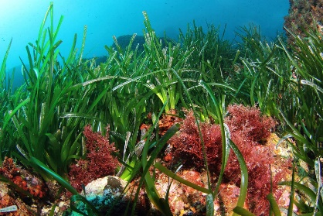
Light & seagrasses
ENVIRONMENT
SEAGRASS PHYSIOLOGY
Porewater chemistry
(1) Leaf pigments
(2) Photosynthesis
(3) Carbohydrates
(4) Shoot biometry and leaf biomass productivity
NO CHANGE
BUT …
Control
60% of light reduction
Control
60% of light reduction
60
60
Max. electron transfer rate (µmol e⁻¹ s⁻¹)
40
Total soluble carbohydrates in rhizomes (mg kg⁻¹_{dw})
40
20
20
0
0
4
5
6
7
8
9
4
5
6
7
8
9
4
5
6
7
8
9
4
5
6
7
8
9
Month
Month
Month
Month
Light acclimation of photosynthetic activity
Decrease in soluble carbohydrate storage
TAKE HOME MESSAGE
High resistance and resilience to five months light deprivation stress.
Decrease in carbohydrate storage = threat to meadow perennity if exposed to recurrent shading.

Slide 4

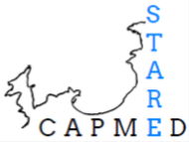

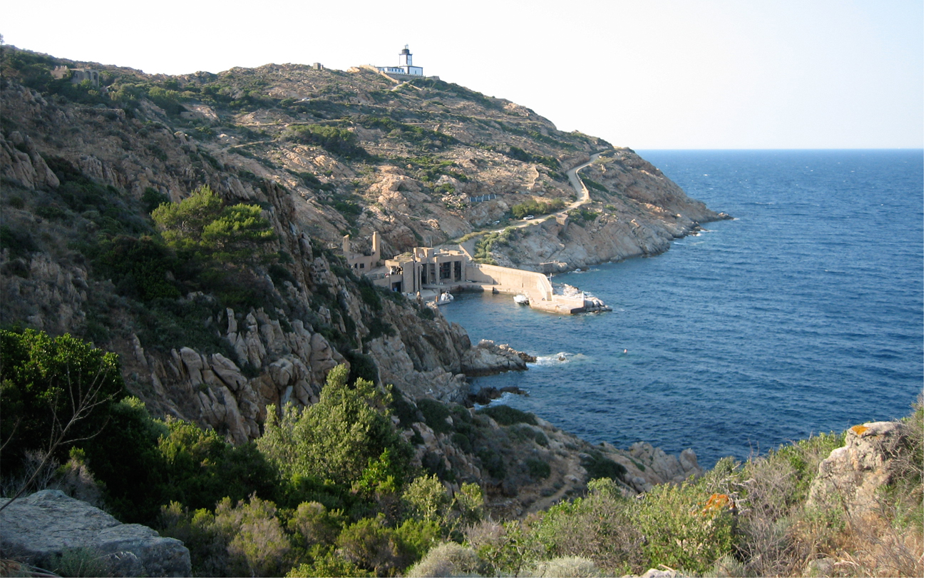
30%
15%
60%
Thank
you for
your attention
control

