Slide 1



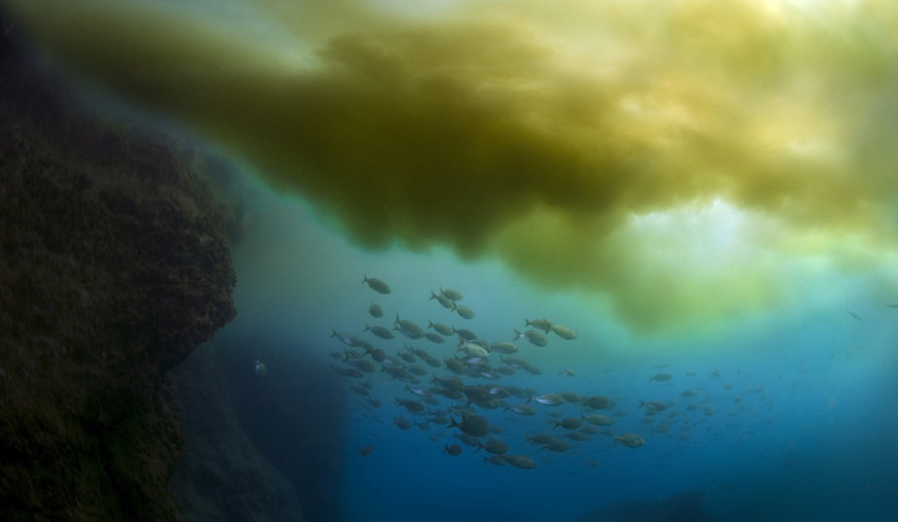

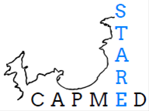


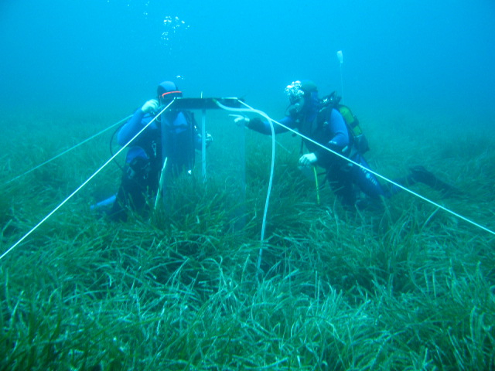

WEBINARS MEHmed, June the 17th 2021
Biomonitoring of trace elements using the item Posidonia oceanica as bioindicator species
Dr J. Richir & Pr S. Gobert
© Ballesta L.

Slide 2
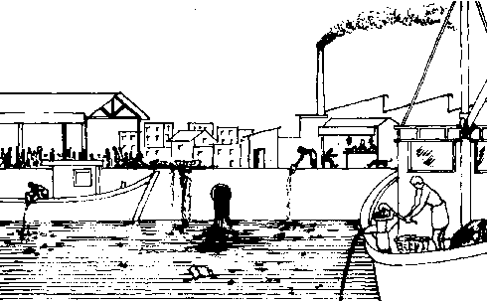
http://www.fao.org/

Slide 3
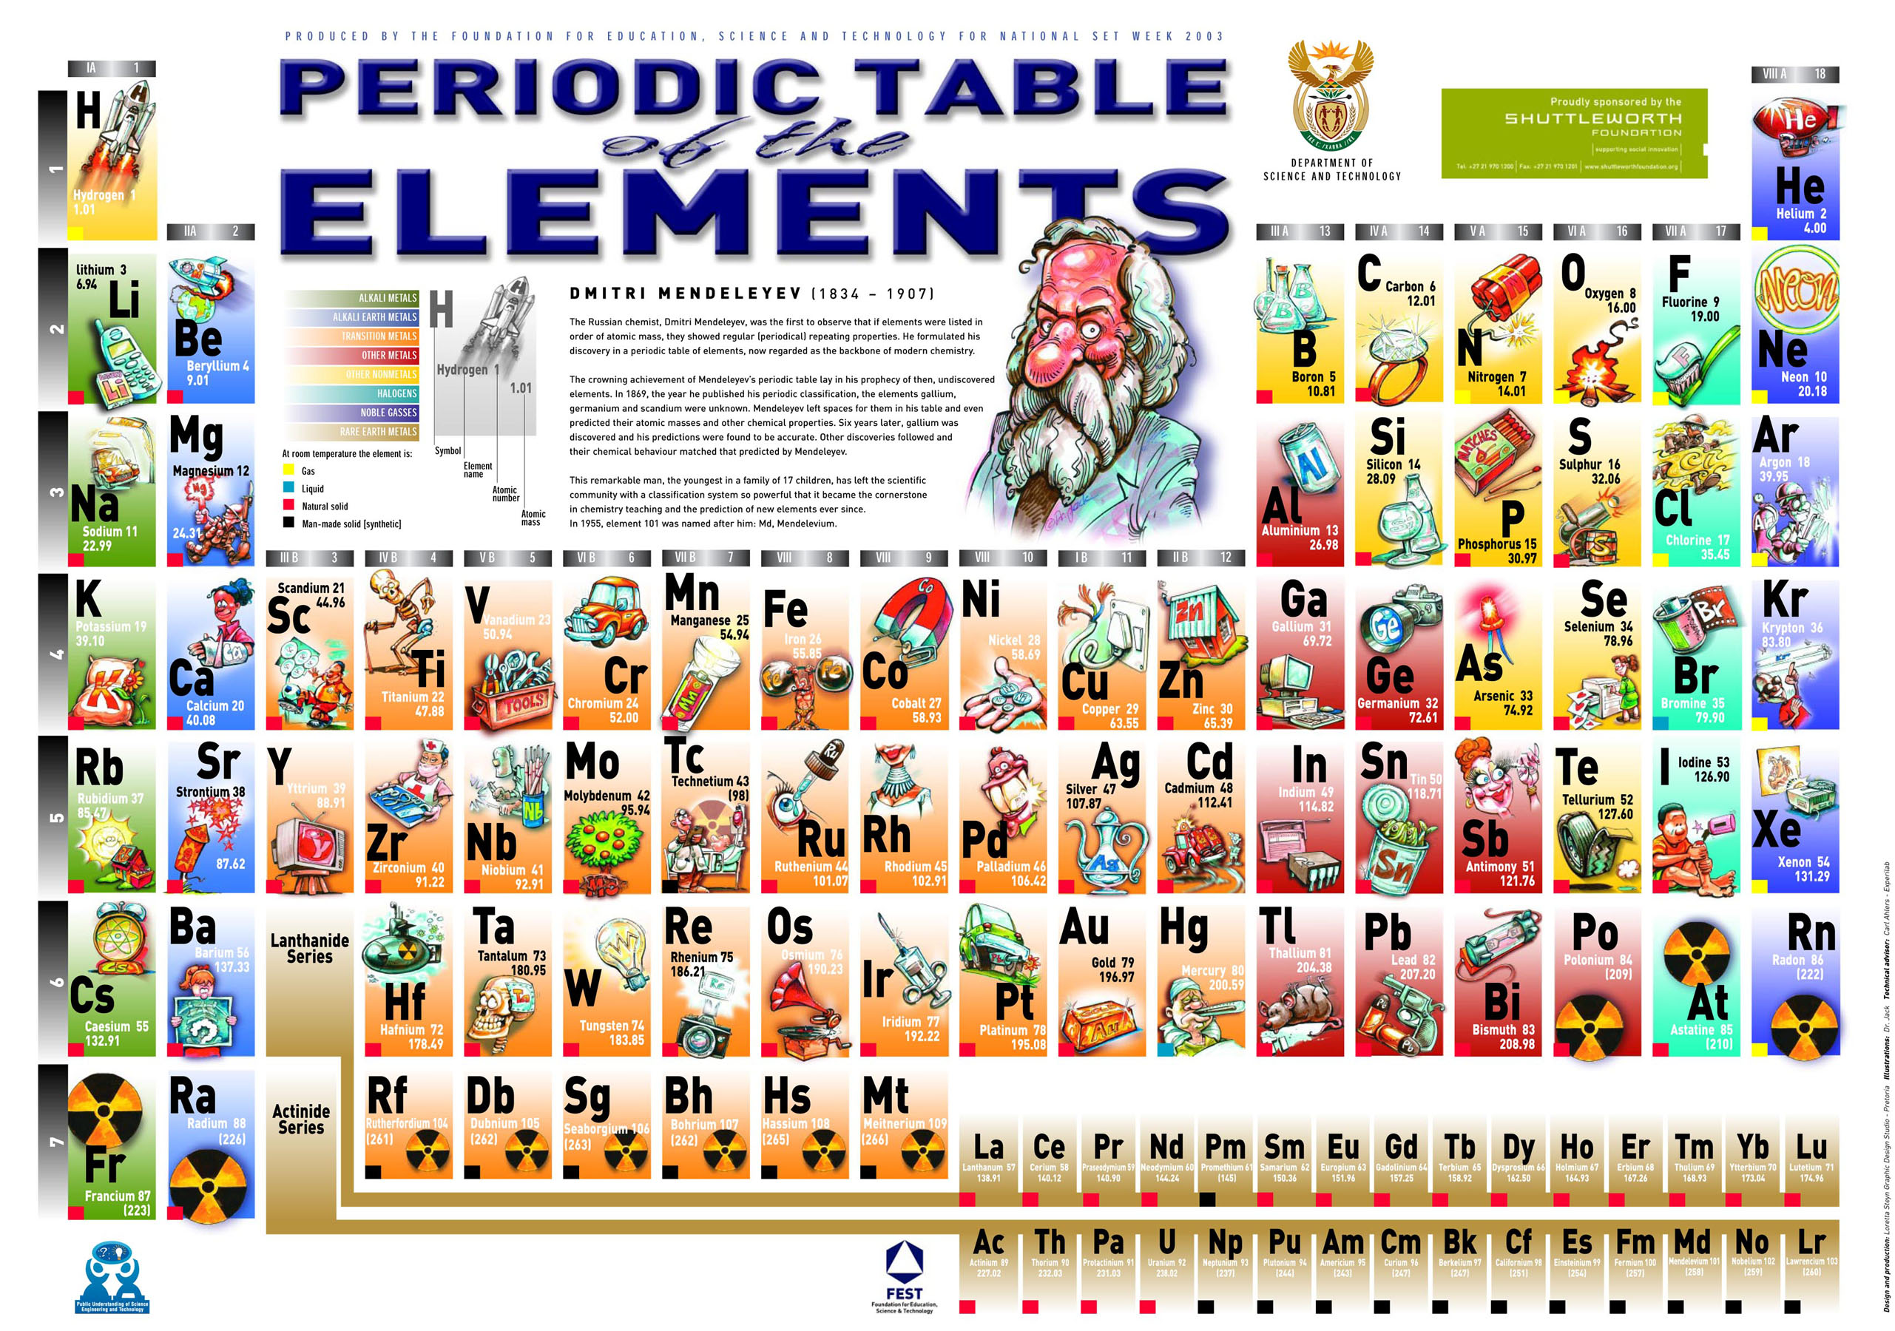

Slide 4

Trace elements (including metals)
(after Amiard 2011)

Slide 5
Trace elements (including metals)
(after Amiard 2011)

Slide 6
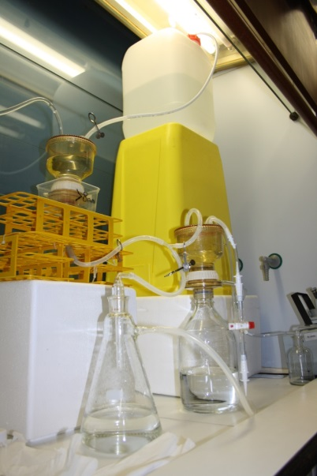
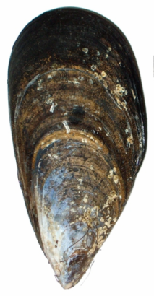
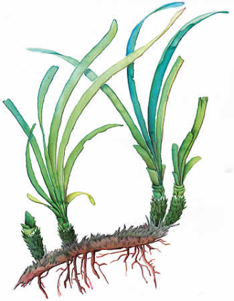
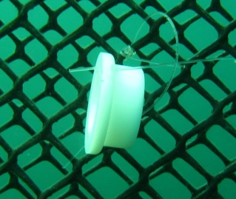
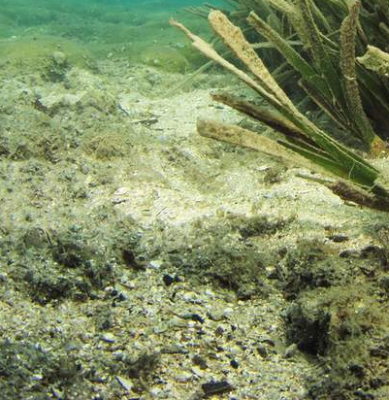

Bio-monitoring
Trace elements
Mytilus
galloprovincialis
direct measurements in the environment:
water
sediment
suspended matter
bioindicators
Posidonia oceanica

Slide 7
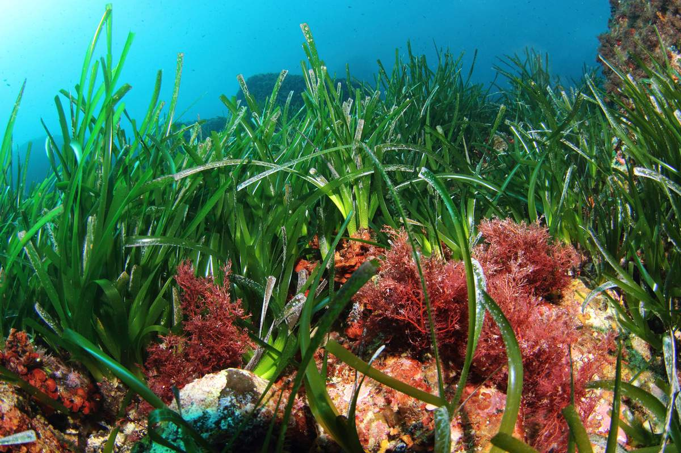
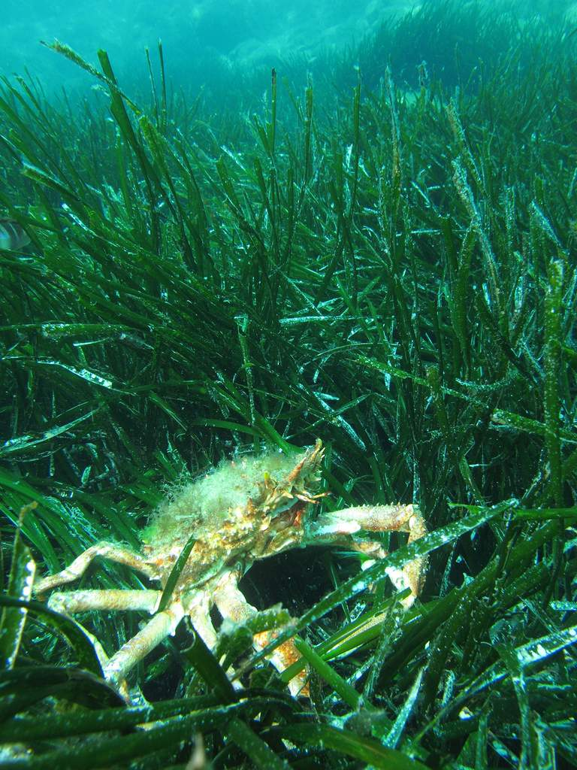
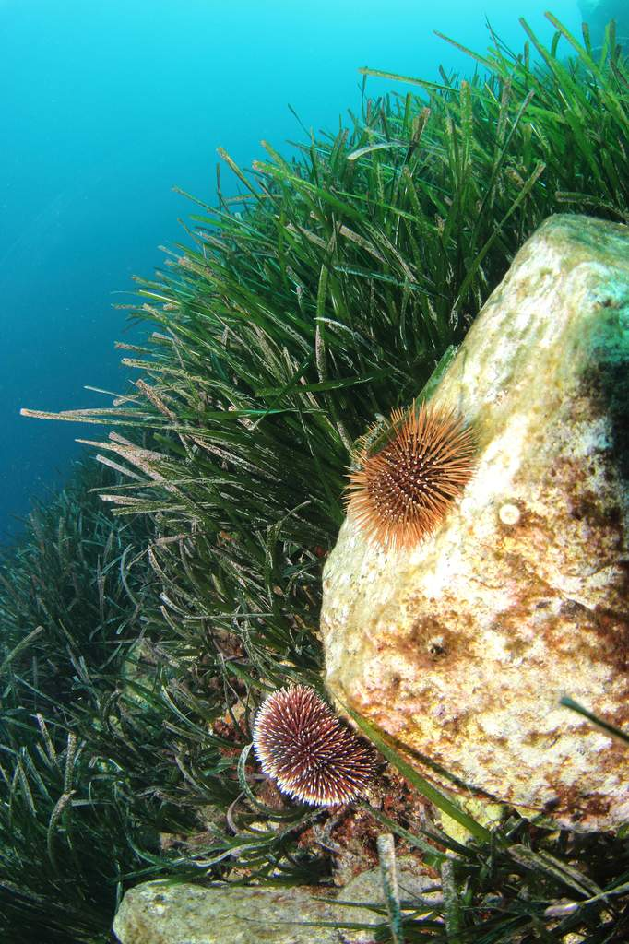
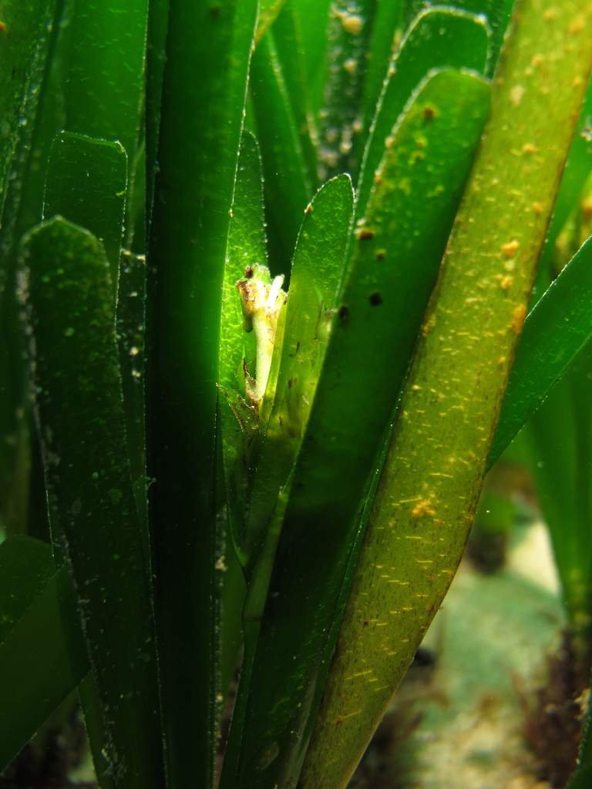
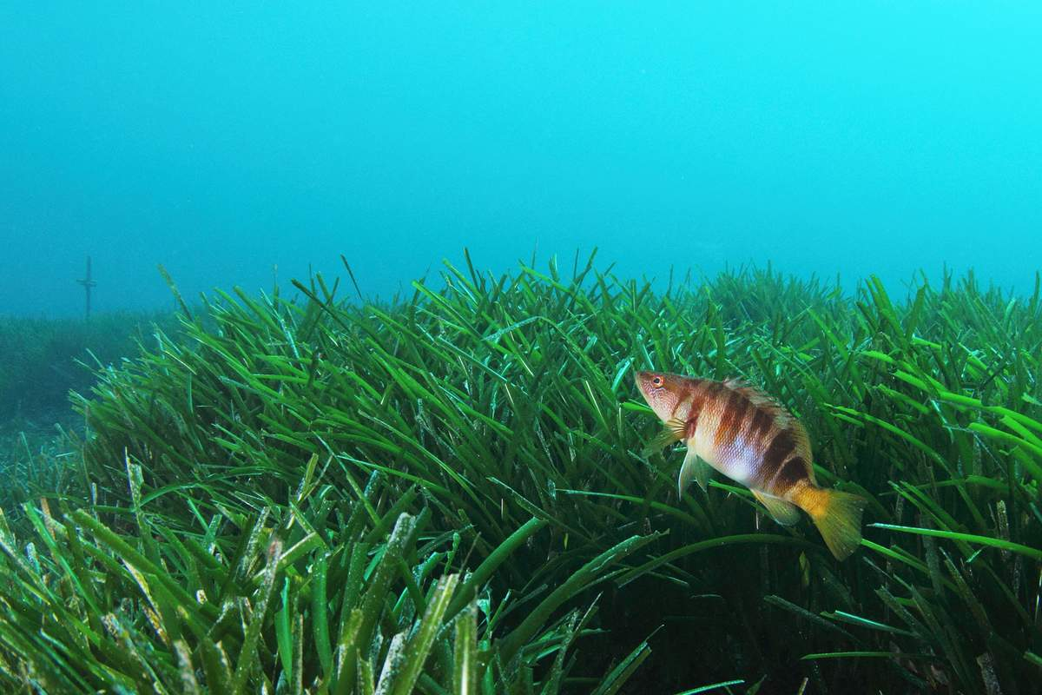

Slide 8
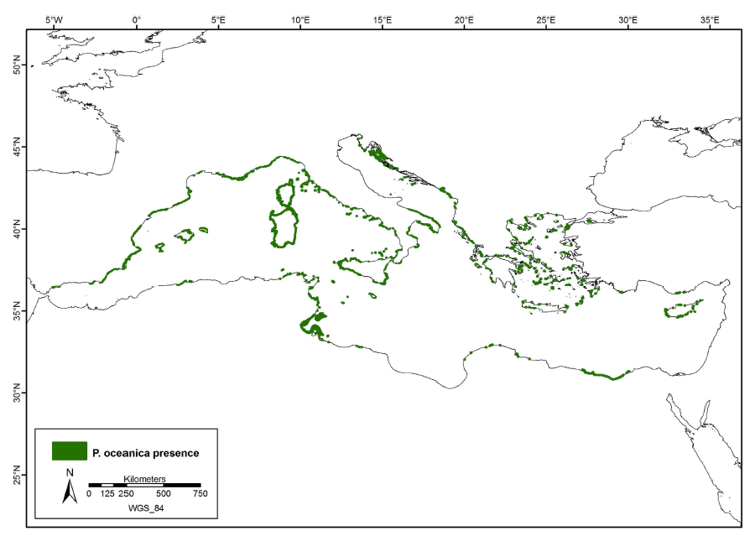
Posidonia oceanica
Telesca & al. 2015, Seagrass meadows (Posidonia oceanica) distribution and trajectories of change
(Telesca et al. 2015, Scientic Reports)

Slide 9
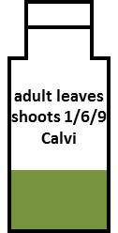
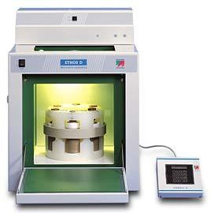
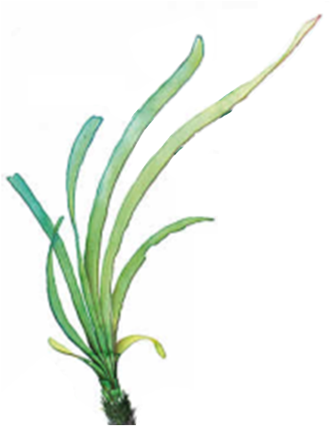
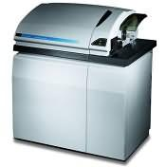
Laboratory analyses
Analytical steps:
homogeneous sample
acidic digestion in a microwave oven
measures :
  inductively coupled plasma mass spectrometer
Ethos D
ELAN DRCII

Slide 10
Topics
Spatial monitoring of contamination
Water quality index and bioindicator complementarity
Seasonality and compartmentalization
Experimental vs. field monitoring
www.wwfsassi.co.za/

Slide 11
Topics
Spatial monitoring of contamination
www.wwfsassi.co.za/

Slide 12
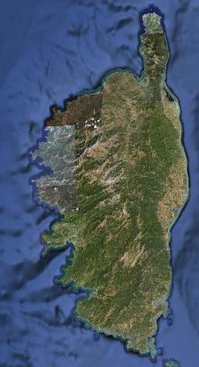


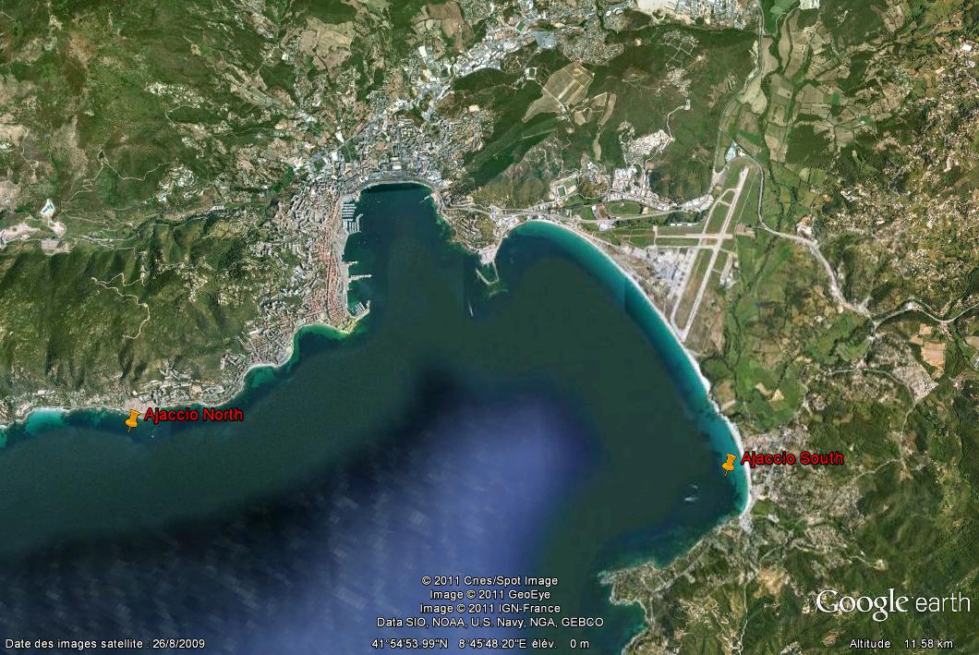
Gradient monitoring: Ajaccio Bay
A1
-A9

Slide 13
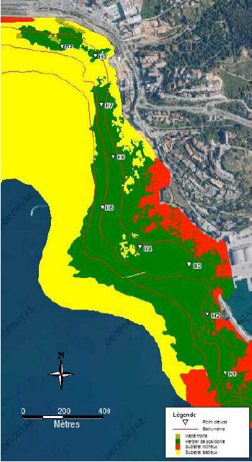
Gradient monitoring: Ajaccio Bay
A1
A2
A3
A4
A1
-A9
A5
A6
A7
A8
A9

Slide 14
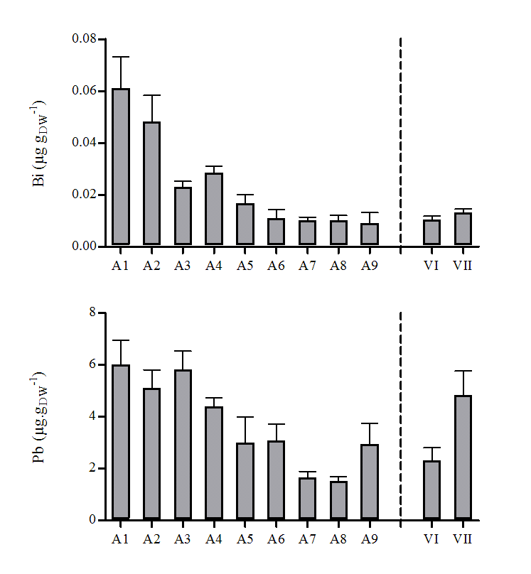
Gradient monitoring: Ajaccio Bay

Slide 15
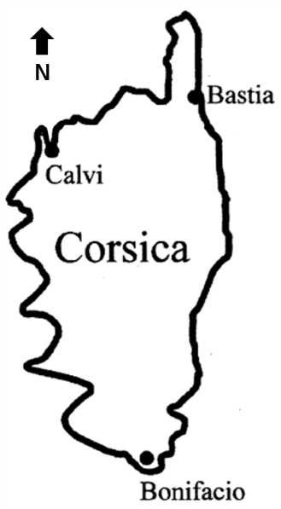
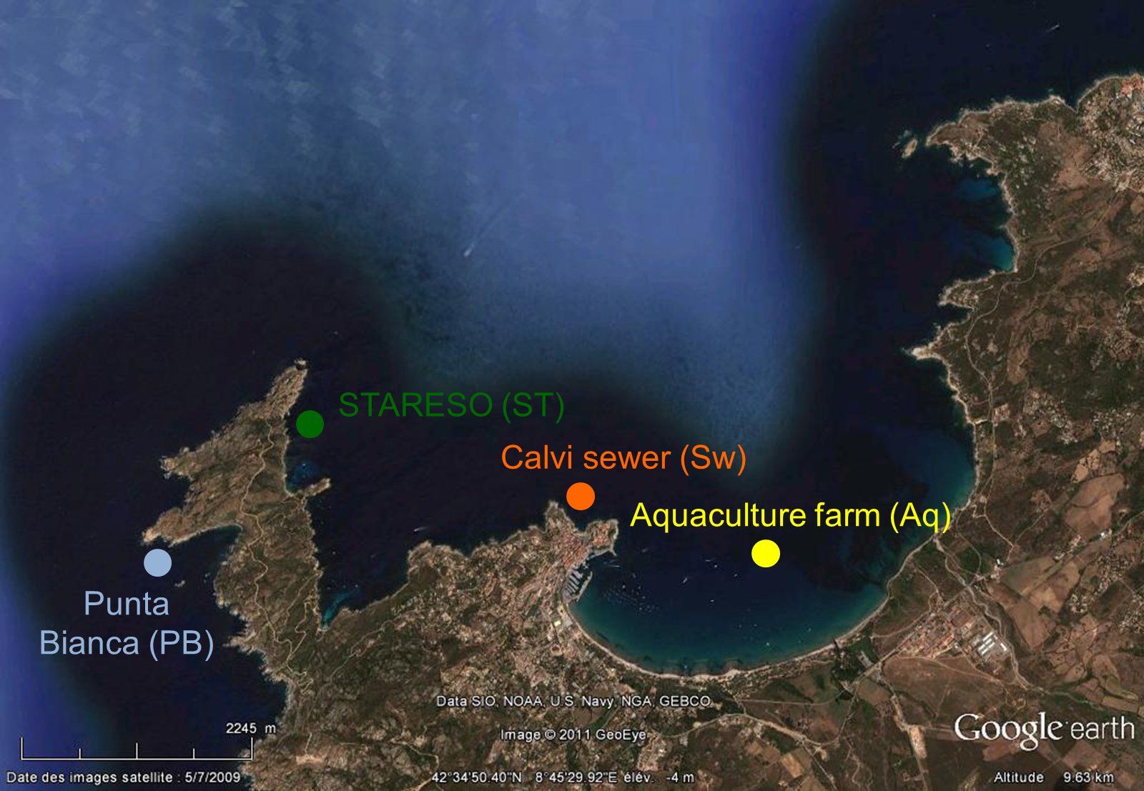
Local monitoring: Gulf of Calvi

Slide 16
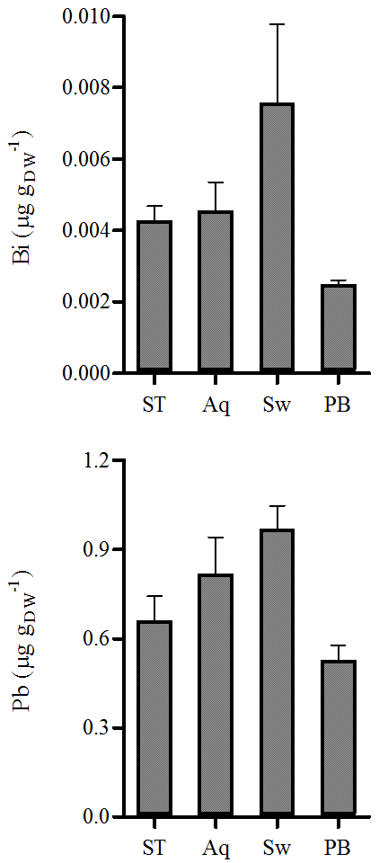

Local monitoring: Gulf of Calvi
Lifestyle of organisms
P. oceanica = rooted primary producer
→ weak point sources of long-term accumulations of pollutants in sediments.

Slide 17
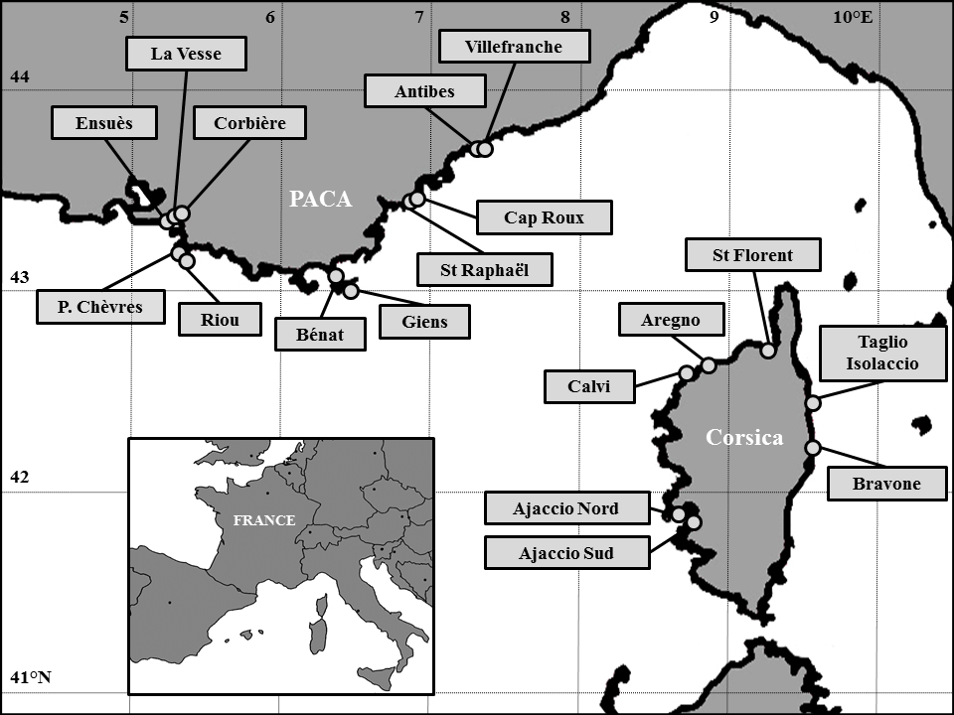
18 stations (sampled in april 2007 at 15m depth)
SPAT IAL
VARI AT ION
11
1
I
VII

Slide 18
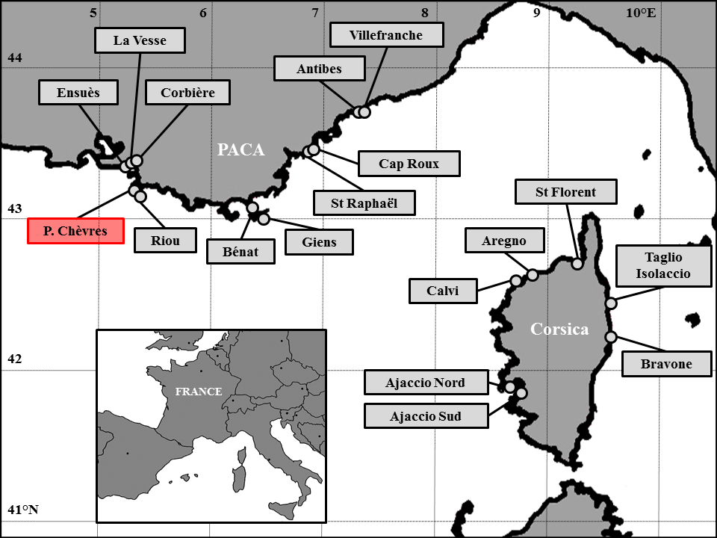
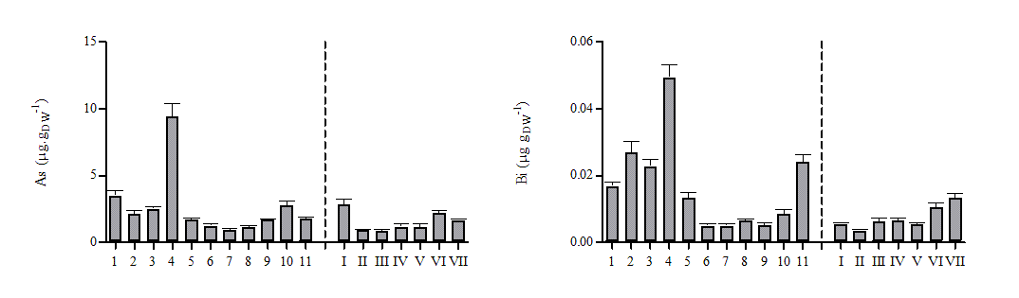
Regional monitoring: French Mediterranean littoral
© Ballesta L.
PACA Corsica
PACA Corsica

Slide 19
Global monitoring: Mediterranean Sea

Slide 20
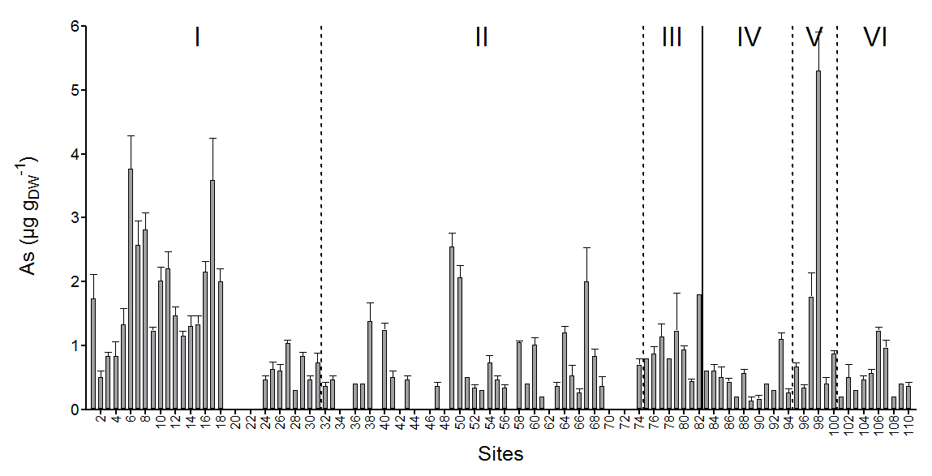
Global monitoring: Mediterranean Sea

Slide 21
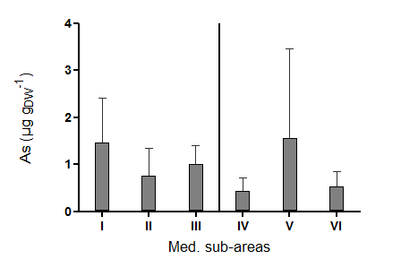
Global monitoring: Mediterranean Sea

Slide 22
Topics
Spatial monitoring of contamination
Water quality index and bioindicator complementarity
www.wwfsassi.co.za/

Slide 23
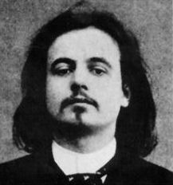
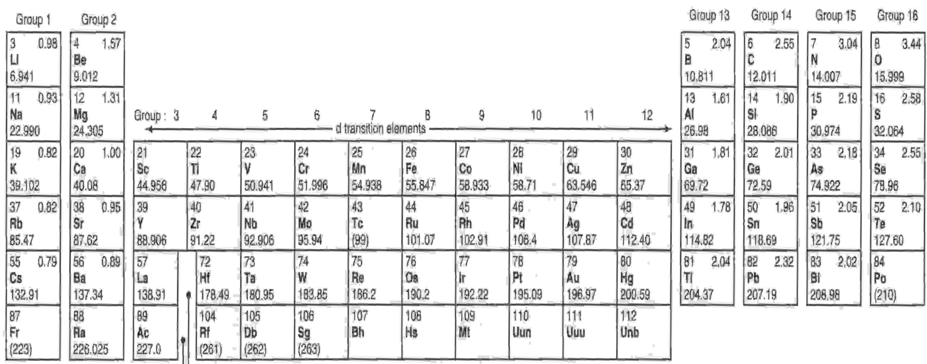
Monitoring of trace element contamination
'Simplicity does not have to be simple', wrote Jarry, 'but complexity, compressed and synthesized.‘
Alfred Jarry, 1873 – 1907.
TEPI = (Cf₁ * Cf₂ … Cf_{n})^{1/n}
Cf_{n} is the mean normalized concentration of the TE n.

Slide 24
Global monitoring: Mediterranean Sea
Ag, As, Cd, Cu,
Hg, Ni, Pb
TEPI

Slide 25
Global contamination

Slide 26

5-level water quality scale
qu. 1
qu. 2
qu. 3
qu. 4
Superior limit of quartiles
5 contamination levels
< 1st qu. mean : very low CL
1st-2nd qu. mean: low CL
2nd-3rd qu. mean: medium CL
3rd-4th qu. mean: high CL
> 4th qu. mean: very high CL
Quartile means

Slide 27
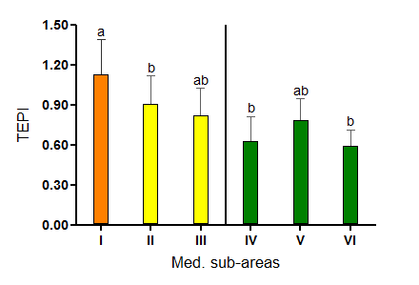

Slide 28
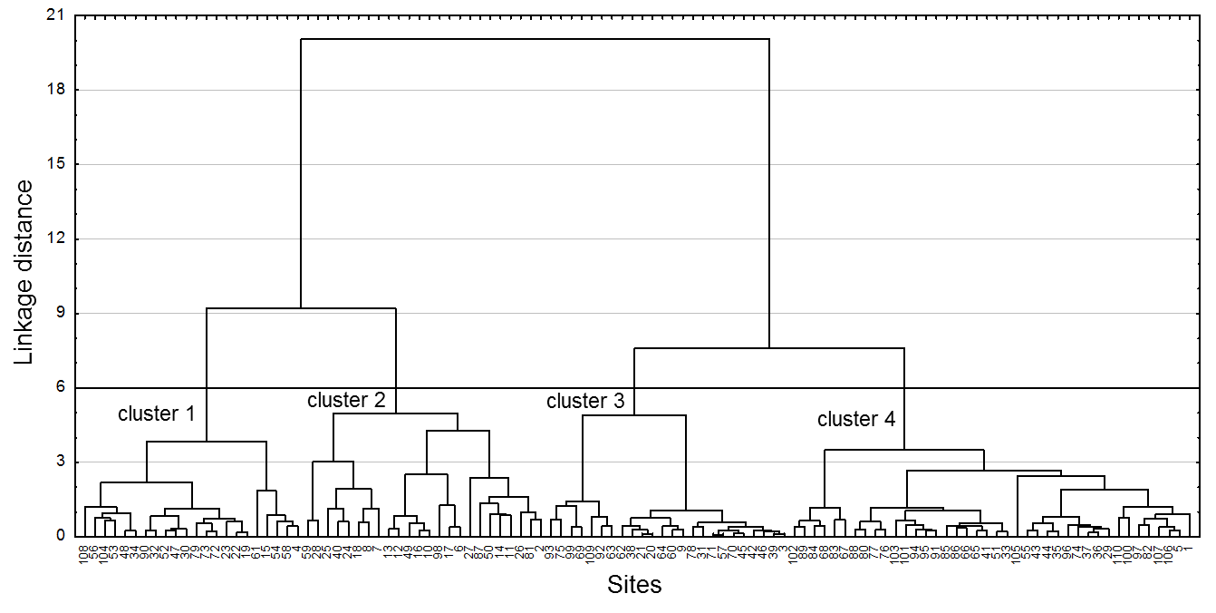
Cluster analysis
sites highly contaminated
sites little contaminated

Slide 29
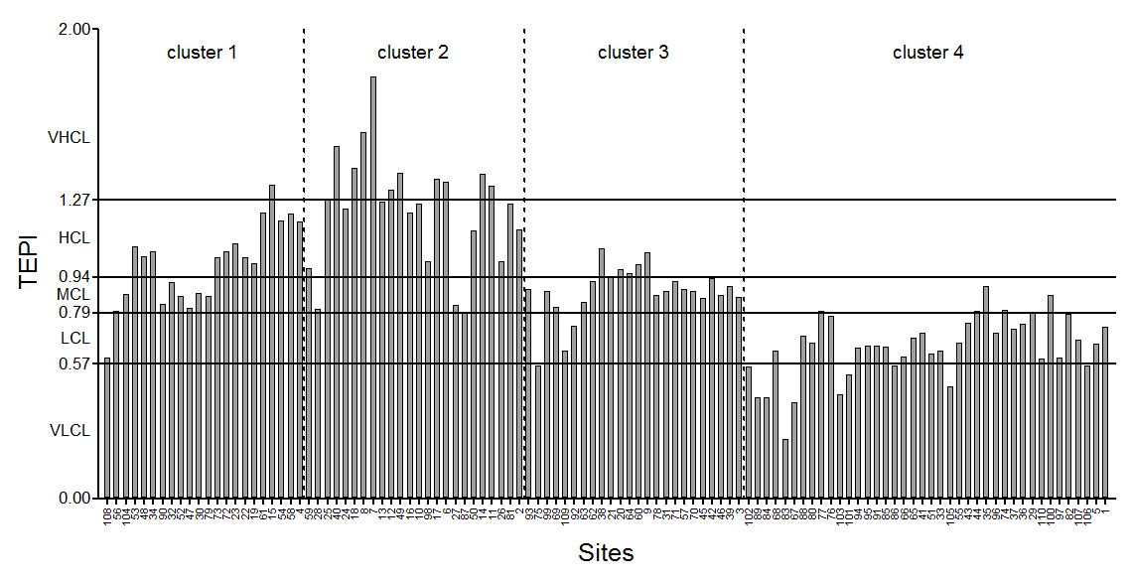
Cluster analysis
HC by Cd, Ni; LC by As
HC by Ag, As, Pb
LC by TEs overall

Slide 31

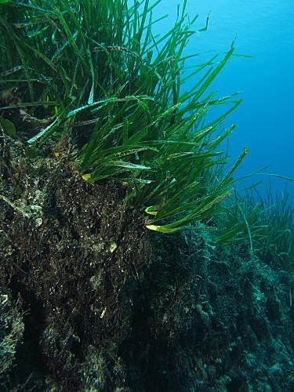
Monitoring of the western Mediterranean
© A. Abadie
©Ifremer/E. Emery
(Richir et al. 2015)
France
Cd
Pb
Ni
Hg
TEPI
Italy
I(1-31)
Corsica
(33-62)
Spain
Sardinia
(63-74)
II(32-74)
Baleares (32)
Mediterranean Sea
III(75-82)
Algeria
Tunisia

Slide 32
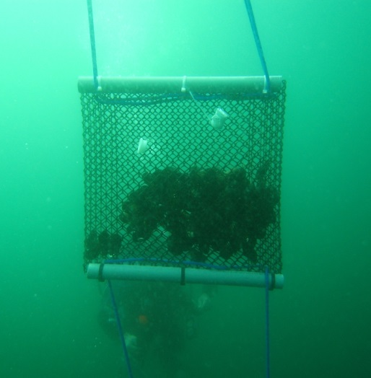
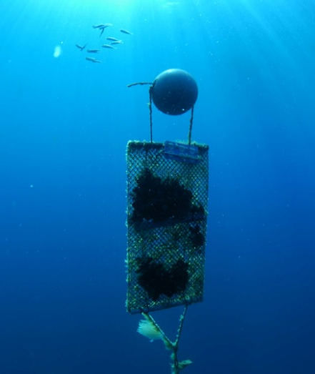
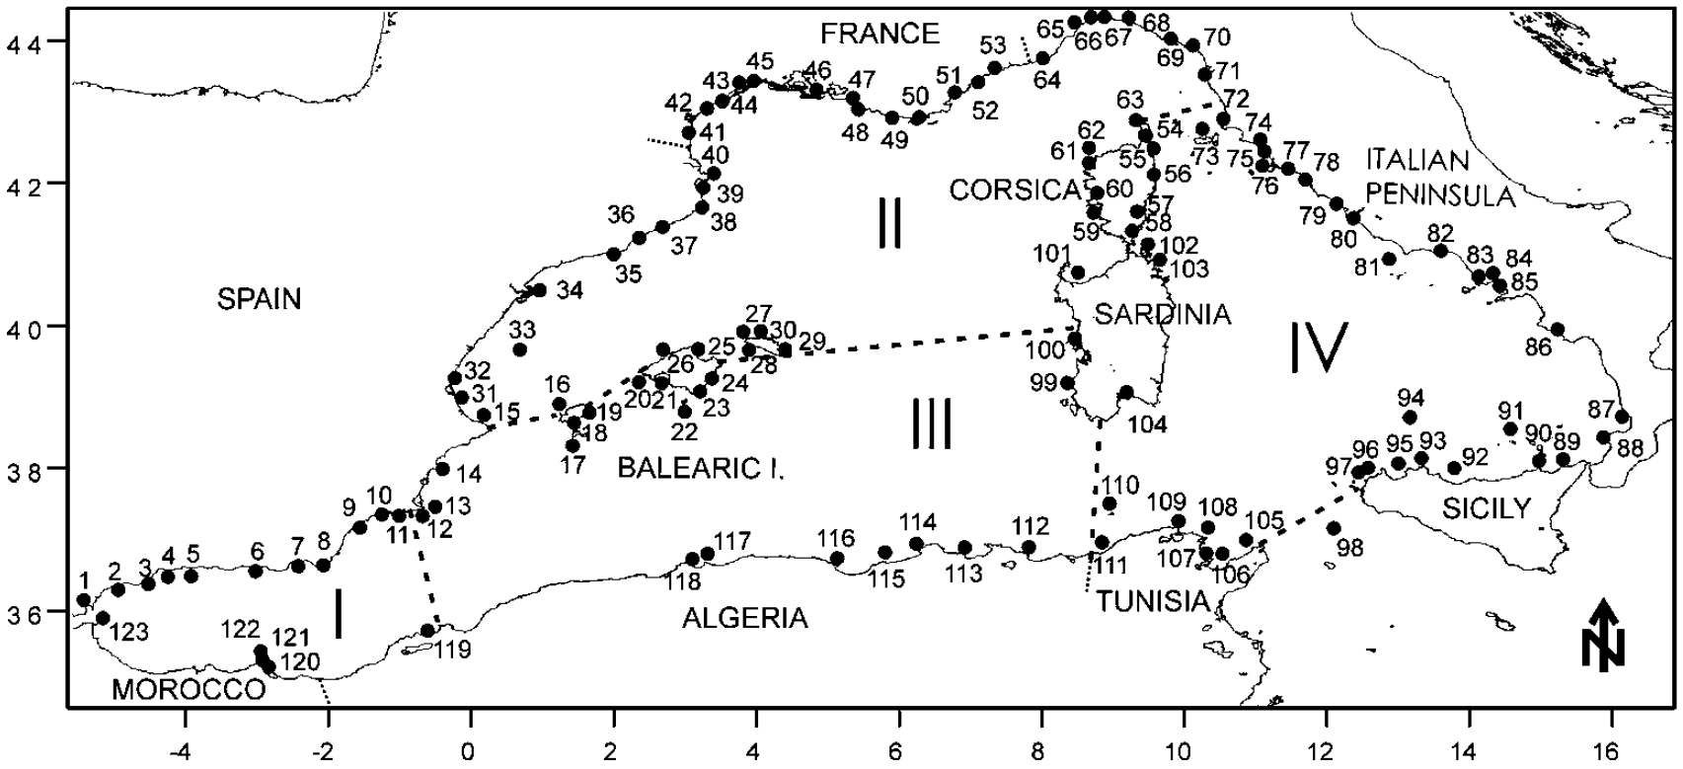
Monitoring of the western Mediterranean
©Ifremer/E. Emery
(Benedicto et al. 2011)
Cd
Pb
Ni
Hg
TEPI

Slide 34
Topics
Spatial monitoring of contamination
Water quality index and bioindicator complementarity
Seasonality and compartmentalization
www.wwfsassi.co.za/

Slide 35
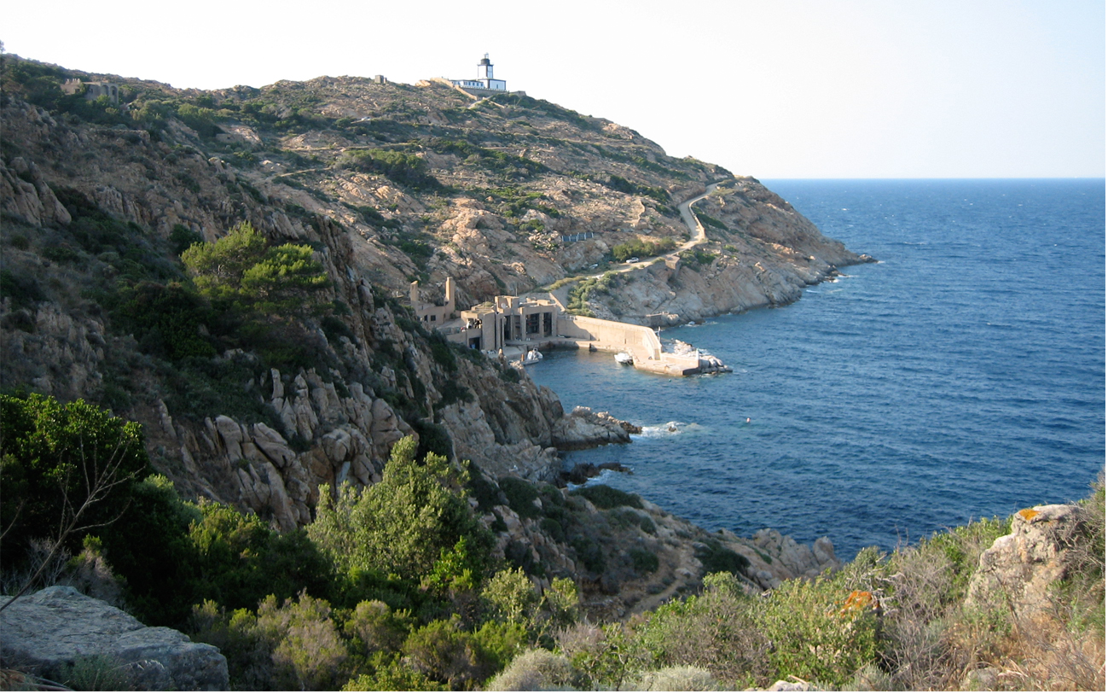

Slide 36
STARESO
Site of reference for the biomonitoring of the pollution with trace elements in the Northwestern Mediterranean?
© A. Abadie

Slide 37
STARESO
Site of reference for the biomonitoring of the pollution with trace elements in the Northwestern Mediterranean?
    P. oceanica shoots, rhizomes and roots;
© A. Abadie

Slide 38
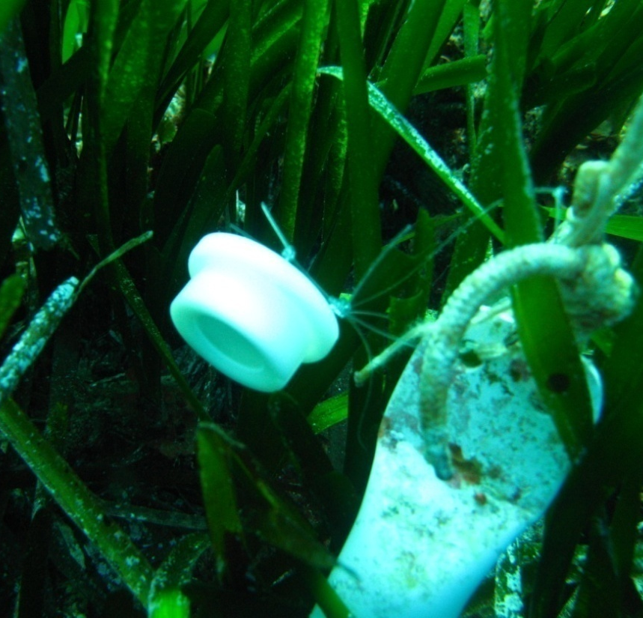
STARESO
Site of reference for the biomonitoring of the pollution with trace elements in the Northwestern Mediterranean?
    P. oceanica shoots, rhizomes and roots;
  superficial sediments;
  water.
© A. Abadie

Slide 39
STARESO
Site of reference for the biomonitoring of the pollution with trace elements in the Northwestern Mediterranean?
► [trace elements] low to very low → YES: site of reference.
© A. Abadie

Slide 40
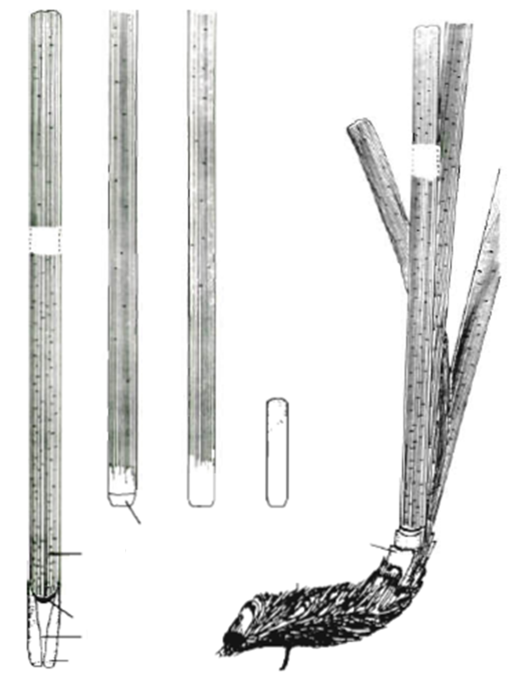

P. oceanica physiognomy
blade
B
C
D
E
plagiotropic shoot
orthotropic shoot
leaf base (petiole)
limb
scale
rhizome
A
rhizome
ligula
roots
leaf base
stipule
root
Left: P. oceanica shoots fixed on a plagiotropic rhizome. Right: (A) shoot of leaves on a plagiotropic rhizome; (B, C) adult leaves; (D) intermediate leaf; (E) juvenile leaf (modified after Libes and Boudouresque 1987).

Slide 41
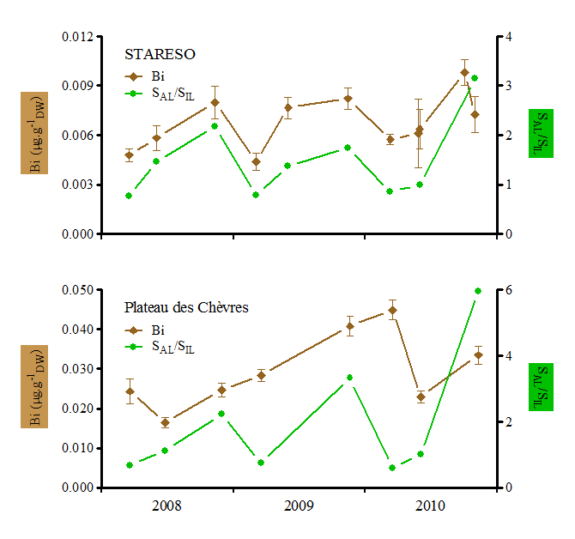
P. oceanica: environment vs. biological cycle

Slide 42
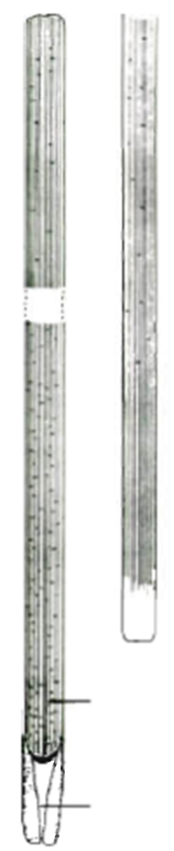
P. oceanica compartmentalization
Hypotheses:
water column accumulation
residence time
dilution effect
IL
BAL
SAL

Slide 43
P. oceanica compartmentalization
Hypotheses:
water column accumulation
residence time
dilution effect
IL
BAL
SAL

Slide 44
P. oceanica compartmentalization
Hypotheses:
sediment accumulation
IL
BAL
SAL

Slide 45
P. oceanica compartmentalization
Hypotheses:
sediment accumulation
Cu = essential micronutrient
IL
BAL
SAL

Slide 46
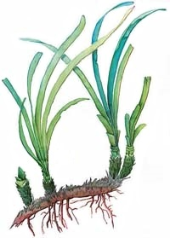

Little invasive, non-destructive shoot method
rank 2
leaf
rank 1
rank 3
rank 4
rank 5
rank 6
plagiotropic shoot
orthotropic shoot
They survive, they regrow … and they flower
rhizome
cut in situ with scissors (rank 3-4 leaf or whole leaf bundle)
roots

Slide 47
Topics
Spatial monitoring of contamination
Water quality index and bioindicator complementarity
Seasonality and compartmentalization
Experimental vs. field monitoring
www.wwfsassi.co.za/

Slide 48
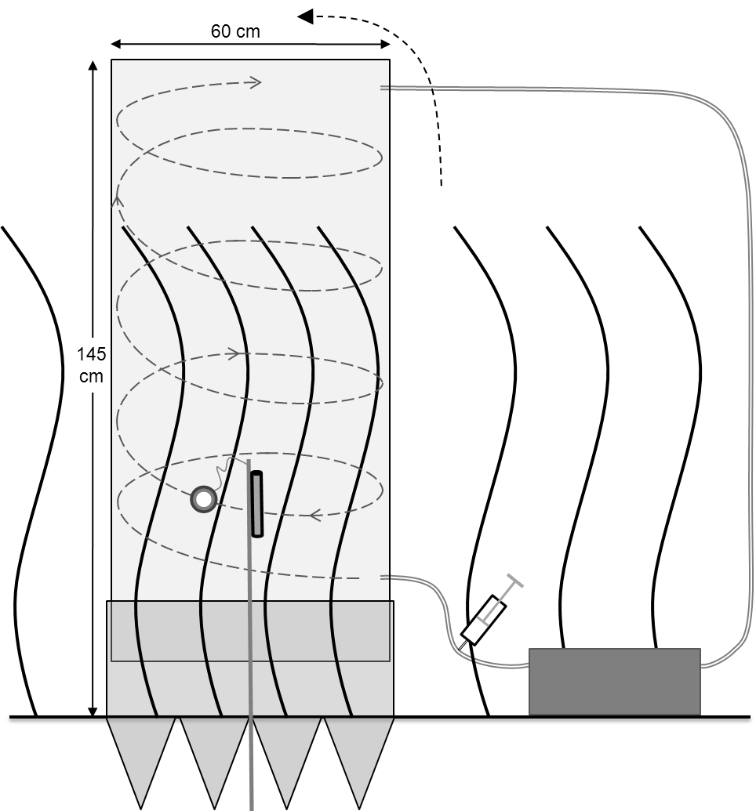
Moderate contamination experiment
5 days of contamination in June 2009;
410L bell-shaped mesocosm;
Contamination every 12 hours (9am-9pm);
15 days of decontamination.

Slide 49
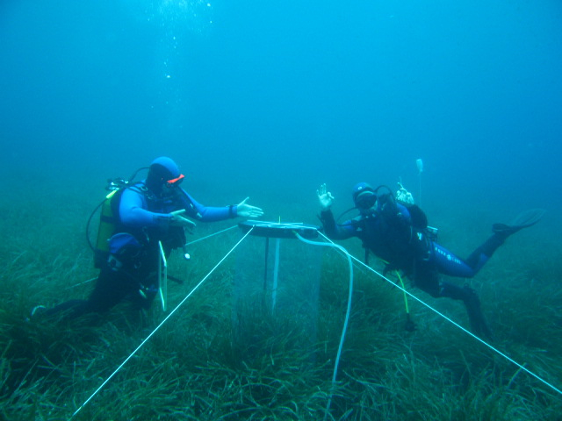
Moderate mesocosm

Slide 50
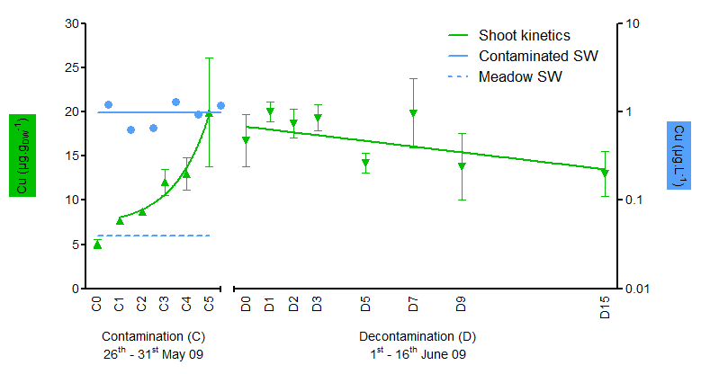
Cu: moderate contamination - shoots and water

Slide 51

Cu: moderate contamination - shoots and leaves

Slide 52

Cu: moderate contamination - rhizomes
Cu in Rhizomes

Slide 53


acropetal translocation
Cu
© Mrkvicka A.

Slide 54
General conclusions
Spatial monitoring of pollution:
sampling strategy will depend on the aims of your study.
Water quality index and bioindicator complementarity:
deliver conscious but precise information to managers and stakeholders.
Seasonality and compartmentalization:
bioaccumulated TE levels evolve according to the species biological cycle and the compartment considered;
Experimental vs. field monitoring:
2 complementary approaches.
www.wwfsassi.co.za/

Slide 55




More information
http://orbi.ulg.ac.be/

Slide 56

Thank you for your attention

