Slide 1
Experimental Investigation of a Condensing Gas Absorption Heat Pump for Residential Buildings
DÁVILA Camila*
PAULUS Nicolas
CUEVAS Cristian
LEMORT Vincent
University of Liège, Thermodynamics Laboratory
Liège, Belgium
cdavila@uliege.be
May 24-28, 2021
Notes:
Hello, good morning everyone, my name is Camila Davila and I’m going to present my work intitled “experimental investigation of a condensing gas absorption heat pump for residential buildings”, work that has been developed in the thermodynamics laboratory of the university of liege in Belgium in collaboration with the authors here mentioned.

Slide 2
Global context
The use of energy is a relevant topic nowadays and the building sector has been pointed as one of the key areas in the matter
In 2017, the household sector represented 30% of the final use of energy consumption in the European Union (EU) ¹
80% of the energy used in the residential sector was destinated for domestic hot water (DHW) and space heating. ¹
Therefore, the search for alternatives applicable at the residential level to produce domestic hot water and heating is a focus of study.
The household’s presence is strongly reflected in the consumption of natural gas, representing 45.6% of the total energy consumption; this is followed by electricity consumption (29.7%) ¹
Between 2005 and 2018, the use of heat pumps in the heating sector in the EU represented an increase in energy consumption of 8.3 Mtoe, surpassed only by the use of solid biomass (23.7 Mtoe) ¹
¹ European Environment Agency
Notes:
As everyone knows, how we produce energy and the final use of this one is a relevant topic nowadays. There are several studies and information available that allow us to understand and split the problem of energy consumption, letting us to focus our efforts in key areas.
One of these key areas in energy consumption is the building sector. According to the European environment agency, in 2017 the household sector represented 30% of the final use of energy in the European union only being surpassed by the industrial sector. Also, 80% of this energy was destinated for DHW production and space heating.
Therefore, the search for alternatives that can be applied at the residential level for the production of domestic hot water and heating is a focus of study.
What are our energy sources under this context?
if we observe the final energy consumption by area in 2010, the household’s presence is strongly reflected in the consumption of natural gas with a 45.6% of the total energy consumption, followed by electricity consumption, solid fuel and petroleum products
What are our options then?
It is here where heat pumps represent an interesting focus of study since it is a market that is undoubtedly growing.

Slide 3
Global context
Gas absorption heat pumps
Substantial cost and energy savings compared to conventional commercially available systems ¹
Correct integration, sizing and control necessary ²
Components, the complexity of the systems, related parameters widely studied, but the role of outdoor conditions especially for GAHP remains to be a subject of study ³
In this work, an experimental analysis of a gas driven absorption heat pump was conducted. Different outdoor ambient conditions regarding temperature and humidity were emulated to characterize its behavior depending on weather conditions and to estimate performance indicators.
¹ Keinath and Garimella (2017)
² Famiglietti, et al., 2021; Fumagalli, et al., 2017
³ Babak Dehghan, et al., 2020; Wu, et al., 2020; ...
Notes:
Even more, the study of gas absorption heap pumps (GAHP) appears as an attractive alternative to traditional appliances since offers substantial cost and energy savings compared to conventional systems thanks to the competitive price of gas
However, the system performance and environmental impact is strongly related and can be seriously affected by an incorrect integration, sizing, and control of the system.
Several studies have been conducted to compare components, the complexity of the systems, inputs and outputs, arriving to complex and detailed models. However, the role of outdoor conditions and the effect on the performance indicators rest still a matter of study especially for gas absorption heat pumps, topics developed in this work.

Slide 4
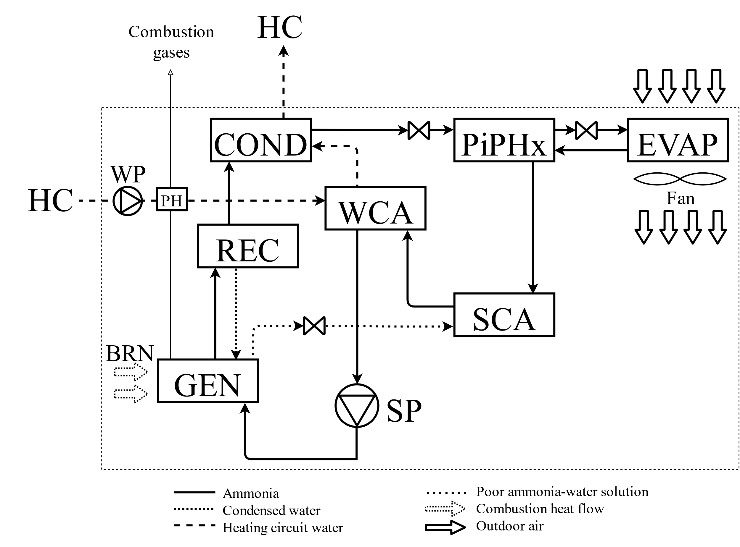
Description of the system
Nominal heating capacity of 18.9 kW
Based on the Water-Ammonia absorption cycle
Notes:
The tested gas absorption heat pump is designed for space heating and domestic hot water (DHW) for residential applications, with a nominal heating capacity of 18.9 kW. The system is based on the Water-Ammonia absorption cycle using outdoor ambient air as renewable energy source and natural gas combustion as high-temperature heat source; the delivered hot water is the medium-temperature heat sink.
Here the Burner (BRN) driven by natural gas is used to heat the absorbent-refrigerant solution in the Generator (GEN) causing the separation of the two components by desorption. The desorbed ammonia vapor leaves the GEN and passes through the Rectifier (REC) to remove the last parts of residual water. Then it continues to the Condenser (COND), transferring the heat of the refrigerant to the water destinated to the Heating Circuit (HC), water previously Pre-Heated (PH) by the combustion gases and impulsed by the Water Circulation Pump (WP). The refrigerant leaving the COND is throttled to reduce its pressure by means of a restrictor valve and cooled down inside the Pipe in Pipe heat exchanger (PiPHx); then, by means of a second restrictor valve, is brought to the ideal pressure and temperature conditions to enter the Evaporator (EVAP). Here the liquid refrigerant evaporates by taking heat from the surrounding air, impulsed by a fan. Then, the low-pressure vapor ammonia is overheated in the PiPHx before arriving to the Solution Cooled Absorber (SCA) where it meets the poor refrigerant solution coming from the GEN. The pressure of the incoming solution is reduced by a restrictor valve.
To complete the absorption process and since it is an exothermic reaction, the solution is sent to the Water Cooled Absorber (WCA) where a considerable amount of thermal energy is transferred to the thermal fluid of the heating circuit. Once this process is completed, the solution is pumped back to the GEN using a Solution Pump (SP), restarting the cycle.

Slide 5
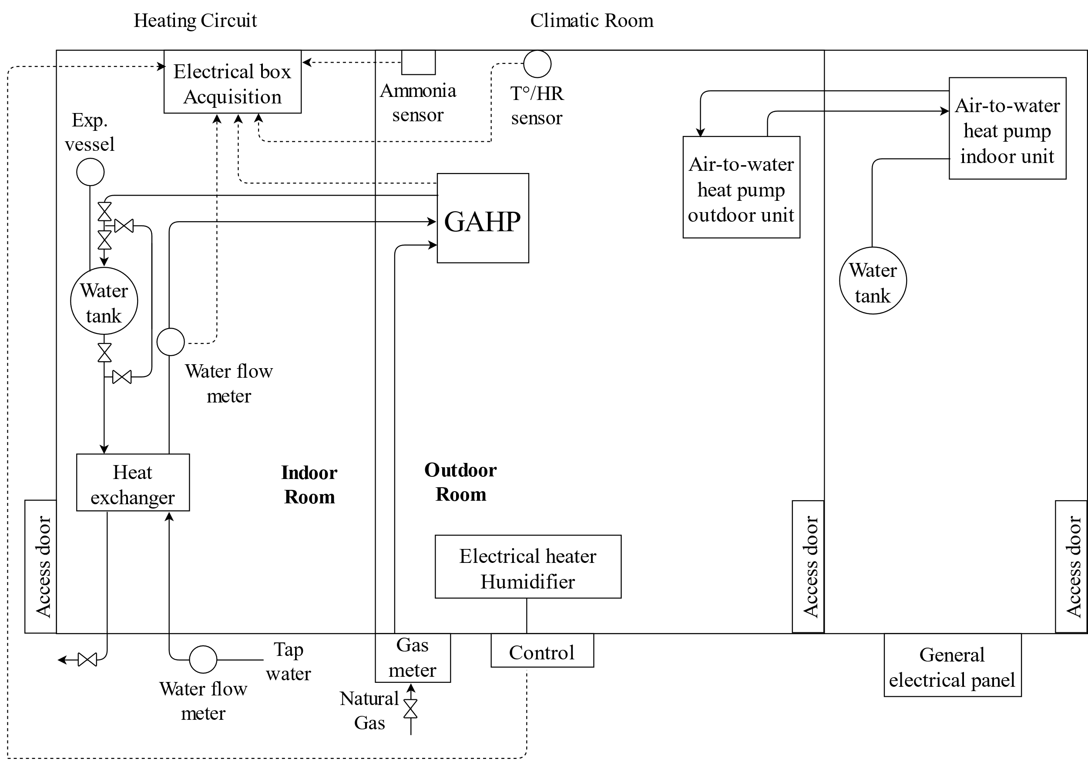
Description of the test bench
Notes:
Since the system is designed to be installed outdoor, tests are performed in a climatic chamber to control temperature and humidity conditions. The test bench was designed in order to be supplied by electricity, natural gas, and chilled water. The electricity and natural gas consumption are measured, as well as water mass flow rates, that are also controlled. The products derived from the operation of the system such as combustion gases, condensate and hot water are removed from the test bench.
The room temperature is controlled by means of an outdoor air-to-water heat pump unit located inside the chamber. On the other hand, the humidity of the room is reduced by water condensation in the evaporators of both units. Once the desired test temperature and humidity conditions are reached, the stationary conditions are maintained by means of an electrical heater and a humidifier. These latter are connected to an acquisition system and controlled by a PI controller which receives the signal of temperature and humidity sensors placed inside the room at the entrance of the evaporator. To emulate the heat demand, a heat exchanger is placed, and the load is controlled by the regulation of the chilled-water flow rate through the exchanger

Slide 6
Test conditions
Outdoor T° conditions → Dry bulb temperatures from the EN 12309
Delivery temperature → All the appliances type from the EN 12309
Humidity → Base-map at 75% RH
Some test at 60% and 85% RH at the most characteristic temperatures of an average climate zone (frost formation)
Steady state tests, 20 minutes as objective
 |  | Water delivery Temperature [°C]
 |  | 35 | 45 | 55 | 65
Outdoor dry bulb Temp.[°C] | 12 | 75%
 | 7 | 60%, 75%, 85%
 | 2
 | -7 | 75%
 | -10
Notes:
With the system in place and in order to achieve the characterization of the system performance, a test campaign is proposed and executed based on the European Standards for gas fired sorption appliances and on a weather data analysis for Belgium.
From the European standards, the test conditions regarding type of application, the reference heating season and the outdoor heat exchanger conditions are considered, corresponding Belgium to an average weather and defining our minimum outdoor temperature.
To consider the weather conditions in terms of temperature and humidity, two local weather stations were selected and a weather data analysis was made for the cold season from October 2018 to March 2019. From here it is observed that the temperature range is well represented by the standards, and that the most frequent value obtained of relative humidity is 75%; additional tests are performed at relative humidities of 60% and 85% to evaluate their impact on the system performance for temperatures ranging from 2°C to 7°C, where frost formation is more likely to occur. Every test is performed at full load on steady state for a period of 20 minutes. Also, the delta T° setpoint of the heating water circuit is fixed at 10 K.

Slide 7
Results
$$∆T\%=\frac{∆T_{\left(τ=0\right)}−∆T_{\left(τ\right)}}{∆T_{\left(τ=0\right)}}$$
COP 75% |  | T° delivery
 |  | 35 | 45 | 55 | 65
Outdoor T° | 12 | 1.45 | 1.34 | 1.19 | 1.05
 | 7 | 1.38 | 1.29 | 1.13 | 1.04
 | 2 | 1.36 | 1.21 | 1.09 | 0.95
 | -7 | 1.21 | 1.13 | 1.02 | 0.86
 | -10 | 1.16 | 1.14 | 0.95 | 0.86
Th. Cap. [kW] 75% |  | T° delivery
 |  | 35 | 45 | 55 | 65
Outdoor T° | 12 | 21.11 | 19.31 | 16.98 | 14.82
 | 7 | 19.55 | 18.57 | 16.30 | 14.92
 | 2 | 20.10 | 18.01 | 15.64 | 13.70
 | -7 | 18.33 | 16.89 | 15.13 | 12.65
 | -10 | 17.36 | 16.82 | 14.14 | 12.66
$$COP=\frac{{\dot{Q}}_{HC}}{{\dot{Q}}_{gas}+{\dot{W}}_{in}}$$
$${\dot{Q}}_{gas}={\dot{V}}_{gas}∗PCS$$
$${\dot{Q}}_{HC}={\dot{m}}_{HC,w}∗c_{p,w}∗\left(T_{out}−T_{in}\right)$$
COP 60% |  | T° delivery
 |  | 35 | 45 | 55 | 65
Outdoor T° | 7 | 1.34 | 1.34 | 1.15 | 0.98
 | 2 | 1.30 | 1.28 | 1.10 | 0.94
Th. Cap. [kW] 60% |  | T° delivery
 |  | 35 | 45 | 55 | 65
Outdoor T° | 7 | 19.68 | 19.40 | 16.73 | 14.20
 | 2 | 19.09 | 18.68 | 16.08 | 13.56
COP 85% |  | T° delivery
 |  | 35 | 45 | 55 | 65
Outdoor T° | 7 | 1.36 | 1.30 | 1.17 | 1.02
 | 2 | 1.36 | 1.21 | 1.09 | 0.96
Th. Cap. [kW] 85% |  | T° delivery
 |  | 35 | 45 | 55 | 65
Outdoor T° | 7 | 19.69 | 18.87 | 17.02 | 14.54
 | 2 | 20.01 | 17.53 | 15.92 | 13.79
COP |  | T° delivery
 |  | 35 |  |  | 45 |  |  | 55 |  |  | 65
 |  | 75% | 60% | 85% | 75% | 60% | 85% | 75% | 60% | 85% | 75% | 60% | 85%
Outdoor T° | 7 | 1.38 | -0.04 | -0.02 | 1.29 | +0.05 | +0.01 | 1.13 | +0.02 | +0.04 | 1.04 | -0.06 | -0.02
 | 2 | 1.36 | -0.06 | - | 1.21 | +0.07 | - | 1.09 | +0.01 | - | 0.95 | -0.01 | +0.01
Notes:
A coefficient of change is defined and computed every 5 minutes to verify that the data collection period is valid and withing the ranges accepted by the standards. the COP for each test was estimated as the ratio between the thermal power output to heat and electric power input. The thermal power output corresponds to the one obtained from the water cooled absorber, the condenser, and the combustion gases, that is donated to the heating circuit, while the inputs are the thermal heat obtained from the natural gas combustion and the electric input to the appliance. Since the internal configuration of the system makes it difficult to install sensors between components that allows to measure the previously defined heat inputs individually, it is decided to estimate the heat input transferred to the water as is shown here. A daily average high calorific value was used, obtaining the following results (-)
For the base map at 75% of relative humidity, the variation of the delivery water temperature has a higher impact on the COP than the outdoor room temperature.
For the variation of the outdoor room temperature, the COP decreases while the temperature decreases and this is reflected in a decrease in the thermal capacity of the system as the outdoor temperature decreases, having as a consequence in the system a decrease in the water flow of the heating circuit. The results obtained for different room humidities follow the same trends, pointing the fact that while higher the outdoor temperature, a bigger amount of latent heat is available on the evaporator resulting in a better COP.
A comparison between the 75% humidity reference and the other tests is shown here (-). For the tests carried out, no conclusive trend is observed. Is interesting to notice though that for most of the cases with the same outdoor and delivery water temperature, a higher humidity has less impact on the COP than a lower humidity. This is strictly related to the way of how the frost layer build’s up and how this one affects the overall heat transfer coefficient on the evaporator.
At lower humidity, the frost layer is more dense and has a greater insulating effect, affecting the heat rate transfer on the evaporator and reducing the COP. On the other hand and for a short period of time, like our tests, the higher the humidity the lower the density of the frost layer that is able to form and therefore, the accumulated mass. This, however, is a short term effect since at higher room humidities, more frequent defrost cycles were triggered by the system’s internal control.

Slide 8
Conclusions and perspectives
An experimental investigation of a gas absorption heat pump has been conducted
Coefficients of performance depending on the delivery water temperature, air temperature and humidity have been calculated
COP mostly affected by the water delivery temperature
Outdoor room temperature and humidity have less effect on the COP in short periods
A greater number of tests and operating points is necessary to obtain more conclusive results
Consider the frost accumulation across time and defrost cycles in performance indicators
 | COP | Outdoor T° | Delivery T° | Humidity
COP | 1.000 | 0.212 | -0.728 | 0.149
Outdoor T° | 0.212 | 1.000 | 0.377 | 0.187
Delivery T° | -0.728 | 0.377 | 1.000 | 0.101
Humidity | 0.149 | 0.187 | 0.101 | 1.000
Notes:
Interesting results were found for the tests performed. It was observed that the biggest effect on the COP is caused by the delivery water temperature, the latter being affected by the thermal power output of the water cooled absorber, condenser, flue gases, and circulation water pump behavior. On the other hand, the outdoor room temperature and humidity have less effect on the COP in short periods of time, being the evaporator the main affected component.
A greater number of tests and operating points is necessary to obtain more conclusive results, work that has been developed after the submission of this paper as it can be seen here (-)
Finally, another point to consider is the frost accumulation across time. The time between defrost cycles involves the formation of a frost layer that could degrade the performance of the appliance in a non-neglected way before arriving to the defrost point, making the control of the system of vital importance to ensure good performance. Nevertheless, considering the defrost cycles in the performance indicators such as the seasonal performance factor will lead to a degradation of the latter.

Slide 9
Thank you
University of Liège, Thermodynamics Laboratory
Liège, Belgium
cdavila@uliege.be

