Slide 1
A multiscale model to investigate gas migrations in clay materials
Third International Workshop on the Finite Element Code LAGAMINE
5-7 July 2022 • Grenoble/ Villard-de-Lans (France)
Gilles Corman¹, Frédéric Collin¹
¹ University of Liège

Slide 2
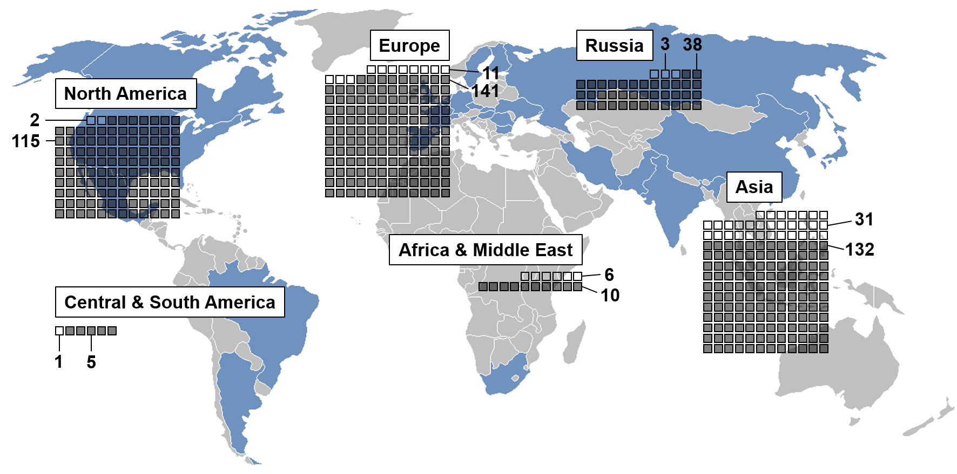
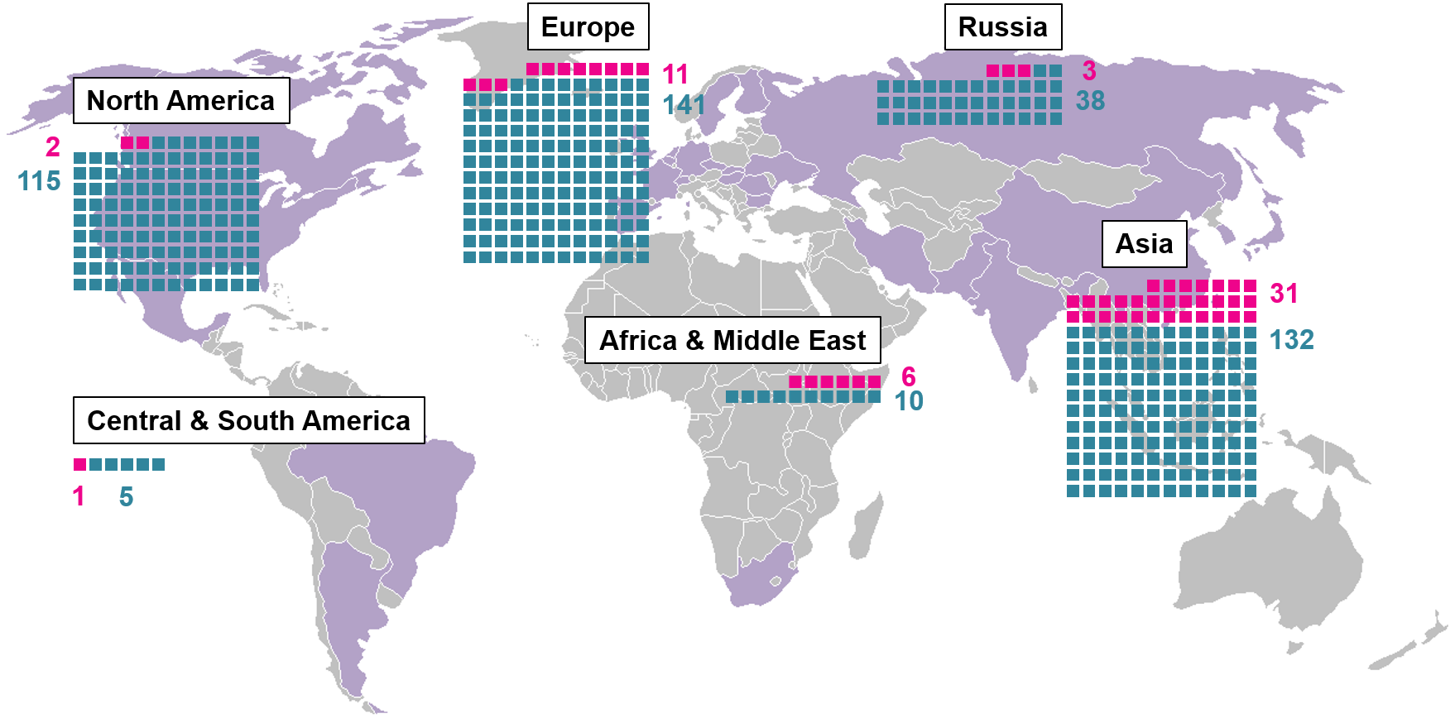
Context
54 reactors under construction
441 operational reactors
10% of the global electric capacity (392 GW)
Production of long-lasting and high-level radioactive wastes, harmful to the biosphere
Deep geological disposal
Global civil nuclear energy in a nutshell, modified after Kernenergie (2021).
3rd International Workshop on the Finite Element Code LAGAMINE – July 2022
01/17

Slide 3
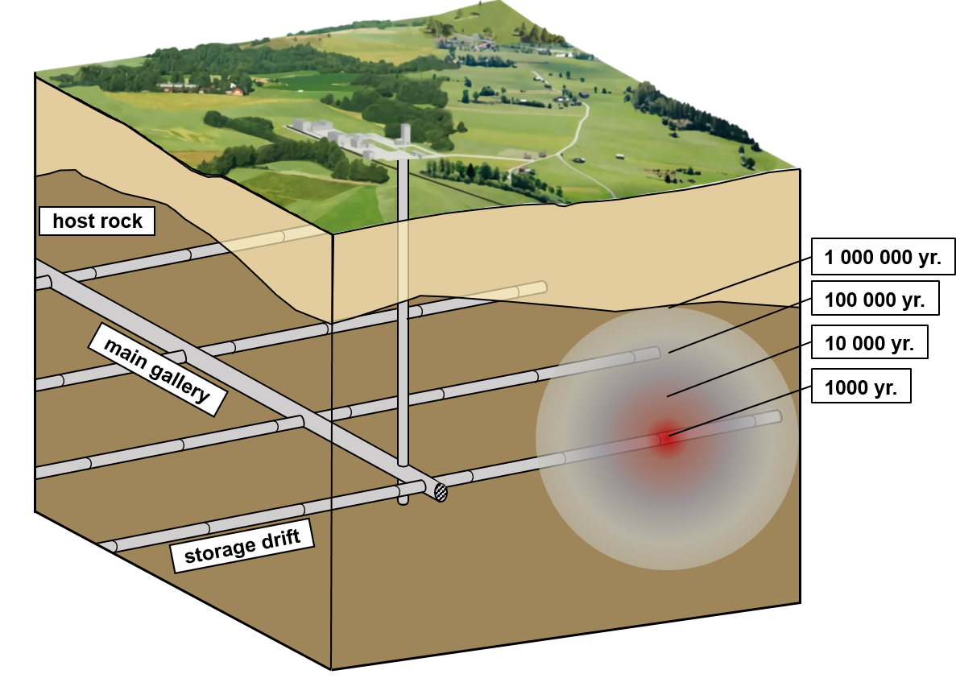
Context
Multi-barriers confinement concept
Conceptual scheme of a deep geological disposal, adapted from ENSI (2013).
3rd International Workshop on the Finite Element Code LAGAMINE – July 2022
02/17

Slide 4
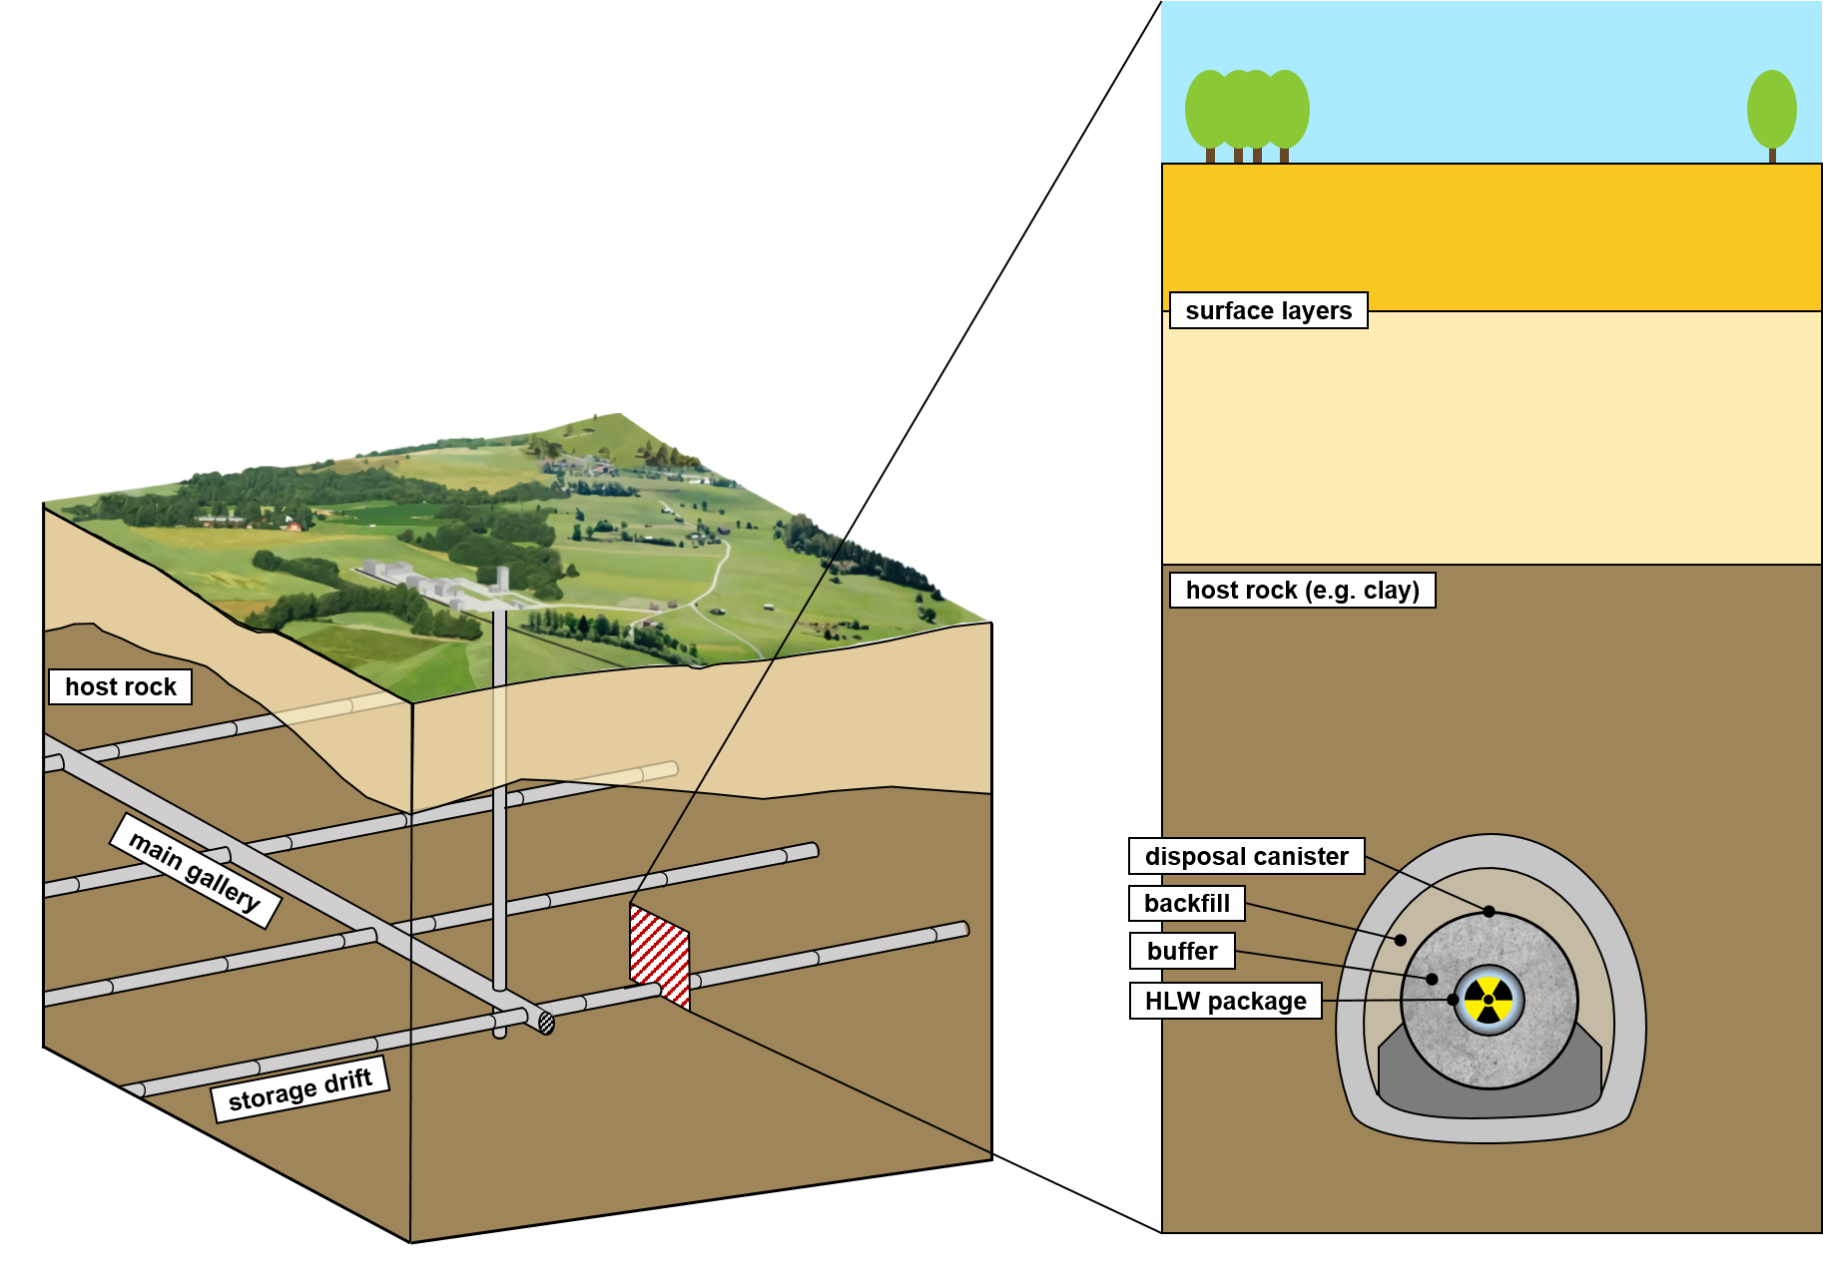
Context
Multi-barriers confinement concept
Conceptual scheme of a deep geological disposal, adapted from ENSI (2013).
Supercontainer reference design, adapted from Grunwald (2021).
3rd International Workshop on the Finite Element Code LAGAMINE – July 2022
02/17

Slide 5
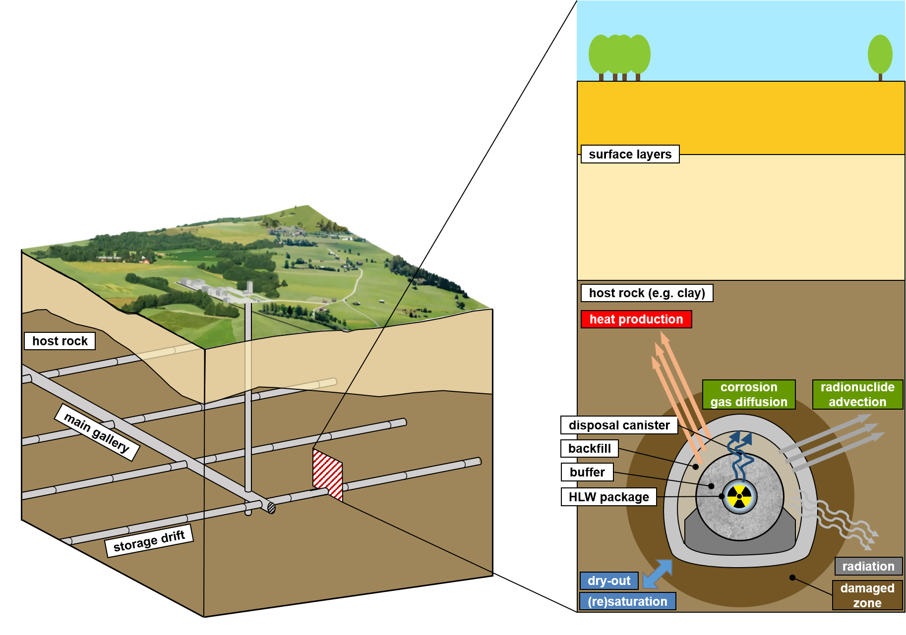
Context
Multi-barriers confinement concept
Multi-physical (THMC) processes
Conceptual scheme of a deep geological disposal, adapted from ENSI (2013).
Supercontainer reference design, adapted from Grunwald (2021).
3rd International Workshop on the Finite Element Code LAGAMINE – July 2022
02/17

Slide 6
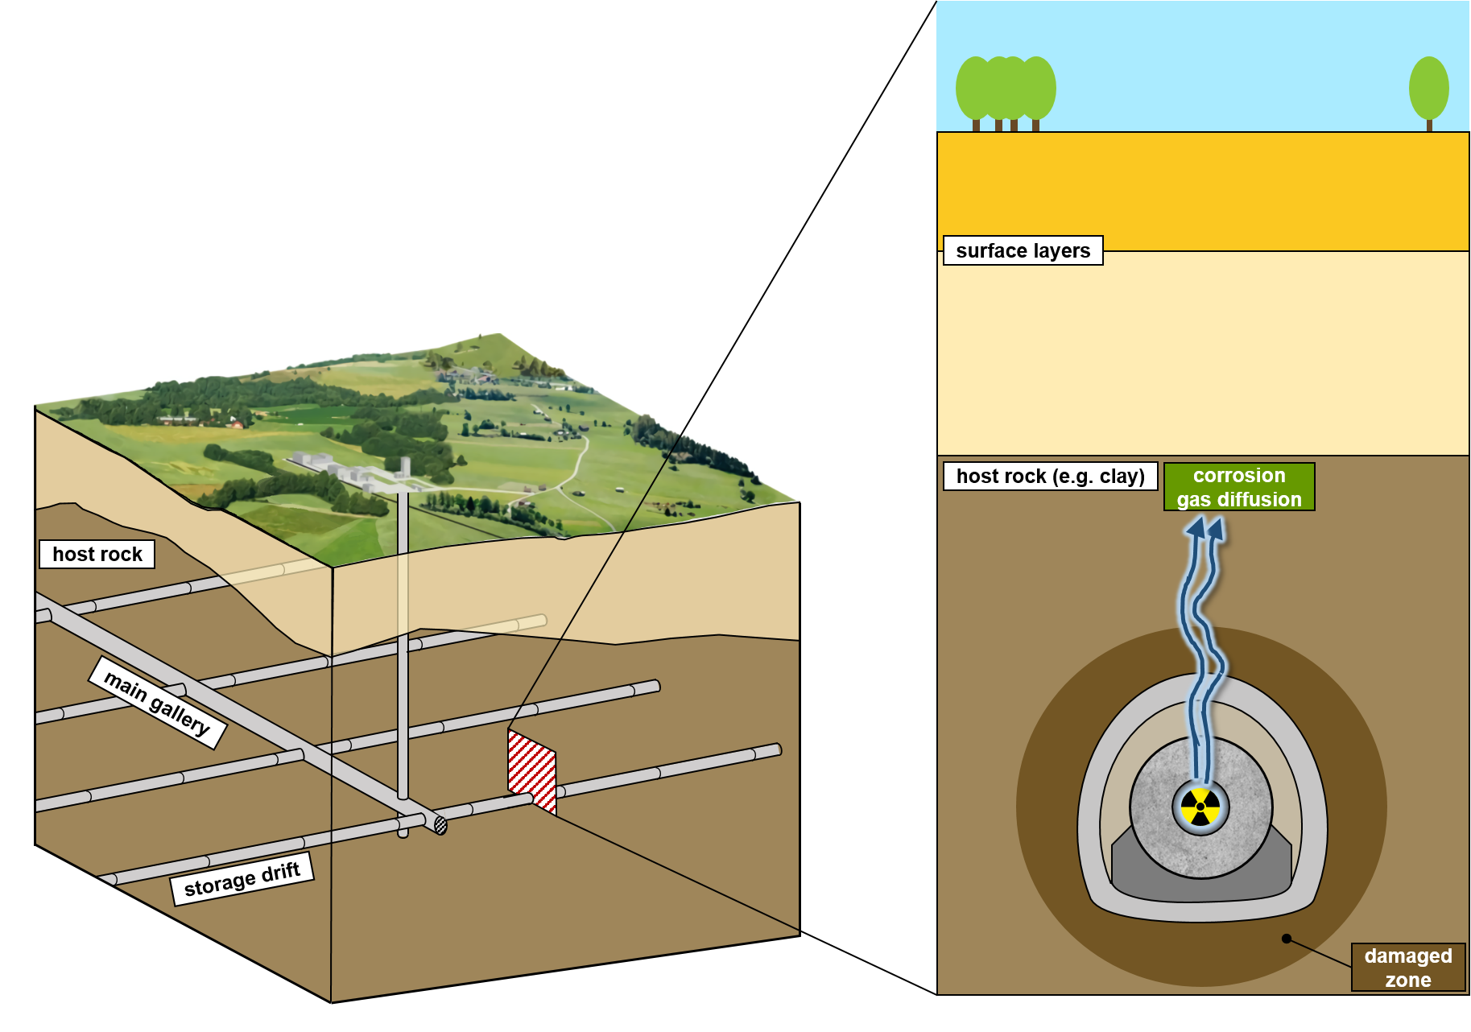
Context
Multi-barriers confinement concept
Multi-physical (THMC) processes
Corrosion
Gas release
Gas pressure build-up
Potential gas migrations through the barrier
Conceptual scheme of a deep geological disposal, adapted from ENSI (2013).
Supercontainer reference design, adapted from Grunwald (2021).
3rd International Workshop on the Finite Element Code LAGAMINE – July 2022
02/17

Slide 7
Context
Gas migrations in the sound rock layers
Governed by the rock structure at a micro-level
Development of a Multi-Scale Model
Complexity and heterogeneity of the microstructure
(pore network morphology, bedding planes)
Hydro-mechanical effects
Boom Clay easily transposed to other host rock formations
Gas migrations in the EDZ
Governed by the hydraulic properties modifications induced by fracturation
Corman et al. (2022) under review
Conceptual scheme of a deep geological disposal, adapted from ENSI (2013).
Supercontainer reference design, adapted from Grunwald (2021).
3rd International Workshop on the Finite Element Code LAGAMINE – July 2022
02/17

Slide 8
Table of content
Context
Description of the model
Characterisation of parameters
Applications
Conclusion
3rd International Workshop on the Finite Element Code LAGAMINE – July 2022
03/17

Slide 9
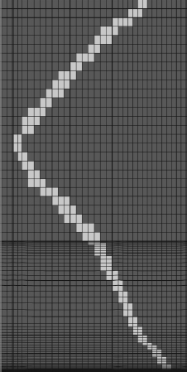
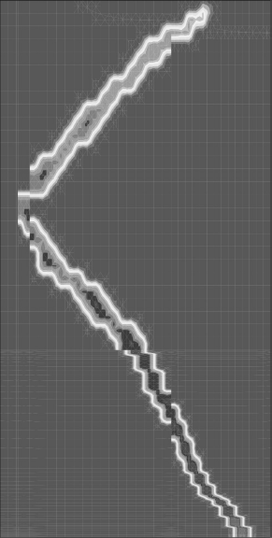
Purpose
Description of the model
Macroscale models
No representation of local phenomena
Gerard et al. (2014)
Sr [-]
Sr [-]
0.998
Cox Sample
0.998
Initial fracture in sample
$$p_{w0}=4.5MPa$$
$$p_{g0}=0.1MPa$$
0.645
0.966
Embedded fracture model, from Gerard et al (2014).
3rd International Workshop on the Finite Element Code LAGAMINE – July 2022
04/17

Slide 10
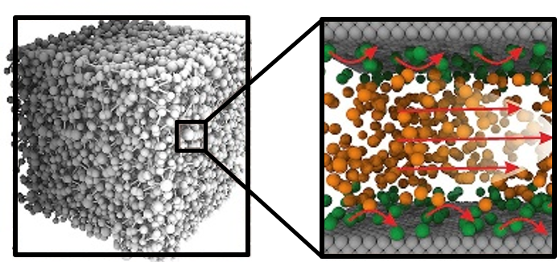
Purpose
Description of the model
Macroscale models
Intermediate-level multiscale models
Nanoscale models
No representation of local phenomena
Based on experimental evidences that some defects within bedding planes and pre-existing fractures govern gas flows
Refined modelling at very low scale of all the pore structure complexity (size, tortuosity, network connectivity,…)
Gerard et al. (2014)
Enriched with embedded fracture model to discern localised pathways
Gonzalez-Blanco (2017)
Yu et al. (2019)
Olivella et al. (2008)
Realistic microstructure including basic ingredients, to reproduce macro-properties (porosity, retention curve, permeability)
Time-consuming computation
Sr [-]
0.998
Initial fracture in sample
0.645
Embedded fracture model, from Gerard et al (2014).
From pore network to molecular model, from Yu et al. (2019).
3rd International Workshop on the Finite Element Code LAGAMINE – July 2022
04/17

Slide 11
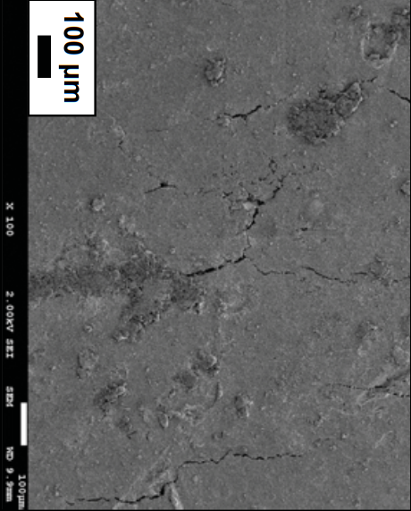
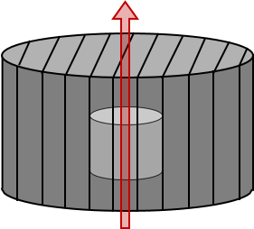
Idealisation of the microstructure (REV)
Description of the model
Bertrand (2020)
1 fracture = bedding plane
A pore network
$$FESEM$$
Half-interdistance between two bedding planes
$$100 μm$$
$$\frac{w}{2}$$
w
w
w
w
Internal microstructure of Boom Clay sample using filled-emission scanning electron microscopy (FESEM), from Gonzalez-Blanco (2017)
Conceptual scheme of the REV geometry
3rd International Workshop on the Finite Element Code LAGAMINE – July 2022
05/17

Slide 12
Idealisation of the microstructure (REV)
Description of the model
Bertrand (2020)
1 fracture = bedding plane
A pore network substituted by an assembly of tubes
$$FESEM$$
Half-interdistance between two bedding planes
$$100 μm$$
$$\frac{w}{2}$$
w
w
w
w
Internal microstructure of Boom Clay sample using filled-emission scanning electron microscopy (FESEM), from Gonzalez-Blanco (2017)
Conceptual scheme of the REV geometry
3rd International Workshop on the Finite Element Code LAGAMINE – July 2022
05/17

Slide 13
Idealisation of the microstructure (REV)
Description of the model
Bertrand (2020)
1 fracture = bedding plane
A pore network substituted by an assembly of tubes
Bridging planes
$$FESEM$$
Half-interdistance between two bedding planes
$$100 μm$$
$$\frac{w}{2}$$
w
w
w
w
Internal microstructure of Boom Clay sample using filled-emission scanning electron microscopy (FESEM), from Gonzalez-Blanco (2017)
Conceptual scheme of the REV geometry
3rd International Workshop on the Finite Element Code LAGAMINE – July 2022
05/17

Slide 14
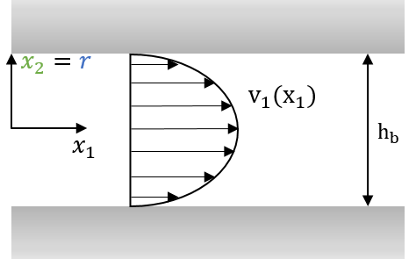
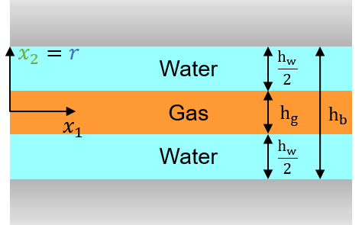
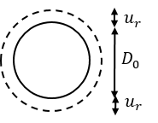
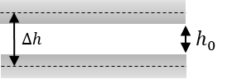
Behaviour of the REV components
Description of the model
Fracture – Bridging plane
Tube
$$q=−\frac{h_{b}^{2}}{12}∙\frac{1}{μ}∙\frac{dp}{dx_{1}}$$
$$→k=\frac{h_{b}^{2}}{12} (·w)$$
$$q=−π\frac{h_{b}^{3}}{128}∙\frac{1}{μ}∙\frac{dp}{dx_{1}}$$
$$→k=π\frac{h_{b}^{3}}{128}$$
Intrinsic permeability (Navier-Stokes)
$$k_{rw}=\frac{{S_{r}^{∗}}^{2}}{2}(3−S_{r}^{∗})$$
$$k_{rw}={S_{r}^{∗}}^{2}$$
Relative permeability curves (multi-phase flow) Yuster et al. (1951)
$$k_{rg}={\left(1−S_{r}^{∗}\right)}^{3}$$
$$k_{rg}={\left(1−S_{r}^{∗}\right)}^{2}$$
$$S_{r}^{∗}=\frac{S_{r}−S_{r,res}}{1−S_{r,res}−S_{r_{g}},res}={\left(1{+\left(\frac{s}{P_{e}}\right)}^{\frac{1}{\left(1−λ\right)}}\right)}^{−λ}$$
Retention curve Van Genuchten (1980) (Laplace equation)
$→$ Evolution of the entry pressure
with the tube diameter: $P_{e}=P_{e,0}{\left(\frac{D_{0}}{D}\right)}^{m}$
$$P_{e,0}=\frac{2σ\cos{θ}}{h}$$
$$P_{e,0}=\frac{2σ\cos{θ}}{\frac{D}{2}}$$
$$m=3$$
Mechanical aperture Goodman (1976)
$$Δh=\frac{Δσ^{′}}{K_{n}(h)}$$
$$ΔD=−\frac{D_{0}}{2G}Δσ^{′}$$
3rd International Workshop on the Finite Element Code LAGAMINE – July 2022
06/17

Slide 15
Table of content
Context
Description of the model
Characterisation of parameters
Applications
Conclusion
3rd International Workshop on the Finite Element Code LAGAMINE – July 2022
03/17

Slide 16
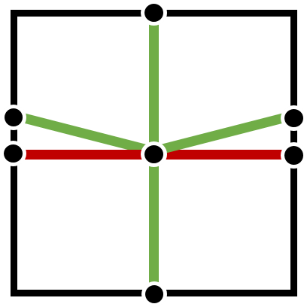
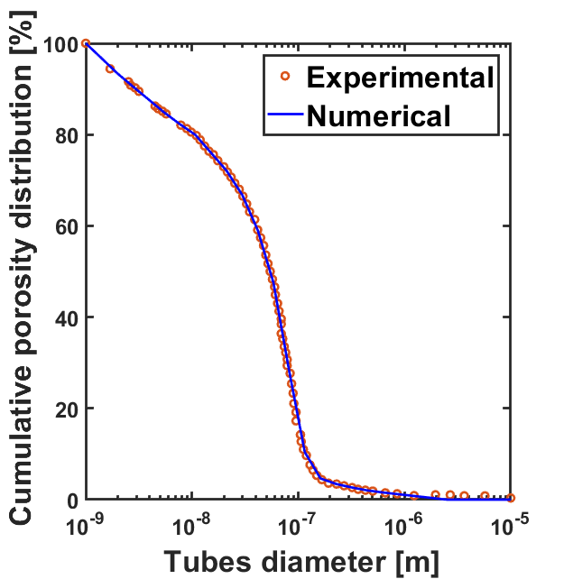
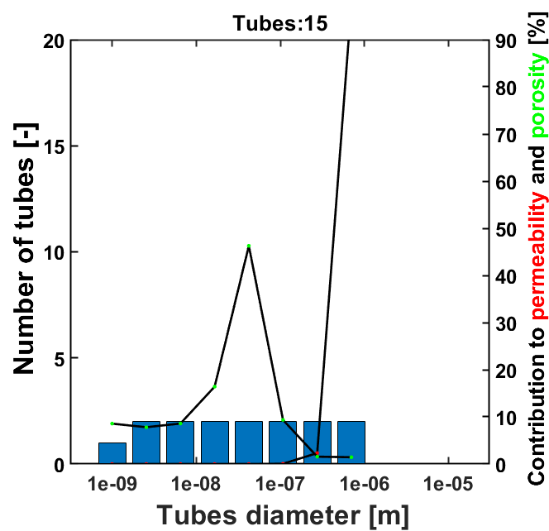
Characterisation of the microstructural parameters
$$k_{y}={1∙10}^{−19}m^{2}$$
Experimental estimations of bedding plane separation, from Gonzalez-Blanco (2017)
$$y$$
$$h$$
FESEM | $μ$-CT
150 – 270 $μm$ | 410 – 560 $μm$
$$w$$
Tubes
$$k_{x}={2∙10}^{−19}m^{2}$$
1. Size of the REV
Bedding plane separation $w=300 μm$
$$x$$
Bedding
2. Macroporosity
Fitting of the pore size distribution
Effect of small-size pores
(Tortuosity = Calibration factor)
3rd International Workshop on the Finite Element Code LAGAMINE – July 2022
07/17

Slide 17
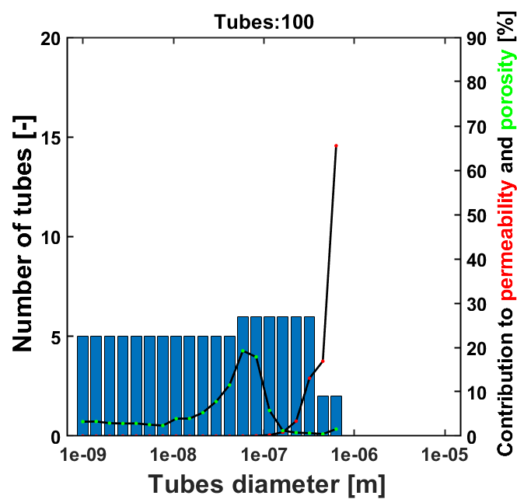
Characterisation of the microstructural parameters
$$k_{y}={1∙10}^{−19}m^{2}$$
Experimental estimations of bedding plane separation, from Gonzalez-Blanco (2017)
$$y$$
$$h$$
FESEM | $μ$-CT
150 – 270 $μm$ | 410 – 560 $μm$
$$w$$
Tubes
$$k_{x}={2∙10}^{−19}m^{2}$$
1. Size of the REV
Bedding plane separation $w=300 μm$
$$x$$
Bedding
2. Macroporosity
Fitting of the pore size distribution
Effect of small-size pores
(Tortuosity = Calibration factor)
3rd International Workshop on the Finite Element Code LAGAMINE – July 2022
07/17

Slide 18
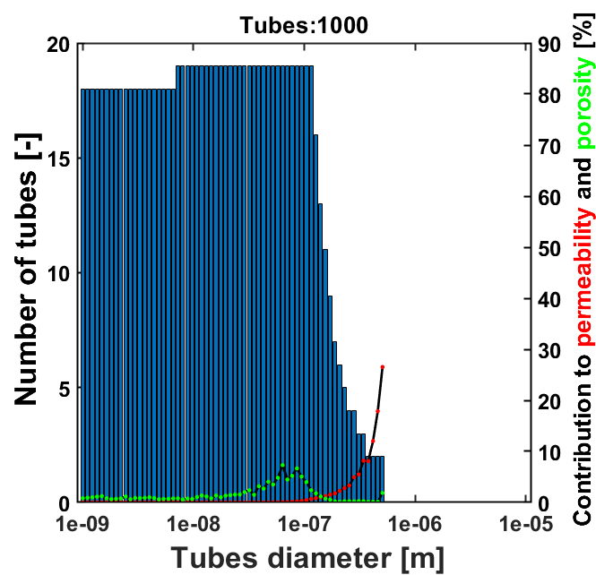
Characterisation of the microstructural parameters
$$k_{y}={1∙10}^{−19}m^{2}$$
Experimental estimations of bedding plane separation, from Gonzalez-Blanco (2017)
$$y$$
$$h$$
FESEM | $μ$-CT
150 – 270 $μm$ | 410 – 560 $μm$
$$w$$
Tubes
$$k_{x}={2∙10}^{−19}m^{2}$$
1. Size of the REV
Bedding plane separation $w=300 μm$
$$x$$
Bedding
2. Macroporosity
Fitting of the pore size distribution
Effect of small-size pores
(Tortuosity = Calibration factor)
Fracture aperture
Macropores
$$k_{x}=\frac{π}{8} {\left(\frac{D}{2}\right)}^{4}\left(\frac{1}{w}\right)+\overset{k_{x,frac}}{\overbrace{\frac{h^{2}(·w)}{12 }\left(\frac{h}{w}\right)}}$$
$$k_{y}=\frac{π}{8} {\left(\frac{D}{2}\right)}^{4}\left(\frac{1}{w}\right)$$
3. Intrinsic permeability
Effect of large-size pores
$$k_{x,frac}={10}^{−19}m^{2}→h=\sqrt[3]{12 w k}$$
3rd International Workshop on the Finite Element Code LAGAMINE – July 2022
07/17

Slide 19
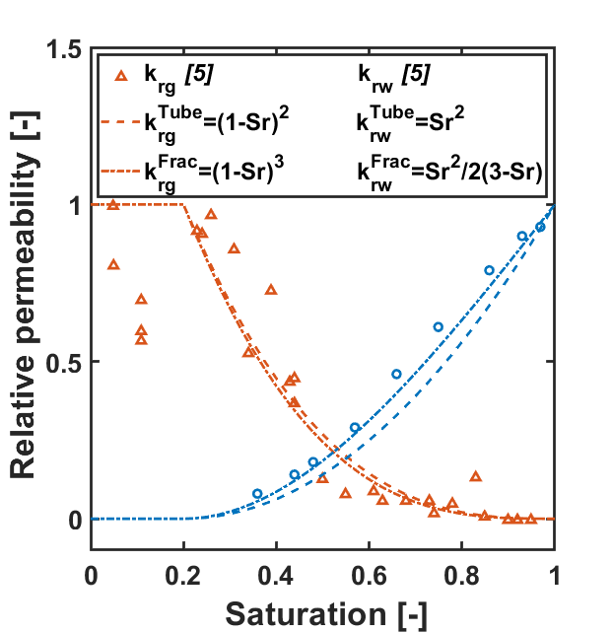
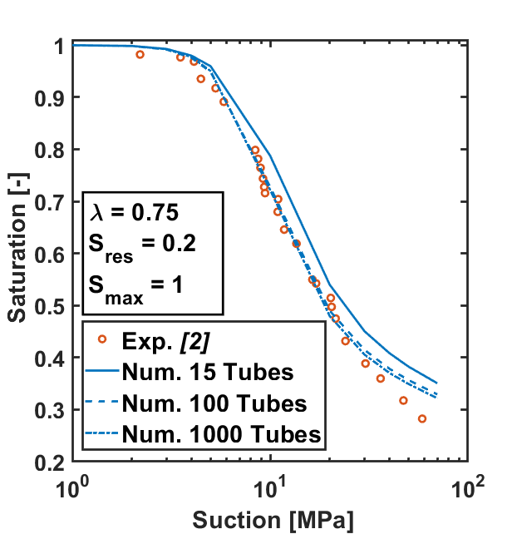
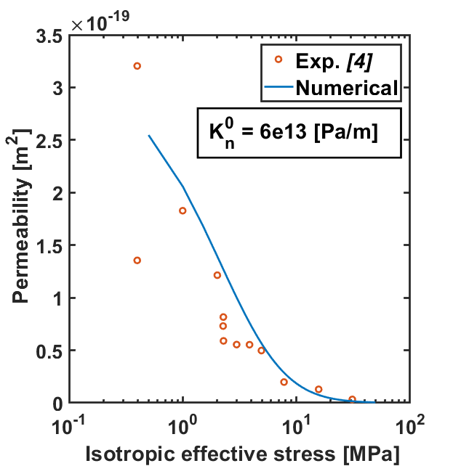
Characterisation of the microstructural parameters
4. Relative permeability curves
5. Retention curve
6. Normal stiffness of the fracture
$$k_{rw}=\frac{{S_{r}^{∗}}^{2}}{2}(3−S_{r}^{∗})$$
$$S_{r}={S_{res}+(S_{max}−S_{res})\left(1+{\left(\frac{s}{P_{e}}\right)}^{\frac{1}{1−λ}}\right)}^{−λ}$$
$$Δσ^{′}=K_{n}Δh with K_{n}=\frac{K_{n}^{0}}{{\left(1+\frac{Δh}{h_{0}}\right)}^{2}}$$
$$k_{rw}={S_{r}^{∗}}^{2}$$
$$k_{rg}={\left(1−S_{r}^{∗}\right)}^{3}$$
$$k_{rg}={\left(1−S_{r}^{∗}\right)}^{2}$$
$$S_{res}=0.2$$
$$S_{max}=1$$
$$λ=0.75$$
$$K_{n}^{0}=6∙10^{13} \left[\frac{Pa}{m}\right]$$
Yuster et al. (1951)
Van Genuchten (1980)
Goodman (1976)
3rd International Workshop on the Finite Element Code LAGAMINE – July 2022
08/17

Slide 20
Table of content
Context
Description of the model
Characterisation of parameters
Applications
Conclusion
3rd International Workshop on the Finite Element Code LAGAMINE – July 2022
03/17

Slide 21
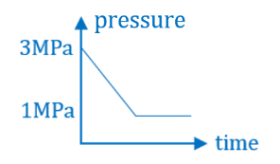
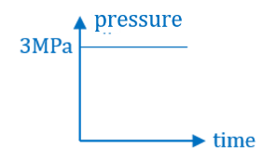
One-element simulation
Applications
5
Bedding plane separation:
$300μm$
Bedding plane aperture:
0.1$μm$
Tubes diameter
$$→Distribution curve$$
Bridging plane aperture
$$→not considered$$
3
Injection test
Mechanically blocked
Water pressure increase
3MPa to 5MPa
Gas pressure imposed at 3MPa
Loading
$$grad P_{w}$$
Response
2m
3rd International Workshop on the Finite Element Code LAGAMINE – July 2022
09/17

Slide 22
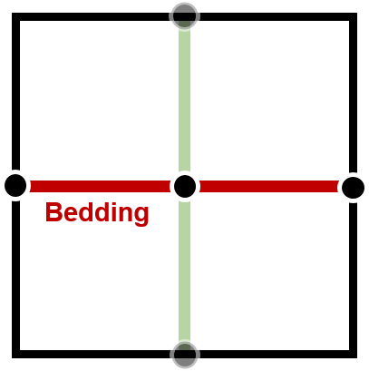
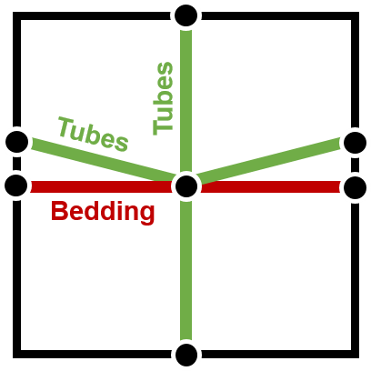
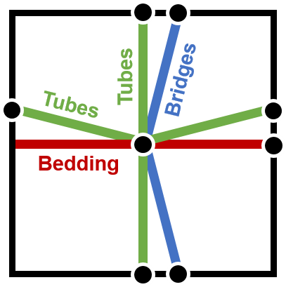
One-element simulation
Applications
5
Bedding plane separation:
$300μm$
Bedding plane aperture:
0.1$μm$
Tubes diameter
$$→Distribution curve$$
Bridging plane aperture
$$→not considered$$
3
Injection test
Mechanically blocked
Water pressure increase
from 3MPa to 5MPa
Gas pressure imposed at 3MPa
Loading
$$grad P_{w}$$
Response
Localisation
2m
Homogenisation
$$300μm$$
$$300μm$$
$$300μm$$
Loading
$$300μm$$
$$300μm$$
$$300μm$$
Response
Bedding
Bedding + n tubes
Bedding + n tubes
+ Bridging planes
3rd International Workshop on the Finite Element Code LAGAMINE – July 2022
09/17

Slide 23
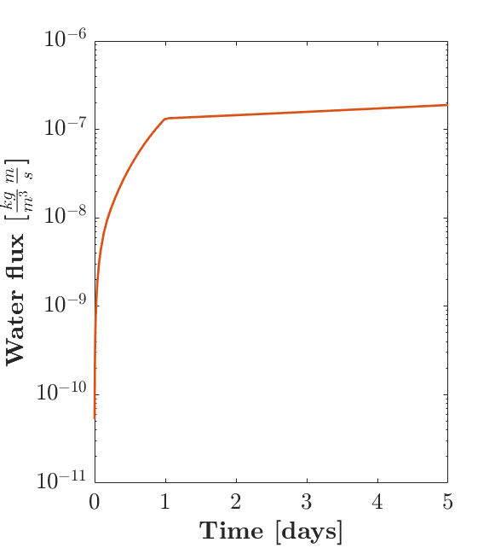
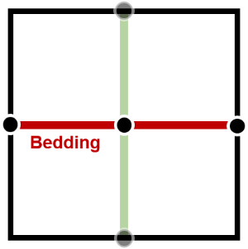
One-element simulation
Applications
Porosity distribution for the tubes
10⁻⁶
$$k_{int}=\frac{μ_{w}}{ρ_{w}}Flux\frac{Δx}{Δp} with \begin{matrix}Δx=2m \\ Δp=2 MPa\end{matrix}$$
10⁻⁷
$$Number of tubes$$ | $$Flux \left[\frac{kg}{m^{3}}\frac{m}{s}\right]$$ | $$k_{int,x} \left[m^{2}\right]$$
$$0$$ | $${1.581∙10}^{−9}$$ | $${1.581∙10}^{−19}$$
10⁻⁸
Water flux $\left[\frac{kg}{m^{3}}\frac{m}{s}\right]$
1 fracture
10⁻⁹
10⁻¹⁰
10⁻¹¹
0 1 2 3 4 5
Time [days]
3rd International Workshop on the Finite Element Code LAGAMINE – July 2022
10/17

Slide 24
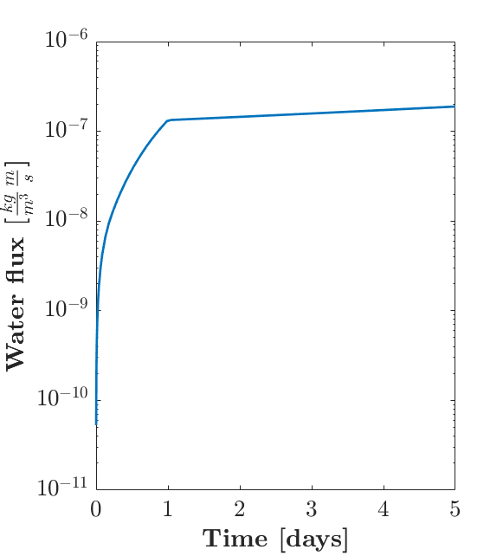
One-element simulation
Applications
Porosity distribution for the tubes
10⁻⁶
$$k_{int}=\frac{μ_{w}}{ρ_{w}}Flux\frac{Δx}{Δp} with \begin{matrix}Δx=2m \\ Δp=2 MPa\end{matrix}$$
10⁻⁷
$$Number of tubes$$ | $$Flux \left[\frac{kg}{m^{3}}\frac{m}{s}\right]$$ | $$k_{int,x} \left[m^{2}\right]$$
$$0$$ | $${1.581∙10}^{−9}$$ | $${1.581∙10}^{−19}$$
$$770$$ | $${1.643∙10}^{−9}$$ | $${1.643∙10}^{−19}$$
10⁻⁸
Water flux $\left[\frac{kg}{m^{3}}\frac{m}{s}\right]$
1 fracture + (micro) tubes
10⁻⁹
Fracture-controlled flow
10⁻¹⁰
10⁻¹¹
0 1 2 3 4 5
Time [days]
3rd International Workshop on the Finite Element Code LAGAMINE – July 2022
10/17

Slide 25
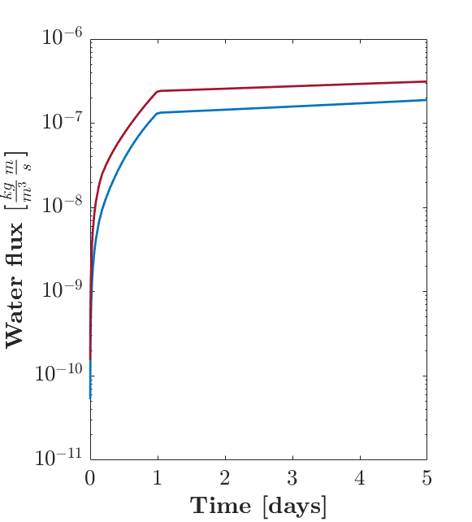
One-element simulation
Applications
Porosity distribution for the tubes
10⁻⁶
$$k_{int}=\frac{μ_{w}}{ρ_{w}}Flux\frac{Δx}{Δp} with \begin{matrix}Δx=2m \\ Δp=2 MPa\end{matrix}$$
10⁻⁷
$$Number of tubes$$ | $$Flux \left[\frac{kg}{m^{3}}\frac{m}{s}\right]$$ | $$k_{int,x} \left[m^{2}\right]$$
$$0$$ | $${1.581∙10}^{−9}$$ | $${1.581∙10}^{−19}$$
$$770$$ | $${1.643∙10}^{−9}$$ | $${1.643∙10}^{−19}$$
$$9995$$ | $${3.057∙10}^{−7}$$ | $${3.057∙10}^{−19}$$
10⁻⁸
Water flux $\left[\frac{kg}{m^{3}}\frac{m}{s}\right]$
1 fracture + all tubes
10⁻⁹
Fracture-controlled flow
10⁻¹⁰
Effect of large pores
10⁻¹¹
0 1 2 3 4 5
Time [days]
3rd International Workshop on the Finite Element Code LAGAMINE – July 2022
10/17

Slide 26
Gas injection experiment
Applications
Gonzalez-Blanco (2017)
Geometry and boundary conditions
Parameters
$$σ_{y}=6.1MPa$$
$$p_{w}=0.6MPa$$
$$p_{g}=0.1MPa$$
Reservoirs
Stiff elements:
Highly conductive:
Flat retention curve:
Downstream reservoir
$$E=10000MPa$$
$$ν=0.3$$
0.017m
$$n=0.5$$
$$k={10}^{−10}m^{2}$$
$$P_{entry}=0.001MPa$$
ZFD
Boom Clay Sample
Boom Clay matrix
Mechanical:
Hydraulic:
Initial aperture: $1∙{10}^{−7}m$
Initial permeability: $\sim 2.0∙{10}^{−19}m^{2}$
Initial porosity: $0.363$
Pore distribution: 15 tubes with $D∈\left[{10}^{−9}m ; {10}^{−6}m\right]$
0.020m
$$E=400MPa$$
$$ν=0.33$$
0.001m
Upstream reservoir
0.034m
Boom Clay Zone of Fracture Development (ZFD)
Initial aperture: increased by 1 order of magnitude
Fracture stiffness: decreased by 2 orders of magnitude
0.025m
$$p_{w}=0.6MPa$$
$$p_{g}=0.1MPa$$
3rd International Workshop on the Finite Element Code LAGAMINE – July 2022
11/17

Slide 27
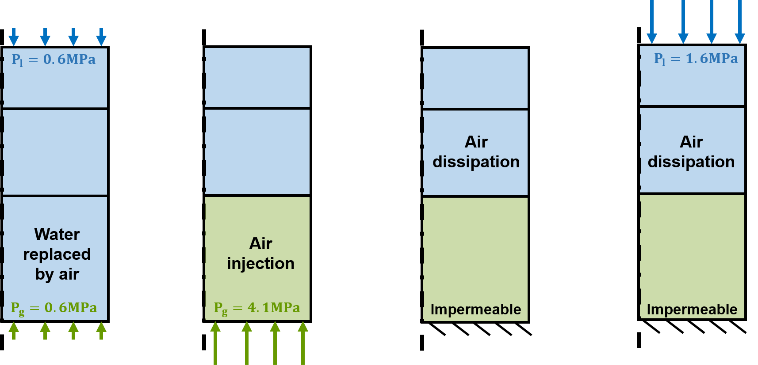
Gas injection experiment
Applications
Gonzalez-Blanco (2017)
Simulation stages
Stage 1
Stage 2
Stage 3
0-500 [min]
500-745 [min]
745-1080 [min]
1080-2300 [min]
3rd International Workshop on the Finite Element Code LAGAMINE – July 2022
12/17

Slide 28
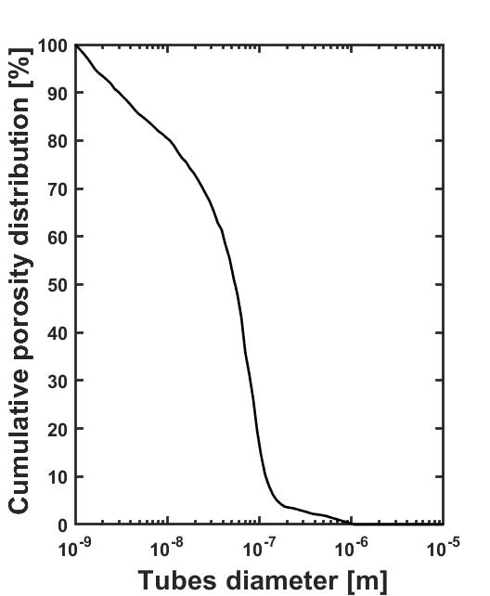
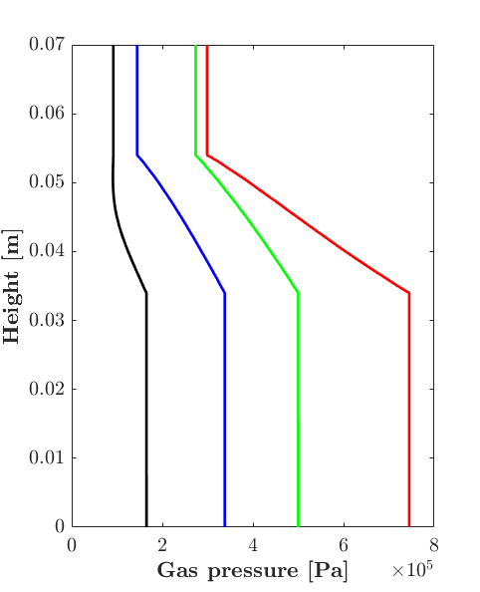
Gas injection experiment
Applications
Gonzalez-Blanco (2017)
Step 1 – Effect of microstructure components
0.07
0.06
0.05
0.04
Height [m]
0.03
Time [s]
4800
17800
30000
32000
0.02
0.01
0
6
8
0
2
4
0
Gas pressure [Pa]
$×$10⁵
3rd International Workshop on the Finite Element Code LAGAMINE – July 2022
13/17

Slide 29
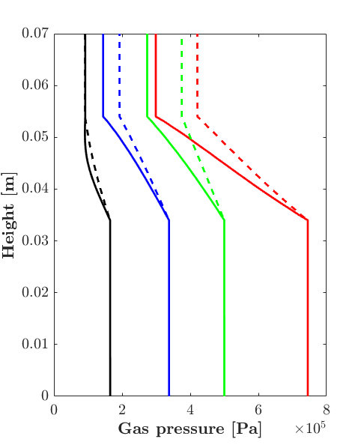
Gas injection experiment
Applications
Gonzalez-Blanco (2017)
Step 1 – Effect of microstructure components
0.07
0.06
0.05
0.04
Height [m]
0.03
Time [s]
4800
17800
30000
32000
0.02
0.01
0
6
8
0
2
4
0
Gas pressure [Pa]
$×$10⁵
3rd International Workshop on the Finite Element Code LAGAMINE – July 2022
13/17

Slide 30
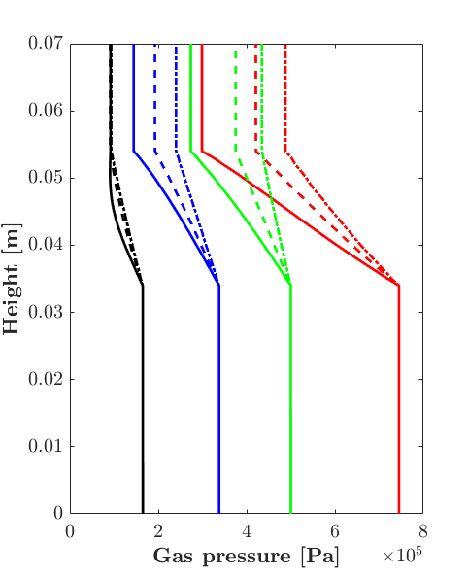
Gas injection experiment
Applications
Gonzalez-Blanco (2017)
Step 1 – Effect of microstructure components
0.07
0.06
0.05
0.04
Height [m]
0.03
Time [s]
4800
17800
30000
32000
0.02
0.01
0
6
8
0
2
4
0
Gas pressure [Pa]
$×$10⁵
3rd International Workshop on the Finite Element Code LAGAMINE – July 2022
13/17

Slide 31
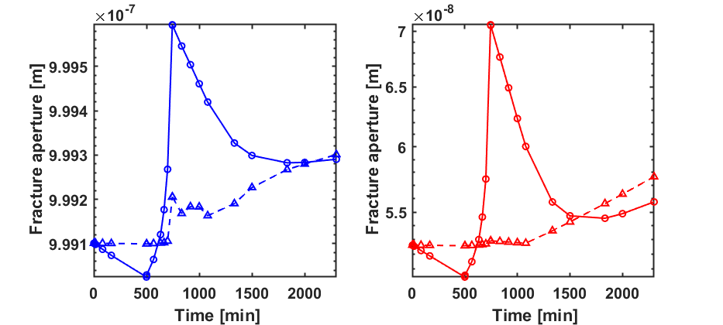
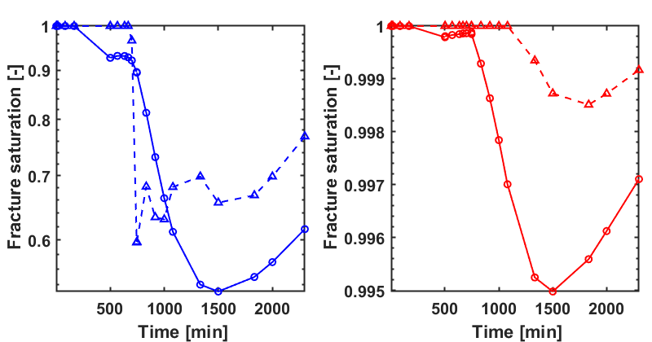
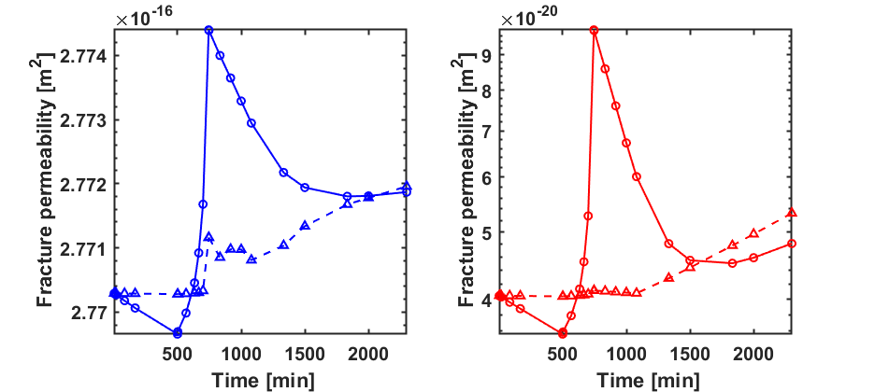
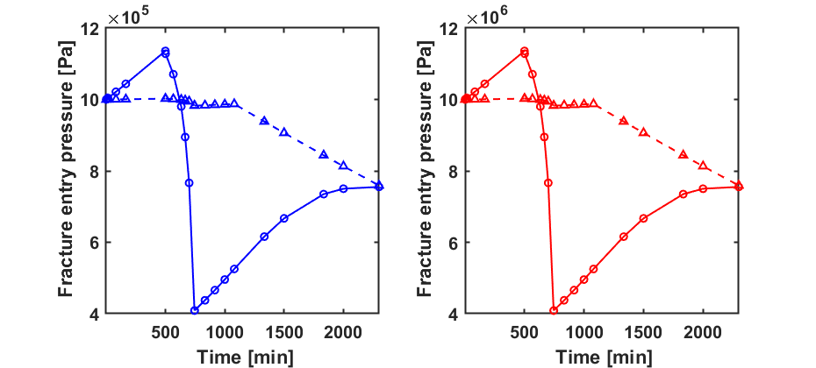
Gas injection experiment
Applications
Gonzalez-Blanco (2017)
Steps 1&2&3 – Fractures properties
$$P_{e}=P_{e,0}{\left(\frac{D_{0}}{D}\right)}^{3}$$
3rd International Workshop on the Finite Element Code LAGAMINE – July 2022
14/17

Slide 32
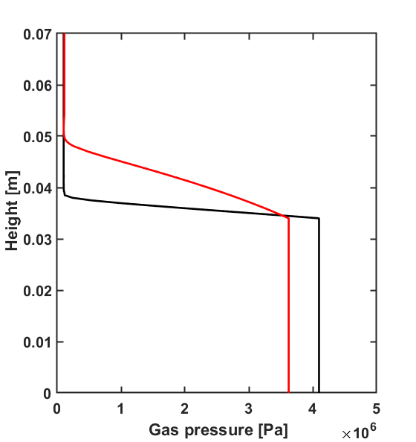
Gas injection experiment
Applications
Gonzalez-Blanco (2017)
Steps 2&3 – Pressures evolution
Start air dissip.
End air dissip.
Exp.
Num.
Num. frac.
3rd International Workshop on the Finite Element Code LAGAMINE – July 2022
15/17

Slide 33
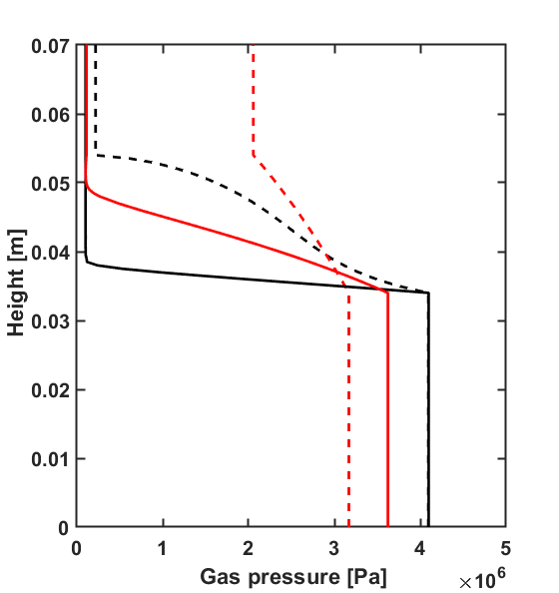
Gas injection experiment
Applications
Gonzalez-Blanco (2017)
Steps 2&3 – Pressures evolution
Start air dissip.
End air dissip.
Exp.
Num.
Num. frac.
3rd International Workshop on the Finite Element Code LAGAMINE – July 2022
15/17

Slide 34
Gas injection experiment
Applications
Gonzalez-Blanco (2017)
Steps 2&3 – Pressures evolution
Exp.
Num.
Num. frac.
$→$ Evolution of the entry pressure
with the tube diameter:
$$P_{e}=P_{e,0}{\left(\frac{D_{0}}{D}\right)}^{m}$$
$$m=3$$
3rd International Workshop on the Finite Element Code LAGAMINE – July 2022
15/17

Slide 35
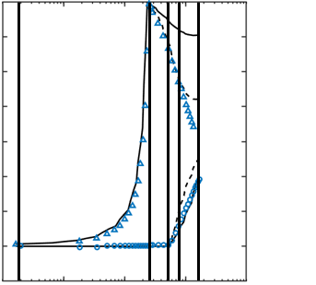
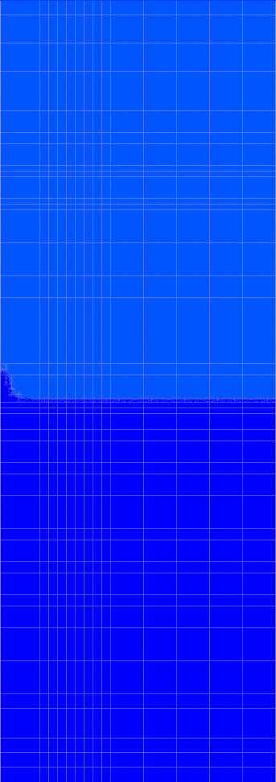
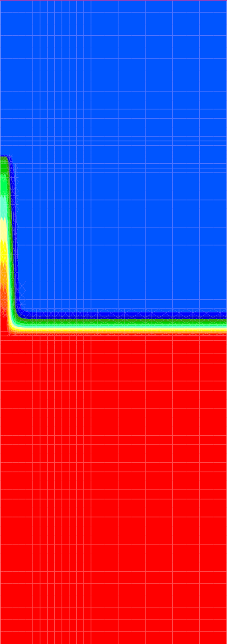
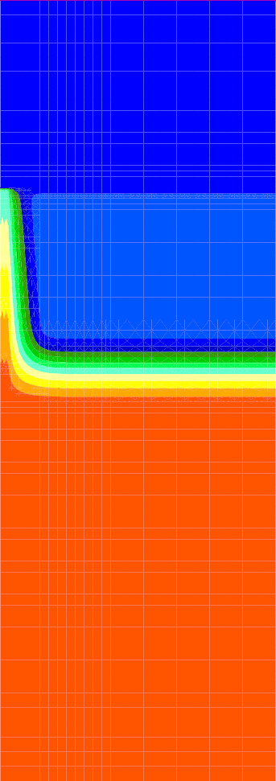
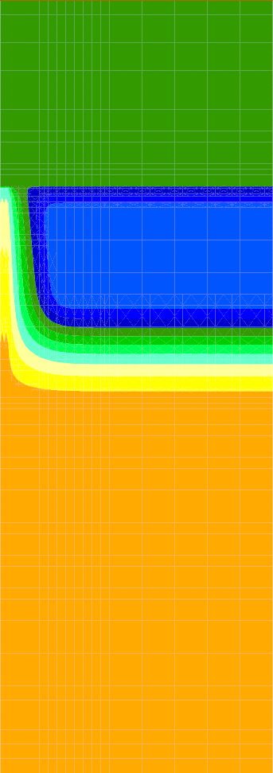
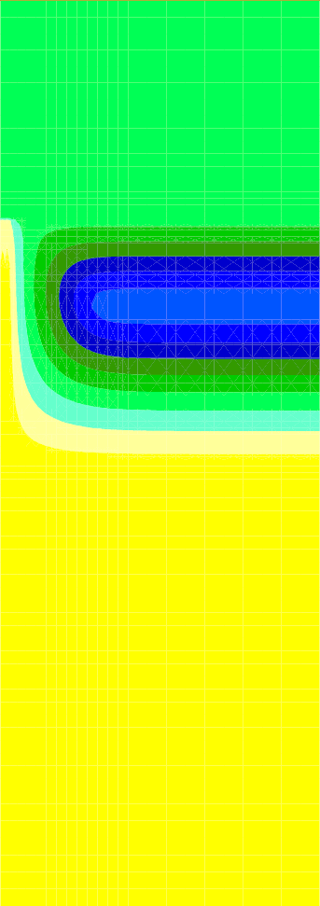
Gas injection experiment
Applications
Gonzalez-Blanco (2017)
Steps 2&3 – Maps of gas pressure
1e4
0 [min]
245 [min]
End phase 2
500 [min]
800 [min]
1800 [min]
End phase 3
3rd International Workshop on the Finite Element Code LAGAMINE – July 2022
16/17

Slide 36
Table of content
Context
Description of the model
Characterisation of parameters
Applications
Conclusion
3rd International Workshop on the Finite Element Code LAGAMINE – July 2022
03/17

Slide 37
Conclusions
We developed a multi-scale model able to
Simply idealise the microstructure of the rock with fractures and tubes
Reproduce mechanisms inherent to gas migrations in sound rock layers
We showed that
Macropores, micropores and fractures play different roles in gas flows
Preferential flow paths can be generated through fractures with weaker properties
We plan to
Release the mechanics at the macroscopic scale
Derive and validate a general formulation linking air entry pressure to fracture aperture
Extent the developments to gas flows perpendicular to bedding planes, using bridging planes
Integrate uncertainty by performing random drawing on the weaker bedding planes
Keep the model general enough to cope with other kinds of host rocks
3rd International Workshop on the Finite Element Code LAGAMINE – July 2022
17/17

Slide 38
Thank you for your attention
Third International Workshop on the Finite Element Code LAGAMINE
5-7 July 2022 • Grenoble/ Villard-de-Lans (France)

Slide 39
References
Kernenergie (2021), L’énergie nucléaire dans le monde, Retrieved April 8, 2021 from https://www.kernenergie.ch/.
N. Grunwald. et al. (2021): Non-isothermal two-phase flow in deformable porous media: Systematic open-source implementation and verification procedure, Geomechanics and Geophysics for Geo-energy and Geo-Resources (submitted)
P. Gerard et al (2014), Modelling of localised gas preferential pathways in claystone, International Journal of Rock Mechanics and Mining Sciences, 67:104-114.
S. Olivella, EE. Alonso (2008), Gas flow through clay barriers. Géotechnique, 58:157-68.
L. Gonzalez-Blanco (2017), Gas migration in Deep Argillaceous Formations: Boom Clay and Indurated Clays, Doctoral thesis, Universitat Politècnica de Catalunya.
H. Yu, Y. Zhu, X. Jin, H. Liu, H. Wu (2019), Multiscale simulations of shale gas transport in micro/nano-porous shale matrix considering pore structure influence, Journal of Natural Gas Science and Engineering, Volume 64, Pages 28-40.
F. Bertrand (2019), Hydro-mechanical modelling of multiphase flow in naturally fractured coalbeds applied to CBM recovery or CO2 storage, Doctoral thesis, University of Liège.
P. Bésuelle, G. Viggiani, JJM. Desrues, C. Pascal (2014), A Laboratory Experimental Study of the Hydromechanical Behavior of Boom Clay, Rock Mechanics and Rock Engineering.
G. Volckaert, L. Ortiz, P. De Canniere, M. Put, S.T. Horseman, J.F. Harrington, V. Fioravante, M. Impey (1995), MEGAS Modelling and experiments on gas migration in repository host rocks. EUR 16235 MEGAS Final Report Phase 1, p.464.
S. Yuster et al. (1951), Theoretical considerations of multiphase flow in idealized capillary systems, In Proceedings of the 3rd World Petroleum Congress, Section II, The Hague, Volume 2, Pages 437-445.
R.E. Goodman (1976), Methods of geological engineering in discontinuous rocks.
M. T. Van Genuchten (1980), A closed-form equation for predicting the hydraulic conductivity of unsaturated soils. Soil science society of America journal, 44(5):892–898.
3rd International Workshop on the Finite Element Code LAGAMINE – July 2022

Slide 40
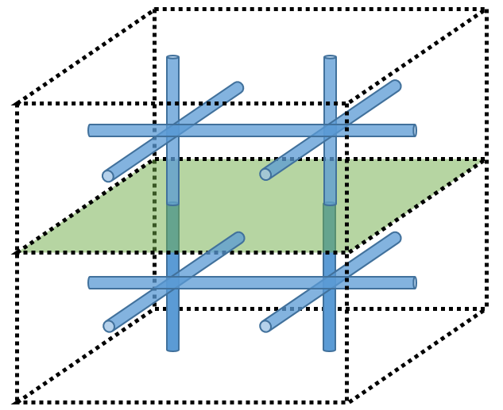
Computation of the model
Definition of the REV
Definition of the REV component behaviours
General principles for the computation of the model
3.1 Hydraulic network respecting these conditions:
Anti-symmetric boundary fluxes
$$w^{2}+w^{5}={−w}^{4}{−w}^{6}$$
$$w^{1}={−w}^{7}$$
Macroscopic pressure gradient between the boundaries
$p_{4}−p_{2}={\left(∇p\right)}_{x}^{M}Δx$ $p_{7}−p_{1}={\left(∇p\right)}_{y}^{M}Δy$
$p_{6}−p_{5}={\left(∇p\right)}_{x}^{M}Δx$ $p_{16}−p_{2}={\left(∇p\right)}_{y}^{M}Δy$
$p_{7}−p_{1}={\left(∇p\right)}_{x}^{M}Δx$ $p_{3}−p_{6}={\left(∇p\right)}_{x}^{M}Δx$
T
7
6
5
4
5
6
L
R
2
2
3
3
4
1
1
B

Slide 41
Computation of the model
Definition of the REV
Definition of the REV component behaviours
General principles for the computation of the model
3.1 Hydraulic network respecting these conditions:
Anti-symmetric boundary fluxes
Macroscopic pressure gradient between the boundaries
3.2 Hydraulic problem established through mass balance on each node (j)
$ω^{i−1}+ω^{i}+ω^{i+1}=0$ with $ω^{i}=φ^{i}\left(p_{j}−p_{j−1}\right)$ where $φ^{i}≡$ Flow model for the channel i
i
i+1
i-1
j

Slide 42
Computation of the model
Definition of the REV
Definition of the REV component behaviours
General principles for the computation of the model
3.1 Hydraulic network respecting these conditions:
Anti-symmetric boundary fluxes
Macroscopic pressure gradient between the boundaries
3.2 Hydraulic problem established through mass balance on each node (j)
3.3 Hydraulic problem solved
for a given mechanical configuration
under steady-state conditions
by applying the macro pressure to one node

