Slide 1
Understanding the Factors Influencing Public Transport
Mode Choice Behavior of Vietnamese Motorcyclists
Son Tung Nguyen ^{1,2}; Mehdi Moeinaddini ³;
Hiep Trung Bui ^{1,2}; Ismaïl Saadi ⁴; Mario Cools ^{1,5,6}
1. University of Liège, Local Environment & Management Analysis (LEMA), Urban and Environmental Engineering (UEE), Belgium
2. University of Economics – The University of Danang, Vietnam
3. School of Medicine, Dentistry and Biomedical Sciences - Queen's University Belfast
4. Université Gustave Eiffel, IFSTTAR, COSYS-GRETTIA, Marne-la-Vallée, France
5. Faculty of Business Economics, Hasselt University, Diepenbeek, Belgium
6. Department of Information Management, Modelling and Simulation, KU Leuven, Brussels, Belgium
May 28 th, 2021
Notes:
PAGE D'INTRODUCTION 1 / page permettant l'insertion du titre de la présentation ainsi que d'autres infos (date, lieu, orateur, sous-titre,…)
Si vous souhaitez modifier la photo de fond :
Allez dans le menu « Affichage » > « Masques » > « Masque des diapositives »
Supprimez l’image du drapeau déjà présente
Allez dans « Insertion » > « Photo » et chargez votre image (en veillant à la bonne qualité de celle-ci)
Placez celle-ci en « Arrière-plan » via le menu « Réorganiser »

Slide 2
CONTENT
Background
Vietnam basic information
Evolution of travel mode in Vietnam
Factors Influencing Public Transport Mode Choice Behavior of Vietnamese Motorcyclists
Results and discussion
Notes:
PAGE DE SECTION / Page avec possibilité d'insertion d'un titre de chapitre et d'un sous-titre

Slide 3
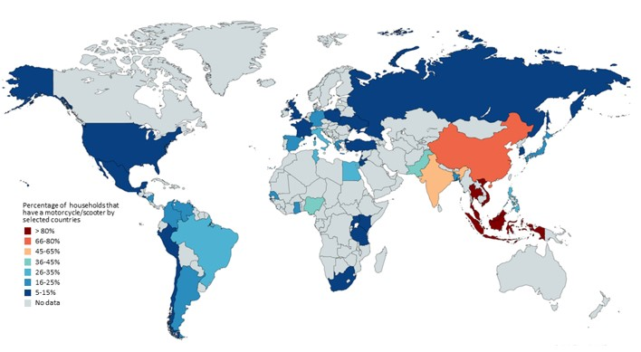
Percentage of households with a motorcycle/ scooter (2014)
(Source: Wanna Yongpisanphob. 2019. Industry Outlook 2019-2021: Motorcycle. Accessed online on 23/05/2021. https://www.krungsri.com/en/research/industry/industry-outlook/Hi-tech-Industries/Motorcycles/IO/io-motorcycles-20)

Slide 4
Background
Previous studies have identified many factors influencing commuters’ mode choice for different travel modes due to the differences in living conditions and land use from country to country ( (Washbrook, et al., 2006; Kim & Ulfarsson, 2008; Eriksson, et al., 2010; Stanton, et al., 2013).
Among the leading 20 countries with high number of motorcycles per 1000 population, 7 of them come from Asia continent, which are Vietnam, Malaysia, Indonesia, Thailand, Lao, Cambodia (Laksanakit, 2014).
Previous studies on motorcycle have mostly focused on traffic safety (Gkritza, 2009; Kepaptsoglou, et al., 2011; Le & Trinh, 2016), economic factors (Burge, et al., 2008; Chang & Wu, 2008; Chen & Lai, 2011; Kepaptsoglou, et al., 2011; Le & Trinh, 2016), and social demographic analyses ( (Sheikh, et al., 2006; Abdullah, et al., 2007; Satiennam, et al., 2016; Le & Trinh, 2016; Nguyen, et al., 2018).
This paper aims to find factors influencing the intention to use public transport of Vietnamese motorcyclists as well as propose an effective model for modal shift from motorcycle mode choice to public transport mode choice.

Slide 5
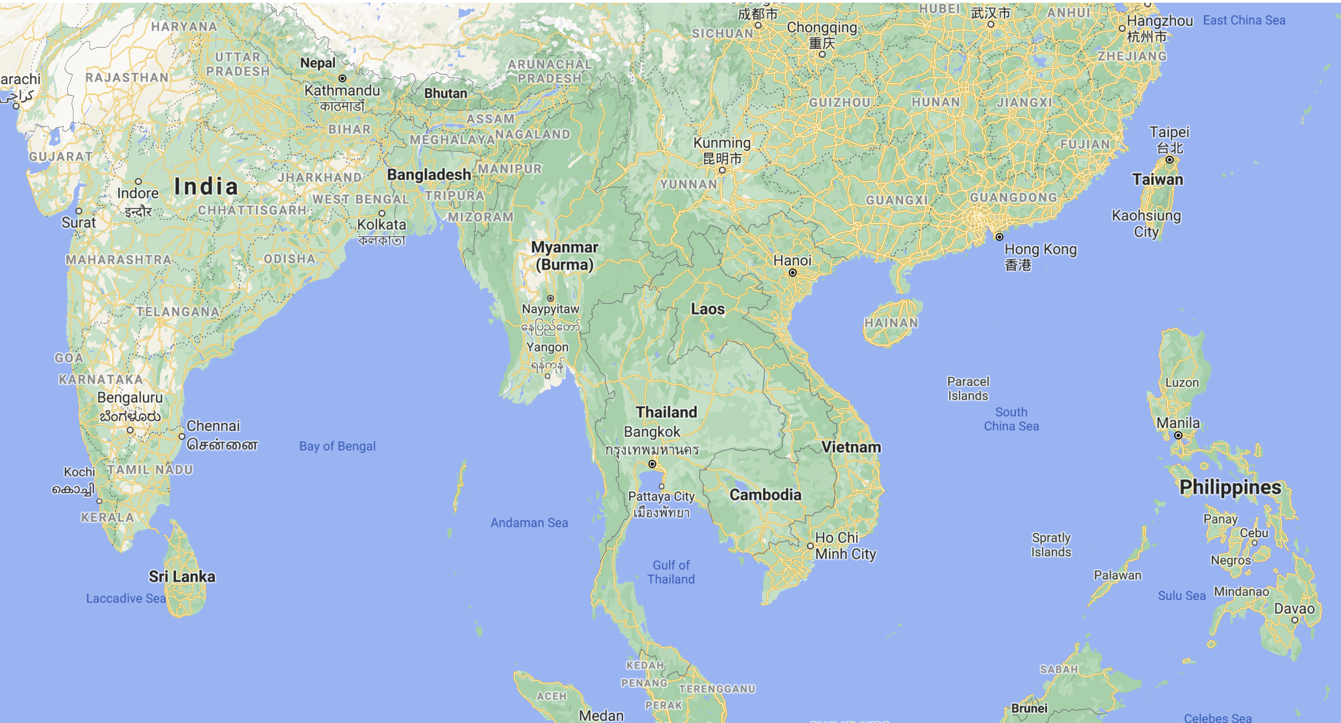
Vietnam basic information
Notes:
PAGE DE CONTENU 1 / Possibilité d'insérer du texte, des images, de la vidéo, des graphiques …

Slide 6
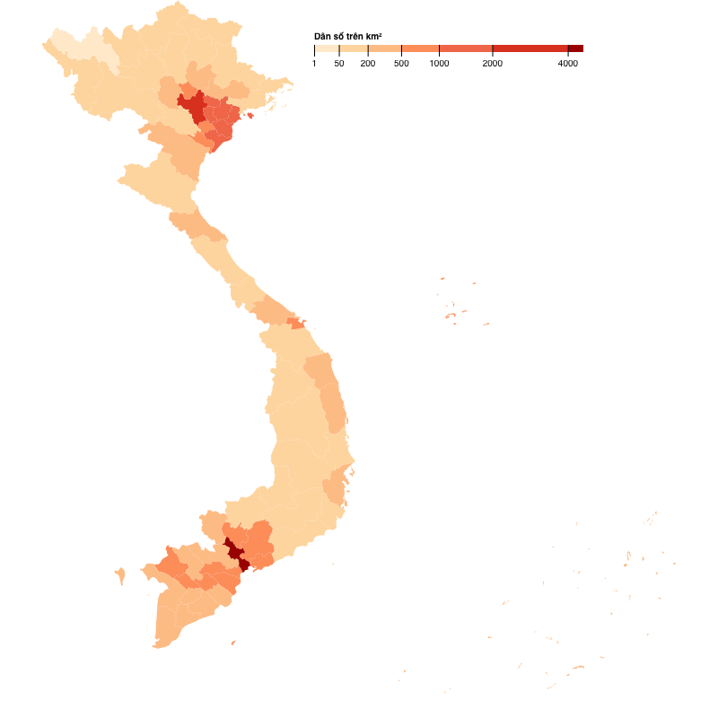
Vietnam basic information (2020)
Area: 331,699 km2 (128,070 sq mi)
Population: 97,338,579 people
Adult population: approximately 68.08 million people
Urban population: 36,727,248 people (37.7%)
(Source: Worldometers.info, 2021, compiling from UN 2020 data. Accessed online on 23/05/2021. https://www.worldometers.info/world-population/vietnam-population/#:~:text=The%20current%20population%20of%20Vietnam,year%20according%20to%20UN%20data. Picture: https://thisisbinh.me/posts/vietnam-choropleth-map/?fbclid=IwAR0gyklivsiGcUWyRQ0F5HbPnixUgrOqoyZTvFtEldirRRSjNhfJNv5pBzY)
Notes:
PAGE DE CONTENU 2 / Possibilité d'insérer, en deux colonnes, du texte, des images, de la vidéo, des graphiques …

Slide 7
Population of Vietnam (2020 and historical)
(Source: Worldometers.info, 2021, compiling from UN 2020 data. Accessed online on 23/05/2021. https://www.worldometers.info/world-population/vietnam-population/#:~:text=The%20current%20population%20of%20Vietnam,year%20according%20to%20UN%20data. )
Notes:
PAGE DE CONTENU 3 / Insertion tout à fait libre

Slide 8
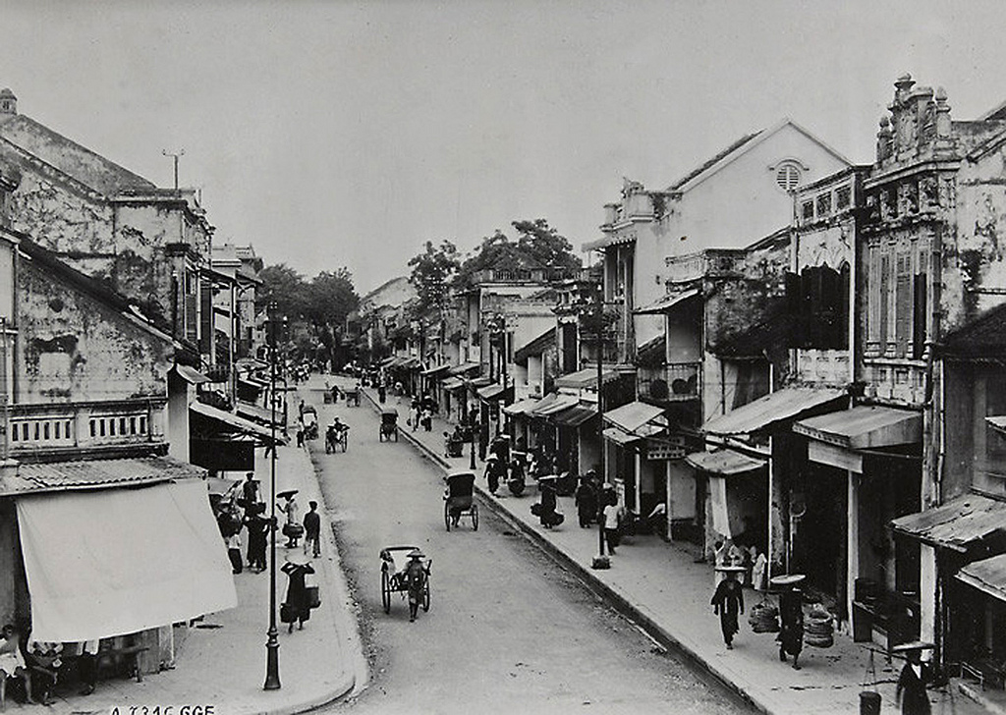
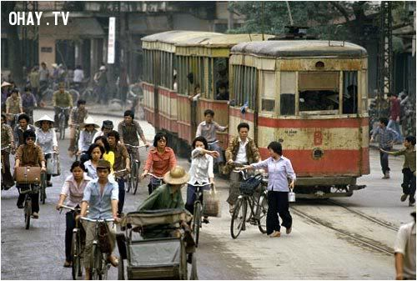
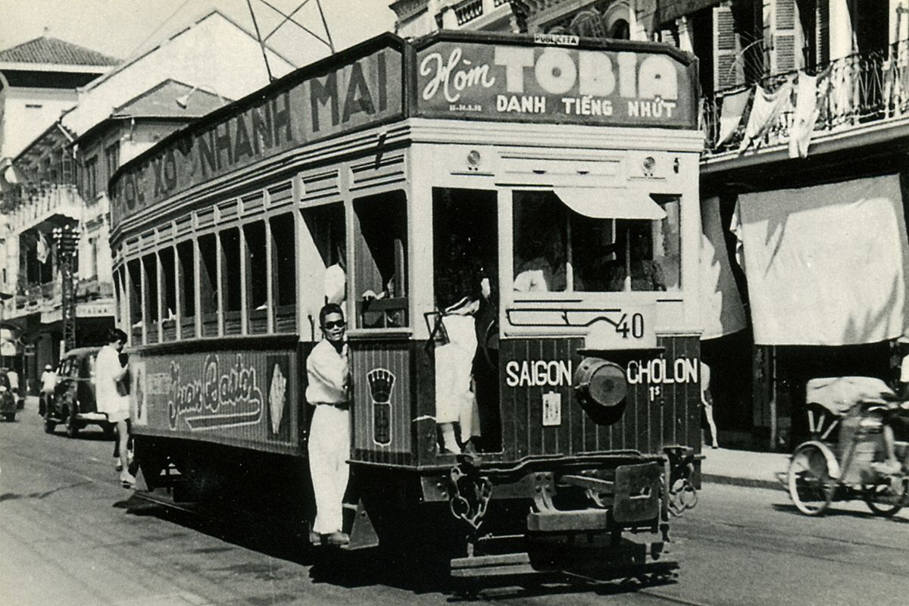
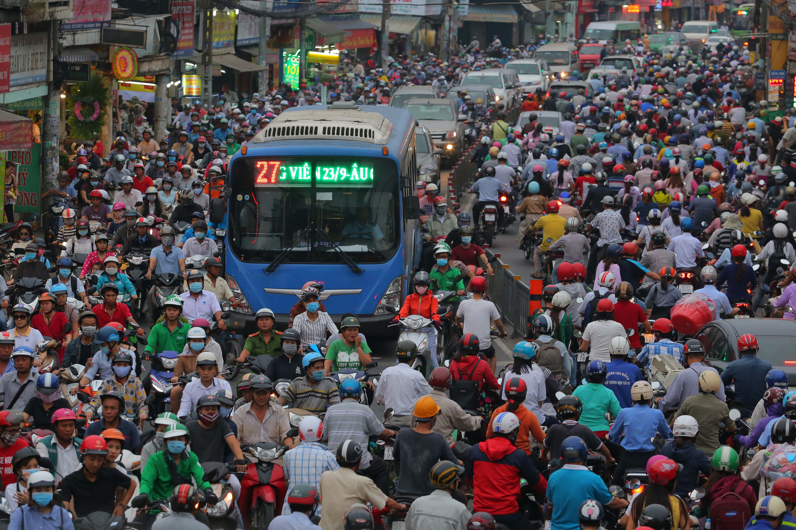
Before 1900s
1960s – 1990s
Travel mode in Vietnam from 1900s - presents
1902 – 1955
1995 - present

Slide 9
Year | Number of motorcycles/ mopeds registered | Number of cars registered
2005 | 16,086,644 | 891,104
2006 | 18,615,960 | 972,912
2007 | 21,721,282 | 1,106,617
2008 | 25,481,039 | 1,361,645
2009 | 28,431,079 | 1,535,987
2010 | 31,452,503 | 1,713,908
2011 | 33,925,839 | 1,882,972
2012 | 36,102,943 | 1,992,589
2013 | 38,643,091 | 2,147,750
2014 | 41,212,965 | 2,349,667
2015 | 44,128,822 | 2,663,269
2016 | 47,131,928 | 3,033,527
(Source: United Nation. 2018. Road Safety Performance Review Viet Nam.)
Notes:
PAGE DE CONTENU 4 / Mise en valeur d'une image avec légende

Slide 10
(Source: Honda 2013 Annual Report)

Slide 12
Percentage of households with a motorcycle/ scooter (2014)
(Source: Wanna Yongpisanphob. 2019. Industry Outlook 2019-2021: Motorcycle. Accessed online on 23/05/2021. https://www.krungsri.com/en/research/industry/industry-outlook/Hi-tech-Industries/Motorcycles/IO/io-motorcycles-20)

Slide 13
Factors Influencing Public Transport Mode Choice Behavior of Vietnamese Motorcyclists
Notes:
PAGE DE SECTION / Page avec possibilité d'insertion d'un titre de chapitre et d'un sous-titre

Slide 15
Conceptual model
(Source: Author's analysis. Extended from TPB Theory (Ajzen, 1991))

Slide 16
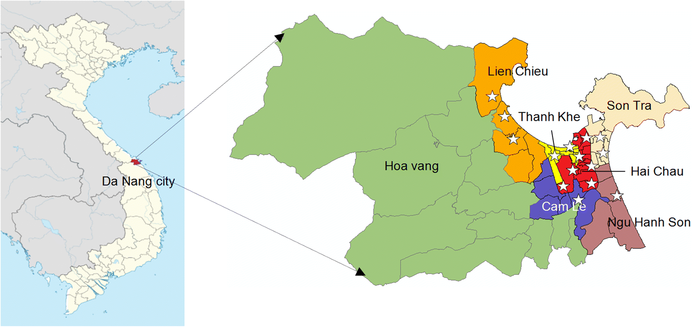
(Source: Vu Chi Mai Tran; Hoang Son Le; and Yasuhiro Matsui. 2019. Current status and behavior modeling on household solid-waste separation: a case study in Da Nang city, Vietnam. Journal of Material Cycles and Waste Management. Vol 21, pp. 1462–1476.

Slide 17
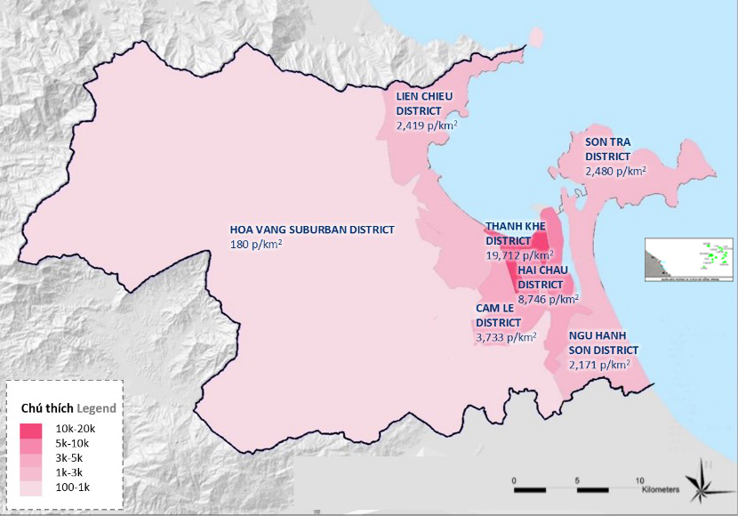
(Source: Danang administration. https://www.danang.gov.vn/web/guest/gioi-thieu/chi-tiet?id=40958&_c=40

Slide 18
Survey design – Received 800 responses
Introduction part: travel route, travel mode, distance, cost per trip, etc.
Main part: rate 32 statements on a 7-point Likert scale (Likert-1 totally disagree, and Likert-7 totally agree). To have accurate data, the authors asked the respondents to rate the statements based on the situation before the Covid-19 pandemic.
Demographic and socio-economic questions

Slide 19
Results and discussion
Notes:
PAGE DE SECTION / Page avec possibilité d'insertion d'un titre de chapitre et d'un sous-titre

Slide 20
Descriptive statistics of Danang motocyclists

Slide 21
Exploratory Factor Analysis results
(Source: Author's analysis)

Slide 22
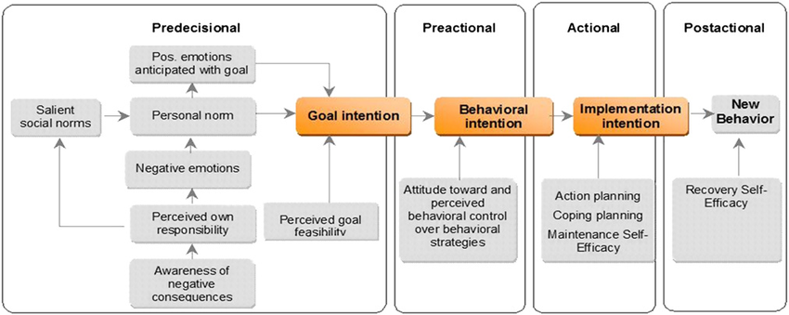
“Core of the stage model of self-regulated behavioral change (SSBC) is the idea that behavioral change is bestviewed as a person’s transition through a temporally orderedsequence of qualitatively different stages. Drawing on the model ofaction phases (e.g.,Gollwitzer, 1990; Heckhausen & Gollwitzer,1987 ), the SSBC assumes that the temporal path of behavioralchange can be broken down into four independent, qualitativelydifferent stages.” (Bamberg, 2013)

Slide 23
Proposed model for PT modal shift in Vietnam - adopted from the SSBC model (Bamberg, 2013)

Slide 24
Merci de votre attention
Questions-suggestions
Notes:
PAGE DE FIN 2 / Possibilité de personnaliser le texte et d'insérer un contact

Slide 25
Notes:
PAGE IDENTITÉ FACULTÉ

