Slide 1
Public participation and values in regional innovation
Hadrien Macq
TUM - Economic and Political Spaces of Innovation
May 31 2021

Slide 2
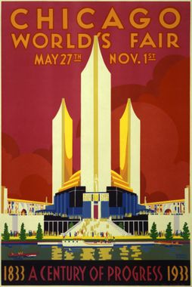
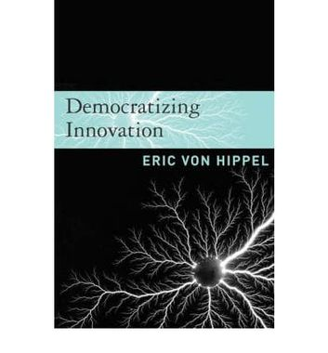
From linear to democratized innovation?
“Science discovers, genius invents, industry applies, and man adapts himself” (Guide officiel, cite dans Gleisten 2002, p. 37)
“Innovation is rapidly becoming democratized. Users (…) increasingly can develop their own new products and services” (Von Hippel 2005)

Slide 3
Theoretical background and ambitions
Innovation growingly presented and analysed as a participatory process (Laurent et al. 2018);
From alternatives to (Callon et al. 2009; Joly et al. 2011) to components of innovation policies (Macq et al. 2020; Delvenne and Macq 2020);
Connect participatory processes to the political machine (Felt & Fochler 2010; Laurent 2016);
Co-production (Jasanoff 2004) of participatory innovation initiatives and the broader political-economic context in which they take place (Engels et al. 2019)

Slide 4
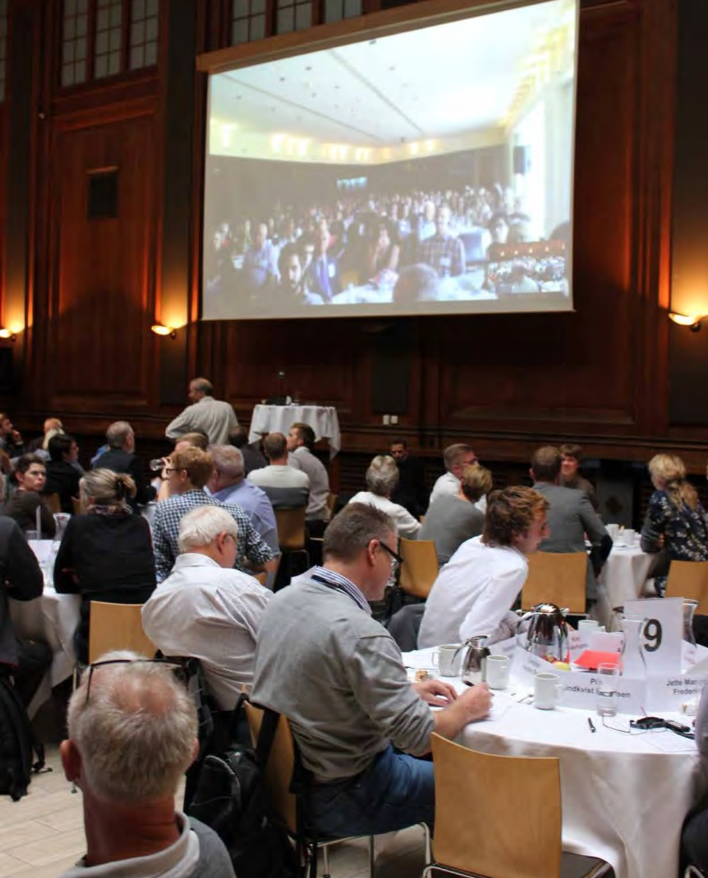
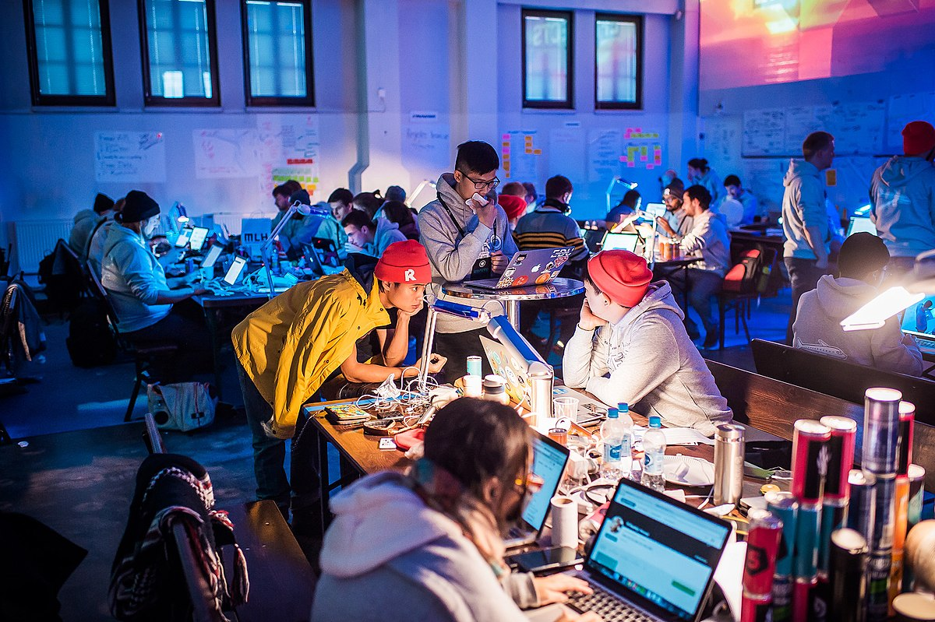
Participatory innovation at the EC
From participation as deliberation…
… to participation as production

Slide 5
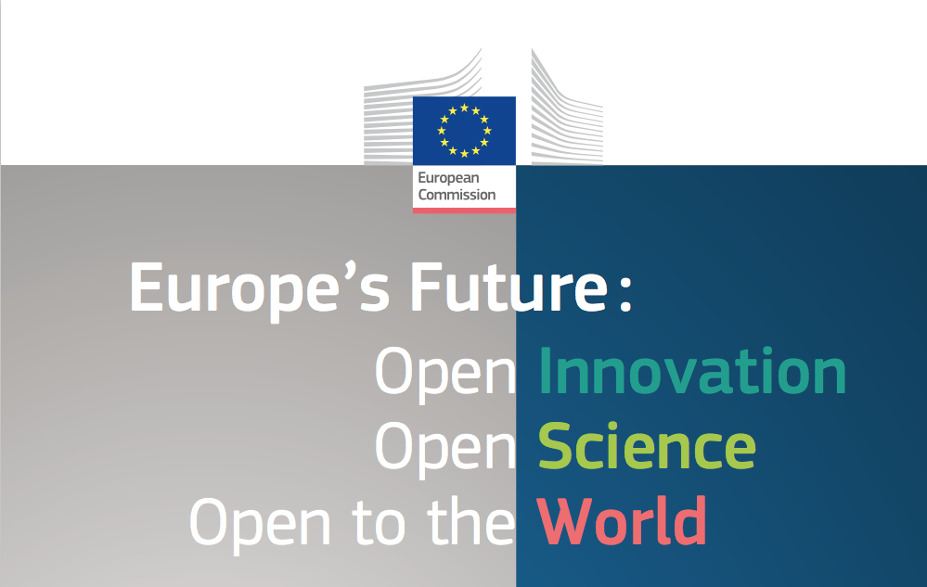
Evolving conception of participation located in a particular institutional context
Aftermath of the 2008 crisis → Focus on economic (re)deployment
Inclusion of society upstream of technological development… to enable more and better marketable innovative products
(Participatory) innovation articulated to the ‘Future of Europe’ → Producing products AND society

Slide 6
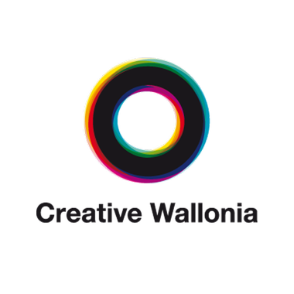
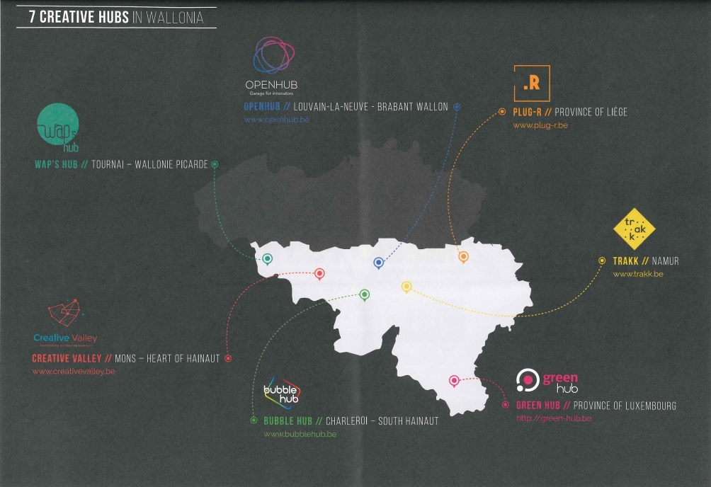
Wallonia

Slide 7
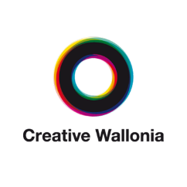
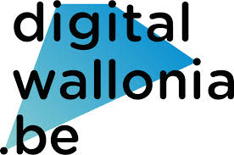
Innovation policies in Wallonia
1980s – 2000s: funding of scientific research and industry as isolated sectors;
2005: fostering collaboration between acamedia and industries (Marshall Plan – Competitiveness clusters)
Articulating innovation to the future of Wallonia as an autonomous entity
Leaving society at bay
Involving society in innovation-making: Creative Wallonia (2010); Digital Wallonia (2015)
…
1990
2000
2010
2020
…

Slide 8
Creative Wallonia’s genesis and ambitions
Diagnoses: Wallonia lagging behind in the global competitiveness race + spread of open innovation
Influenced by theories of ‘creative cities’ (HEC Montreal);
Upperground Big companies, public sector
Middleground Fab Labs, Living Labs, Hackathons, Hub créatifs
Underground Creative citizens
“Exploit this breeding ground to foster innovation”

Slide 9
Developping an innovative society
New vision of innovation: more than increasing R&D investments → changing the mental attitudes of citizens, making them contribute to innovation-making
The idea was (...) something like 'sowing the seeds of creativity to develop innovation throughout the territory', so it's about empowering people, this notion of empowerment, because everyone is creative, it's not just saying 'it's creativity for universities' or 'it's creativity for companies', it's about strengthening the creative capacities of Walloon citizens so that we can see the results in terms of producing innovation (Personal interview, July 2017, my translation).

Slide 10
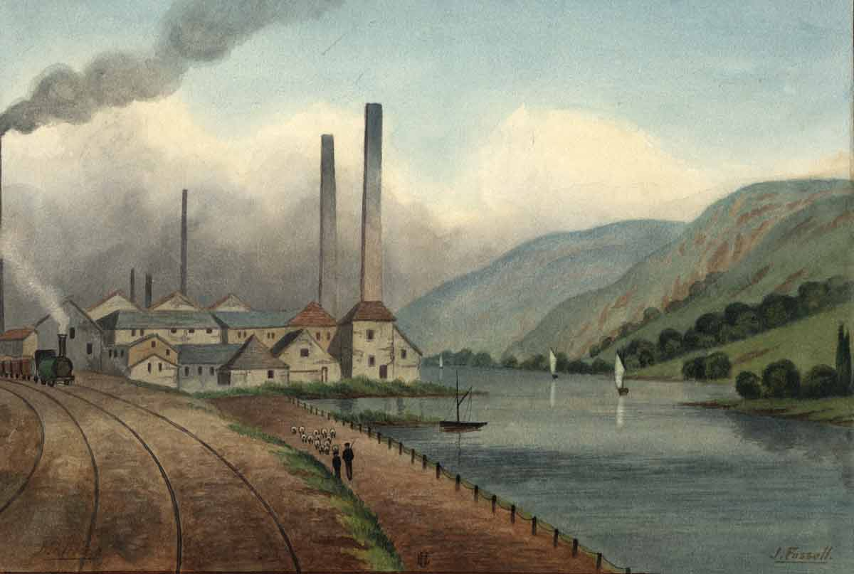
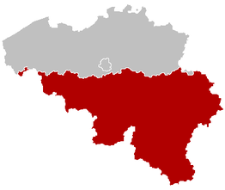
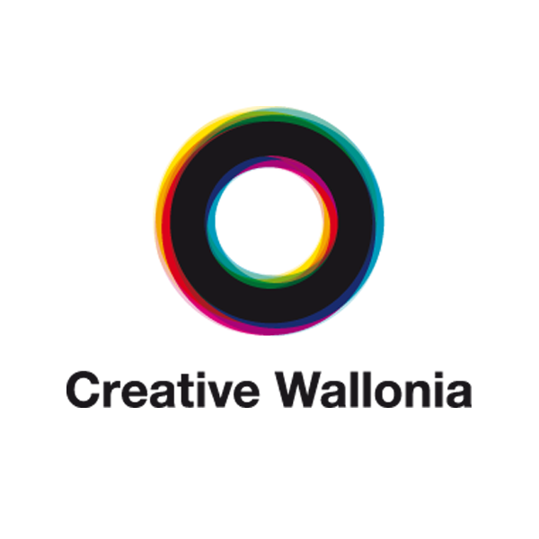
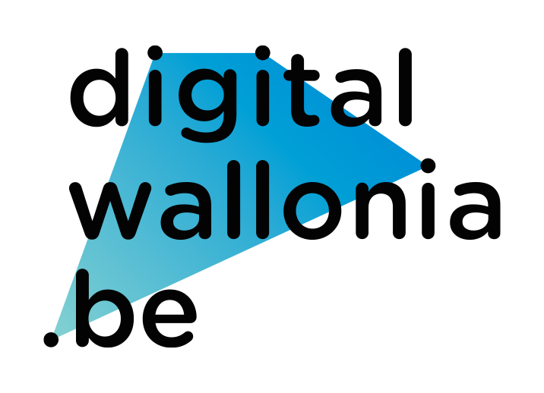
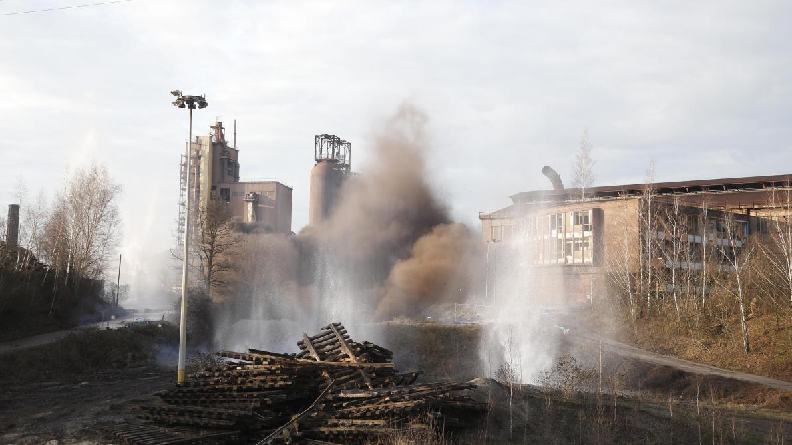
Participatory innovation as part of a sociotechnical imaginary (Jasanoff & Kim 2015)
“Turning Wallonia into a creative and innovative society”

Slide 11
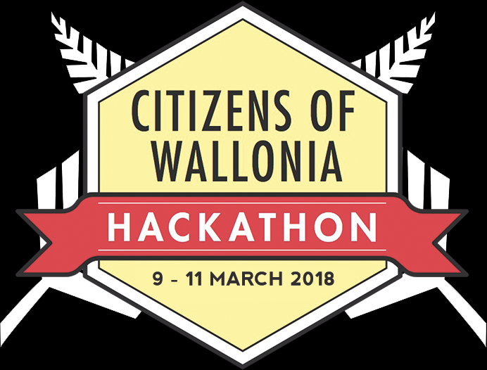
Delving into sites of participatory innovation
Influenced by ‘travelling’ models that are adapted in local contexts
Set up in domains pre-identified as key for the development of Wallonia
“Bridging the valley of death of innovation” (ensuring marketability)
“From ideas to start-ups”
Forced to show economic results and viability (funding)

Slide 12
What the economic focus does to participation
Dual trend:
Acceleration (intense events, time conceived as a scarce resource);
Intensification (extracting as much value as possible from participants)
Maximization of quantitatively measured outputs.

Slide 13
Discussion (I)
Beyond technological outputs → Transformation of a territory and its citizens
New ways of governing;
Acculturating citizens;
New instrumental logic of innovation: generate economic growth and innovative citizens for an innovative territory
Experimentation on the part of decision makers (Ehrenstein and Laurent 2015);
Experiment with participatory innovation instruments;
Experiment with what public authorities are in a changing socio-political order
Participatory innovation as a means of fostering territorial development through innovation, while delegating to citizens the task of (co-)creating tomorrow’s innovations;

Slide 14
Discussion (II)
If innovation-making and territory-making are interrelated… Then who takes part?
Economic focus: individual users, consumers;
The ‘creative class’ (Florida 2002) as an ‘atomized subject’ (Peck 2010) → Individualistic vision of citizenship (Barber 1998)

Slide 15
Discussion (III)
Participatory innovation is one instrument in the global competition between territories…
… which generates winners and losers
The circulation of innovation models might just deepen power asymmetries and economic inequalities

Slide 16
Thanks for your attention!

Slide 17
References
Barber, B. (1998). A Place for Us : How to Make Society Civil and Democracy Strong. Hill and Wang.
Callon, M., Lascoumes, P., & Barthe, Y. (2009). Acting in an Uncertain World. MIT Press.
Delvenne, P., & Macq, H. (2020). Breaking Bad with the Participatory Turn? Accelerating Time and Intensifying Value in Participatory Experiments. Science as Culture, 29(2), 245‑268.
Ehrenstein, V., & Laurent, B. (2015). Ehrenstein, V., & Laurent, B. (2015). State experiments with public participation. French nanotechnology, Congolese deforestation and the search for national publics. In Remaking participation. Science, democracy and emergent publics.
Engels, F., Wentland, A., & Pfotenhauer, S. M. (2019). Testing future societies? Developing a framework for test beds and living labs as instruments of innovation governance. Research Policy, 48(9).
Felt, U., & Fochler, M. (2010). Machineries for Making Publics : Inscribing and De-scribing Publics in Public Engagement. Minerva, 48(3), 219‑238.
Florida, R. L. (2002). The Rise of the Creative Class. Basic Books.
Florida, R. L. (2005). The World is Spiky : Globalization has changed the economic playing field, but hasn’t leveled it. The Atlantic Monthly, 48‑51.
Jasanoff, S. (Éd.). (2004). States of Knowledge : The Co-Production of Science and the Social Order. Routledge.
Jasanoff, S., & Kim, S.-H. (2015). Dreamscapes of Modernity : Sociotechnical Imaginaries and the Fabrication of Power. The University of Chicago Press.
Joly, P.-B., Rip, A., & Callon, M. (2011). Réinventer l’innovation ? In D. Llerena & D. Rieu (Éds.), Innovation, Connaissances et Société. Vers une Societé de l’Innovation. L’Harmattan.
Laurent, B. (2016). Political experiments that matter : Ordering democracy from experimental sites. Social Studies of Science, 46(5), 773‑794.
Laurent, B., Baker, M., Beaudoin, V., & Raulet-Croset, N. (Éds.). (2018). Innovation et participation. Approches critiques. Presses des Mines.
Macq, H., Tancoigne, É., & Strasser, B. J. (2020). From Deliberation to Production : Public Participation in Science and Technology Policies of the European Commission (1998–2019). Minerva, 58(4), 489‑512.
Peck, J. (2010). Constructions of Neoliberal Reason. Oxford University Press.
von Hippel, E. (2005). Democratizing Innovation. MIT Press.

Slide 18
Public participation and values in regional innovation
Hadrien Macq
TUM - Economic and Political Spaces of Innovation
May 31 2021

